Slide 1
A-Maize-ing Planter
Summary for Professor Bill Raun, OSU
June Cho | Lily Mueller | Lingmiao Wang |
Noah Jung | Rhett James | Thomas Smith | Toria Yan
Notes:
Name + Team Introduction

Slide 2
2.739 is an interdisciplinary cross listed MIT and RISD course that walks students through the design process as laid out in Product Design and Development by Steven Eppinger.
Throughout the semester, students work in teams of 6-7 to solve a peer identified user need. The course concludes with a final product pitch presentation.
This is a summary deck of our final product.
Notes:
Most of the magic happens in our seed dispensing mechanism.
Which was inspired by the gumball machine.
A single moving slider piece with a seed cavity aligns with the openings of the top and bottom bottom pieces as it is pushed releasing a single seed into the PVC pipe.
Which then travels down and drops to the soil.

Slide 3
Our Mission is...
to create an affordable tool to facilitate seed planting for non-commercial conservation farming

Slide 4
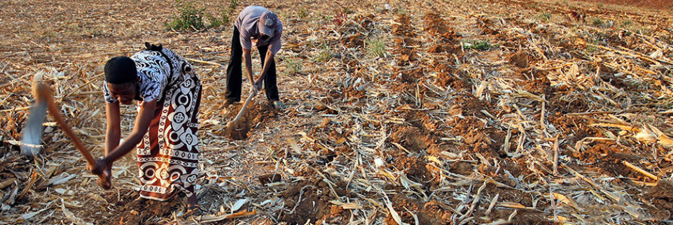
Our Stakeholders Non-commercial farmers who already practice conservation farming
+ NGOs operating in Africa

Slide 5
User Needs + Key Goals
The product is Intuitive to use
The product deposits one seed per hole
The product is easy to fix
The product can last a minimum of 5 years
The product cuts through mulch
The product is economical
Notes:
We down selected to these key user needs after speaking with different stakeholders. Because it was difficult to get a hold of current non-commercial conservation farmers, we reached out to individuals who have worked first hand with these farmers or in similar environments.

Slide 6
The A-Maize-ing Planter…
Delivering on price, reliability and durability through simplicity
Notes:
The final design emphasizes simplicity from material choice to assembly and maintenance. The mechanism is assembled with four screws and fits right into the top of the PVC pipe. An additional piece of PVC is fit on top as the seed hopper. The trowel is inserted into the bottom of the PVC pipe with a rubber gasket to hold it in place and a small funnel to guide the seed. Outside of the mechanism, everything is press fit to allow easily assembly and disassembly.

Slide 7
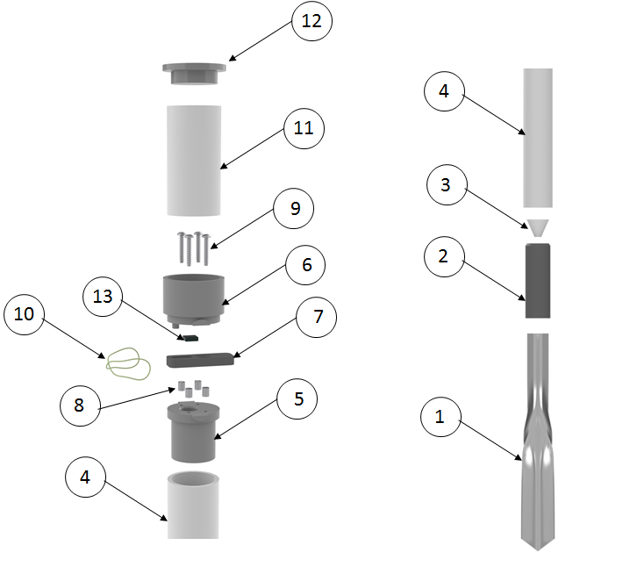
Item | Part | Qty | Material | Manufacturing Method
1 | Trowel | 1 | Stainless Steel | Stamping + Roll Forming
2 | Rubber Gasket | 1 | Rubber (Tire Rubber) | Purchased
3 | Seed Funnel | 1 | Plastic | Thermoforming
4 | Body | 1 | PVC (1.5” ID) | Purchased
5 | Dispense Mechanism Bottom | 1 | Plastic | Injection Molding
6 | Dispense Mechanism Top | 1 | Plastic | Injection Molding
7 | Dispense Mechanism Slider | 1 | Plastic | Injection Molding
8 | Spacer | 4 | Stainless Steel | Purchased
9 | Screw | 4 | Stainless Steel | Purchased
10 | Rubber Band | 1 | Rubber | Purchased
11 | Seed Canister | 1 | PVC | Purchased
12 | Cap | 1 | Plastic | Injection Molding
13 | Sponge | 1 | Foam | Purchased
BOM
Top
Bottom
Notes:
In theory, the user can adapt or remake every part of the product. For example, the PVC can be cut to match the user’s height or the trowel replaced with any sort of “blade” that can be attached to the bottom of the PVC pipe. The side of the alignment holes can also be modified to fit seeds of varying sizes.
Note: the sponge (13) is glued into a gap in the Mechanism Top and is necessary to prevent jamming (probably similar to brush inside GreenSeeder?).

Slide 8
Gumball machine inspired mechanism
Single moving piece aligns slots to separate and drop seed
Notes:
Most of the magic happens in our seed dispensing mechanism which was inspired by the gumball machine.
A single moving slider piece with a seed cavity aligns with the openings of the top and bottom bottom pieces as it is pushed releasing a single seed into the PVC pipe.
Which then travels down and drops to the soil.

Slide 9
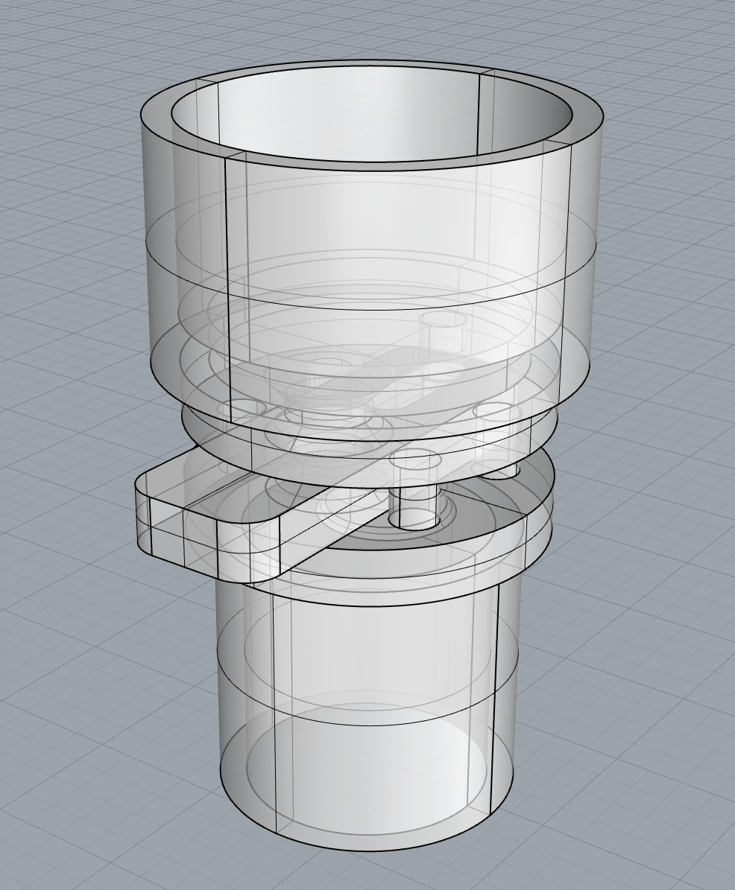
When ready, user presses the extended part of the slider to drop the captured seed
The rubber band (green) resets the slider after each use.

Slide 10
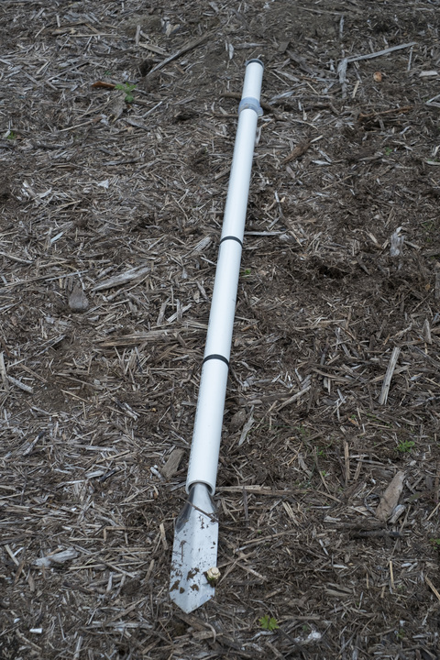
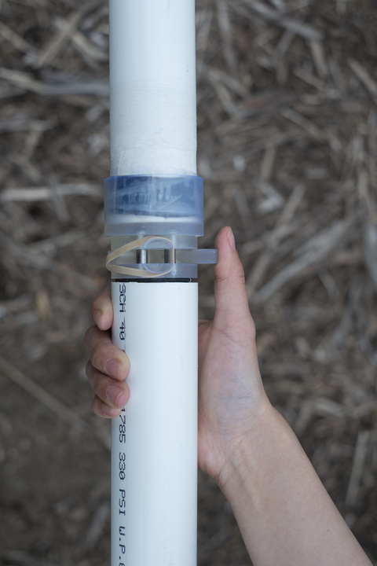
Alpha Prototype
Notes:
The seed dispensing mechanism was 3D printed (resin) for the alpha prototype. While we found the resin to be too brittle for a final product, its semi-transparent nature was actually a benefit for the users we tested on because it allows the user to see the seed move through the mechanism. For the trowel, we used https://www.amazon.com/Wilcox-All-Pro-202S-Stainless/dp/B002GJ030U/ref=sr_1_3?keywords=trowel&qid=1560291414&s=gateway&sr=8-3 from Amazon (with the plastic handle cover removed).

Slide 11
Field Testing at Clarke Farm
Notes:
Once we had our prototype fully finished and functioning, we took it to the Clarke Farm to do some user testing.
Feedback from Andrew (head farmer):
Good to see/hear the seed dropping into hole
”I like that you can use this product until the very last seed. Other products have a certain threshold that you must maintain otherwise it stops working” - Andrew the farmer
The video on the right shows Andrew using the product for the first time and a seed hopper refill (halfway through)

Slide 12
Business Case
Notes:
Business Case

Slide 13
Meet Joseph,
Seed Planter Entrepreneur
Granted a $100 loan
Received training from a local NGO
Service valued at about $10 per acre
He can plant 1 acre of in a day by himself
In a planting season, he can plant 40 acres
Notes:
We don’t think it will just work to just sell the A-Maize-ing Planter
Small farmers need to keep their cash for food, medicine and school fees - even if it was really cheap, they wouldn’t be able to buy it.
So, we have a different plan - we want to create:
Village Level Entrepreneurs
He was granted a $100 loan to buy an A-Maizing Planter, and received training from a local NGO
With his planter, he can plant one acre of maize in about a day by himself
Farmers in his village will value his service at about $10 per acre
(although payment may be barter or return of labor rather than cash)
In a 2 month planting season, Joseph can plant 40 acres and earn $400 - a good annual salary and easily enough to repay his $100 loan in one season

Slide 14
Implementation Partners
Smallholder Machinery Companies
could add planter to their range
Smallholder Suppliers
could help distribute + train
Local NGOs
could train farmers and sell the A-Maize-ing Planter and provide credit
Smallholder Training Organizations
could teach through their network
Notes:
Local NGOs - Such as One Acre Fund based in Kenya which reaches nearly 1M smallholder farmer families in Sub Saharan Africa. It’s model is to provide seeds and fertilizer to smallholder groups on credit, along with training on a planting protocol. Their group liability model enables high level of credit payback. We could envisage a co-beneficial partnership where a local NGO trains their farmers on A-Maizing Planter and enable sales.
Smallholder Machinery Companies - KickStart International has sold over 300,000 of it’s well-known treadle pumps. The robust pumps have been especially designed for smallholder farmers. The company has experience in training farmers and has existing mechanisms in place to provide credit. We could envisage a distribution arrangement with KickStarter, where A-Maizing Planter is an enhancement to their product range.
Smallholder Training Organisations - Conservation Farming Union (CFU) started in Zambia but now is expanding across Africa. It reaches hundreds of thousands of farmers each year through its network of village level lead farmers. We could envisage a training partnership, where the benefits of the A-Maizing Planter are added to their curriculum.
Smallholder Suppliers - Seed and Fertilizer Companies across africa have networks of field trainers who work with smallholder farmers every day. The A-Maizing Planter could make small farmers more productive, and so a partnership with input suppliers could be interested in helping to train, or even distribute.
Ideal would be partnership with One Acre Fund- big reach very quickly, training programs already set up

