Slide 1
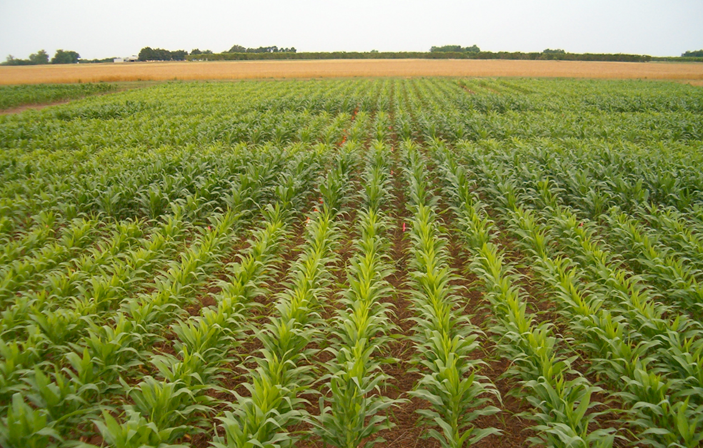
Unpredictable Nature of Environment on Nitrogen Supply and Demand Convention Center 303C November 13, 2019 8:50 – 9:05
nue.okstate.edu

Slide 2
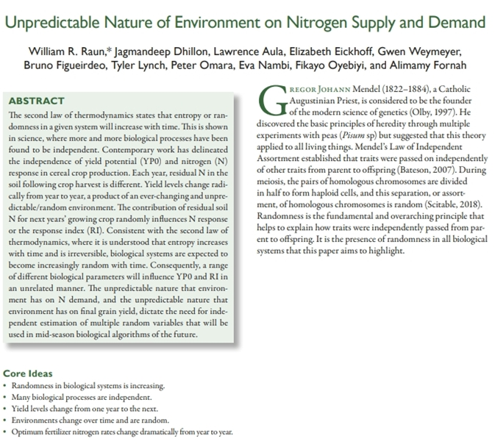
doi:10.2134/agronj2019.04.0291

Slide 3
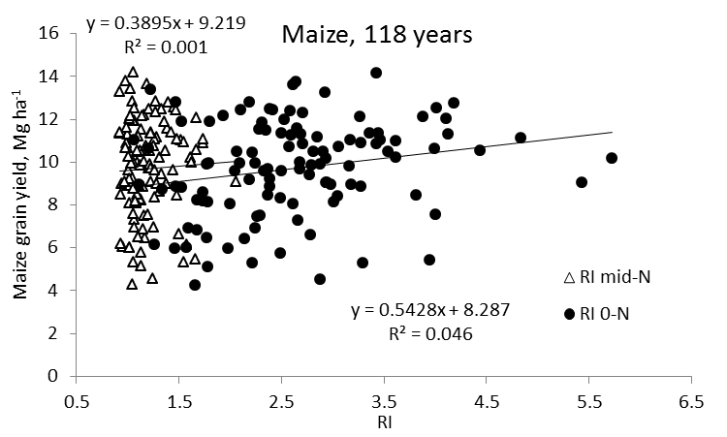
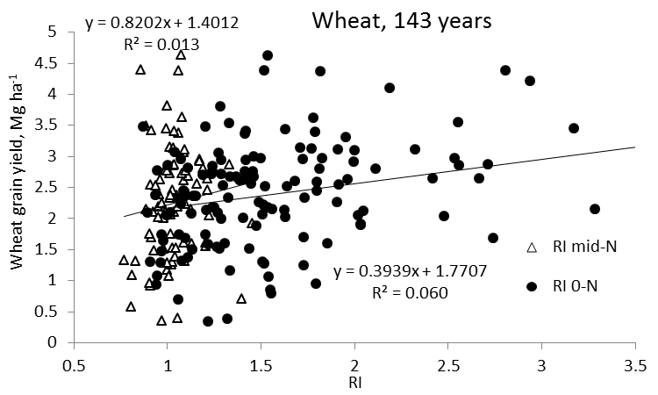
Independence of Yield Potential and Nitrogen response
Random influence of the environment
Total entropy always increases and the process is irreversible
Iowa Wisconsin
Nebraska Oklahoma
2013. Relationship between grain crop yield potential and nitrogen response. Agron. J. 105:1335–1344.
2010. Independence of yield potential and crop nitrogen response. Prec. Agric. 12:508-518.

Slide 5
Maize grain yield for the check (0N), high N treatment and optimum N rate in 26 field experiments , 213 site years of published data, 1958-2010. Dhital, Agron. J. 108 (2016)
Source | Location | Years | Time period | † (0-N) Yield Range | ‡ High N Yield Range | *Optimum N rate kg ha⁻¹
 |  |  |  | ---- Mg ha⁻¹ ---- |  | Min | Max | Avg. | SD
Bundy et al. (2011) | WI | 21 | 1958-1983 | 1.6-7.6 | 4.3-8.8 | 50 | 233 | 130 | 53
Bundy et al. (2011) | WI | 9 | 1984-1997 | 2.7-5.6 | 5.7-9.96 | 58 | 235 | 179 | 51
Mallarino and Torres (2006) | IA | 20 | 1979-2003 | 0.8-5.9 | 5.1-12.4 | 81 | 237 | 165 | 49
Mallarino and Torres (2006) | IA | 14 | 1985-2010 | 1.4-6.2 | 5.3-12.8 | 134 | 239 | 197 | 32
Varvel et al. (2007) | NE | 5 | 1995-2005 | 6.6-10.9 | 10.4-13.3 | 73 | 193 | 131 | 49
Jokela et al. (1989) Carroll | MN | 3 | 1982-1984 | 5.5-7.3 | 7.1-9.1 | 5 | 131 | 84 | 69
Jokela et al. (1989) Webster | MN | 3 | 1982-1984 | 1.7-5.6 | 1.8-8.7 | 70 | 113 | 91 | 21
Fenster et al. (1976) Waseca | MN | 5 | 1970-1975 | 3.2-7.4 | 7.1-10.6 | 60 | 199 | 135 | 50
Fenster et al. (1976) Martin A | MN | 7 | 1970-1976 | 3.8-8.2 | 4.0-9.6 | 23 | 126 | 69 | 36
Fenster et al. (1976) Martin B | MN | 6 | 1971-1976 | 6.2-11.3 | 6.2-12.0 | 0 | 37 | 18 | 15
Al Kaisi et al. (2003) | CO | 3 | 1998-2000 | 5.6-10.2 | 8.3-10.8 | 66 | 111 | 91 | 23
Ismail et al. (1994) NT | KY | 20 | 1998-2000 | 2.1-7.4 | 5.2-10.9 | 35 | 230 | 128 | 46
Ismail et al. (1994) CT | KY | 20 | 1970-1990 | 1.9-9.5 | 3.5-10.4 | 0 | 203 | 98 | 52
Rice et al. (1986) NT | KY | 15 | 1970-1985 | 3.1-4.9 | 5.7-9.2 | 102 | 178 | 144 | 30
Rice et al. (1986) CT | KY | 15 | 1970-1985 | 1.9-6.1 | 5.0-8.8 | 69 | 204 | 124 | 47
Stecker et al. (1993) Columbia | MO | 3 | 1988-1990 | 3.3-5.6 | 6.0-10.1 | 99 | 194 | 153 | 49
Stecker et al. (1993) Novelty | MO | 3 | 1988-1990 | 4.5-7.2 | 6.7-9.9 | 45 | 182 | 103 | 71
Stecker et al. (1993) Corning | MO | 2 | 1989-1990 | 5.0-6.0 | 8.2-8.5 | 90 | 117 | 104 | 20
Peterson et al. (1989) | NE | 4 | 1983-1986 | 2.1-6.4 | 3.9-10.0 | 11 | 218 | 104 | 88
Eck (1982) | TX | 2 | 1977-1978 | 2.7-4.4 | 5.6-5.9 | 59 | 116 | 88 | 40
Shapiro et al. (2006) RS 51cm | NE | 3 | 1996-1998 | 6.2-8.9 | 9.4-11.1 | 69 | 96 | 83 | 13
Shapiro et al. (2006) RS 76cm | NE | 3 | 1996-1998 | 5.0-8.9 | 7.1-11.0 | 13 | 114 | 75 | 54
Meisinger et al. (1985) MT | MD | 4 | 1974-1977 | 1.8-2.6 | 5.8-8.2 | 127 | 233 | 183 | 45
Meisinger et al. (1985) PT | MD | 4 | 1974-1977 | 2.7-4.2 | 5.1-8.1 | 36 | 196 | 142 | 75
Gehl et al. (2005) Rossville | KS | 2 | 2001-2002 | 6.4-7.9 | 11.3-12.6 | 182 | 204 | 193 | 15
Gehl et al. (2005) Scandia | KS | 2 | 2001-2002 | 2.7-7.4 | 3.8-11.5 | 51 | 160 | 105 | 77
Total |  | 198 |  |  | Average | 62 | 173 | 120 | 45
 |  |  |  |  | SD | 44 | 55 | 43 | 20
range in the recorded maize grain yields for the check plot where no N was applied
‡ - range in the recorded maize grain yields for the high N rate treatment in each experiment. These high N rates ranged from 1.8 to13.3 Mg ha⁻¹
* - optimum N rates determined by subtracting the yield the check (0N) treatment from the yield in the high N treatment, multiplying by a known N concentration, and dividing by a fixed nitrogen use efficiency (NUE), set at 0.33

Slide 6
Dhital, Agron. J. 108 (2016)
Yield level and N response contribute to the final optimum N rate. Nonetheless, yield level and N response need to be considered independent of one another before deciphering N rate recommendations for maize.
If the same N rates are applied each year, they will not include accurate accounting for variability in soil N and maize N uptake, which are dramatically influenced by the changing growing conditions from one year to the next.
Extensive variability in optimum N rates for maize should be reflected in current day N recommendations

Slide 7
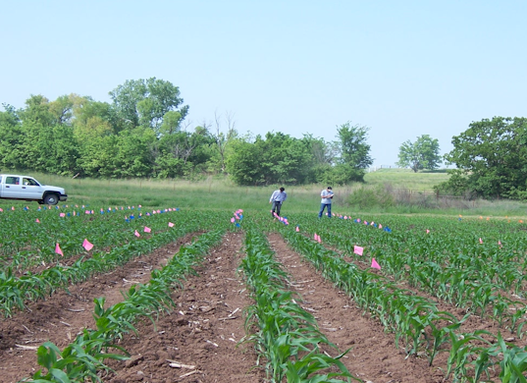
Agron. Journal, 2019. doi:10.2134/agronj2019.04.0291
Randomness is increasing, more and more processes are independent
Residual N in the soil following crop harvest is different
Yield levels change radically from year to year, a product of an ever-changing and unpredictable/random environment
Contribution of residual soil N for next years’ growing crop, randomly influences N response or the response index (RI)
2nd law of thermodynamics (entropy or orderliness increases with time and is irreversible)
Need for independent estimation of multiple random variables for mid-season biological algorithms of the future

Slide 8
In an irreversible process, entropy always increases, so the change in entropy is positive. The total entropy of the universe is continually increasing.
Delta S is entropy. Measurement of randomness or disorder.
Measure the change through a chemical process (Organic chemistry tutor)

Slide 12
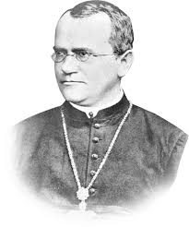
Gregor Johann Mendel (1822 – 1884) Catholic Augustinian Priest, founder of the modern science of genetics (Olby, 1997)
Discovered basic principles of heredity via experiments with peas (Pisum sp), suggested that this theory applied to all living things
Mendel’s Law of Independent Assortment established that traits were passed on independently of other traits from parent to offspring (Bateson, 2007).
Random helped explain how traits were independently passed from parent to offspring
Presence of randomness in all biological systems
Olby, R.C., 1997. Mendel, Mendelism and genetics. Mendel-Web, URL: www. netspace. org/MendelWeb/MWolby. intro. html.
Bateson, W., 2007. Mendel's principles of heredity. Cosimo, Inc.
Georges Lemaitre

Slide 13
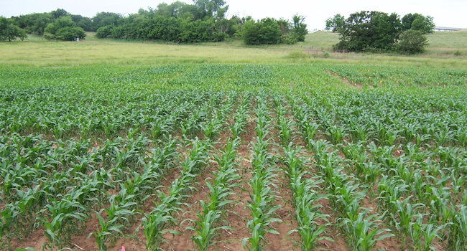
Yield level from one year to the next was documented to be random and unpredictable, while the response to fertilizer N year to year was also random (Dhital 2016, Lamb et al., 1997)
Because both affect the demand for fertilizer N (yield level and N response), independent estimates of both were suggested to calculate realistic in-season fertilizer N rates (Agron J. 2013 (105)
Dhital, S., and W. R. Raun. 2016. Variability in Optimum Nitrogen Rates for Maize. Agron. J. 108:2165-2173. doi:10.2134/agronj2016.03.0139
Lamb, J. A., R. H. Dowdy, J. L. Anderson, and G. W. Rehm. 1997. Spatial and Temporal Stability of Corn Grain Yields. J. Prod. Agric. 10:410-414. doi:10.2134/jpa1997.0410.
Arnall, D.B., A.P. Mallarino, M.D. Ruark, G.E. Varvel, J.B. Solie, M.L. Stone, J. L. Mullock, R.K. Taylor, and W.R. Raun*. 2013. Relationship between grain crop yield potential and nitrogen response. Agron. J. 105:1335–1344

Slide 14
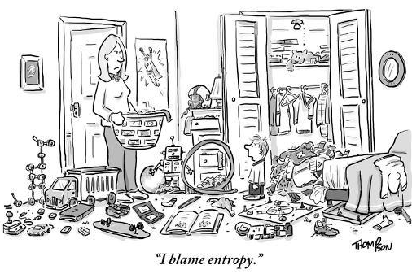
Entropy and Randomness
Mann (1970) recognized randomness in fundamental biological processes and organic evolution
Entropy is a gauge of randomness or chaos within a closed system. As usable energy is irretrievably lost, disorganization, randomness, and chaos increase (https://www.allaboutscience.org)
Second law of thermodynamics: total entropy (disorder or randomness) of an isolated system can never decrease over time (Costa et al., 2002).
Mann, J. C. (1970). Randomness in Nature. GSA Bulletin ; 81 (1): 95–104. doi: https://doi.org/10.1130/0016-7606(1970)81[95:RIN]2.0.CO
Costa, M., A. L. Goldberger, and C.K. Peng. 2002. Multiscale entropy analysis of complex physiologic time series. Physical Review Letters: 89(6) 68-102.

Slide 15
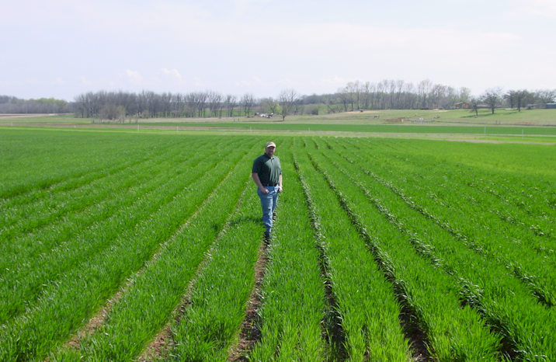
Heams (2014) randomness is an inherent feature of evolutionary biology and genetics
Udgaonkar (2001) second law of thermodynamics does not distinguish between living and non-living things
Concepts of thermodynamics constitute the unifying principles of physics, chemistry, and biology
Heams, T.. 2014. Randomness in biology. Mathematical Structures in Computer Science, 24(3), E240308. doi:10.1017/S096012951200076X
Udgaonkar, J.B., 2001. Entropy in biology. Resonance 6: 61-66. https://doi.org/10.1007/BF02837738

Slide 16
Udgaonkar (2001) Second law of thermodynamics implies that the principle of total entropy, as a measure of disorder, must steadily increase. This work included biology and tied the second law of thermodynamics to plant and crop production systems
Udgaonkar, J.B., 2001. Entropy in biology. Resonance 6: 61-66. https://doi.org/10.1007/BF02837738

Slide 17
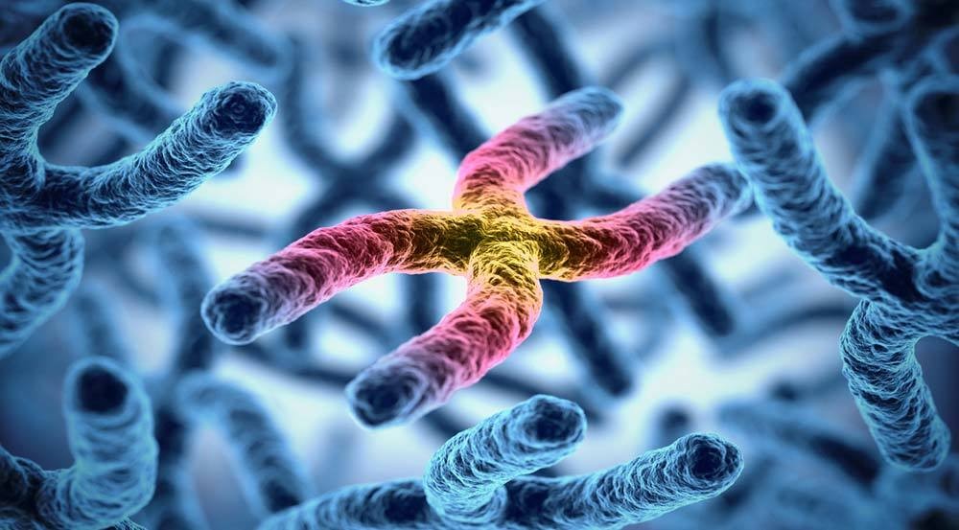
2nd law of thermodynamics helps explain why ostensibly similar biological components (RI and YP0) were independent. Law delineates that everything is becoming more and more random with time (Agron J. 105, 2013; Prec. Ag. 2011).
Mendel’s Law of Independent Assortment (traits passed on independently), and the 2nd law of thermodynamics (impact/influence of randomness on all biological properties) leads to understanding that any one of these biological variables should not be related.

Slide 18
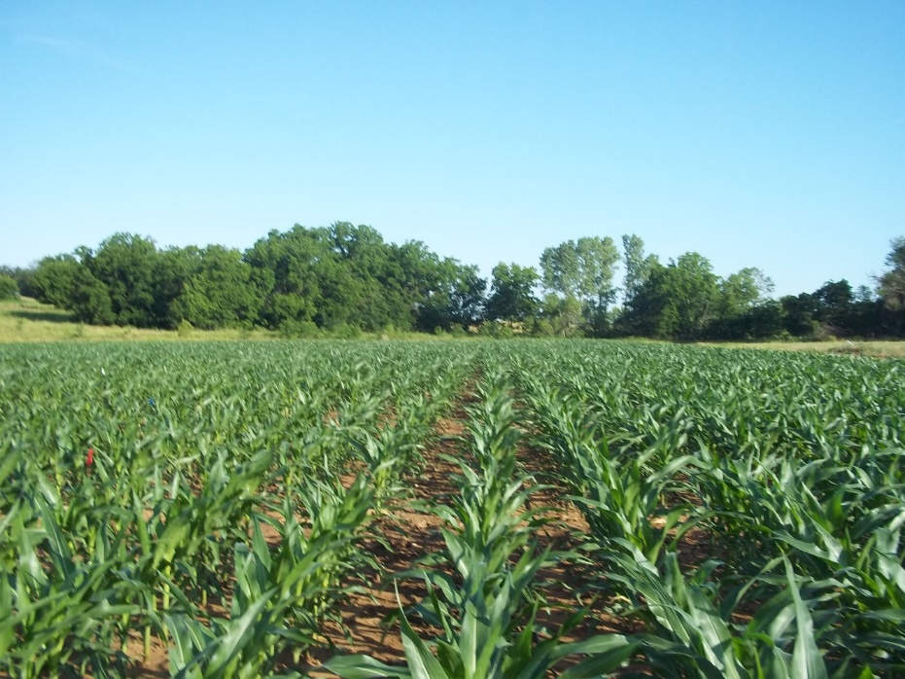
Stochastic process and random process are used interchangeably, Randomness is the lack of pattern or predictability.
Saunders and Ho (1976) evolution tends to produce organisms which are more and more complex, as such more and more random
Systems do not necessarily tend toward chaos, but to a situation that is inherently unstable and unpredictable. At any given moment, random variations occur with varying consequences and varying degrees of predictability (Spielman et al., 2009)
Olson et al. (1976) Residual mineral N influenced both wheat and corn grain protein levels, and differed by environment. A consequence of unpredictable weather effects on crop requirements has been to use reference plots (high N rates) and crop sensing before in-season N application (Tremblay and Belec, 2006).
Saunders, P.T., and M.W. Ho. 1976. On the increase in complexity in evolution. J. Theo. Biol. 63: 375-384.
Spielman, D.F., J. Ekboir, and K. Davis. 2009. The art and science of innovation systems inquiry: Applications to Sub-Saharan African agriculture. Tech. in Society: 3:399-405
Olson, R. A., K. D. Frank, E. J. Deibert, A. F. Dreier, D. H. Sander, and V. A. Johnson. 1976. Impact of Residual Mineral N in Soil on Grain Protein Yields of Winter Wheat and Corn. Agron. J. 68:769-772. doi:10.2134/agronj1976.00021962006800050021x
Tremblay, N., and C. Belec. 2006. Adapting nitrogen fertilization to unpredictable seasonal conditions with the least impact on the environment. Horticulture Technology, 16:408-412.

Slide 19
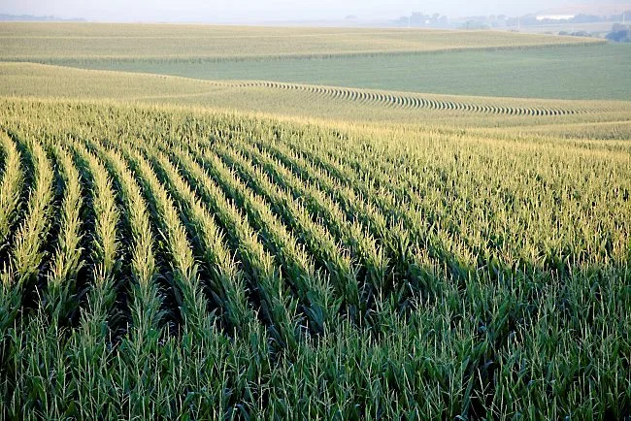
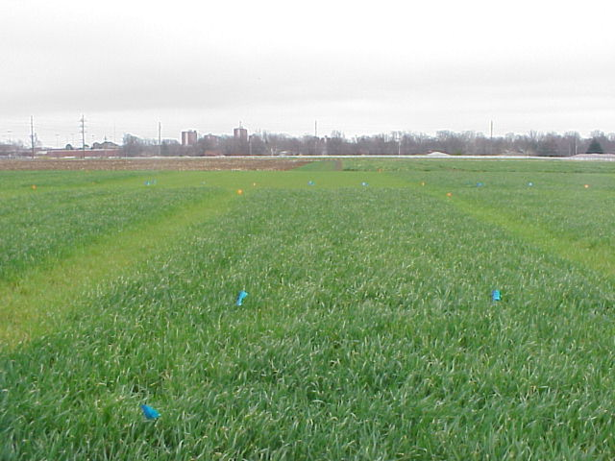
One of the reasons that yield potential and N response are independent is because residual N from the previous year is always different, and likely random due to last year’s environment (Jokela and Randall 1989).
Jokela, W.E., and G.W. Randall. 1989. Corn yield and residual soil nitrate as affected by time and rate of nitrogen application. Agron. J. 81:720-726

Slide 20
Unpredictable nature that environment has on N demand and the unpredictable nature that environment has on final yield dictate that both be estimated independently of one another
Algorithms of the future are likely to take on independent estimates of more and more properties. If these individual properties are known to impact and affect the output parameter (e.g., estimate of fertilizer N rate), each should be estimated independently

Slide 21
Norman Borlaug Mother Teresa 1914 – 2009 1910 - 1997

Slide 22
The implication is that a yield component, as such, does not necessarily need to be included in development of an in-season N recommendation algorithm
Schepers and Holland, 2012, Prec. Agric. 13:276

Slide 23
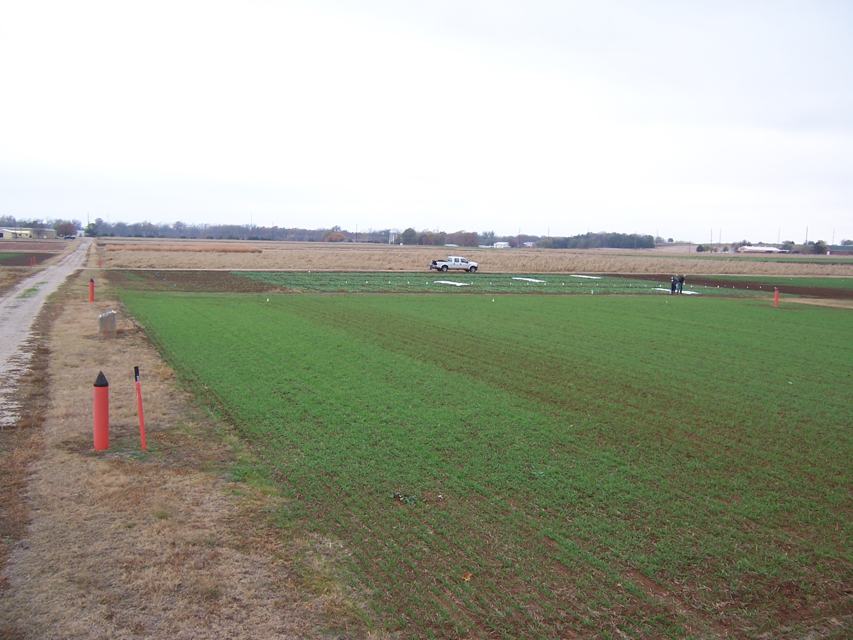
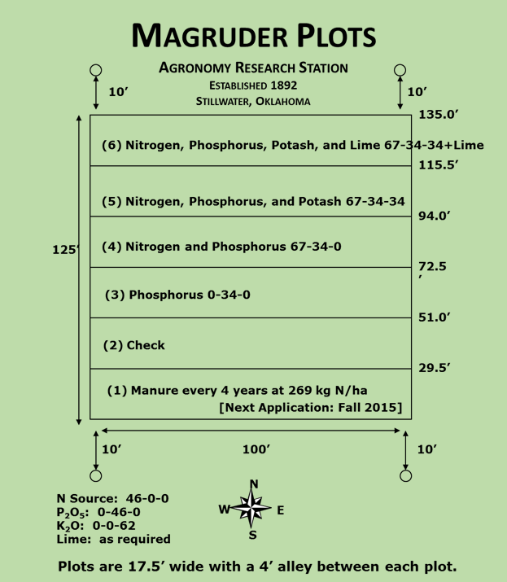
Magruder Plots
Free living cyanobacteria (blue green algae) found in the check plot.
Sun, et al., 2004. Bacterial community structure and diversity in a century-old manure-treated agroecosystem. Appl. Environ. Micro. 70:5868-5874.
1892

Slide 25
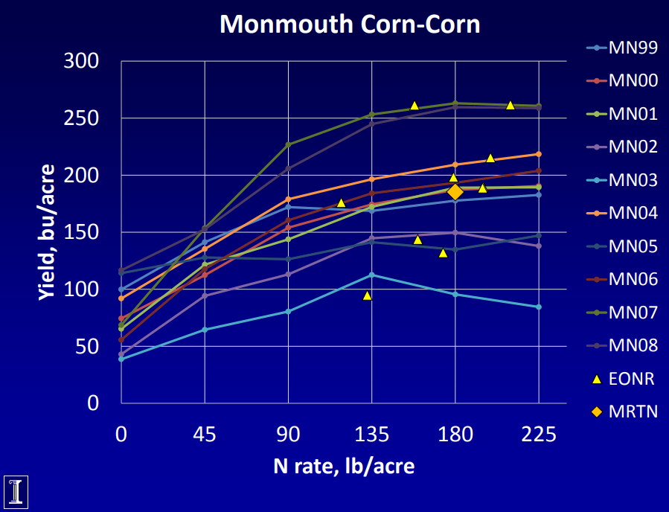
Nafziger, 2019

Slide 26
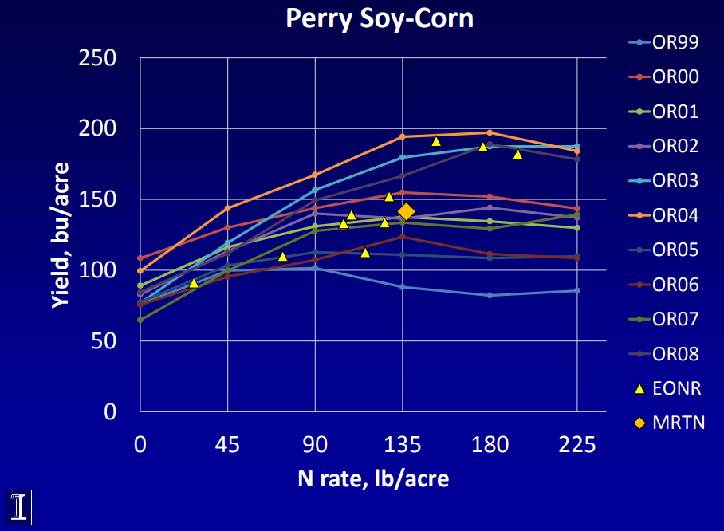
Nafziger, 2019

Slide 28
