Slide 1
Origin, Development and Delivery of the OSU Hand Planter January 14, 2021 Dr. Dwayne Cartmell
nue.okstate.edu

Slide 2
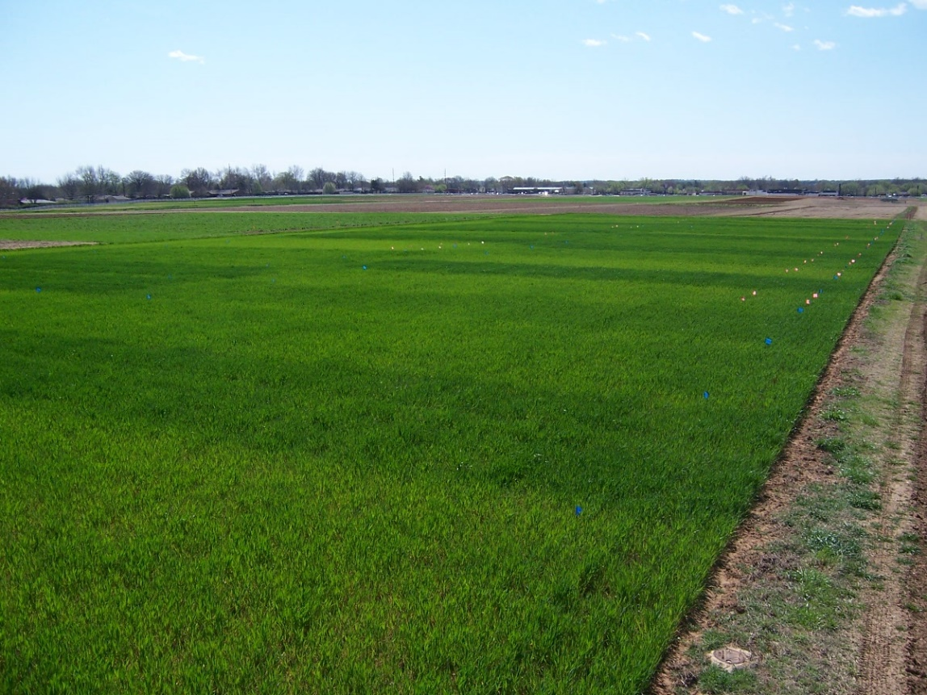
E₂₂₂

Slide 3
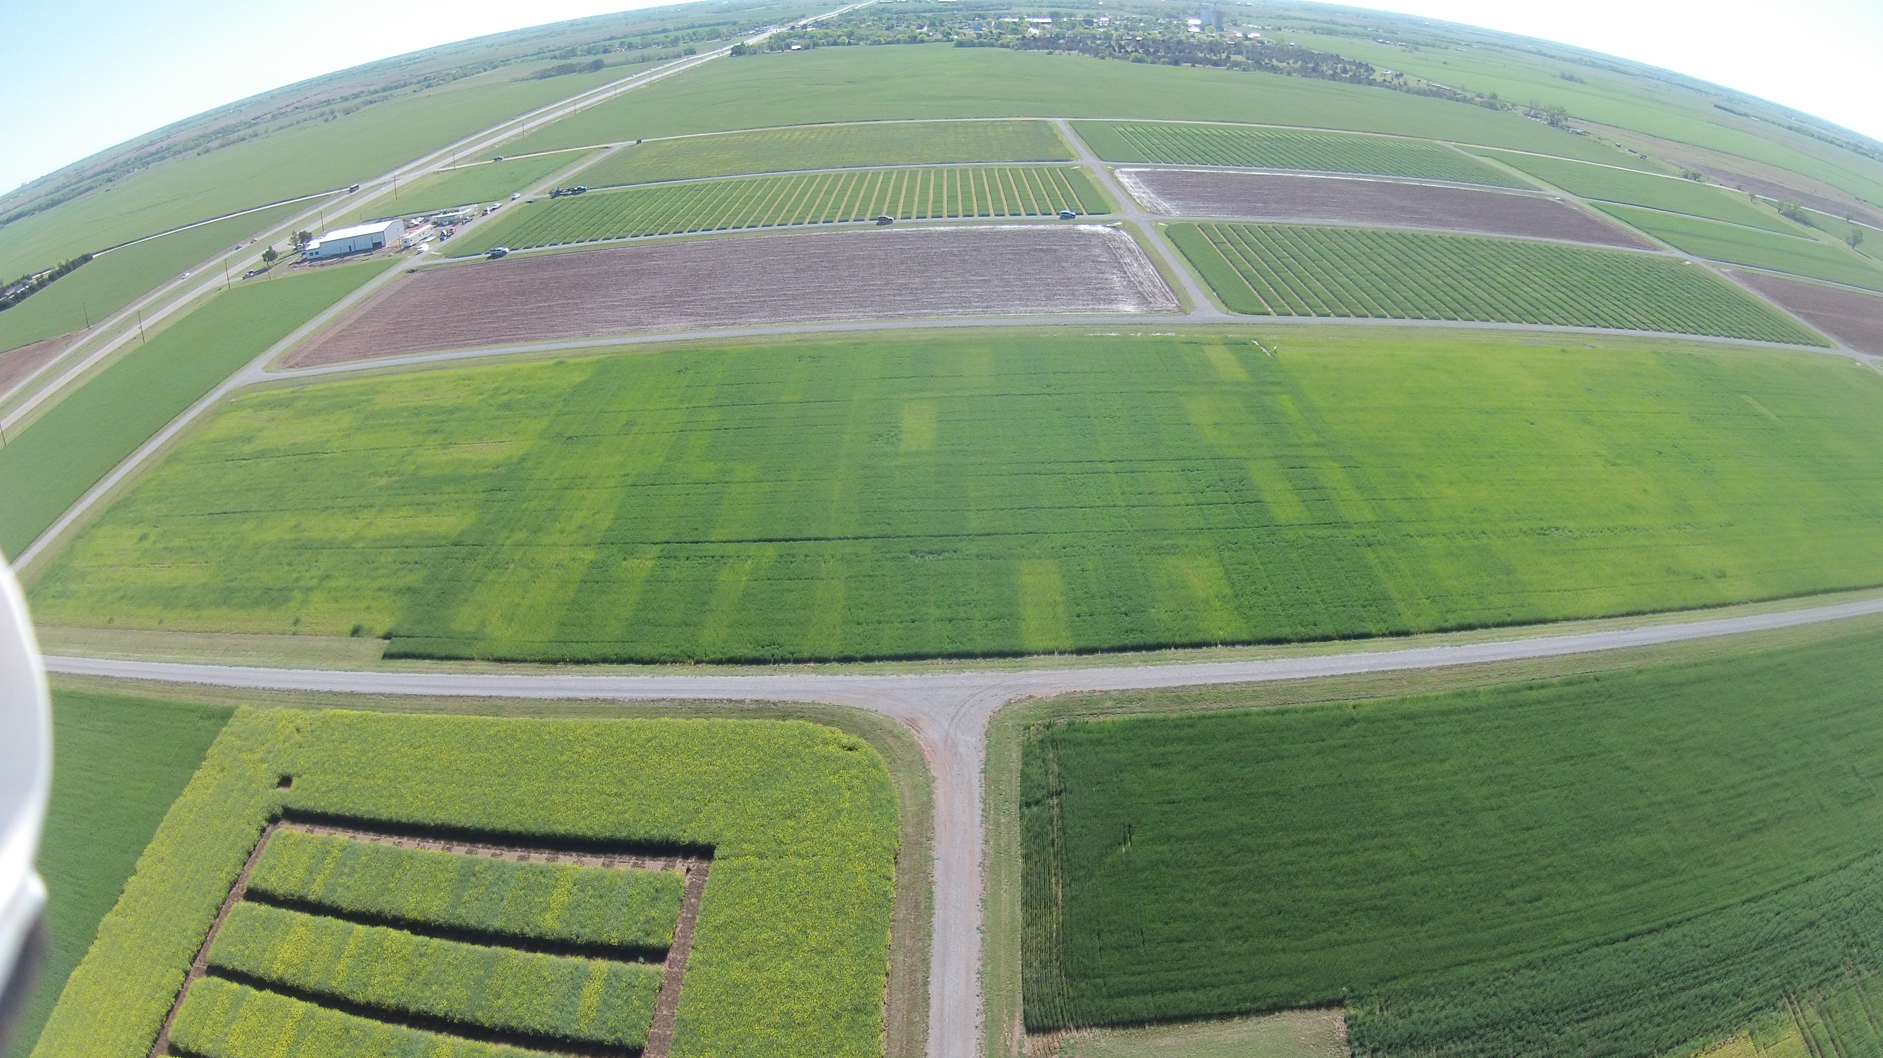
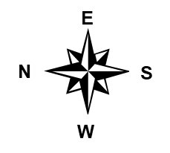
E₅₀₂
Plant losses, denitrification, surface runoff and leaching, volatilization
Nitrogen Use Efficiency (NUE)
Relative balance between amount of fertilizer taken up and used by the crop versus amount of fertilizer lost (Nielsen, 2006)
Grain dry weight or grain nitrogen as a function of N supply (Van Sanford & MacKown, 1986)
World cereal grain NUE estimated at 33% (Raun and Johnson, 1999)

Slide 4
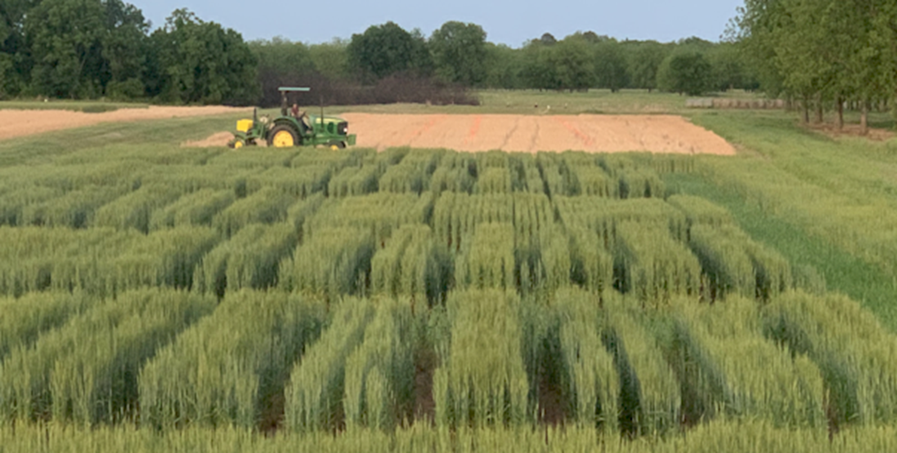
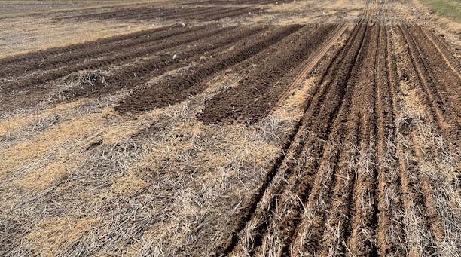

Slide 5
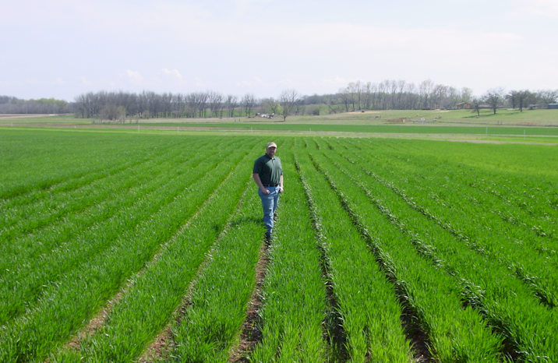

Slide 6
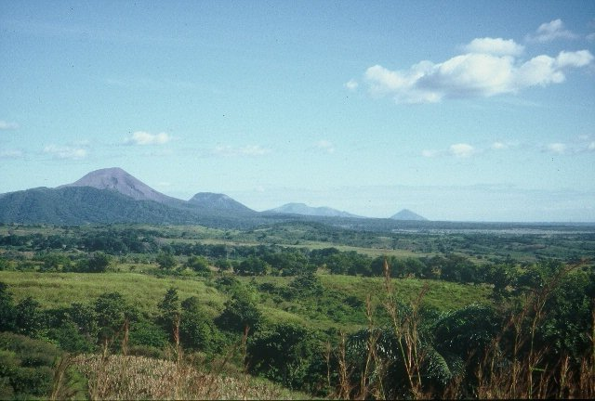
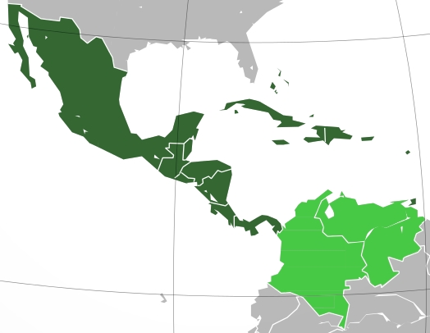
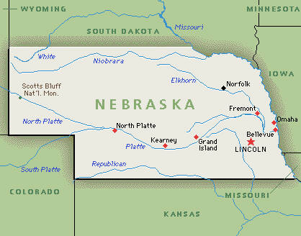
Minden, Nebraska, 1957-1959 Mexico City, Mexico, 1960-1963 Bogota, Colombia, 1964-1967 Cali, Colombia, 1968-1974
Oklahoma State University, 1975-1982 University of Nebraska, 1982-1985 CIMMYT, Mexico, Guatemala, 1985-1991 Oklahoma State University, 1991-present
CaSO₄ DAP, 3-17
Volcan de fuego
Middle America

Slide 7
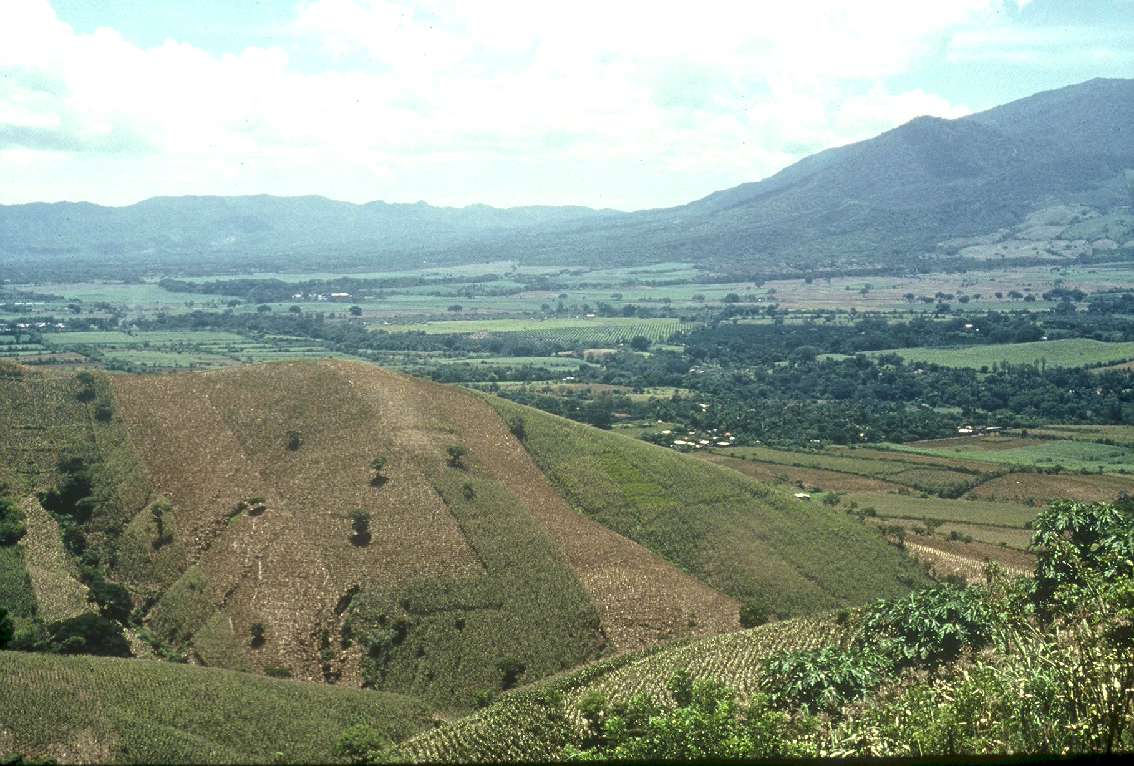
Planter Chronology (35 years) 1985, CIMMYT
1987, Regional Agronomist Central America
1991, Faculty OSU
1999, FP - Hand Planter work
2000, Design/construction started
2013, OSU-MS, Aula, Omara
2019, Planter redesign, Rotary Grant / Importance
Rotary Contributions (OK, NE, Nigeria)

Slide 8
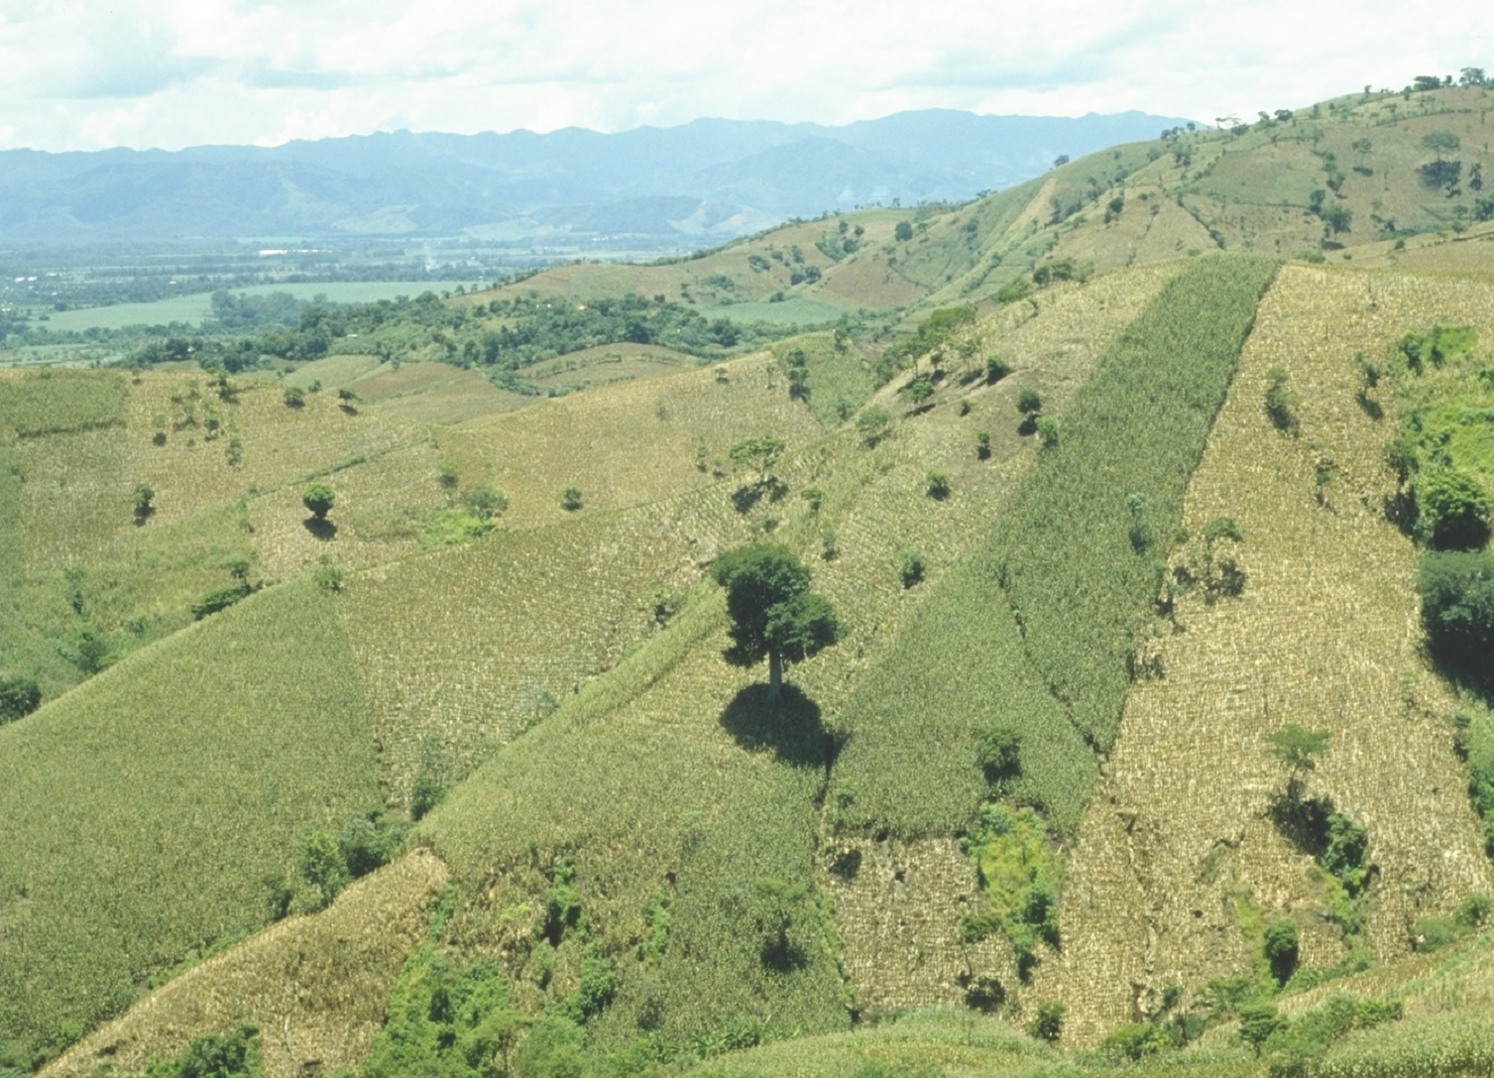
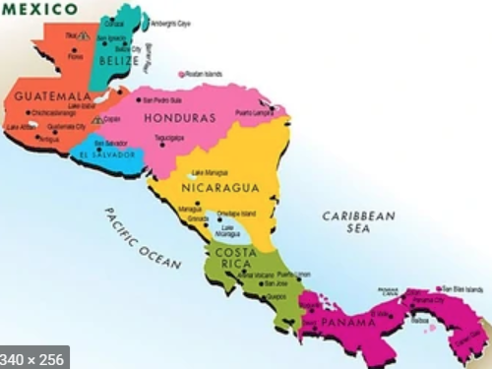

Slide 9
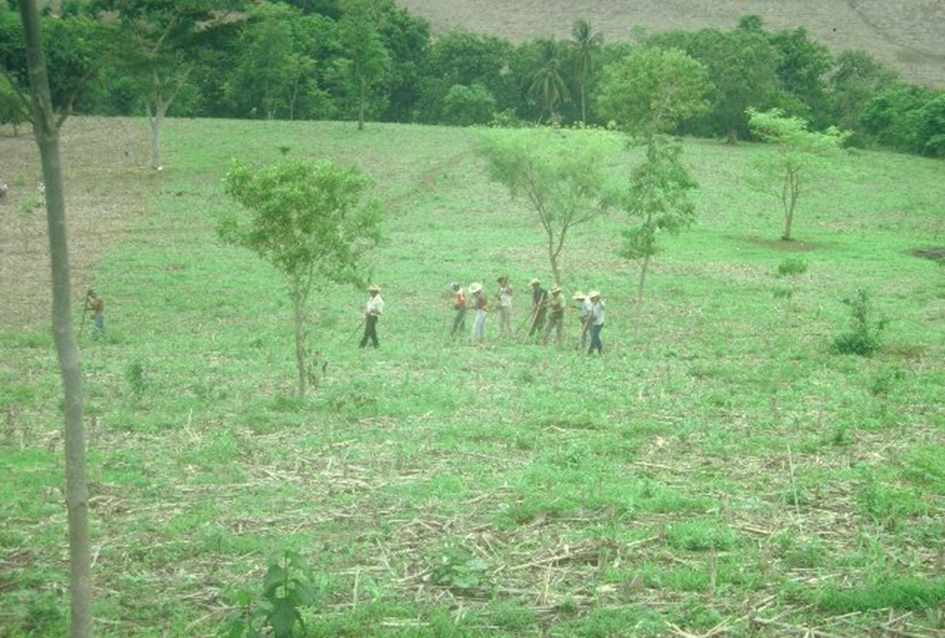

Slide 10
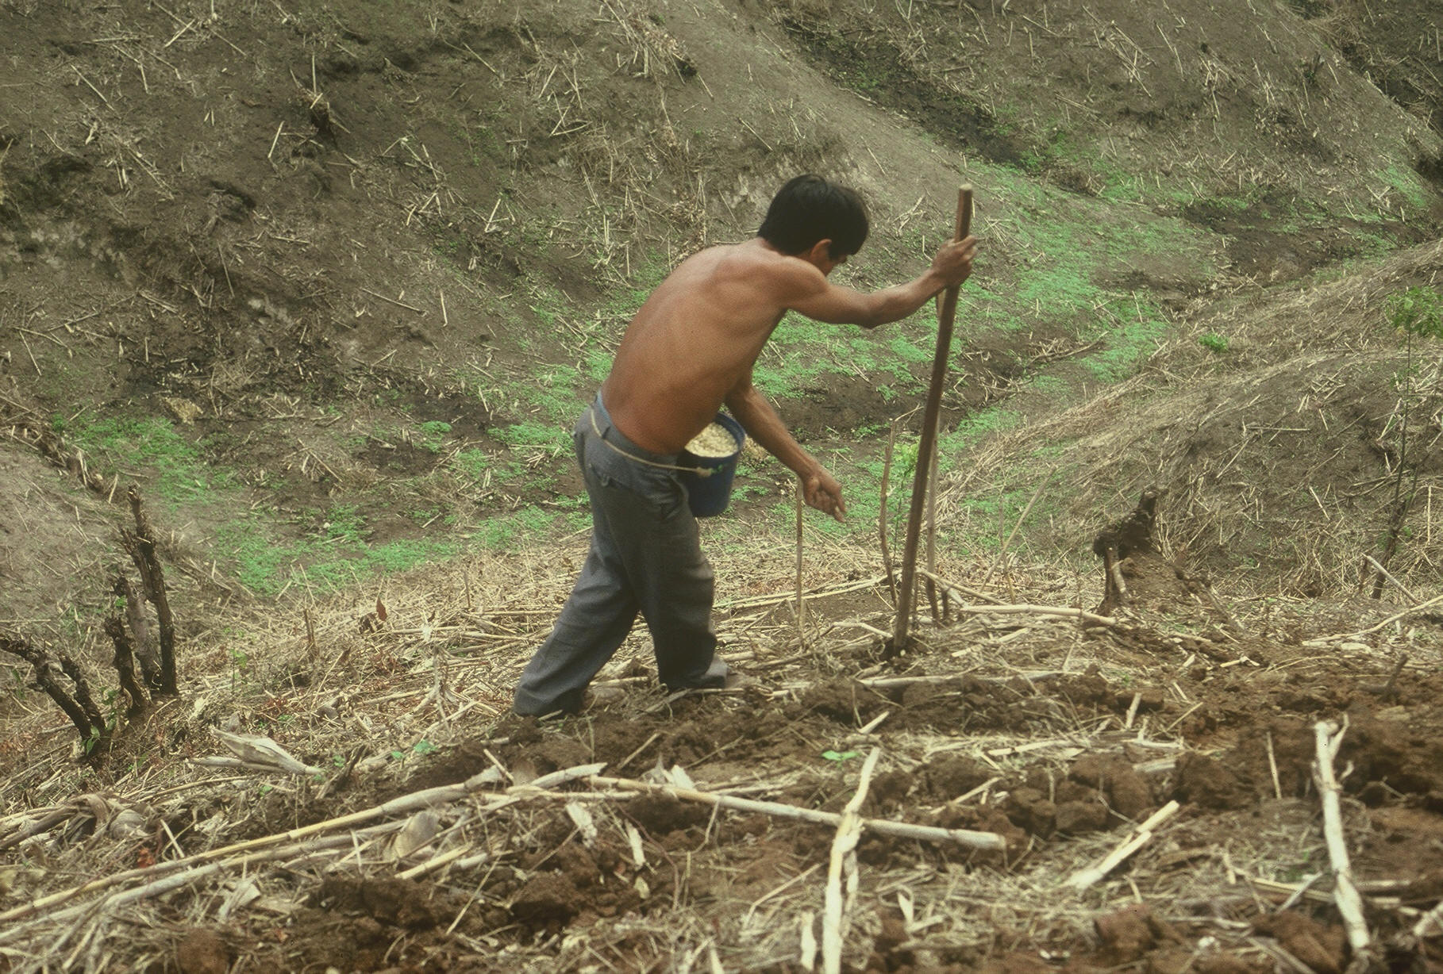
1987 (33)

Slide 11
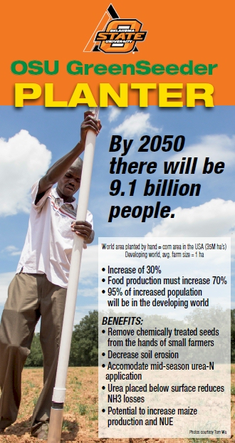
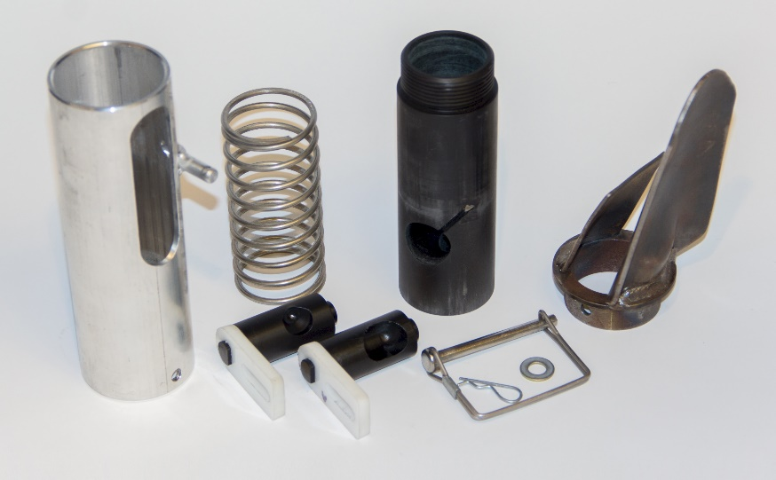
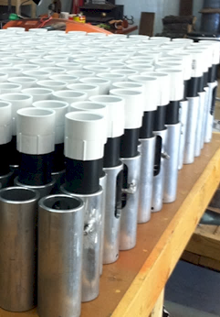

Slide 12
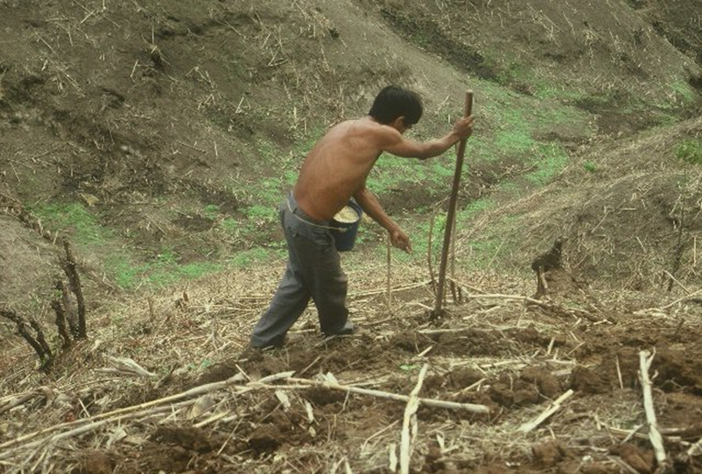
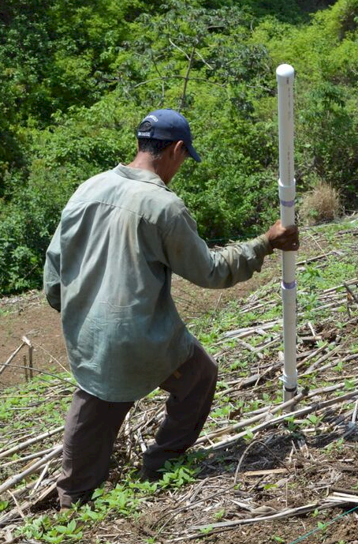

Slide 13
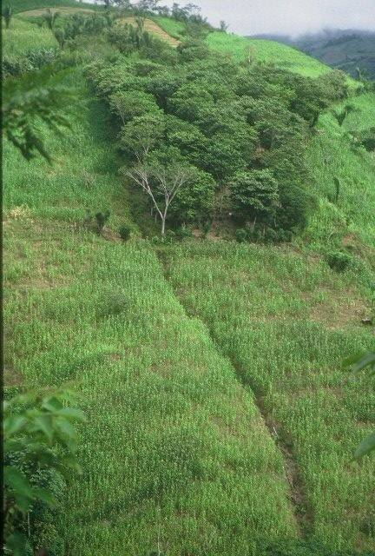
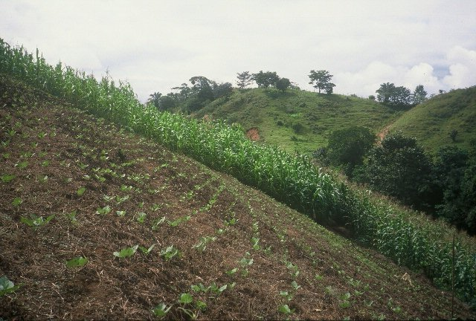

Slide 14
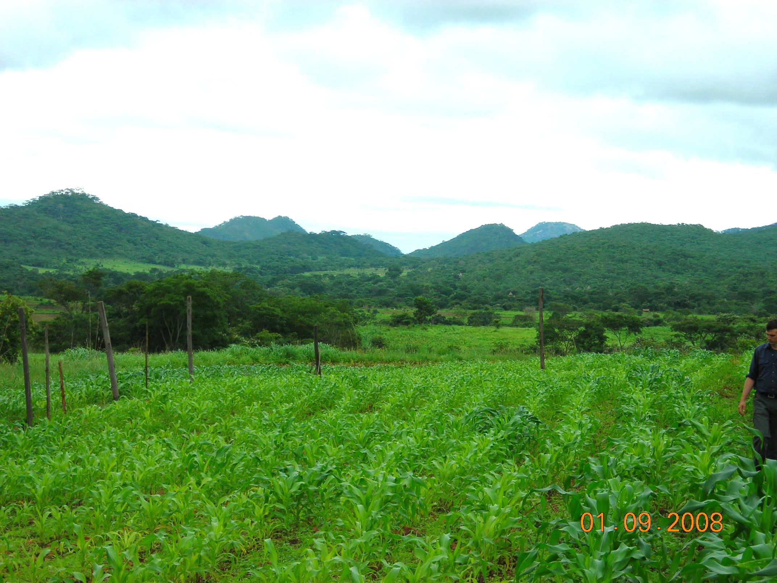
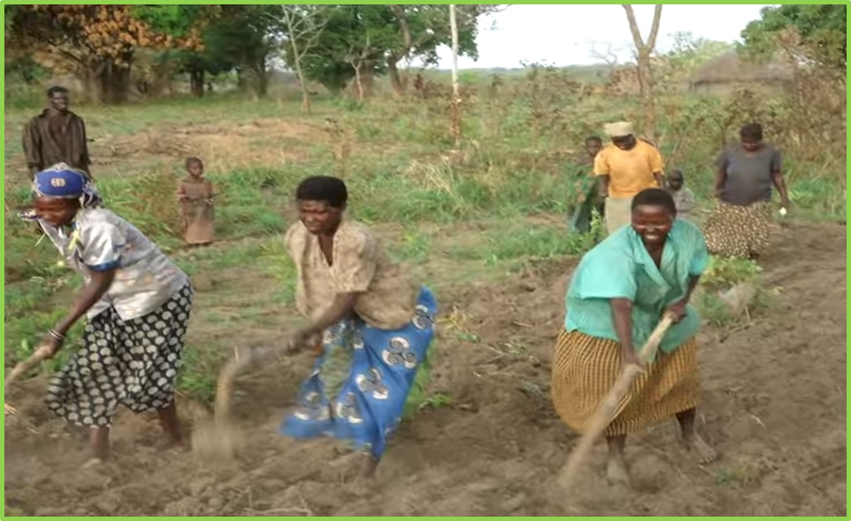
ZIMBABWE, UGANDA
Remote Locations Surface applications of urea

Slide 15
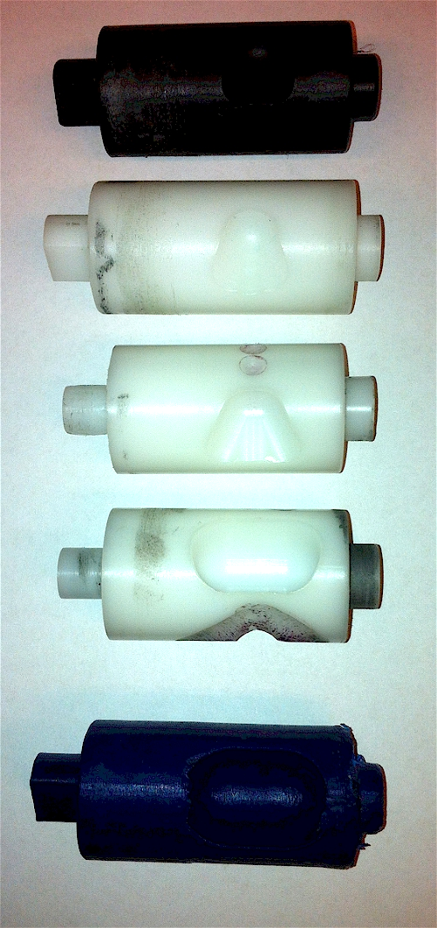
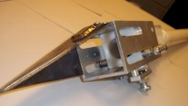
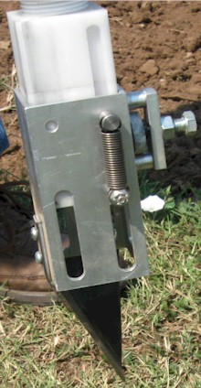
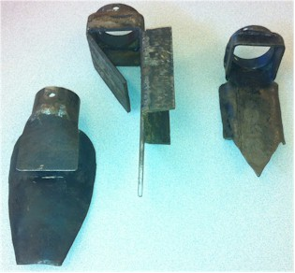
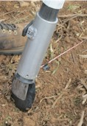
Internal Brush/Strength
Drum size/material
Cavity size/angle
Tip size/design/material
Internal/Ext. spring/tension

Slide 16
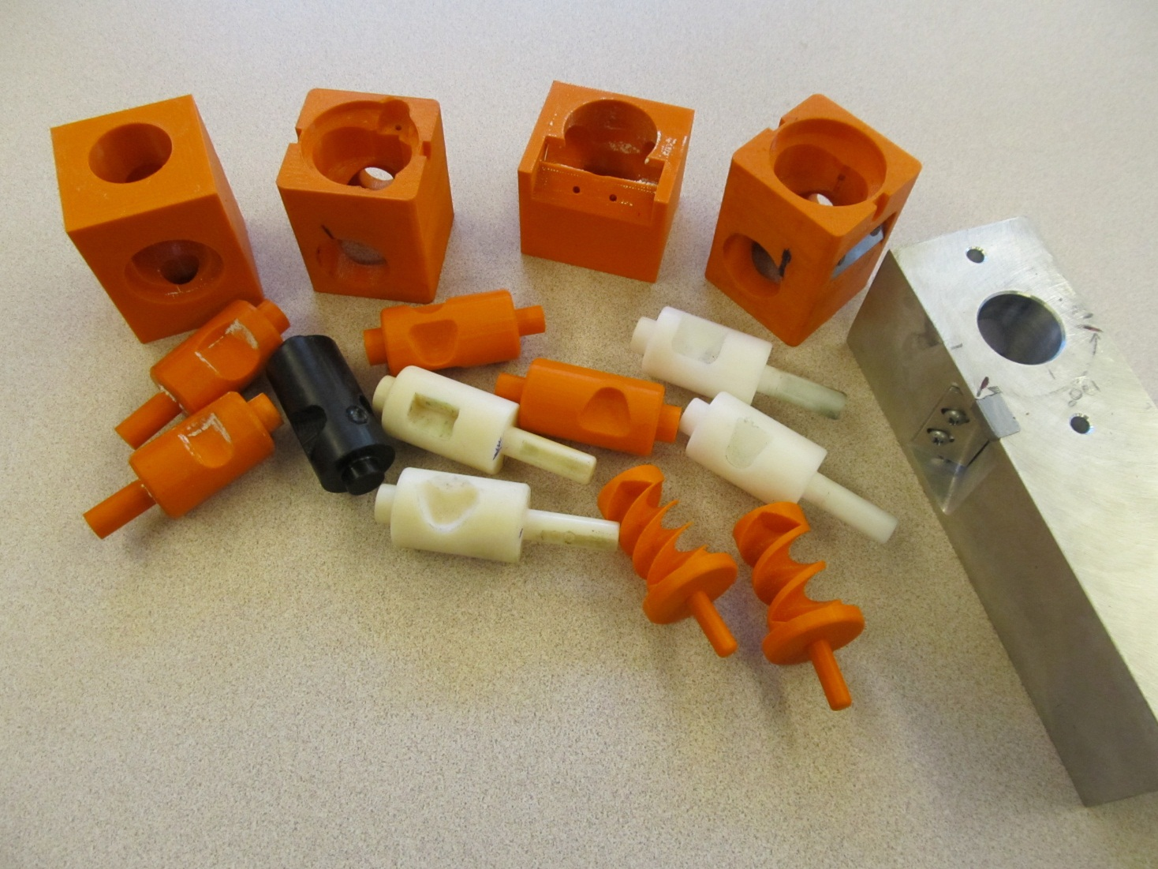
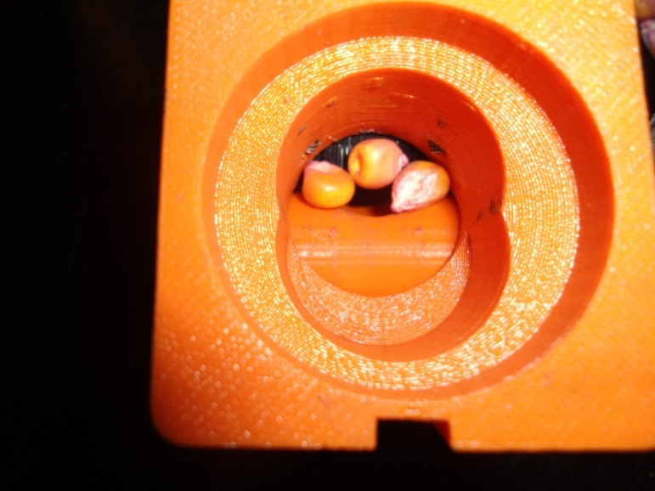
Singulation Design 3D printing
Rotary International AGCO Sitlington Chair
ASA Reinvest, Jessica Davis
Tolerances
Materials
Failure analysis/testing

Slide 17
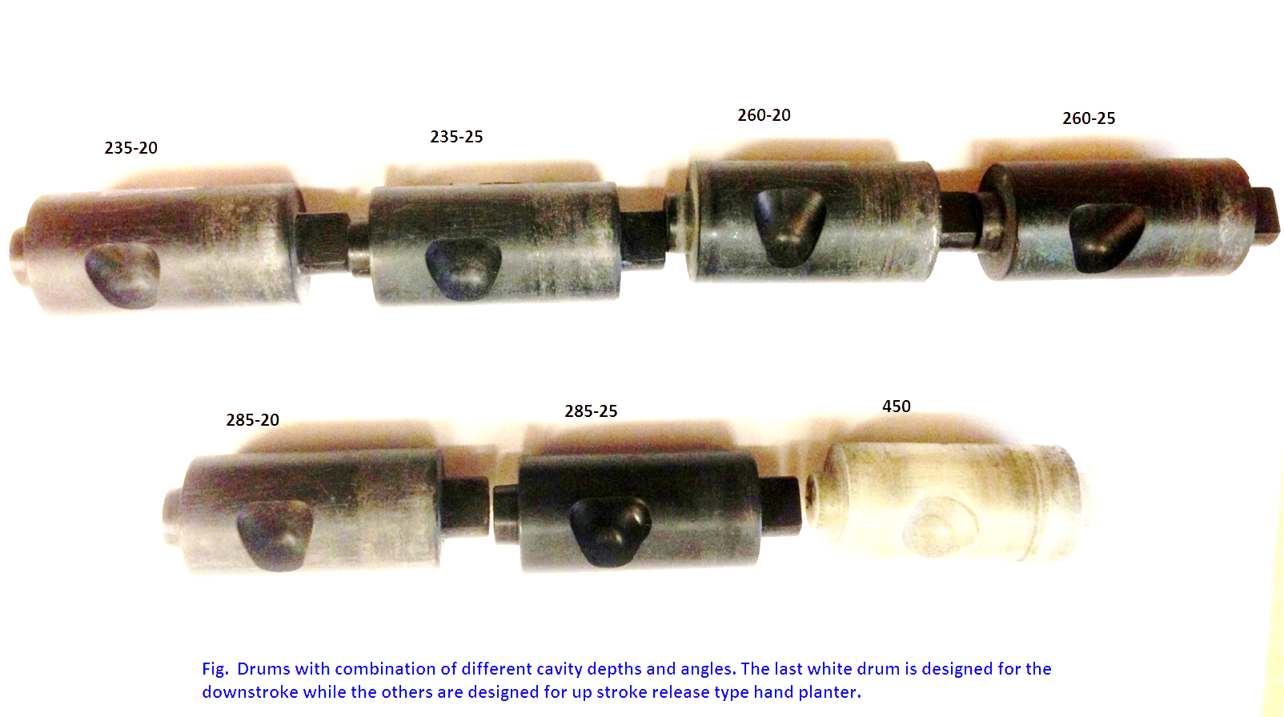
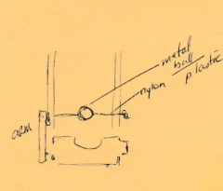

Slide 19
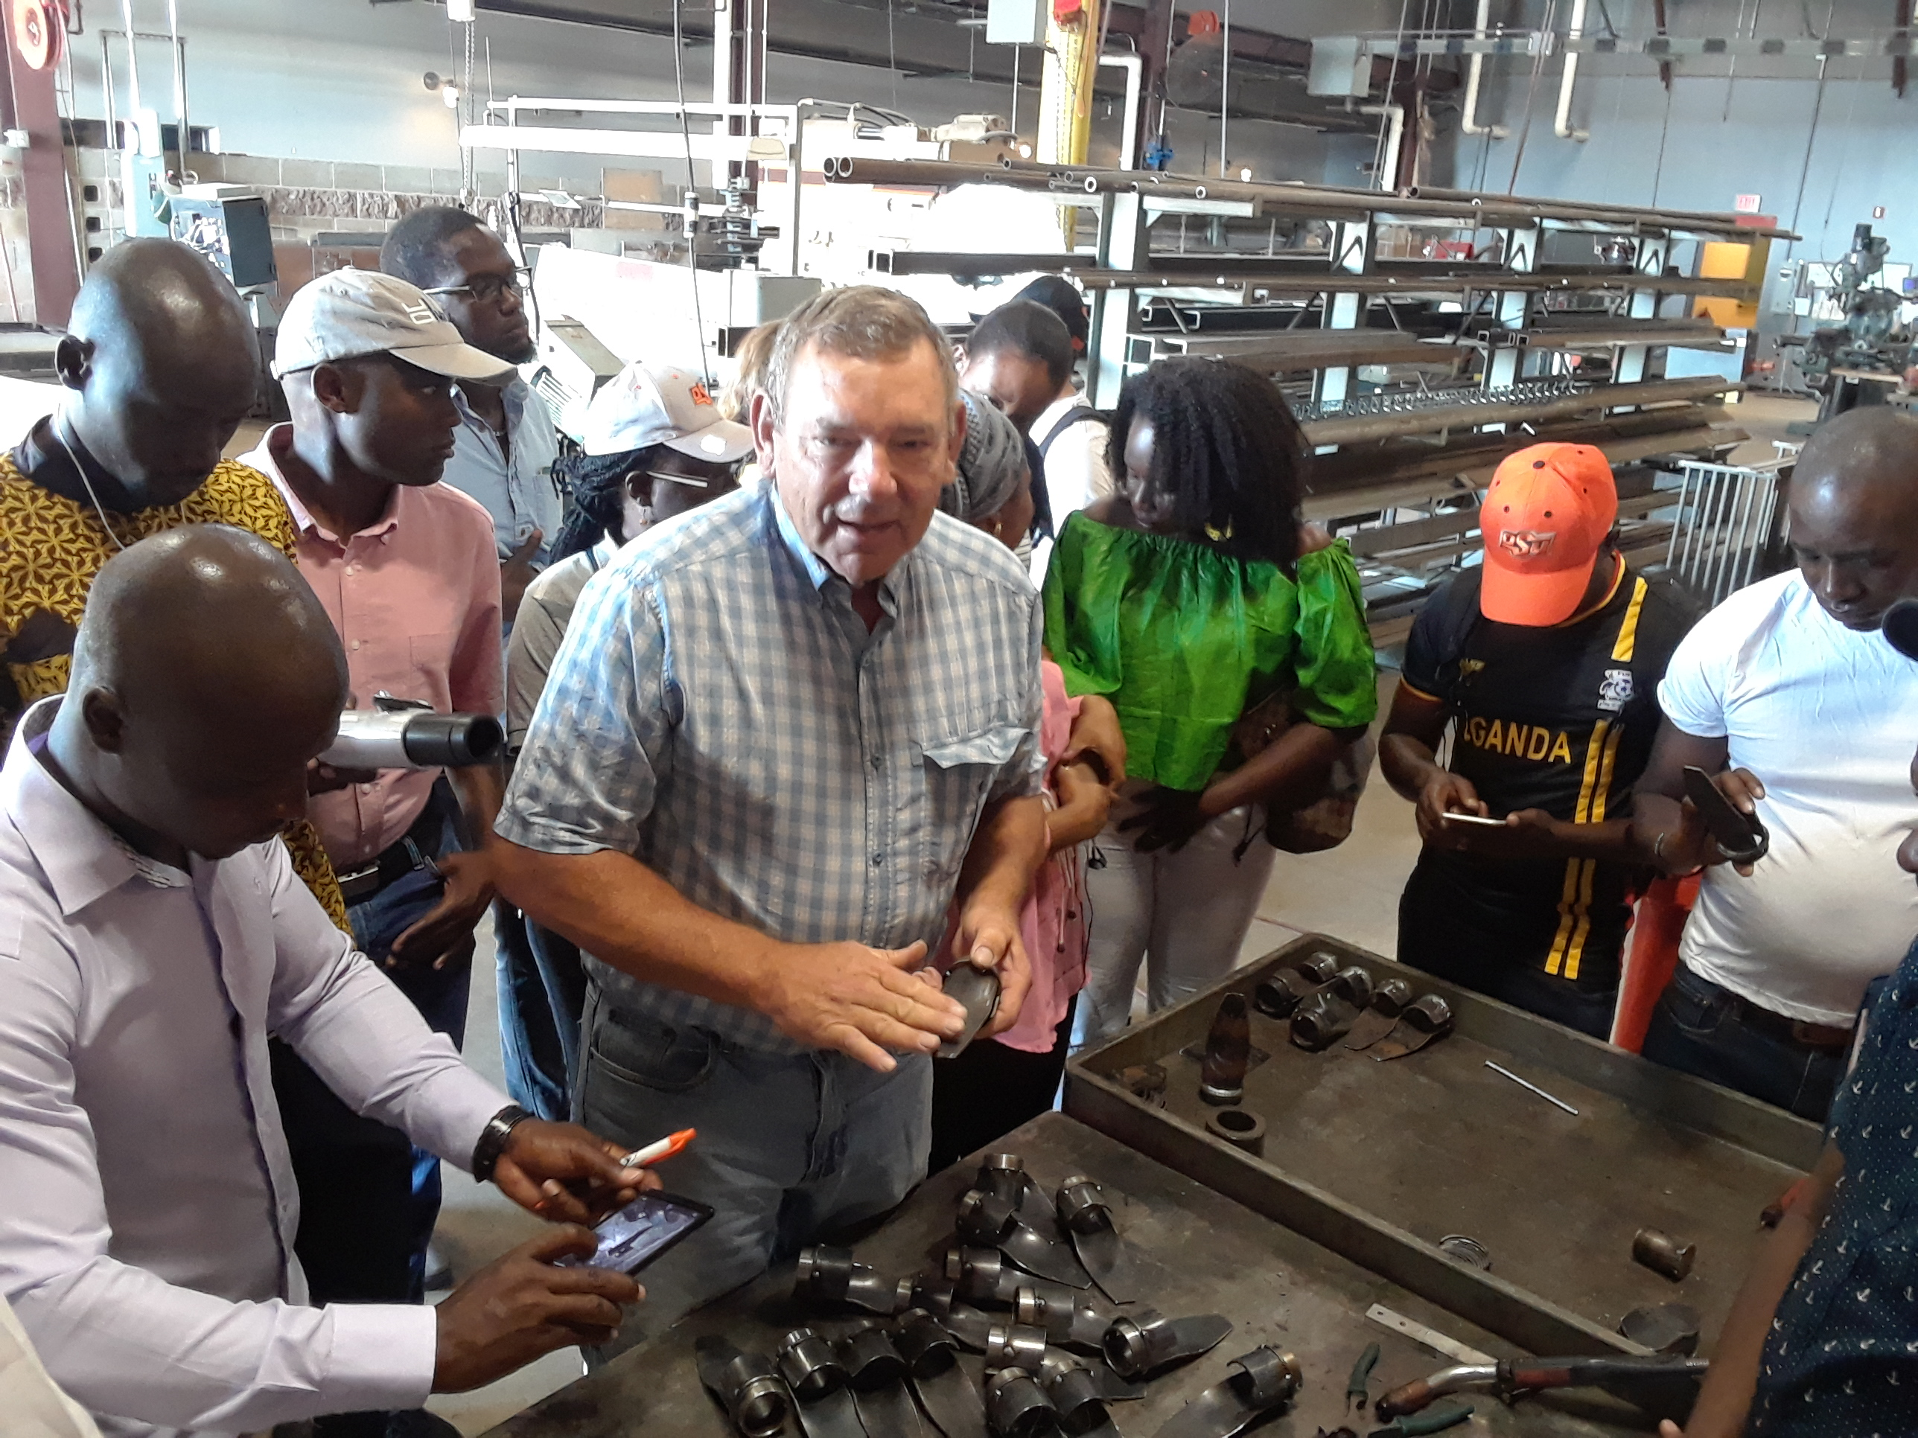
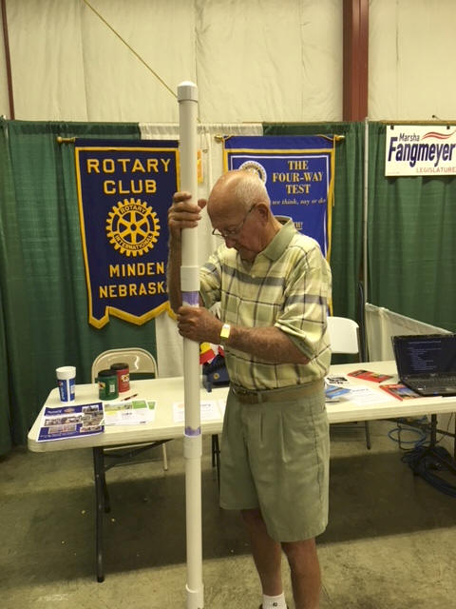
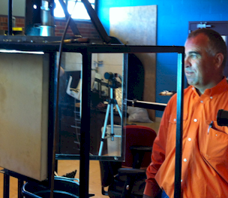
Wayne Kiner
Institutional Memory
Kearney County Fair Minden, Nebraska
Randy Taylor tolerance testing
Koemel Law, PLLC 205 W. 7th Ave. Suite 101-B Stillwater, OK 74074
http://nue.okstate.edu/Hand_Planter.htm

Slide 20
Wayne Kiner, Mandela Fellows 2018

Slide 21
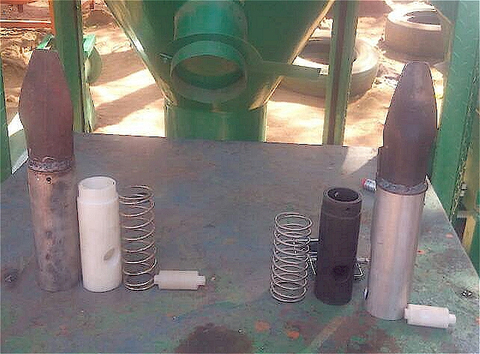
Current Cost Estimates
Grand Victory Ltd Tsim Sha Tsui Hong Kong Rm 1604 16/F Lee Wai Coml Bldg Tsim Sha Tsui
1000, $25 each
Usman Ali, Nigeria, Mandela Fellows
July 11, 2019: Bernard Ato Brown , Kumasi Ghana (Agricultural Engineer)

Slide 22
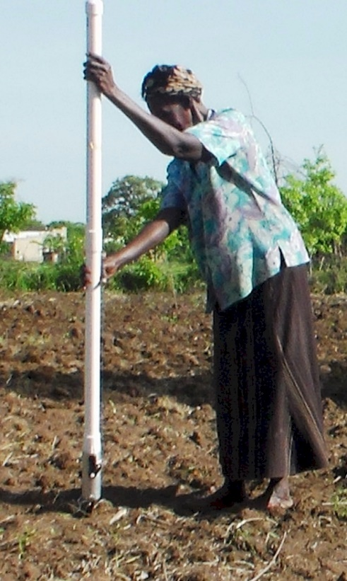
Opico Quezaltepeque, El Salvador
LIRA UGANDA
EL SALVADOR
Peter Omara MS 2013
Worlds Apart
Avg. Farm Size: 1 ha
Avg. Maize Grain Yield, 2 Mg/ha Maize seed, Hybrids (US, others)
Social aspects/technology transfer

Slide 23
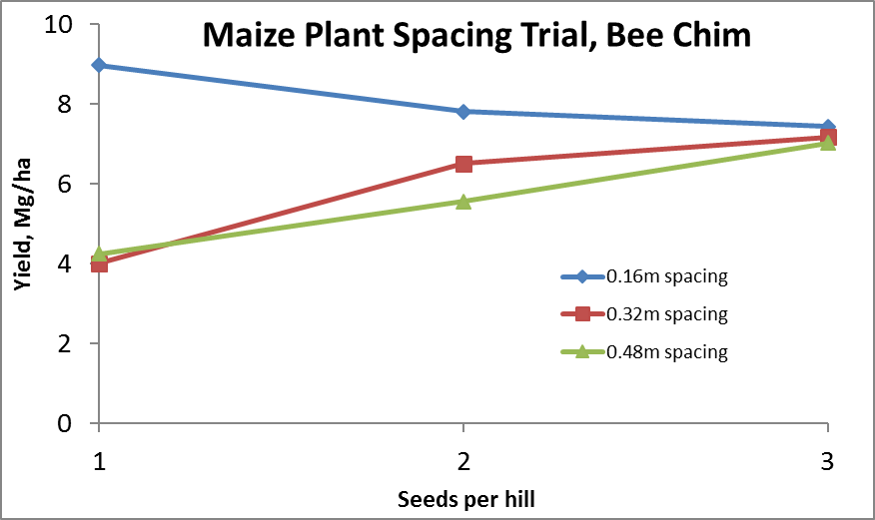
Importance of Singulation
0.76m Row Spacing
Heterogeneity in plant spacing, and plant stands reduce yields
www.agry.purdue.edu/ext/corn/pubs/agry9101.htm

Slide 24
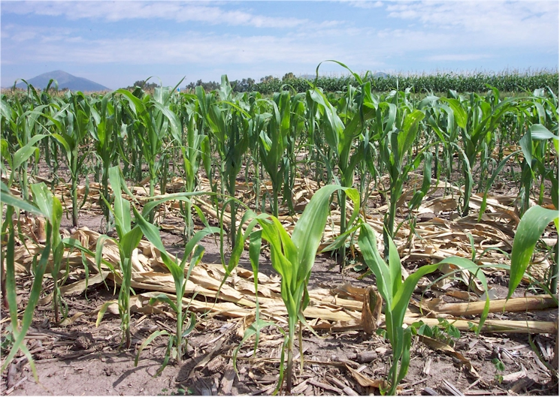
Homogeneity of plant stands

Slide 25
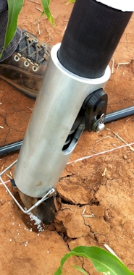
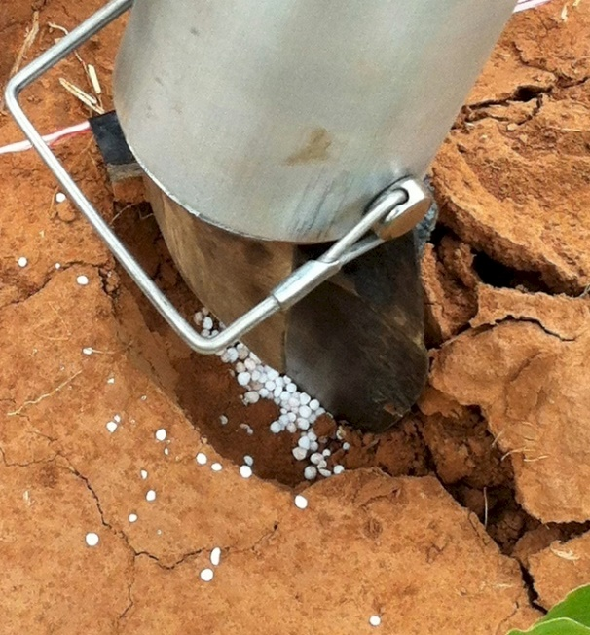
MID Season Fertilizer N
Combined, Efaw and Perkins
Topdress N, Corn, V12 |  | 70,000 plants/ha
Methods | N, kg/ha | Mg/ha
Check | 0 | 6.6
Hand planter (0.9 g/plant) | 30 | 11.2
Hand planter (1.8 g/plant) | 60 | 10.6
Broadcast | 30 | 6.4
Broadcast | 60 | 7.0
Dribble urea | 30 | 9.3
Dribble urea | 60 | 7.8
Dribble UAN | 30 | 7.3
Dribble UAN | 60 | 10.4
SED = 1.81

Slide 26
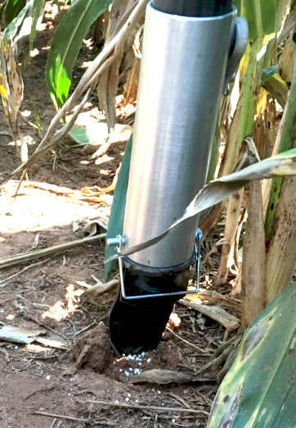
Benefits
Remove chemically treated seeds from the hands of producers
Decrease soil erosion via improved plant spacing
Accommodate mid-season N application
Urea placed below the surface reducing NH₃ loss
Increased production and NUE
Potential Uses
Seed, all types
Alternative chemicals, EPA, mosquito abatement
Food plots/hunters
Gardeners

Slide 27
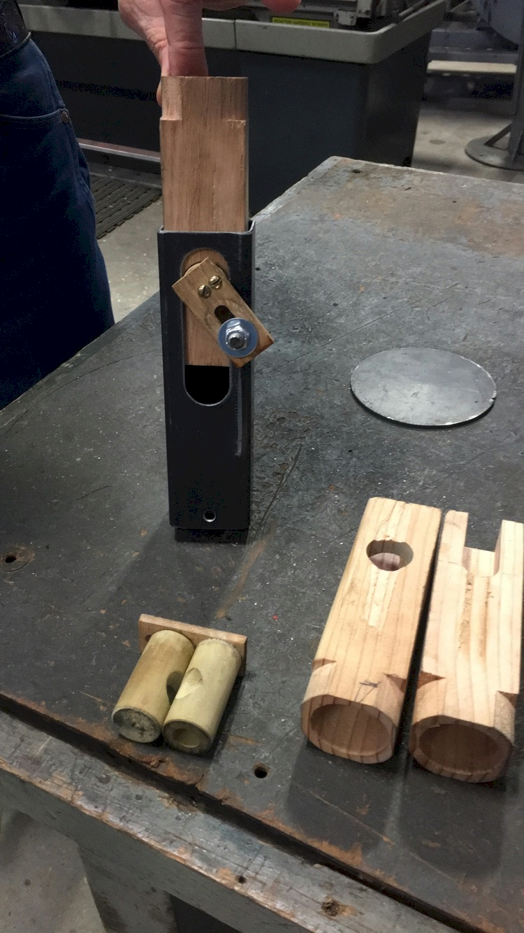
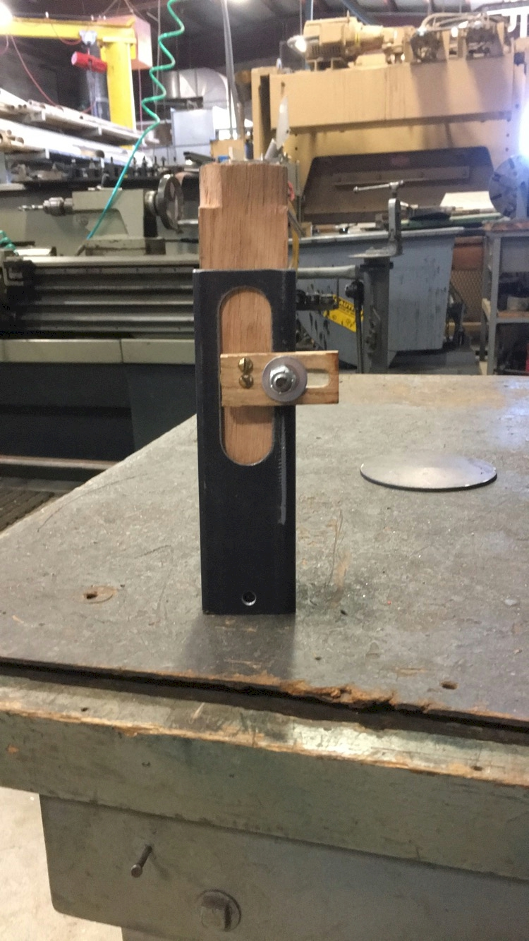
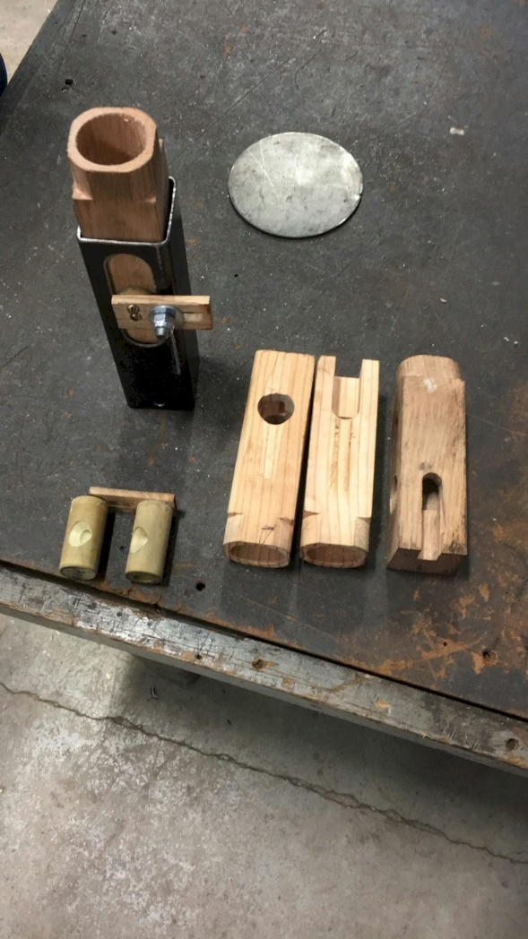
NOT DONE YET
$

Slide 28
MAIZE (FAOSTAT.COM)
Area, ha Production, Mt Avg. Mg/ha
World 183,319,737 1,038,281,035 5.7 (90 bu/ac)
USA 33,644,310 361,091,140 10.9 (174 bu/ac)
China 35,981,005 215,812,100 6.2 (98 bu/ac)
Brazil 15,450,180 80,516,571 5.2 (83 bu/ac)

Slide 29
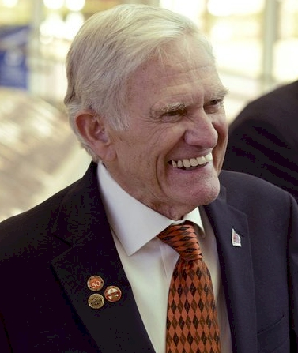
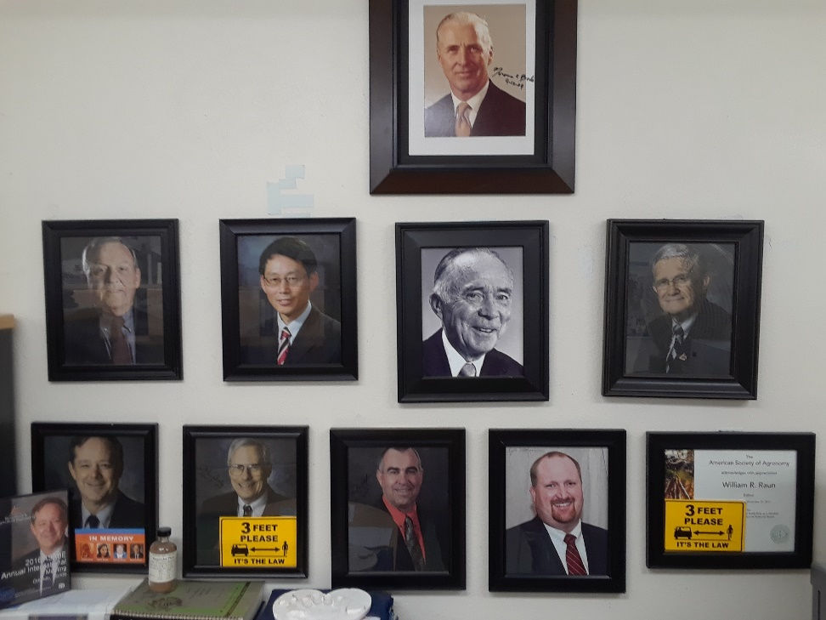
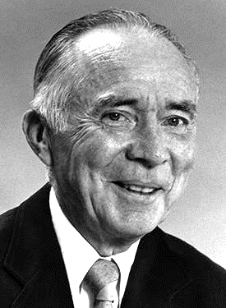
Dr. Robert L. Westerman
Opportunity
Professor R.A. Olson

Slide 30
Norman Borlaug Mother Teresa 1914 – 2009 1910 - 1997

Slide 32
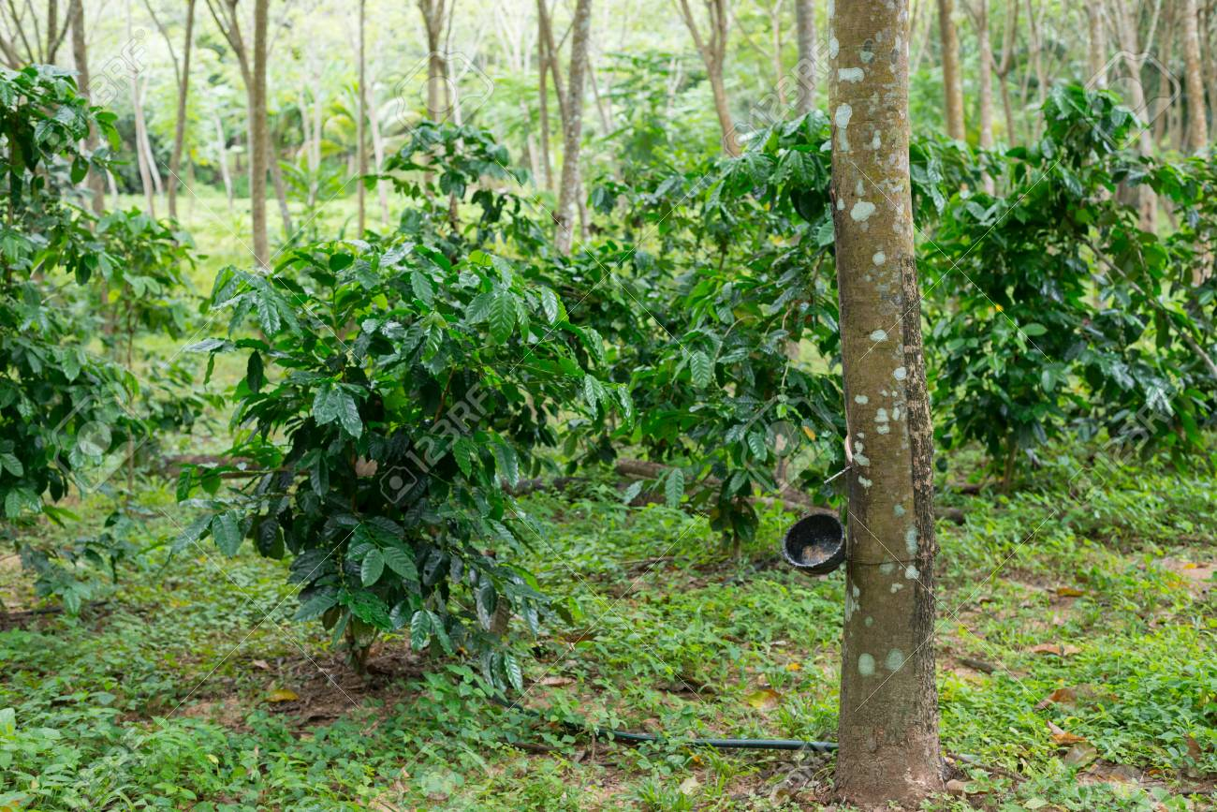
Hemileia vastatrix, leaf rust
(more at lower altitudes)
Coffee Imports to the US (2019)
Colombia $1.14 B
Brazil $1.03 B
Vietnam $300 M
Guatemala $320 M
Indonesia $280 M
Honduras $297 M
Nicaragua $295 M
Costa Rica $140 M
Mexico $160 M
2500-6000 ft asl
Coffee Coffea arabica
Rubber Hevea brasiliensis, 1940 USDA

Slide 33
Population Nebraska 1.92
Kansas 2.78
Iowa 3.03
Oklahoma 3.93
13.3 million acres of corn IA
9.5 million acres of corn NE (200 bu/ac irrigated, 147 bu/ac dryland)
7.6 million acres of wheat, KS (48 bu/ac) 2017
5.3 million acres of wheat, OK (39 bu/ac) 2015
1.0 million acres of wheat, NE, (46 bu/ac) 2017
5.7 million acres of soybeans, NE (58 bu/ac) 2017
12.6 million cattle (cows + CAFO’s Texas)
6.6 million cattle (cows + CAFO’s Nebraska)
5.1 million cattle (cows + CAFO’s Oklahoma)
John Deere invented the steel plow in 1837, Barbed wire 1874, extensive tillage/first tractor, 1892 (John Froelich, Clayton County IA) Atmospheric CO2, 1880 (290 ppm) Atmospheric CO2, 2010 (407 ppm) Atmospheric CO2, 2016 (411 ppm) Atmospheric CO2, 2020 (414 ppm)
Animal agriculture accounts for 18% of all GHG emissions (CO₂ equivalent, CH₄=20x that of CO₂, N₂O=300x that of CO₂)
Tillage 1890 forward, responsible for 25% of the CO₂ increase

Slide 34
Time, $, Products
post PhD, 1985-present, 34 years
Greenseeker Years: 1991–2001, 11 years, $4.7M
Delivery, 2002-present
Stone, Solie, students
OSU Hand Planter (Greenseeder)
Years: 1987-2020, 33 years, $175K
Taylor, Koller, many students,
Delivery, >450, plans for more
OSU graduates, Kenya, Uganda, El Salvador, Mexico, Dr. Joshua Ringer, Dr. Craig Edwards, Mandela Washington Fellows

