Slide 1

Soil Fertility Research and Education Advisory Board Meeting,
Friday May 20, 2016
Building 615, Agronomy Experiment Station
Stillwater, OK 74078
405 744-1722
Agenda
11:30 am Convene at the Soil Fertility Shop, Lunch will be served
12:00 Opening Remarks, Dr. Jeff Edwards, Dr. Brian Arnall
12:15 Soil Fertility Progress Report and Overview
B. Arnall, B. Raun, H. Zhang
12:30 Update on current projects, Brian Arnall
12:40 Engineering Update, Randy Taylor
12:50 Agronomic applications, iPhone apps, Brian Arnall
1:00 New Projects
1:15 Open Discussion
2:00 Adjourn

Slide 2
Fertilizer Advisory Board will meet in the spring of each year. The primary purpose of the Fertilizer Advisory Board is to ensure that fertilizer dealers and fertilizer manufacturers, farmers that use fertilizers, and other clientele that SB-432 (previously SB-314) serves, have a mechanism for input to suggest priority research areas that (a) benefit agricultural producers in the state of Oklahoma; (b) promote efficient use of fertilizers in agronomic crop and forage production while protecting the environment and groundwater supplies; and (c) fulfill the spirit and intent of SB-432.
1. Fertilizer Advisory Board Chair, Rick Howard
2. Fertilizer manufacturer,
3. Fertilizer retail dealer (1) Mike Rosen, Wheeler Brothers
4. Fertilizer retail dealer (2) Kevin Brown, WB Johnston Grain Co.
5. Fertilizer retail dealer (3) Allan Nusser
6. Producer/Farmer, at large (1) Jimmy Kinder
7. Producer/Farmer, at large (2) Brent Rendel
8. CCA Board Chair, Jeff Ball
9. OARA President and CEO, Joe Neal Hampton
10. OARA Board Chair, Randy Gilbert, Bayer CropScience, Bethany, OK
11. Oklahoma Farm Bureau, Marla Peek
12. American Farmers and Ranchers, Terry Detrick
13. Oklahoma Department of Agriculture, Food and Forestry, Lance Kunneman
14. Oklahoma Department of Environmental Quality, Robert Huber

Slide 3
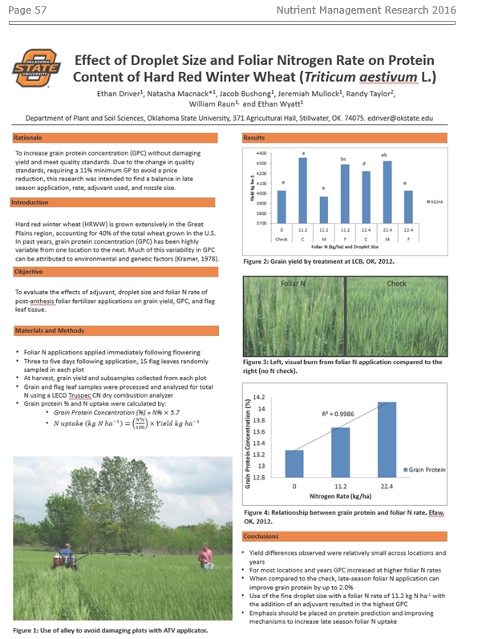
Soil Fertility Research Highlights
Research Highlights 2016
http://nue.okstate.edu/checkoff.htm
58 pages
- Reduce preplant N
- Extend SBNRC (32)
- N Rich Strip

Slide 4
Summary for 2015
i-phone, algorithms developed (3)
Soil Fertility Handbook is in layout design (8th Edition)
Trimble Greenseeker Hand Held Crop Sensors manufactured and now sold all over the world.
Graduate students placed in leadership positions with Mosaic, Monsanto, IPNI, IITA, Potash Corp, Virginia Tech, Kansas State, Univ. Idaho, Louisiana State University, Washington State University, University of Wisconsin, Bayer CropScience, Dupont-Pioneer, University of Wisconsin, and Oklahoma State University.
13th International NUE Conference, Aug 3-5, 2015, Auburn, AL
Research Highlights, 2016, 58p. (http://nue.okstate.edu/checkoff.htm)
CSA NEWS, Cover story, March 2016
Agronomy Journal Editor
Commencement Speaker, December 2015

Slide 5
Other milestones for 2015:
8 students completed Graduate Degrees (4 M.S., 4 Ph.D)
21 refereed Journal Publications
9 students traveled to Ciudad Obregon, Mexico, to collect added spring wheat data and to assist in refining present algorithms with CIMMYT personnel.
Handheld GreenSeekers distributed to County level OCES
Web-based dissemination of field scale N fertilization rates based on our optical sensor-based technology (http://www.nue.okstate.edu)
Two additional algorithms added (SBNRC)
5 mobile apps released, 11 apps in total
Currently have 18 graduate students supported by our program thanks to continued support from the Soil Fertility Research and Education Advisory Board. These students are paid on average $15,660 per year, working full time in the summer and ½ time in the fall and spring semesters. They are the life-blood of our program and we are most grateful to them.

Slide 6

Phosphorus in No-Till
Utilizing a 2 inch sectioned soil sample to a 6 inch depth there is Phosphorus stratification occurring in No-Till soils in central Oklahoma.
Phosphorus concentrations appear to decrease about 1/3 in concentration from the sampling depth above it.
Mehlich III extractable P did not accurately predict yield response to surface applied fertilizers at our site locations.
Mehlich III extractable soil phosphorus needs to be re-evaluated as an acceptable method for determining wheat yield response to surface applied phosphorus fertilizers.
Mehlich III extractable Phosphorus concentrations may be greatly affected by pH within the soil sampling depth and is currently being investigated.

Slide 7
Evaluation of OSU Soil Sampling Methods and P Recommendations in No-Till Winter Wheat
SOIL SAMPLING IS GOOD!!! Soil sampling is an excellent method for determining plant response to applied nutrients and soil concentrations prior to planting.
But may not always provide accurate in season plant demands.
Investigations into the plant available soil phosphorus pools needs to be made with respect to non-labile pools.
Phosphorous availability and extractable P appears to be correlated with pH and binding ion concentration of Fe, Al, and possibly other ions.
Fertilizer rich strips appear to be an excellent tool in determining in season plant demand for nutrients.

Slide 8
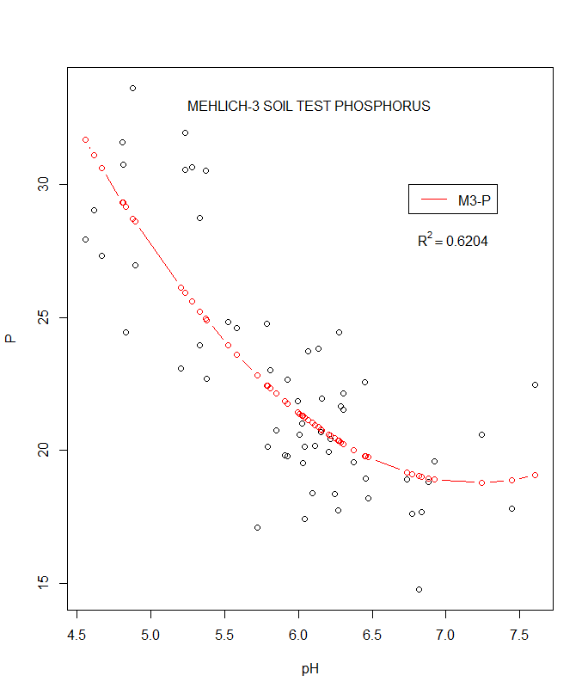

Impact of soil pH on soil-P extractions
Description
Preliminary Findings (Chickasha, OK)
Phosphorus deficiencies are common in OK soils
Soil-pH commonly varies by >2 units within a single field; Is one extraction method appropriate?
5 soil extractants will be tested on a wide range of soils (texture, and pH); M3, Bray, Olsen, Water, Organic-P, & Chang-Jackson (Total-P)
Extractions will be analyzed with ICAP
Study in progress!!

Slide 9
Ammonia volatilization from UAN applications
Description
Results
UAN is commonly used for liquid top-dress N applications
Potential for NH3 volatilization is dependent on environmental conditions and urease activity.
Study intended to evaluate the effectiveness of 3 volatilization inhibitors (Agrotain, VLS3003, VLS3007) relative to UAN and NH4NO3
Applications made on 3/21/16; traps placed between rows; readings collected every 24 hrs with Draeger tubes (0.25-5.0 ppm) for 10 days; 3 replications

Slide 10
Evaluation of SulfurTrap in canola production
Description
Results
SulfurTrap is a caustic material used in desulfurization of hydrocarbon stream processes
pH>14
Nutrient analysis: 0-0-60-15 + Fe solids
Study conducted at 2 locations this year (LCB and Chickasha)
4 rates (0,5,10,20 gpa) and 2 timing (PP&TD)
Analyses include NDVI, grain yield, grain nutrient
NDVI collected pre-freeze, at green-up, and at bolt for all locations
Study in progress!!

Slide 11
Liming potential of SulfurTrap
Description
Results
SulfurTrap: pH>14; 0-0-60-15
Alternative liquid liming agent?
Raw material consists of solid and liquid components
Raw material filtered using Whatman #40; liquid and solid fractions analyzed separately
acid titration → soil incubation
4 low pH soils from 2 locations (Lahoma, Perkins)
Study in progress…

Slide 12
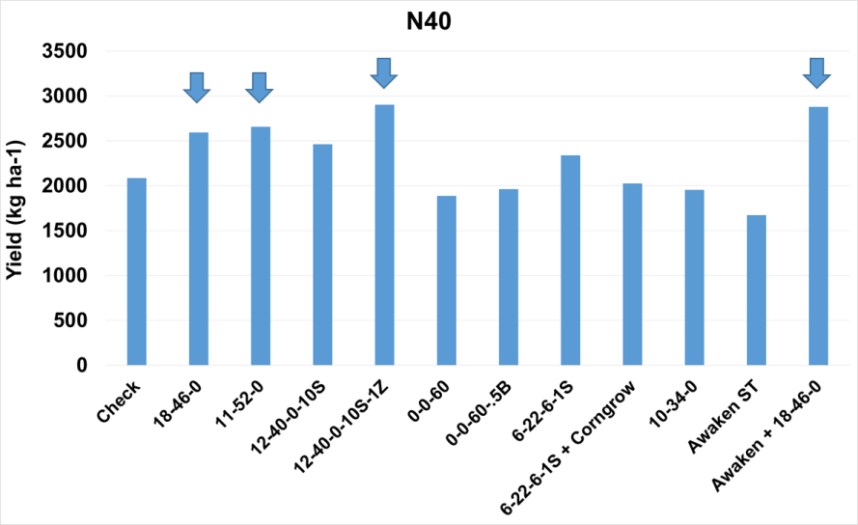
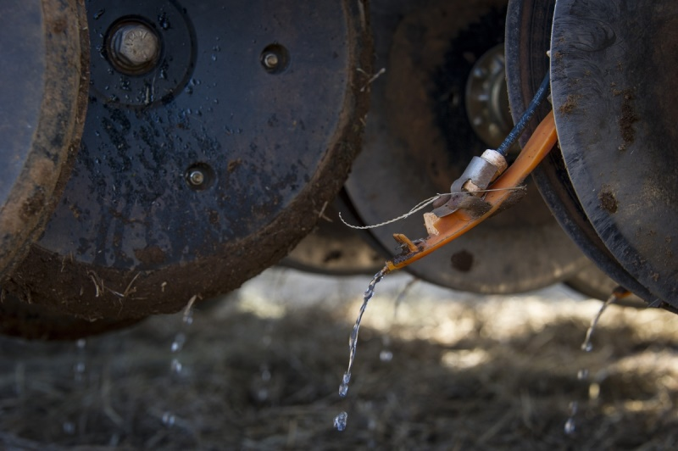
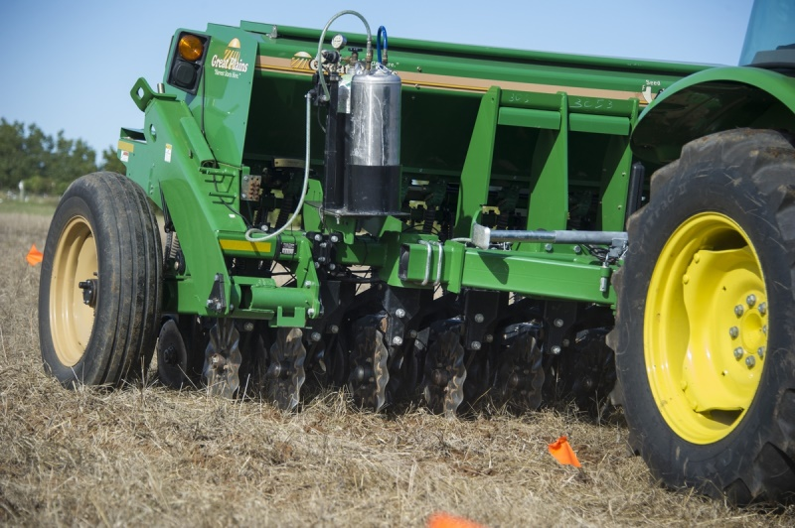
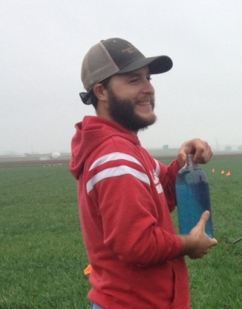
Starter Fertilizer in Wheat
12 treatments
Variable no-till conditions- 3 locations
Phosphorus Source
S, Zn, K, B.
Liquid vs. Dry
Proprietary vs. Generic
Evaluate yield, grain mineral, and economical differences
Compare soil test recommendation and fertilizer application.

Slide 13
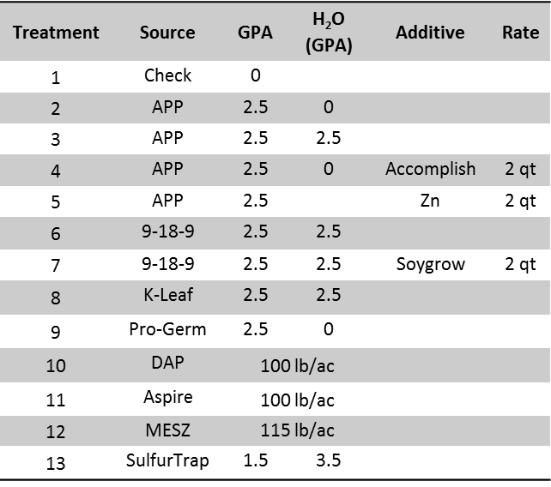
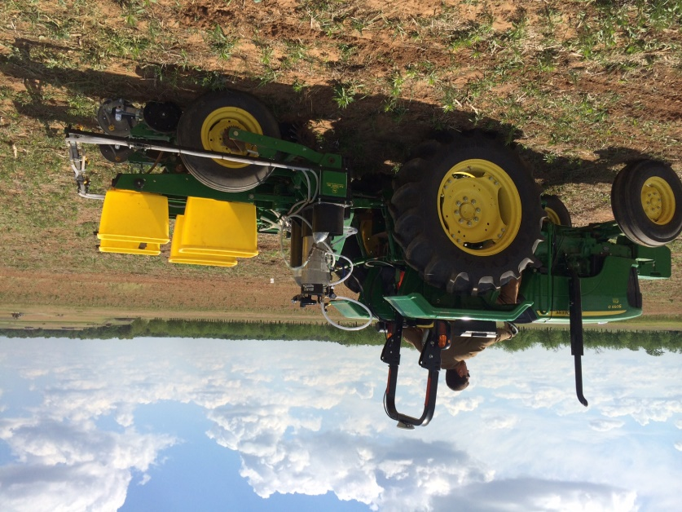

Starter Fertilizer in Soybean
Results (Stillwater and Perkins - 2015)
  Stand count
  NDVI
  Canopeo
  Yield
  Protein content
  Oil content
  Stillwater and Perkins: Significant statistical difference (p < 0.05) between treatments by location, but no statistical difference or lower values when compared to the check
Stillwater: There were no statistical difference among the treatment.

Slide 14
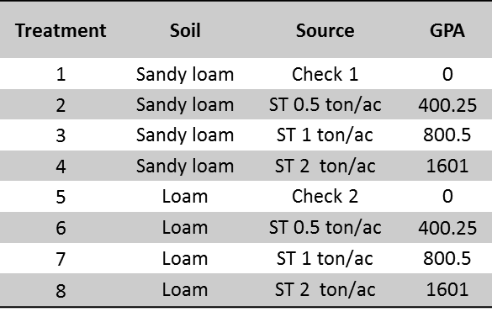
A novel use for an oil and gas industry by-product
Description
  Sulfurtrap is a by-product derived from the cleaning of oil and natural gas;
    High potassium and sulfur concentration (liquid 0-0-60-15);
    High pH (>14);
    25% of ECCE;
  There is no information about the utility of this product as fertilizer or liming source;
  The objective is to analyze the effect of high volume of Sulfurtrap on the soil nutrient concentration and pH, as well as, on the leachate solution.
Material and Methods
  8 treatments / 4 replication
    4 rates
    2 soil texture (loam soil and sandy loam soil)
Proposed analysis
  Soil analysis
    Nutrient concentration;
    pH
  Leachate analysis
    Leachate volume;
    Nutrient concentration

Slide 15

Tissue Nutrient Concentrations of Canola and Corn as Affected by Temporal Variability
Results
Tissue concentration of all nutrients varied among stages, days, and time-of-day samplings
  No distinct trend/indication of when to best conduct tissue sampling
  Environment significantly influenced nutrient concentration levels.
Use of plant analysis remains a useful tool in observing crop status, however, it should not be used alone to provide mid-season nutrient recommendations for canola and corn in Oklahoma

Slide 16
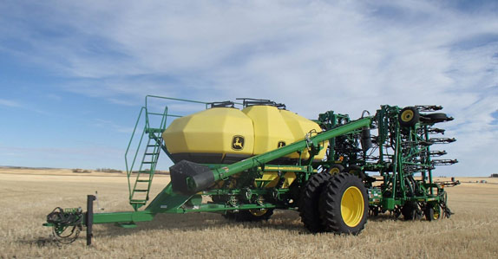

Skip Row Fertilization
Using an air seeder for sorghum and canola.
Plant on 15” fertilizer on 7.5”
N, P and K.

Slide 17
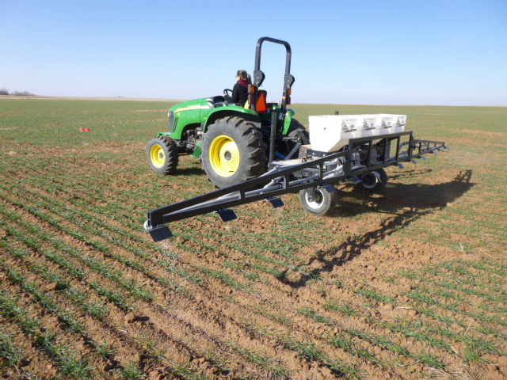

NPKS Response in Double Crop
NPKS Strips applied in
Double Crop Sorghum
and Soybean.
At planting soil samples
Field history
Current Practices
Grain samples harvested.

Slide 18
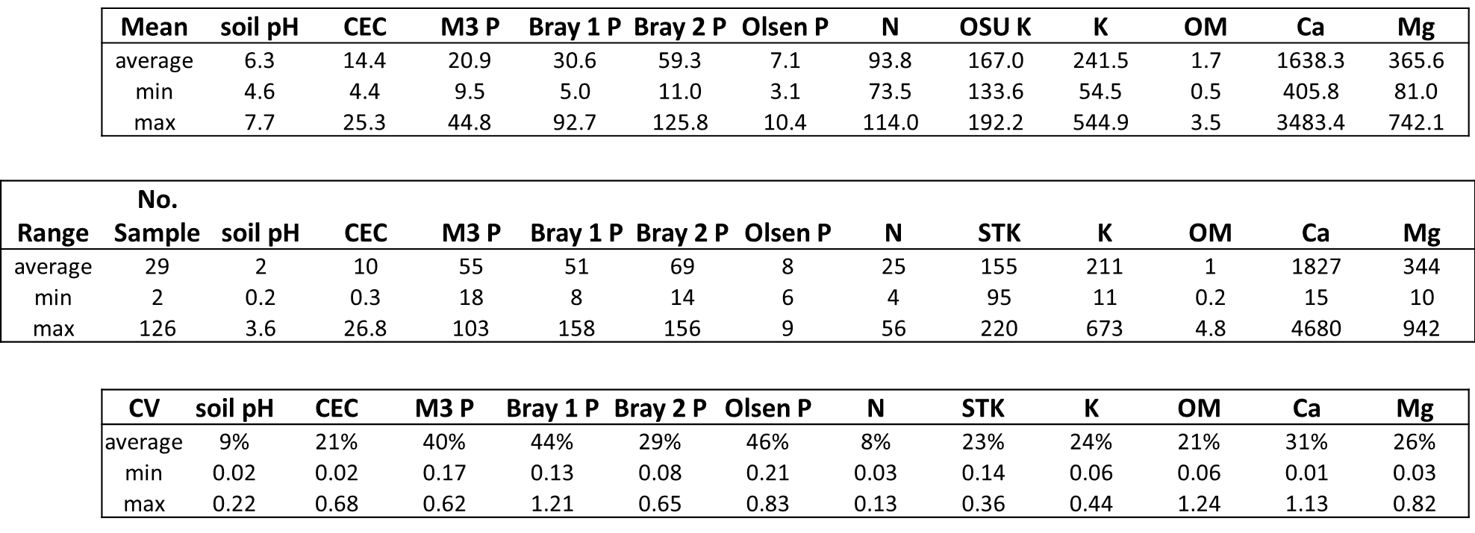
Grid Soil Sampling
Have nearly 200 fields worth of data.
Agronomic and Economic analysis.

Slide 19
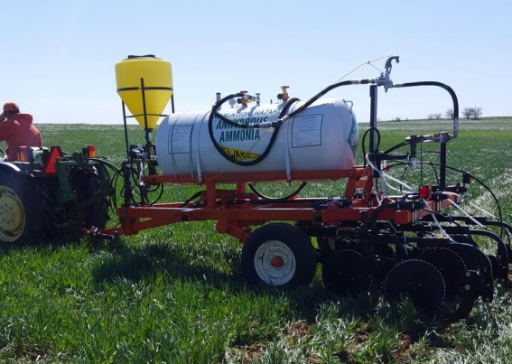
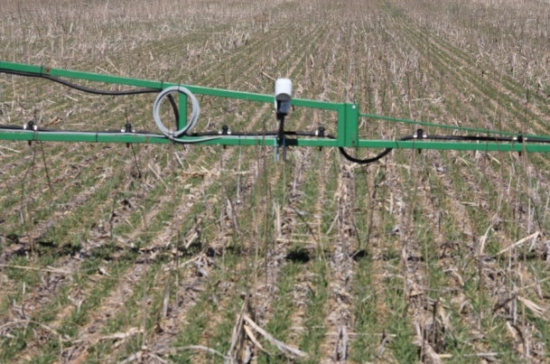
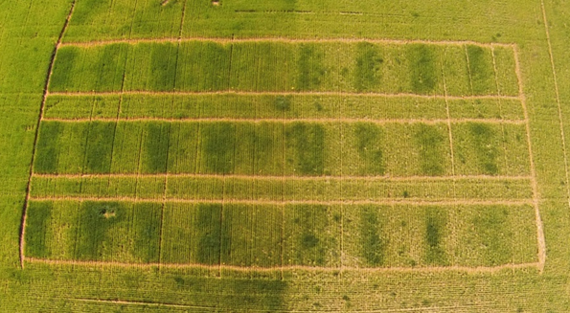
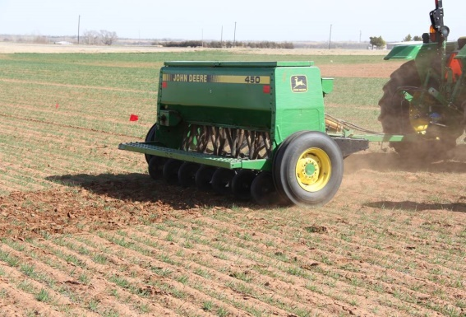
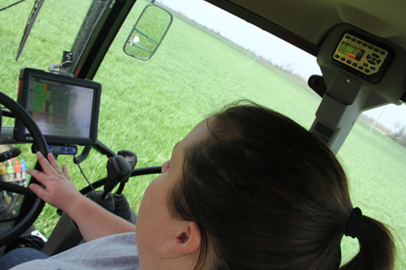
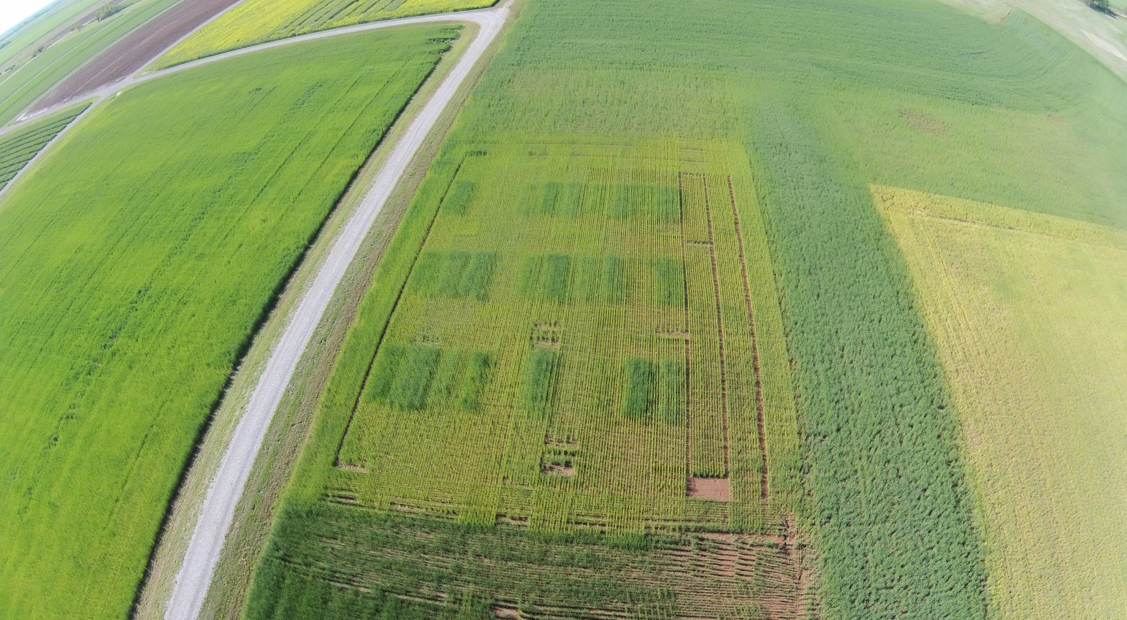
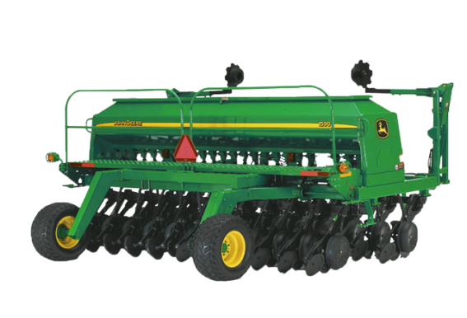
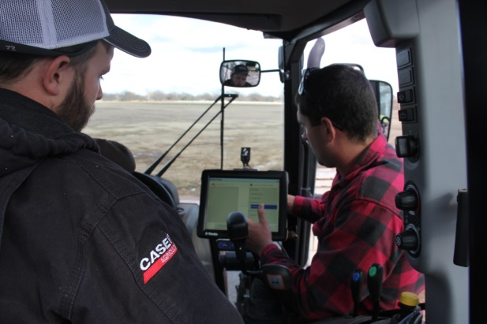
Other Work

Slide 20
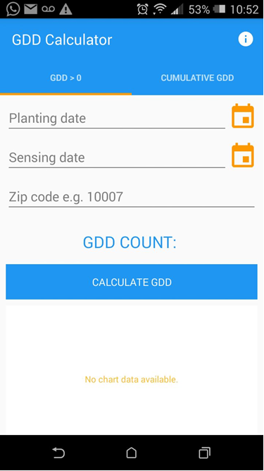
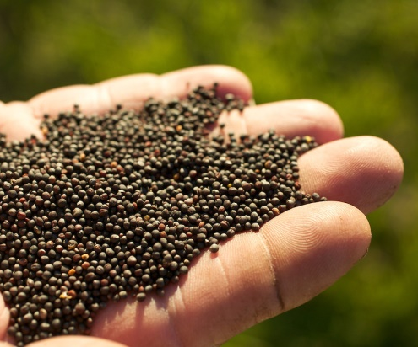
APPs New or in Process
Catching Android up to iOS
iOS GDD>0
Trimble Handheld

Slide 21

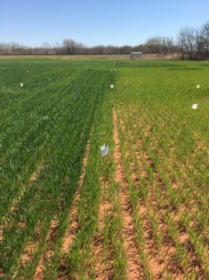

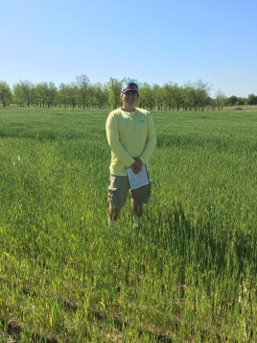
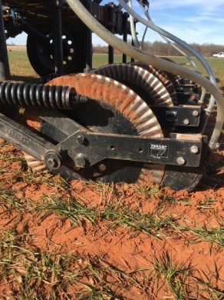

Evaluation of Midseason UAN Application Depth in Winter Wheat
Ryan Bryant-Schlobohm
Department of Plant and Soil Sciences, Oklahoma State University
Objective
Treatment Structure
Objective: Identify midseason application depths of UAN that provide the greatest NUE in corn and winter wheat
Treatment | Midseason N Rate (lbs. N/acre) | Application Depth
1 | 0 | --
2 | 30 | Surface
3 | 30 | 2
4 | 30 | 4
5 | 60 | Surface
6 | 60 | 2
7 | 60 | 4
8 | 90 | Surface
9 | 90 | 2
10 | 90 | 4
11 | 120 | Surface
12 | 120 | 2
13 | 120 | 4
Figure 1. Visible response to fertilized N between treatment 7 (60 lbs. N/acre at 4 inches) and the check (0 lbs. N/acre)
Figure 2. Rolling coulters of the variable rate applicator used to apply subsurface N applications
Ryan Bryant-Schlobohm

Slide 22

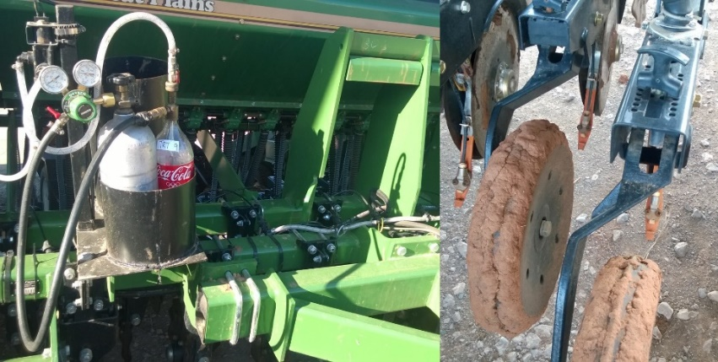

Effect of Micronutrient Fertilizers on Winter Wheat Grain Yield
Bruno Morandin Figueiredo
Table 1. Mean wheat grain yields in bu/ac for growing season 2014-15.
Objective: Evaluate micronutrient fertilization in winter wheat, combined with tillage and method of application.
Treatments | Yields (bu/ac)
 | Perkins | LCB
Check | 40.149* | 37.175*
Check | 47.584 | 43.123
Foliar Calcium | 49.071 | 44.61
Soil Boron | 44.61 | 40.149
Foliar Boron | 43.123 | 40.149
Soil Chlorine | 46.097 | 41.636
Foliar Chlorine | 43.123 | 40.149
Soil Copper | 44.61 | 40.149
Foliar Copper | 52.045 | 47.584
Soil Zinc | 46.097 | 41.636
Foliar Zinc | 47.584 | 43.123
* No significant differences at the 5 % probability level
Figure 1. Great Plains no-till drill adapted with CO₂ system for liquid fertilizer.
Bruno Morandin Figueiredo

Slide 23
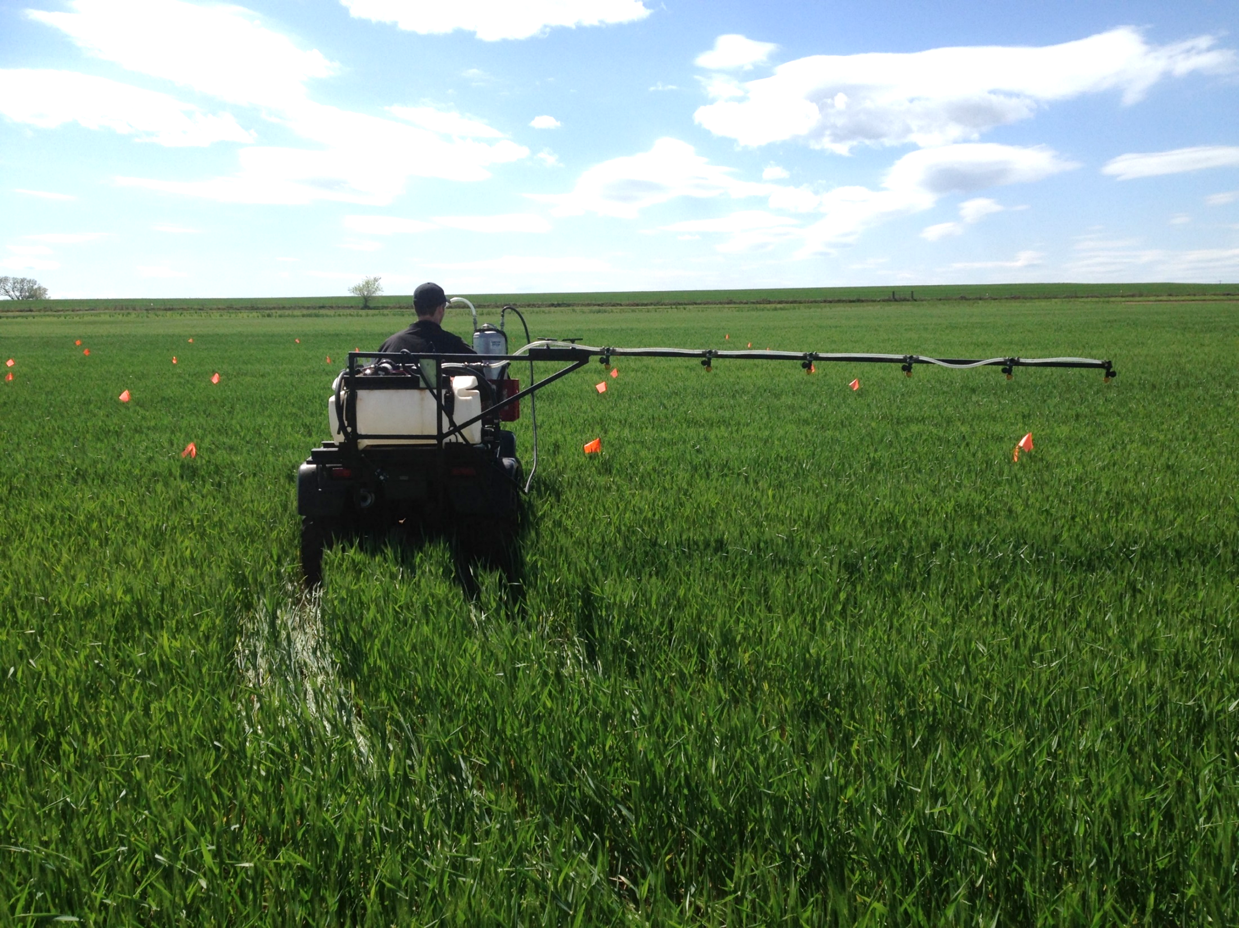

Foliar UAN and Timing on Grain Yield and Nitrogen
Concentration in Winter Wheat (Triticum aestivum L.)
Mariana Ramos Del Corso
  Objective: Determine the amount of UAN that can be applied in foliar form for optimizing yield and grain protein
Treat. | UAN (Ib N/ac) | Timing | Spray nozzle
1 | Check | Feekes 4 | -
2 | 14 | Feekes 4 | 80015 20psi 8mph
3 | 28 | Feekes 4 | 8002 20psi 5mph
4 | 40 | Feekes 4 | 8002 45psi 5mph
5 | 14 | Feekes 10 | 80015 20psi 8mph
Mariana Ramos Del Corso

Slide 24

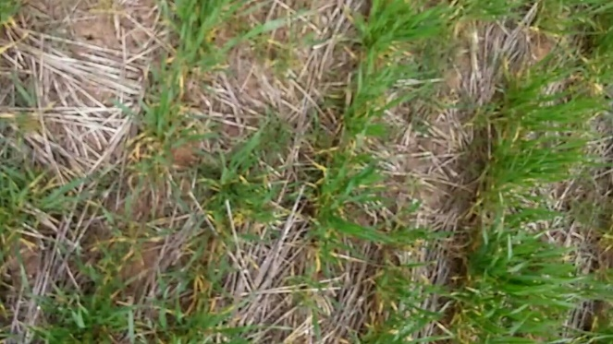




Use of qualitative and quantitative measures of canopy cover to adjust yield for heterogeneous plant stands
Experiment 502, Lahoma, OK
Average Canopy Cover: 33%
Average Canopy Cover: 88%
Objective: Measured percent canopy cover with the Canopeo mobile application video setting.
Will allow for an analysis of the covariate to be performed in order to make final yield more accurately reflect treatment response independent of heterogeneous plant stands
Original
Original
Processed
Processed
Melissa Golden

Slide 25
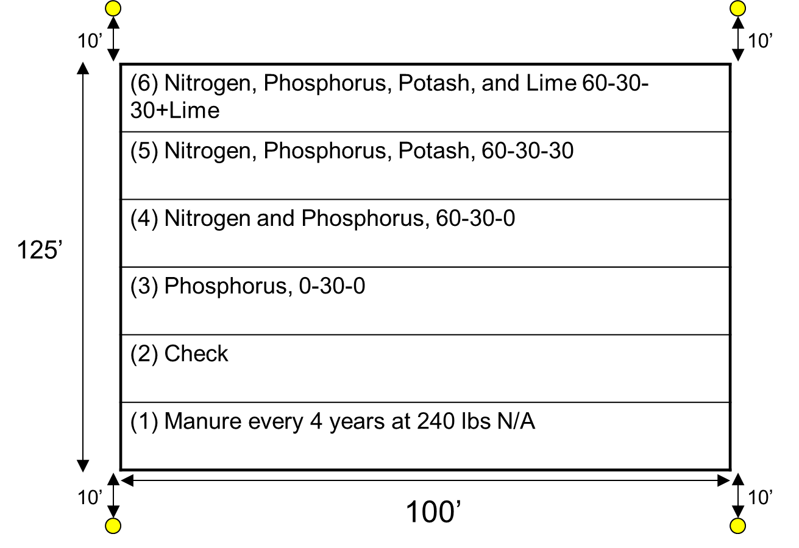
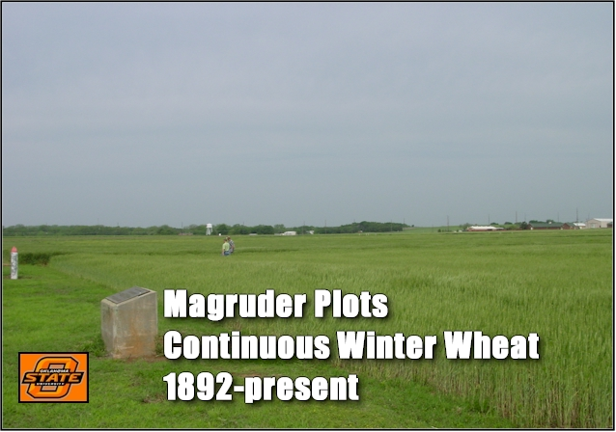
Effects of Climate on Total Organic Carbon (SOC),
Soil pH, and Total Nitrogen in a Long Term Experiment in Oklahoma
Mariana Ramos Del Corso
Objective: to document the relationship between soil organic carbon (OC), total nitrogen (TN), and pH over 25 years
Mariana Ramos Del Corso

Slide 26
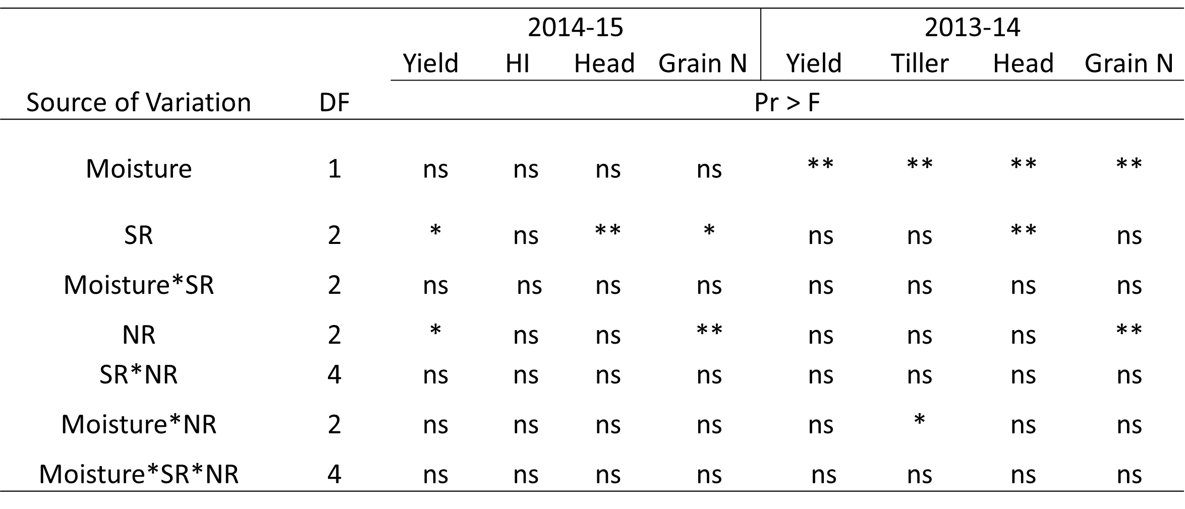

Effect of Irrigation, Nitrogen and Population Rate on Winter Wheat Grain Yield
Sulochana Dhital
Objective:
effect of soil moisture at planting on seeding density and preplant N rate
Data Collection:
Preplant soil moisture, NDVI (F1 – F10; CV), Feekes 5 biomass, head counts at harvest, Grain yield.
*Significant at P = 0.05. ns, not significant at P =0.05
**Significant at P = 0.01.
Conclusions:
Two and three way interaction between seeding rate, N rate and moisture was not significant
Early irrigation had no influence in areas receiving higher rainfall during the growing season
Sulochana Dhital

Slide 27
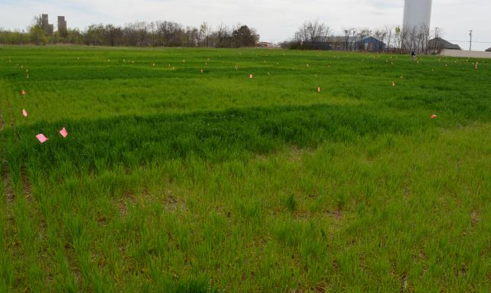

Optimum Preplant N Rate for Winter Wheat
Ethan Driver
Objective: to determine the minimum amount of N that could be applied preplant, and still optimize yields and N use efficiency.
Ethan Driver

Slide 28
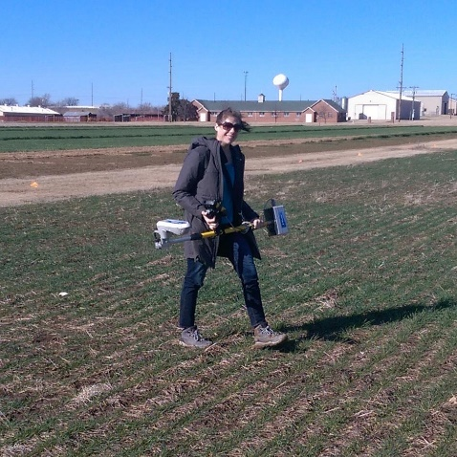

Wheat Response Index Evaluation
Nicole Remondet
Objective: Sequential NDVI measurements from two long-term nutrient management experiments to illustrate growth changes over the life cycle with NDVI. Further evaluation/refinement of the response index (RI) over time.
Nicole Remondet

Slide 29
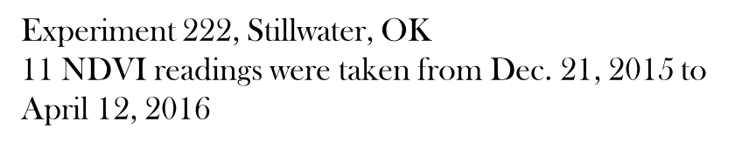
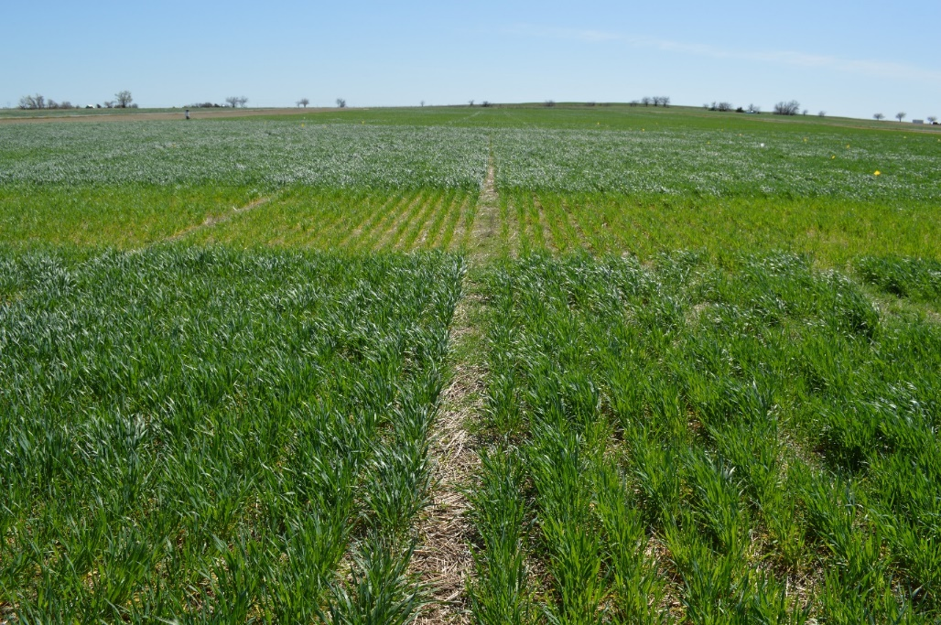
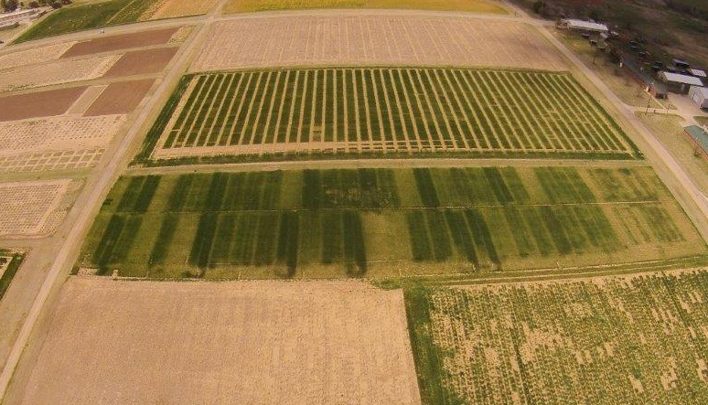


Sequential NDVI Measurements in Winter Wheat for Improved Prediction of
Winter Wheat Grain Yields and Mid-Season Fertilizer Rates
Melissa Golden
Experiment 502, Lahoma, OK
10 NDVI readings were taken from Dec. 18, 2015 to April 07, 2016
Melissa Golden (left)
Nicole Remondet (right)

Slide 30
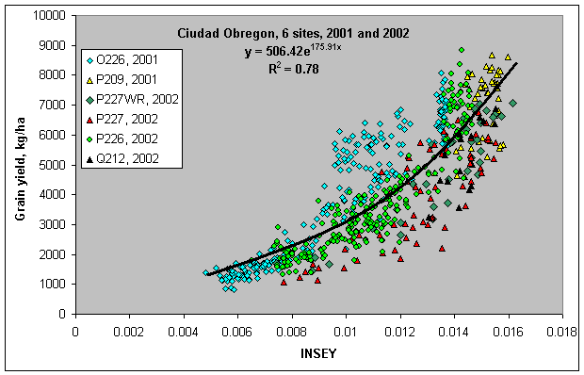
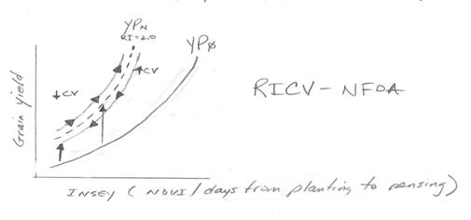
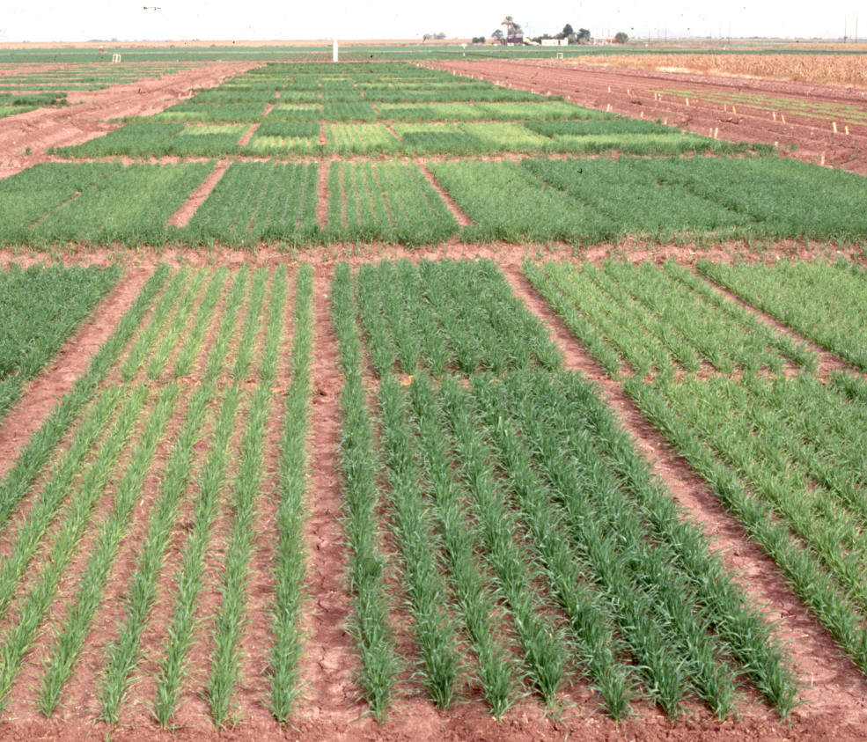


Use of Coefficient Variation (CV) from NDVI, to Improve Yield Prediction
Gwen Wehmeyer and Eva Nambi
Objective: To evaluate the use of coefficient variation (CV) from Normalized Difference Vegetative Index (NDVI) readings for predicting wheat grain yield
Gwen Wehmeyer & Eva Nambi

Slide 31


South Central Great Plains Winter Wheat N Algorithm
Treatment | N - Rate (lb N/ac) | Yield (bu/ac) | Net Return ($/ac)
Split Application | 100 | 35 ± 16 | 154 ± 100
SBNRC | 45 ± 21 | 34 ± 16 | 172 ± 94
Average Difference |  |  | 12 ± 25
 |  |  | Max: 66
 |  |  | Min: -52
Fertilizer Price (28-0-0) = $0.56/lb N
Grain Price = $6.00/bu
http://nue.okstate.edu/SBNRC/mesonet.php
Option 3: Winter Wheat, South Central Great Plains
Tyler Lynch & Bruno Morandin Figueiredo

Slide 32
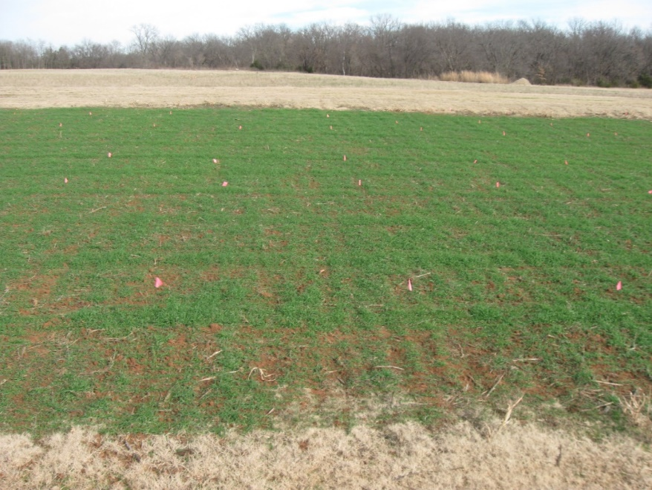
Residual N Availability Following a Failed Crop (Wheat and Sorghum)
Tyler Lynch
Objective: Residual N effect on crop growth following one failed crop cycle
Treatment | Previous Crop | Previous Crop Pre N rate (lb N/ac) | Wheat Pre N Rate (lb N/ac)
1 | Sorghum | 0 | 0
2 | Sorghum | 30 | 0
3 | Sorghum | 60 | 0
4 | Sorghum | 90 | 0
5 | Sorghum | 120 | 0
6 | Sorghum | 150 | 0
7 | Sorghum | 60 | 30
8 | Sorghum | 60 | 60
9 | Sorghum | 60 | 90
10 | Sorghum | 60 | 120
11 | Sorghum | 60 | 150
Tyler Lynch

Slide 33

In Season Prediction of Grain Sorghum Yield Using Red and Red Edge NDVI
Sulochana Dhital
Treatment | Preplant N (lb N/ac) | Sidedress N (lb N/ac) | Method of Application
1 | 0 | 0 | Check
2 | 150 | 0 | N Rich Strip
3 | 30 | 0
4 | 30 | 30
5 | 30 | 60
6 | 30 | 90
7 | 30 | 120
8 | 30 | 150
9 | 30 | 180
10 | 60 | 0
11 | 90 | 0
12 | 120 | 0
Objective:
Use of two different active-optical sensors that employ red and red edge technology, and compare them to estimate the in-season yield potential (YP₀) in grain sorghum
Sulochana Dhital

Slide 34
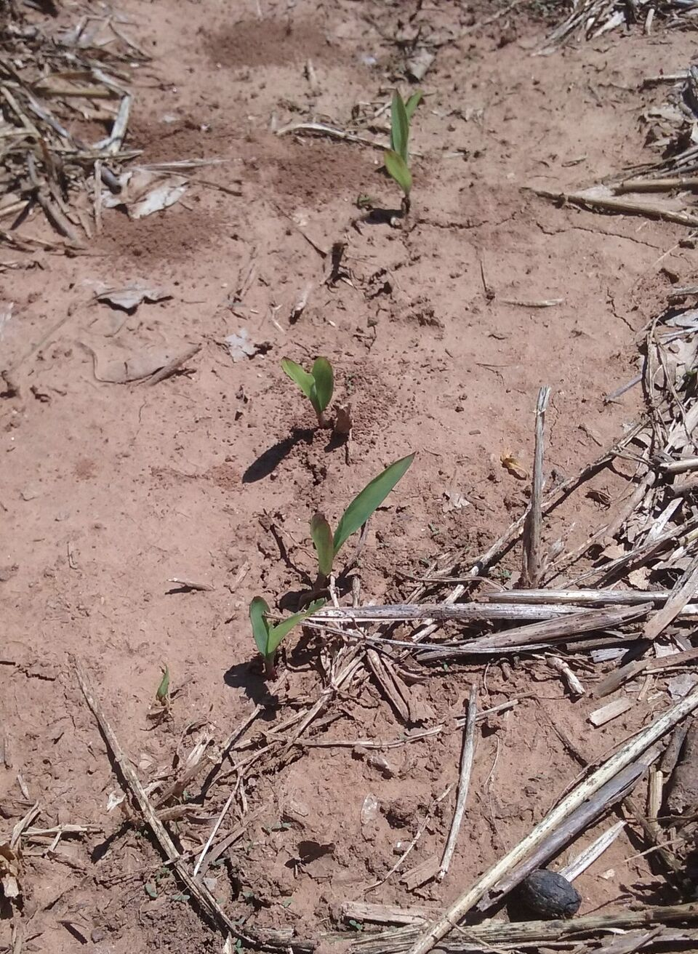
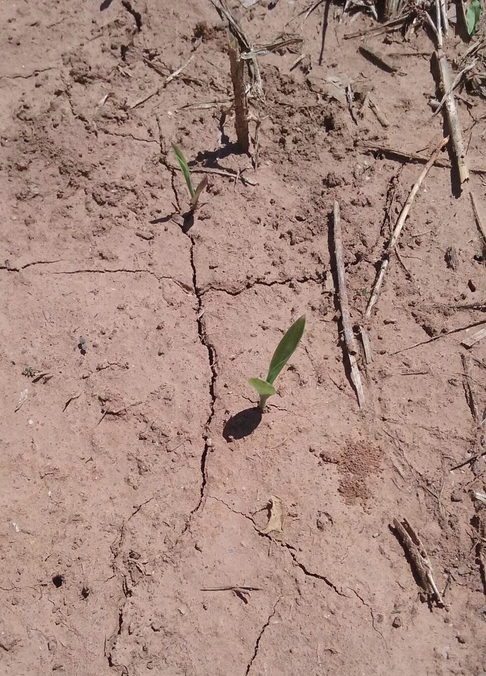
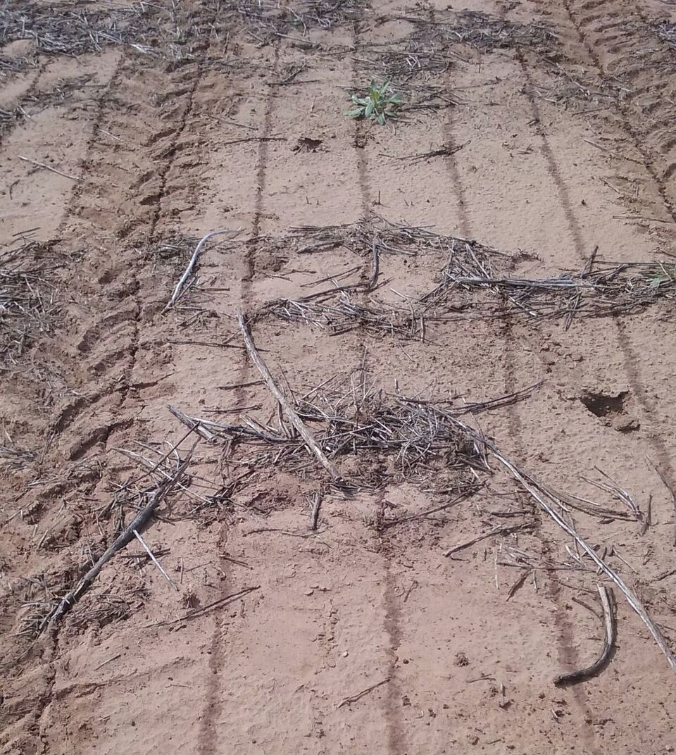

Objective: Determine correct amount of nitrogen that can be applied preplant for optimizing grain yields and NUE
Optimum Preplant Nitrogen (N) Rates in Sorghum
Gwen Wehmeyer
Treatment | Preplant N (lbs/ac) | Sidedress N (lbs/ac)
1 | 0 | 0
2 | 15 | 0
3 | 30 | 0
4 | 45 | 0
5 | 60 | 0
6 | 90 | 0
7 | 0 | 30
8 | 15 | 30
9 | 30 | 30
10 | 45 | 30
11 | 60 | 30
12 | 90 | 30
Gwen Wehmeyer & Ethan Driver

Slide 35
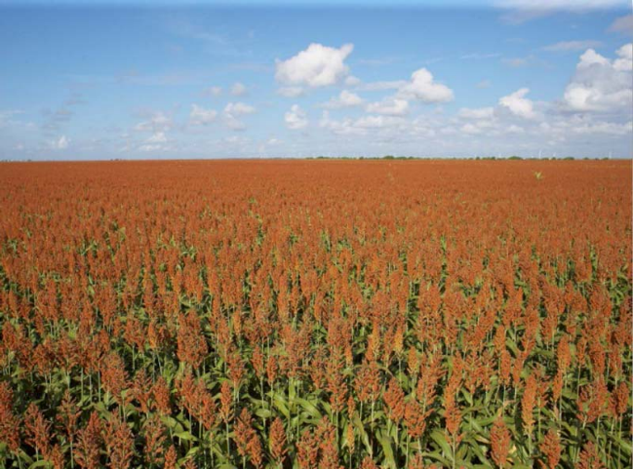
Sulfur Fertilization for Grain Sorghum in Oklahoma
Ryan Bryant-Schlobohm
Department of Plant and Soil Sciences, Oklahoma State University
Objective
Treatment Structure
Objective: economic feasibility of applying sulfur for Oklahoma grain sorghum producers
Treatment | Side-Dress N Rate (lb/acre) | Sulfur Rate (lb/acre)
1 | 0 | 0
2 | 60 | 0
3 | 60 | 10
4 | 60 | 15
5 | 60 | 20
6 | 120 | 0
7 | 120 | 10
8 | 120 | 15
9 | 120 | 20
10 | 60 | Soil SO₄₋ Test Recommendation
11 | 120 | Soil SO₄₋ Test Recommendation
Ryan Bryant-Schlobohm

Slide 36

Variability in Optimum N Rates for Maize in the Central Great Plains
Source | Location | Years | Time period | † (0-N) Yield Range | ‡ High N Yield Range | *Optimum N rate kg ha⁻¹
 |  |  |  | ---- Mg ha⁻¹ ---- |  | Min | Max | Avg. | SD
Bundy et al. (2011) | WI | 21 | 1958-1983 | 1.6-7.6 | 4.3-8.8 | 50 | 233 | 130 | 53
Bundy et al. (2011) | WI | 9 | 1984-1997 | 2.7-5.6 | 5.7-9.96 | 58 | 235 | 179 | 51
Mallarino and Torres (2006) | IA | 20 | 1979-2003 | 0.8-5.9 | 5.1-12.4 | 81 | 237 | 165 | 49
Mallarino and Torres (2006) | IA | 14 | 1985-2010 | 1.4-6.2 | 5.3-12.8 | 134 | 239 | 197 | 32
Varvel et al. (2007) | NE | 5 | 1995-2005 | 6.6-10.9 | 10.4-13.3 | 73 | 193 | 131 | 49
Jokela et al. (1989) Carroll | MN | 3 | 1982-1984 | 5.5-7.3 | 7.1-9.1 | 5 | 131 | 84 | 69
Jokela et al. (1989) Webster | MN | 3 | 1982-1984 | 1.7-5.6 | 1.8-8.7 | 70 | 113 | 91 | 21
Fenster et al. (1976) Waseca | MN | 5 | 1970-1975 | 3.2-7.4 | 7.1-10.6 | 60 | 199 | 135 | 50
Fenster et al. (1976) Martin A | MN | 7 | 1970-1976 | 3.8-8.2 | 4.0-9.6 | 23 | 126 | 69 | 36
Fenster et al. (1976) Martin B | MN | 6 | 1971-1976 | 6.2-11.3 | 6.2-12.0 | 0 | 37 | 18 | 15
Al Kaisi et al. (2003) | CO | 3 | 1998-2000 | 5.6-10.2 | 8.3-10.8 | 66 | 111 | 91 | 23
Ismail et al. (1994) NT | KY | 20 | 1998-2000 | 2.1-7.4 | 5.2-10.9 | 35 | 230 | 128 | 46
Ismail et al. (1994) CT | KY | 20 | 1970-1990 | 1.9-9.5 | 3.5-10.4 | 0 | 203 | 98 | 52
Rice et al. (1986) NT | KY | 15 | 1970-1985 | 3.1-4.9 | 5.7-9.2 | 102 | 178 | 144 | 30
Rice et al. (1986) CT | KY | 15 | 1970-1985 | 1.9-6.1 | 5.0-8.8 | 69 | 204 | 124 | 47
Stecker et al. (1993) Columbia | MO | 3 | 1988-1990 | 3.3-5.6 | 6.0-10.1 | 99 | 194 | 153 | 49
Stecker et al. (1993) Novelty | MO | 3 | 1988-1990 | 4.5-7.2 | 6.7-9.9 | 45 | 182 | 103 | 71
Stecker et al. (1993) Corning | MO | 2 | 1989-1990 | 5.0-6.0 | 8.2-8.5 | 90 | 117 | 104 | 20
Peterson et al. (1989) | NE | 4 | 1983-1986 | 2.1-6.4 | 3.9-10.0 | 11 | 218 | 104 | 88
Eck (1982) | TX | 2 | 1977-1978 | 2.7-4.4 | 5.6-5.9 | 59 | 116 | 88 | 40
Shapiro et al. (2006) RS 51cm | NE | 3 | 1996-1998 | 6.2-8.9 | 9.4-11.1 | 69 | 96 | 83 | 13
Shapiro et al. (2006) RS 76cm | NE | 3 | 1996-1998 | 5.0-8.9 | 7.1-11.0 | 13 | 114 | 75 | 54
Meisinger et al. (1985) MT | MD | 4 | 1974-1977 | 1.8-2.6 | 5.8-8.2 | 127 | 233 | 183 | 45
Meisinger et al. (1985) PT | MD | 4 | 1974-1977 | 2.7-4.2 | 5.1-8.1 | 36 | 196 | 142 | 75
Gehl et al. (2005) Rossville | KS | 2 | 2001-2002 | 6.4-7.9 | 11.3-12.6 | 182 | 204 | 193 | 15
Gehl et al. (2005) Scandia | KS | 2 | 2001-2002 | 2.7-7.4 | 3.8-11.5 | 51 | 160 | 105 | 77
Total |  | 198 |  |  | Average | 62 | 173 | 120 | 45
 |  |  |  |  | SD | 44 | 55 | 43 | 20
Objective: To document the relationship between maize grain yield levels and optimum N rates, over a wide range of locations and years, from published literature.
Conclusions:
N applied each year in the Central Great Plains does not include accurate accounting for variability in soil N and corn N uptake which are dramatically influenced by changing growing conditions from one year to the next.
Published results from multiple sites, years revealed extensive variability in optimum nitrogen rates for maize
Table 1. Maize grain yield for the zero-N treatment (check plot), high N treatment and a computed optimum N rate in 26 field experiments that encumbered 198 site years of published data in the Central Great Plains, United States 1958-2010.
Sulochana Dhital

Slide 37
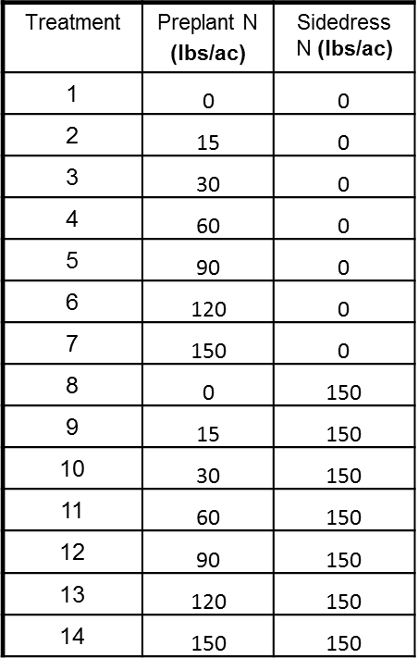
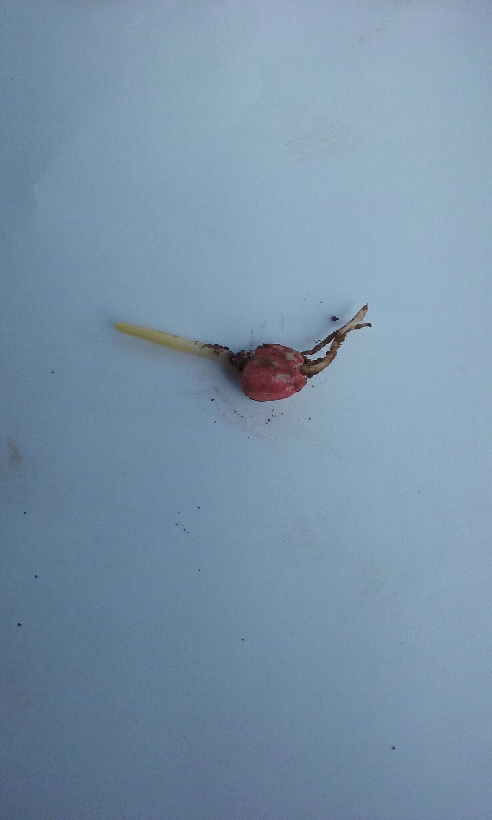
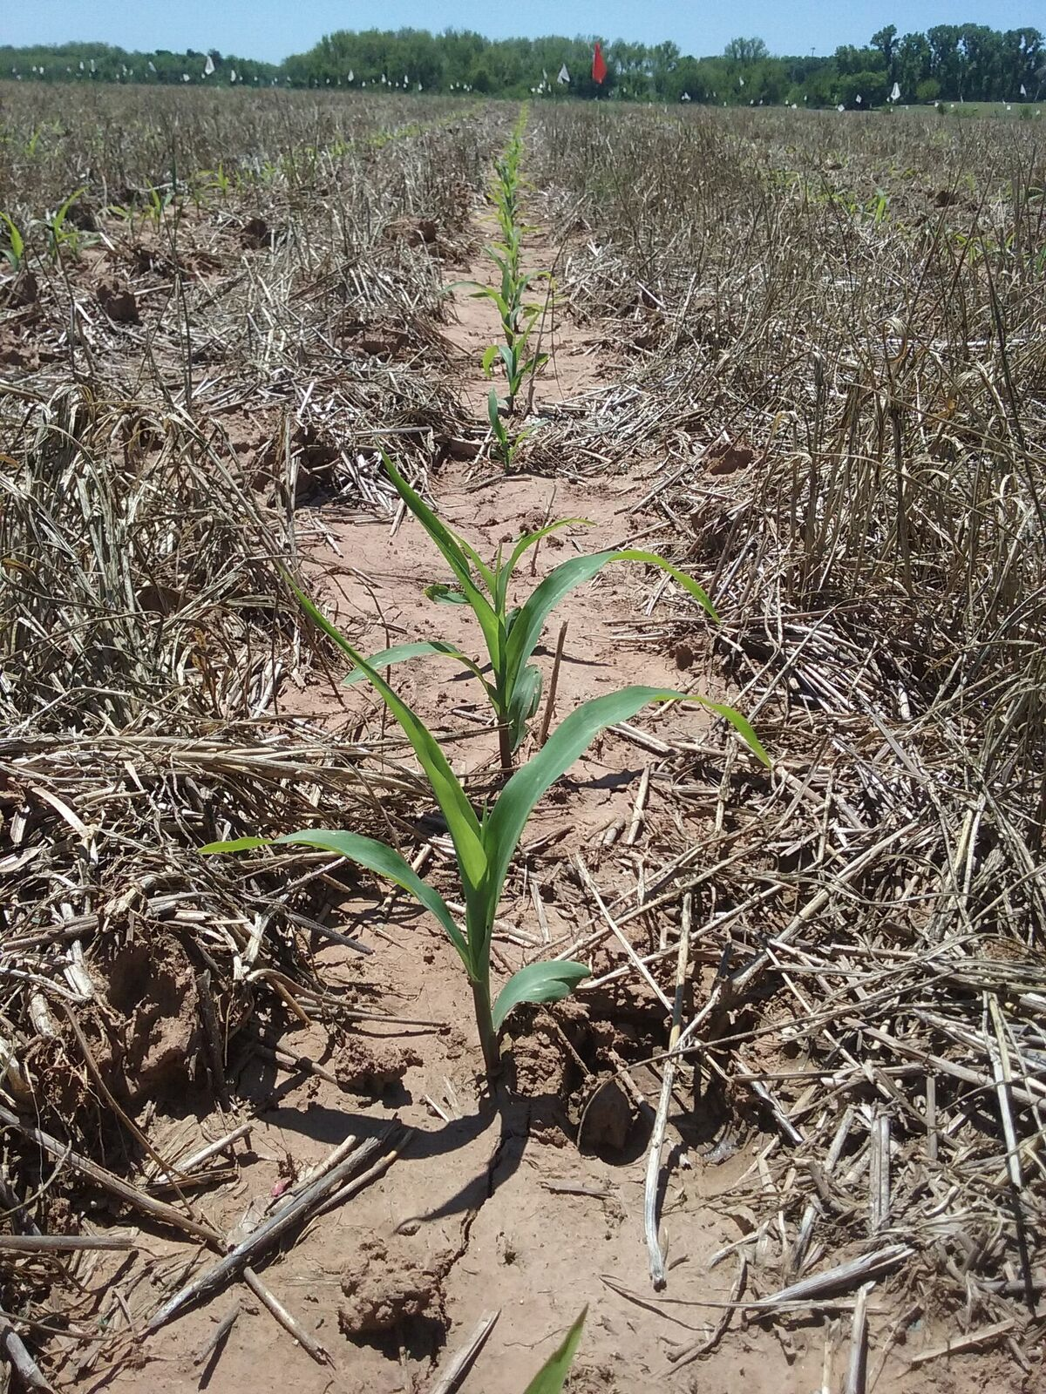


Objective: Determine correct amount of preplant nitrogen that can be applied to optimize grain yields and nitrogen use efficiency
Optimum Preplant Nitrogen (N) Rates in Maize
Gwen Wehmeyer
Gwen Wehmeyer & Ethan Driver

Slide 38
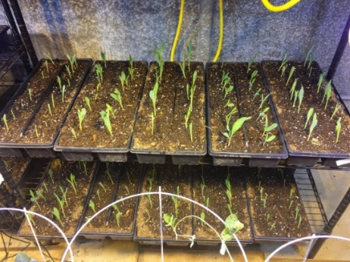
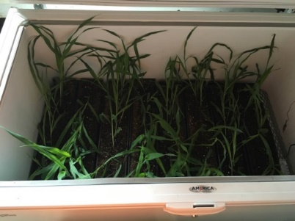
Mitigation of Late Spring Freeze in Maize
Ryan Bryant-Schlobohm
Department of Plant and Soil Sciences, Oklahoma State University
Objective
Treatment Structure
Determine if low rates of foliar applied UAN fertilizer applied prior to an expected freeze can mitigate the damage caused to young corn plants.
Treatment | Temperature | UAN Rate (lbs. N/acre)
1 | No Freeze | 0
2 | No Freeze | 5
3 | No Freeze | 10
4 | 32˚F | 0
5 | 28˚F | 0
6 | 32˚F | 5
7 | 32˚F | 10
8 | 28˚F | 5
9 | 28˚F | 10
Comments
Trial run showed us where to improve current methods
Future trials will be on winter wheat, simulating a late spring freeze after the growing point has moved above ground
Ryan Bryant-Schlobohm

Slide 39
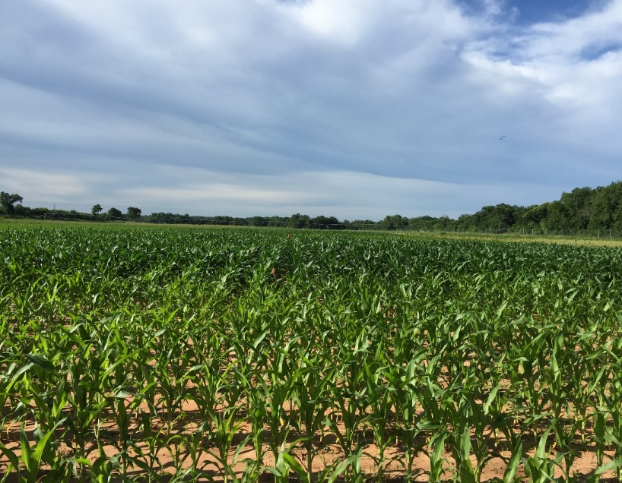

Maize Regional Trial
Jagman Dhillon
Objective: Refinement of the sensor based N rate calculator (SBNRC) and optimum N
Treatment | Preplant N (lb N/ac) | Sidedress N (lb N/ac) | Method of Application
1 | 0 | 0 | Check
2 | 200 | 0 | N Rich Strip
3 | 40 | 0
4 | 40 | 30
5 | 40 | 60
6 | 40 | 90
7 | 40 | 120
8 | 40 | 150
9 | 40 | 180
10 | 80 | 0
11 | 120 | 0
12 | 160 | 0
Jagman Dhillon

Slide 40




World Phosphorus Use Efficiency (PUE)
Ethan Driver, Jagman Dhillon, & Ryan Bryant-Schlobohm
Objective: To Refine the World estimate of PUE
Current estimate of World PUE in cereal crops is 16%
Guilherme Torres (not pictured), Ethan Driver, Jagman Dhillon, & Ryan Bryant-Schlobohm

