Slide 1
Digitizing the Human Sensor
Tyler Lynch, Bruno Figueiredo, Jagmandeep Dhillon, Peter Omara, Gwen Wehmeyer, Eva Nambi, Alimamy Fornah, Fikayo Oyebiyi, Robert Lemings, Elizabeth Eickhoff
Tampa, Florida, ASA Monday, October 23, 2017 Marriott, Tampa Waterside 10:30 am, Grand Ballroom C

Slide 2
Context
Can we make better use of the human element, especially in the developing world where everything is done by hand?
How do we improve the use of the human experience, human sensory facilities for, planting, weeding, fertilizing, harvesting, etc.
Equipment
Instruction
Research based

Slide 3
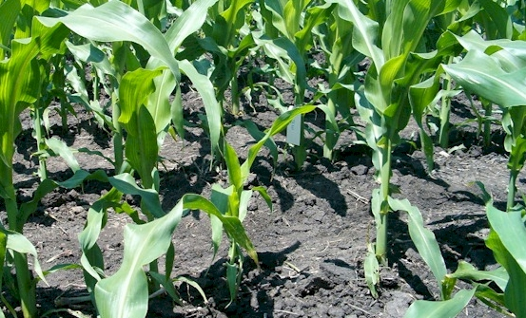
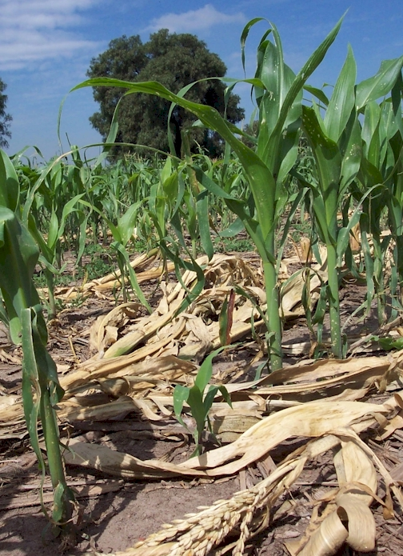
Homogeneity of plant stands
(Lawles, et al., 2012) JPN
Over all sites and years, for each day delay in emergence (one out of every 3 plants), corn grain yields decreased 0.225 to 1.379 Mg ha⁻¹ day⁻¹.
Importance of depth of planting, gauged by human strength/force
(Rutto, et al. (2011) JPN
Over locations and years, the mean grain yield decrease of the delayed plant versus neighboring plants for each day delay was 0.122 Mg ha⁻¹.

Slide 4
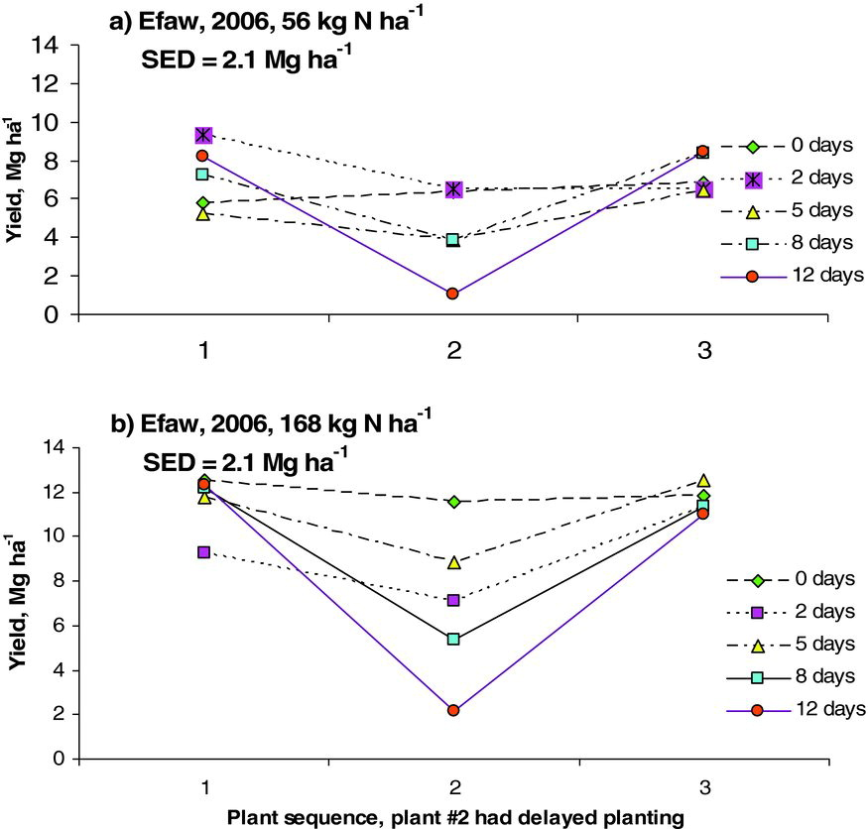
Influence of Delayed Planting on Maize Grain Yield
Consequences of delayed emergence

Slide 5
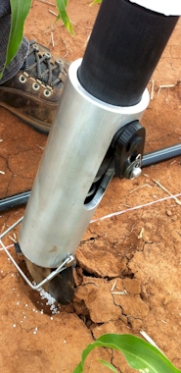
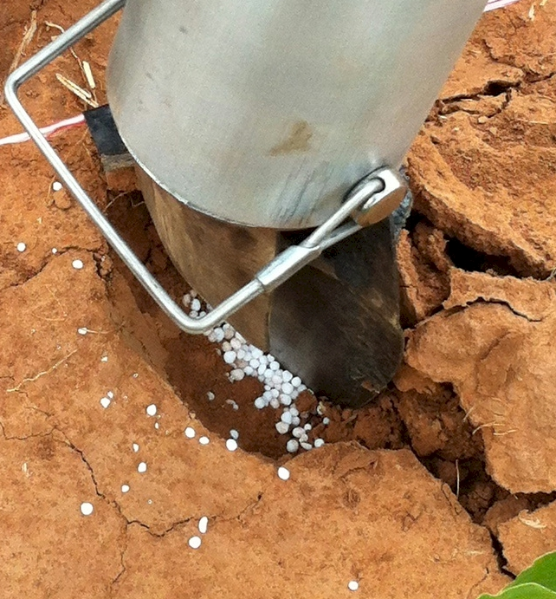
Value of Mid-Season Incorporated Fertilizer N
Plant Proximity
Combined, Efaw and Perkins
Topdress N, Corn, V12 |  | 70,000 plants/ha
Methods | N, kg/ha | Mg/ha
Check | 0 | 6.6
Hand planter (0.9 g/plant) | 30 | 11.2
Hand planter (1.8 g/plant) | 60 | 10.6
Broadcast | 30 | 6.4
Broadcast | 60 | 7.0
Dribble urea | 30 | 9.3
Dribble urea | 60 | 7.8
Dribble UAN | 30 | 7.3
Dribble UAN | 60 | 10.4
SED = 1.81

Slide 6
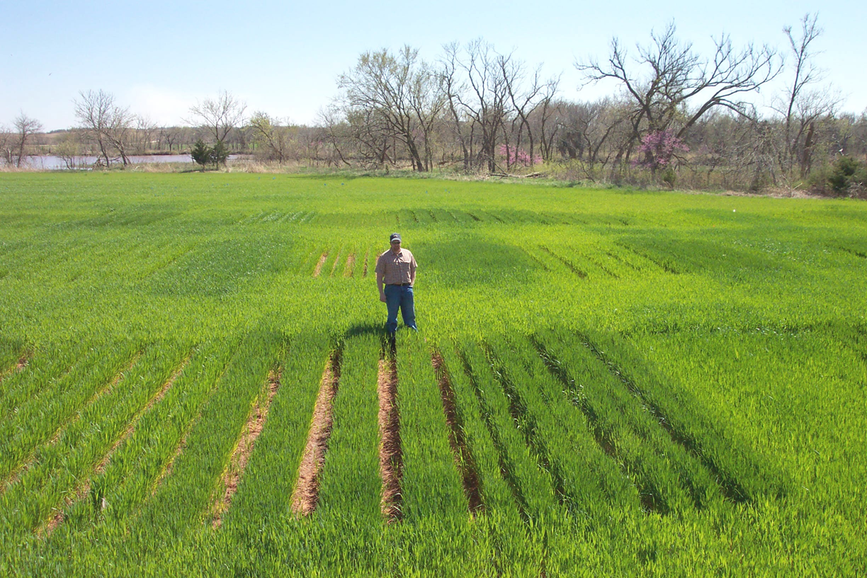
Color Height
Distance
Vigor
In agriculture, it is not as if we haven’t been doing a good job, because we have. But, because the focus has been on the developed world, some of our technologies have inadvertently imparted risk in the developing world

Slide 7
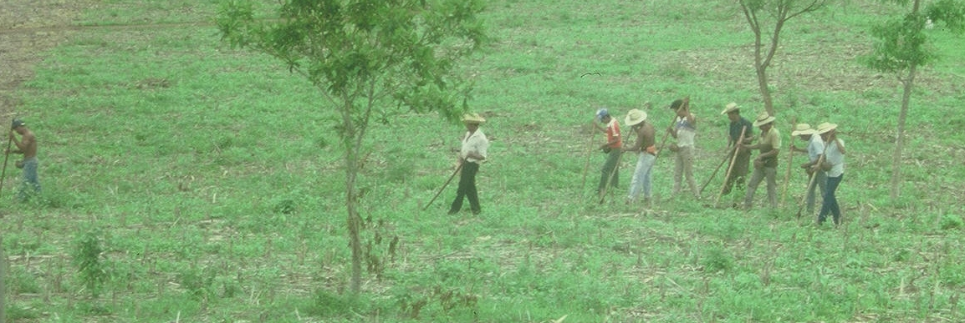
Social aspects/technology transfer
EL SALVADOR
Don Efrain

Slide 8
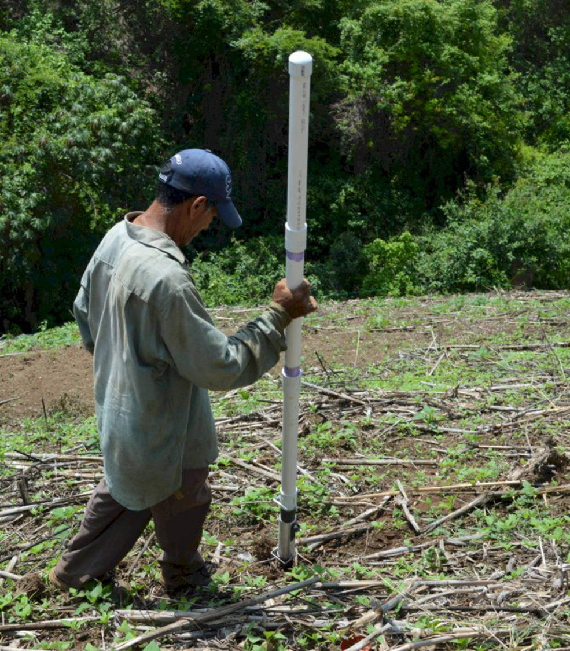
Worlds Apart
(El Salvador, Uganda)
Avg. Farm Size: 1 ha
Avg. Maize Grain Yield, 2 Mg/ha Maize seed, Hybrids (US, others)

Slide 9
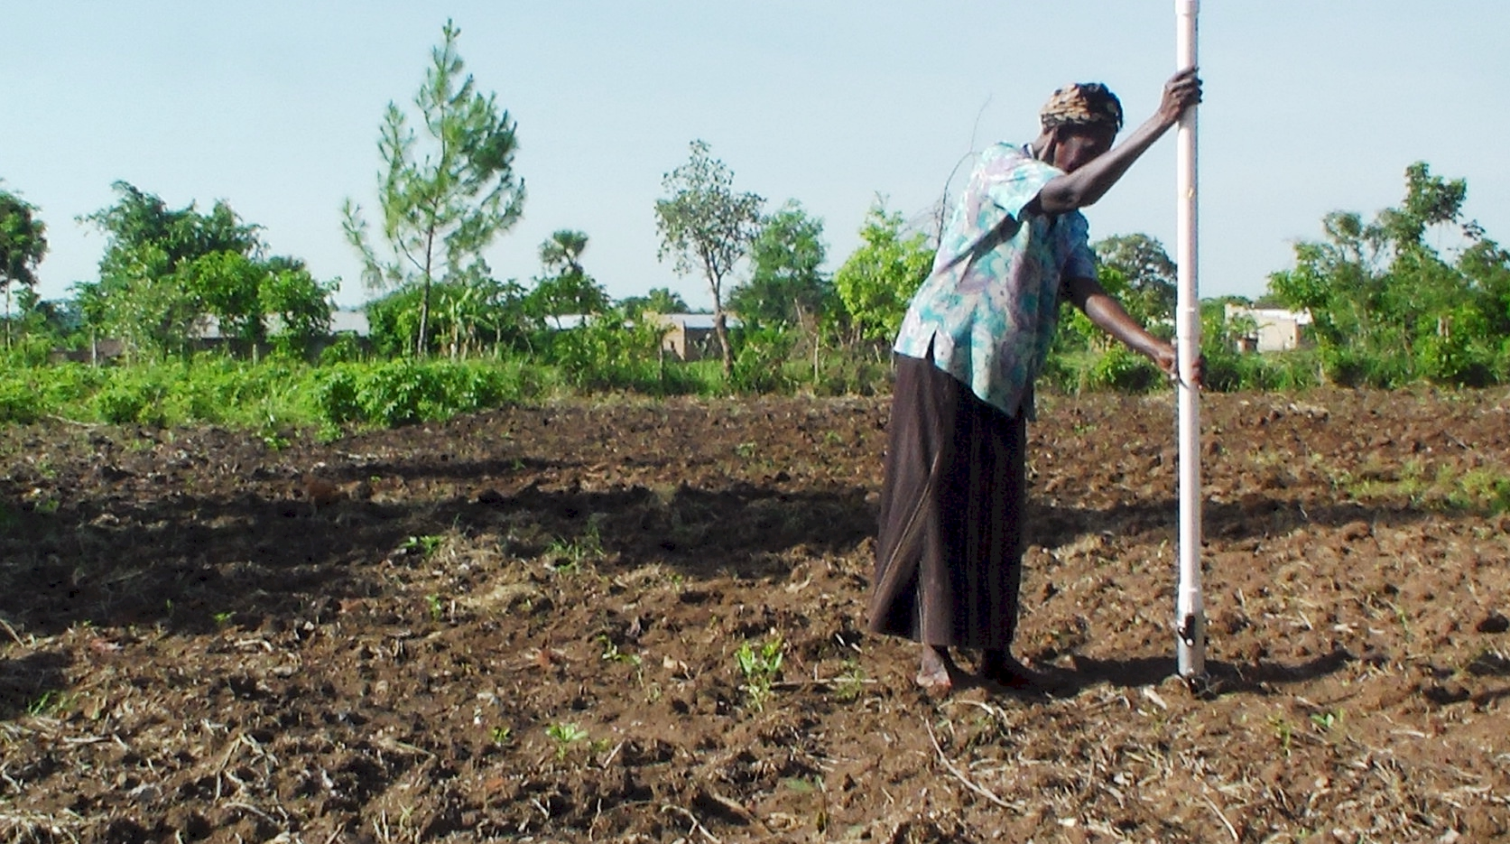
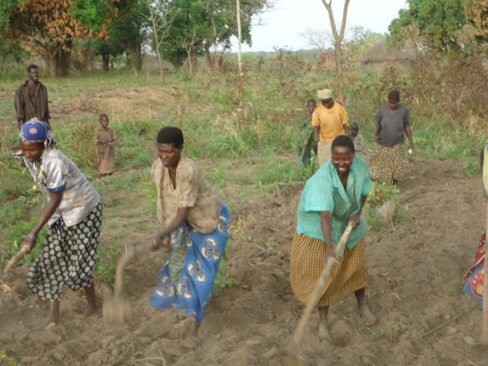
Ergonomics
Back Pain/Tension
Texture
Moisture
UGANDA

Slide 10
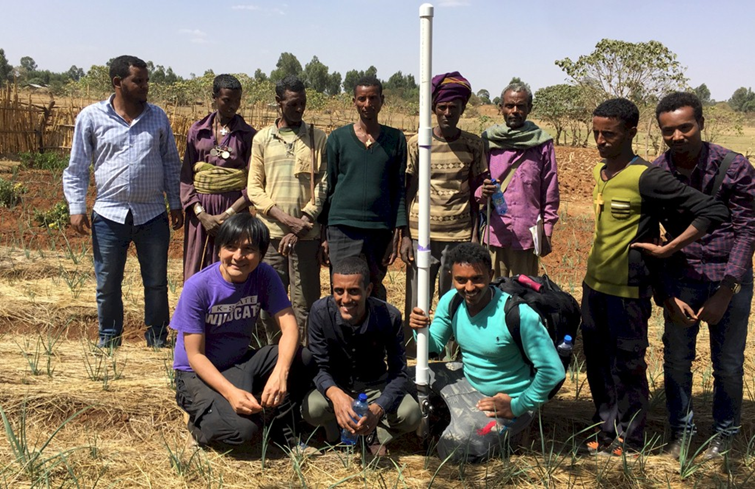
Stress Spacing
Homogeneity
Residue
Harmony
ETHIOPIA

Slide 11
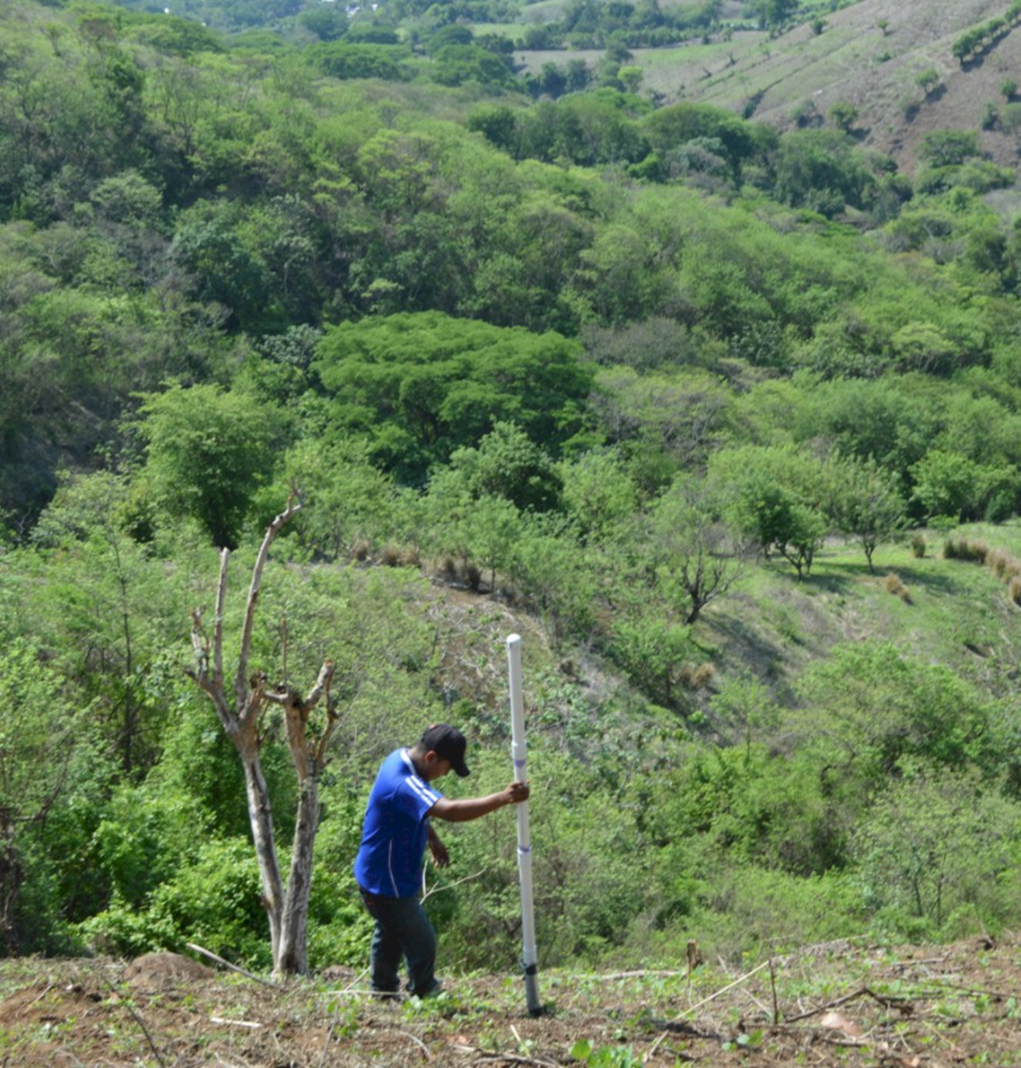
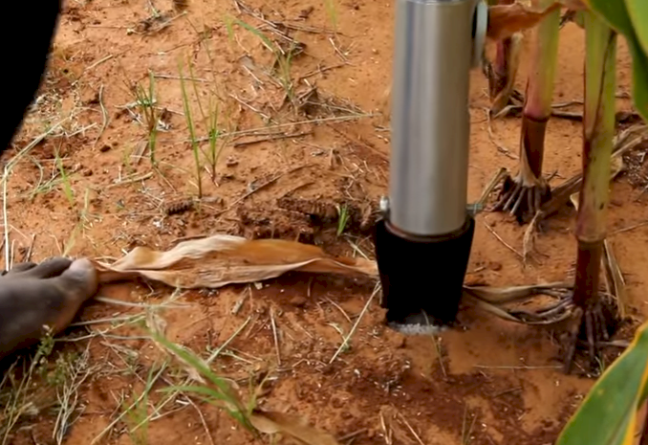
Slope
Sustainability
Proximity
Placement
Weed density

Slide 12
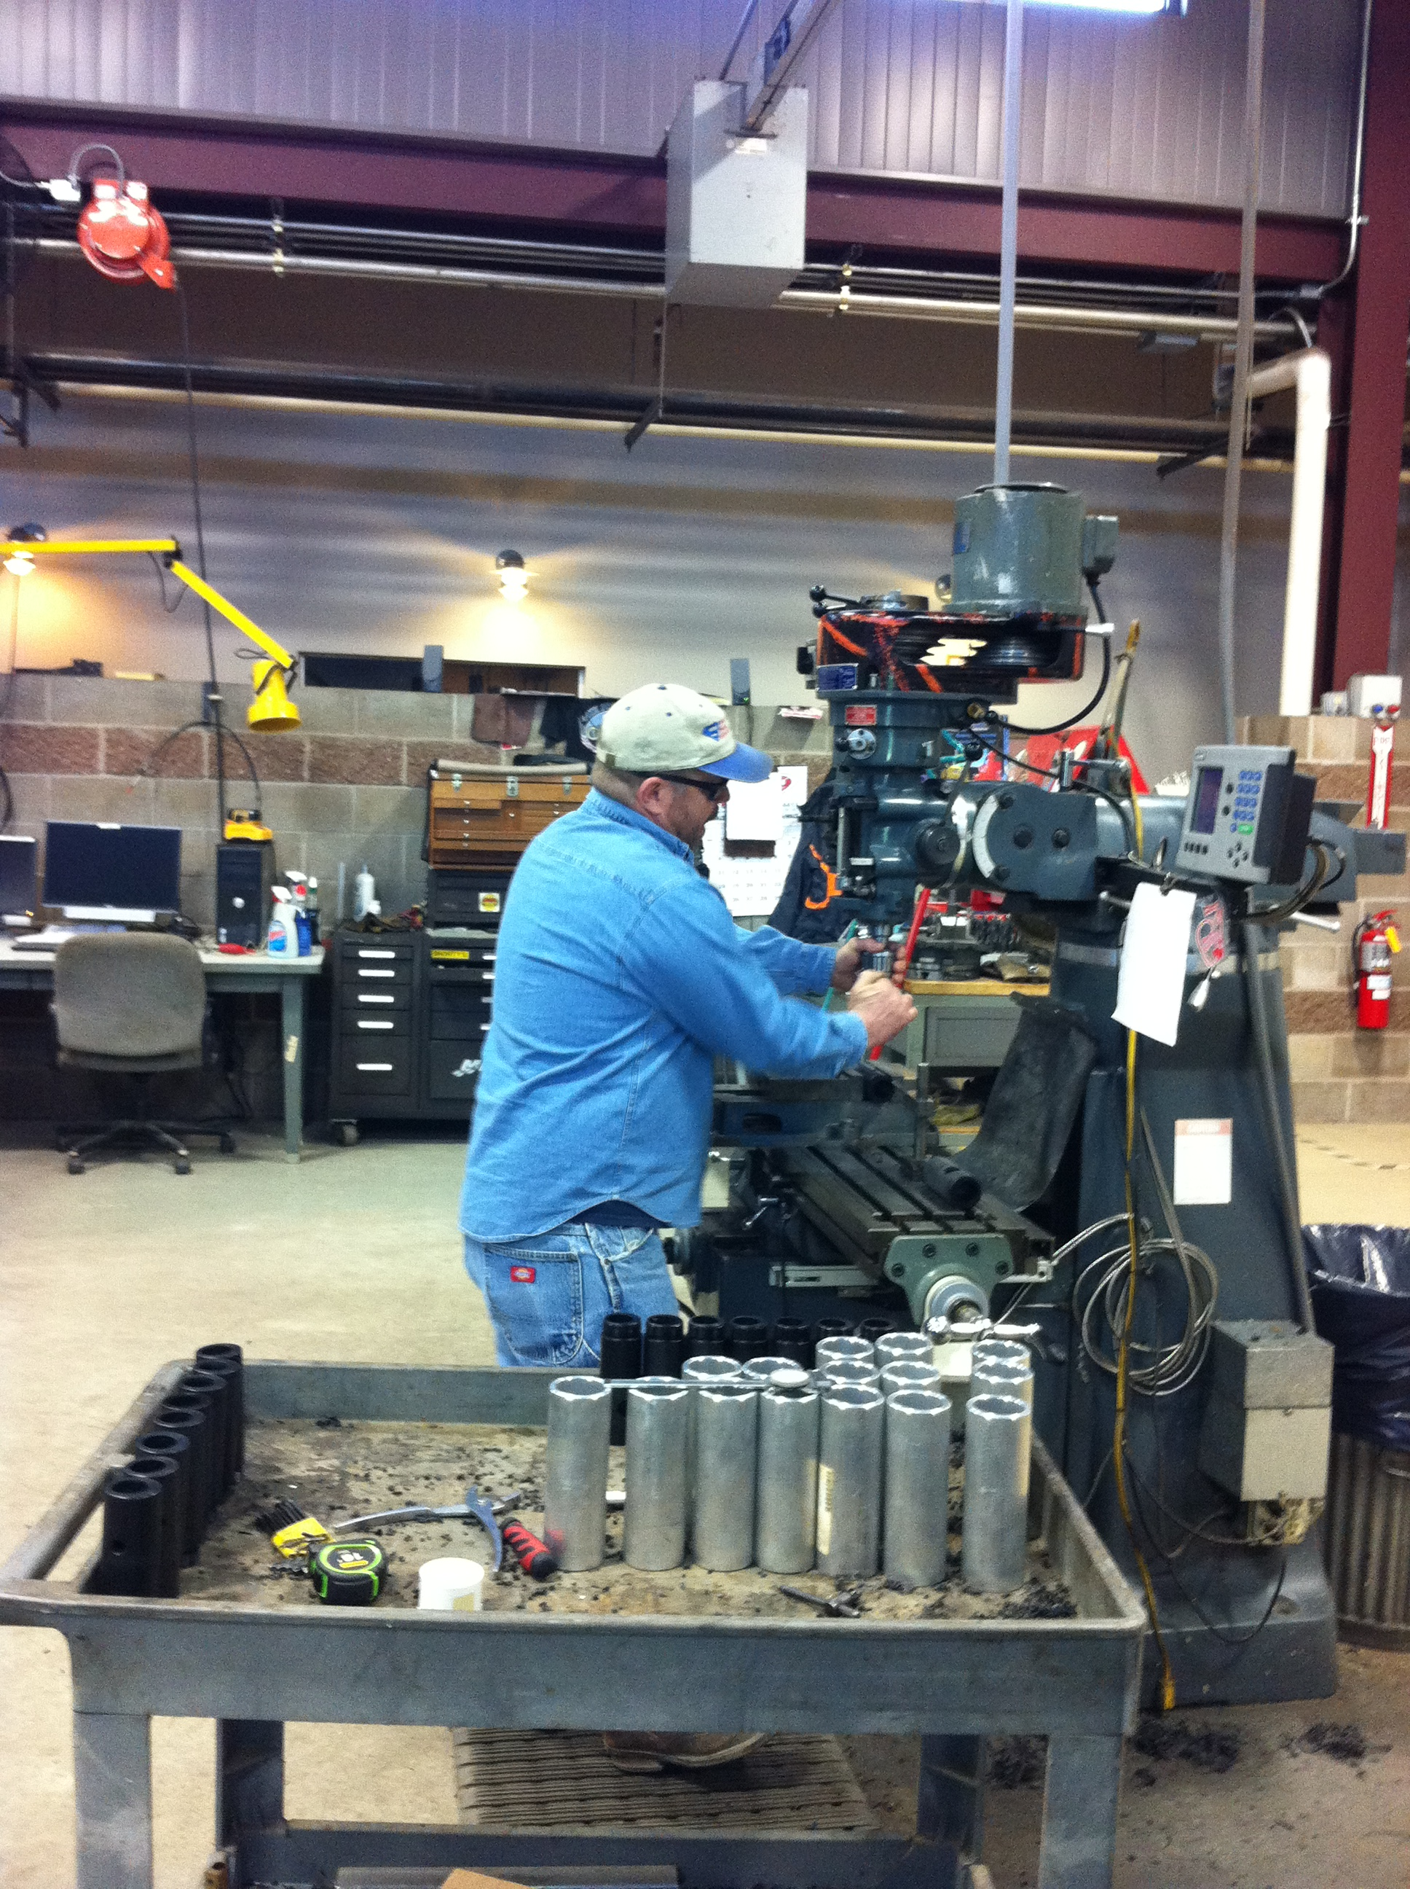
Lawrence Aula, OSU-MS-grad Lira, Uganda
There is absolutely no doubt in my mind that the planter is working. As an example, a farmer supported with one HP in Oyam District reported a slightly higher yield advantage of HP (about 720 kg corn /ac) over conventional hand hoe (about 600kg corn /ac).
Smallholder producers in Uganda, who are the majority may still need a subsidy to acquire the planter perhaps through NGOs.

Slide 13
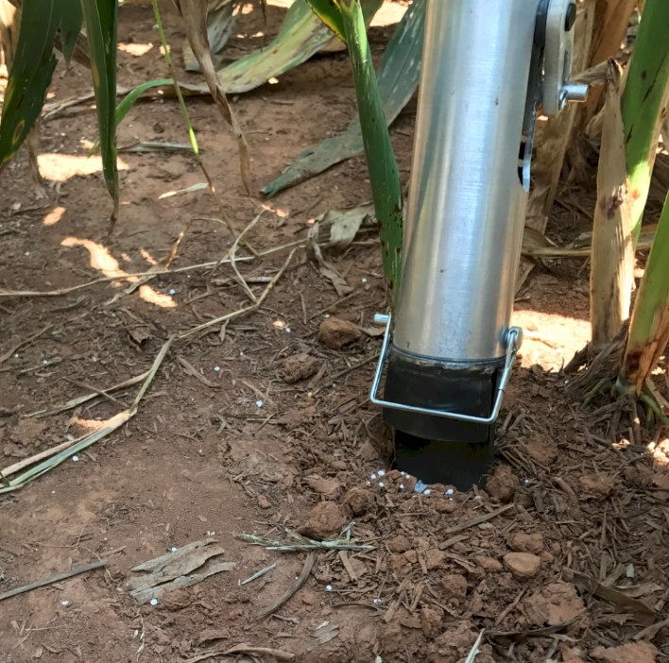
Why is a by-plant nutrient management resolution so hard to understand when weed removal is targeted by-plant?

Slide 14
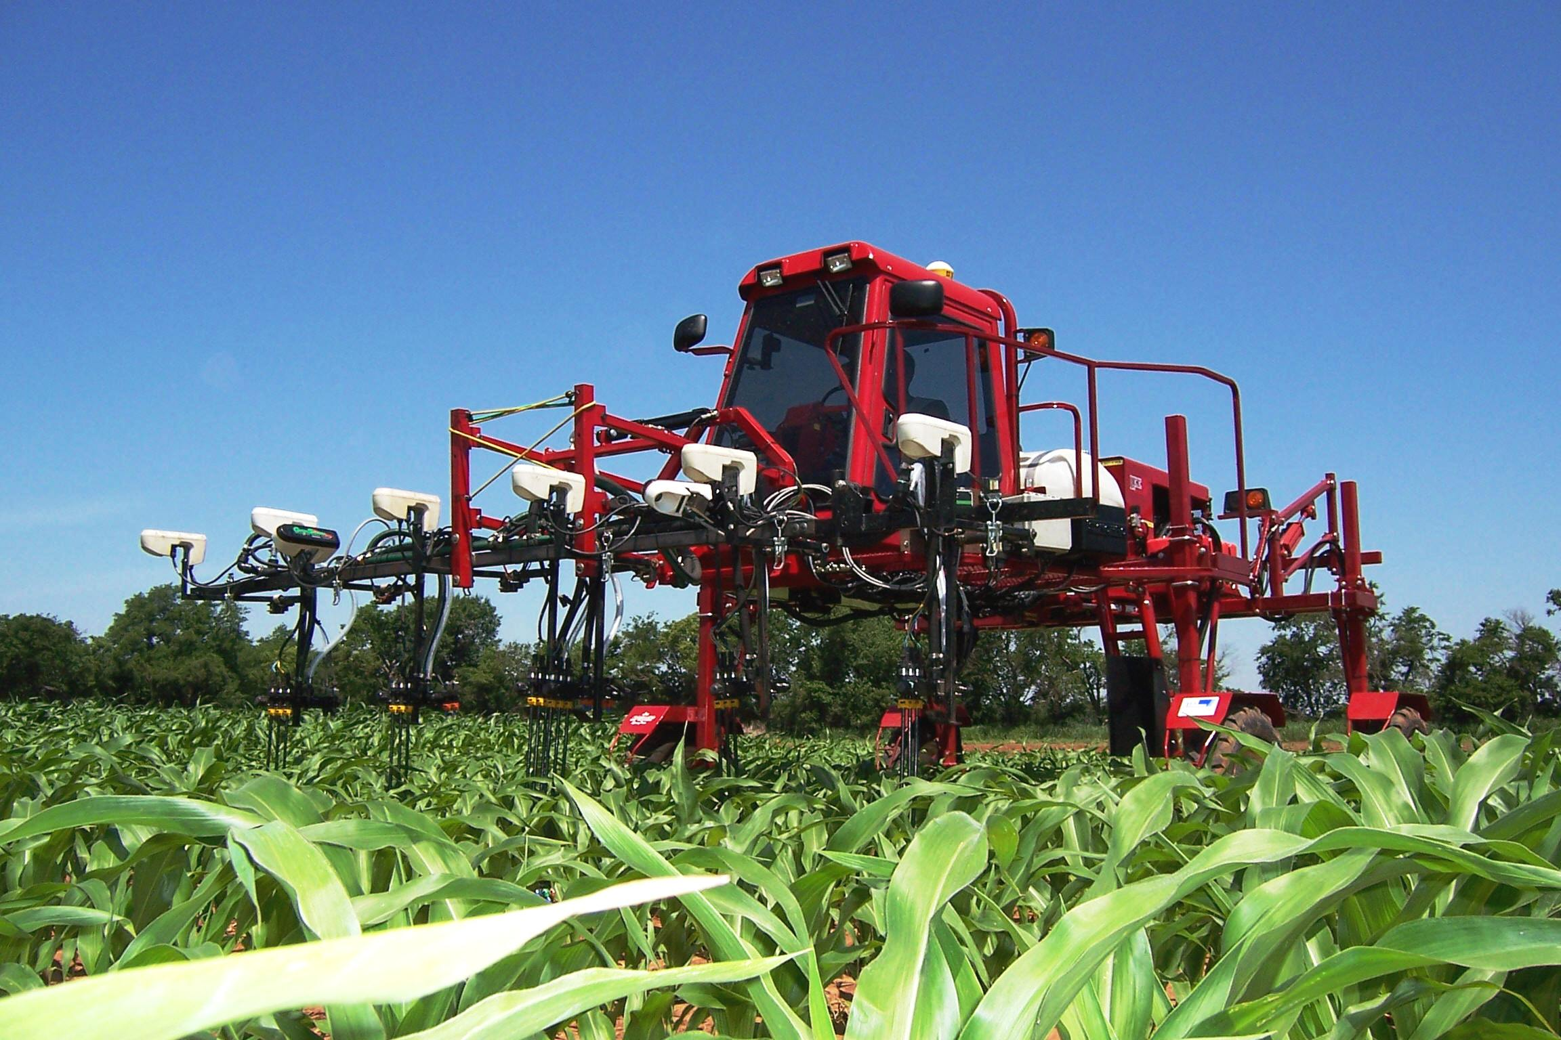
How is this by-plant applicator any different from by-plant N fertilization by hand?
USA

Slide 15
Embedded Components from Research
Woolfolk, Agron. J. 94:429-434
Grain protein averaged over years/locs 14.9%, no N, 16.5%, 34 kg N ha⁻¹, pre flowering 16.3%, 34 kg N ha⁻¹, post flowering
Seed Technology
Insecticides
Incorporation of UREA to avoid NH3 loss

Slide 16
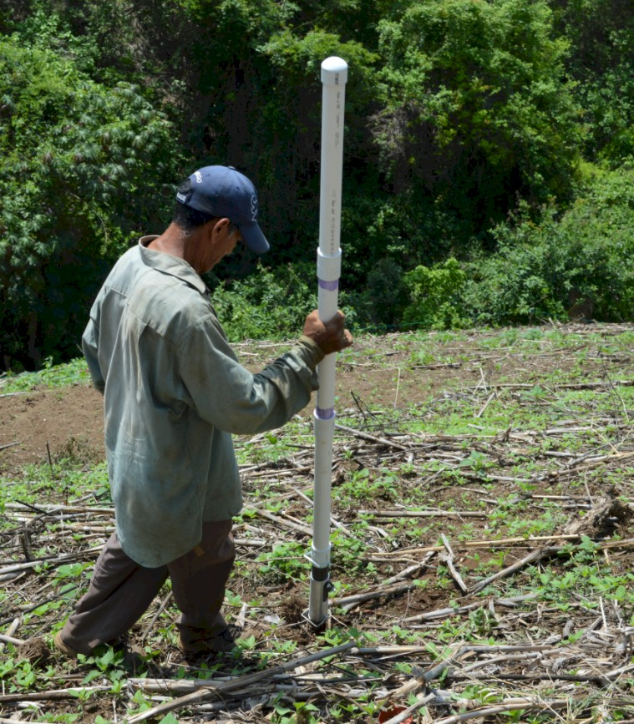
http://nue.okstate.edu/Hand_Planter.htm
Isn’t this a crop sensor?
Fertilizing individual plants
Not fertilizing weeds
Homogeneity of plant spacing
CV estimation
Disease recognition
Soil disturbance
Surface residue
Weed presence
Crop vigor,
Crop competition
Instantaneous risk assessment
GREEN SEEDER

Slide 17
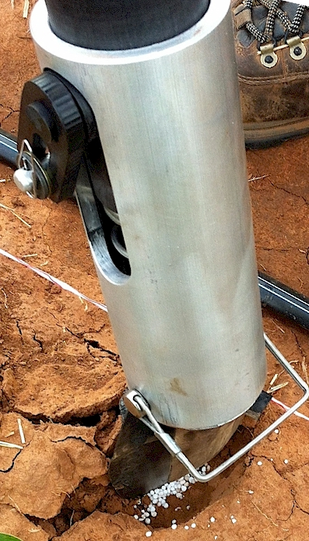
Benefits
Remove chemically treated seeds from the hands of producers
Decrease soil erosion via improved plant spacing
Accommodate mid-season application of urea-N
Place urea below the surface reducing NH3 loss
Potential to increase maize production and NUE
Chim, Bee Khim, Peter Omara, Jeremiah Mullock, Sulochana Dhital, Natasha Macnack, and William Raun. 2014. Effect of seed distribution and population on maize (Zea mays L.) grain yield. Int. J. Agronomy. V2014. . http://dx.doi.org/10.1155/2014/125258.
Planting 1 seed, every 0.16m increased yields by an average of 1.15 Mg ha⁻¹ (range, 0.33 to 2.46 Mg ha⁻¹) when compared to the farmer practice of placing 2 to 3 seeds per hill, every 0.48 cm.
Omara, Peter, Lawrence, Aula, Bill Raun, Randy Taylor, Adrian Koller, Eric Lam, Joshua Ringer, Jeremiah Mullock, Sulochana Dhital and Natasha Macnack. 2015. Hand planter for maize (Zea mays L.) in the developing world. J. Plant Nutr. DOI:10.1080/01904167.2015.1022186
Dhillon, J.S., B. Figueiredo, L. Aula, T. Lynch, R.K. Taylor, and W.R. Raun. 2017. Evaluation of drum cavity size and planter tip on singulation and plant emergence in maize (Zea mays L.). J. Plant Nutr. DOI:10.1080/01904167.2017.1382532.

Slide 18
OSU Hand Planter Countries
Region | Country | Region | Country | Region | Country
Africa | Burundi | Asia | Australia | South America | Argentina
Africa | Congo | Asia | Bangladesh | South America | Belize
Africa | Ethiopia | Asia | India | South America | Brazil
Africa | Equatorial Guinea | Asia | Malaysia | South America | Colombia
Africa | Ghana | Asia | Nepal | South America | Ecuador
Africa | Guinea | Asia | Philippines | South America | Suriname
Africa | Kenya | Asia | Vietnam | Europe | Hungary
Africa | Liberia | Cent. America | El Salvador | Europe | Netherlands
Africa | Malawi | Cent. America | Guatemala | Europe | Switzerland
Africa | Mali | Cent. America | Haiti | North America | Canada
Africa | Mozambique | Cent. America | Honduras | North America | USA
Africa | NIgeria | Cent. America | Panama | North America | Mexico
Africa | Rwanda
Africa | Senegal
Africa | Sierra Leone
Africa | Tanzania
Africa | Togo
Africa | Uganda
Africa | Zambia
Africa | Zimbabwe

Slide 19
Hand Planter (uses)
Mosquito abatement USEPA, Northfield, IL
https://www.epa.gov/mosquitocontrol
Squash production, Valley Center, KS
Pumpkin production, Stillwater, OK
Wildlife food plots,
Home gardeners
Mid-row, maize, coffee plantations, Colombia

Slide 20
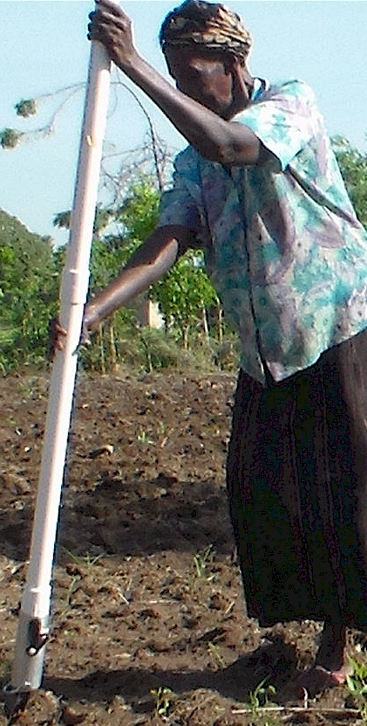
Some technologies are more efficient in their use of scarce production resources than modern technologies. Modern researchers should seek to understand the rationale behind traditional smallholder farmer behavior in technology use. This will make their future technological interventions in smallholder agriculture more effective. (Muzari et al., 2012. J. Sust. Dev)

Slide 21
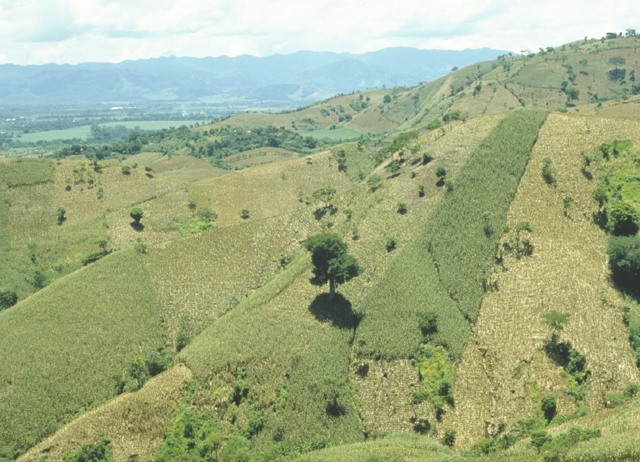
1987
EL SALVADOR

Slide 22
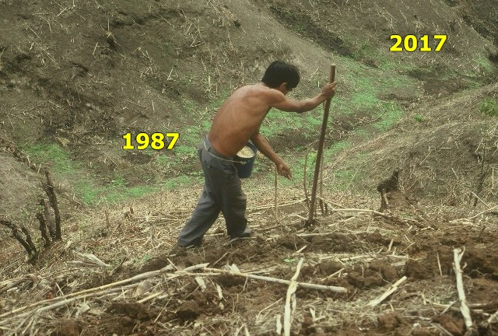
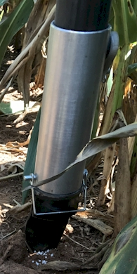

Slide 23
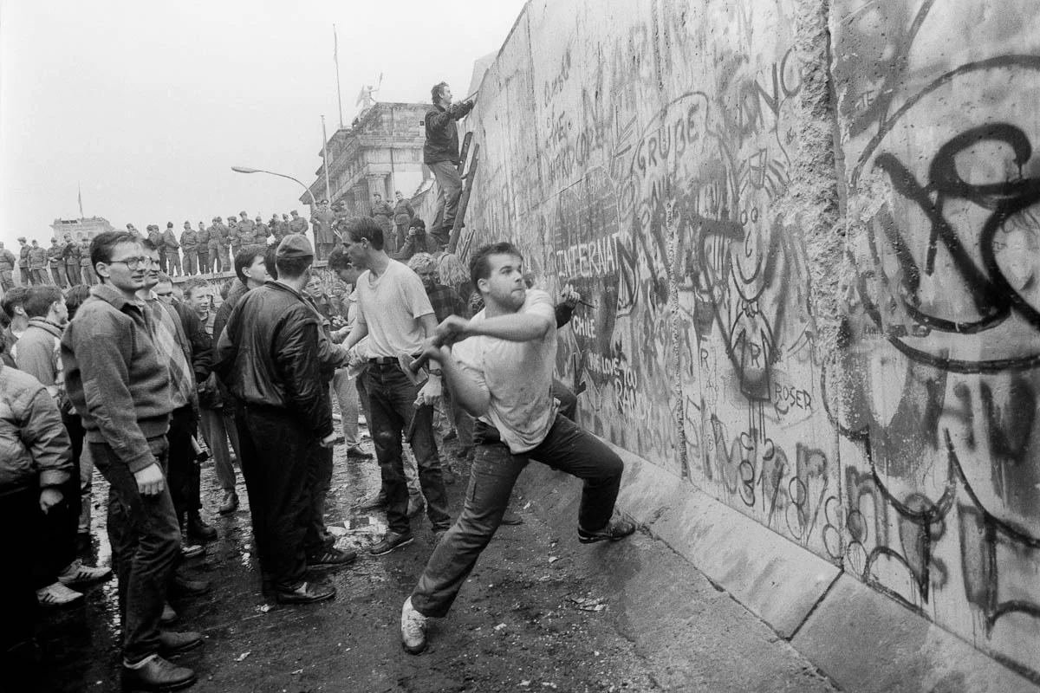
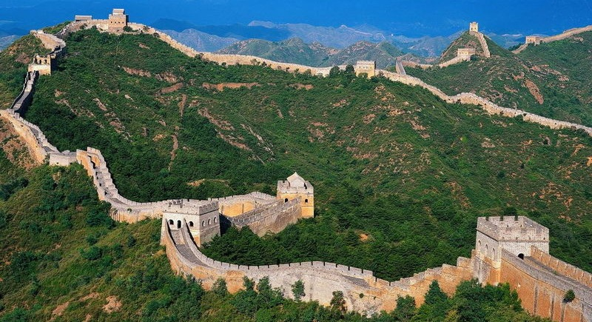
How exactly do we Digitize the Human Sensor?
27

