Slide 1
Moving Beyond Yield Goals
June 10, 2019

Slide 2

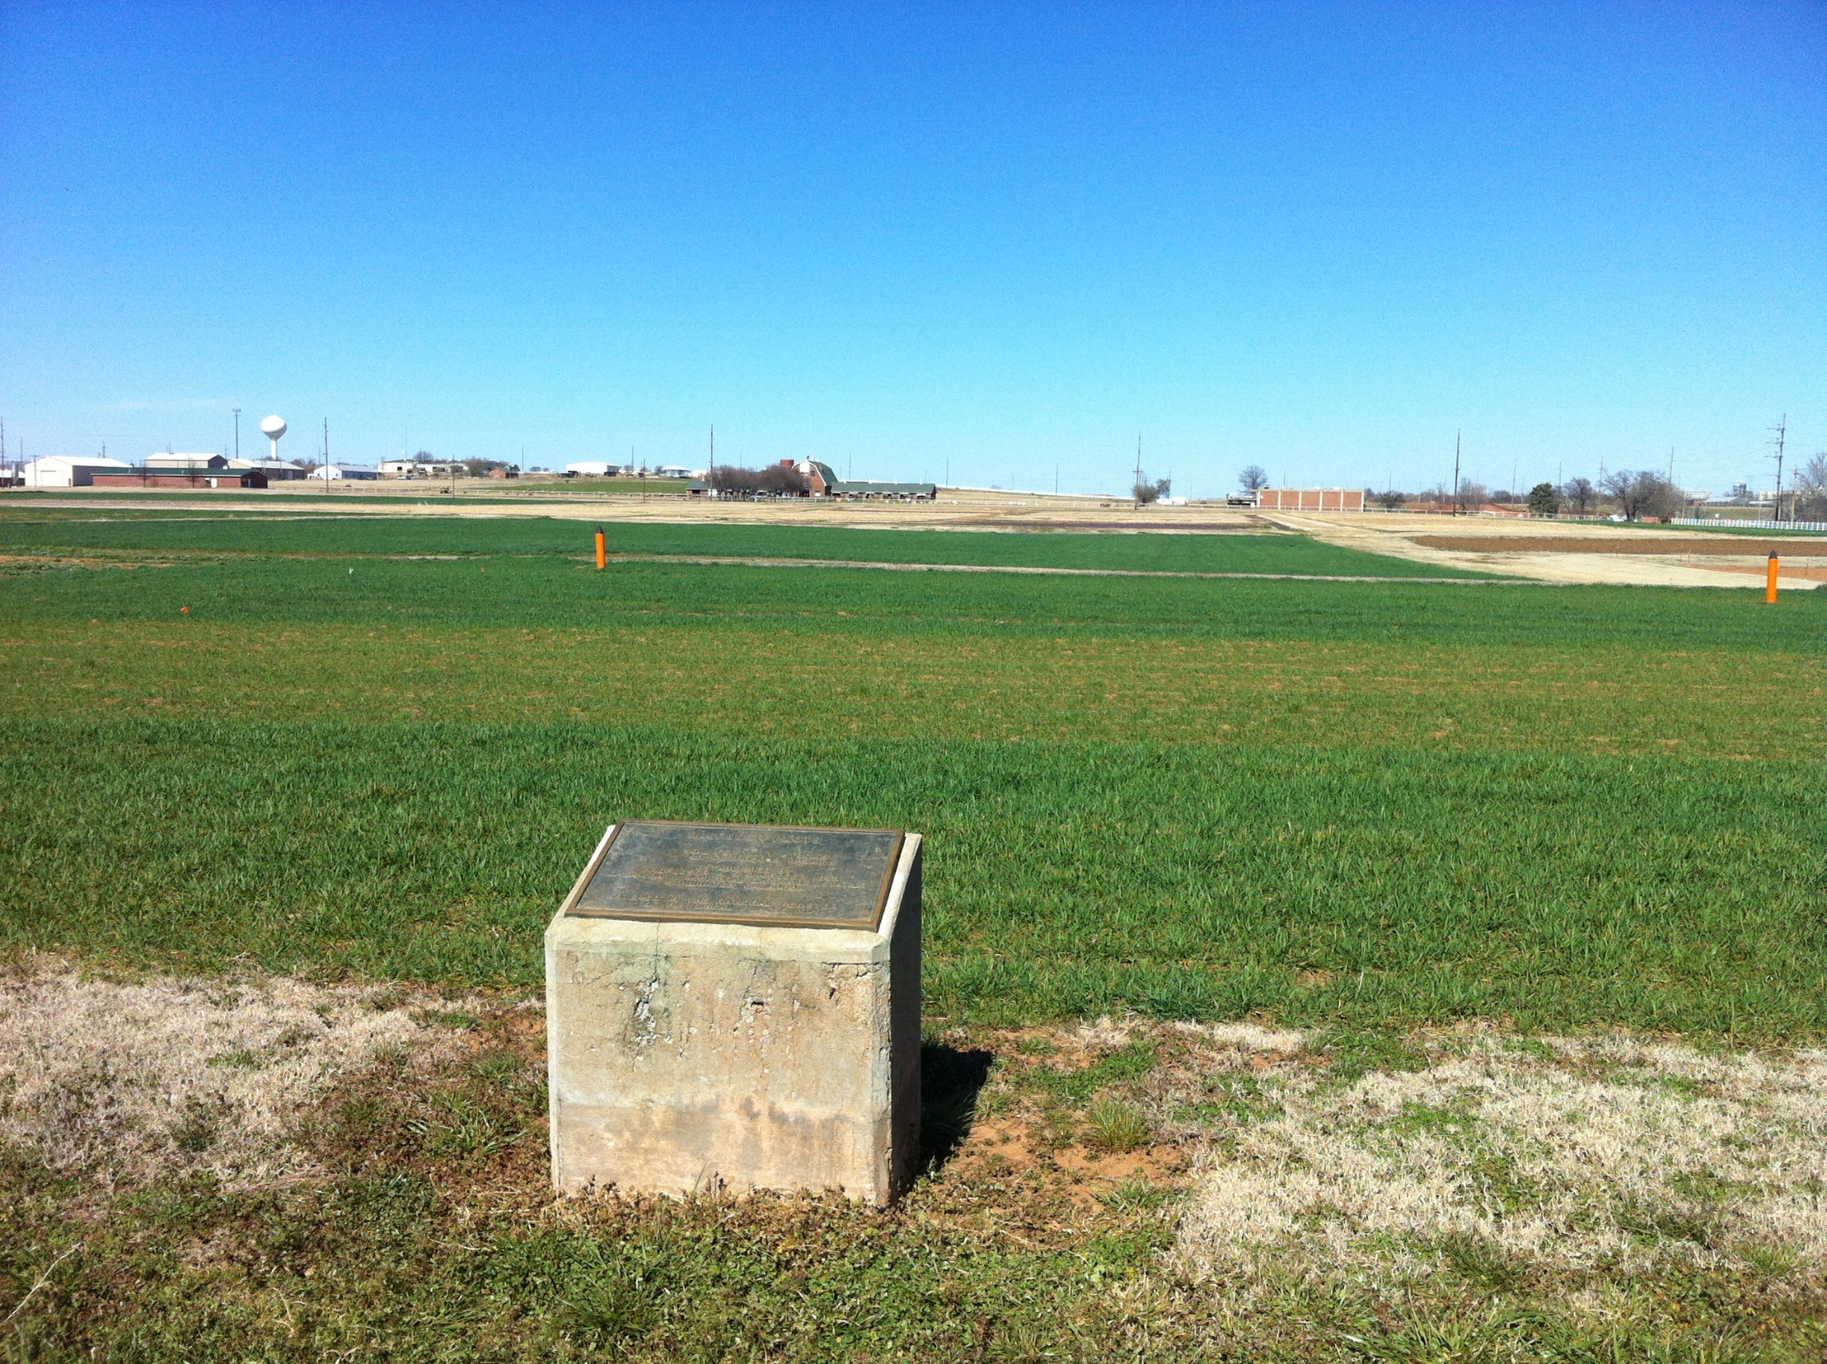
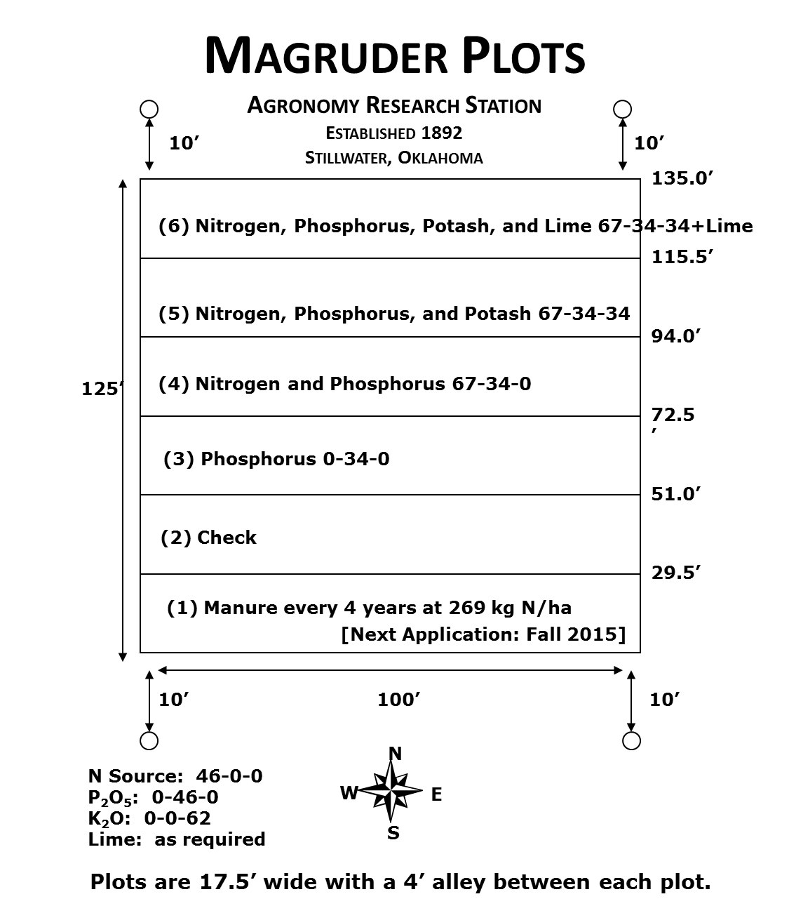
1892 (Oxford, UK 1096)

Slide 3
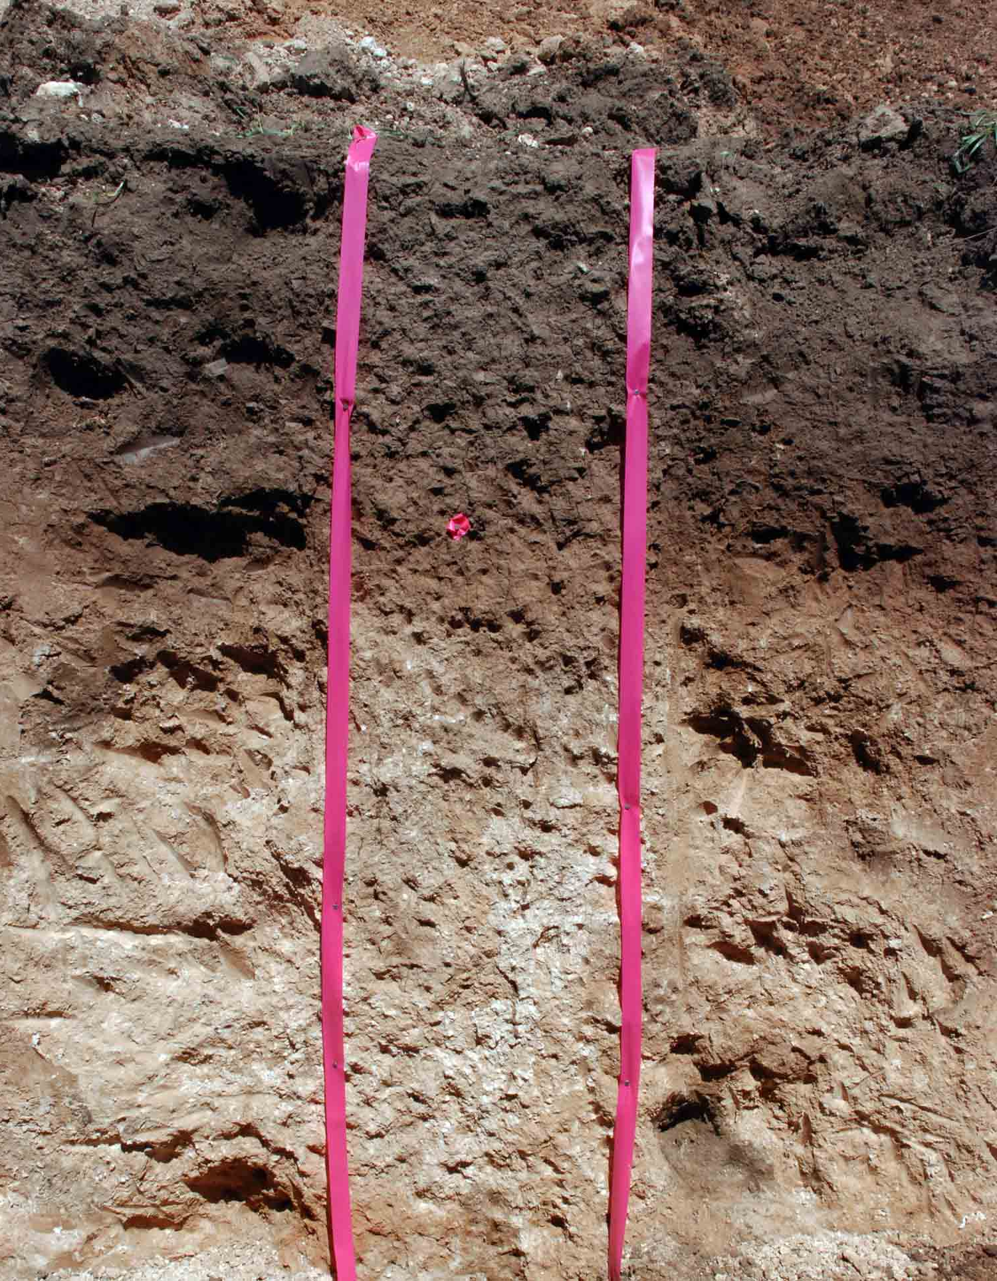
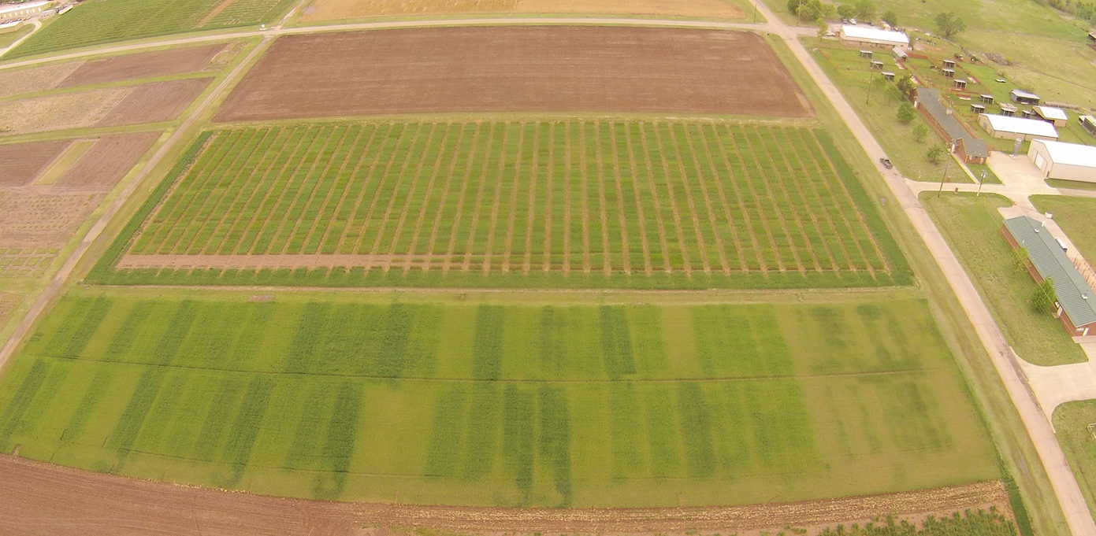
Wheat Fertility Experiment No.222
Agronomy Research Station
Established 1969
Kirkland silt loam (fine, mixed, thermic, Udertic Paleustoll
Location: Stillwater
TRT | Pre-plant N rate (lb N / ac) | Pre-plant P rate (lb P₂O₅ / ac) | Pre-plant K rate (lb K₂O / ac)
1.* | 0 | 60 | 40
2.* | 40 | 60 | 40
3.* | 80 | 60 | 40
4.* | 120 ^ | 60 | 40
5. | 80 | 0 | 40
6. | 80 | 30 | 40
7. | 80 | 90 | 40
8. | 80 | 60 | 0
9. | 80 | 60 | 80
10.* | 0 | 0 | 0
11. | 120 ^ | 90 | 80
12. | 120 ^ | 90 | 0
13. | 80 | 60 | 40 (Sul-Po-Mag)
N applied as 46-0-0 (Urea) P applied as 0-46-0 (Triple Super Phosphate) K applied as 0-0-60 (Potash) * - YP plot ^ - Split 120 lb N rates to 60 lb N (fall) and 60 lb N (spring)
Plot size: 20’ x 60’
Alley: 17’
Total Trial Area: 137’ x 520’
E
N
S
W
OBJECTIVE: To study fertilizer nitrogen, phosphorus, and potassium in winter wheat. In recent years, this study has also been used to develop yield potential models and yield predictions through sensor based technologies.
1, 2 – Harvest Sequence Number
1, 2 – Treatment Number
1 , 2 – Soil Sample Sequence Number
137 | 52 | 49 | 48 | 45 | 44 | 41 | 40 | 37 | 36 | 33 | 32 | 29 | 28 | 25 | 24 | 21 | 20 | 17 | 16 | 13 | 12 | 9 | 8 | 5 | 4 | 1
 | 13 | 13 | 8 | 5 | 7 | 3 | 2 | 11 | 12 | 6 | 9 | 1 | 10 | 4 | 6 | 2 | 11 | 5 | 3 | 8 | 12 | 10 | 9 | 1 | 7 | 4
77 | 26 | 25 | 24 | 23 | 22 | 21 | 20 | 19 | 18 | 17 | 16 | 15 | 14 | 13 | 12 | 11 | 10 | 9 | 8 | 7 | 6 | 5 | 4 | 3 | 2 | 1
 | Rep 2 | Rep 1 | Rep 2 |  |  |  |  |  |  |  |  |  |  |  | Rep 1
60 | 51 | 50 | 47 | 46 | 43 | 42 | 39 | 38 | 35 | 34 | 31 | 30 | 27 | 26 | 23 | 22 | 19 | 18 | 15 | 14 | 11 | 10 | 7 | 6 | 3 | 2
 | 13 | 13 | 8 | 10 | 7 | 12 | 9 | 5 | 2 | 11 | 1 | 3 | 4 | 6 | 3 | 11 | 1 | 8 | 6 | 9 | 12 | 2 | 5 | 10 | 4 | 7
0 | 52 | 51 | 50 | 49 | 48 | 47 | 46 | 45 | 44 | 43 | 42 | 41 | 40 | 39 | 38 | 37 | 36 | 35 | 34 | 33 | 32 | 31 | 30 | 29 | 28 | 27
 | Rep 4 | Rep 3 | 60 | 80 | 100 | 120 | 140 | 160 | 180 | 200 | 220 | 240 | 260 | 280 | 300 | 320 | 340 | 360 | 380 | 400 | 420 | 440 | 460 | 480 | 500 | 520
 |  |  | Rep 4 |  |  |  |  |  |  |  |  |  |  |  | Rep 3
1969

Slide 4
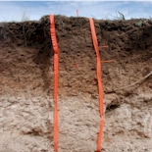
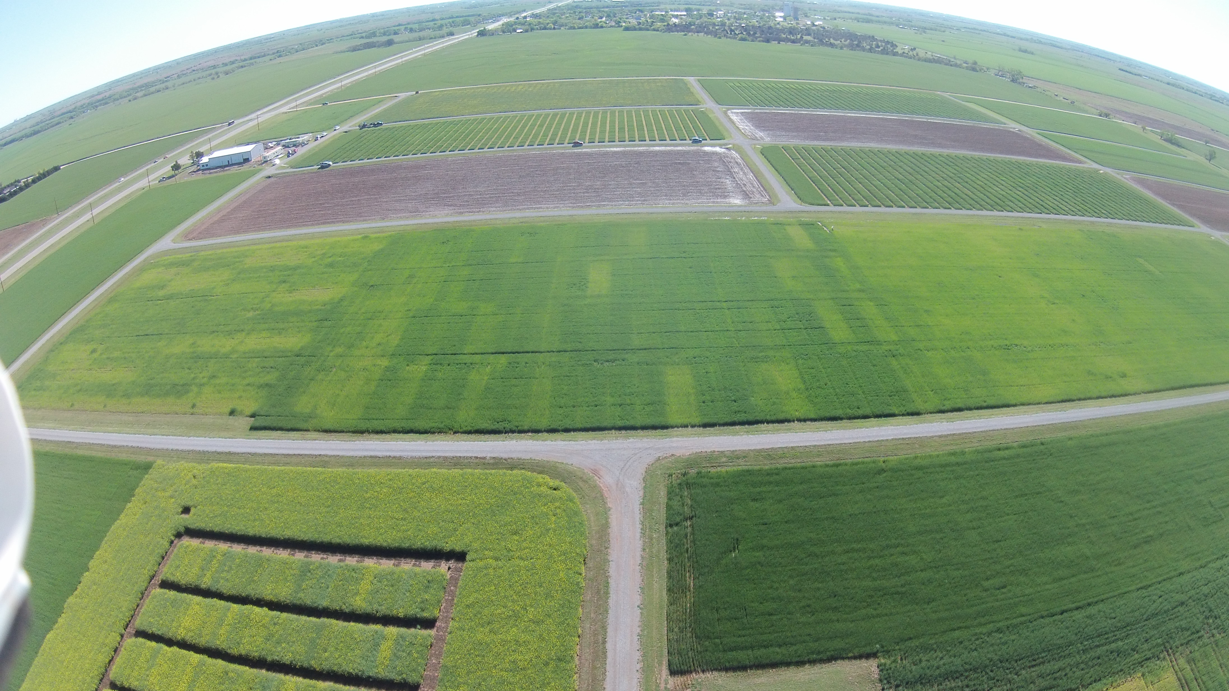
Wheat Fertility Experiment No.502
North Central Experiment Station
Established 1970
Location: Lahoma
TRT | Pre-plant N rate (lb N / ac) | Pre-plant P rate (lb P₂O₅ / ac) | Pre-plant K rate (lb K₂O / ac)
1.* | 0 | 0 | 0
2.* | 0 | 40 | 60
3.* | 20 | 40 | 60
4.* | 40 | 40 | 60
5.* | 60 | 40 | 60
6.* | 80 | 40 | 60
7.* | 100 | 40 | 60
8. | 60 | 0 | 60
9. | 60 | 20 | 60
10. | 60 | 60 | 60
11. | 60 | 80 | 60
12. | 60 | 60 | 0
13. | 100 | 80 | 60
14. | 60 | 40 | 60 (Sul-Po-Mag)
N applied as 46-0-0 (Urea) P applied as 0-46-0 (Triple Super Phosphate) K applied as 0-0-60 (Potash) * - YP plot
Grant silt loam (fine-silty, mixed, superactive, thermic, Udic Argiustoll
Plot size: 16’ x 60’
Alley: 20’
Total Trial Area: 224’ x 300’
W
S
N
E
OBJECTIVE: To study fertilizer nitrogen, phosphorus, and potassium in winter wheat. In recent years, this study has also been used to develop yield potential models and yield predictions through sensor based technologies.
1, 2 – Harvest Sequence Number
1, 2 – Treatment Number
1 , 2 – Soil Sample Sequence Number
 | 300 | 4 | 5 | 12 | 13 | 20 | 21 | 28 | 29 | 36 | 37 | 44 | 45 | 52 | 53
Rep 4 |  | 3 | 5 | 13 | 6 | 10 | 2 | 4 | 7 | 12 | 1 | 8 | 14 | 9 | 11
 | 240 | 43 | 44 | 45 | 46 | 47 | 48 | 49 | 50 | 51 | 52 | 53 | 54 | 55 | 56
 | 220 | 3 | 6 | 11 | 14 | 19 | 22 | 27 | 30 | 35 | 38 | 43 | 46 | 51 | 54
Rep 3 |  | 1 | 14 | 2 | 7 | 11 | 3 | 9 | 12 | 5 | 13 | 4 | 8 | 10 | 6
 | 160 | 29 | 30 | 31 | 32 | 33 | 34 | 35 | 36 | 37 | 38 | 39 | 40 | 41 | 42
 | 140 | 2 | 7 | 10 | 15 | 18 | 23 | 26 | 31 | 34 | 39 | 42 | 47 | 50 | 55
Rep 2 |  | 4 | 8 | 3 | 1 | 11 | 13 | 12 | 7 | 14 | 6 | 9 | 10 | 2 | 5
 | 80 | 15 | 16 | 17 | 18 | 19 | 20 | 21 | 22 | 23 | 24 | 25 | 26 | 27 | 28
 | 60 | 1 | 8 | 9 | 16 | 17 | 24 | 25 | 32 | 33 | 40 | 41 | 48 | 49 | 56
Rep 1 |  | 8 | 2 | 4 | 6 | 14 | 9 | 10 | 5 | 7 | 12 | 1 | 3 | 13 | 11
 |  | 1 | 2 | 3 | 4 | 5 | 6 | 7 | 8 | 9 | 10 | 11 | 12 | 13 | 14
 | 0 | 16 | 32 | 48 | 64 | 80 | 96 | 112 | 128 | 144 | 160 | 176 | 192 | 208 | 224
1970

Slide 5

Setting Realistic Yield Goals
December 5, 2008
Charles Shapiro, Extension Soils and Nutrient Management Specialist
Added profit: Decreasing a yield goal that was 10 bu/ac too high: $7.50/ac¹
Increasing a yield goal that was 10 bu/ac too low: $42.50/ac²
¹ The added profit calculations refer to situations in which the yield goal was over or underestimated by 5%, which is commonly observed. On average, this amounts to about 10 bu/ac of corn. If we assume a corn price of $5.00/bu and a nitrogen price of $0.75/lb, decreasing a too-high yield goal results in a nitrogen fertilizer savings of about $7.50/acre (10 lbs N/ac less at $0.75/lb N).
² If we assume a corn price of $5.00/bu and an N price of $0.75/lb N, increasing a too-low yield goal by 5% (10 bu/ac) results in $42.50/ac added profit due to higher yield ($50/ac at $5.00/bu corn), which requires slightly more fertilizer (10 lbs N/ac more at $0.75/lb N).

Slide 6

University of Minnesota
Adjusting The Past Average -- Recent average (3-5 years) is increased by 10% to 20% with the higher yield becoming the yield goal.
If, soil moisture is limiting at the start of the growing season, it may be wise to strive for a low percentage increase or no increase at all. With favorable soil moisture and a good long range forecast, it would be smart to aim for a 10% to 20% increase over the recent average. This method allows for maximum flexibility in the establishment of yield goals. Crop yields will also increase slowly over time if this approach is used for setting yield goals and yield goals are met.
Be Positive
There is every reason to be positive in setting yield goals. If common logic is used, realistic yield goals can be established. If you plan for a poor yield, you will get a poor yield.
George Rehm and Michael Schmitt, extension soil scientists

Slide 7
2 lbs N/bu
2.35% N, wheat grain
40 bu/ac, 70% NUE
2 lb N/bu
80 lb N/ac
40 bu/ac* 60 lb/bu = 2400 lbs
2400* 0.0235 %N =56 lbs N/ac removed
56 / 0.70 = 80 lbs N/ac

Slide 8
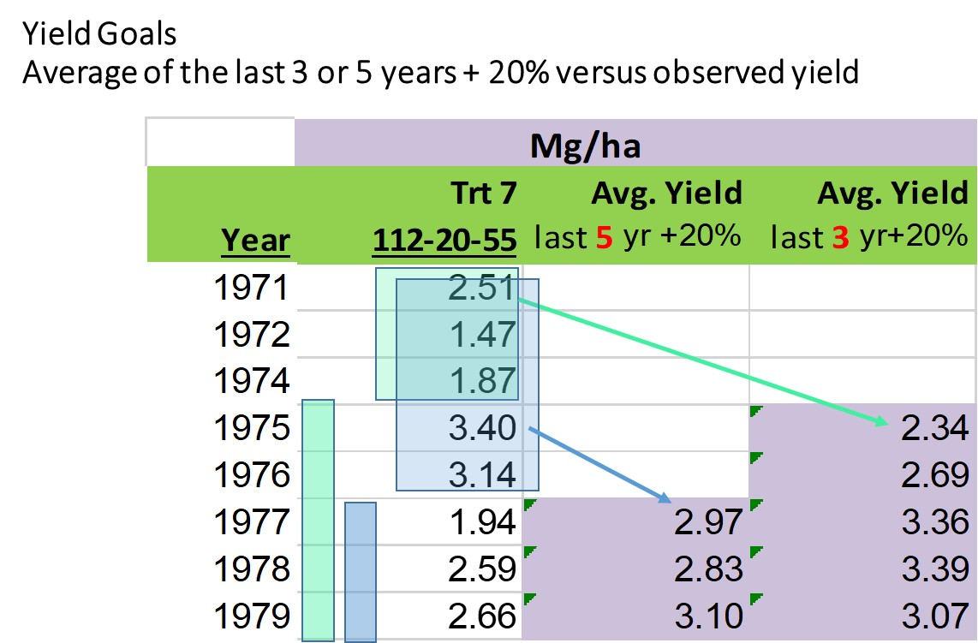

Slide 9
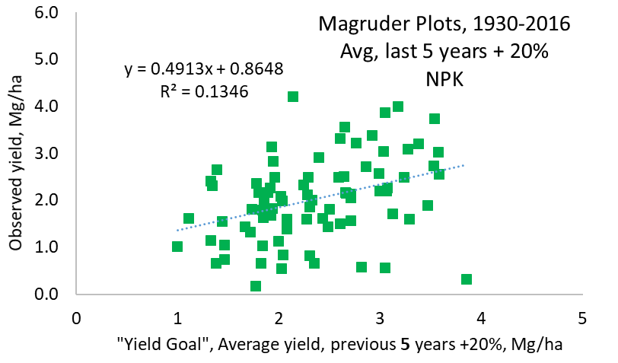
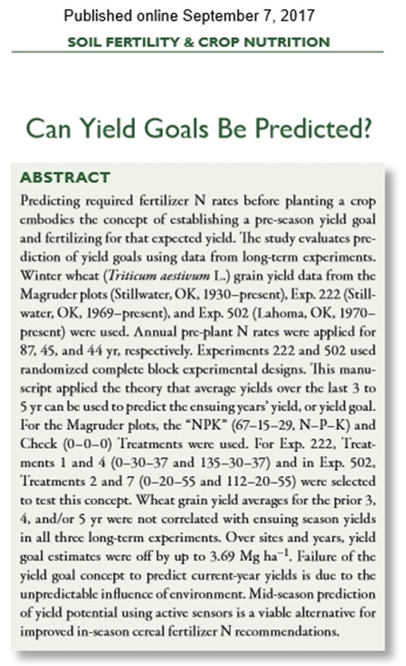
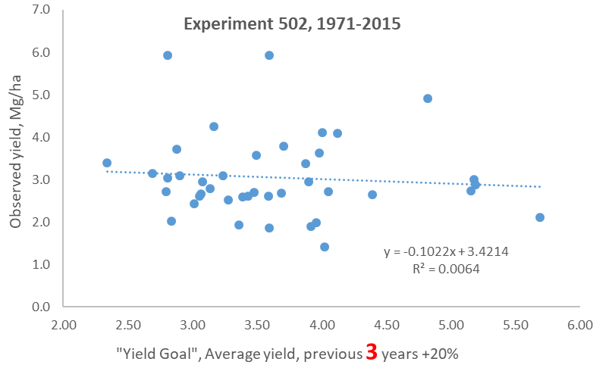

Slide 10
SBNRC emulates yield goal
1. Predict Mid-Season Yield Potential (YP0)
NDVI/days where growth was possible
2. Determine Response Index (RI, N Rich Strip)
3. Establish %N in the grain
4. Predict the response to applied N
5. The predicted attainable yield with added nitrogen is calculated as:
YP_{N} = YP₀ * RI
6. Grain N uptake, YP₀ = Grain Yield (YP₀) * expected % N in the Grain
GNUP_YP₀ = YP₀*0.0239
GNUP_YP_{N} = YP_{N}*0.0239
where 0.0239 represents 2.39%N in the grain for winter wheat
7. Fertilizer N Rate:
(GNUP_YPN – GNUP_YP0)/0.7
In the example we use 70% or 0.70 as the divisor (range 50% to 80%)

Slide 11
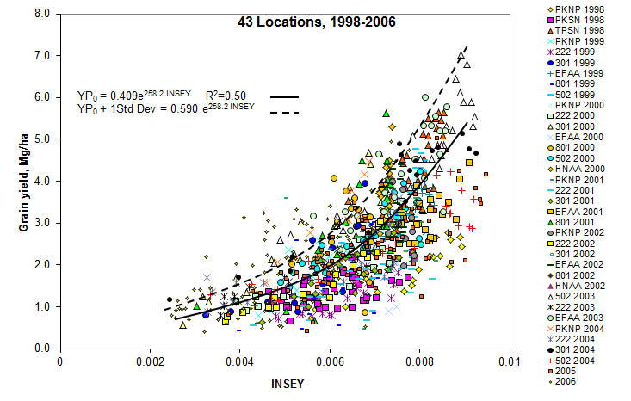

Slide 12
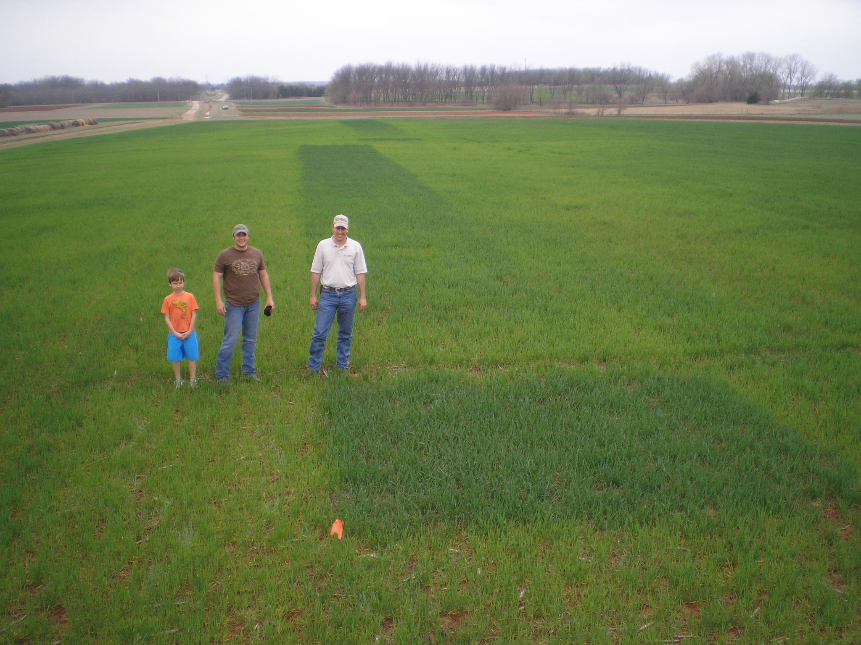

Slide 13
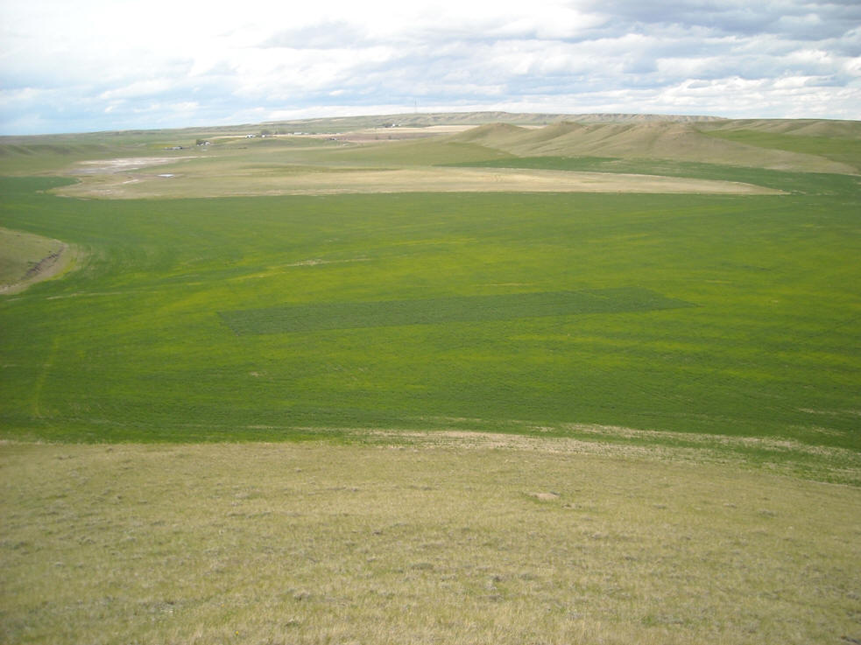

Slide 14
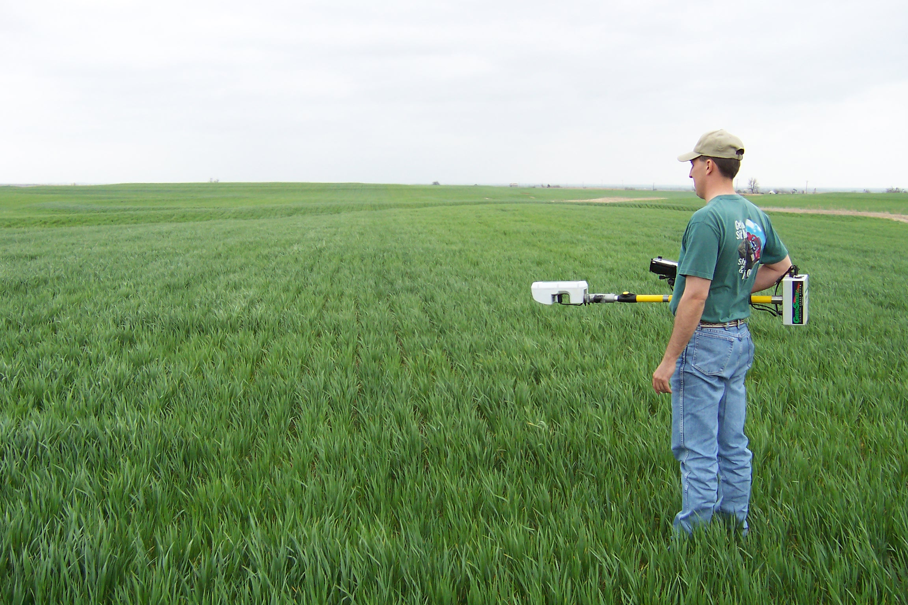

Slide 15
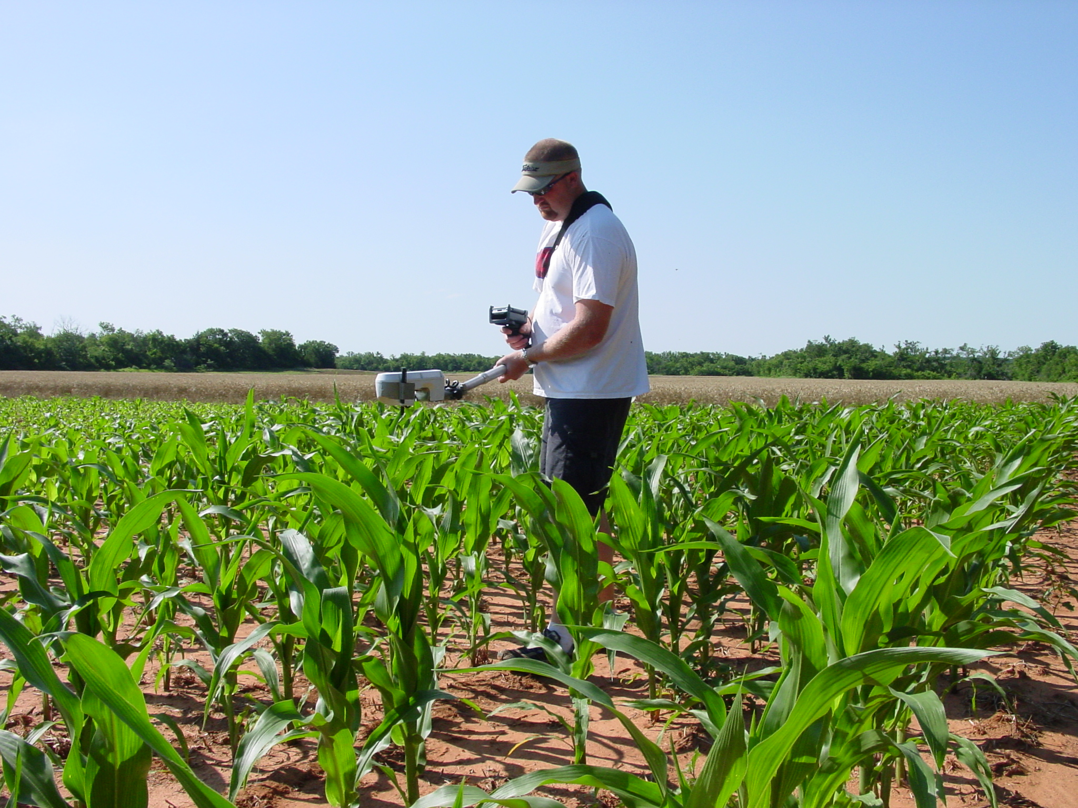

Slide 16
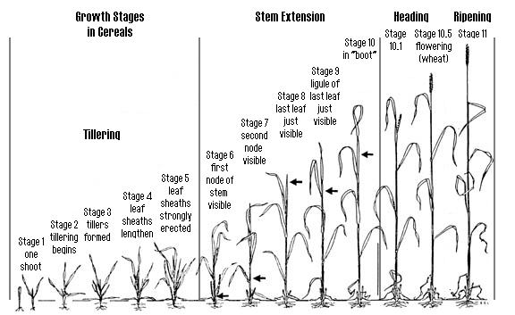

Slide 17
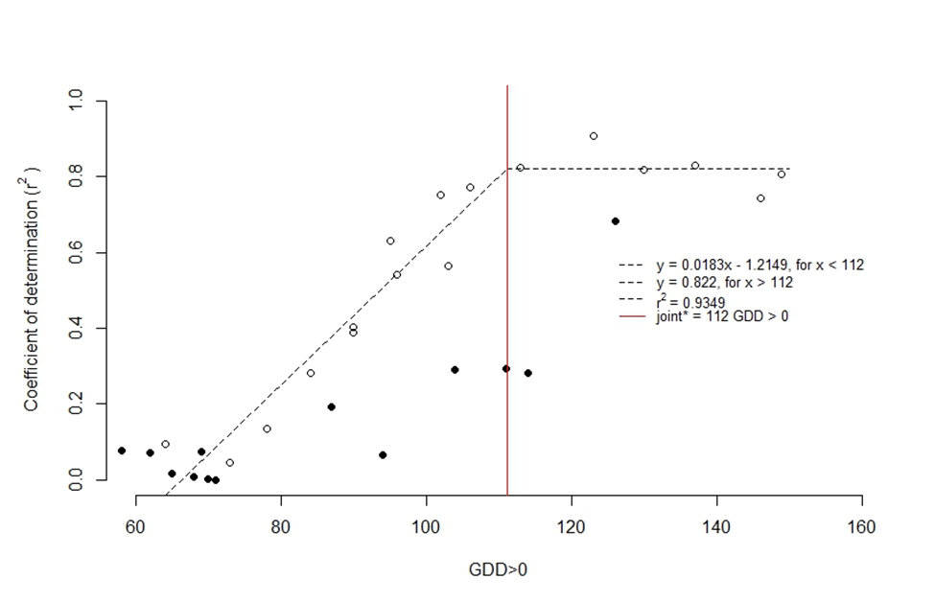
Experiment 222, 2016 2017

Slide 18
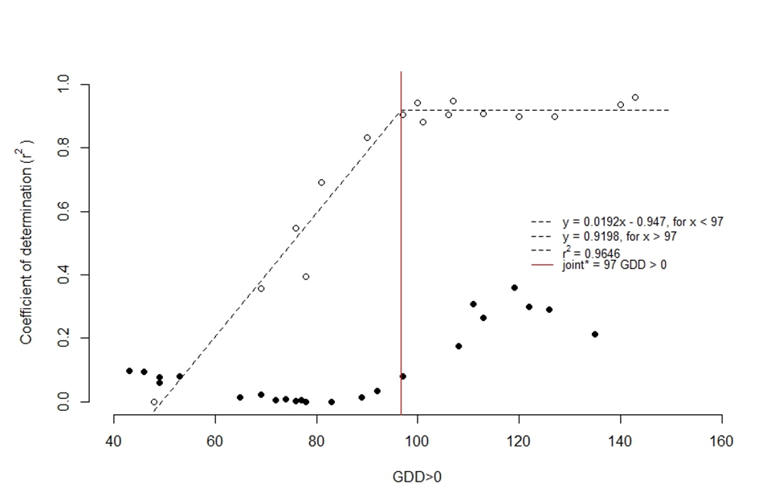
Experiment 502, 2016, 2017

Slide 19
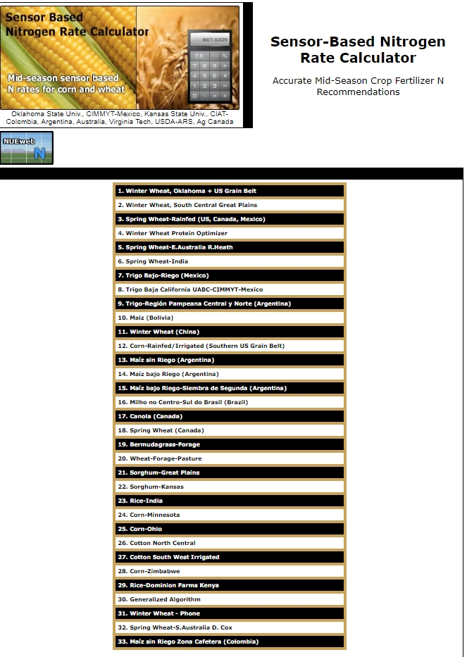
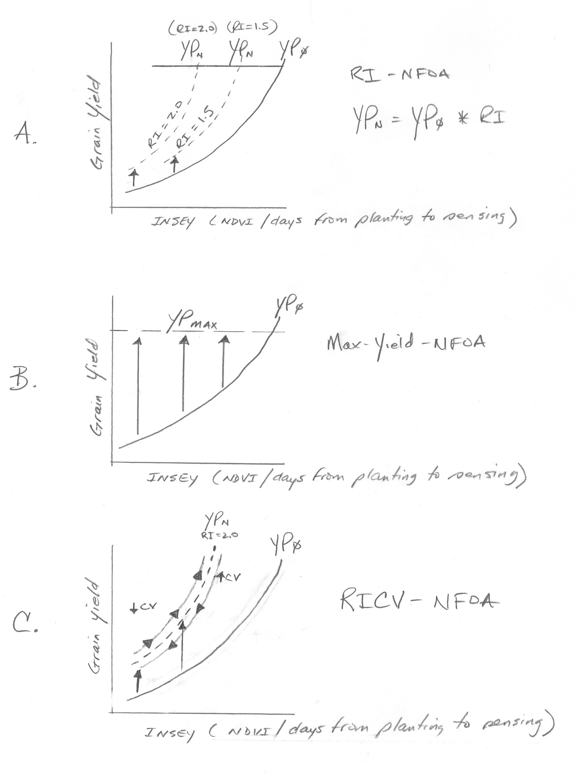

Slide 20
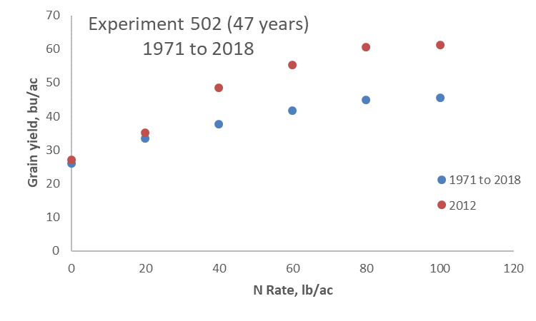
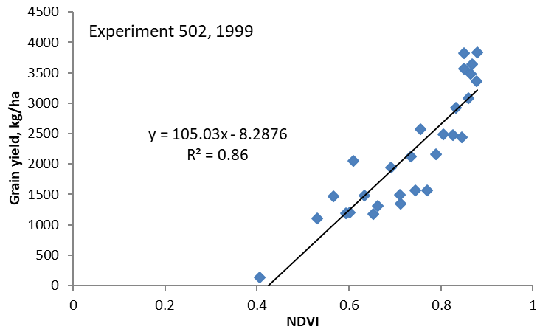
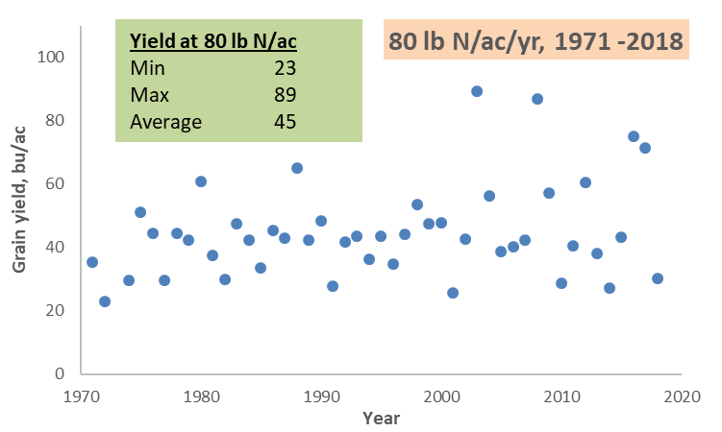
Experiment 502, 1970-2018

Slide 21
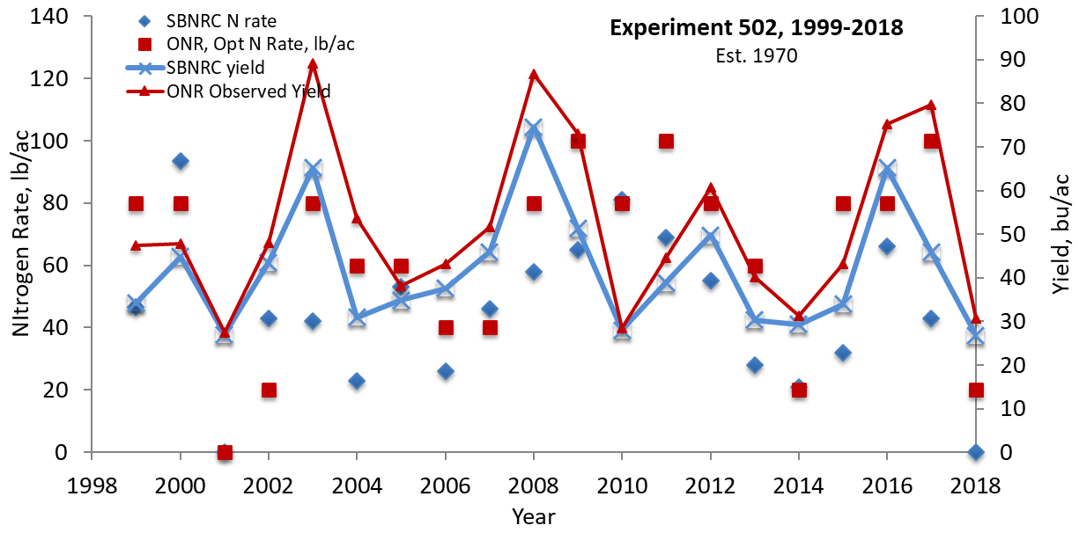

Slide 22


Slide 23
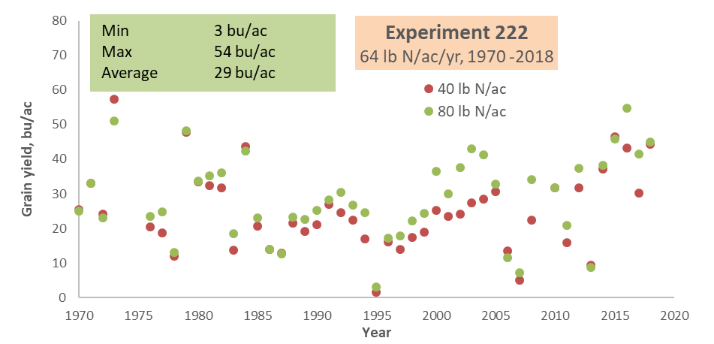
Experiment 222 1969-2018
Averages inappropriate
for predictive tools

Slide 24
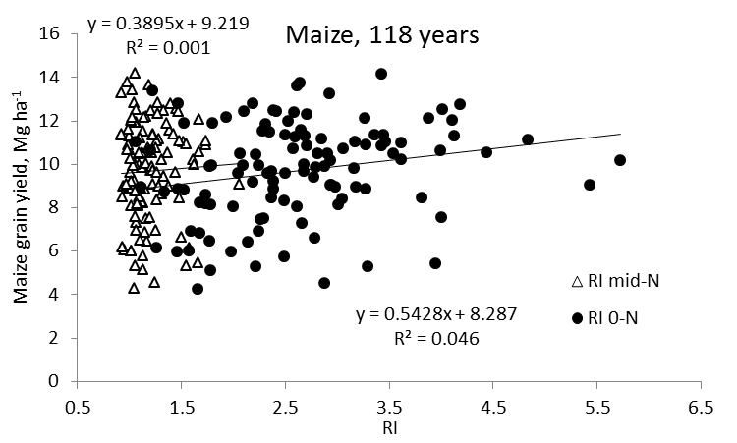
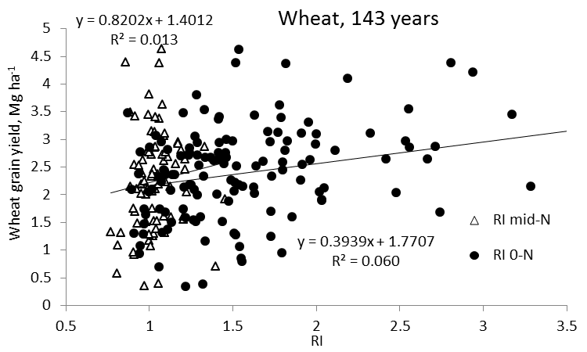
Independence of Yield potential and Nitrogen response
Iowa
Nebraska
Wisconsin
Oklahoma
2011. Independence of yield potential and crop nitrogen response. Precision Agric. 12:508-518.
2013. Relationship between grain crop yield potential and nitrogen response. Agron. J. 105:1335–1344.

Slide 25
Independence of Biological Processes in Agriculture
Biodiversity and randomness will increase.
More and more processes found to be independent.
Each year, residual N in the soil following crop harvest is different
Yield levels change radically from year to year, a product of an ever changing and unpredictable/random environment
Contribution of residual soil N for next years’ growing crop, randomly influences N response or the response index (RI)
2nd law of thermodynamics total entropy or orderliness increases with time and is irreversible
Biological systems are expected to become more and more random with time.
Unpredictable nature that environment has on N demand, and the unpredictable nature that environment has on final grain yield, dictate the need for independent estimation of multiple random variables

Slide 26
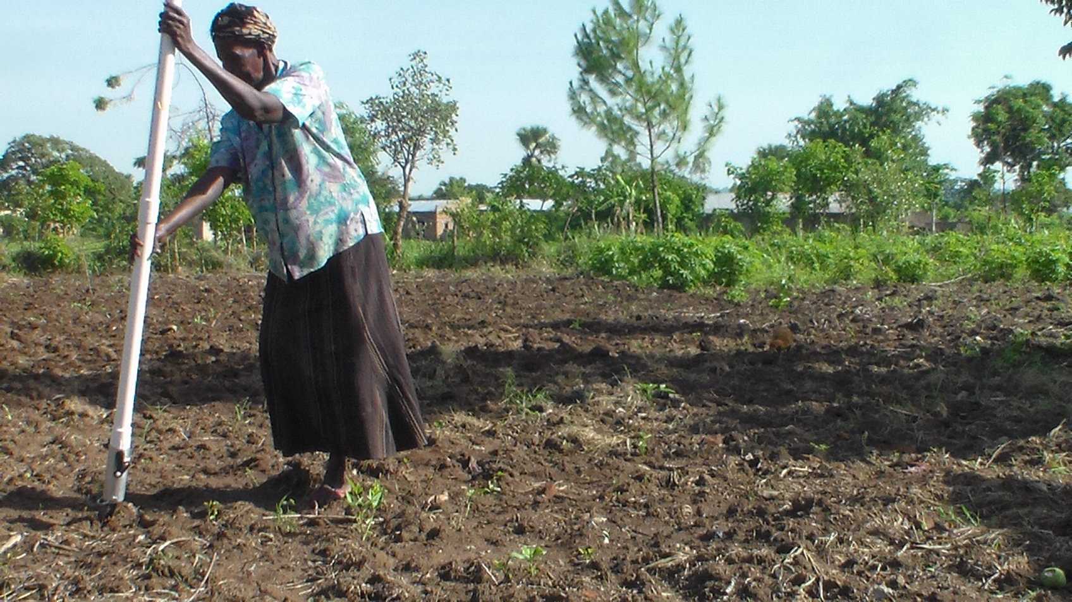

Slide 27
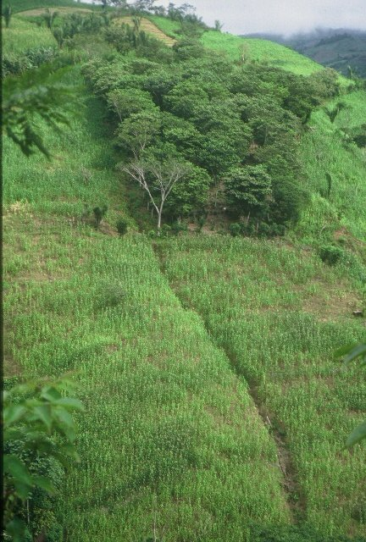
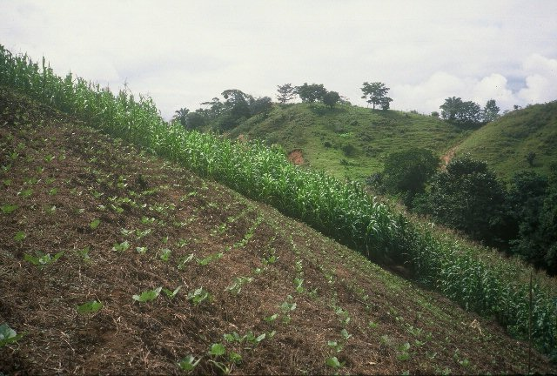

Slide 28


Slide 29
2nd law of thermodynamics: entropy/randomness will increase with time.
More and more biological processes have been found to be independent. Independence of yield potential (YP0) and nitrogen (N) response in cereals
Residual N in the soil following crop harvest is different.
Yield levels change from year to year (unpredictable/random environment)
Contribution of residual N for next years’ growing crop, randomly influences N response or the response index (RI).
Biological systems are expected to become more and more random with time.
Range of different biological parameters will each influence YP0 and RI in an unrelated manner.
Unpredictable nature that environment has on N demand, and the unpredictable nature that environment has on final grain yield, dictate the need for independent estimation of multiple random variables that will be used in mid-season biological algorithms of the future.

Slide 30
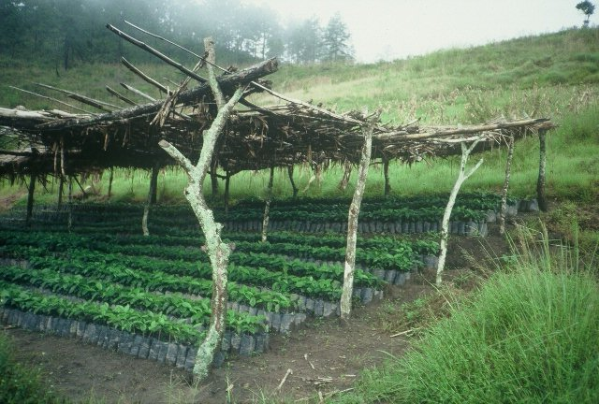
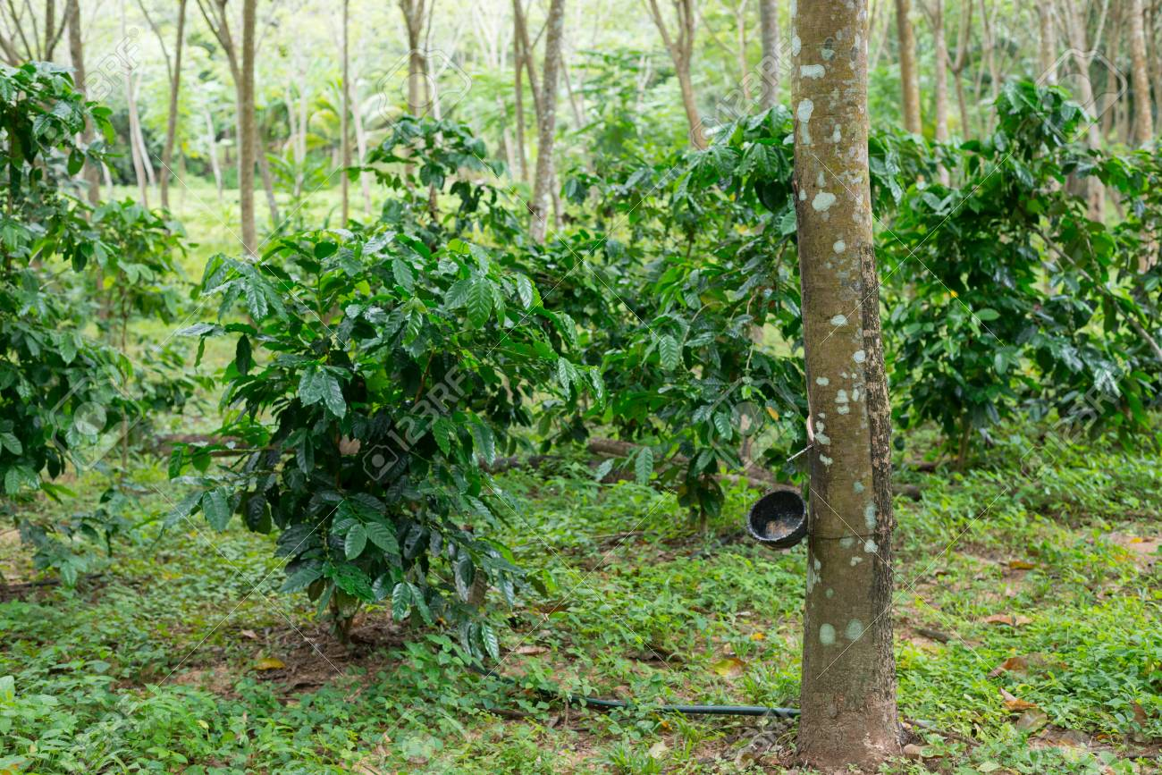
Hemileia vastatrix, leaf rust
(more at lower altitudes)
Coffee Exports
Brazil, $4.6B
Colombia, $2.6B
Honduras, $1.2B
Guatemala, $0.8B
2500-6000 ft asl
Coffee Coffea arabica
Rubber Hevea brasiliensis, 1940 USDA

