Slide 1
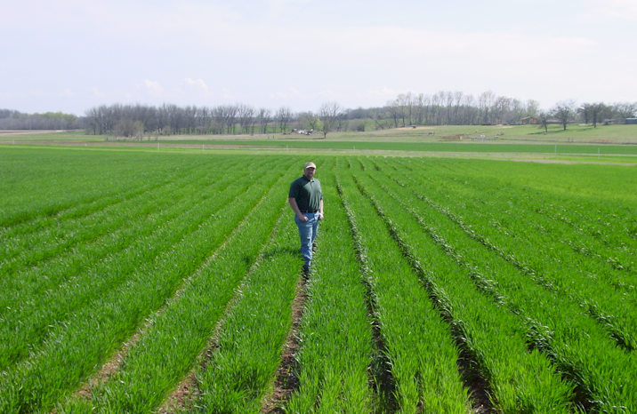
Your First Job (One Template)
Spanish
Technology CIMMYT
Dr. Kyle Freeman, PhD, OSU 2005 Director Business Development, OCP
Office Chérifien des Phosphates
1985, PhD, University of Nebraska
1985-1991, CIMMYT, International Maize and Wheat Improvement Center, Mexico, Guatemala
1991-present, OSU 100 Thesis Required Graduates (MS and PHD),Elizabeth Eickhoff
PASS Senior Seminar Dr. Beatrix Haggard

Slide 2
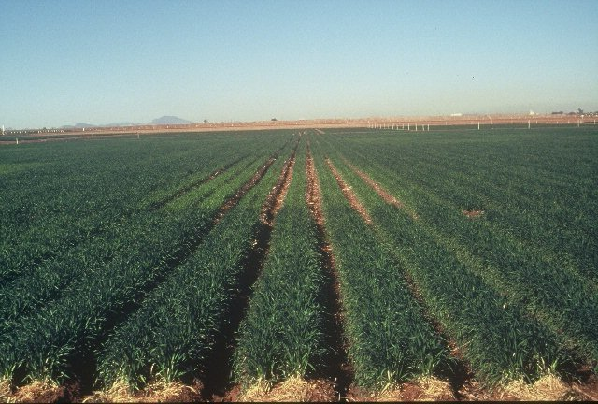
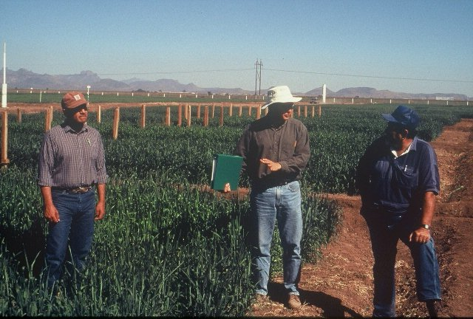
Ciudad Obregon MEXICO

Slide 3
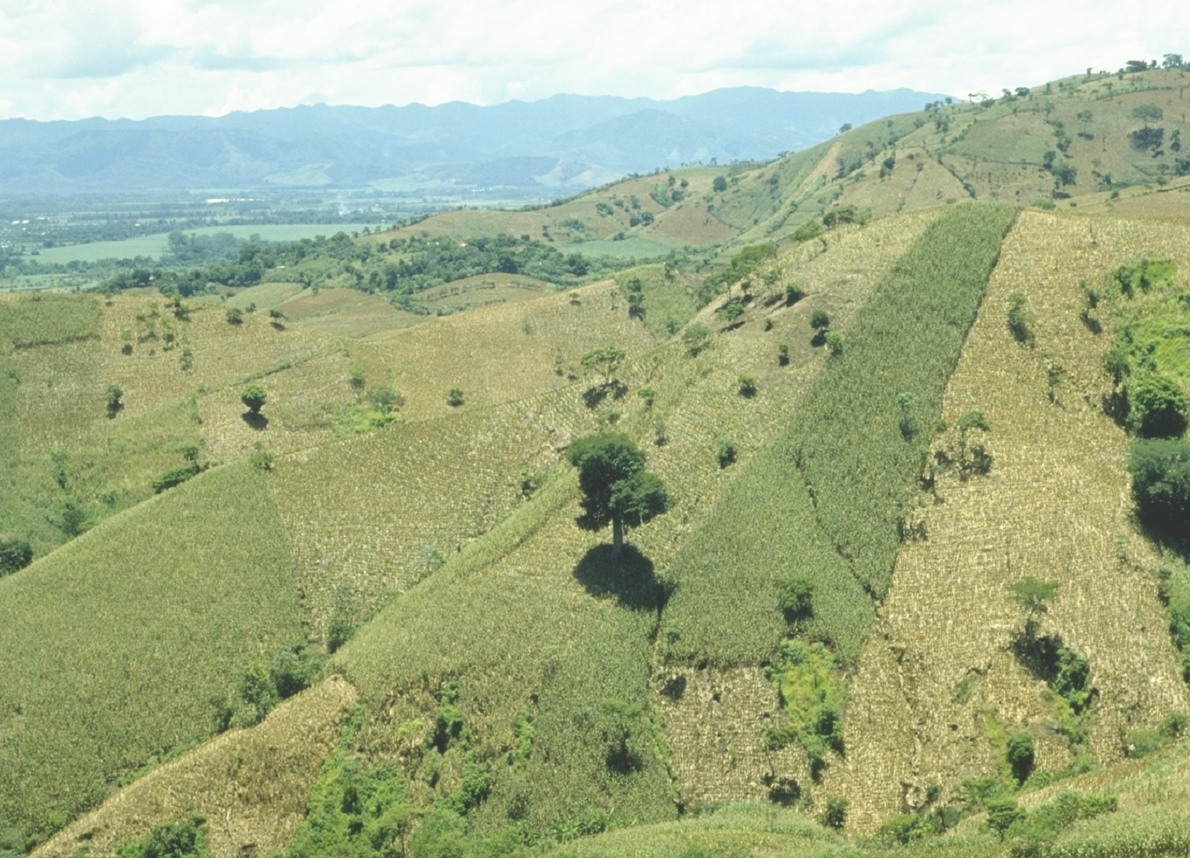
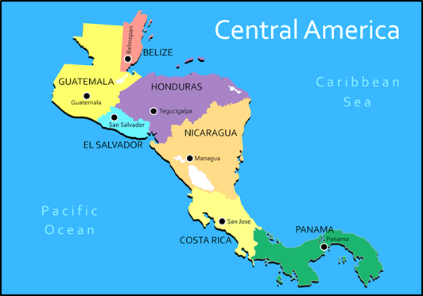
EL SALVADOR

Slide 4
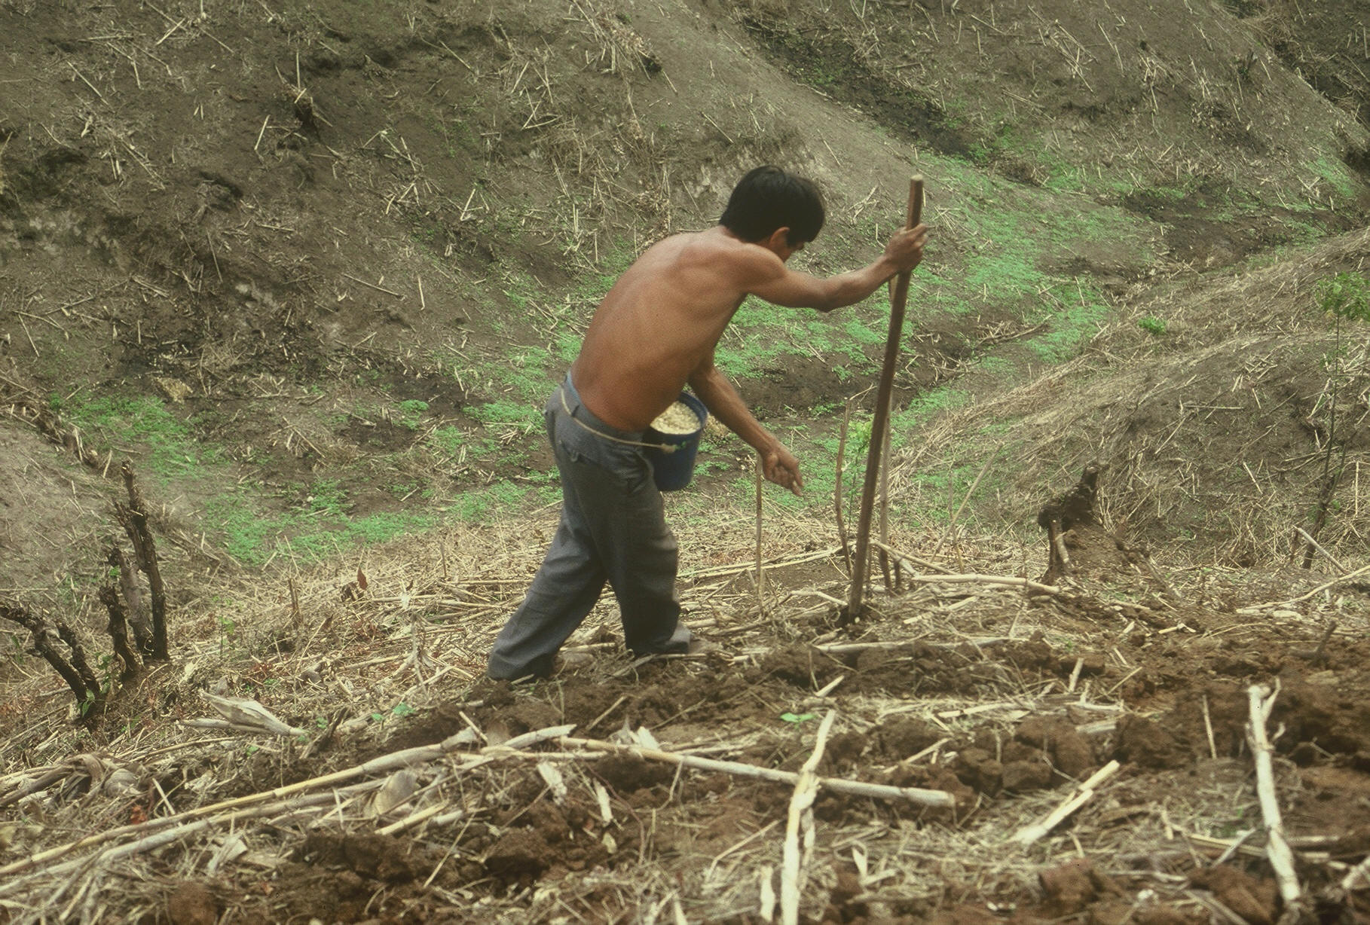

Slide 5
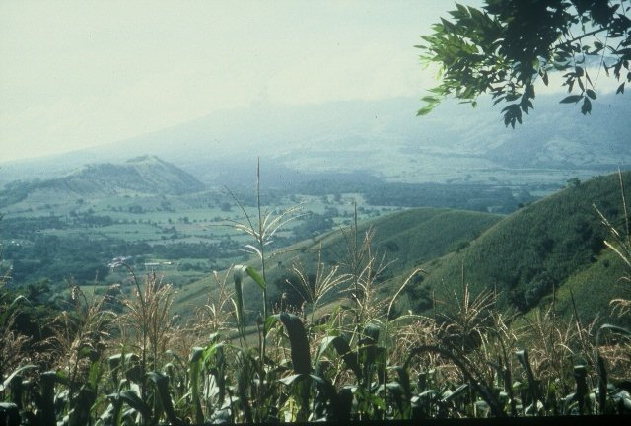

Slide 6
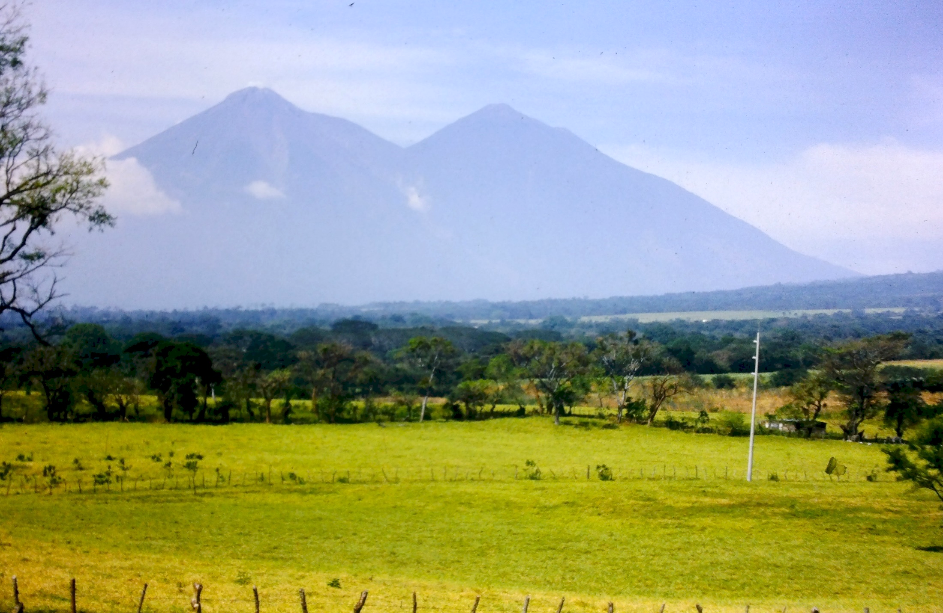

Slide 7
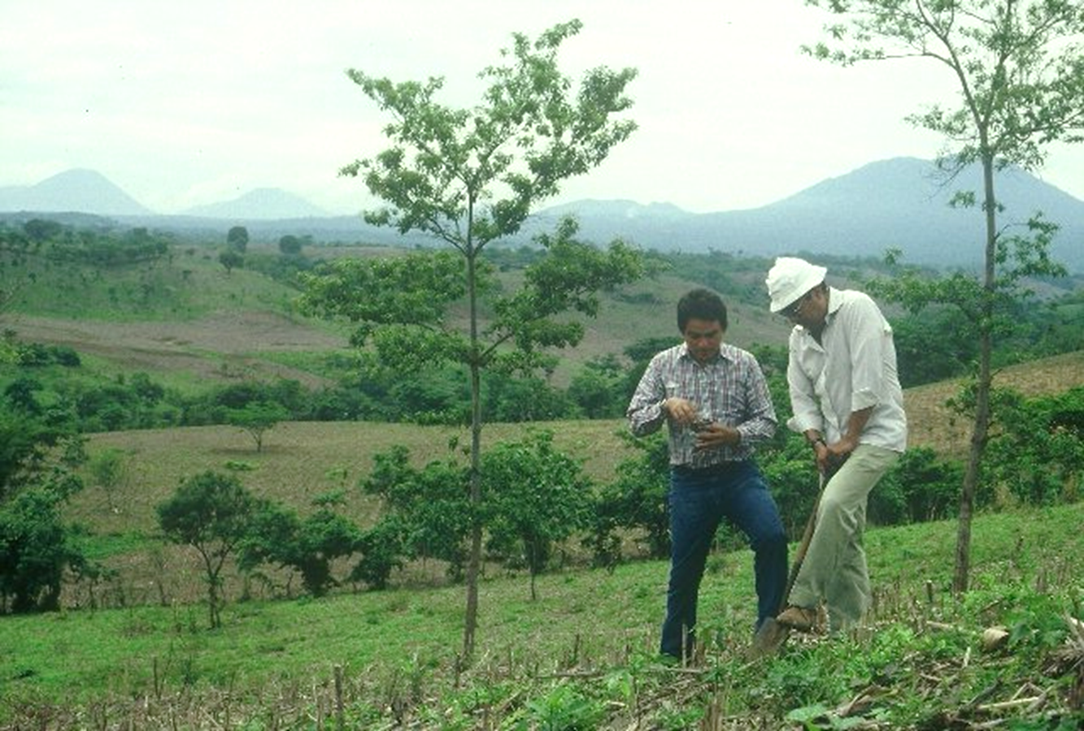

Slide 8
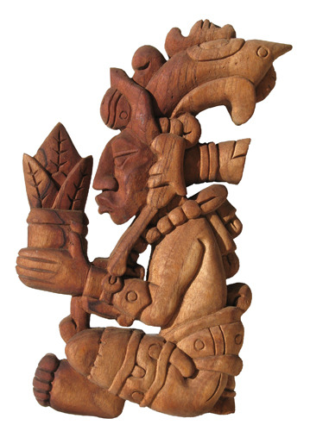
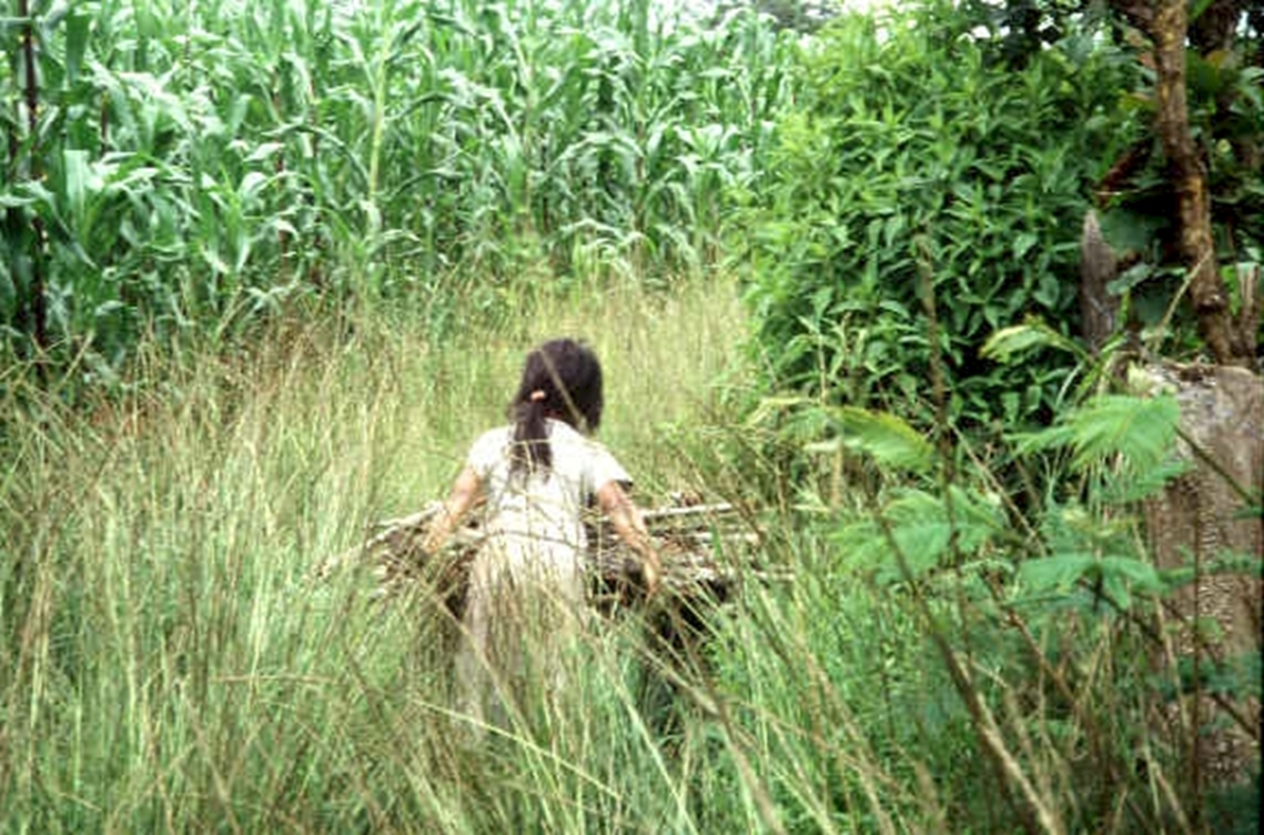
Centeotl, Aztec maize deity
17% of the worlds maize production takes place on marginal landscapes
(33M / 185M)
Domestication 9000 years ago 21 % of human nutrition
http://nue.okstate.edu/Crop_Information/World_Wheat_Production.htm

Slide 9
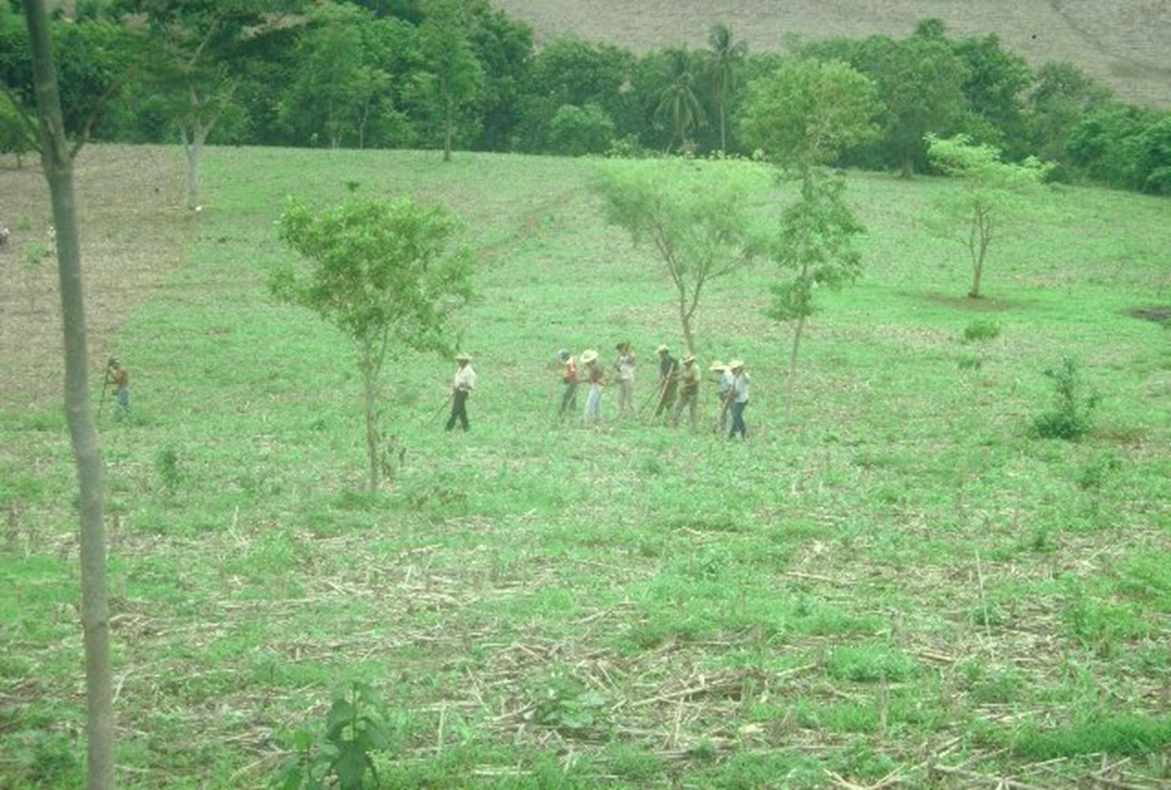

Slide 10
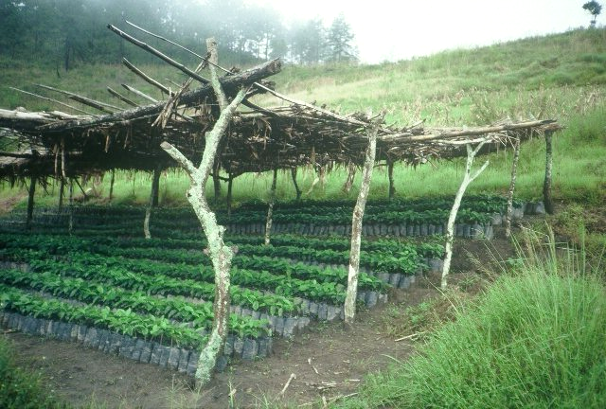

Slide 11
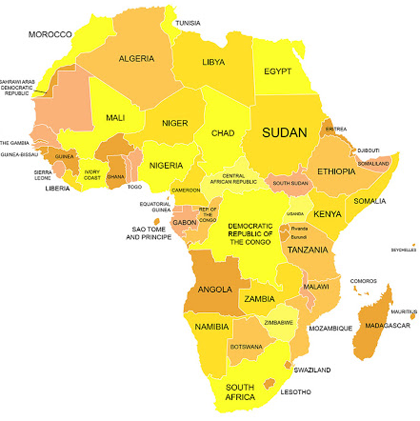
E_{SSA}
Cereal production in SSA is inadequate for supporting the nutritional demands of a rapidly growing population
Nutrient mining, particularly nitrogen (N), has taken place in virtually all areas where cereals are produced in SSA
Estimated NUE’s for SSA exceed 100%
This suggests that SSA is doing a remarkable job in managing fertilizer N
Reality is that so little fertilizer N is used that estimates of NUE are grossly exaggerated

Slide 12
Sub-Saharan Africa vs. USA
SSA USA
Population, million 1,100 328
Cereals, million ha 88 56
Production, million tons 118 440
Yield, tons/ha 1.3 7.8
Fertilizer N, million tons 1.3 10.9
Avg. N rate, kg/ha 4 52
% of world N consumed 1.3 13
% of world population 14 4

Slide 13
Maize (FAOSTAT, 2013)
Area, ha Production, Mt Avg. Mt/ha
World 184,239,959 1,016,431,783 5.5 (87 bu/ac)
USA 35,478,012 353,699,441 9.9 (157 bu/ac)
China 35,276,500 217,830,000 6.2 (98 bu/ac)
Brazil 15,450,180 80,516,571 5.2 (83 bu/ac)
Low income Food Deficit Countries
49,356,985 117,590,512 2.4 (38 bu/ac)
60% hand planted
29,614,180
USA 2014, 37,125,000 ha’s

Slide 14
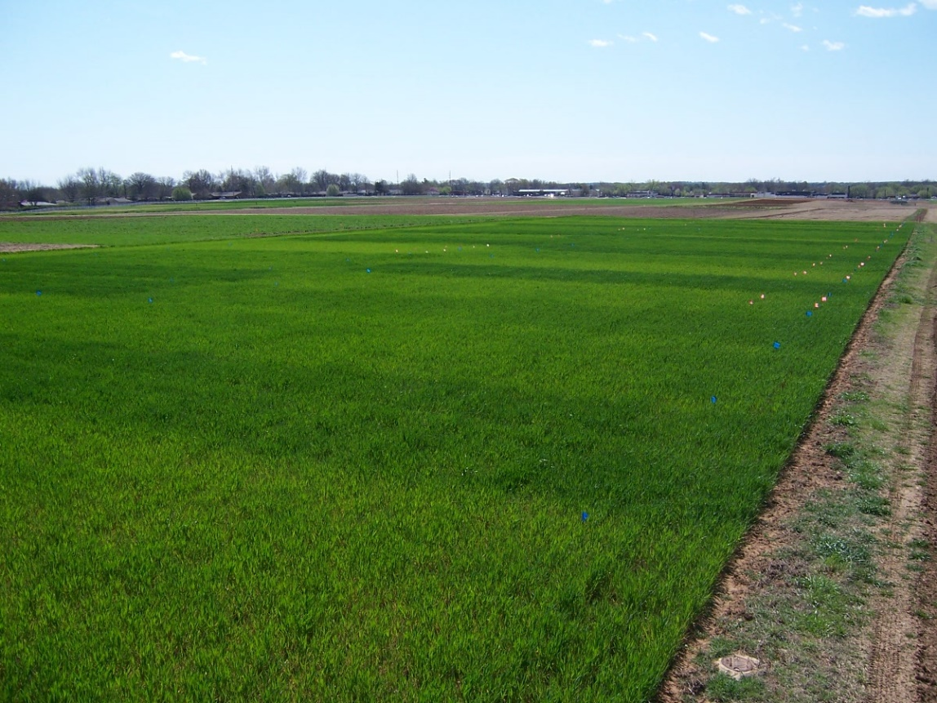
E₂₂₂

Slide 15
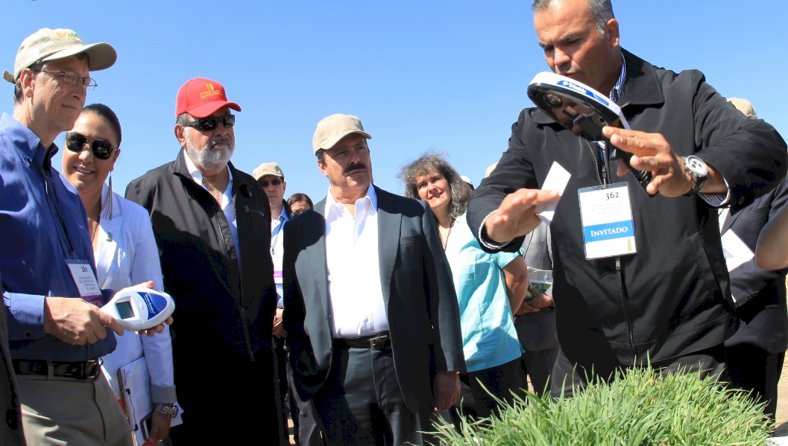
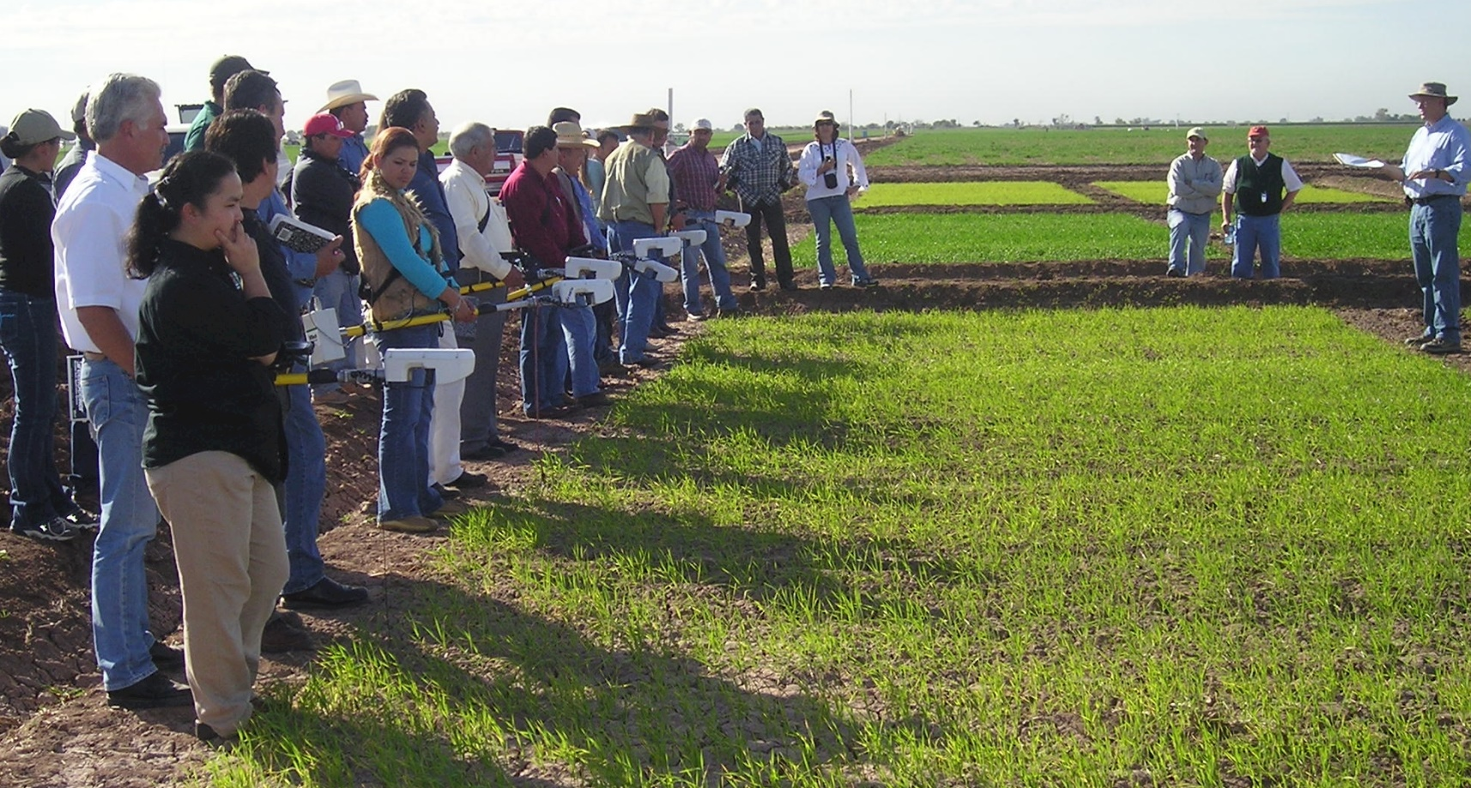

Slide 16
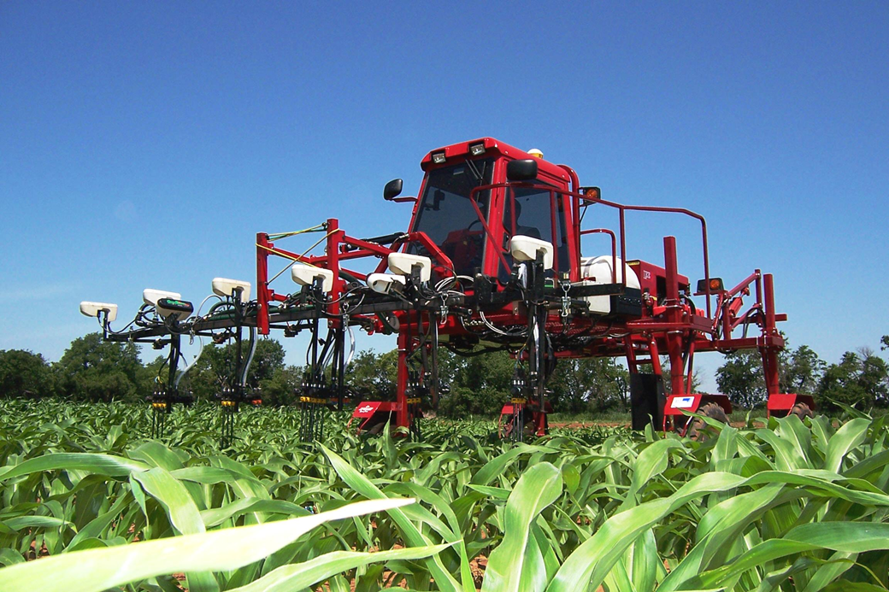
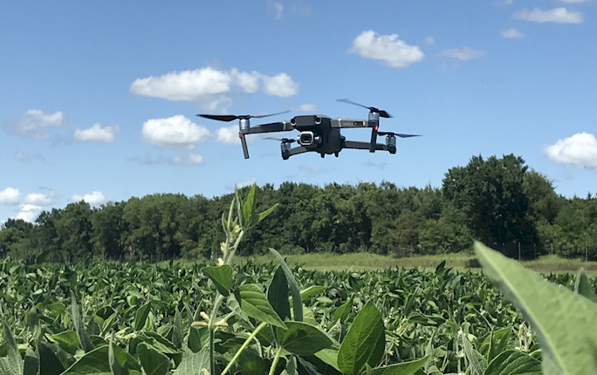
Increasing NUE, Proximal Sensing, Drones

Slide 18
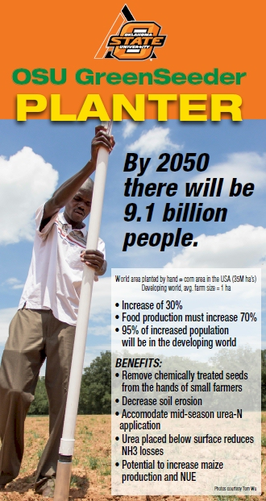
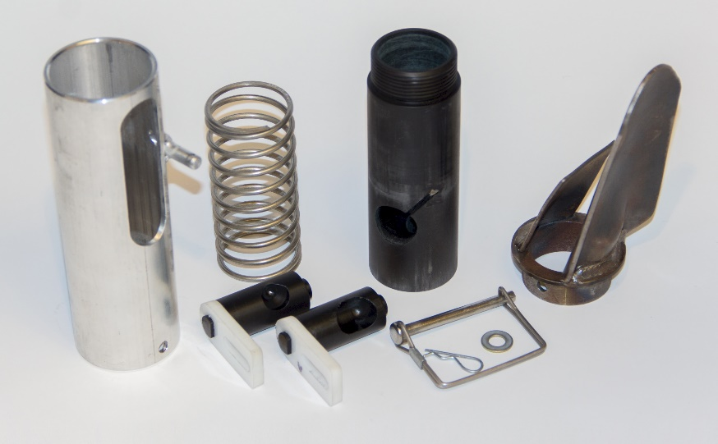
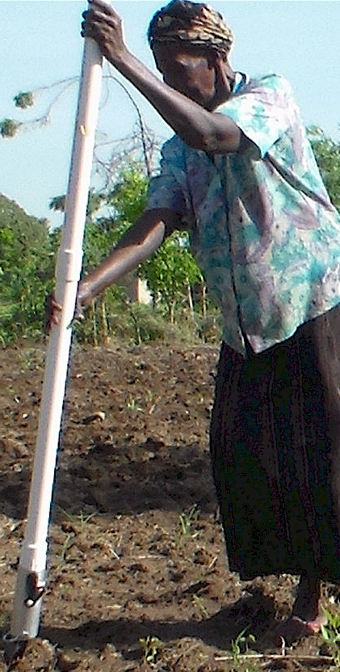
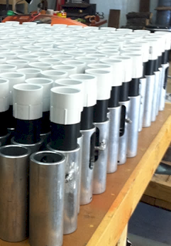
Drums

Slide 19
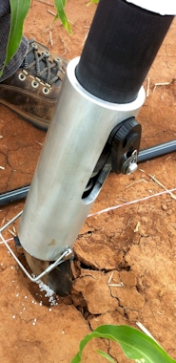
Benefits
Remove chemically treated seeds from the hands of small farmers
Decrease soil erosion via improved plant spacing
Accommodate mid-season application of urea-N
Place urea below the surface reducing NH3 losses
Potential to increase maize production and NUE
Khim et al. (2014). Over three sites, planting 1 seed, every 0.16m increased yields by an average of 1.15 Mg ha⁻¹ (range, 0.33 to 2.46 Mg ha⁻¹) when compared to the farmer practice of placing 2 to 3 seeds per hill, every 0.48 cm.

Slide 20
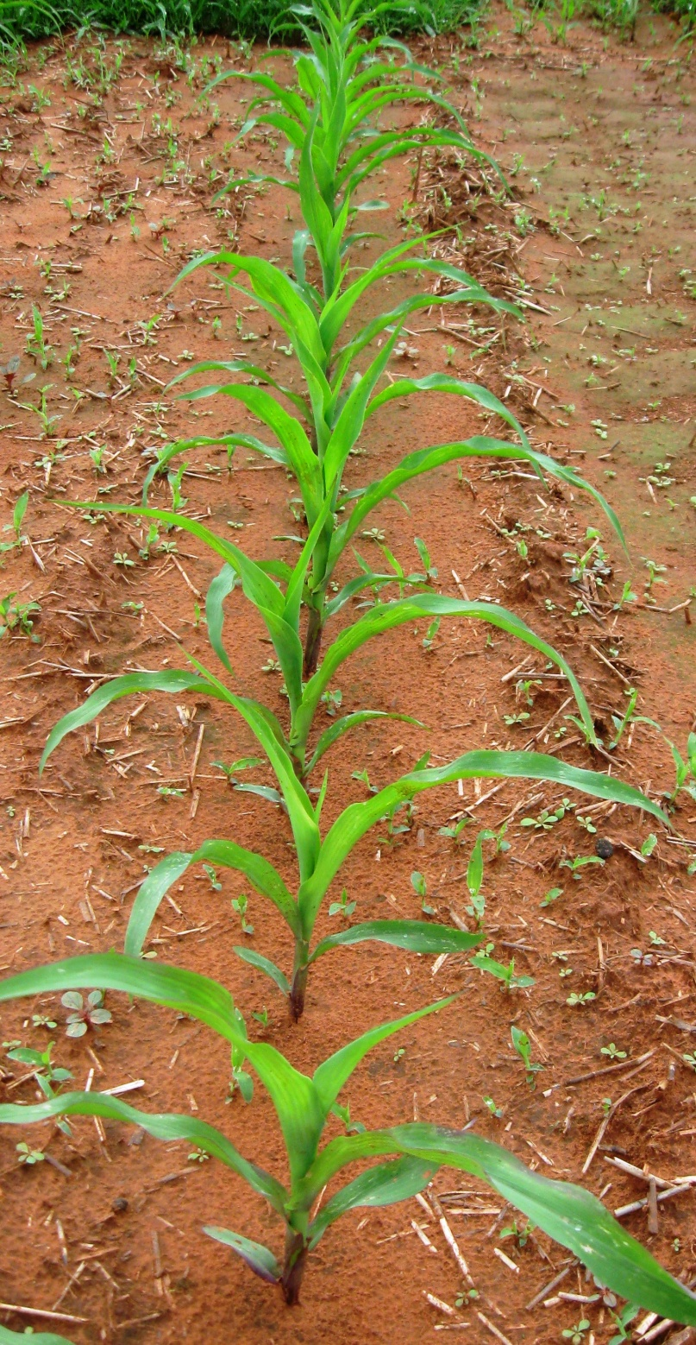
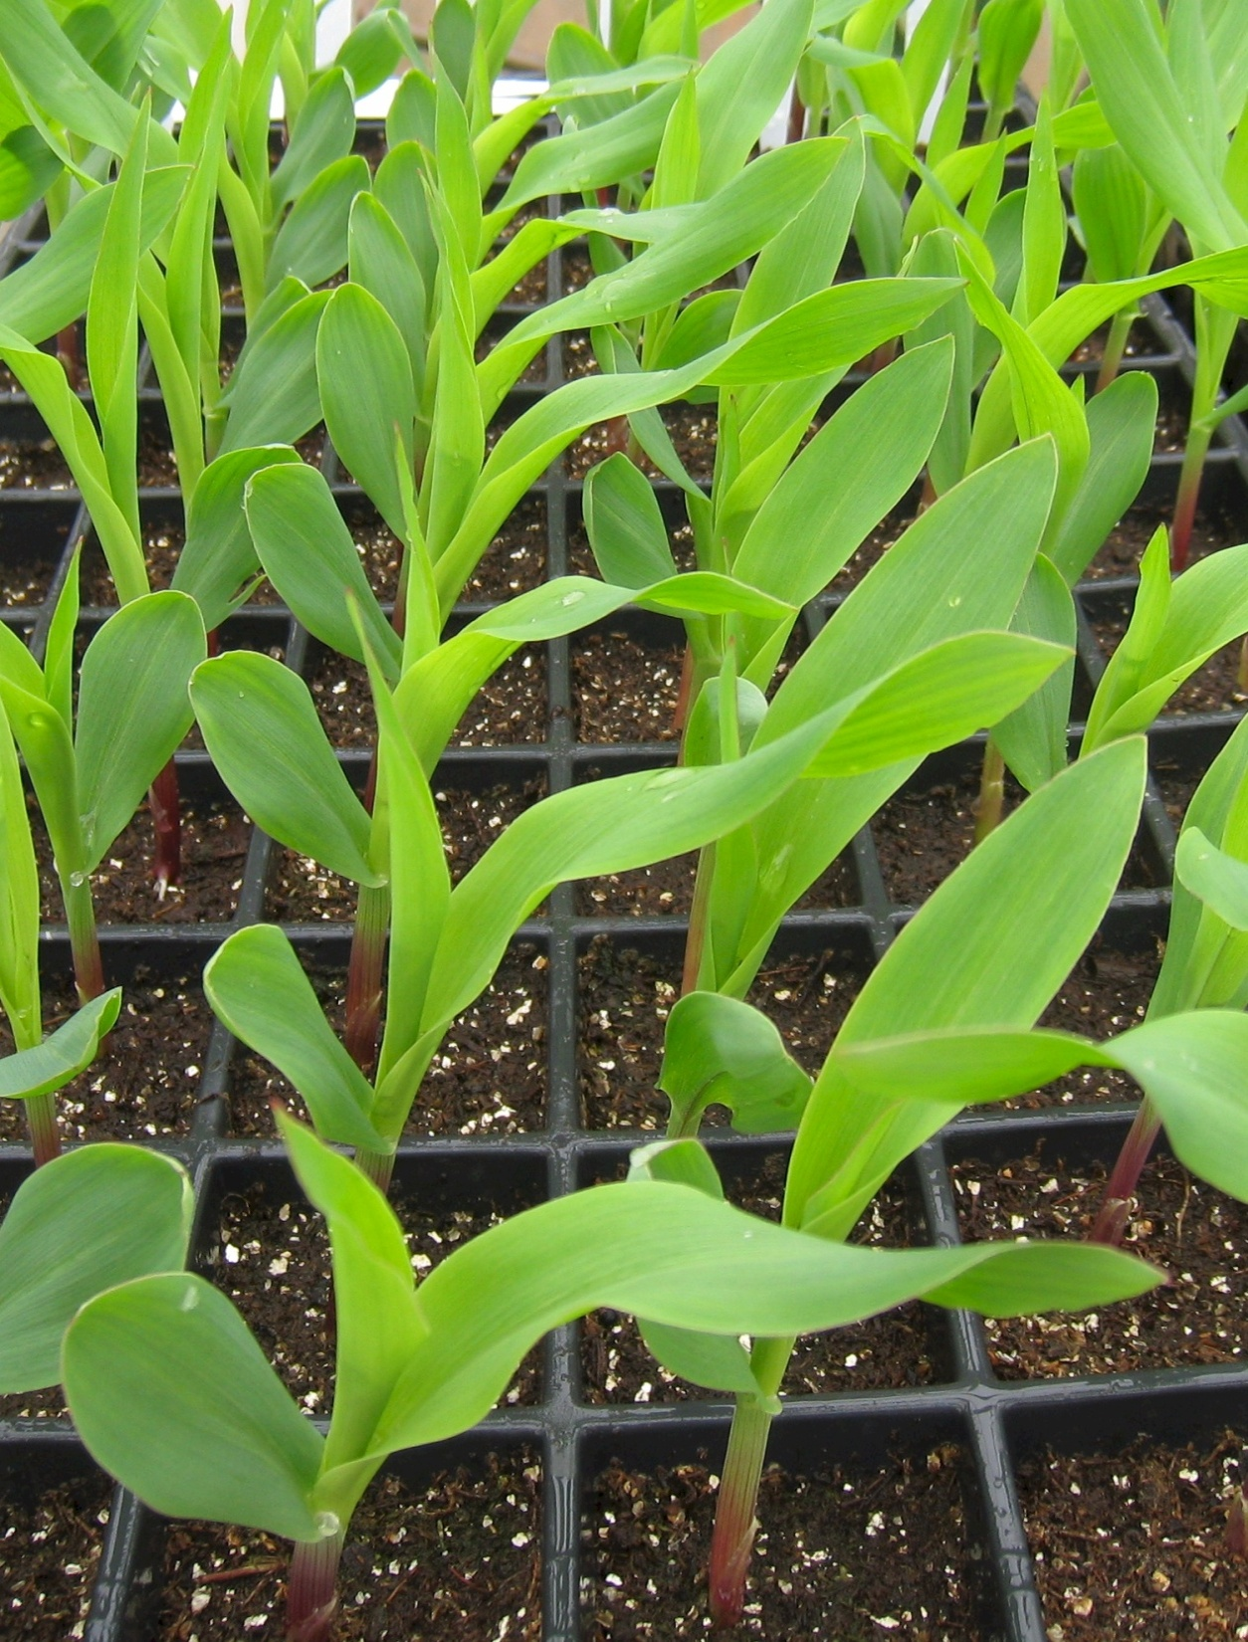

Slide 21
Fikayo Oyebiyi, PhD Student
Bruno Figuereido, Private Business, Brazil
Robert Lemings, Farmer, OK
Alimamy Fornah, Asst. Professor, Cameron State University Jagmandeep Dhillon, Asst. Professor, Mississippi State University

Slide 22
“With great power comes great responsibility” Uncle Ben to Spider Man
“The Price of Greatness is Responsibility” Winston Churchill
"In a democratic world, as in a democratic Nation, power must be linked with responsibility... .“ Franklin Roosevelt
“Much will be required of the person entrusted with much and still more will be demanded of the person entrusted with more.” (Luke 12:48)

