Slide 1
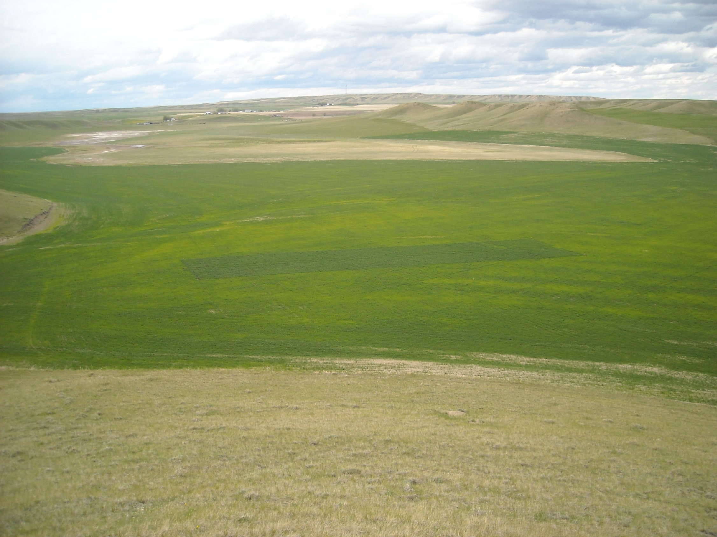




The Future of Sensor Based Agriculture
Theory/OSU Approach
Institutional memory (Dr. Tucker, Dr. Westerman, 222, 502, Magruder)
Independence of yield potential and RI
Extensive variability in optimum N rates, year to year and location to location
Randomness is increasing
2nd law of thermodynamics (entropy increases with time and is irreversible), biological systems are expected to become more and more random with time.
Environment, Mathematical
Roger Bray’s
Mobility Concept
R.A. Olson
Long Term Trials
John Solie, Marvin Stone, Robert Westerman, Ivan Ortiz Monasterio, Kyle Freeman, Brian Arnall, Bill Raun

Slide 2
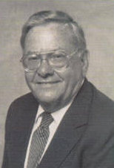

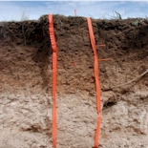
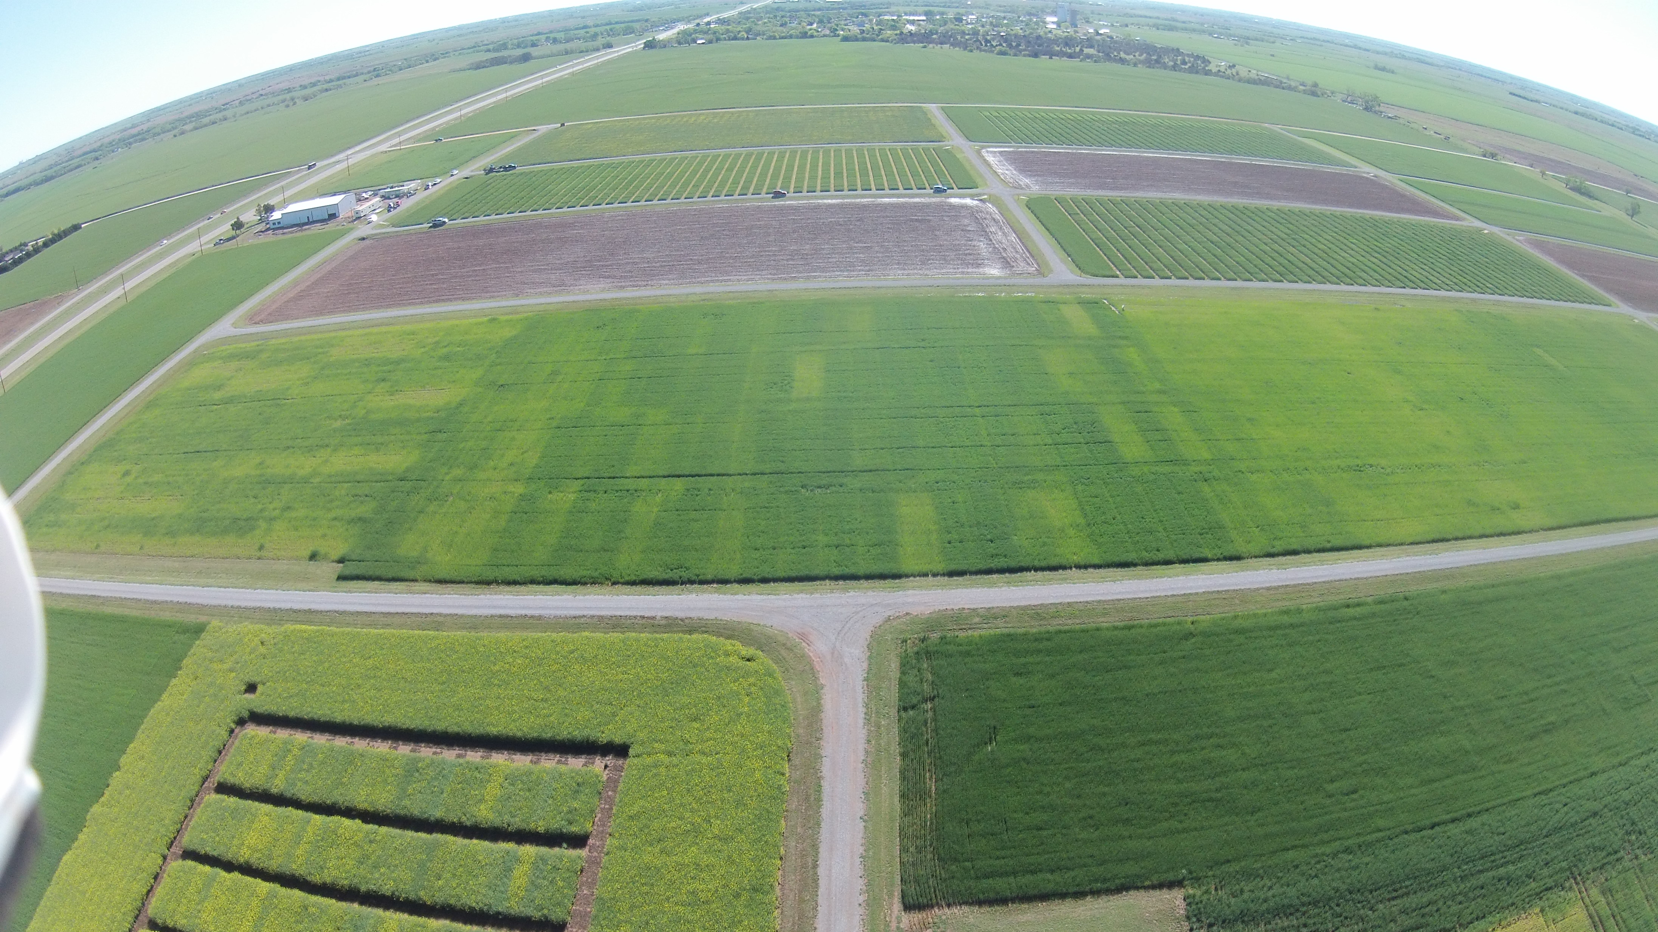

Wheat Fertility Experiment No.502
North Central Experiment Station
Established 1970
Location: Lahoma
TRT | Pre-plant N rate (lb N / ac) | Pre-plant P rate (lb P₂O₅ / ac) | Pre-plant K rate (lb K₂O / ac)
1.* | 0 | 0 | 0
2.* | 0 | 40 | 60
3.* | 20 | 40 | 60
4.* | 40 | 40 | 60
5.* | 60 | 40 | 60
6.* | 80 | 40 | 60
7.* | 100 | 40 | 60
8. | 60 | 0 | 60
9. | 60 | 20 | 60
10. | 60 | 60 | 60
11. | 60 | 80 | 60
12. | 60 | 60 | 0
13. | 100 | 80 | 60
14. | 60 | 40 | 60 (Sul-Po-Mag)
N applied as 46-0-0 (Urea) P applied as 0-46-0 (Triple Super Phosphate) K applied as 0-0-60 (Potash) * - YP plot
Grant silt loam (fine-silty, mixed, superactive, thermic, Udic Argiustoll
Plot size: 16’ x 60’
Alley: 20’
Total Trial Area: 224’ x 300’
W
S
N
E
OBJECTIVE: To study fertilizer nitrogen, phosphorus, and potassium in winter wheat. In recent years, this study has also been used to develop yield potential models and yield predictions through sensor based technologies.
1, 2 – Harvest Sequence Number
1, 2 – Treatment Number
1 , 2 – Soil Sample Sequence Number
 | 300 | 4 | 5 | 12 | 13 | 20 | 21 | 28 | 29 | 36 | 37 | 44 | 45 | 52 | 53
Rep 4 |  | 3 | 5 | 13 | 6 | 10 | 2 | 4 | 7 | 12 | 1 | 8 | 14 | 9 | 11
 | 240 | 43 | 44 | 45 | 46 | 47 | 48 | 49 | 50 | 51 | 52 | 53 | 54 | 55 | 56
 | 220 | 3 | 6 | 11 | 14 | 19 | 22 | 27 | 30 | 35 | 38 | 43 | 46 | 51 | 54
Rep 3 |  | 1 | 14 | 2 | 7 | 11 | 3 | 9 | 12 | 5 | 13 | 4 | 8 | 10 | 6
 | 160 | 29 | 30 | 31 | 32 | 33 | 34 | 35 | 36 | 37 | 38 | 39 | 40 | 41 | 42
 | 140 | 2 | 7 | 10 | 15 | 18 | 23 | 26 | 31 | 34 | 39 | 42 | 47 | 50 | 55
Rep 2 |  | 4 | 8 | 3 | 1 | 11 | 13 | 12 | 7 | 14 | 6 | 9 | 10 | 2 | 5
 | 80 | 15 | 16 | 17 | 18 | 19 | 20 | 21 | 22 | 23 | 24 | 25 | 26 | 27 | 28
 | 60 | 1 | 8 | 9 | 16 | 17 | 24 | 25 | 32 | 33 | 40 | 41 | 48 | 49 | 56
Rep 1 |  | 8 | 2 | 4 | 6 | 14 | 9 | 10 | 5 | 7 | 12 | 1 | 3 | 13 | 11
 |  | 1 | 2 | 3 | 4 | 5 | 6 | 7 | 8 | 9 | 10 | 11 | 12 | 13 | 14
 | 0 | 16 | 32 | 48 | 64 | 80 | 96 | 112 | 128 | 144 | 160 | 176 | 192 | 208 | 224
1970

Slide 3
Refereed Journal Publications coming from Experiment 502

Slide 4
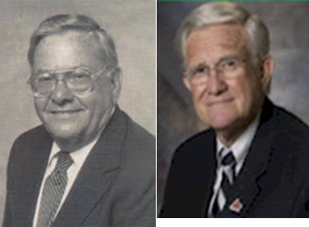
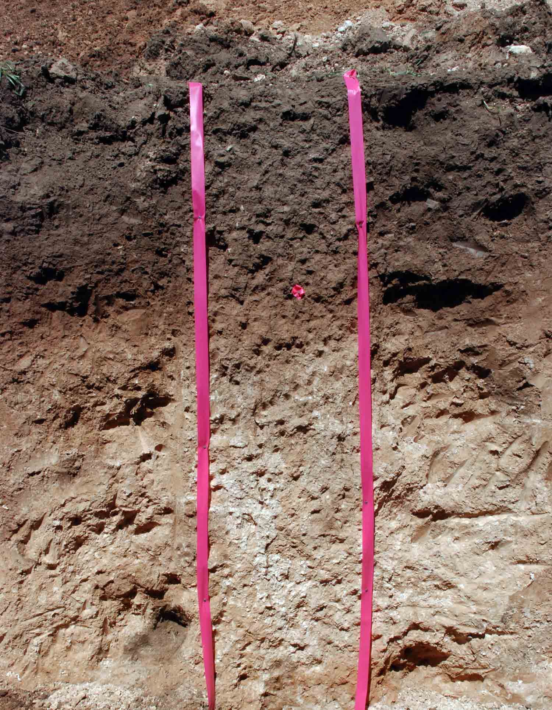
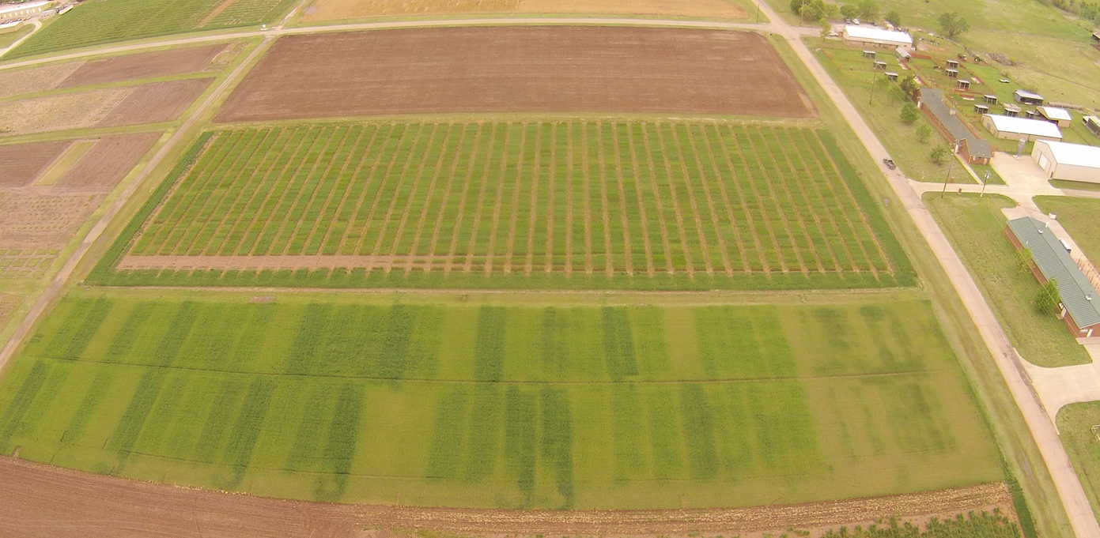
Wheat Fertility Experiment No.222
Agronomy Research Station
Established 1969
Kirkland silt loam (fine, mixed, thermic, Udertic Paleustoll
Location: Stillwater
TRT | Pre-plant N rate (lb N / ac) | Pre-plant P rate (lb P₂O₅ / ac) | Pre-plant K rate (lb K₂O / ac)
1.* | 0 | 60 | 40
2.* | 40 | 60 | 40
3.* | 80 | 60 | 40
4.* | 120 ^ | 60 | 40
5. | 80 | 0 | 40
6. | 80 | 30 | 40
7. | 80 | 90 | 40
8. | 80 | 60 | 0
9. | 80 | 60 | 80
10.* | 0 | 0 | 0
11. | 120 ^ | 90 | 80
12. | 120 ^ | 90 | 0
13. | 80 | 60 | 40 (Sul-Po-Mag)
N applied as 46-0-0 (Urea) P applied as 0-46-0 (Triple Super Phosphate) K applied as 0-0-60 (Potash) * - YP plot ^ - Split 120 lb N rates to 60 lb N (fall) and 60 lb N (spring)
Plot size: 20’ x 60’
Alley: 17’
Total Trial Area: 137’ x 520’
E
N
S
W
OBJECTIVE: To study fertilizer nitrogen, phosphorus, and potassium in winter wheat. In recent years, this study has also been used to develop yield potential models and yield predictions through sensor based technologies.
1, 2 – Harvest Sequence Number
1, 2 – Treatment Number
1 , 2 – Soil Sample Sequence Number
137 | 52 | 49 | 48 | 45 | 44 | 41 | 40 | 37 | 36 | 33 | 32 | 29 | 28 | 25 | 24 | 21 | 20 | 17 | 16 | 13 | 12 | 9 | 8 | 5 | 4 | 1
 | 13 | 13 | 8 | 5 | 7 | 3 | 2 | 11 | 12 | 6 | 9 | 1 | 10 | 4 | 6 | 2 | 11 | 5 | 3 | 8 | 12 | 10 | 9 | 1 | 7 | 4
77 | 26 | 25 | 24 | 23 | 22 | 21 | 20 | 19 | 18 | 17 | 16 | 15 | 14 | 13 | 12 | 11 | 10 | 9 | 8 | 7 | 6 | 5 | 4 | 3 | 2 | 1
 | Rep 2 | Rep 1 | Rep 2 |  |  |  |  |  |  |  |  |  |  |  | Rep 1
60 | 51 | 50 | 47 | 46 | 43 | 42 | 39 | 38 | 35 | 34 | 31 | 30 | 27 | 26 | 23 | 22 | 19 | 18 | 15 | 14 | 11 | 10 | 7 | 6 | 3 | 2
 | 13 | 13 | 8 | 10 | 7 | 12 | 9 | 5 | 2 | 11 | 1 | 3 | 4 | 6 | 3 | 11 | 1 | 8 | 6 | 9 | 12 | 2 | 5 | 10 | 4 | 7
0 | 52 | 51 | 50 | 49 | 48 | 47 | 46 | 45 | 44 | 43 | 42 | 41 | 40 | 39 | 38 | 37 | 36 | 35 | 34 | 33 | 32 | 31 | 30 | 29 | 28 | 27
 | Rep 4 | Rep 3 | 60 | 80 | 100 | 120 | 140 | 160 | 180 | 200 | 220 | 240 | 260 | 280 | 300 | 320 | 340 | 360 | 380 | 400 | 420 | 440 | 460 | 480 | 500 | 520
 |  |  | Rep 4 |  |  |  |  |  |  |  |  |  |  |  | Rep 3
1969

Slide 5



YP0
N Rate
Randomness
GDD
Environment Metric
YP0 (yield potential)
GDD (growing degree days)
RI (response index, N Rich Strip)
YPN (yield possible with added N)
N rate (N uptake YPN- N uptake YP0)/efficiency factor
Independence of YP0 and RI (need independent estimates)
Variability in N rates over time/location
Increased Randomness with time
Soil Moisture at the time of NDVI sensing
Inclusion of mathematical Metric for environment
Soil Moisture
RI
Highly variable N rates
Independence of YP0 and RI

Slide 6
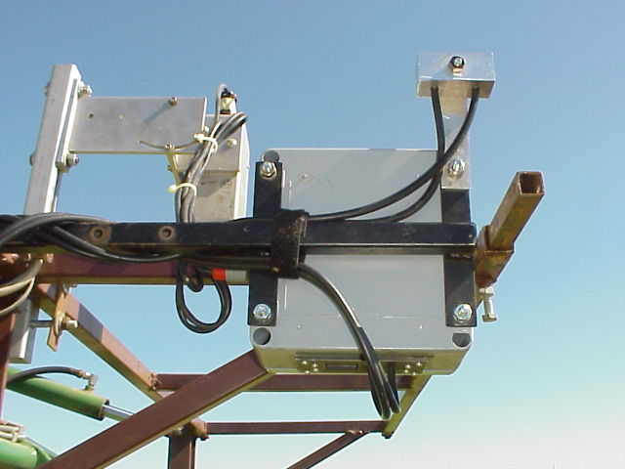

Passive Sensor Accounting for Incident Light
1994

Slide 7
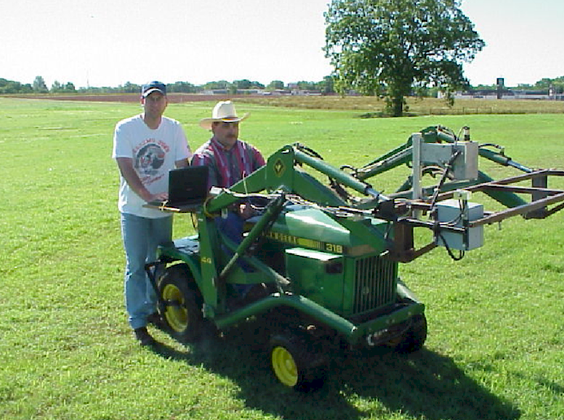
Passive Sensor Accounting for Calibrated Incident Light
1994
Notes:
Here is the optical sensor we used. It’s mounted on a John Deere tractor. It measures both solar irradiance and plant surface reflectance.

Slide 8
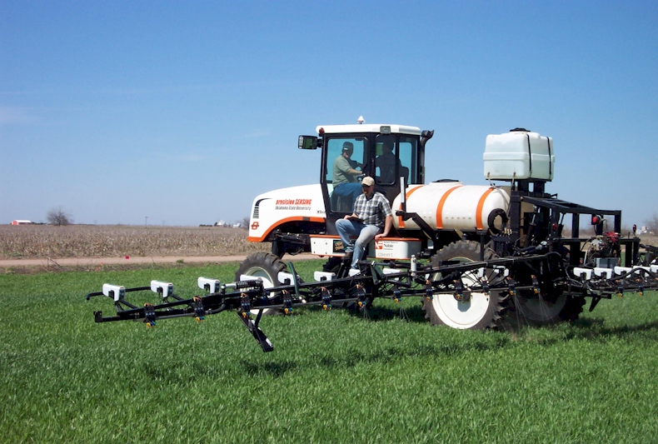


Active sensing/fertilizing,
2001
precision SENSING

Slide 9

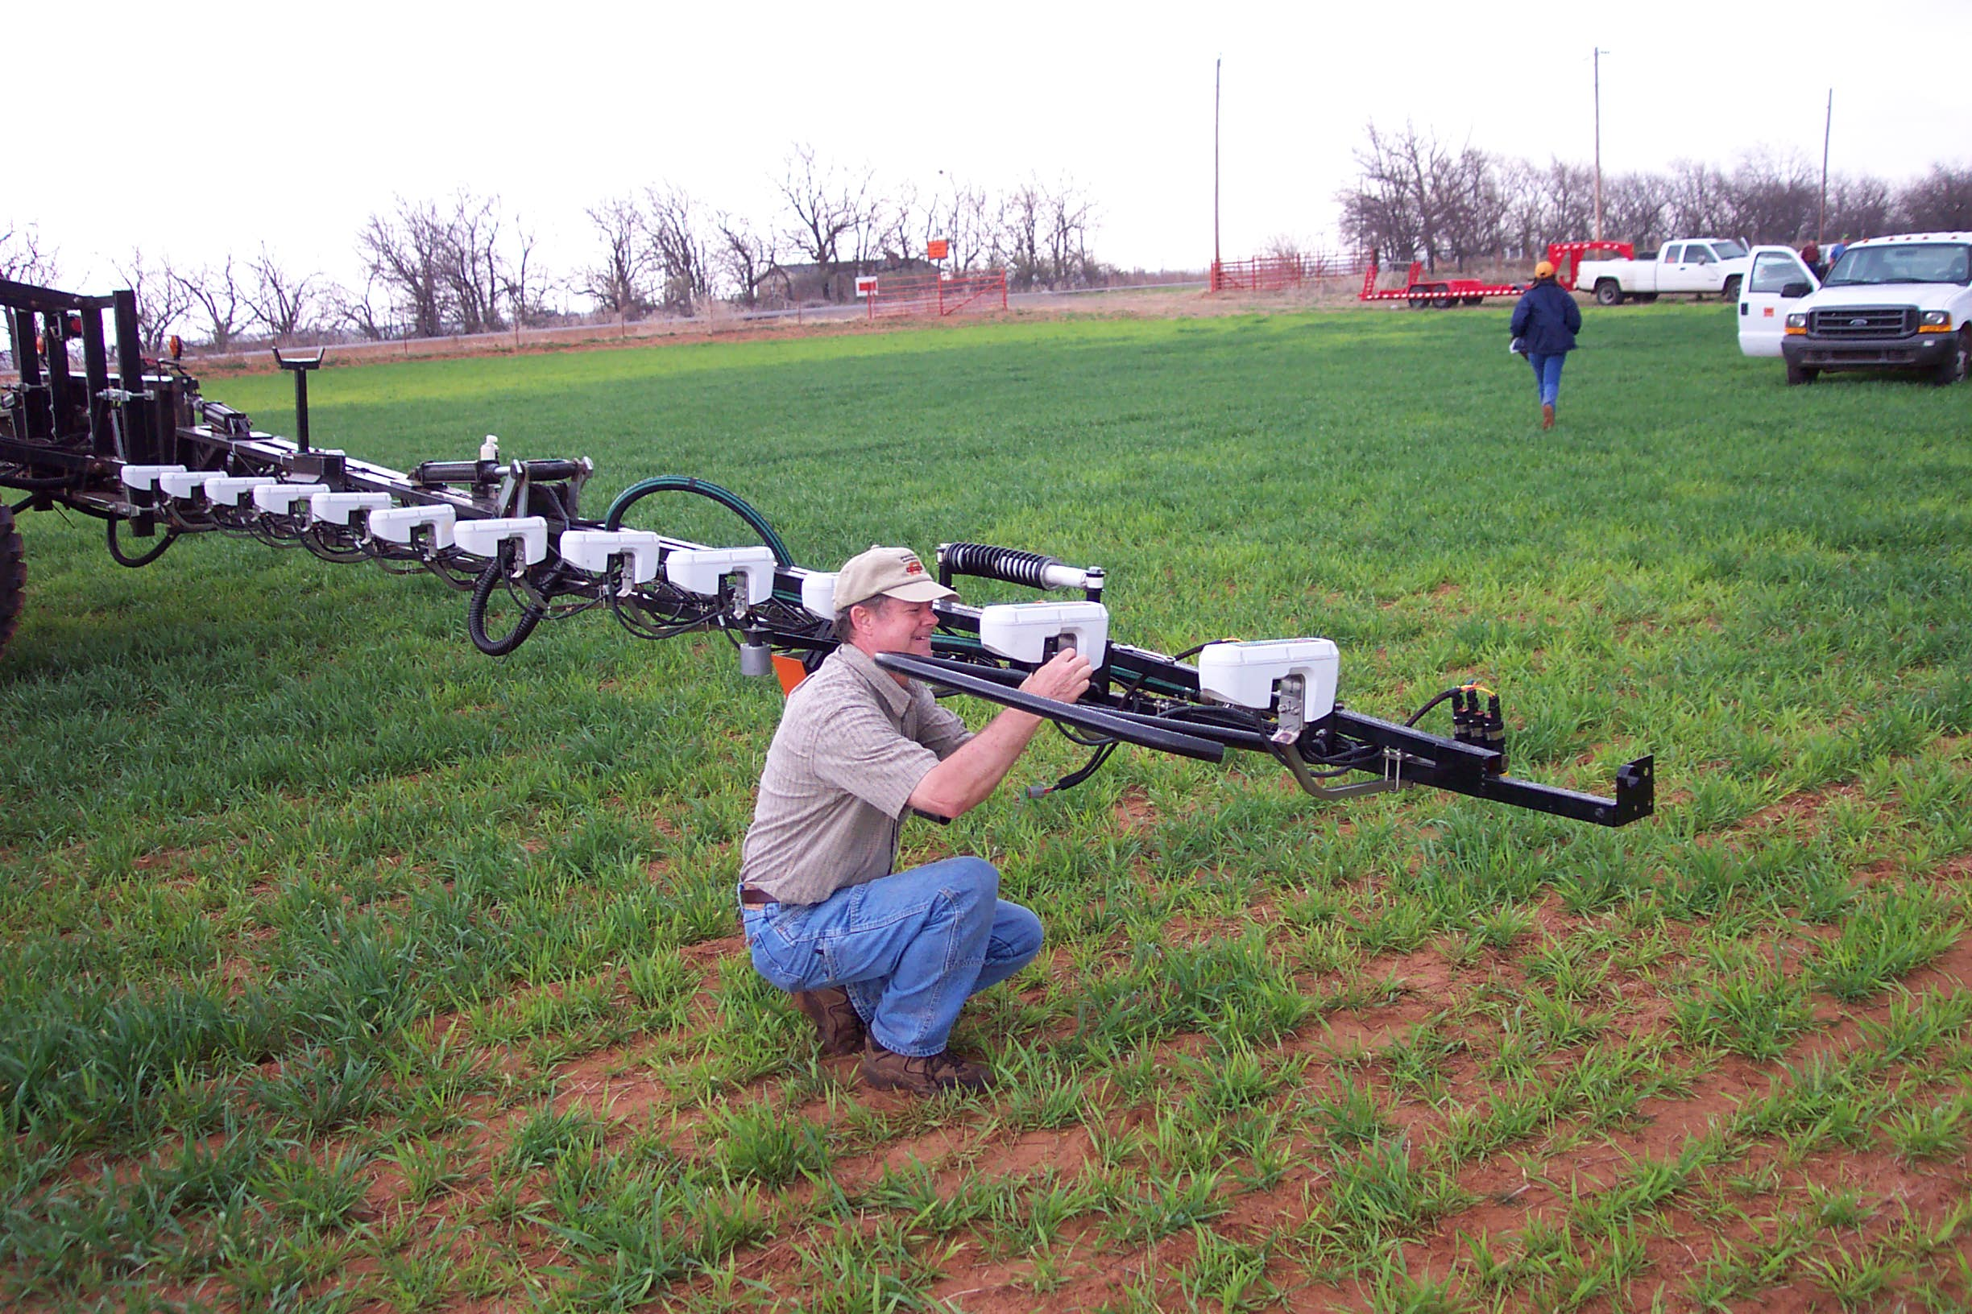

Slide 10
If Yield Goals (YG) Worked ?
YG, 60 bu/ac, 2 lb N/bu = 120 lbs N preplant
=60 bu/ac * 60 lbs/bu = 3600 lbs/ac
Percent N in wheat grain = 2.39
lbs of N removed in 60 bu = 3600*0.0239 = 86 lbs N
N removed in cereals coming from the soil and that deposited in rainfall (50% of the total, AJ, 91:357-363)
86*0.5 = 43 lbs N coming from the fertilizer
43/120 = 0.35 (NUE)
%N * 5.7 = protein (2.39 * 5.7 = 13.6)

Slide 11
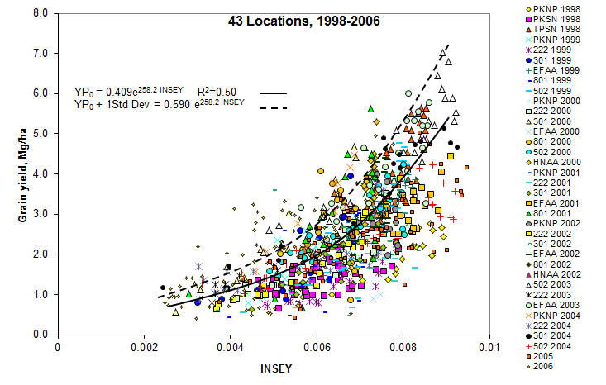
Yield Prediction (YP0) using NDVI and days from planting to sensing where growth was possible (40F threshold). Biomass/day

Slide 12
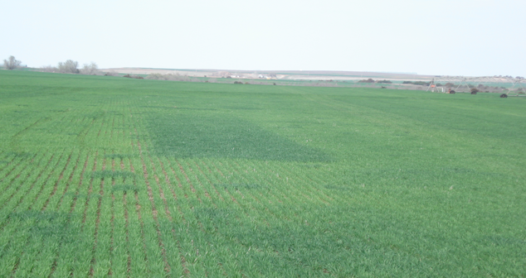
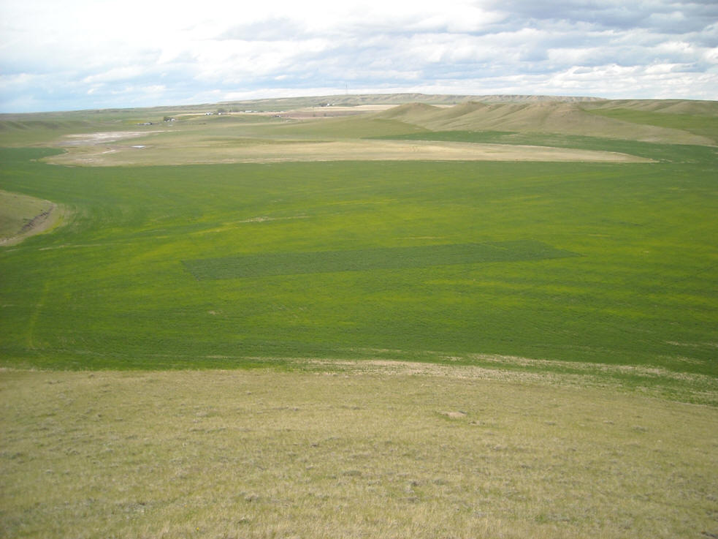
2X Strip
N Reference Strip
N Rich Strip

Slide 13
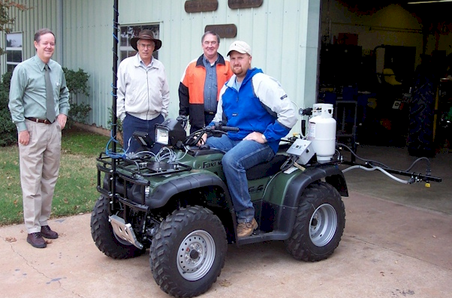
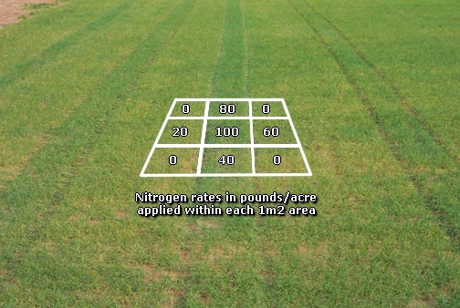
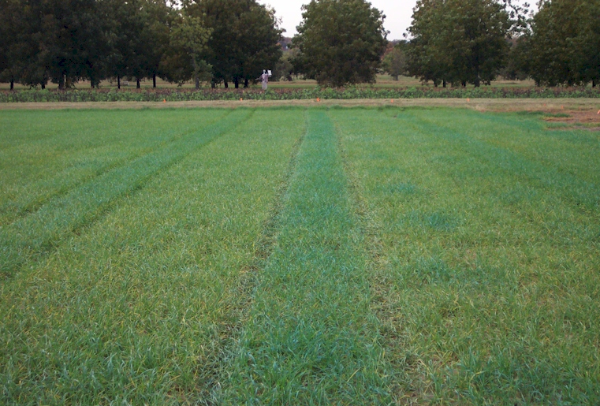
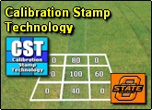
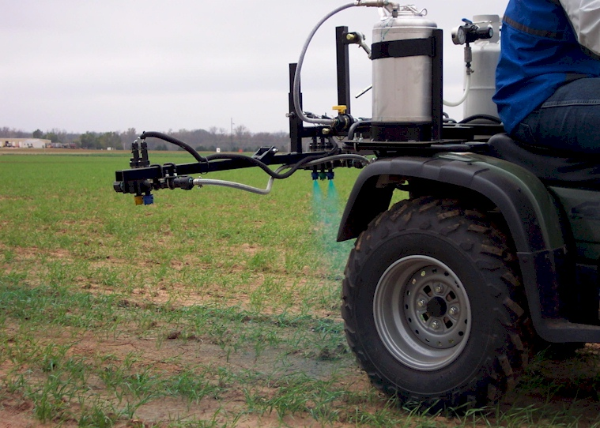
2005. Automated calibration stamp technology for improved in-season nitrogen fertilization. Agron. J. 97:338-342.
N Calibration Stamp 2003

Slide 14
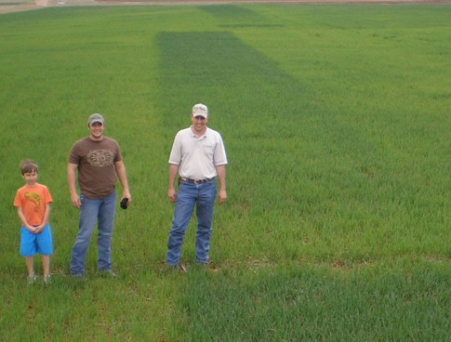
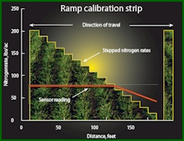
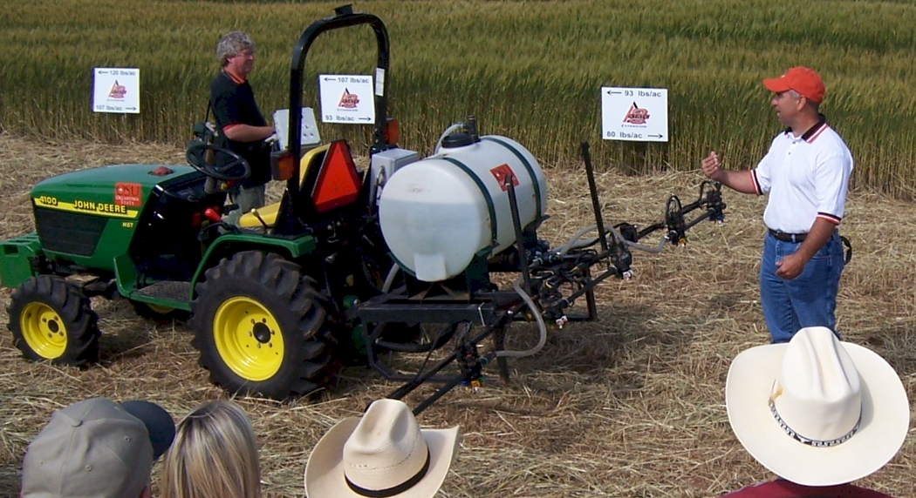
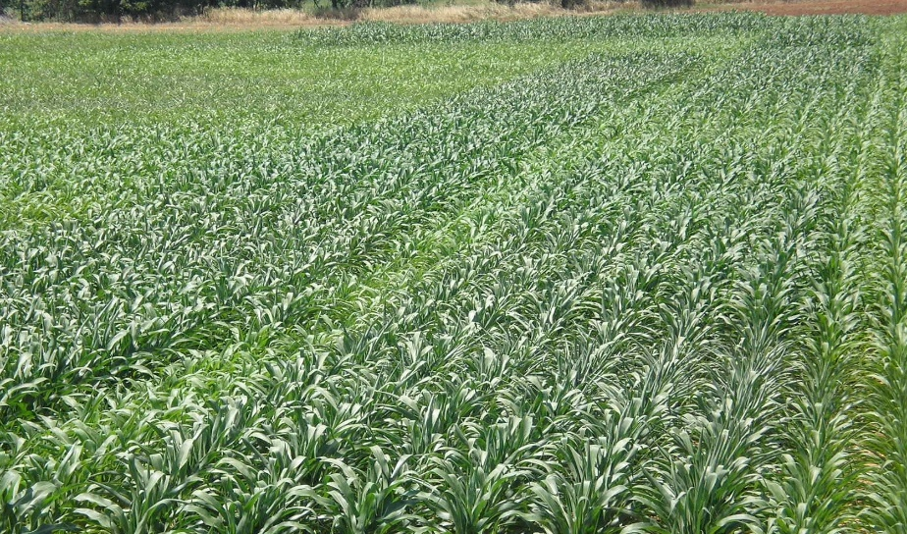
2008. Ramp calibration strip technology for determining mid-season N rates in corn and wheat. Agron. J. 100:1088-1093.
Ramp Calibration Strip, 2004

Slide 15
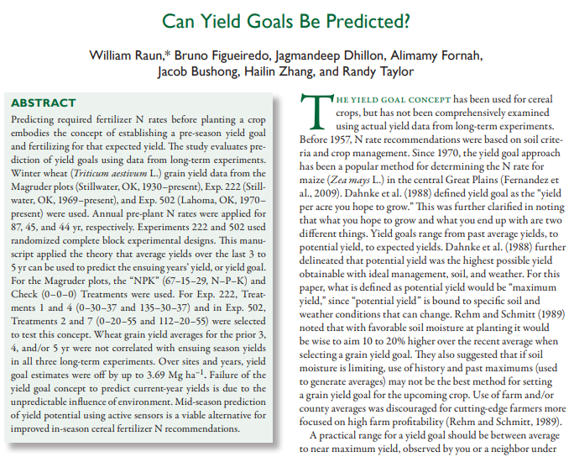
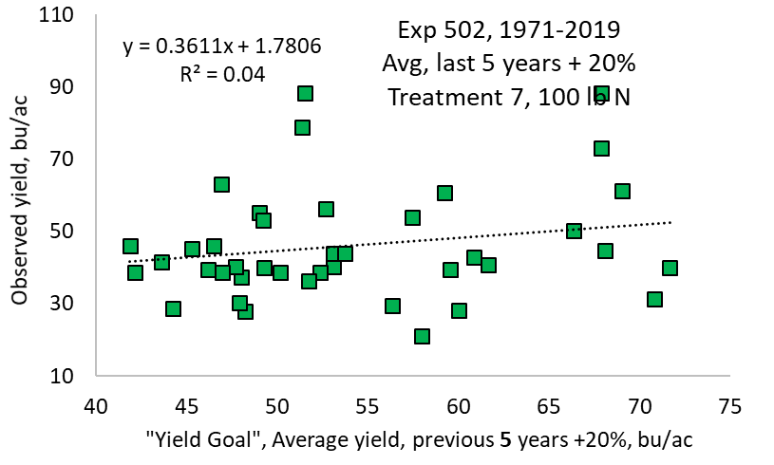
Raun, W.R., B. Figueiredo, J. Dhillon, J.T. Bushong, R.K. Taylor, H. Zhang, A. Fornah. 2017. Can yield goals be predicted? Agron. J. 109(5) DOI: 10.2134/agronj2017.05.0279

Slide 16
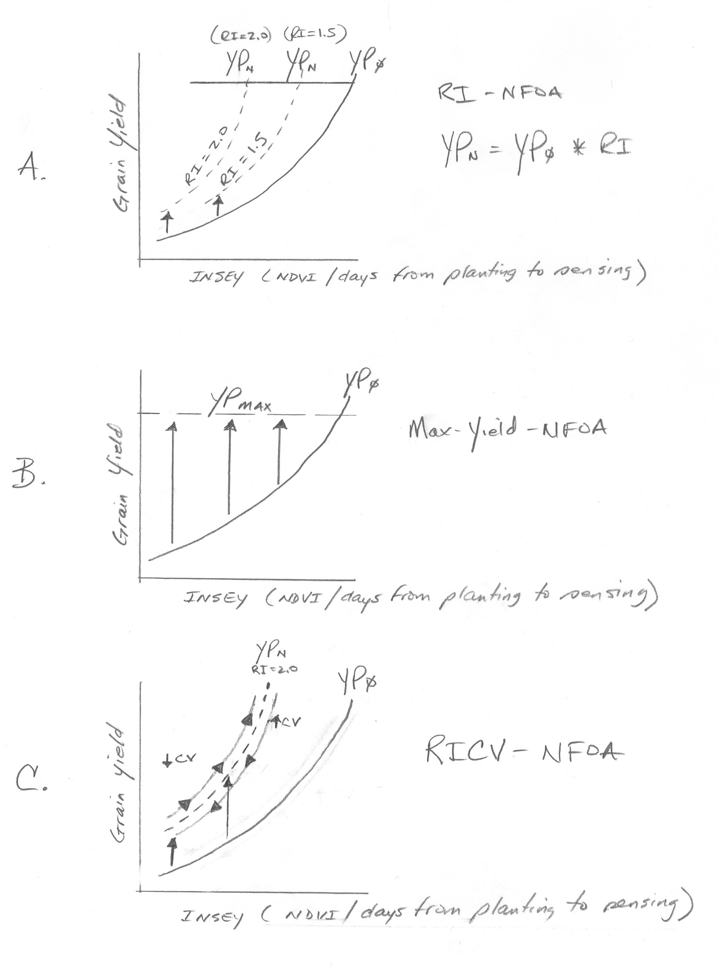
OSU Algorithm

Slide 17
33% NUE
After five years, 27 to 33% of the applied fertilizer N had been removed by the grain (Olson and Swallow, SSSAJ, 48:583-586)
Worldwide NUE for cereal production (wheat, corn, rice, barley, sorghum, oats, rye) 33% (Raun and Johnson, AJ, 91:357-363).
Following 109 years, estimate of nitrogen use efficiency (NUE) (N removed in the grain, minus N removed in the grain of the Check plots, divided by the rate of N applied) was 32.8%. (Magruder Plots)
http://www.nue.okstate.edu/N_Fertilizers/NUE_definition.html

Slide 18
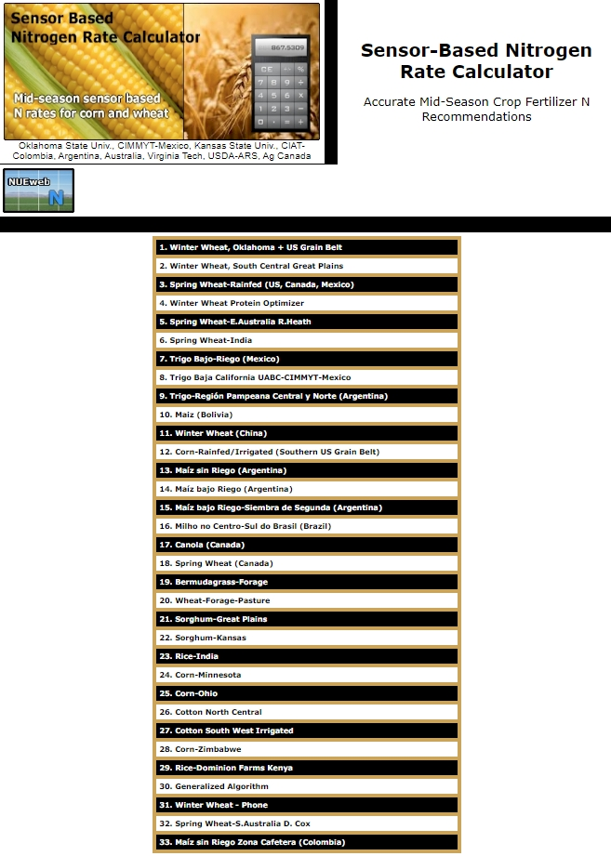
SBNRC
on Line Since 2002
www.nue.okstate.edu
33 Options

Slide 19
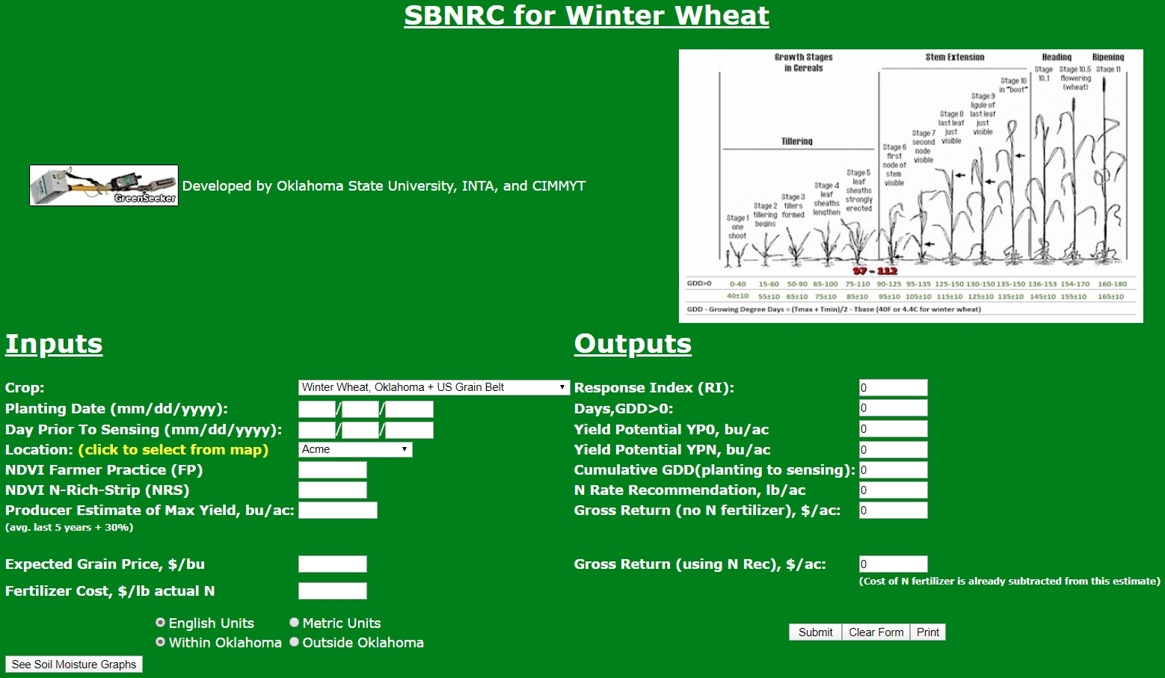
33 on-line options
2002 - 2019
X

Slide 20
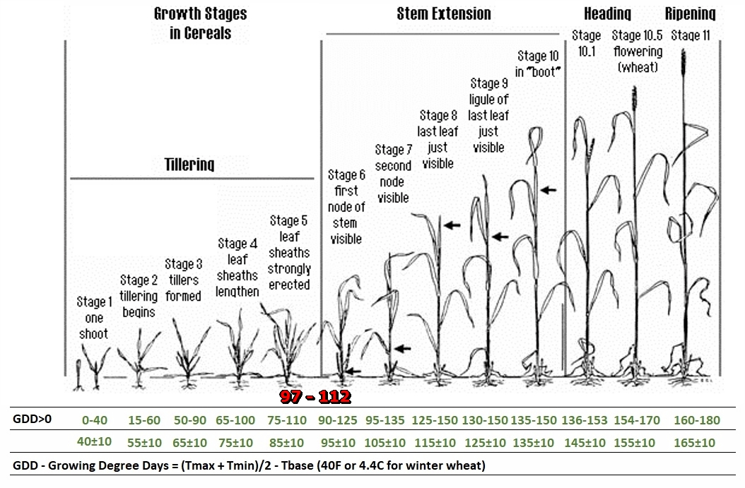

Slide 21
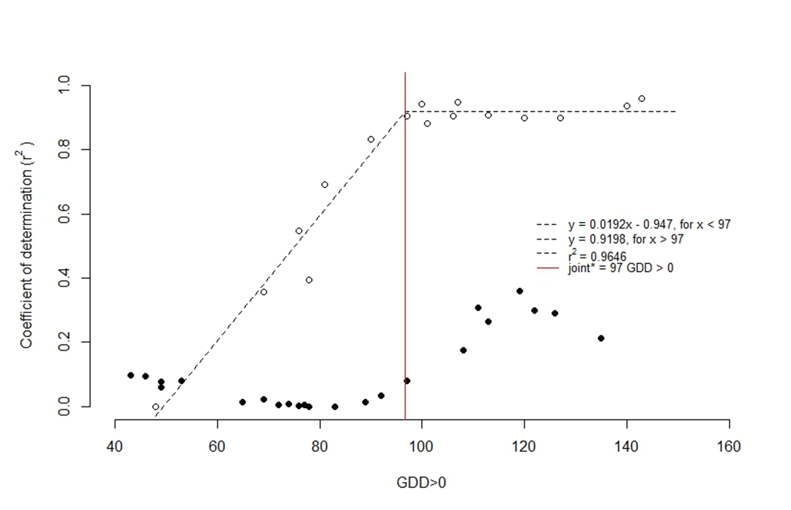
Kyle Freeman
Jeremiah Mullock
Bruno Figueiredo
Jagmandeep Dhillon
Melissa Golden
Correlation of NDVI versus winter wheat grain yield, for readings collected over the season where the number of days from planting to sensing (GDD>0) ranged from 48 to 143. GDD computed as (Tmin+Tmax)/2 – 4.4°C, Experiment 502, Lahoma, OK, 2016 and 2017. dots, not used for 2018

Slide 22
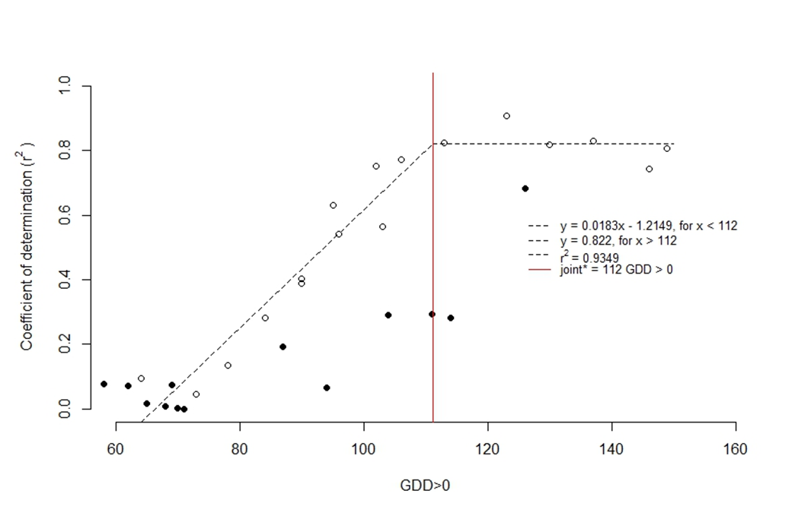
Correlation of NDVI versus winter wheat grain yield, for readings collected over the season where the number of days from planting to sensing (GDD>0) ranged from 64 to 149. GDD computed as (Tmin+Tmax)/2 – 4.4°C, Experiment 222, Stillwater, OK, 2016 and 2017. dots not used for 2018

Slide 23
Averaged over three years and two sites, the optimum GDD>0 needed to accurately predict yield potential was between 97 and 112.
Using GDD>0 as a numeric metric to delineate the best time/date to collect NDVI readings can then be used to prescribe mid-season fertilizer rates using established algorithms.
Having numeric limits that surround in-season, GDD>0 data, is of value, and that would eliminate the use of highly subjective morphological scales. Critical GDD>0 values from the Oklahoma Mesonet can then be accessed on a day-to-day, by-location basis for in-season producer use.
Optimum N rate is becoming more and more variable/random with time

Slide 24
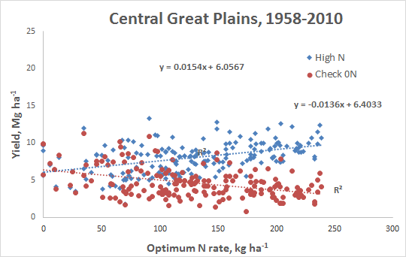
Extreme Variability in Optimum N Rates
Dhital, S., and W. R. Raun. 2016. Variability in Optimum Nitrogen Rates for Maize. Agron. J. 108:2165-2173. doi:10.2134/agronj2016.03.0139

Slide 25

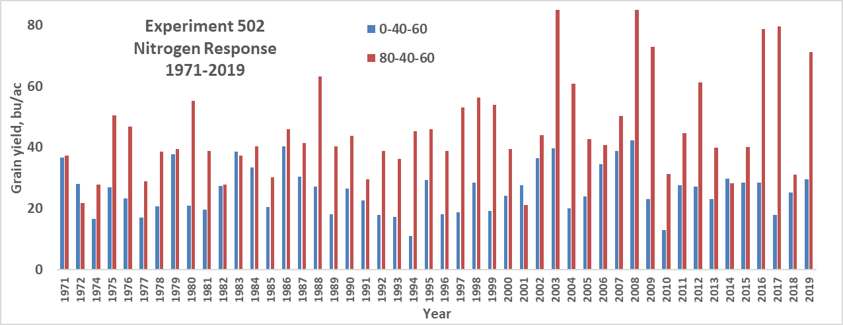
Experiment 502
Lahoma, OK

Slide 26
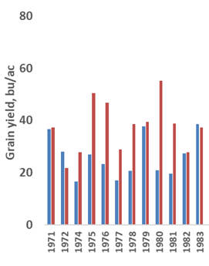
Experiment 502
Lahoma, OK

Slide 27
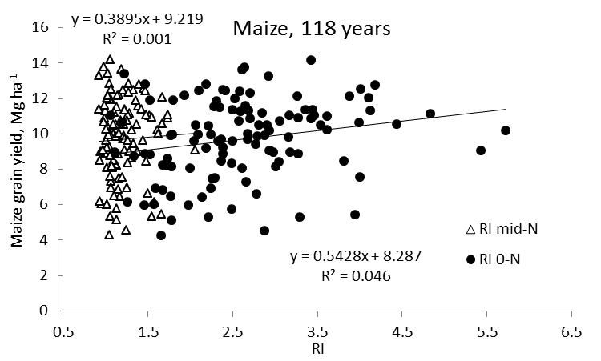
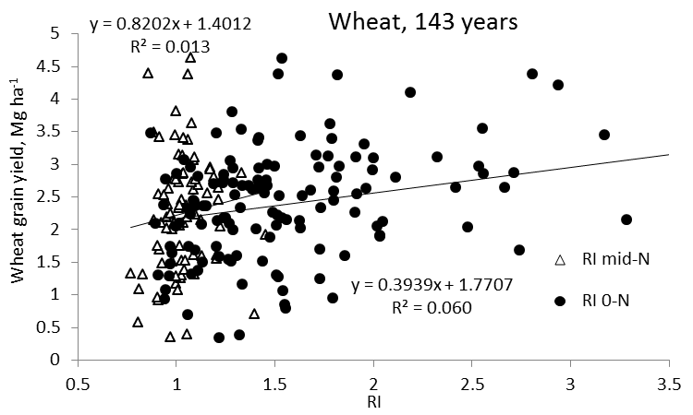
Independence of Yield potential and Nitrogen response
Iowa
Nebraska
Wisconsin
Oklahoma
2013. Relationship between grain crop yield potential and nitrogen response. Agron. J. 105:1335–1344.
Independence of yield potential and crop nitrogen response. Precision Agric. 12:508-518.

Slide 28
Second law of thermodynamics states that entropy or randomness in a given system will increase with time
More and more biological processes have been found to be independent
Independence of yield potential (YP0) and nitrogen (N) response
Each year, residual N in the soil following crop harvest is different
Yield levels change radically from year to year (unpredictable/random environment
Contribution of residual soil N for next years’ growing crop randomly influences N response or the response index (RI)
Biological systems are expected to become increasingly random with time
Range of different biological parameters will influence YP0 and RI in an unrelated manner
Unpredictable nature that environment has on N demand, and the unpredictable nature that environment has on final grain yield, dictate the need for independent estimation of multiple random variables that will be used in mid-season biological algorithms of the future

Slide 29
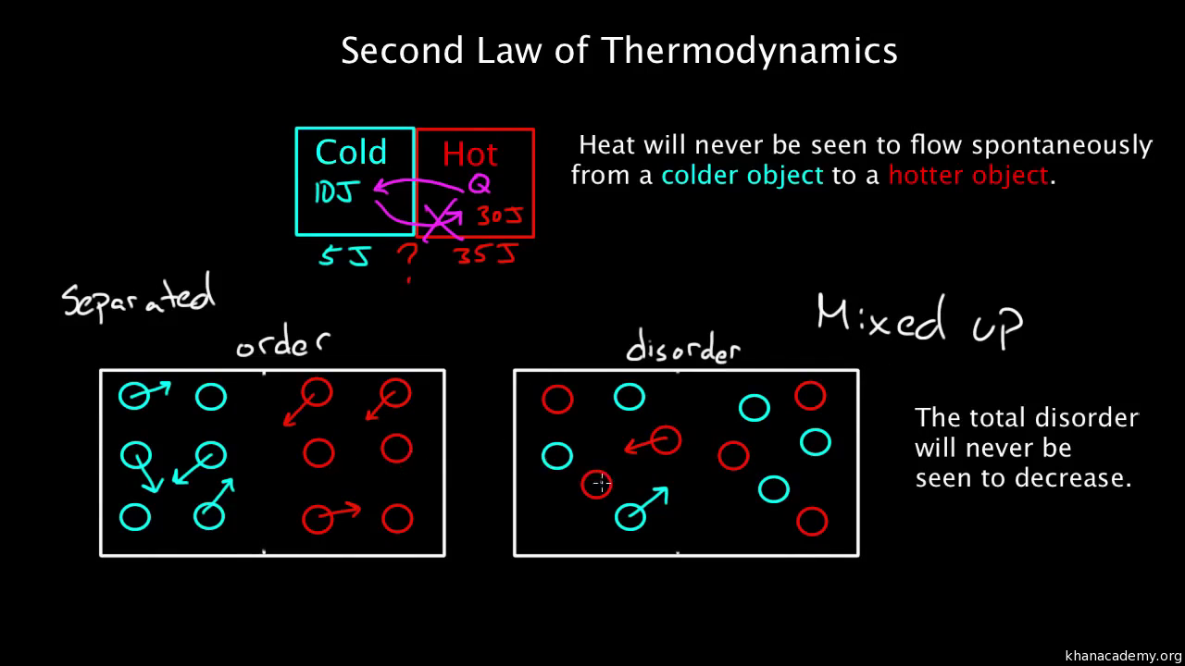

Slide 30
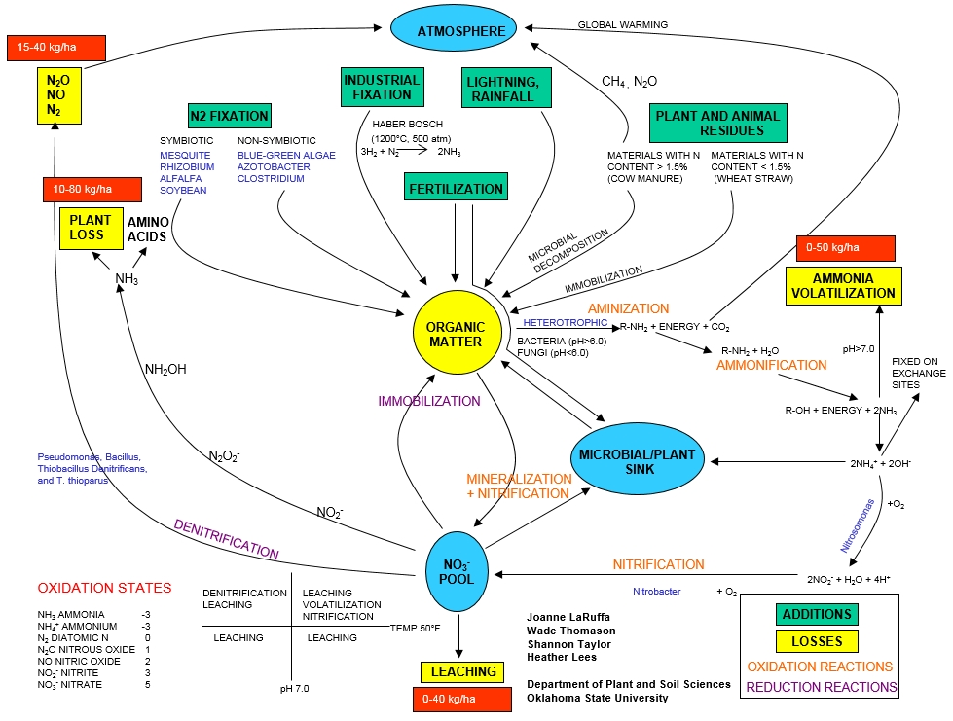

Slide 31
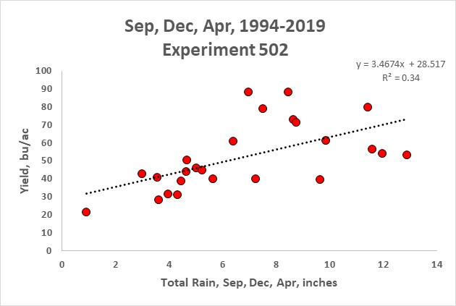
Cumulative rainfall from the months of September, December, and April used to improve mid-season yield prediction
Yield prediction should improve using an additive model (NDVI, GDD, rain) mid-season, within the same months. OSU will be the first to encumber all three (Great plains states have never embraced ‘yield prediction’)
Sum of rainfall determined once a critical GDD had been achieved (97 to 112 GDD>0) (Dhillon et al., 2020), in addition to the mid-season NDVI reading will be useful to better predict yield potential
Moving Forward

Slide 32
Mathematical Metric that defines Environment
This manuscript aims to show how the information within ‘environment’ can be quantified. Furthermore, to use salient examples that partition different environments into recognizable and reproducible groups.
A mathematical metric for environment is needed if climatological characterization is to be tied to a better understanding of the variability in the dependent variable (e.g., grain yield) from year to year and location to location.

Slide 33

YP0 (yield potential)
GDD (growing degree days)
RI (response index, N Rich Strip)
YPN (yield possible with added N)
N rate (N uptake YPN- N uptake YP0)/efficiency factor
Independence of YP0 and RI (need independent estimates)
Variability in N rates over time/location
Increased Randomness with time
Soil Moisture at the time of NDVI sensing
Inclusion of mathematical Metric for environment
“avoiding the pursuit of academic butterflies” Dr. N.E. Borlaug

Slide 34
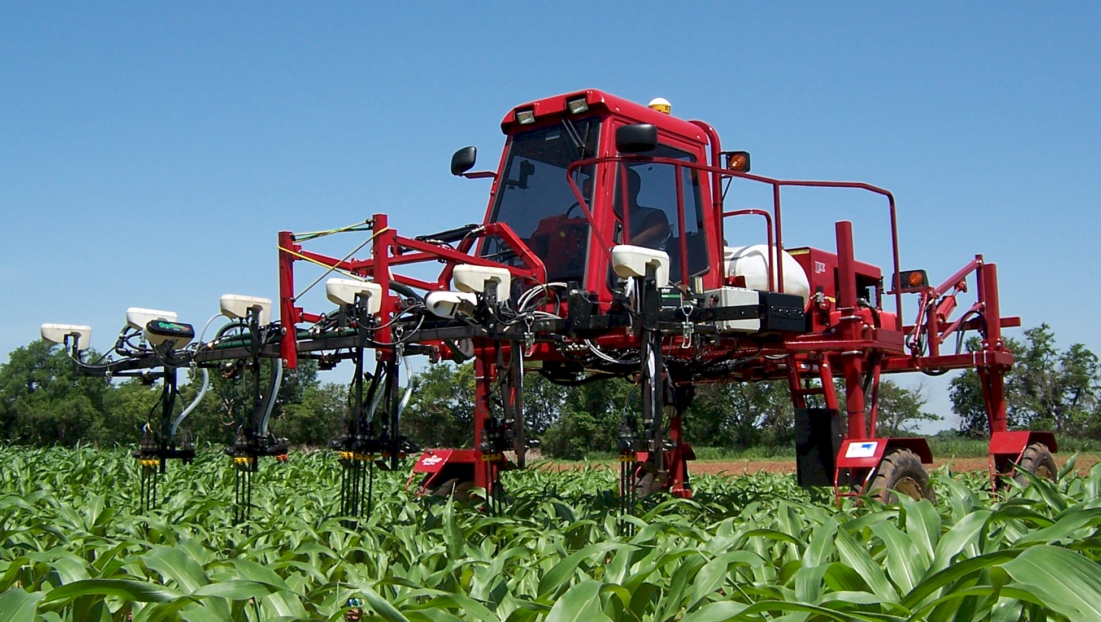
Sense and Fertilize by-plant
2006

Slide 35
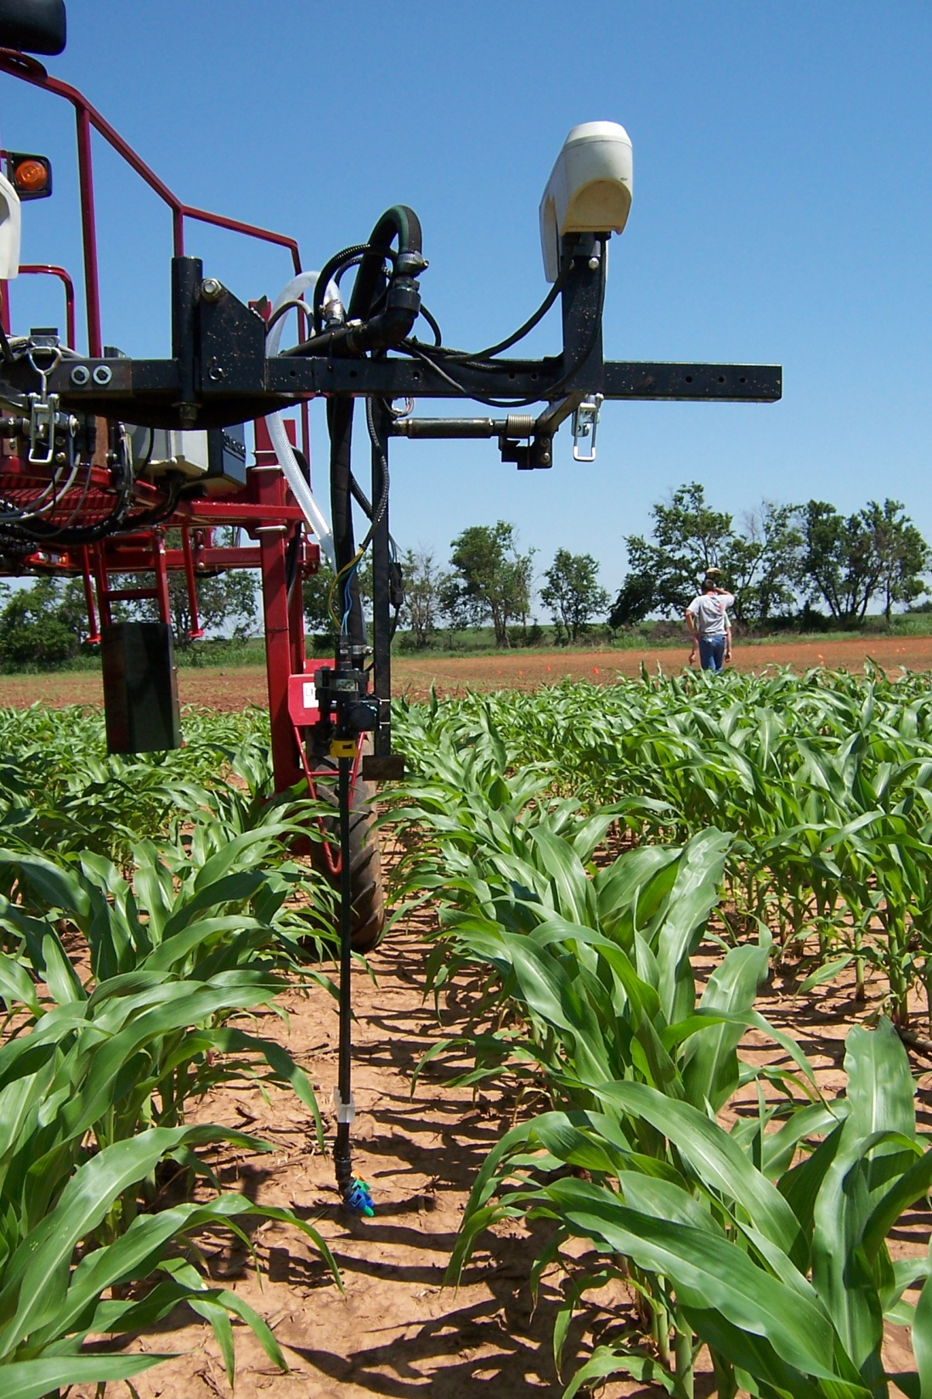


Slide 36
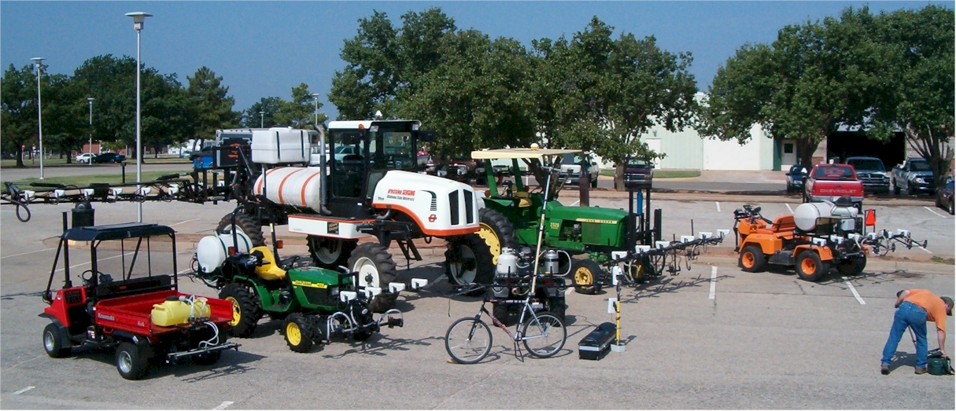
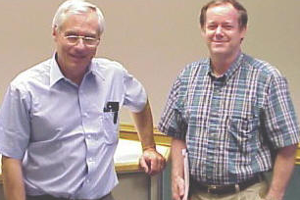
John Solie, 1946-2019
Marvin Stone, 1950-2015

Slide 37
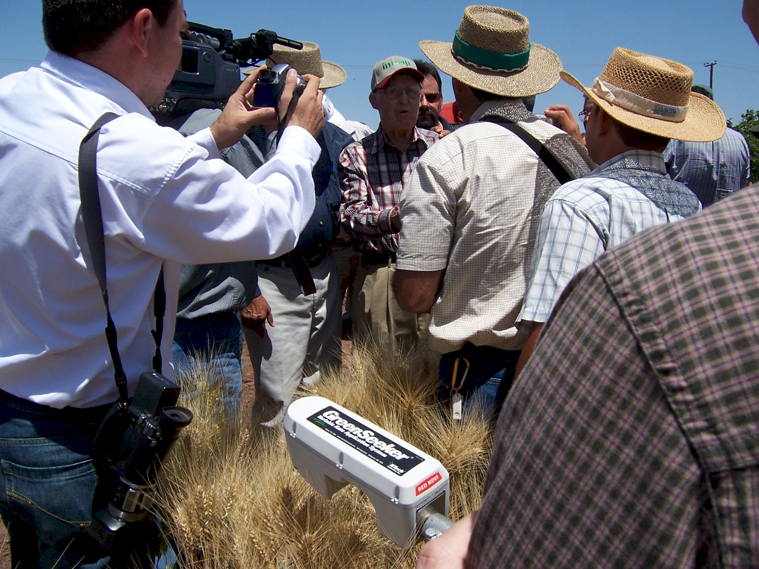

GreenSeeker sensing technology endorsed by Dr. Norman E. Borlaug, April 16, 2007
3/25/1914
9/12/2009

Slide 38
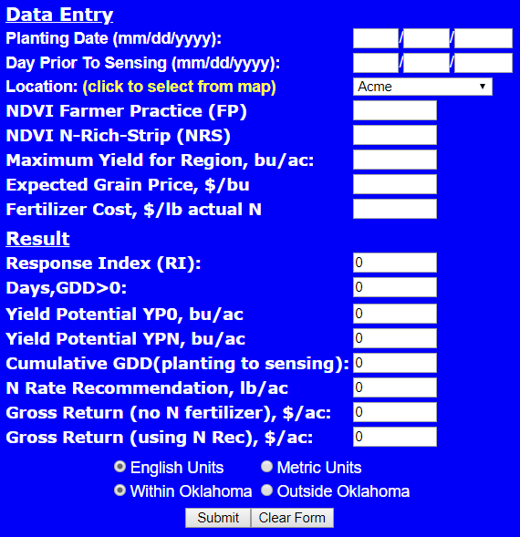
SBNRC 2010
GA Phone App

Slide 39
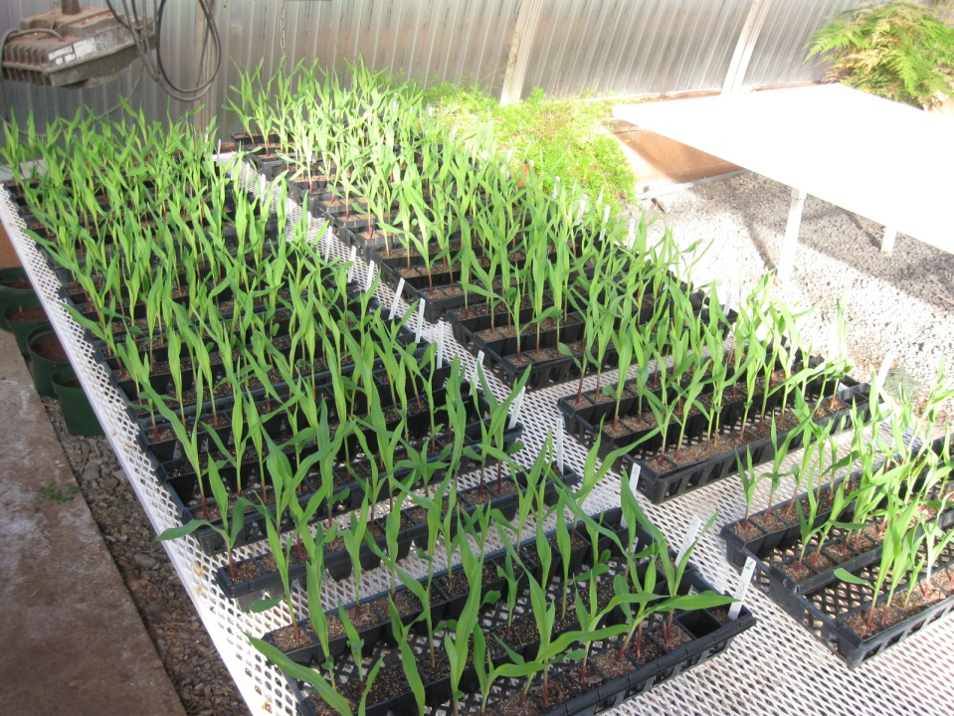
Seed Orientation
Sensor Restriction

Slide 40
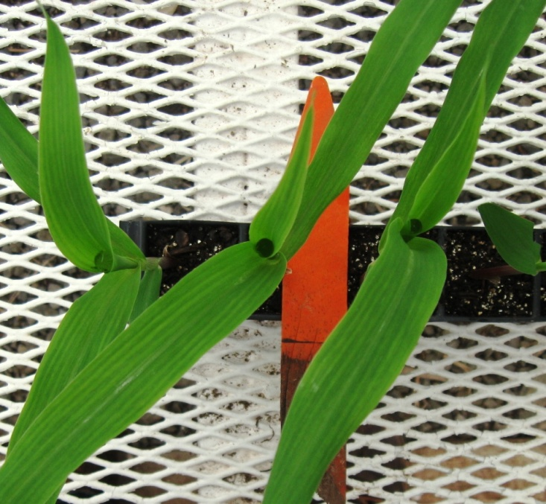
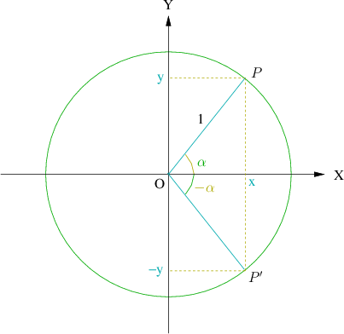
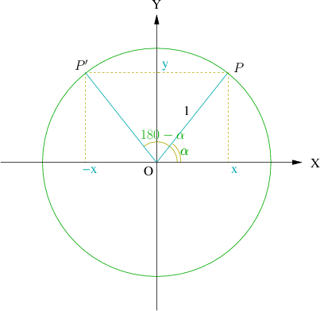
Leaf angle
Between 0° and 90°
Deviation from the corn row

Slide 41
Experiment #1 (E1)
Pioneer 33B54
6 treatments
3 leaf stage
Experiment #2 (E2)
Pioneer 33B54
13 treatments
4 leaf stage

Slide 42
With-row
Leaf orientation
Across-row
Leaf orientation

Slide 43
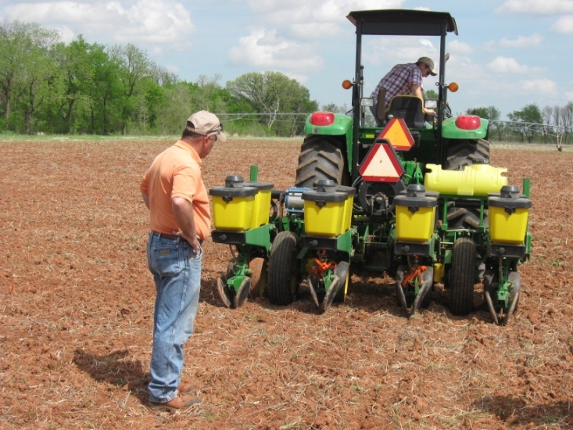



Slide 44



Slide 45



By-Plant N Management
IOWA
OKLAHOMA

Slide 46
Spatial Variability in Winter Wheat, Yields Every 3 Feet
Kevin Waldschmidt

Slide 47



Pocket Sensor
  3rd world
  Common Farmer Tool
Pocket Sensor
Notes:
Economists: Profit is directly proportional to risk

Slide 48



Slide 49

N Sensors
1996, first passive, multi sensor variable N rate application system
1999, first active sensor based variable N rate application system
2001, Greenseeker-NTech, first active commercial sensor based variable nitrogen rate application system
2010, >500,000 acres, GreenSeeker sensors
>110,000 acres Europe

Slide 50
GreenSeeker 2010

Slide 51

Custom designed drop tube assemblies. Made to penetrate through the canopy to get fertilizer to the ground pre-tassle. Used in 22" to 30" row spacing

Slide 52



Slide 53


Slide 54


Slide 55

Frankfurt, Germany

Slide 56

Intimidation of Precision Agriculture

Slide 57



Slide 58

Extension/Training
Farmer training, Ciudad Obregon, Mexico, January 2007

Slide 59

Paul Raymer
The FARM OFFICE, Ontario, Canada

Slide 60




Visual Confirmation

Slide 61

extension
SBNRC
Mexico
India
China
Kenya
Zimbabwe Argentina
Australia
Canada
Ethiopia
nue.okstate.edu

Slide 62



Corn Research

Slide 63
Regional Trials
Opt.N SBNRC 0-N Opt. N
N Rate N Rate Yield Yield
lb/ac lb/ac bu/ac bu/ac
Lahoma 50 50 25 38
Lake Carl Blackwell 25 39 40 55
Hennessey 75 51 38 56

Slide 64

Influence of seed placement on leaf orientation, increased light interception
Better prediction of yield potential using the MESONET
Use of soil profile moisture at sensing for improved prediction of yield

Slide 65
What we have learned
Yield potential can be predicted in corn, wheat, and rice (biomass produced per day)
Response to applied N is variable from year to year and can be predicted
Nutrient removal is tied to yield level
Yield potential and N responsiveness are independent
Value of N Rich Strips

Slide 66
Summary
Development of active sensors capable of collecting NDVI readings day or night has been advanced to highly affordable pocket sensors
Sensor technology has been expanded into applied functional algorithms that predict fertilizer N needs from mid-season data
On-the-go sensor based N management in cereals is commercially used to maximize farmer profits and minimize environmental risk via the judicious application of N fertilizers

Slide 67
Where do we stand?
Sub-Saharan Africa USA
Population, million 700 300
Cereals, million ha 88 56
Production, million tons 97 364
Yield, tons/ha 1.1 6.5
Fertilizer N, million tons 1.3 10.9
Avg. N rate, kg/ha 4 52
NUE >100* 35
% of world N consumed 1.4 13
% of world population 10 4
1 billon dollars in excess N flowing down the Mississippi River, annually **

Slide 68


