Slide 1




Norman Borlaug Mother Teresa
1914 – 2009 1910 - 1997
SOIL 4213 Precision Agriculture, Wednesday, November 14, 2018

Slide 2
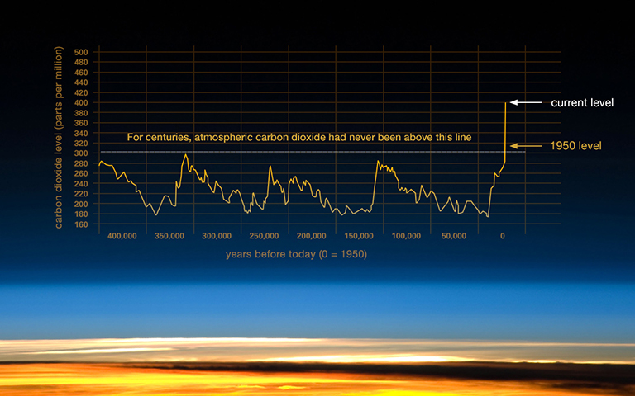

http://climate.nasa.gov/climate_resources/24/

Slide 3
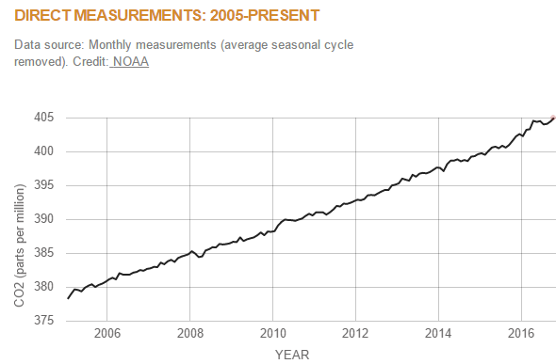

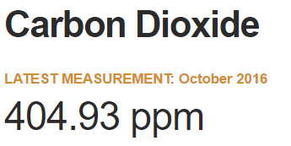
December 13, 2016
2016 - 1950
404 – 311 = 93
30% increase in 66 years
What is it today?
https://climate.nasa.gov/vital-signs/carbon-dioxide/

Slide 4
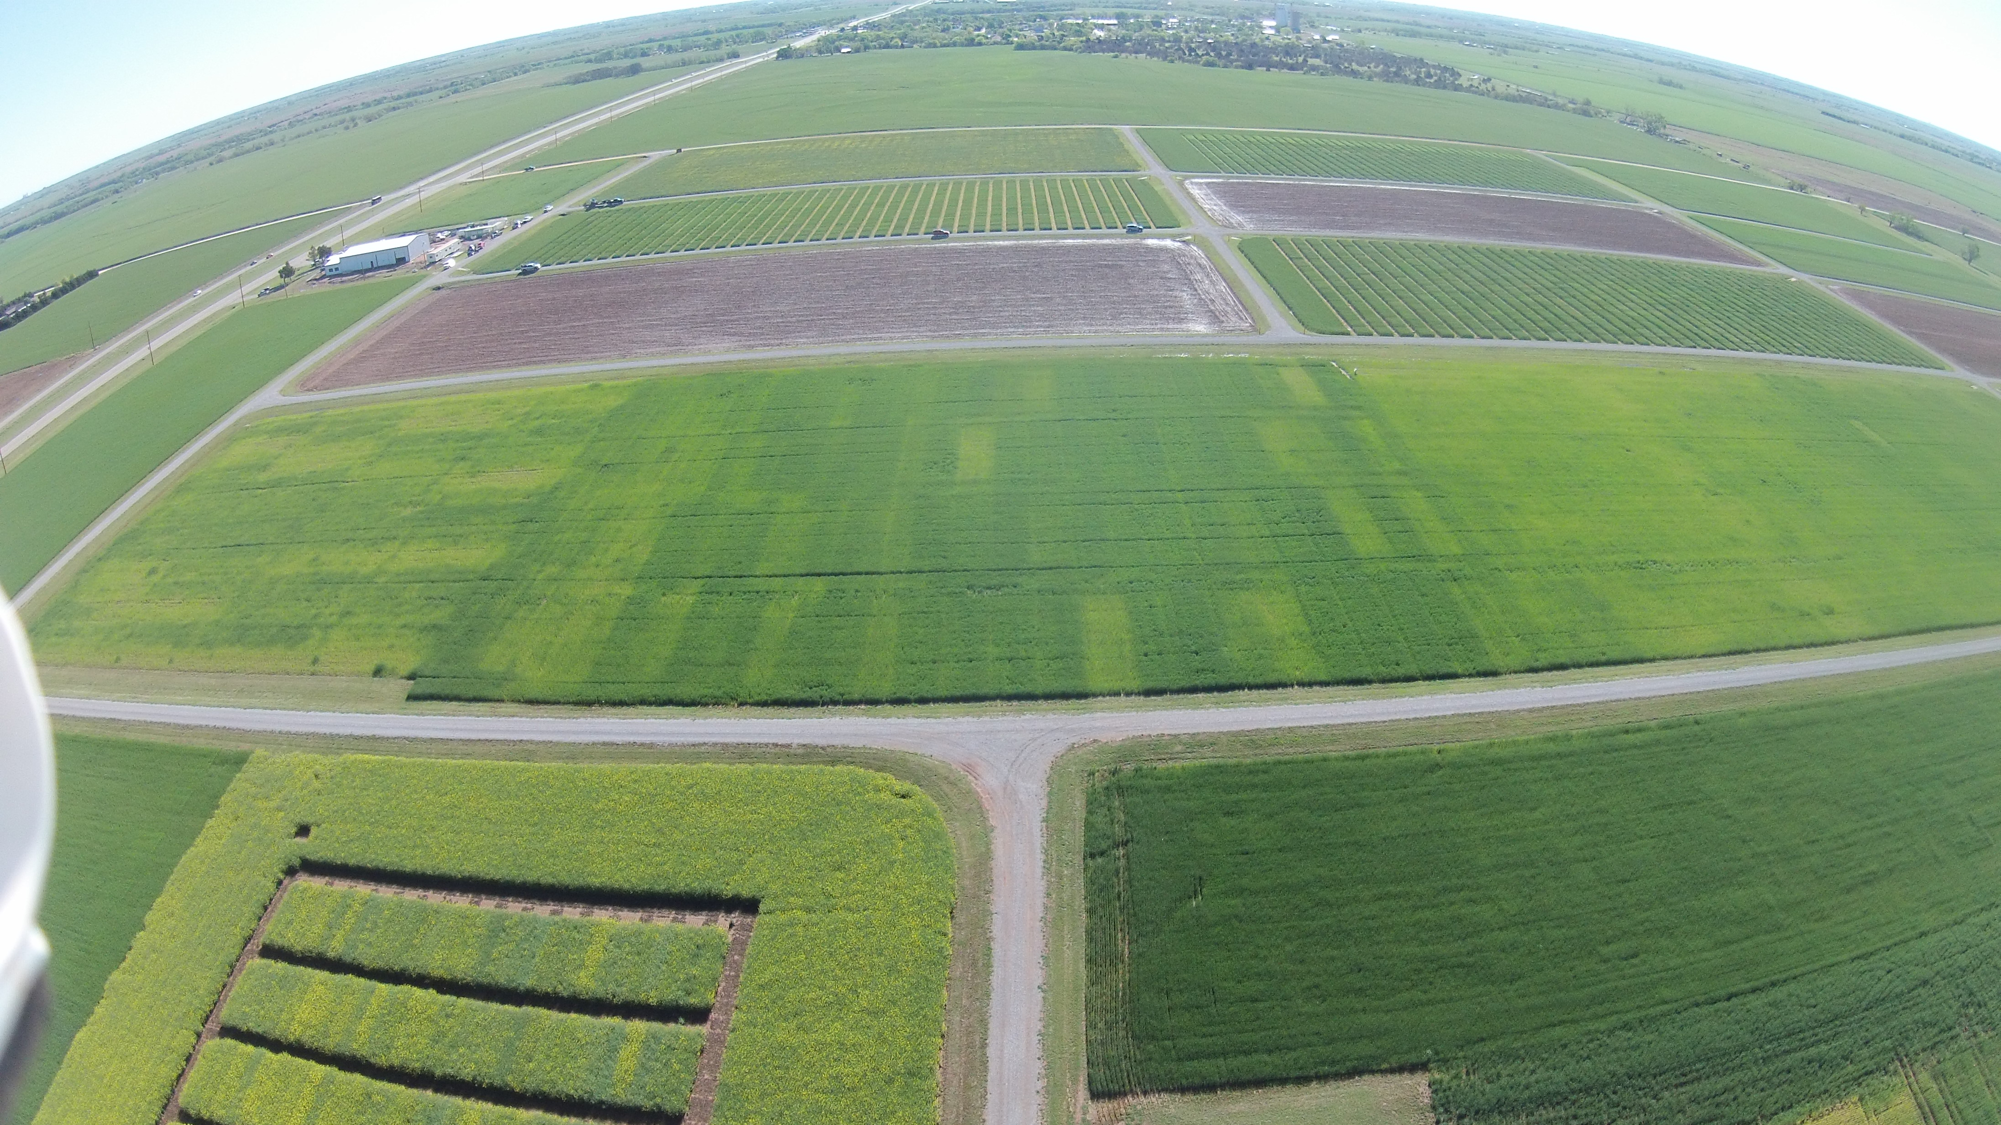
Experiment 502, 1970-present
Lahoma, OK
Precision Agriculture
At what scale should “precision agriculture operate?

Slide 5
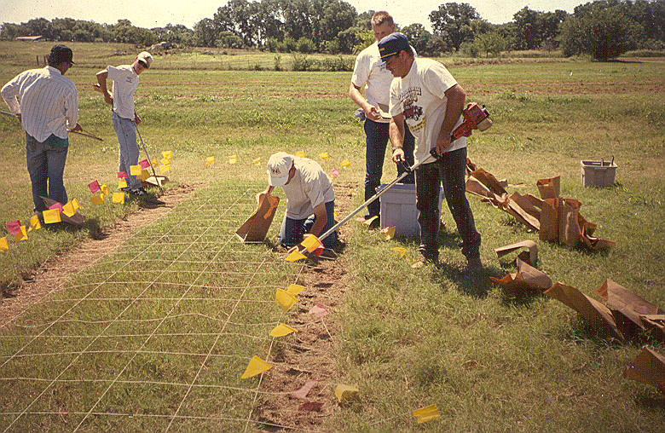
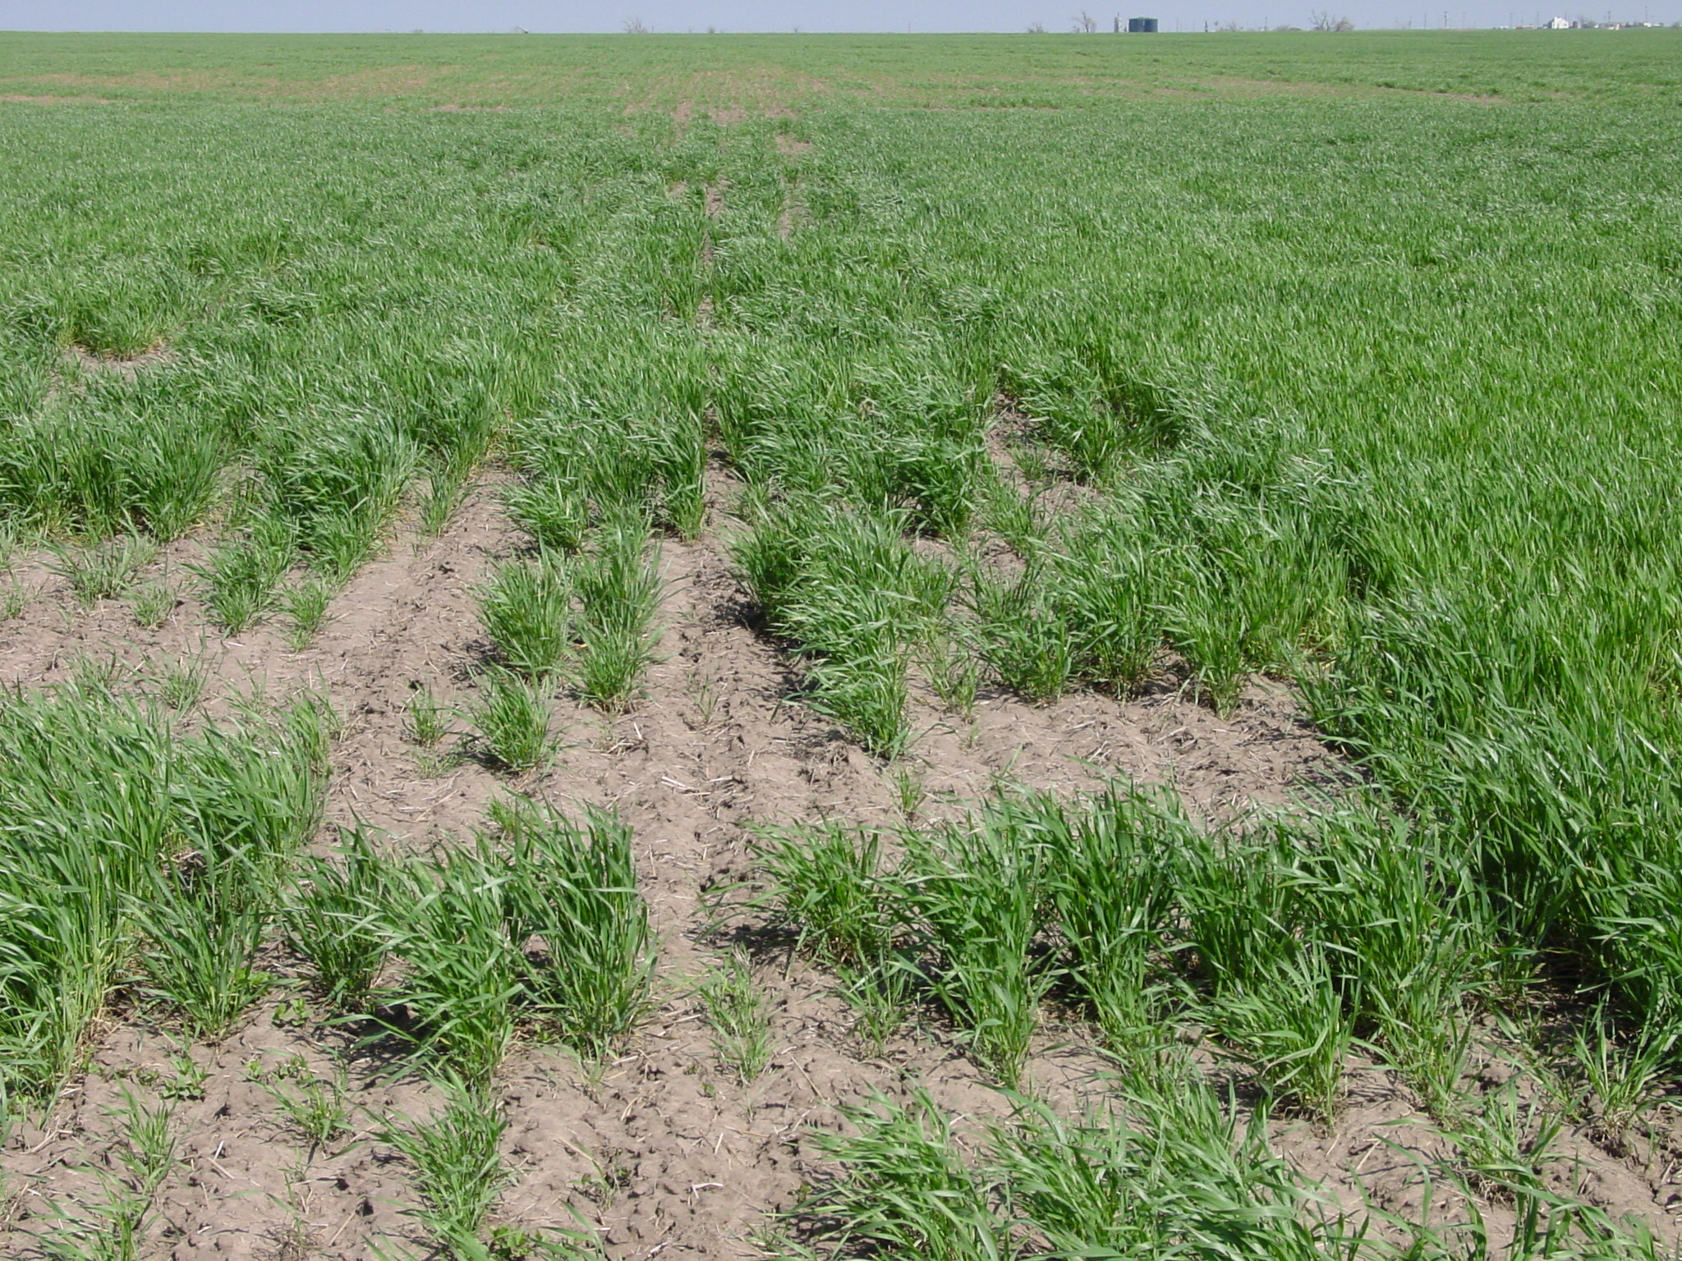
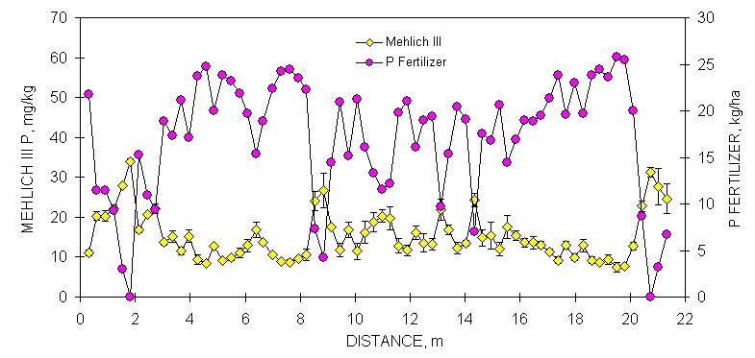
Resolution

Slide 6
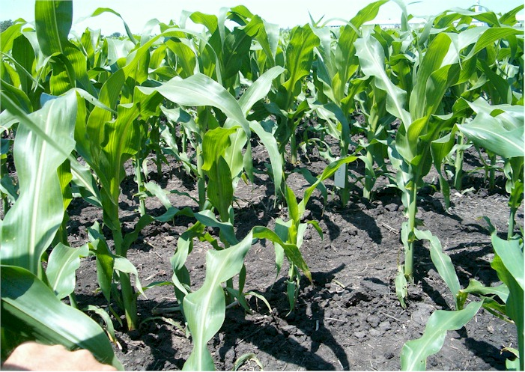
Iowa

Slide 7
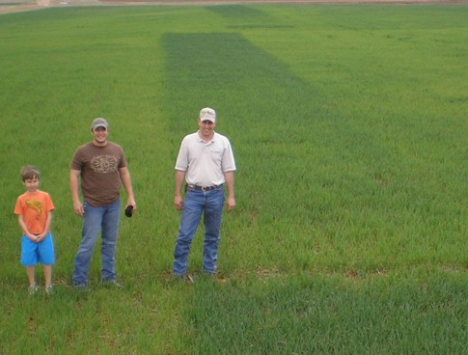
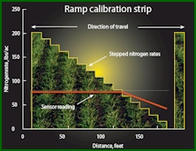
Nitrogen RAMPS
Optimum N rates in the same field vary as do N rates from year to year
2016. Variability in optimum nitrogen rates for maize. Agron. J. 108

Slide 8
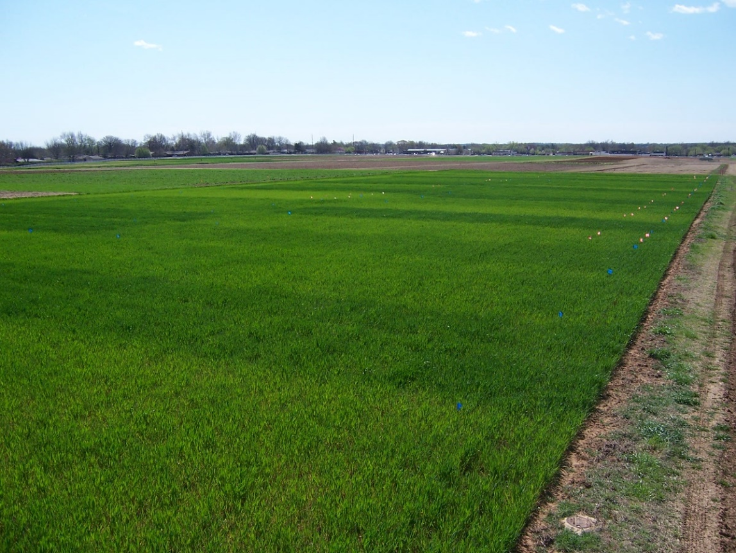
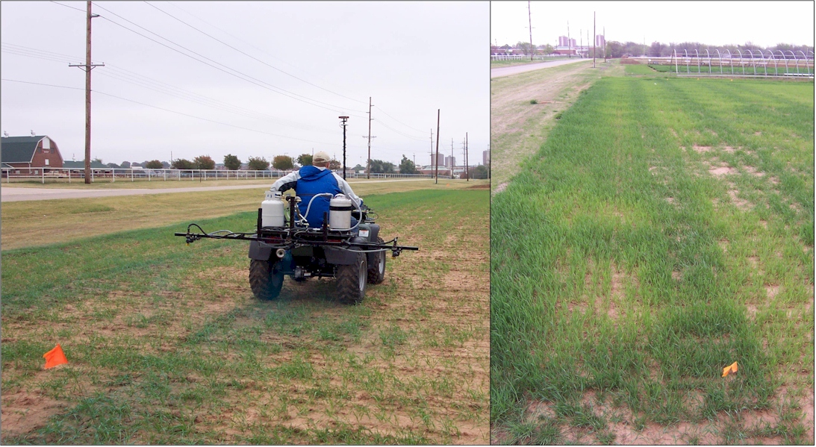

Experiment 222
Stillwater, OK
est. 1969, 48 years, 2016
Raun, W.R., J.B. Solie, M.L. Stone, K.L. Martin, K.W. Freeman. And D.L. Zavodny. 2005. Automated calibration stamp technology for improved in-season nitrogen fertilization. Agron. J. 97:338-342.
Raun, W.R., J.B. Solie, R.K. Taylor, D.B. Arnall, C.J. Mack, and D.E. Edmonds. 2008. Ramp calibration strip technology for determining mid-season N rates in corn and wheat. Agron. J. 100:1088-1093.
Calibration Stamps
Optimum N rate changed within each 9 m2

Slide 9
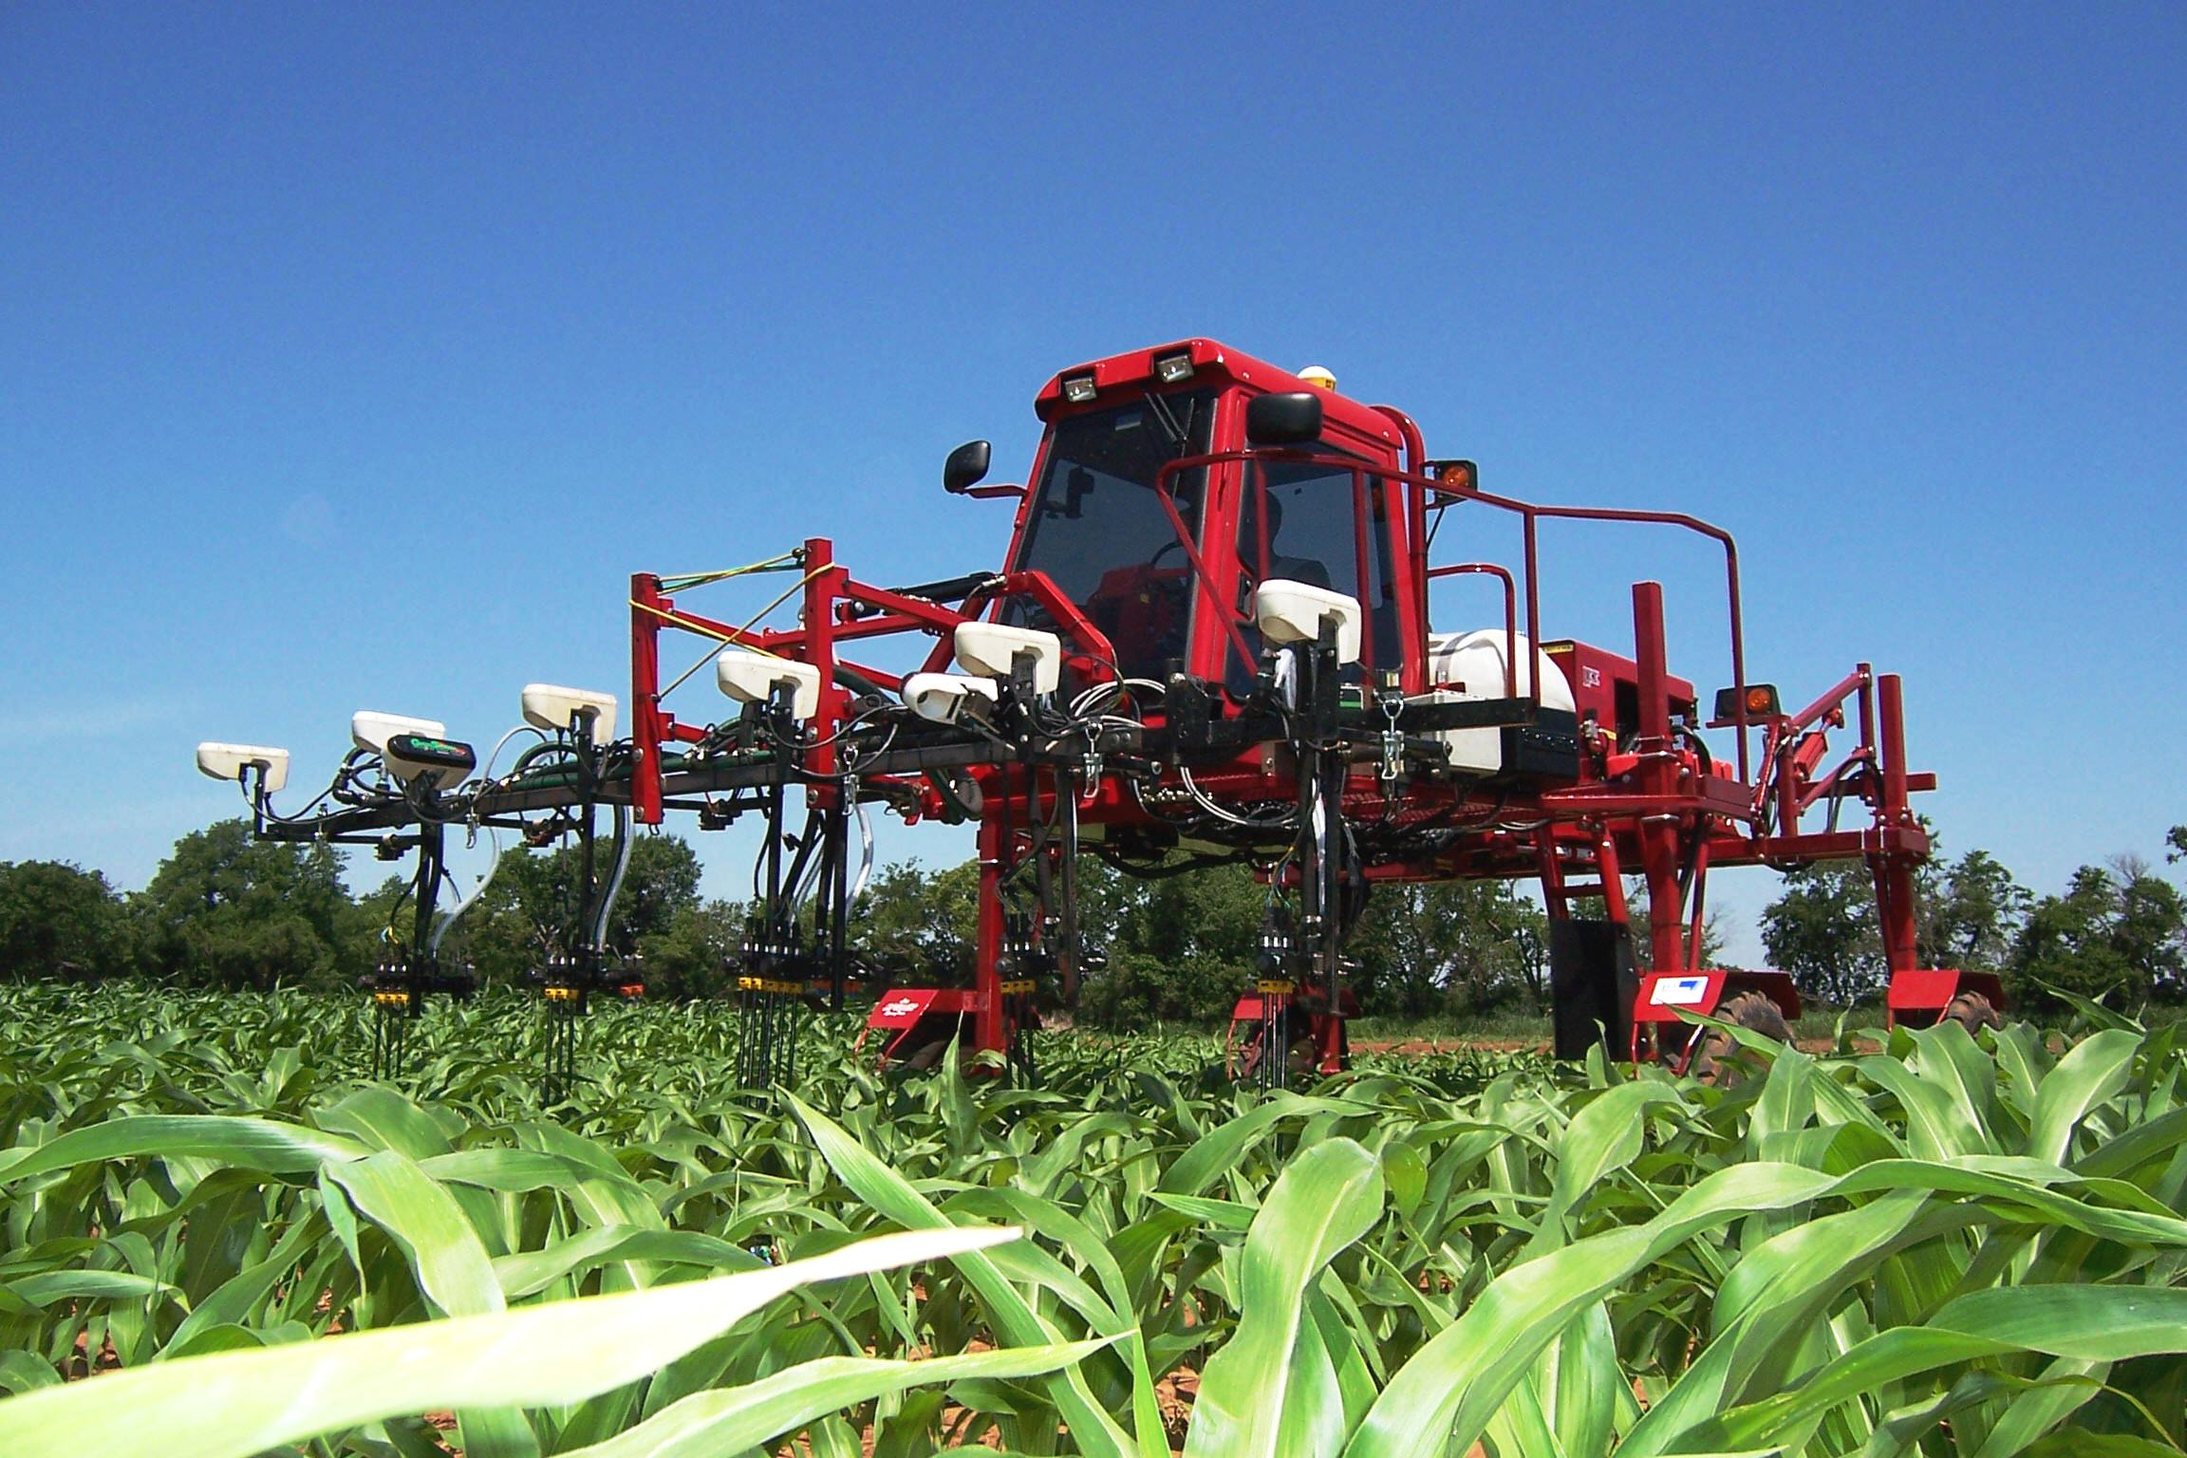
Dr. Marvin Stone, Dr. John Solie, Dr. Randy Taylor
RESOLUTION
Predict yield / yield potential (YP0)
In season estimate of N response (RI)
Estimate N removal (YPN)
CV, weight /sensor-x
Algorithm for N Rate
right order
engineering
wheat/corn

Slide 10
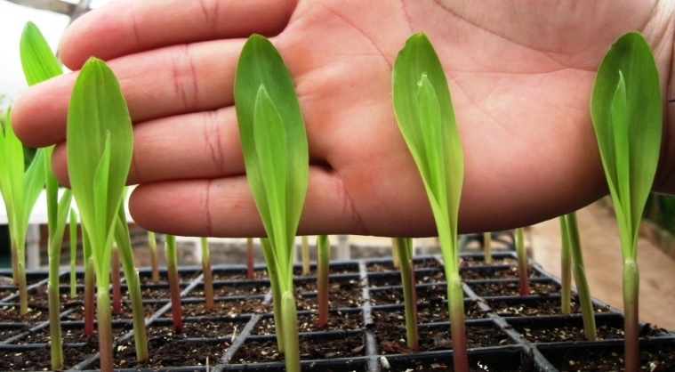
Precision Planting of Corn (Zea mays L.) to Manipulate Leaf Geometry
2011. Maize (Zea mays L.) Leaf Angle and Emergence as Affected by Seed Orientation at Planting. J. Exp. Agric. doi:10.1017/S001447971100038X.

Slide 11
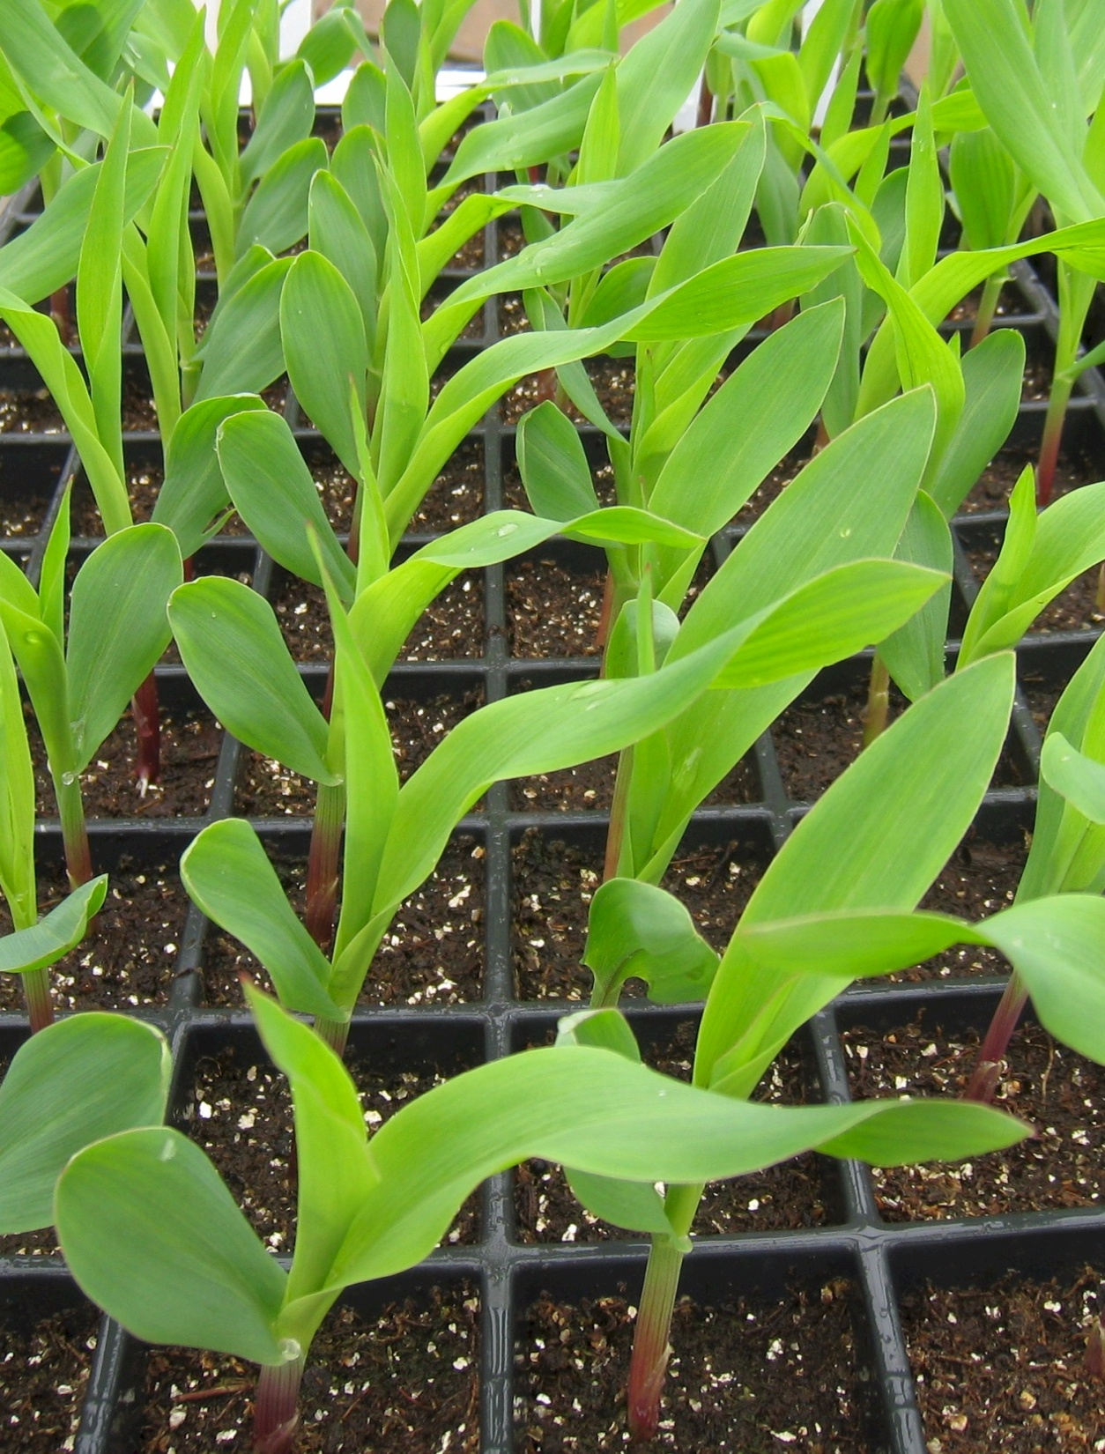
What could be done to better see each plant, Yield Increase

Slide 12
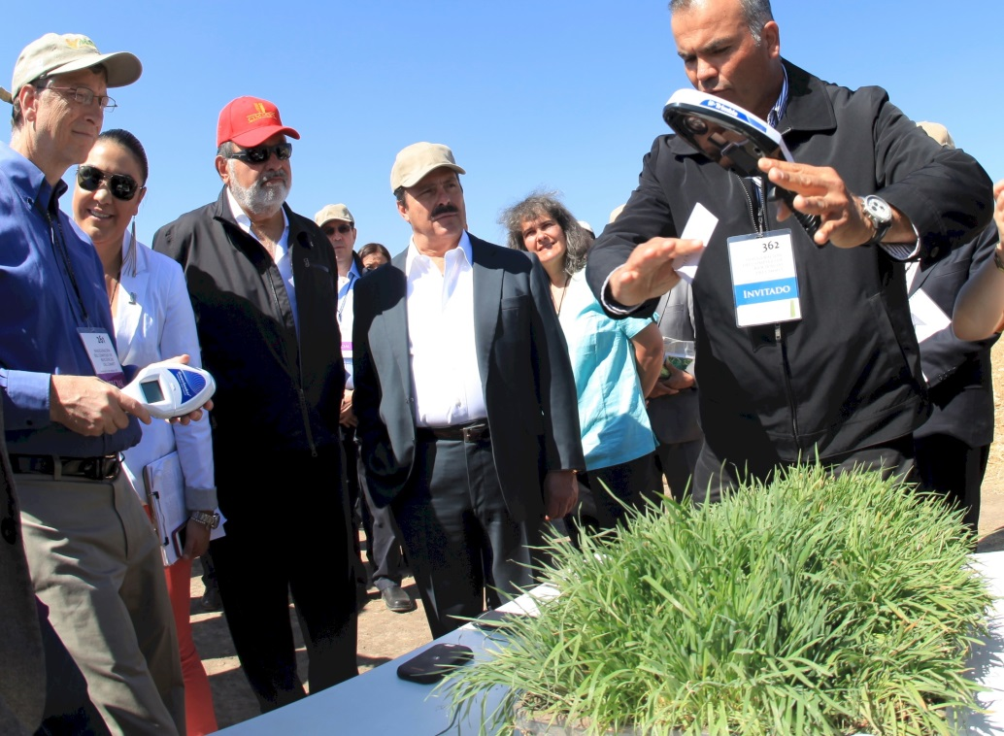

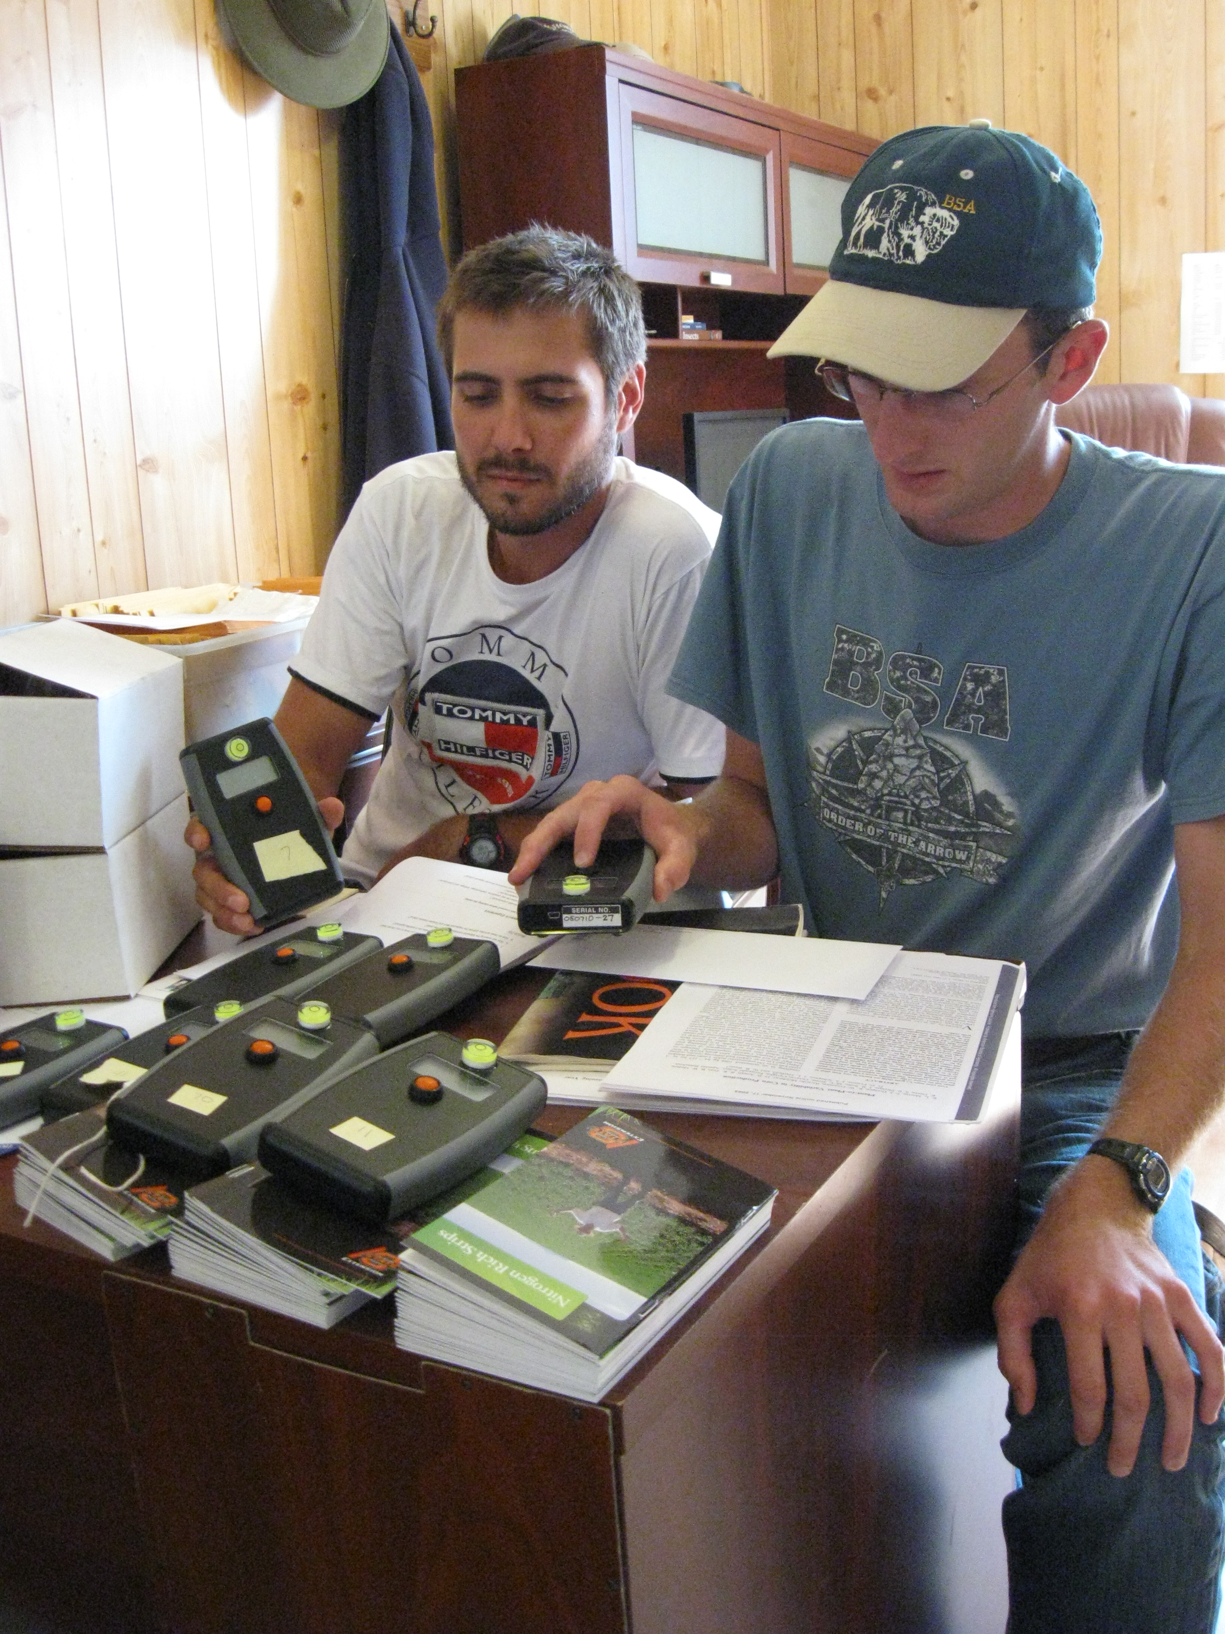


Slide 13
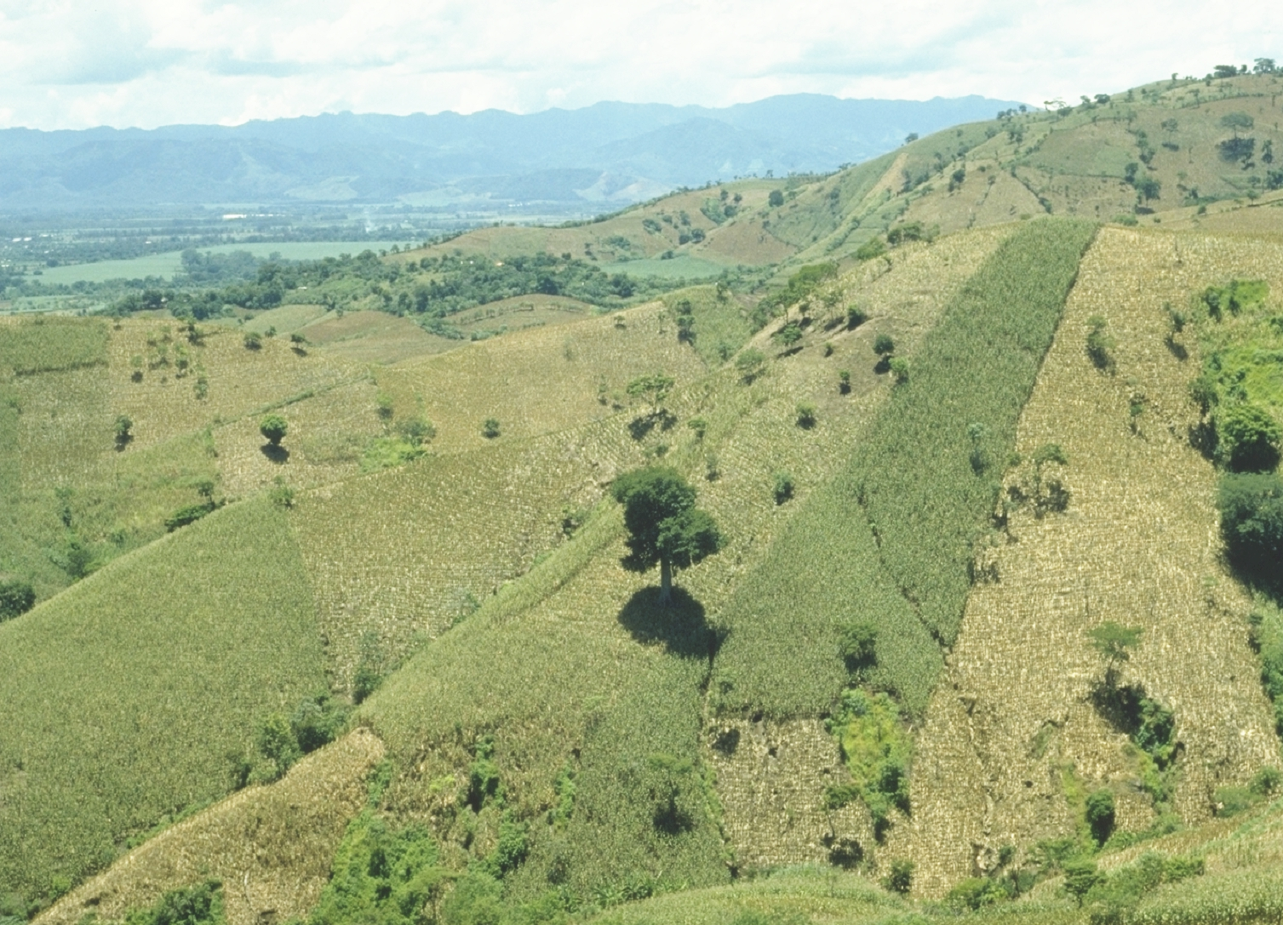
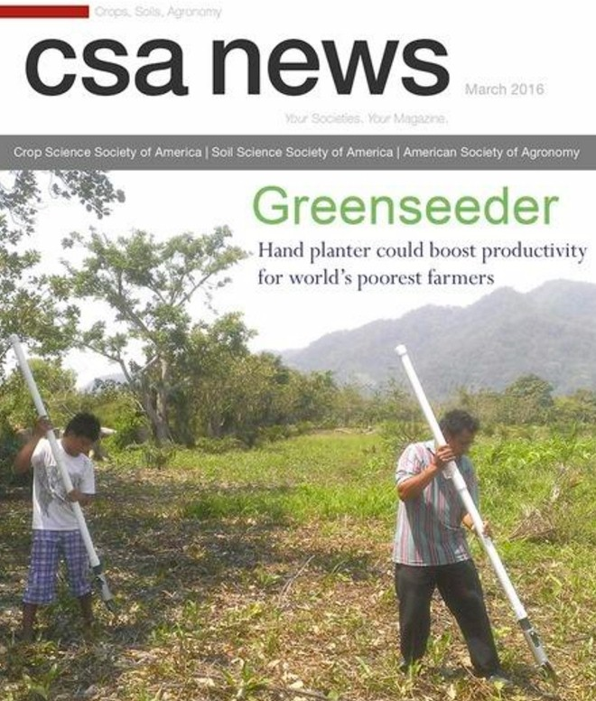
Opico Quezaltepeque, El Salvador

Slide 14
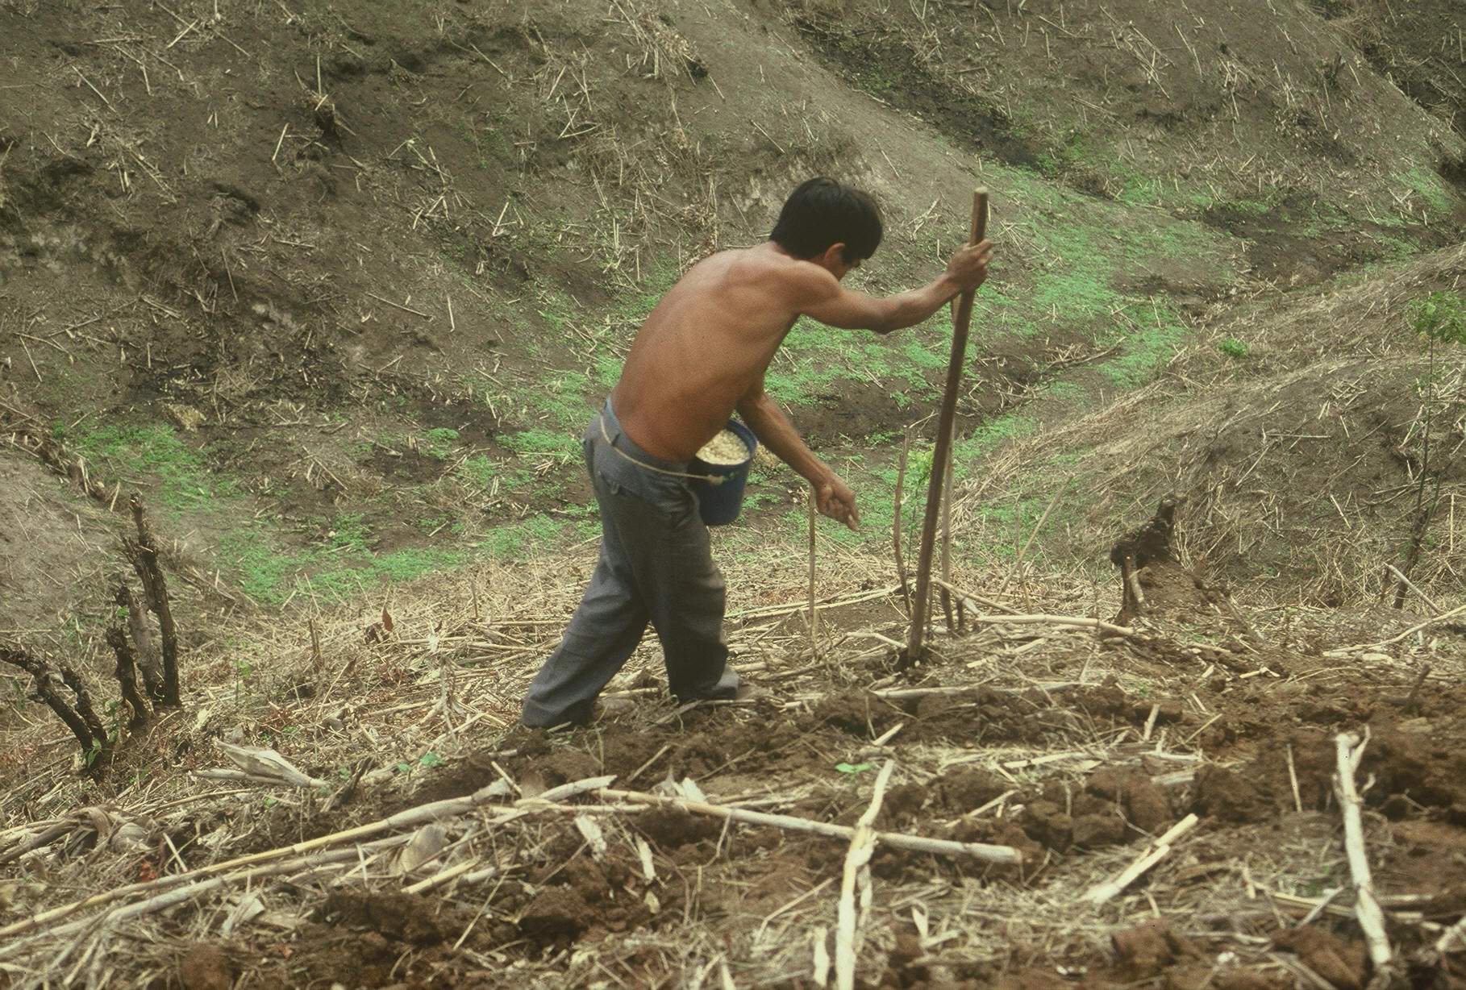

El Salvador
Notes:
22

Slide 15
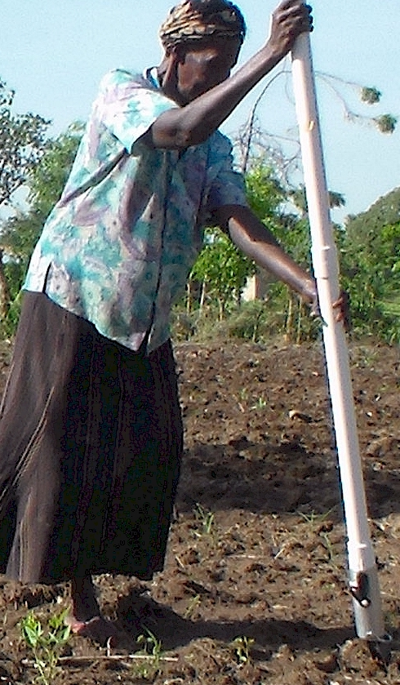
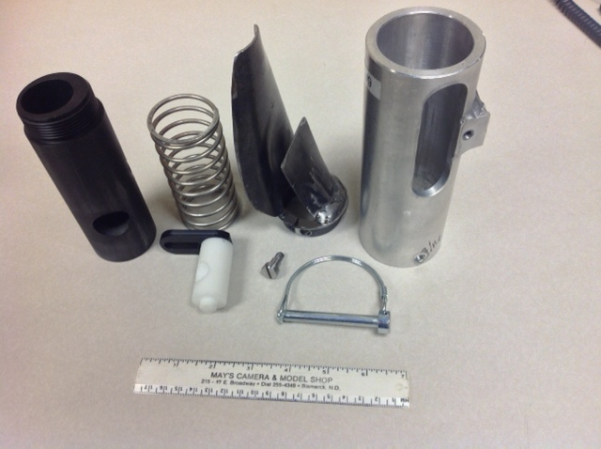
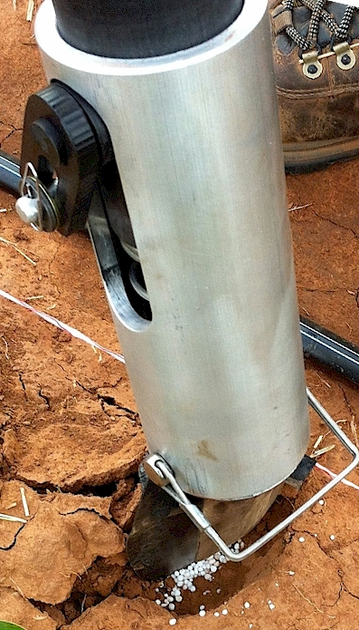

OSU Hand Planter
Dr. Randy Taylor
Wayne Kiner
Lira, Uganda
Peter Omara
Lawrence Aula
Can only be put together one way

Slide 16


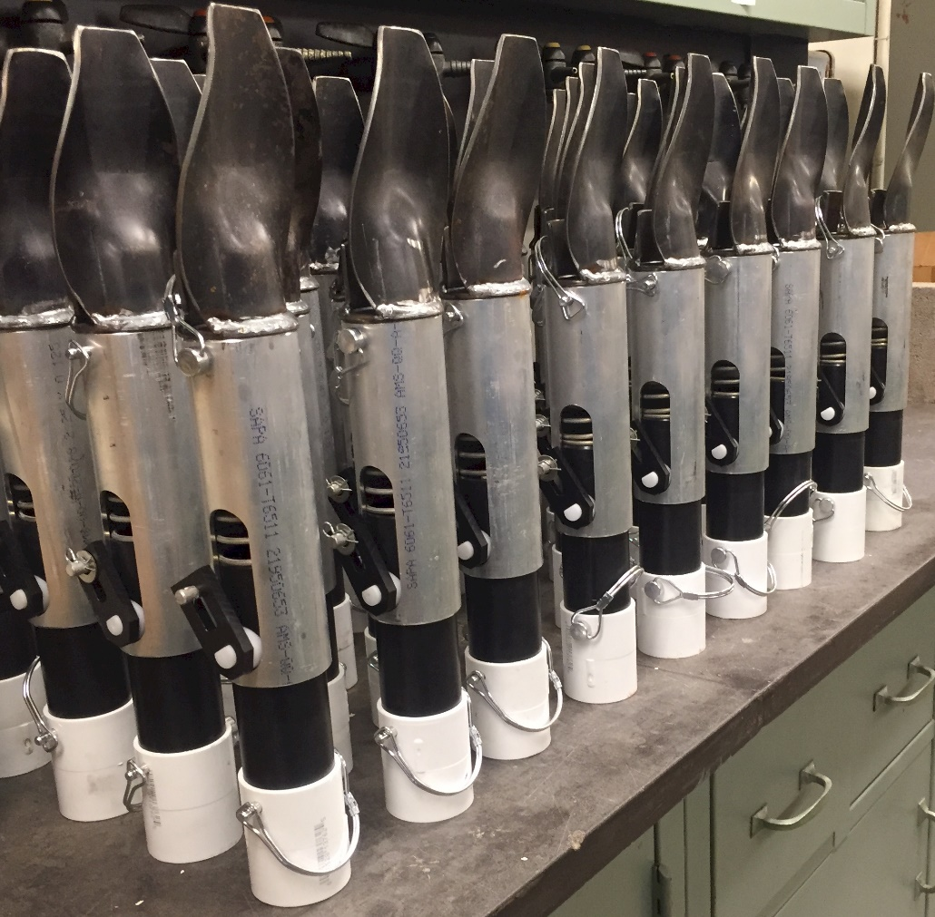
OSU Hand Planter
One Minute Video

Slide 17
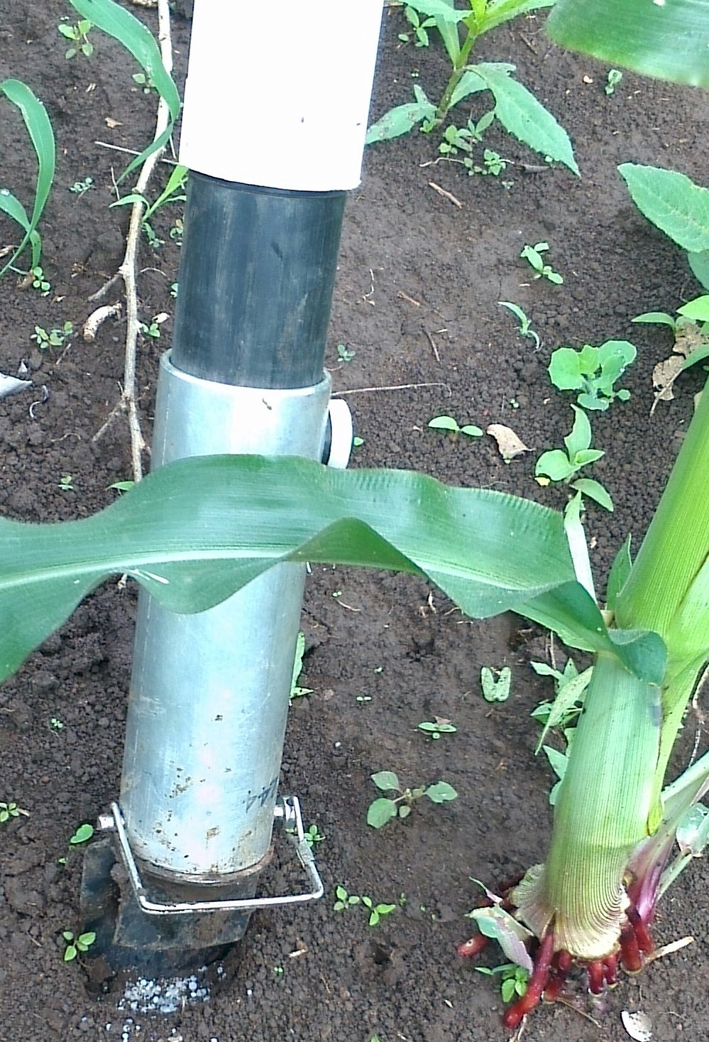
For both the developed and developing world, precision agriculture for maize needs to operate, by plant
2014. Effect of seed distribution and population on maize (Zea mays L.) grain yield. Int. J. Agronomy. V2014. http://dx.doi.org/10.1155/2014/125258.

Slide 18

Agron. J. 91:357-363 (pdf)
NUE
NUE for cereal grain production = 33%
Agronomy Journal 91:357-363
Estimated NH3 plant loss, 4-28 kg N/ha
J. Plant Nutr. 20:389-404
Plat loss as NH3 increased at higher N rates
J. Plant Nutr. 23:219-230

Slide 19
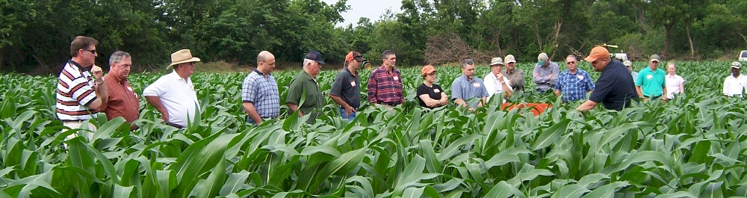
Becoming a Nitrogen Cycle Ninja
Growmark Advanced Agronomy day,
Tuesday, February 3, 2015, Bloomington, IL
Howard Brown
Retention of cyclic information in biological sciences is poor.
Nitrogen cycle is more than just a ‘graphic cycle.’ It is a living cycle that embeds decision and consequence
Nitrogen Cycle Ninja’s have comprehensive understanding of N dynamics, authenticated via this achievement

Slide 20
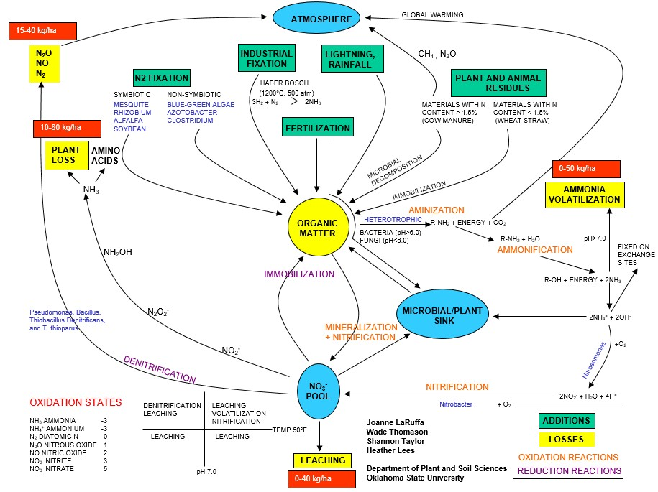

Slide 21
NUE Sub-Saharan Africa
100 % NUE
Continued rise in price, elevated economic risk of N fertilization
Existing low yield levels of cereal production
High NUE’s, result of applying so little fertilizer N, at the expense of mining an already depleted soil resource
Edmonds, Daniel E., Silvano L. Abreu, Adelheid West, Donna R. Caasi, Travis O. Conley, Michael C. Daft, Birehane Desta, Brandon B. England, Chelsea D. Farris, Tia J. Nobles, Nehaben K. Patel, Elliott W. Rounds, Brennan H. Sanders, Samar S. Shawaqfeh, Lakmini, Lokuralalage, Roji Manandhar, and W. R. Raun. 2009. Cereal nitrogen use efficiency in Sub Saharan Africa. J. Plant Nutr. 32:2107-2122.
5L 2F 5000

Slide 22
40 transects,
Argentina, Mexico, Iowa, Nebraska, Ohio, and Oklahoma, 2002-2004.
______________________________________________________________________________
Location Years Trans. Min Max Mean Stdev Max/Min CV
------------------------ kg/ha ------------------------ %
Oklahoma, <6000 kg/ha 2003-4 11 1128 9169 4652 1724 10.0 37.2
Oklahoma, >6000 kg/ha 2003-4 8 1947 14120 7050 2167 11.6 30.5
Ames, Iowa, Shelton, NE 2004 4 1872 21173 8320 3660 14.1 46.0
Phillips, NE 2004 5 7098 21492 14383 2926 3.2 20.3
Ohio 2004 1 2066 19458 9759 4367 9.4 50.2
El Batan, MX 2002 3 606 9440 4268 1935 22.4 45.3
Argentina 2003 9 2806 28058 11478 4211 15.0 36.8
All Sites 02-04 40 2410 17034 8173 2746 11.8 35.2
______________________________________________________________________________
Plant-to-plant variability in corn grain yield can be expected, averaged more than 2765 kg/ha (44 bu/ac) over sites and years. Agron. J. 97:1603-1611.

Slide 23
Ramp Calibration Strips

Slide 24




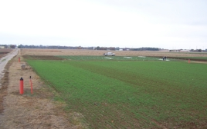
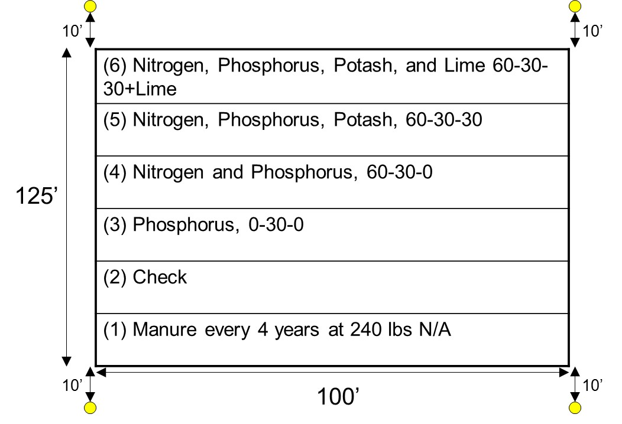
125th Harvest, June 2017
Appl. Environ. Micro. 70:5868-5874. Cyanobacteria
AC Magruder, 1892
Horace Harper, 1926-1951 (25)
Billy Tucker, 1957-1976 (19)
Robert Westerman, 1977-1991 (14)
1991-2018 (27)

Slide 25
Maize grain yield for the check (0N), high N treatment and optimum N rate in 26 field experiments , 213 site years of published data, 1958-2010.
Source | Location | Years | Time period | † (0-N) Yield Range | ‡ High N Yield Range | *Optimum N rate kg ha⁻¹
 |  |  |  | ---- Mg ha⁻¹ ---- |  | Min | Max | Avg. | SD
Bundy et al. (2011) | WI | 21 | 1958-1983 | 1.6-7.6 | 4.3-8.8 | 50 | 233 | 130 | 53
Bundy et al. (2011) | WI | 9 | 1984-1997 | 2.7-5.6 | 5.7-9.96 | 58 | 235 | 179 | 51
Mallarino and Torres (2006) | IA | 20 | 1979-2003 | 0.8-5.9 | 5.1-12.4 | 81 | 237 | 165 | 49
Mallarino and Torres (2006) | IA | 14 | 1985-2010 | 1.4-6.2 | 5.3-12.8 | 134 | 239 | 197 | 32
Varvel et al. (2007) | NE | 5 | 1995-2005 | 6.6-10.9 | 10.4-13.3 | 73 | 193 | 131 | 49
Jokela et al. (1989) Carroll | MN | 3 | 1982-1984 | 5.5-7.3 | 7.1-9.1 | 5 | 131 | 84 | 69
Jokela et al. (1989) Webster | MN | 3 | 1982-1984 | 1.7-5.6 | 1.8-8.7 | 70 | 113 | 91 | 21
Fenster et al. (1976) Waseca | MN | 5 | 1970-1975 | 3.2-7.4 | 7.1-10.6 | 60 | 199 | 135 | 50
Fenster et al. (1976) Martin A | MN | 7 | 1970-1976 | 3.8-8.2 | 4.0-9.6 | 23 | 126 | 69 | 36
Fenster et al. (1976) Martin B | MN | 6 | 1971-1976 | 6.2-11.3 | 6.2-12.0 | 0 | 37 | 18 | 15
Al Kaisi et al. (2003) | CO | 3 | 1998-2000 | 5.6-10.2 | 8.3-10.8 | 66 | 111 | 91 | 23
Ismail et al. (1994) NT | KY | 20 | 1998-2000 | 2.1-7.4 | 5.2-10.9 | 35 | 230 | 128 | 46
Ismail et al. (1994) CT | KY | 20 | 1970-1990 | 1.9-9.5 | 3.5-10.4 | 0 | 203 | 98 | 52
Rice et al. (1986) NT | KY | 15 | 1970-1985 | 3.1-4.9 | 5.7-9.2 | 102 | 178 | 144 | 30
Rice et al. (1986) CT | KY | 15 | 1970-1985 | 1.9-6.1 | 5.0-8.8 | 69 | 204 | 124 | 47
Stecker et al. (1993) Columbia | MO | 3 | 1988-1990 | 3.3-5.6 | 6.0-10.1 | 99 | 194 | 153 | 49
Stecker et al. (1993) Novelty | MO | 3 | 1988-1990 | 4.5-7.2 | 6.7-9.9 | 45 | 182 | 103 | 71
Stecker et al. (1993) Corning | MO | 2 | 1989-1990 | 5.0-6.0 | 8.2-8.5 | 90 | 117 | 104 | 20
Peterson et al. (1989) | NE | 4 | 1983-1986 | 2.1-6.4 | 3.9-10.0 | 11 | 218 | 104 | 88
Eck (1982) | TX | 2 | 1977-1978 | 2.7-4.4 | 5.6-5.9 | 59 | 116 | 88 | 40
Shapiro et al. (2006) RS 51cm | NE | 3 | 1996-1998 | 6.2-8.9 | 9.4-11.1 | 69 | 96 | 83 | 13
Shapiro et al. (2006) RS 76cm | NE | 3 | 1996-1998 | 5.0-8.9 | 7.1-11.0 | 13 | 114 | 75 | 54
Meisinger et al. (1985) MT | MD | 4 | 1974-1977 | 1.8-2.6 | 5.8-8.2 | 127 | 233 | 183 | 45
Meisinger et al. (1985) PT | MD | 4 | 1974-1977 | 2.7-4.2 | 5.1-8.1 | 36 | 196 | 142 | 75
Gehl et al. (2005) Rossville | KS | 2 | 2001-2002 | 6.4-7.9 | 11.3-12.6 | 182 | 204 | 193 | 15
Gehl et al. (2005) Scandia | KS | 2 | 2001-2002 | 2.7-7.4 | 3.8-11.5 | 51 | 160 | 105 | 77
Total |  | 213 |  |  | Average | 62 | 173 | 120 | 45
 |  |  |  |  | SD | 44 | 55 | 43 | 20

Slide 26
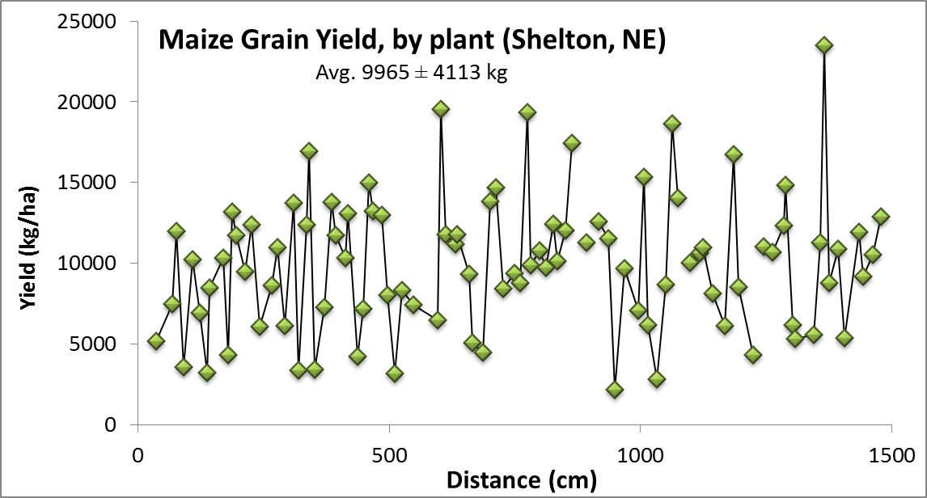
By-plant grain yields
Plant-to-Plant Variability in Corn Production. 2005. Agron. J. 97:1603-1611.

