Slide 1
Soil Fertility Research and Education Advisory Board

Slide 2
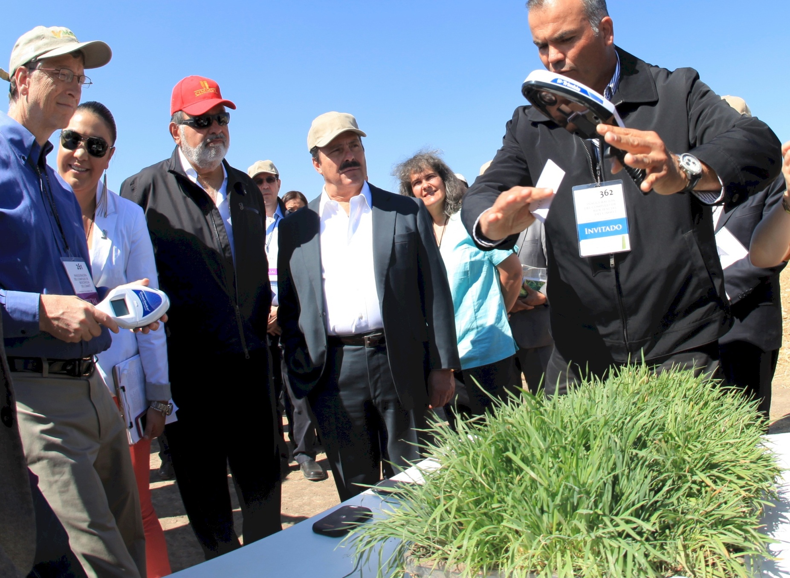
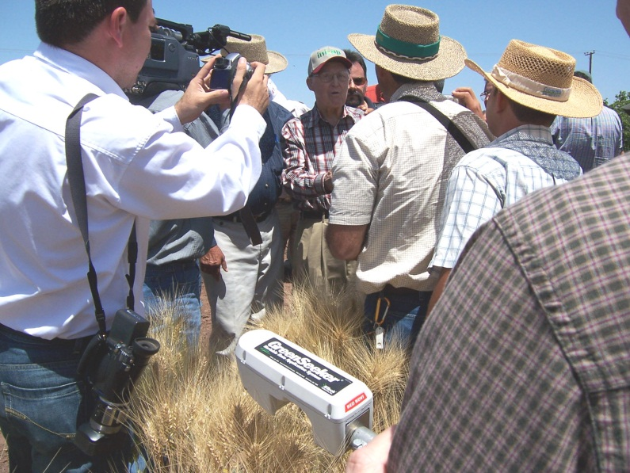
Bill Gates, Carlos Slim, CIMMYT
Soil Fertility Research and Education Advisory Board

Slide 3
Improving In-Season Estimates of Wheat Yield with Soil Moisture Data
Objective: Improve in-season estimate of yield for winter wheat utilizing profile soil moisture (0-80 cm) obtained from Oklahoma Mesonet data.
Lahoma 2012--New INSEY with Soil Moisture
Lahoma 2012--Current INSEY
Bushong

Slide 4
Managing Nitrogen in Corn in a Water-Limited Environment
Objective: Determine proper nitrogen source and application method and timing for optimizing corn grain yield, water use efficiency, and nitrogen use efficiency.
Nitrogen Sources: Ammonium sulfate, urea ammonium nitrate, Nitamin (Foliar)
Application Methods and Timings: Pre-plant incorporated, mid-season between row and foliar.
Grain Yield (bu/acre)--Organge Bars
N Use Efficiency (Percent)--Blue Squares
Water Use Efficiency
(kg grain/meter of water)
Bushong

Slide 5
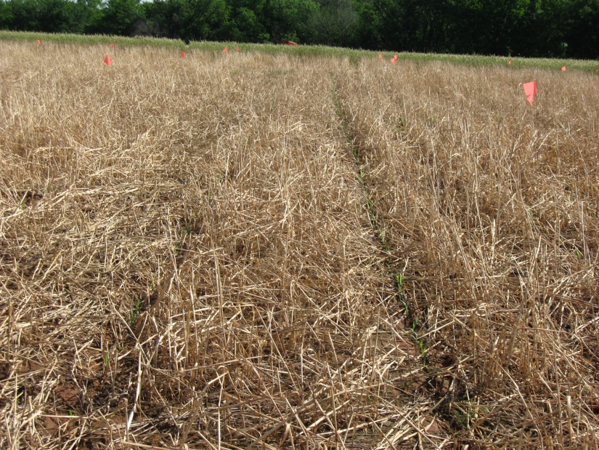
Effect of Nitrogen Fertilizer Application Timing After Chemical Burndown of Cover Crop in Sorghum
Objective: Determine optimum rate and timing of N fertilizer application after chemical burndown to maximize yield and nitrogen use efficiency in no-till sorghum

Slide 6
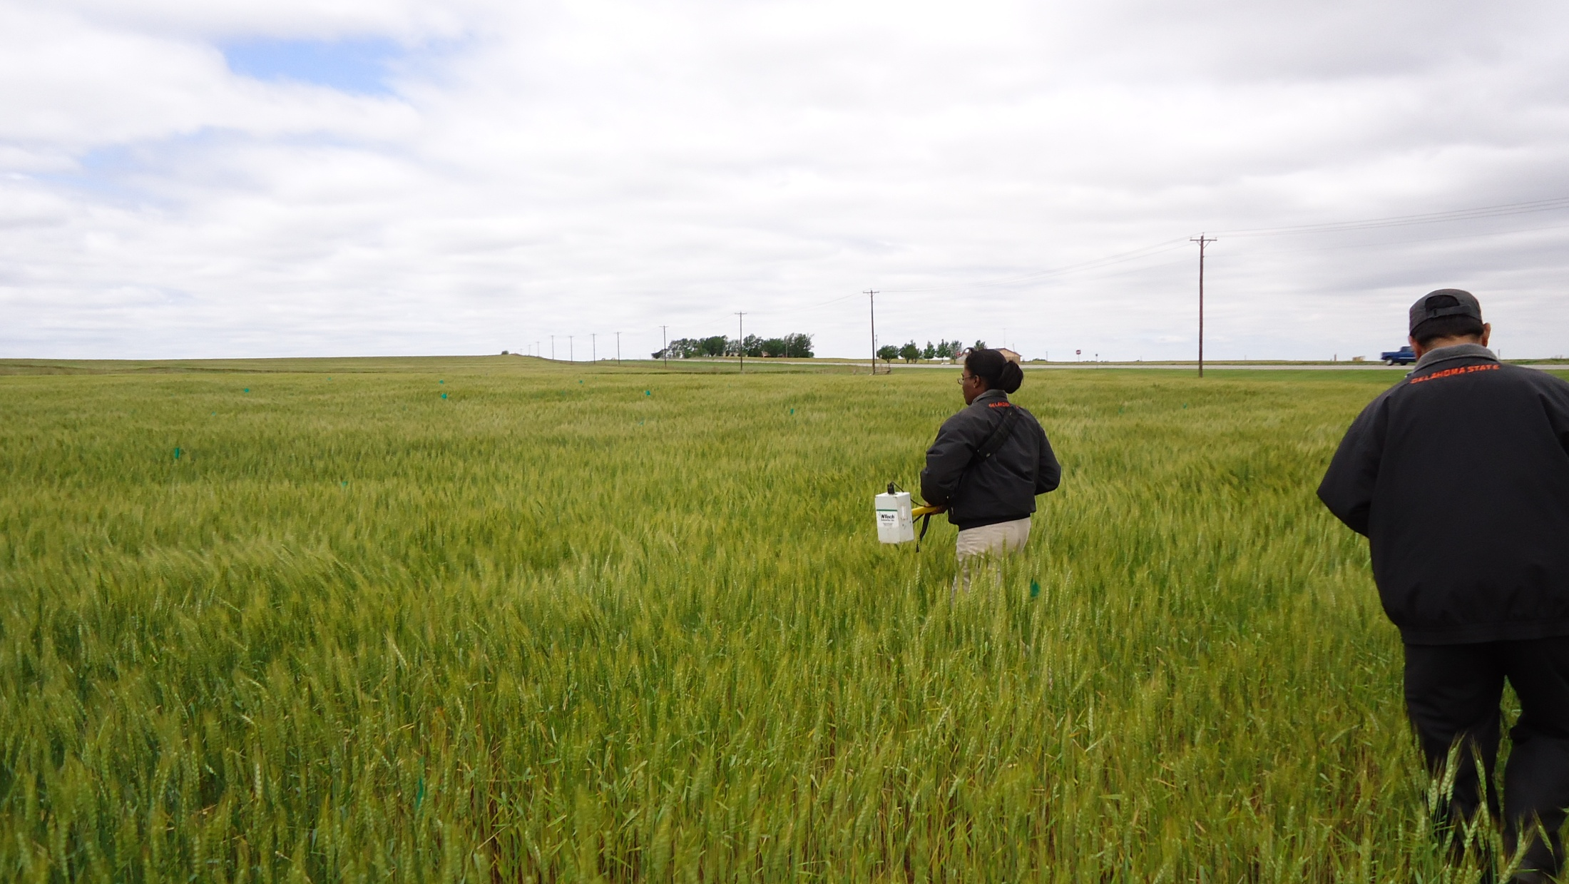
Predicting Nitrogen Use Efficiency and Grain Protein in Winter Wheat using GreenSeeker NDVI
Objective: Evaluate the use of mid-season NDVI readings to predict NUE and GPC in winter wheat.
Three locations in Oklahoma Hennessey, Lahoma and Lake Carl Blackwell
14 treatments, 4 replicates in RCBD
Preplant N rates; 28, 56, 84, 112, 140, 224 kg N/ha
Top-dress N rates: 28, 56, 84, 112, 140 kg N/ha
NDVI measurements at growth stages F3, F4, F5,F6, and F7

Slide 7
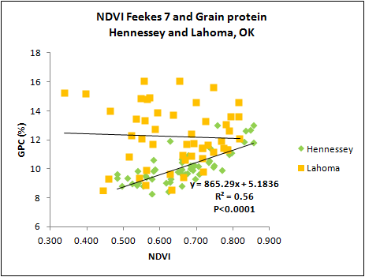
Results
Grain yields and GPC increased with increasing N rates;
Protein levels ranged from 8-18%, over three locations;
Optimum N rate in relationship to NUE varied over locations;
NUE ranged from 20-42%, over three locations;
No significant relationship between NDVI at F3, F5, F6, F7 and GPC at two locations; F7 at Lahoma significant relationship with GPC;
For NUE and GPC, differences recorded between pre-plant and split N fertilizer application

Slide 8
Preplant N Placement, Corn Row Distance
Objective: Evaluate preplant N placement at different distances from corn rows on grain yield.
Methodology: Preplant N Rates (0, 56, 112, 224 kg N ha⁻¹); Distances of 0, 8, 15, 25, 38 cm.
N applied preplant with RTK-GPS
with toolbar shifted to
achieve X distance from
row. Corn was planted
with same “A-B” line.
Mullock

Slide 9
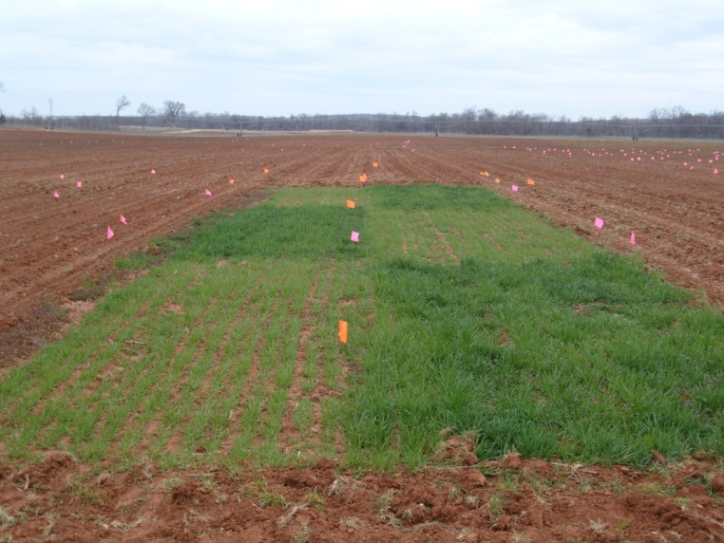
Indicator Crop N-Rich Reference Strips
Barley
Wheat
Corn
Wheat
Objective: Utilize the N response in winter wheat and barley to predict N requirements in corn
Photo Courtesy of Jacob Bushong 3/21/2013
Feekes 5
0 lbs N
NDVI=0.34
150 lbs N
NDVI=0.62
Miller

Slide 10
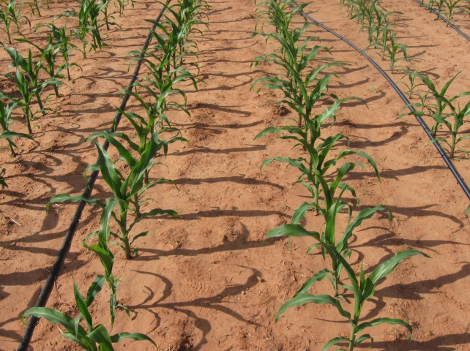
Evaluation of Drought Tolerant Corn Hybrids in Different Production Systems
Objective: Determine NUE and WUE of drought tolerant and non-drought tolerant corn hybrids in dryland and irrigated production systems
Hybrids:
Drought Tolerant
Pioneer P1498: Optimum AQUAmax
Dekalb 63-55: Droughtgard
Non-Drought Tolerant
Pioneer P1395
Dekalb 62-09
Photo Courtesy of Jacob Bushong
Dryland Production System
Seeding Rate
22,000 seeds ac⁻¹
N Fertilizer Rates
0, 60, and 120 lbs N ac⁻¹
Irrigated Production System
Seeding Rate
30,000 seeds ac⁻¹
N Fertilizer Rates
0, 90, and 180 lbs N ac⁻¹
Miller

Slide 11
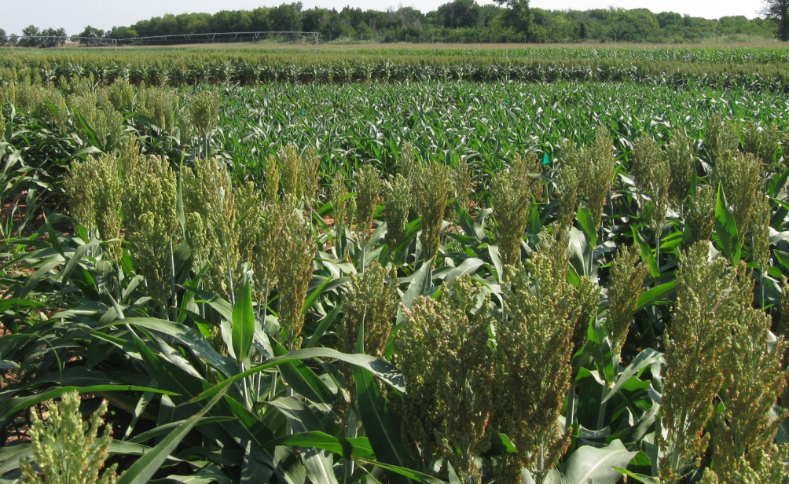
Grain Sorghum Response to Nitrogen Rate and Planting Date
Late
Early
Objective: Determine optimum preplant N rate for early and late planted sorghum.
Photo Courtesy of Bill Raun
Miller

Slide 12
Influence of Foliar Sulfur, Chloride and Nitrogen on Winter Wheat Grain Yield and Protein
Objective
Evaluate the main effects and interactions of foliar applied N, S, and Cl on winter wheat grain yield and protein
TRT | Pre-plant N kg N/ha | Foliar N rate, kg N/ha | Foliar N source | Foliar S kg S/ha
1 | 0 | 0 |  | 0
2 | 40 | 0 |  | 0
3 | 40 | 10 | UAN | 0
4 | 40 | 10 | UAN | 6
5 | 40 | 10 | N-Sure | 0
6 | 40 | 20 | UAN | 0
7 | 40 | 20 | UAN | 6
8 | 40 | 20 | N-Sure | 0
9 | 80 | 0 |  | 0
10 | 80 | 10 | UAN | 0
11 | 80 | 10 | UAN | 6
12 | 80 | 10 | N-Sure | 0
13 | 80 | 20 | UAN | 0
14 | 80 | 20 | UAN | 6
15 | 80 | 20 | N-Sure | 0
16 | 80 | 20 | N-Sure | 6+
 |  |  |  | CaCl₂
Methods
Two sites, Lahoma & Lake Carl Blackwell, RCBD 4 reps and 16 treatments
10 kg Cl ha⁻¹ half of each plot in rep 4 and treatment 16 in each rep.
Foliar applied using CO2 back pack sprayer at flag leaf stage
Data analyzed using SAS: Proc GLM, Non-orthogonal contrasts, Paired T-test
Dhital

Slide 13
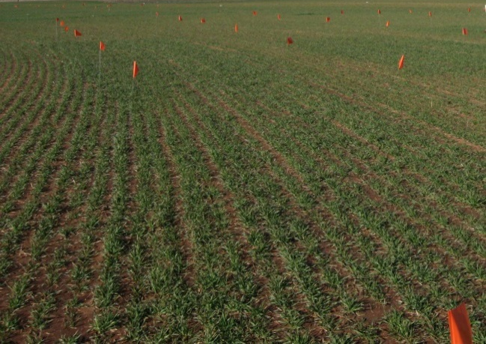
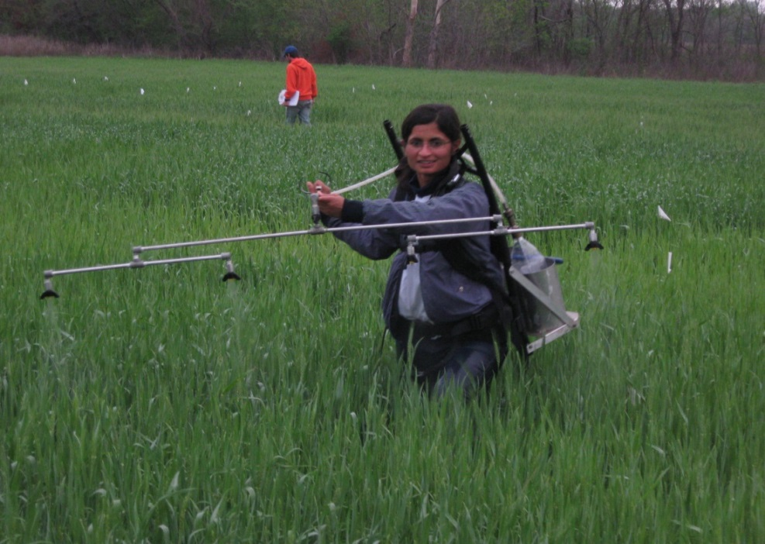
Results
Source of Variation | df | Lahoma Yield Protein |  | Lake C. Blackwell Yield Protein
 |  | PR > F
Pre N | 2 | 0.0002 | 0.0003 | 0.3209 | 0.0449
Fol N | 2 | 0.4630 | 0.4386 | 0.6650 | 0.6207
Fol S | 1 | 0.6458 | 0.2931 | 0.7590 | 0.3276
Pre N *Fol N | 2 | 0.3901 | 0.7689 | 0.8066 | 0.2053
Fol N *Fol S | 1 | 0.3527 | 0.8838 | 0.8544 | 0.6523
Pre N *Fol S | 1 | 0.5643 | 0.5044 | 0.6821 | 0.4734
Pre N *Fol N*Fol S | 1 | 0.9711 | 0.5474 | 0.2516 | 0.8838
When grain yields were higher protein levels were lower
Linear increase in grain protein with increasing preplant N at LCB and LAH
Linear increase in yield at Lahoma with increasing preplant N
Quadratic increase in yield at LCB with increasing preplant N
No response to foliar S at both locations
No response to foliar Cl at both locations
Dhital

Slide 14
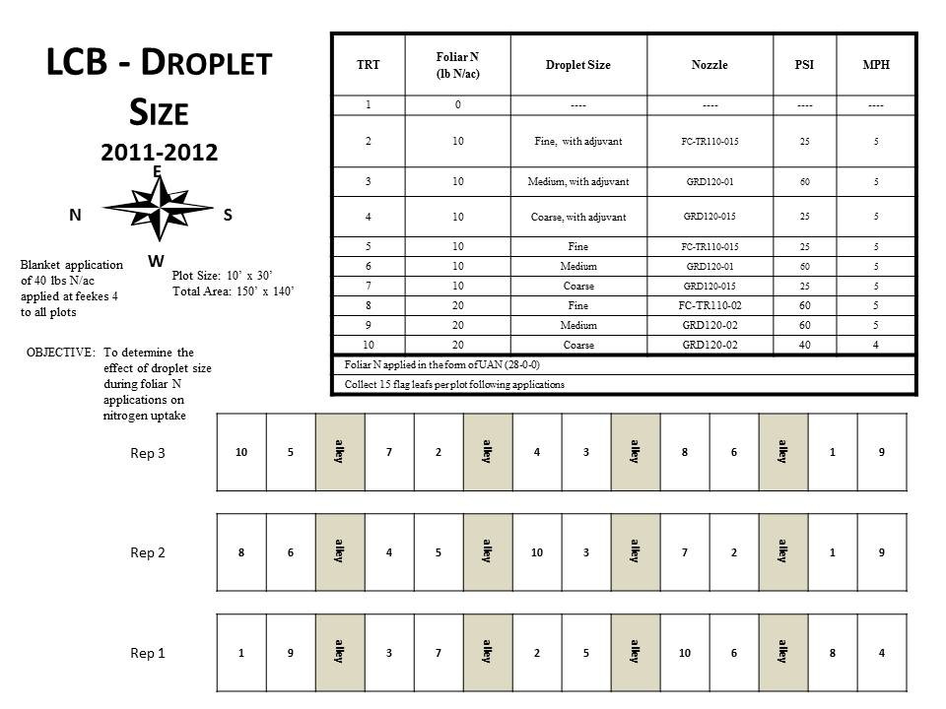
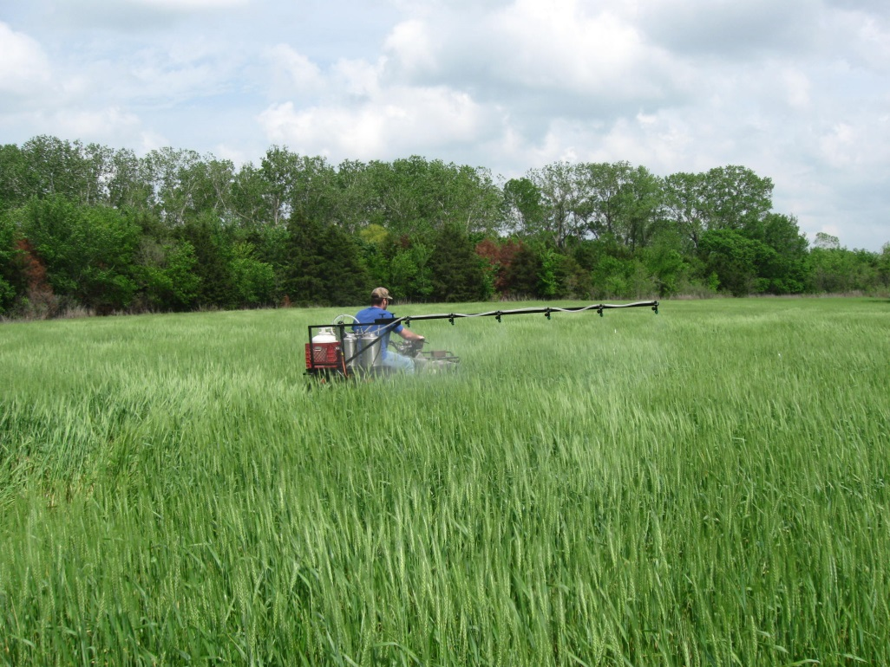
Effect of Droplet Size and Nitrogen Rate on Protein Content of Hard Red Winter Wheat
Objective: Evaluate the effects of droplet size and foliar N rate on wheat grain yield and protein.
Wyatt

Slide 15
Effect of Droplet Size and Nitrogen Rate on Protein Content of Hard Red Winter Wheat
Location: EFAW, Stillwater, OK
Figure 1: Linear relationship between nitrogen rate and grain protein concentration (significant at the 5% level)
Figure 2: Differences in yield and grain protein (droplet size).
Figure 1.
Figure 2.
Wyatt

Slide 16
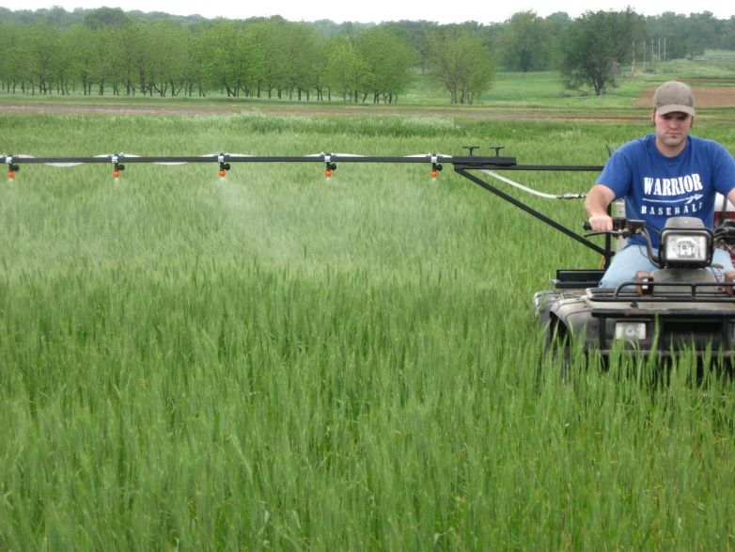
Effect of Droplet Size and Nitrogen Rate on Protein Content of Hard Red Winter Wheat
Location: Lake Carl Blackwell, Oklahoma
Figure 1: Interaction of droplet size and nitrogen rate on yield. Foliar N at 22.4 kg/ha significantly different (5% level)
Figure 2: Relationship of yield and nitrogen uptake with droplet size. Yield and N uptake significant (5% level)
Figure 3: Applying foliar nitrogen to the droplet size experimental plots.
Figure 2
Figure 1.
Wyatt

Slide 17
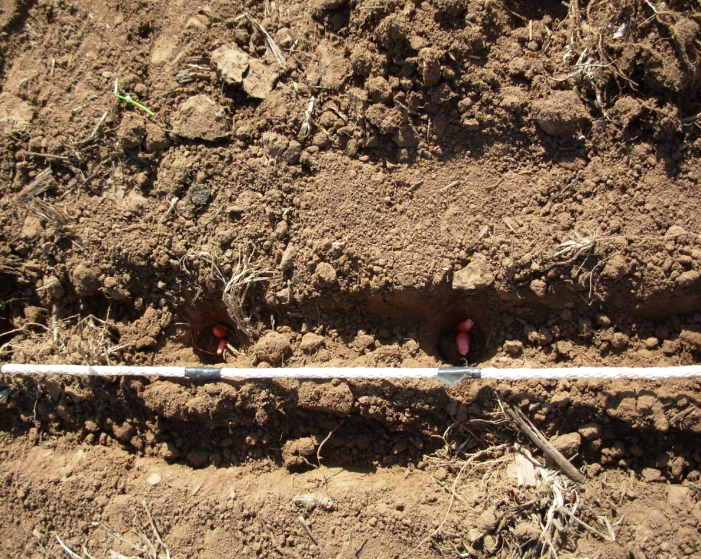
EFFECT OF SEED DISTRIBUTION AND POPULATION ON MAIZE (Zea mays L.) GRAIN YIELDS
Objective
To determine the significance of yield difference between one, two and three seeds per hill
Average maize yield in the developing world is ≤ 2 t/ha
Current planting methods are ineffective
Planting single seeds per strike can increase yield
Omara

Slide 18
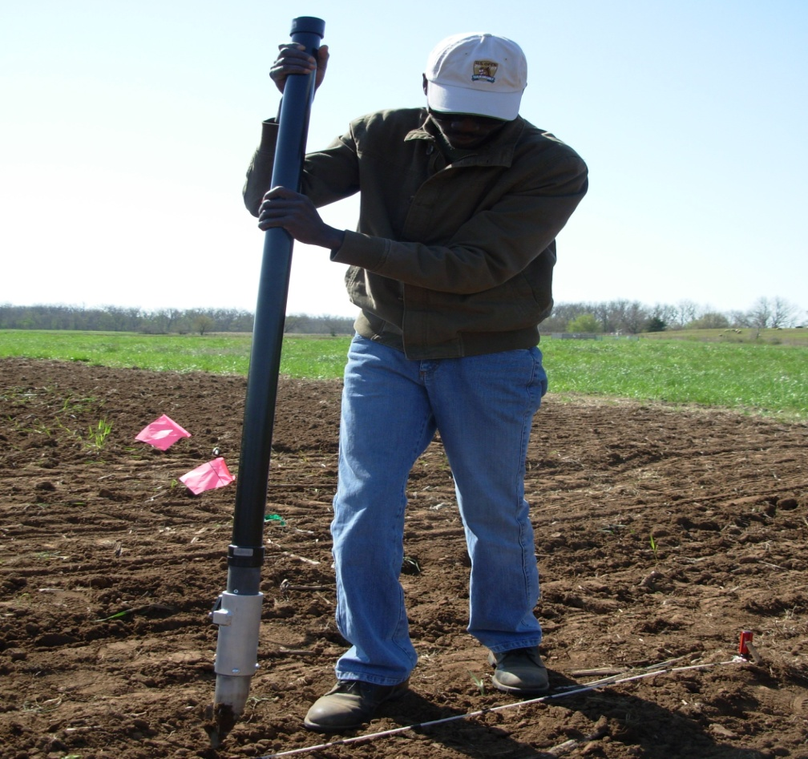
Materials and Methods
Start trial: Summer 2013
Locations: LCB and Efaw, near
Stillwater, OK.
13 treatments and 3 reps at each
location
Factorial study
Plant placement distances
0.16, 0.32 and 0.48 M
Number of seeds per hill: 1, 2
and 3.
Traditional stick planter and new
OSU designed Hand Planter
Expect significantly increased yields when maize is planted with single seeds per strike
Omara

Slide 19
Products
2005 to 2013:
25,000 N Rich Strips have been put on in Oklahoma
represents 1,973,040 acres.
Average profit of $10.00/ac, producers using the GreenSeeker and OSU N Rate recommendation, represents a total positive economic impact of $19,730,400
i-phone, algorithm developed
Trimble Greenseeker Hand Held Crop Sensors manufactured and now sold all over the world
Colorado State University – OSU Workshop
Hand planter prototype nears completion
Alternative Product Evaluation (Avail, Nutrisphere, Agrotain, ESN, Super U, CoRoN, MESZ, ASPA80)
Critical soil pH levels established for sorghum and sunflower
Grain protein optimizer
Ammonia loss calculator
Seed placement, leaf orientation

Slide 20
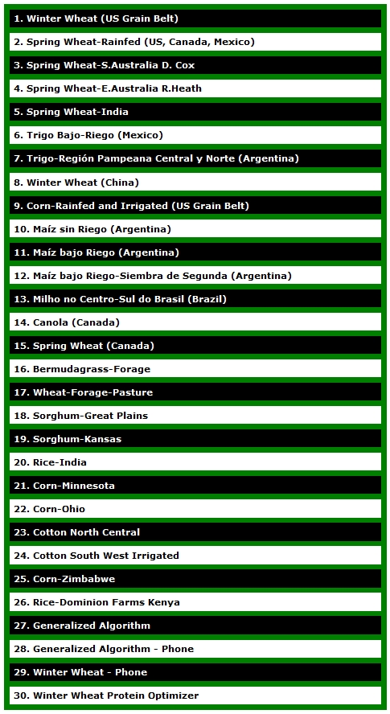
http://www.soiltesting.okstate.edu/SBNRC/SBNRC.php
currently 30 options,
New-protein optimizer

Slide 21
Faculty level graduates
Oklahoma State University
Washington State University
Montana State University
Virginia Tech
Louisiana State University
IPNI Alabama
McNeese State (LA)
Northwest College (WY)
USDA-ARS (SD)
Industry/Private graduates
Mosaic VP
Potash Corp. Director Agronomy
Noble Foundation
John Deere
Bayer Crop Science
SST
CIMMYT-Kenya
CARE-El Salvador
Chapingo, Mexico
National Program, Indonesia
Monsanto 5
Pioneer 2

Slide 22
Sustained Focus Areas
Benefits of variable rate technology for treating spatial variability
Continued demonstration of the N Rich Strip in many crops including canola, corn, switchgrass, and sorghum
Participation in regional trials with Kansas, Nebraska, Missouri, Colorado, Iowa, and Minnesota.
Continued search for alternative light indices capable of detecting P, K, S, and other micronutrient deficiencies.
Graduate program training.
Development of regionally specific algorithms for improved N fertilization (http://www.soiltesting.okstate.edu/SBNRC/SBNRC.php)
GreenSeeker based i-phone applications.
BAE-PASS team development/evaluation of relevant precision agriculture technologies. By-plant recognition, seed placement-seed orientation, hand-planter, new-age-wireless VRT system design.
Refinement of the pocket sensor for widespread use and adoption

