Slide 1
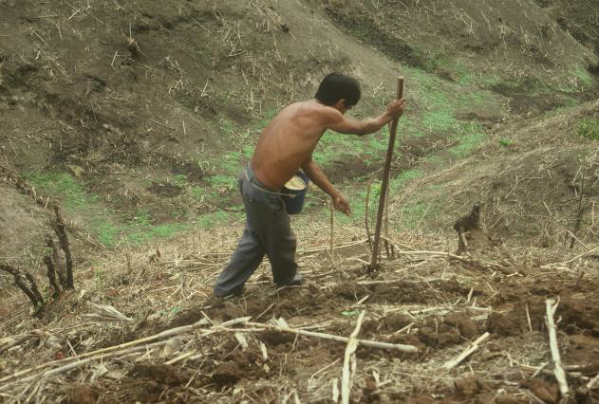
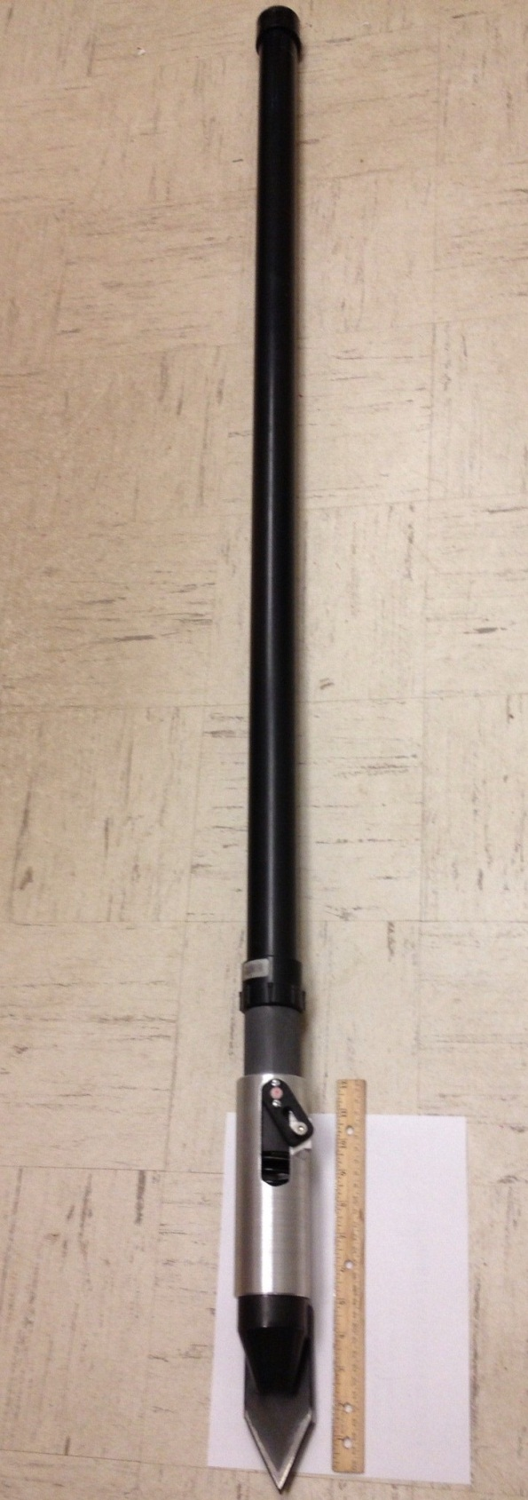
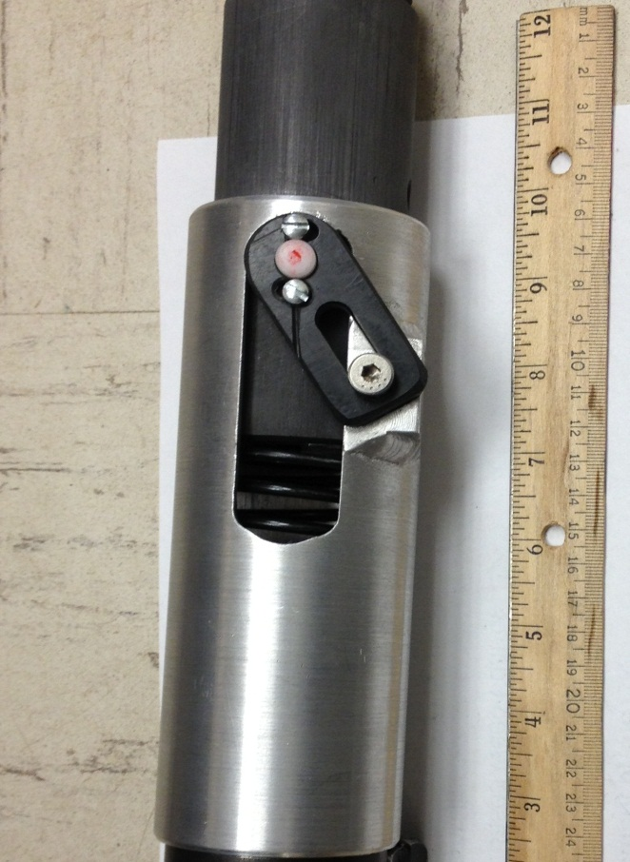
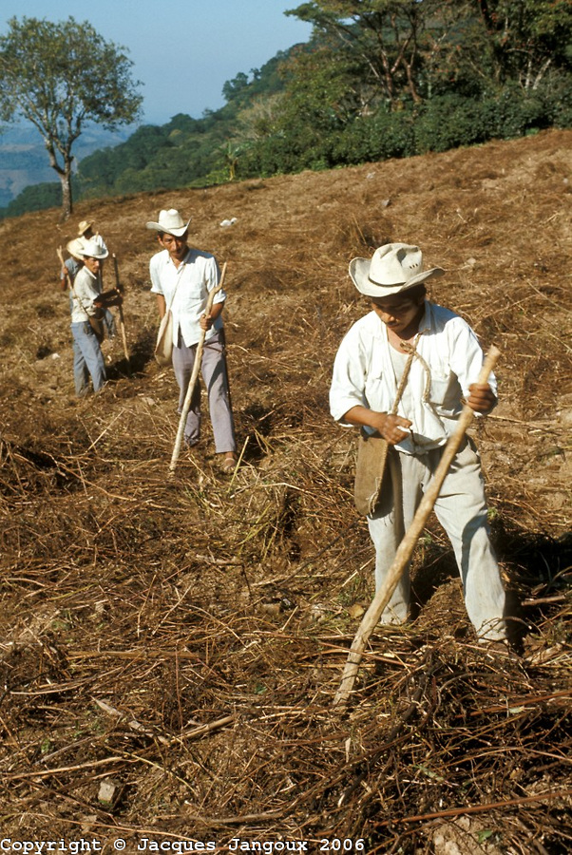
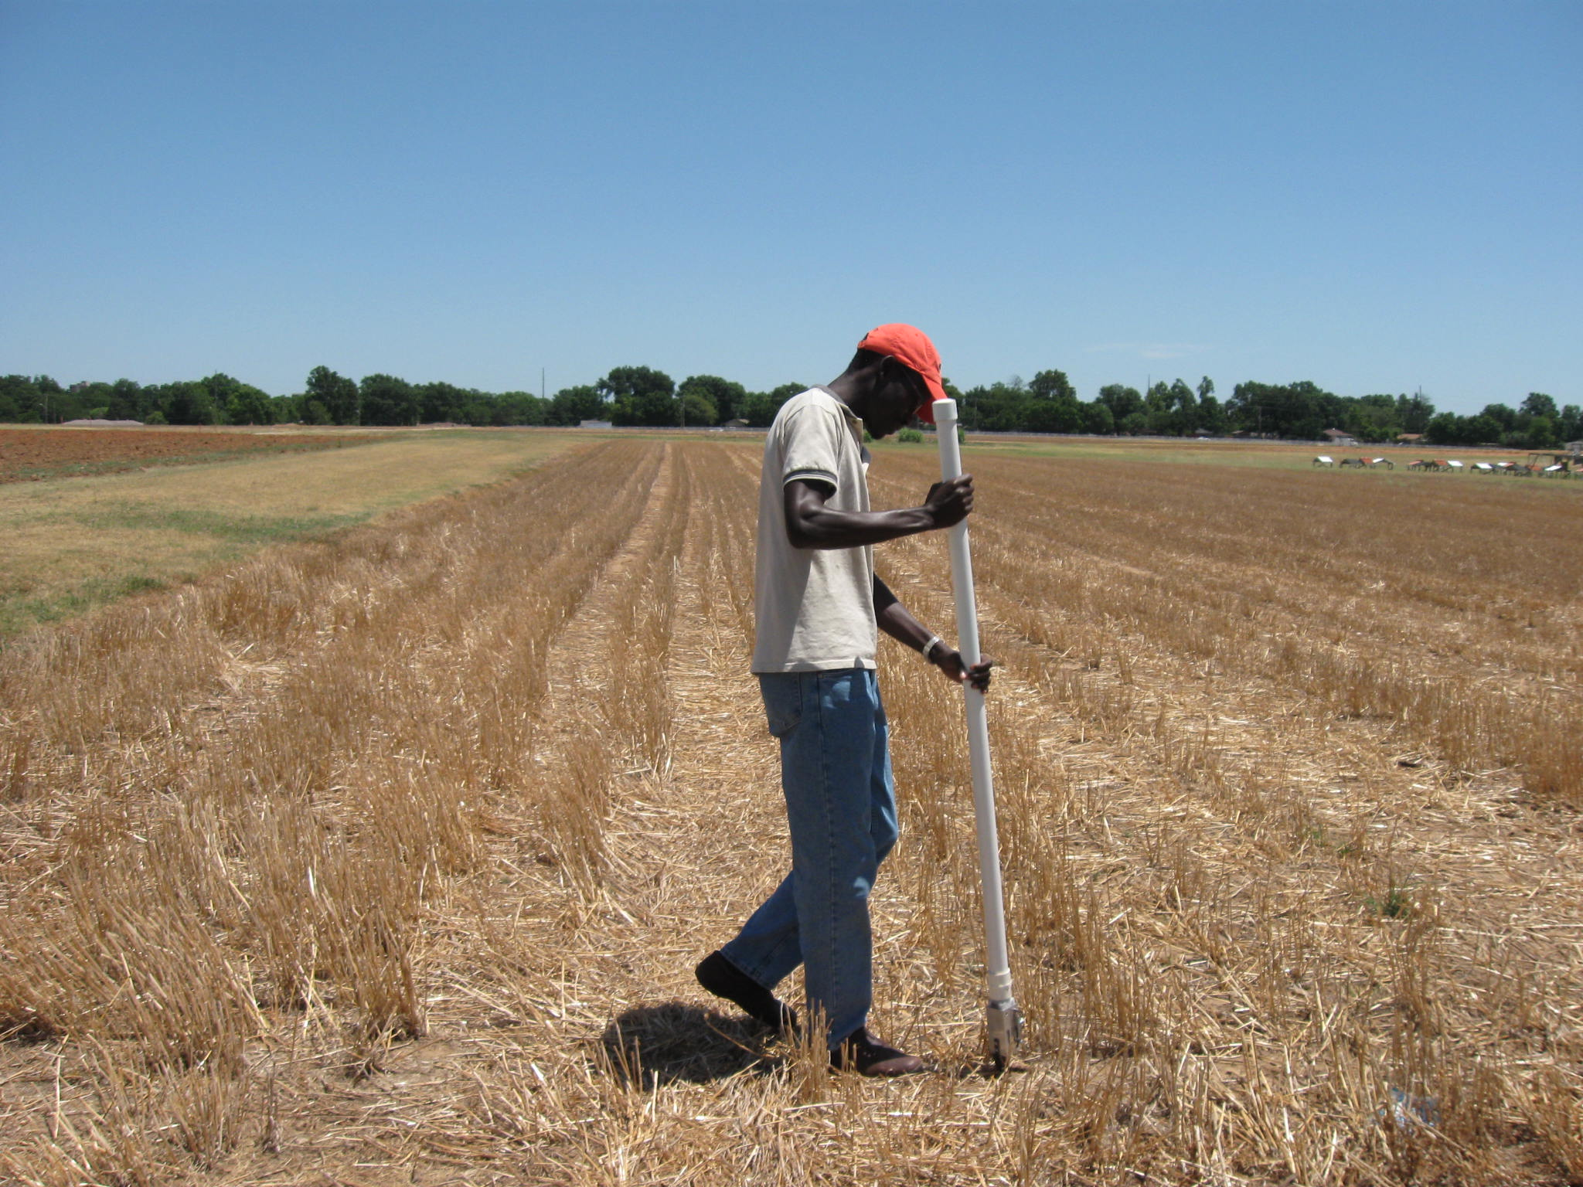
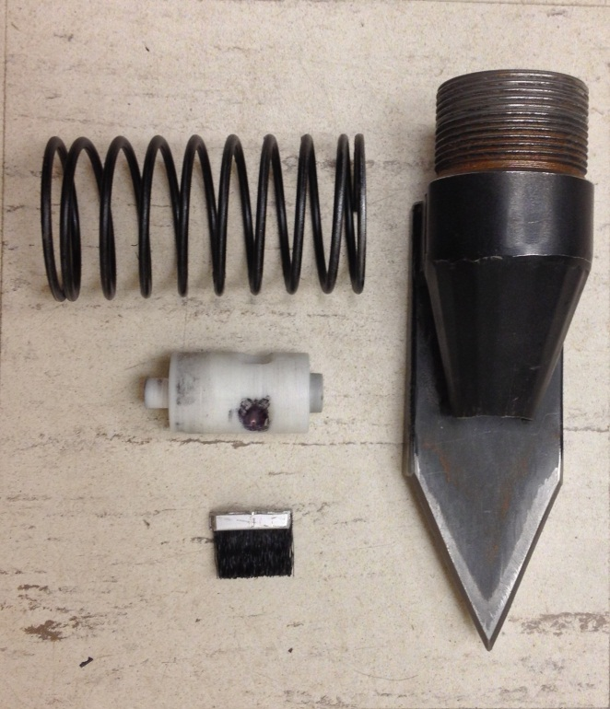
DEVELOPMENT AND EVALUATION OF A SINGULATING MAIZE HAND PLANTER FOR USE IN DEVELOPING COUNTRIES
S. Dhital¹, P. Omara¹, J. Mullock¹, N. Macnack¹, E. Miller¹, J. Bushong¹, E. Wyatt¹, Candibyani¹, M. Del Corso¹, R. Taylor² and W. Raun¹.
¹ Department of Plant and Soil Sciences, Oklahoma State University
² Department of Biosystems and Agricultural Engineering, Oklahoma State University
INTRODUCTION
MATERIALS AND METHODS
Maize (Zea mays L.) is one of the most important staple crops for small farmers in the developing world. Maize is grown in diverse climatic and ecological regions. Maize provides 50 % of the calories to the third world countries (Ofori et al., 2009). In the developing world, maize planting is accomplished with different labor intensive methods. The use of heavy stick is a common practice (Fig.1) where 2-4 seeds are placed per hill at 40 cm apart using wooden sticks. Oklahoma State University has developed a maize hand planter capable of placing single seeds per hill. By decreasing plant spacing to 20 cm apart, this could increase yields by 25% .
OSU planter tested in January 2013 to evaluate performance, variables seed size, drum, spring and brush.
Three seed sizes: large round (LR), medium round (MR) and medium flat (MF), two springs: black and yellow, and three brushes: 2, 3 and 4 and four different drums(cavity depth, cavity angle): X(0.26, 20°), R(0.26, 25°), G(0.235, 25°) and D1(0.235, 25°) were used.
Each seed size was tested with alternative brush, drum and springs. OSU planter operated for a total of 100 strikes.
Number of seeds coming out of the planter (singles, doubles) along with blanks were recorded. Testing the process was repeated for all seed sizes and variables.
Data were analyzed using SAS statistical software and the progress of singulation on changing different variables was determined.
Fig .5 Performance of Drums (G, R, X,) Over Time
Performance of drum G, R and X are reported. X showed a clear trend in increasing singulation with decreasing doubles and blanks. The drum D1 was the highest (not included in graph).
RESULTS AND DISCUSSION
S I N G U L A T I N G M A I Z E H A N D P L A N T E R
Fig. 1 Farmer in Central America planting maize with traditional metal/wooden stick
OBJECTIVES
To develop a singulating maize hand planter that delivers at least 90 % single seeds and that will result in increased yields and planting efficiency
Fig .6 Average Singles, Doubles and Blanks for Brush, Drum and Spring
Fig. 3 Percentage of Singles, Doubles and Blanks for Large round, Medium round and Medium flat Seeds.
The combination of brush 4, drum G and Black Spring gave the highest singles (86) with lowest doubles and blanks.
DESIGN
Singulation percentage for seedsize was not different. However, LR seed performed repeatedly better by giving higher singulation, above 76 percent. MF and MR were between 62-80 percent.
CONCLUSIONS
The hand planter has a seed hopper made of a Polyvinyl Chloride pipe, 1.4 m long. Attached to the hopper is a metering system consisting of a spring, drum and brush. A striking force applied rotates the drum, which captures and releases one seed at a time. The brush helps control the number of seeds captured by the drum. The size of the drum cavity determines the number of seeds released, whereas the strength of the spring indicates the force required to release the seeds. A planter tip with is attached to the metering system.
Increase in singulation percentage over time attributed to changing drum (cavity depth and angle) and brush position.
Percentage of blanks and doubles decreased with changing drum and brush position.
Singulation for seedsizes were not significantly different.
New drum D1 with medium flat seed was able to give the highest percentage (94), avg of 86.
Results form a good foundation for commercialization of the OSU maize hand planter
Fig. 2 (from left) traditional planter, OSU singulating maize hand planter, (top right) the metering system, (bottom right) the components in the system: spring, brush, drum and tip.
Fig. 4 Average Performance of Planter with Different Drums
The drums R, X and G were not significantly different. Overall, the latest drum D1 gave the highest percentage singulation with a significant decrease in blanks and doubles. This is because of the position of the brush on drum D1, was different from other drums.

