Slide 1
Energy Harvesting for a Stick Planter
Final Presentation
A. Koller & J. Rascon
BAE 5030, Spring 2011

Slide 2
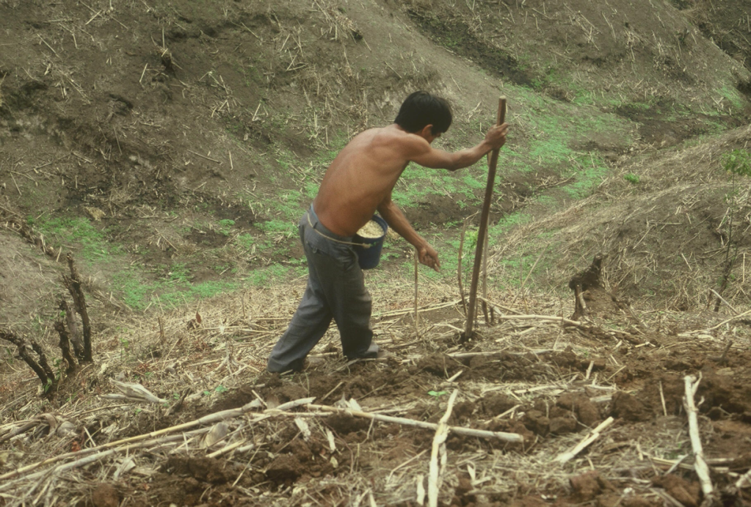
Overview
Rural Central American
Farmers use
Stick Planters to plant
corn
  Planting in "hills"
  Too far apart
  Touching treated seeds with bare hands
Develop a Stick Planter that
  Singulates seeds
  Removes the need to touch seeds
Harvest energy from planting motion to "power" stick

Slide 3
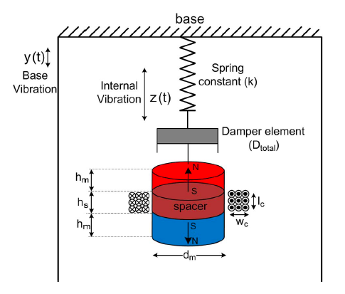
Use Coil Inductance as Microgenerator
A magnet moves relative to a coil
→ generates an electromagnetic
field
Store energy in a capacitor
Drive a seed release/singulation
system
Source: Dayal et al., 2011. "A new design for vibration-based Electromagnetic Energy Harvesting Systems Using Coil Inductance Microgenerator", IEEE Transactions, vol. 47, pp. 820-830.

Slide 4
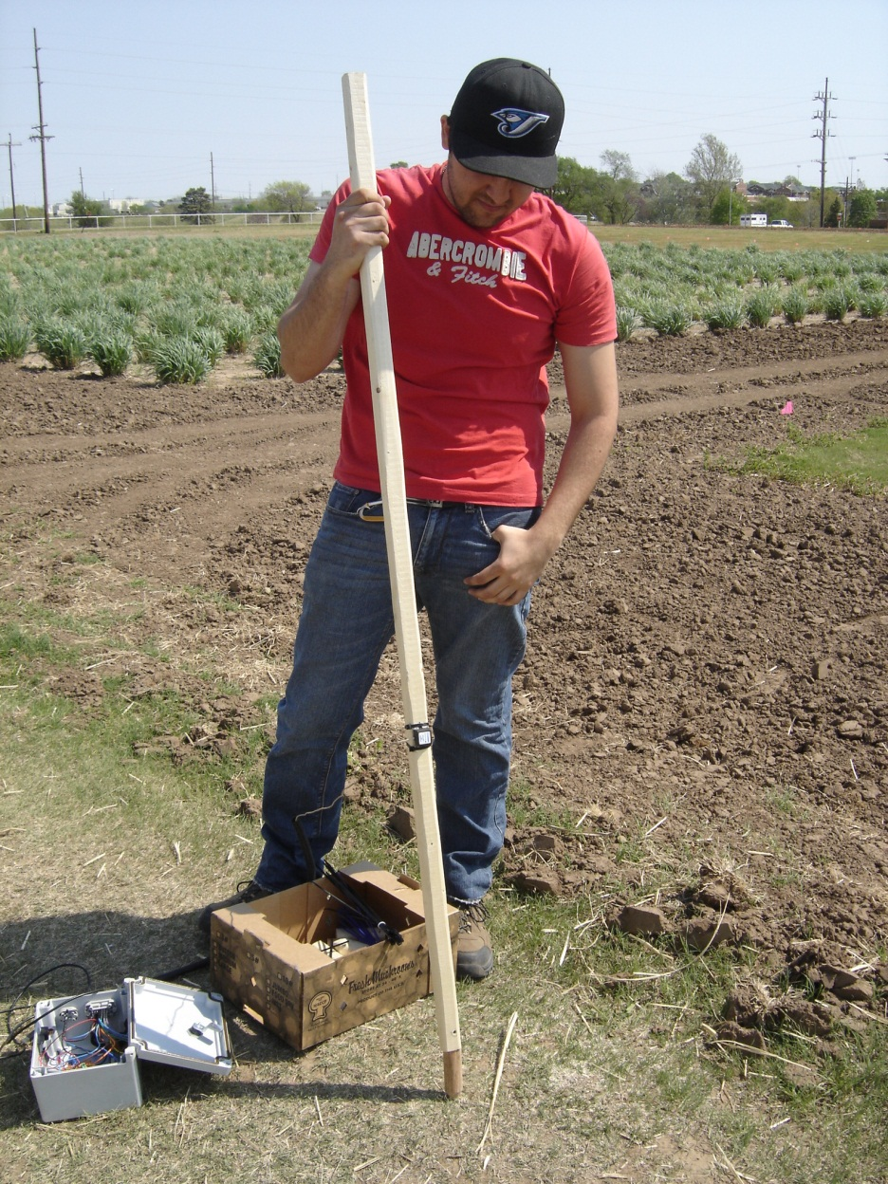
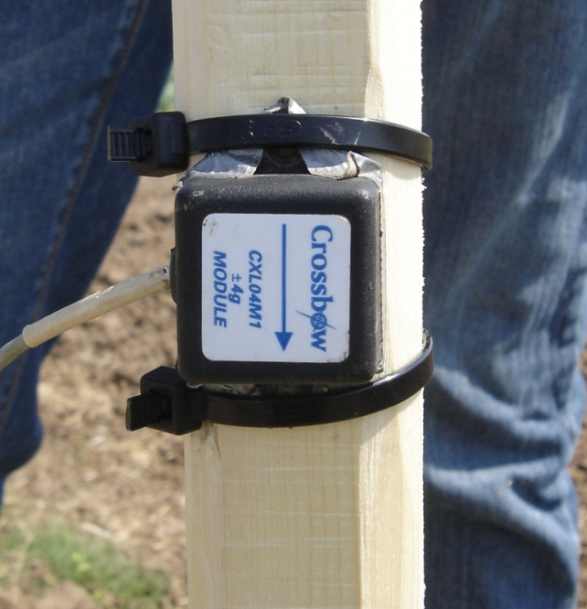
Input Characterization

Slide 5
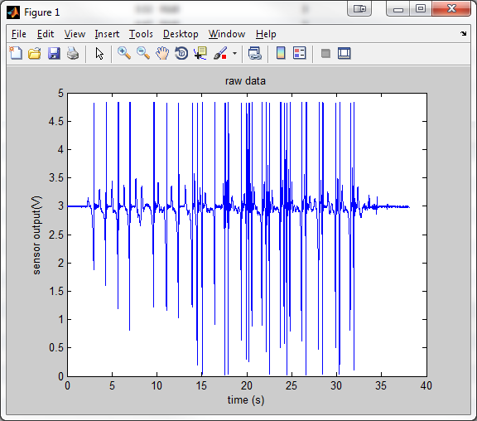
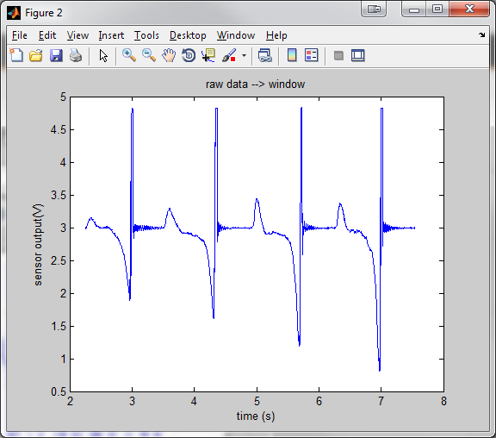
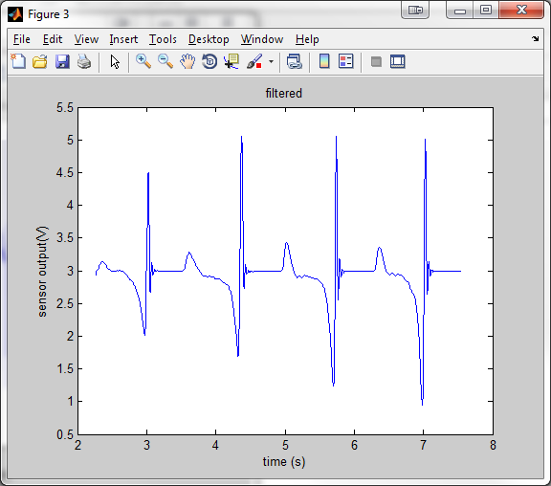
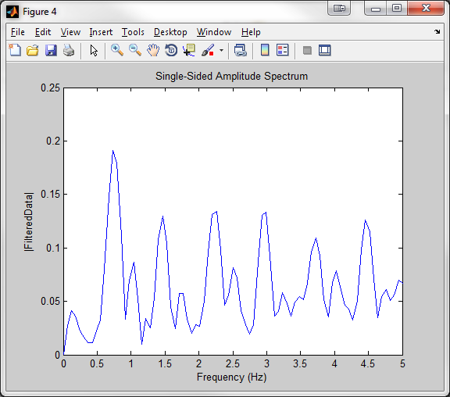
Data Analysis
Target Resonance

Slide 6

Experimental design
Electromagnetism materials
  Magnet
Neodymium Rod
Diameter: 0.875”
Length: 1”
Neodymium sphere
Neodymium Rod
Diameter: 0.375”
Length: 1”
Mass: 13.38 g
Mass: 72.82 g
Mass: 7.93 g
Diameter: 0.5”

Slide 7
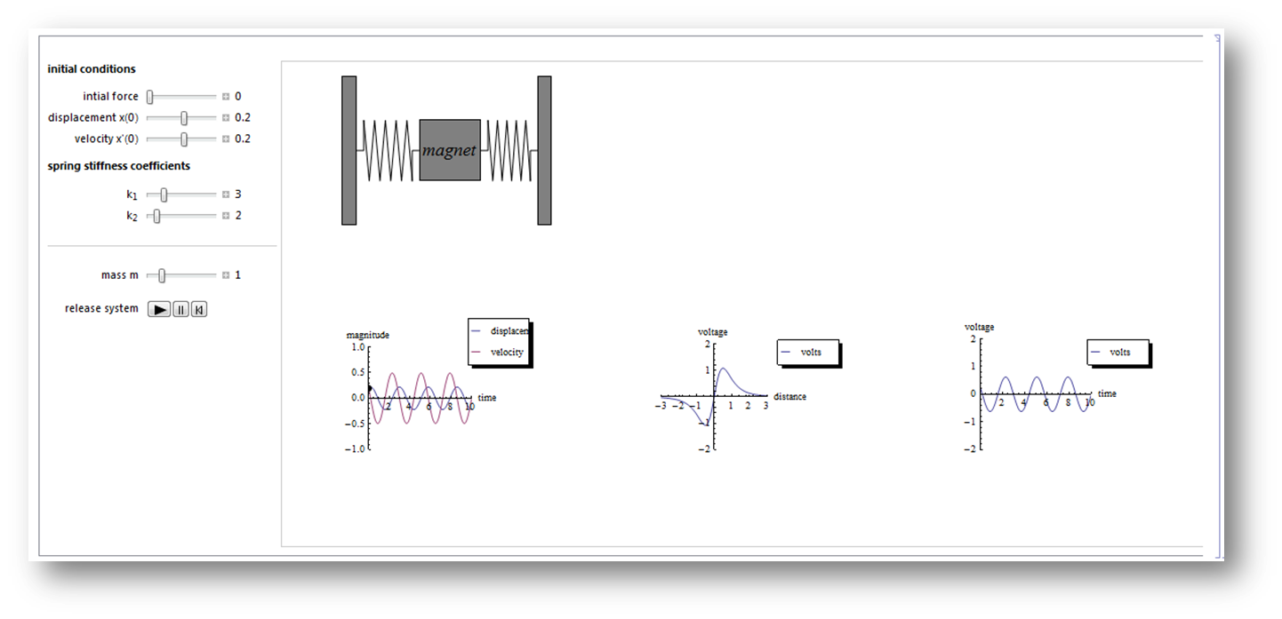
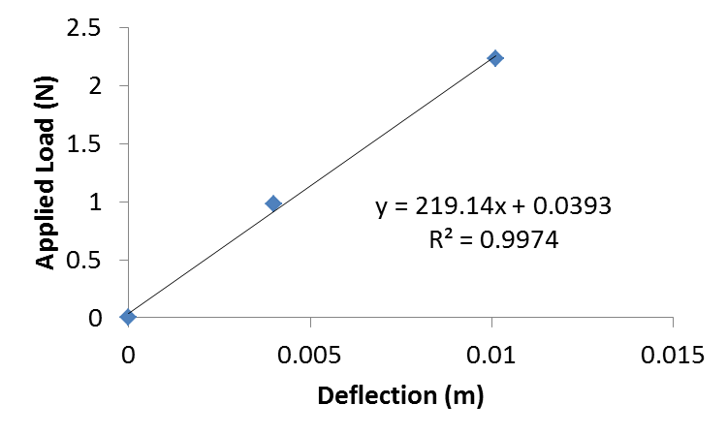

Spring Sizing
Target: Resonance at 4.5 Hz
$f=\frac{1}{2π} \sqrt{\frac{2k}{m}}$
Given f, m → find k
➔ required spring constant: k = 5.4 N/m
Available "Scrap Spring":
  Length = 1"
  k around 220 N/m ➔ too stiff
g

Slide 8
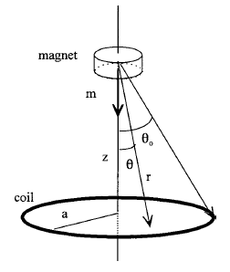

Capsule Dimensions (1/3)
According to Kingman et. al (2001), extreme values of induction are proportional to $\frac{1}{a^{2}}$ and occur at a ratio of Γ = z/a = ±1/2 .

Slide 9
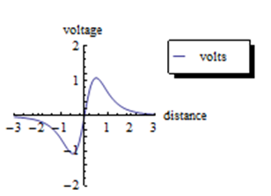
Capsule Dimensions (2/3)
  The objective was to capture at least 90% of the energy under the curve. So, according to the graph we use ±2 ratio.

Slide 10
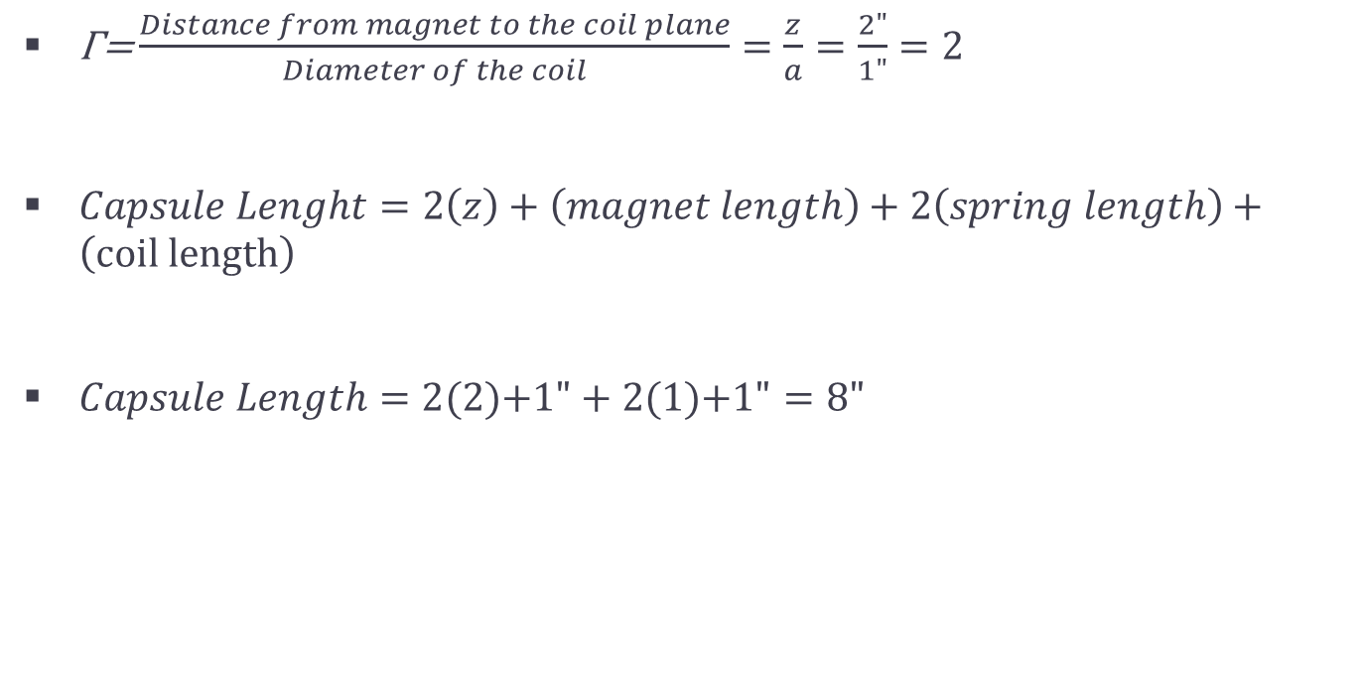
Capsule Dimensions (3/3)
$\text{Γ}\text{=}\frac{Distance from magnet to the coil plane}{Diameter of the coil}=\frac{z}{a}=\frac{2"}{1"}=2$
$Capsule Lenght=2\left(z\right)+\left(magnet length\right)+2\left(spring length\right)+\left(coil length\right)$
$Capsule Length=2(2\text{)+1"}+2(1\text{)+1"}=8"$

Slide 11
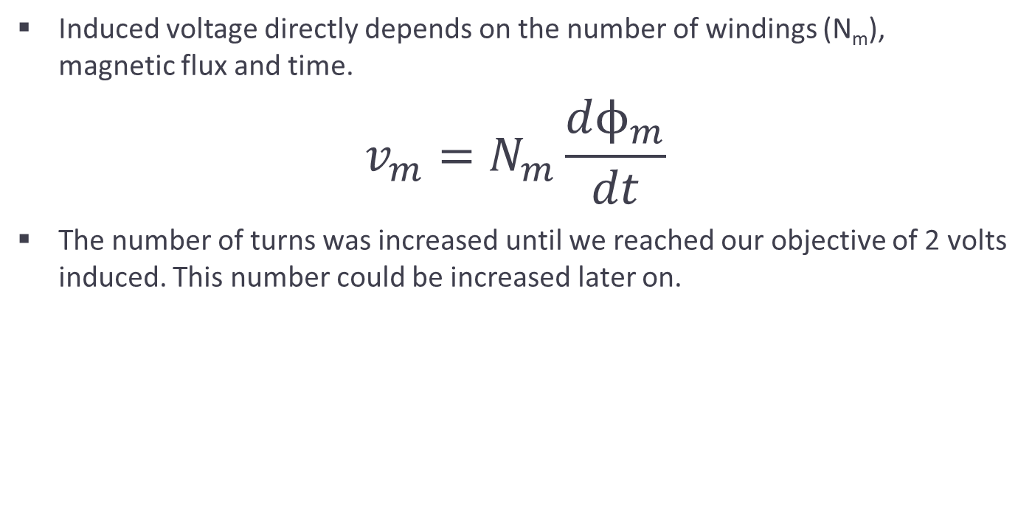
Number of turns
Induced voltage directly depends on the number of windings (N_{m}),
magnetic flux and time.
$$v_{m}=N_{m}\frac{dϕ_{m}}{dt}$$
The number of turns was increased until we reached our objective of 2 volts induced. This number could be increased later on.

Slide 12
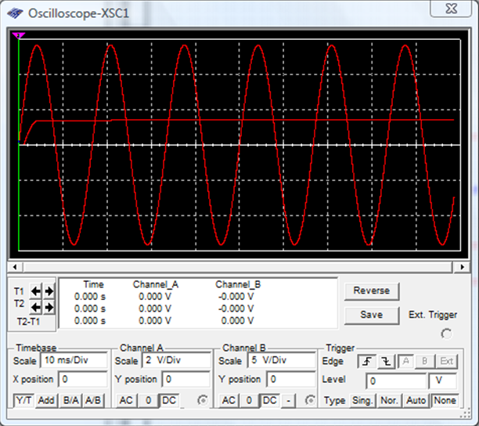
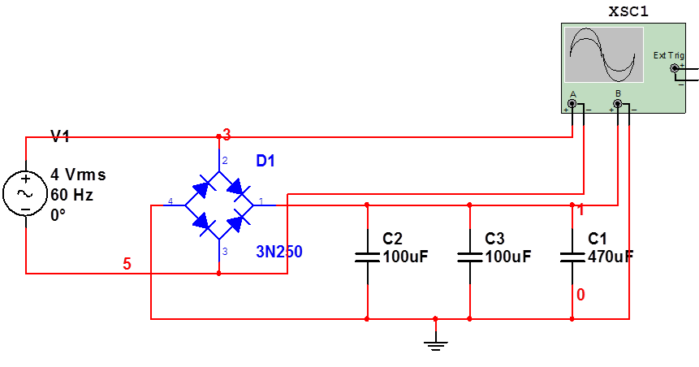
Circuit Design

Slide 13
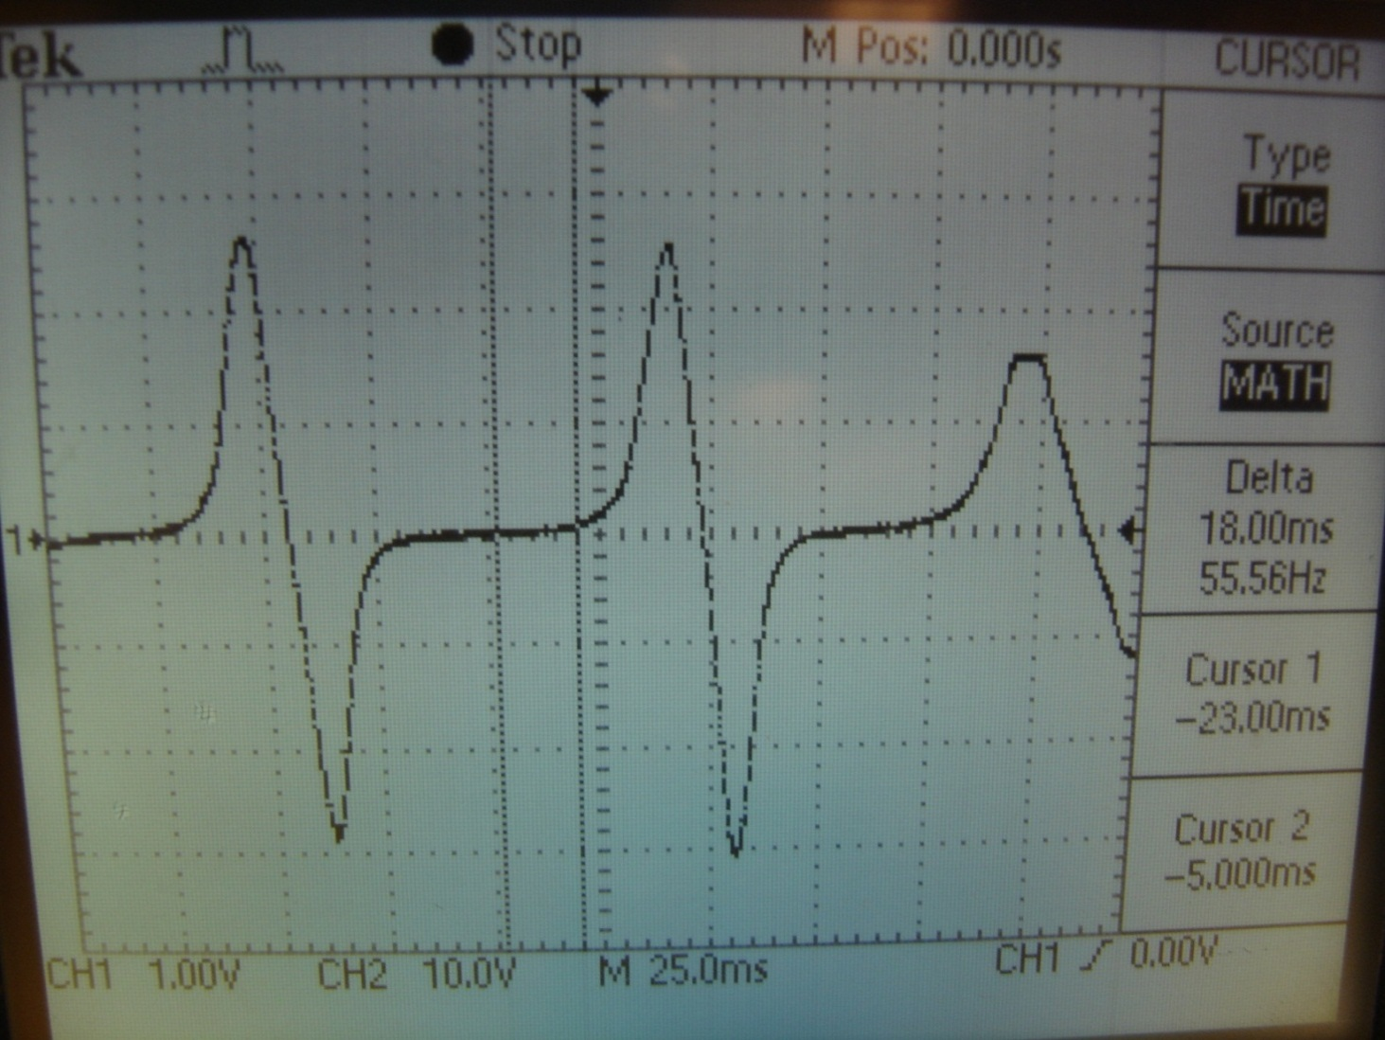
Test Results
Voltage output

Slide 14
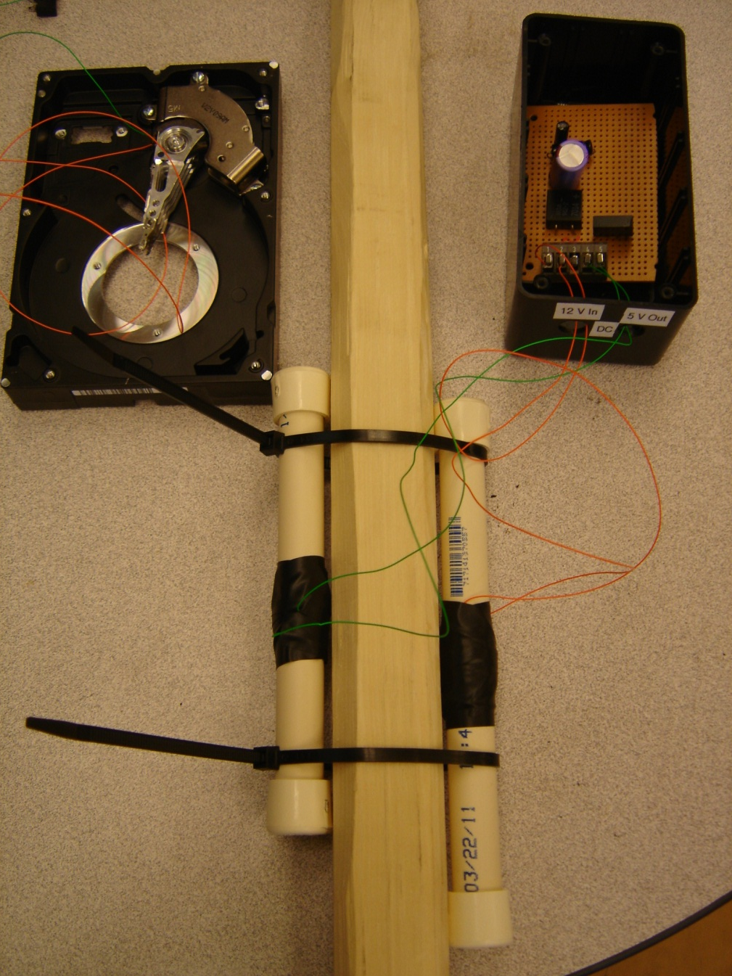
Stick Assembly

Slide 15
Discussion
Objectives accomplished
  Harvest energy from planting motion to "power" stick
  Develop a light-weight energy harvesting system
Further research
  Modifications
    Springs
    Number of turns
    Arrangement of turns
  Singulation/seed release

Slide 16
Any questions?

