Slide 1
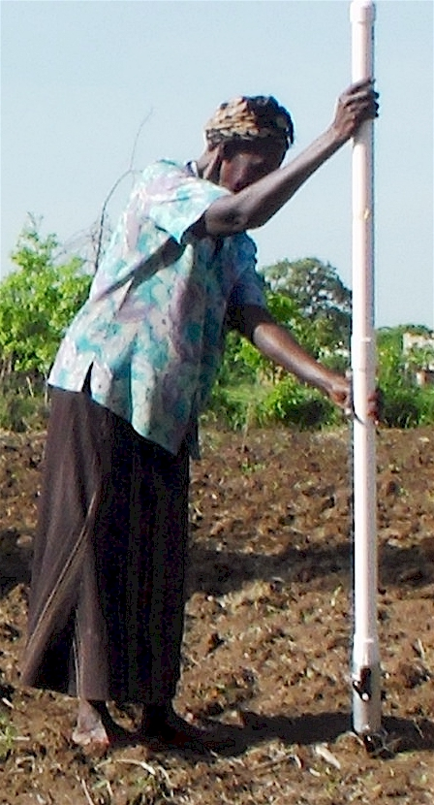
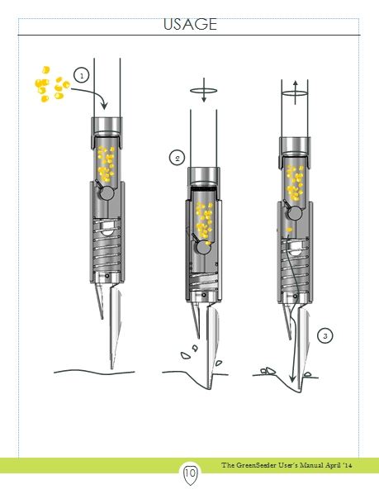
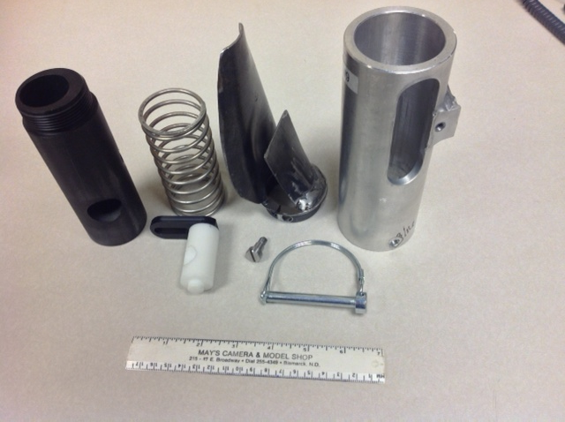
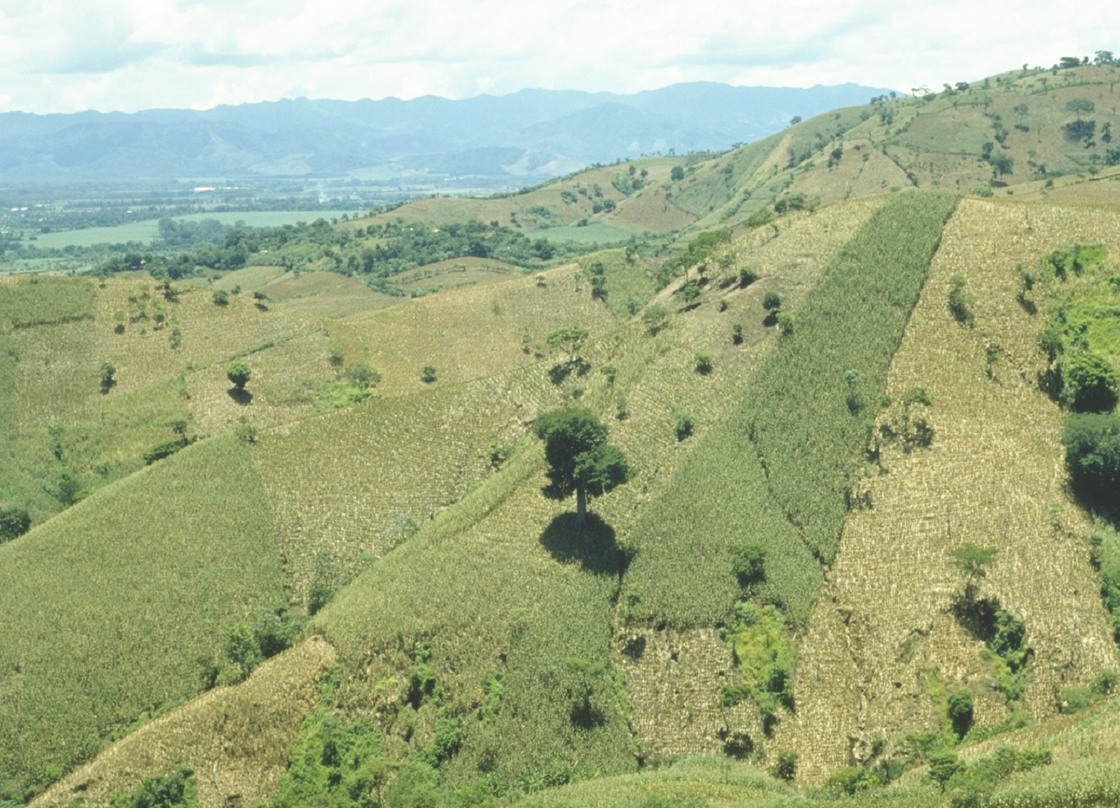
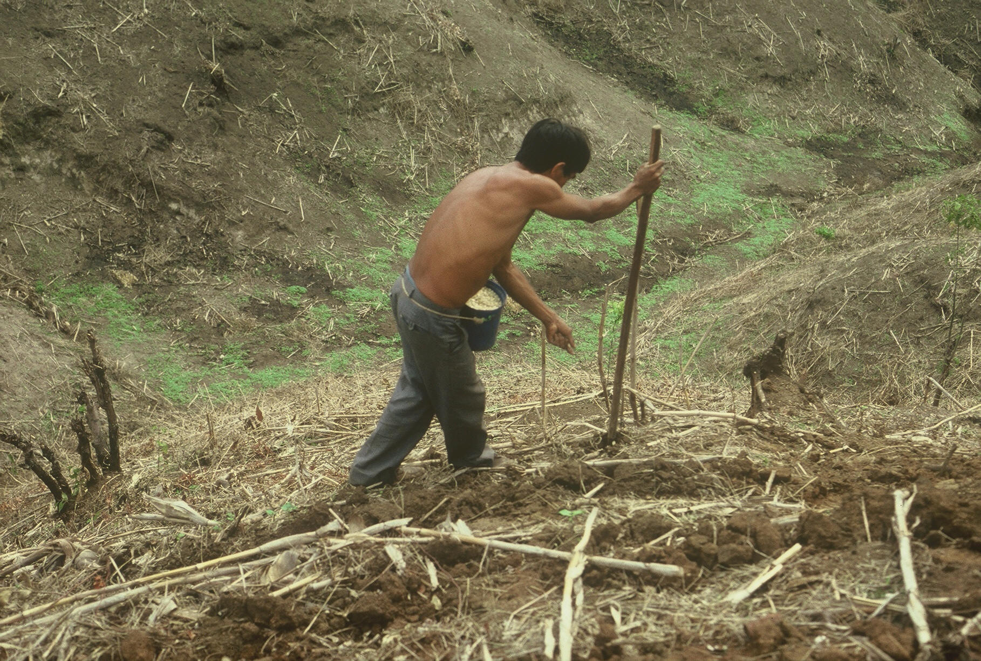
OSU GreenSeeder Planter
Mike.davis10@okstate.edu
World area planted by hand ≈ corn area in the USA (35M ha’s)
Developing world, avg. farm size = 1 ha
By 2050 there will be 9.1 billion people.
Increase of 30%
Food production will have to increase 70%
95% of increased population will be in the developing world
Benefits
Remove chemically treated seeds from the hands of small farmers
Decrease soil erosion via improved plant spacing
Accommodate mid-season application of urea-N
Place urea below the surface reducing NH3 losses
Potential to increase maize production and NUE
OSU Planter and components
Marginal landscapes where maize is planted (El Salvador)

