Slide 1
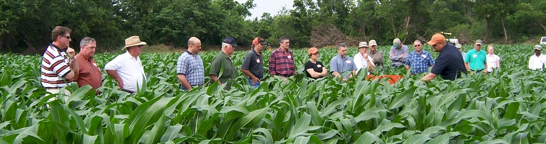


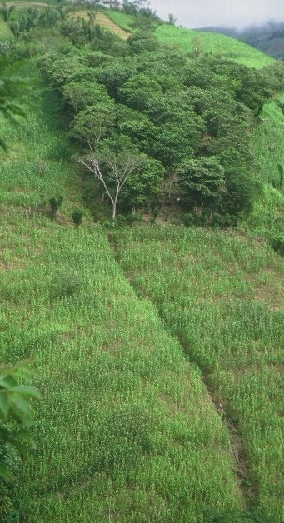
nutrient management research/teaching feb 16, 2015

Slide 2
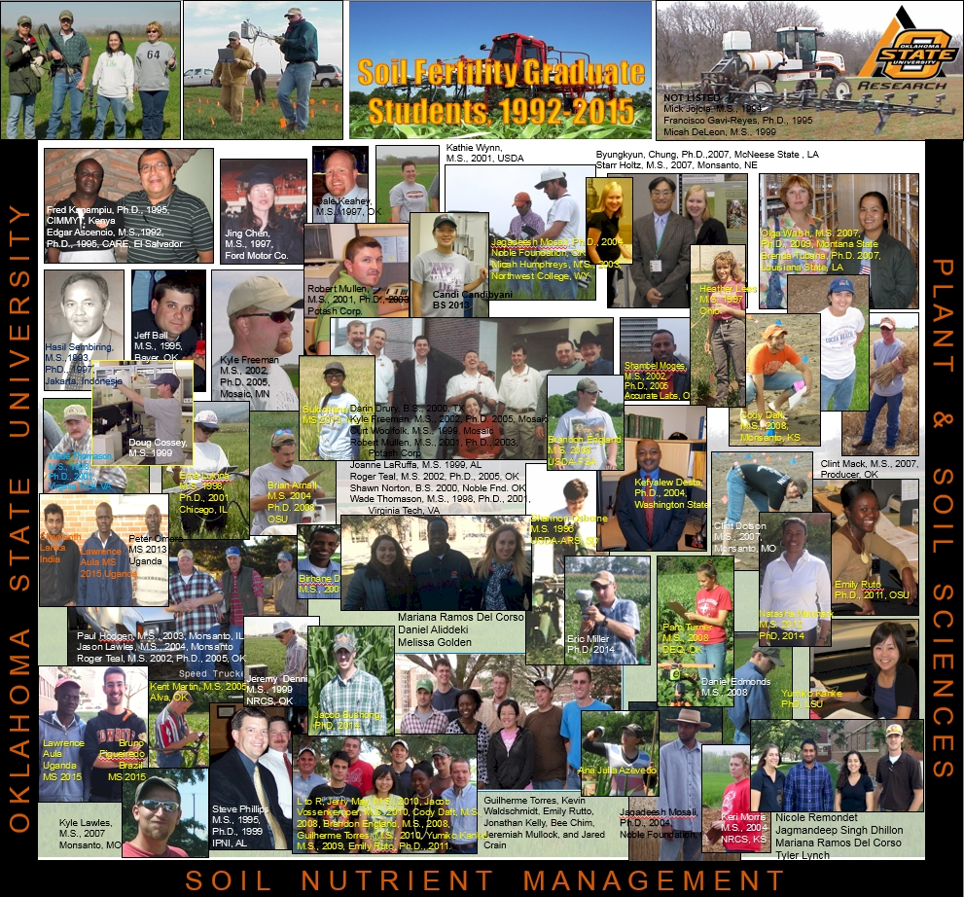
75 thesis-degree graduates
25 PhD, 50, MS

Slide 3
plan
10-15 minutes/day
ask good questions

Slide 4
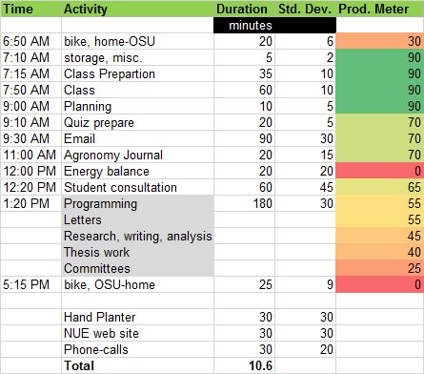

Slide 5
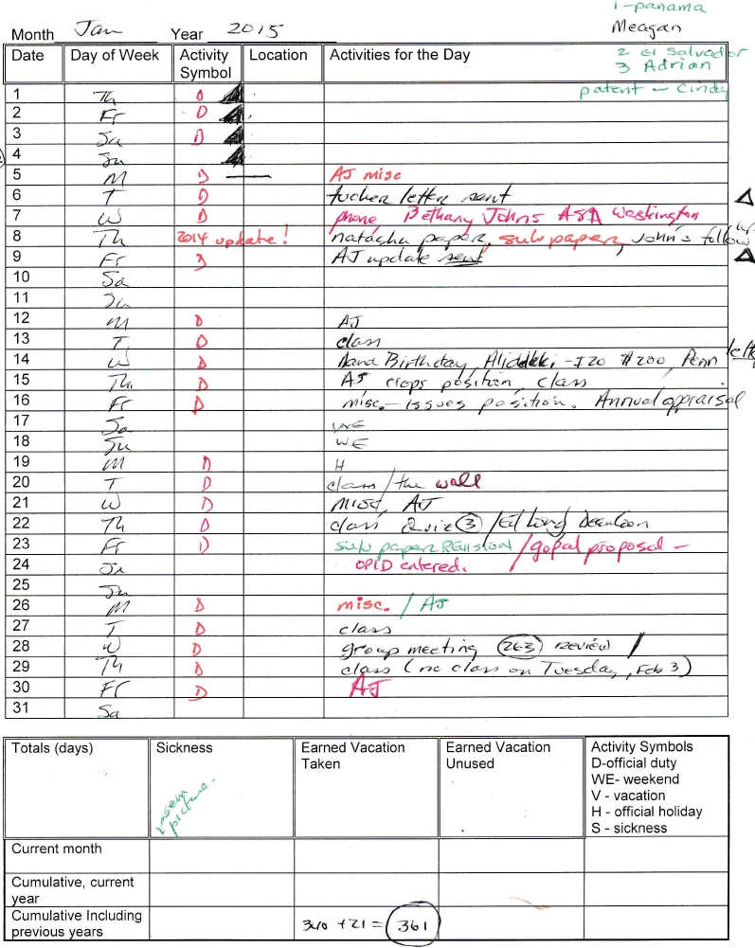

Slide 7
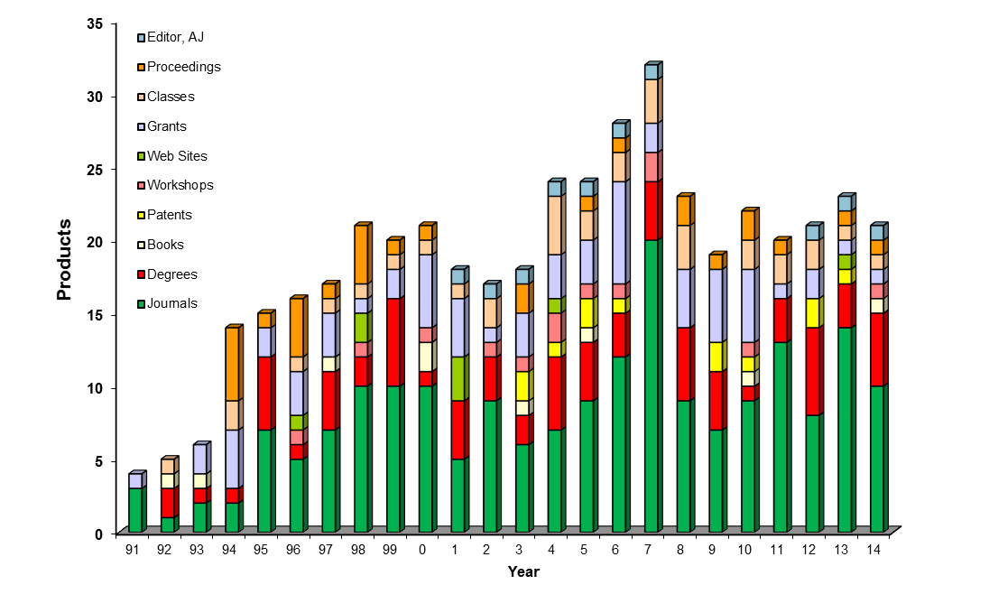
products
> 1 per month
average: 19

Slide 8
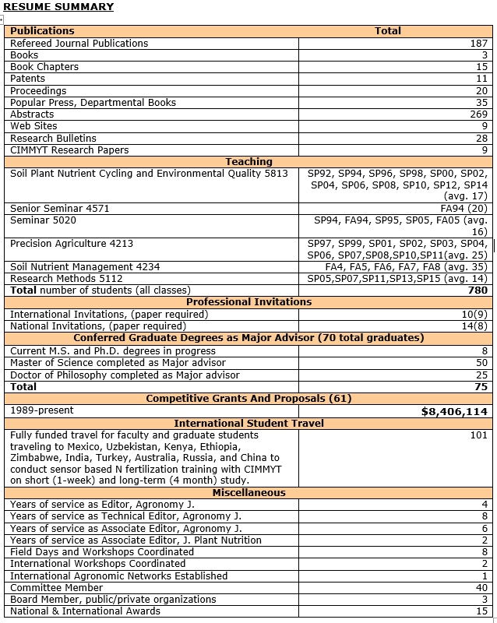

Slide 9
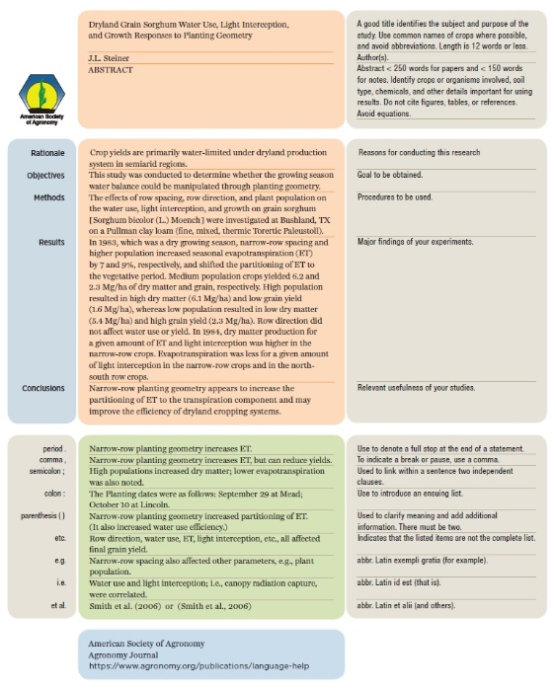
abstract =
handshake
Total = 638
Rejected outright = 154
Reviewed = 484
Accepted = 40%

Slide 10
ATMOSPHERE
GLOBAL WARMING
15-40 kg/ha
N₂O
NO
N₂
INDUSTRIAL
FIXATION
LIGHTNING,
RAINFALL
CH_{4 ,} N₂O
N2 FIXATION
HABER BOSCH
PLANT AND ANIMAL
RESIDUES
SYMBIOTIC
NON-SYMBIOTIC
(1200°C, 500 atm)
MESQUITE
RHIZOBIUM
ALFALFA
SOYBEAN
BLUE-GREEN ALGAE
AZOTOBACTER
CLOSTRIDIUM
3H₂ + N₂ 2NH₃
MATERIALS WITH N
CONTENT > 1.5%
(COW MANURE)
MATERIALS WITH N
CONTENT < 1.5%
(WHEAT STRAW)
10-80 kg/ha
FERTILIZATION
PLANT
LOSS
AMINO
ACIDS
MICROBIAL
DECOMPOSITION
0-50 kg/ha
NH₃
IMMOBILIZATION
AMMONIA
VOLATILIZATION
AMINIZATION
ORGANIC
MATTER
HETEROTROPHIC
R-NH₂ + ENERGY + CO₂
BACTERIA (pH>6.0)
FUNGI (pH<6.0)
R-NH₂ + H₂O
pH>7.0
NH₂OH
AMMONIFICATION
FIXED ON
EXCHANGE
SITES
IMMOBILIZATION
R-OH + ENERGY + 2NH₃
Pseudomonas, Bacillus,
Thiobacillus Denitrificans,
and T. thioparus
N₂O₂⁻
MICROBIAL/PLANT
SINK
2NH₄⁺ + 2OH⁻
MINERALIZATION
+ NITRIFICATION
NO₂⁻
+O₂
DENITRIFICATION
Nitrosomonas
NO₃⁻
POOL
NITRIFICATION
OXIDATION STATES
DENITRIFICATION
LEACHING
LEACHING
VOLATILIZATION
NITRIFICATION
Nitrobacter
+ O₂
2NO₂⁻ + H₂O + 4H⁺
NH₃ AMMONIA -3
NH₄⁺ AMMONIUM -3
N₂ DIATOMIC N 0
N₂O NITROUS OXIDE 1
NO NITRIC OXIDE 2
NO₂⁻ NITRITE 3
NO₃⁻ NITRATE 5
TEMP 50°F
Joanne LaRuffa
Wade Thomason
Shannon Taylor
Heather Lees
Department of Plant and Soil Sciences
Oklahoma State University
ADDITIONS
LEACHING
LEACHING
LOSSES
LEACHING
OXIDATION REACTIONS
pH 7.0
0-40 kg/ha
REDUCTION REACTIONS

Slide 11
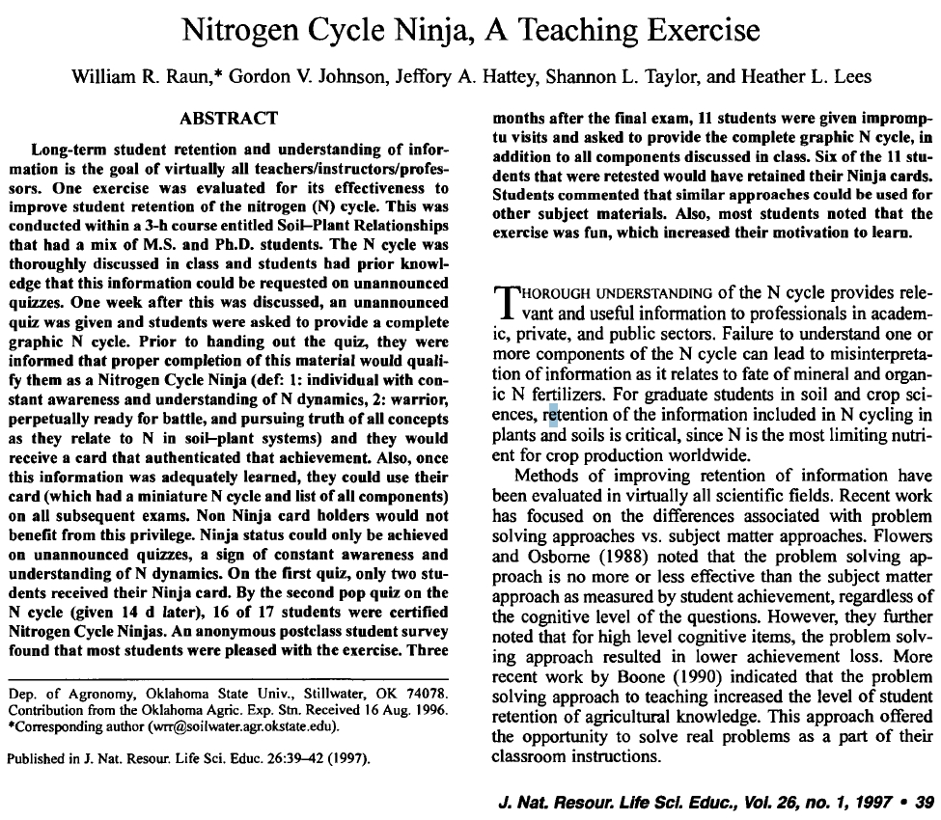
need a product to go with everything you do
2004-2009 175 Raun
2009-pres. 191 Arnall

Slide 12
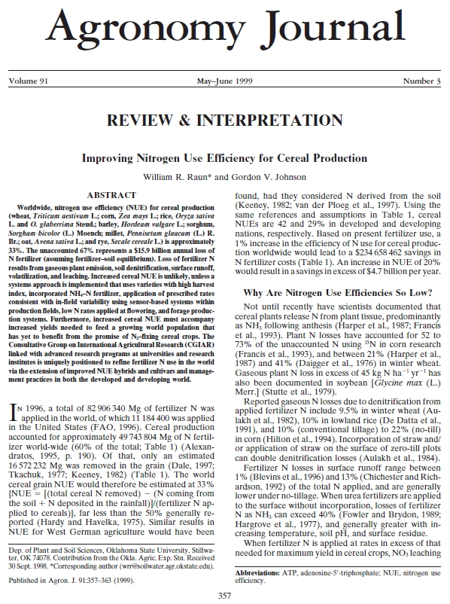
worldwide, nitrogen use efficiency (NUE) for cereal production is approximately 33%
Raun, W.R., and G.V. Johnson. 1999. Improving nitrogen use efficiency for cereal production. Agron. J. 91:357-363.

Slide 13
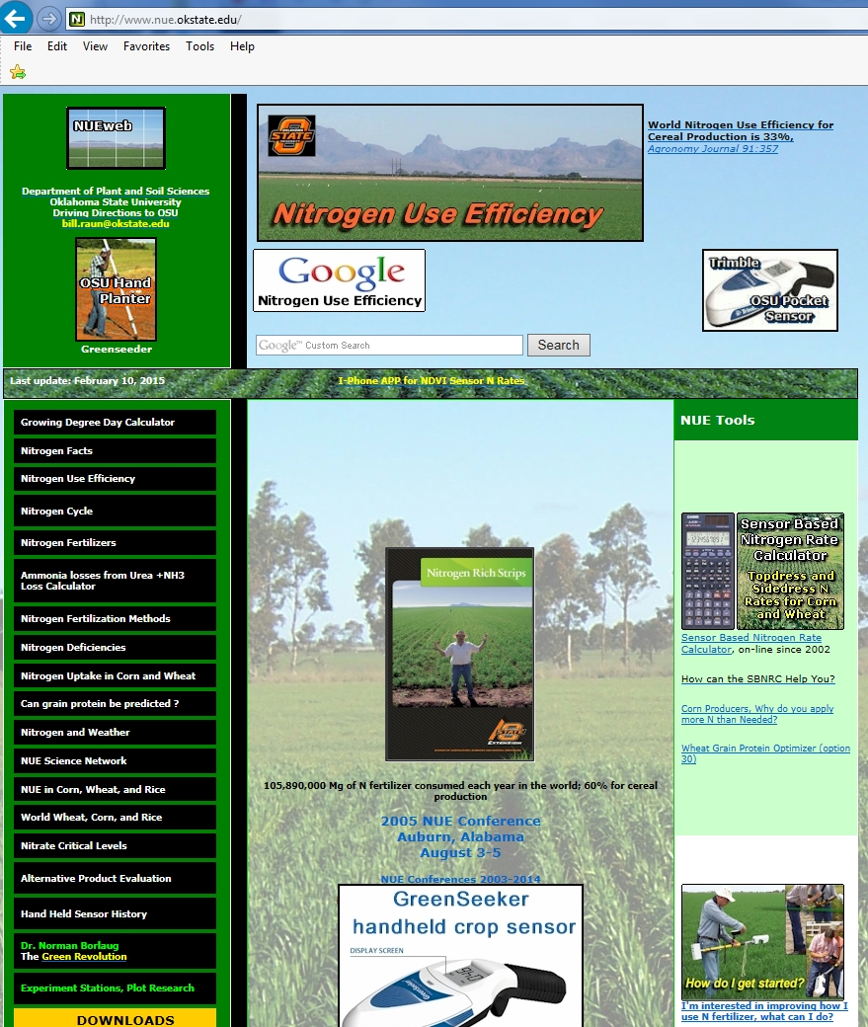
Sensor Based Nitrogen Rate Calculator
32 options
maize
winter wheat
spring wheat
rice
canola
bermudagrass
sorghum
protein (wheat)

Slide 14
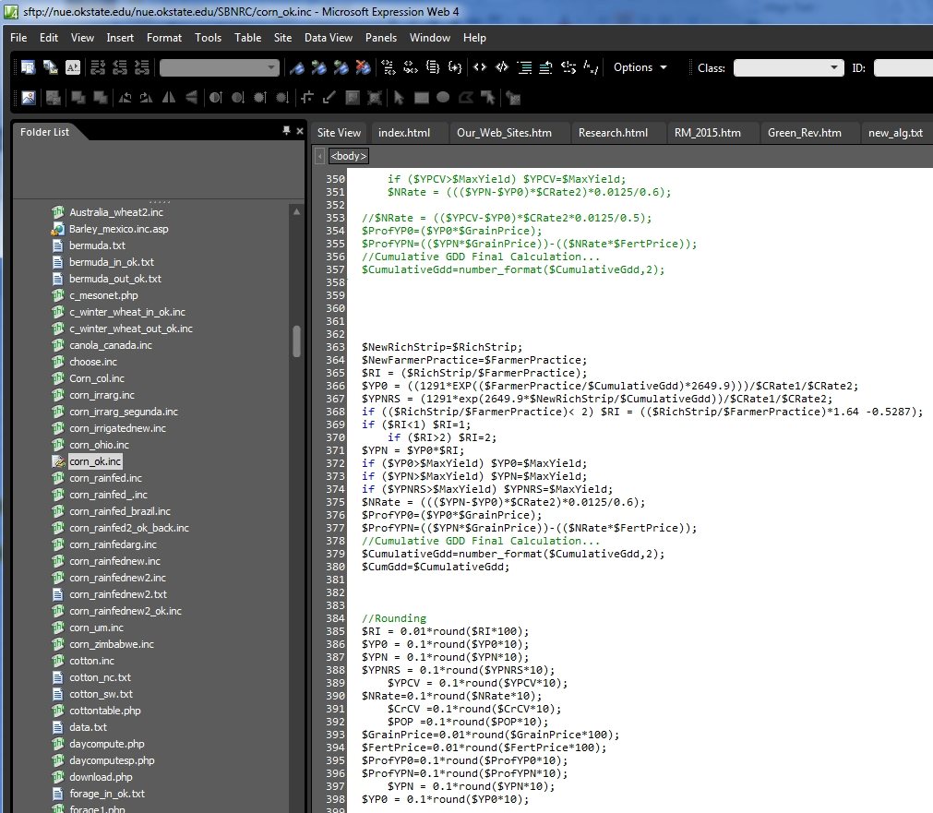
PHP code
editor
expression web

Slide 15
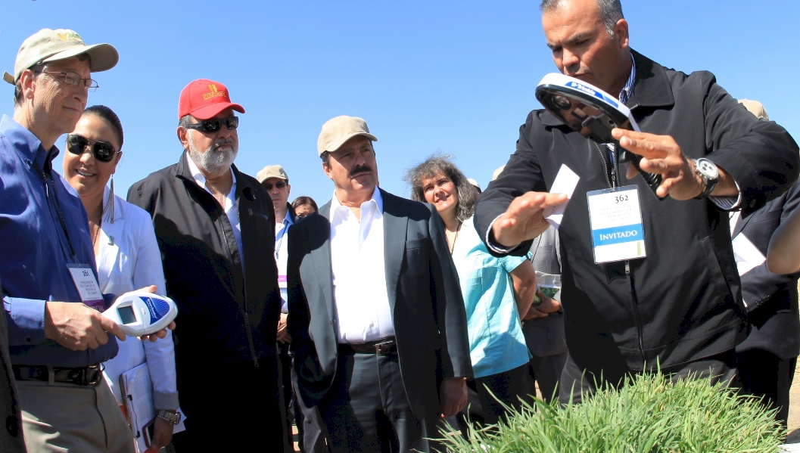
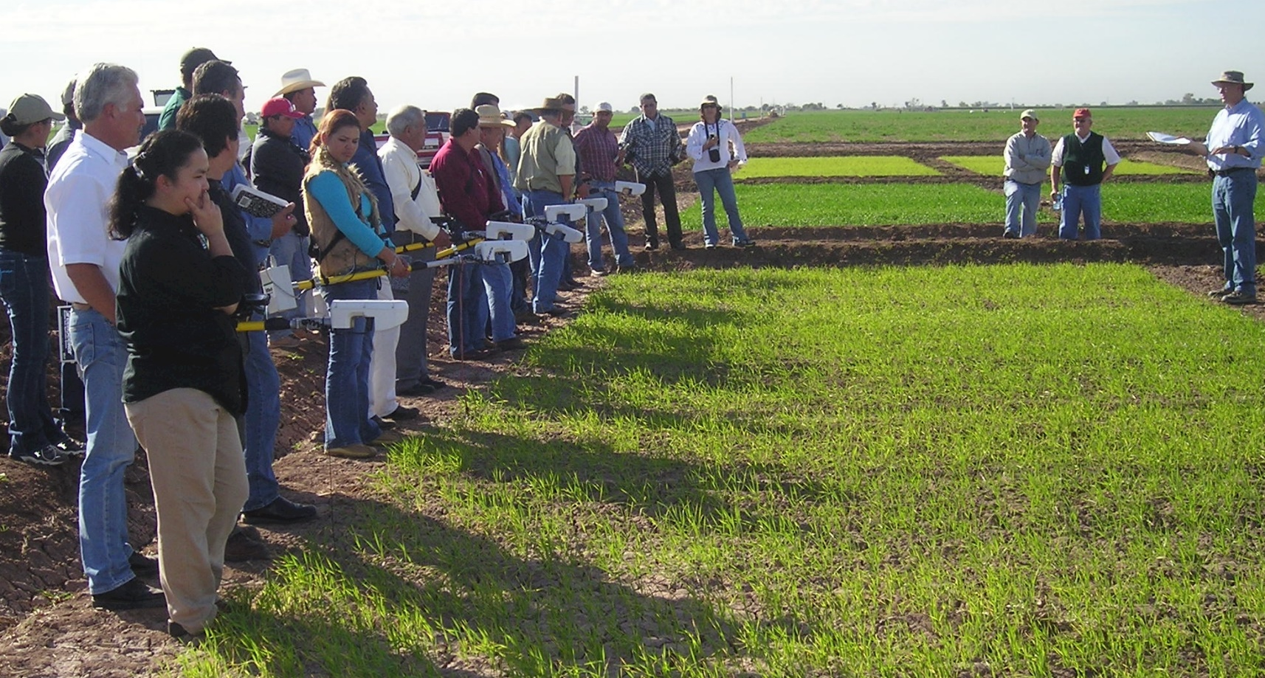

Slide 16
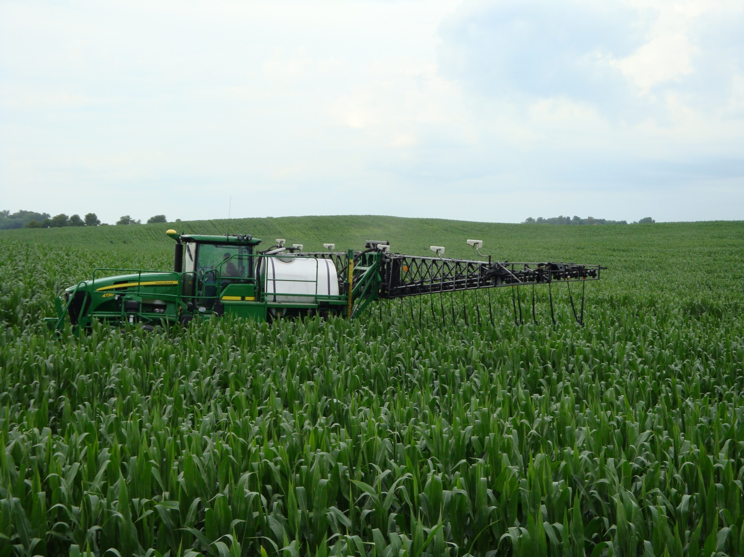


Slide 17

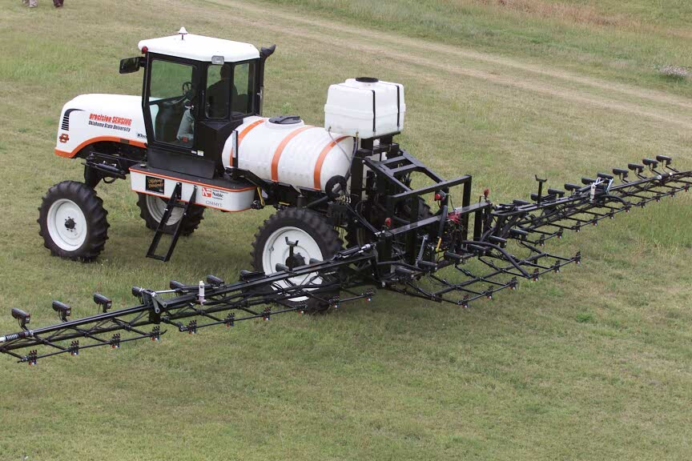
precision SENSING
Oklahoma State University 2001

Slide 18
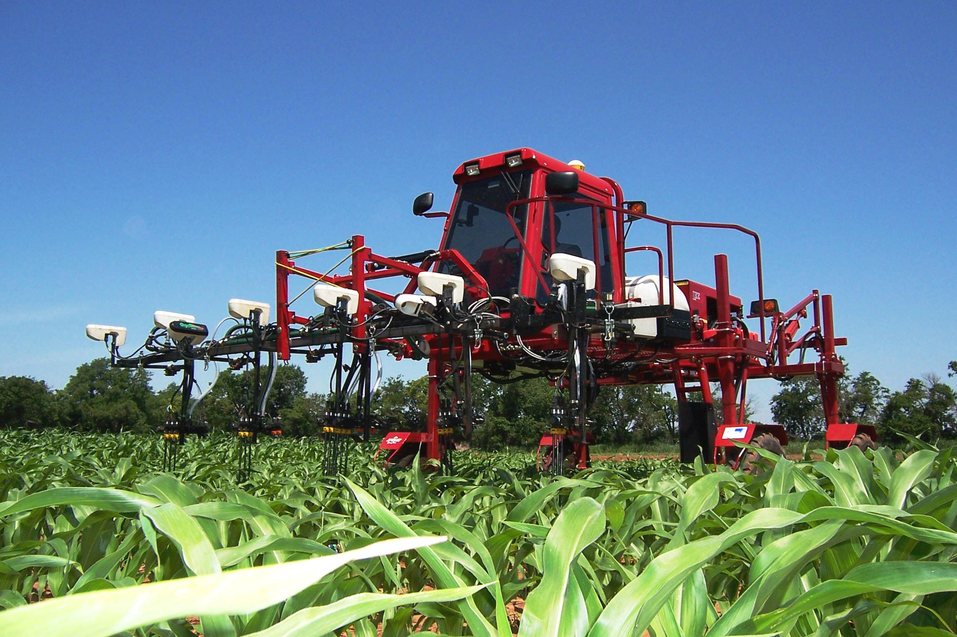
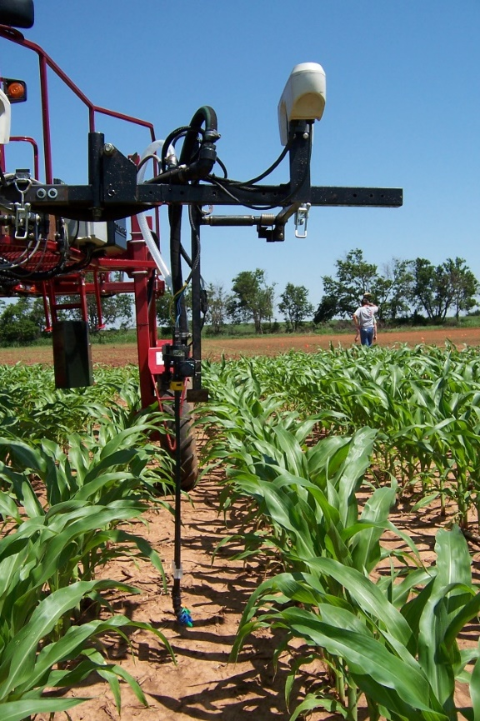
By-plant N Fertilization 2007
By plant statistical properties

Slide 19
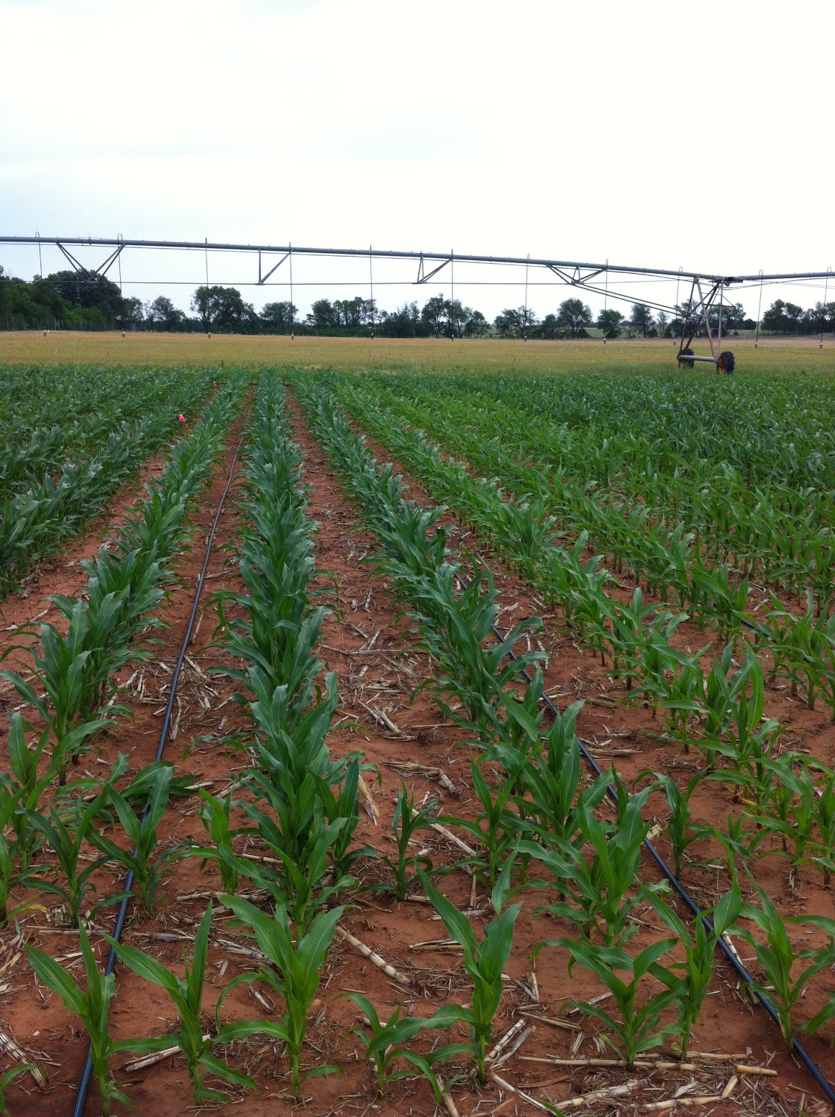
agricultural technology driven by corn

Slide 20
Situation
US maize consumes 37-51% of total annual Nitrogen (N) fertilizer (Snyder, 2012).
Drainage systems allow nitrate deposition to water bodies (Cooper, 1993).
Nutrient runoff from agriculture has contributed to the hypoxic zone in the Gulf of Mexico. (Rabalais et al ., 1999)
Illinois, Iowa and Indiana produce 15% of the world’s maize and have impacted N and Phosphorus (P) loading in the Gulf of Mexico (Dale et al., 2010).
Inability to estimate year to year, field to field optimum N rates has decreased nitrogen use efficiency (Shanahan, 2011).

Slide 21
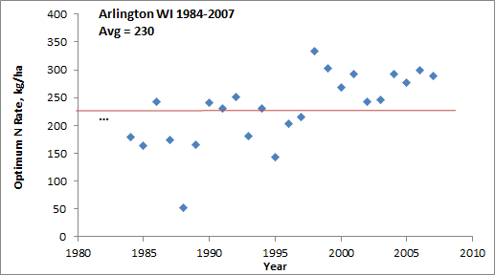
“Again, the results provide no clear indication of a change in N rates over time” (Page 11, Concepts and Rationale for Regional Nitrogen Rate Guidelines for Corn, ISU Extension, 2006)

Slide 22
More N removed in IA, IL, IN, NE, MN
More N applied
More N lost
- pathways change from year to year
What are we doing?

Slide 23
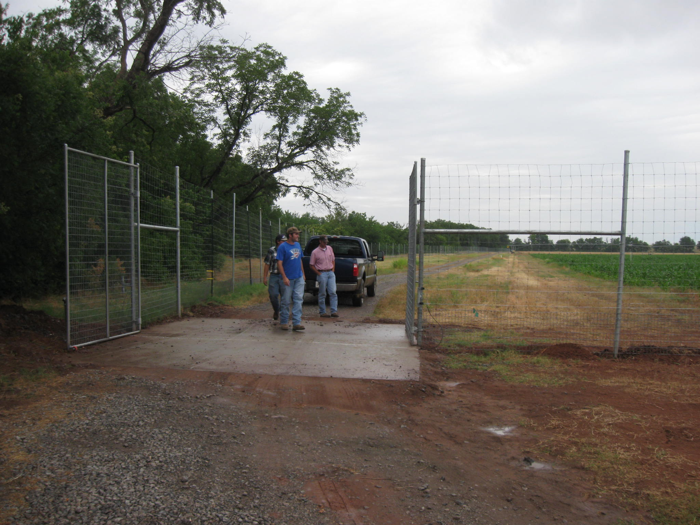
1. Feral hogs
2. Deer
3. Raccoons
4. 100F heat
Corn Research at Oklahoma State University is difficult,
nonetheless we believe it is the right thing to do

Slide 24
Today’s corn crop is mainly used for biofuels (roughly 40 percent of U.S. corn is used for ethanol) and as animal feed (roughly 36 percent of U.S. corn, plus distillers grains left over from ethanol production, is fed to cattle, pigs and chickens). Much of the rest is exported. Small fraction of the national corn crop is directly used for food for Americans, much of that for high-fructose corn syrup.
It’s Time to Rethink America’s Corn System
March 5, 2013 |By Jonathan Foley (Director, Inst. Env. Univ. Minnesota)
Scientific American

Slide 25
How Meat Contributes to Global Warming
February 2009 | By Nathan Fiala
Scientific American, February 2009
FAO (2006) report found that current production levels of meat contribute between 14 and 22 percent of the 36 billion tons of "CO2-equivalent" greenhouse gases the world produces every year. Half a pound of hamburger for someone's lunch, a patty of meat the size of two decks of cards releases as much greenhouse gas into the atmosphere as driving a 3,000-pound car nearly 10 miles.

Slide 26
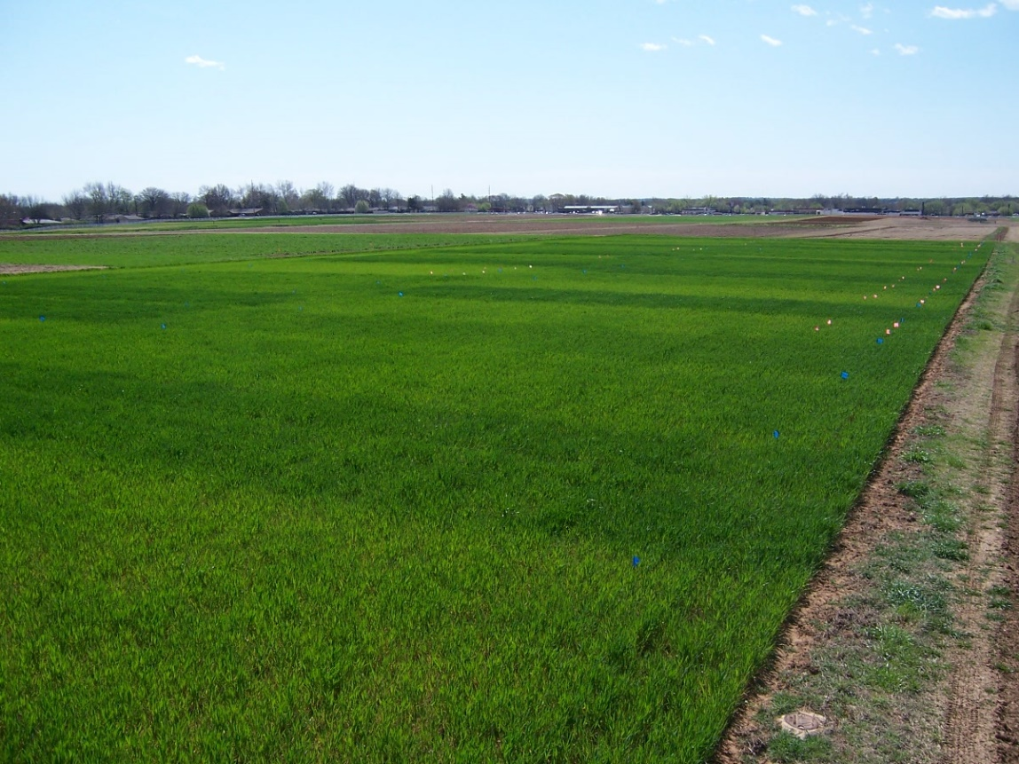
Long-Term Experiments
Class Projects

Slide 27
The percent increase in atmospheric CO₂ due to a worldwide decrease in soil organic matter of arable land was estimated to account for 6 to 25% of the 80 mg kg⁻¹ (340-260) increase in atmospheric CO₂ over the last 150 years.
Commun. Soil Sci. Plant Anal., 30, 1713-1719 (1999), Estimated Increase in Atmospheric Carbon Dioxide Due to Worldwide Decrease in Soil Organic Matter, Mullen et al. 1999
For Sub Saharan Africa, NUE’s for cereal production exceed 100%. High NUE’s for SSA are a direct result of applying so little fertilizer N, at the ultimate expense of mining an already depleted soil resource.
Journal of Plant Nutrition, 32: 2107–2122 (2009)
Cereal Nitrogen Use Efficiency in Sub
Saharan Africa, Edmonds et al. (2009)

Slide 28
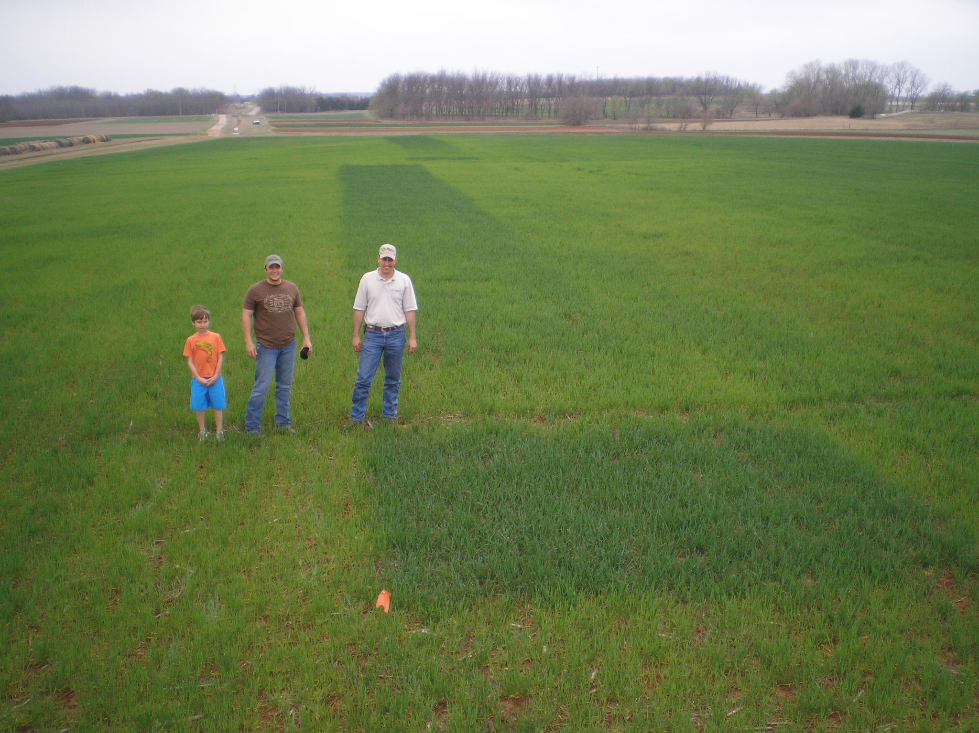
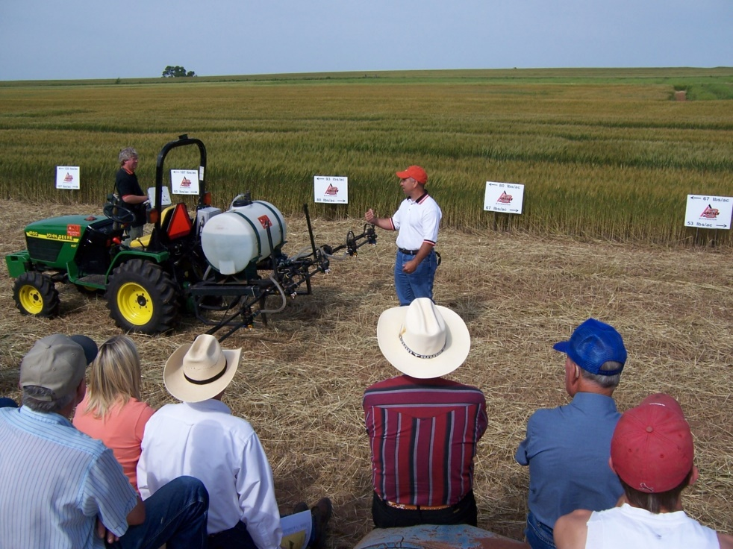

Slide 29
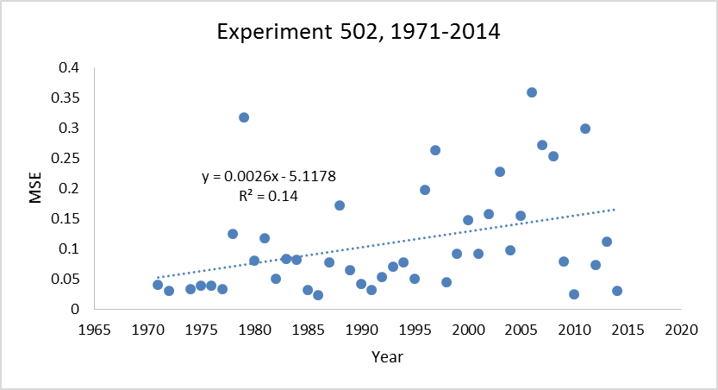
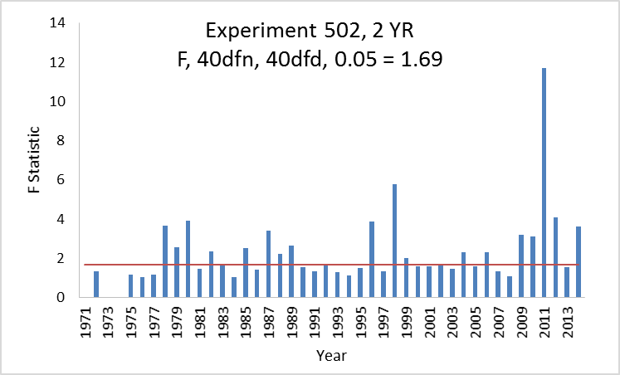
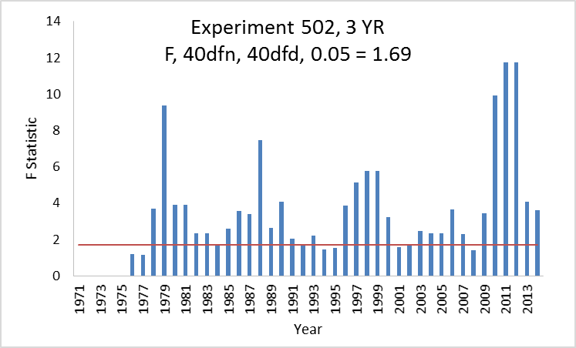
SOIL 5112
spring 2015

Slide 30
Do Nitrogen Rates Change Every Year?
Source | Location | Years | Years | High N Yield Range | Check plot Yield Range | Optimum N rate
 |  |  |  | Mg ha⁻¹ | Mg ha⁻¹ | Min | Max | Avg.
Bundy et al. (2011) | WI | 21 | 1958-1983 | 4.3-8.8 | 1.57-7.59 | 46 | 213 | 119
Bundy et al. (2011) | WI | 24 | 1984-2007 | 5.7-14.1 | 1.67-5.58 | 143 | 334 | 238
Mallarino and Torres (2006) | IA | 32 | 1979-2010 | 5.1-12.5 | 0.75-5.91 | 75 | 314 | 193
Mallarino and Torres (2006) | IA | 26 | 1985-2010 | 5.3-12.8 | 1.4-6.3 | 123 | 332 | 214
Varvel et al. (2007) | NE | 11 | 1995-2005 | 10.4-13.6 | 3.5-10.9 | 67 | 280 | 191
Jokela et al.(1989) Carroll | MN | 3 | 1982-1984 | 7.1-9.1 | 5-7.3 | 5 | 120 | 77
Jokela et al.(1989) Webster | MN | 3 | 1982-1984 | 1.8-8.7 | 1.7-5.6 | 64 | 103 | 84
Fenster et al. (1976) Waseca | MN | 7 | 1970-1976 | 7.12-10.65 | 2.71-7.43 | 55 | 227 | 140
Fenster et al. (1976) Martin | MN | 7 | 1970-1976 | 4-9.6 | 3.8-8.2 | 21 | 116 | 62
Fenster et al. (1976) Martin | MN | 6 | 1971-1976 | 6.2-12 | 6.2-11.3 | 0 | 34 | 15
Al Kaisi et al.(2003) | CO | 3 | 1998-2000 | 5-14.1 | 3.53-12.57 | 24 | 126 | 84
Ismail et al.(1994) NT | KY | 20 | 1998-2000 | 5.2-10.9 | 2.1-7.4 | 32 | 211 | 117
Ismail et al.(1994) CT | KY | 20 | 1970-1990 | 3.5-10.4 | 1.9-9.5 | 0 | 186 | 90
Rice et al.(1986) NT | KY | 16 | 1970-1985 | 5.7-9.2 | 3.1-4.9 | 93 | 163 | 132
Rice et al.(1986) CT | KY | 16 | 1970-1985 | 5-8.8 | 1.9-6.1 | 63 | 187 | 114
Stecker et al.(1993) | MO | 3 | 1988-1990 | 6.04-10.13 | 3.32-5.59 | 91 | 178 | 140
Stecker et al.(1993) | MO | 3 | 1988-1990 | 6.7-9.9 | 4.54-7.2 | 42 | 167 | 94
Stecker et al.(1993) | MO | 2 | 1989-1990 | 8.2-8.5 | 4.95-5.98 | 82 | 108 | 95
Peterson et al.(1989) | NE | 4 | 1983-1986 | 3.9-10 | 2.1-6.4 | 10 | 200 | 96
Woodruff et al.(1983) | SC | 3 | 1974-1976 | 13-20.2 | 1.04-15.6 | 0 | 639 | 302
Eck (1982) | TX | 3 | 1977-1979 | 3.41-13.21 | 1.79-5.03 | 13 | 300 | 146
Shapiro et al.(2006) RS 51cm | NE | 3 | 1996-1998 | 9.4-11.14 | 6.24-8.93 | 64 | 88 | 76
Shapiro et al.(2006) RS76cm | NE | 3 | 1996-1998 | 7.12-11.04 | 5.02-8.88 | 12 | 105 | 69
Meisinger et al. (1985) MT | MD | 4 | 1974-1977 | 5.8-8.2 | 1.8-2.6 | 117 | 213 | 168
Meisinger et al. (1985) MT | MD | 4 | 1974-1977 | 5.1-8.1 | 2.7-4.2 | 33 | 180 | 130
Gehl et al.(2005) Ellinwood | KS | 4 | 2001-2002 | 9-11.9 | 2.7-7.2 | 147 | 307 | 220
Gehl et al.(2005) Rossville | KS | 2 | 2001-2002 | 11.3-12.6 | 6.4-7.9 | 167 | 187 | 177
Gehl et al.(2005) scandia | KS | 2 | 2001-2002 | 3.8-11.5 | 2.7-7.4 | 47 | 147 | 97
Gehl et al.(2005) Manhattan | KS | 2 | 2001-2002 | 10.5-10.7 | 2.8-6.4 | 143 | 260 | 202
Total |  | 257 |  |  | average | 61 | 208 | 134
 |  |  |  |  | stdev | 50 | 114 | 63

Slide 31
At some sites the 0-N check plot yielded the same as the high N rate plot after years of continuous maize production.
Conclusion
Static N recommendations do not account for the variability in soil available N and maize N uptake as influenced by environment (temperature/rainfall)

Slide 32
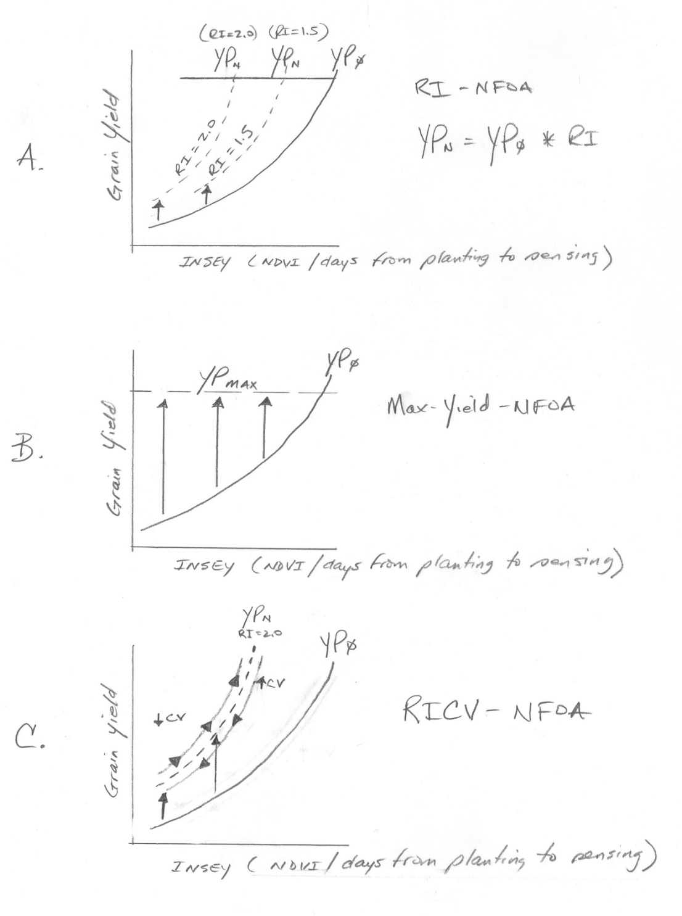
N theory
N algorithm

Slide 33
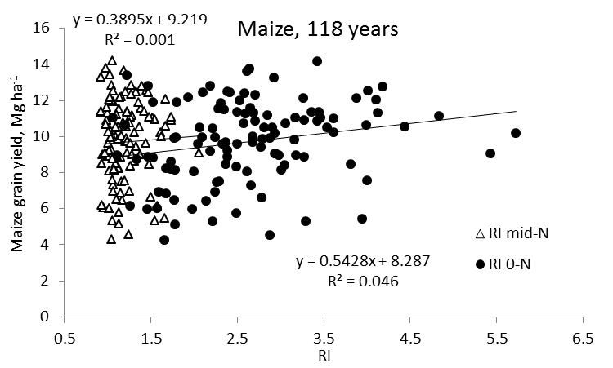
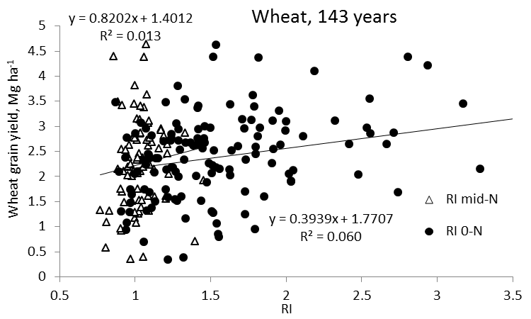
Independence of yield potential and nitrogen response
Iowa
Nebraska
Wisconsin
Oklahoma
(Agron J. 105:1335-1344)

Slide 34
Fertilizer recommendations that ignore yield entirely are limited to explaining less than 50% of the variation in the economic optimum N rate for maize (Agron. J. 95:994-999)
Research conducted over locations and years in Missouri noted that economically optimum fertilizer N rates vary widely from year to year, and from place to place within a field (Agron J. 97:452-461)
Because yield level and N responsiveness are independent, and both impact N demand, using both will assist in formulating more accurate fertilizer N recommendations (Agron J. 105:1335-1344)

Slide 35
OSU Corn Algorithm
YP₀=1291*(EXP(NDVI/Sum of GDD*2649.9) V8 to V12
RI = NDVI- N Rich Strip/ NDVI – Farmer Practice
YPN = YP0 * RI
N Rate = ((YPN – YP0)* 0.0125)/expected fertilizer use efficiency

Slide 36
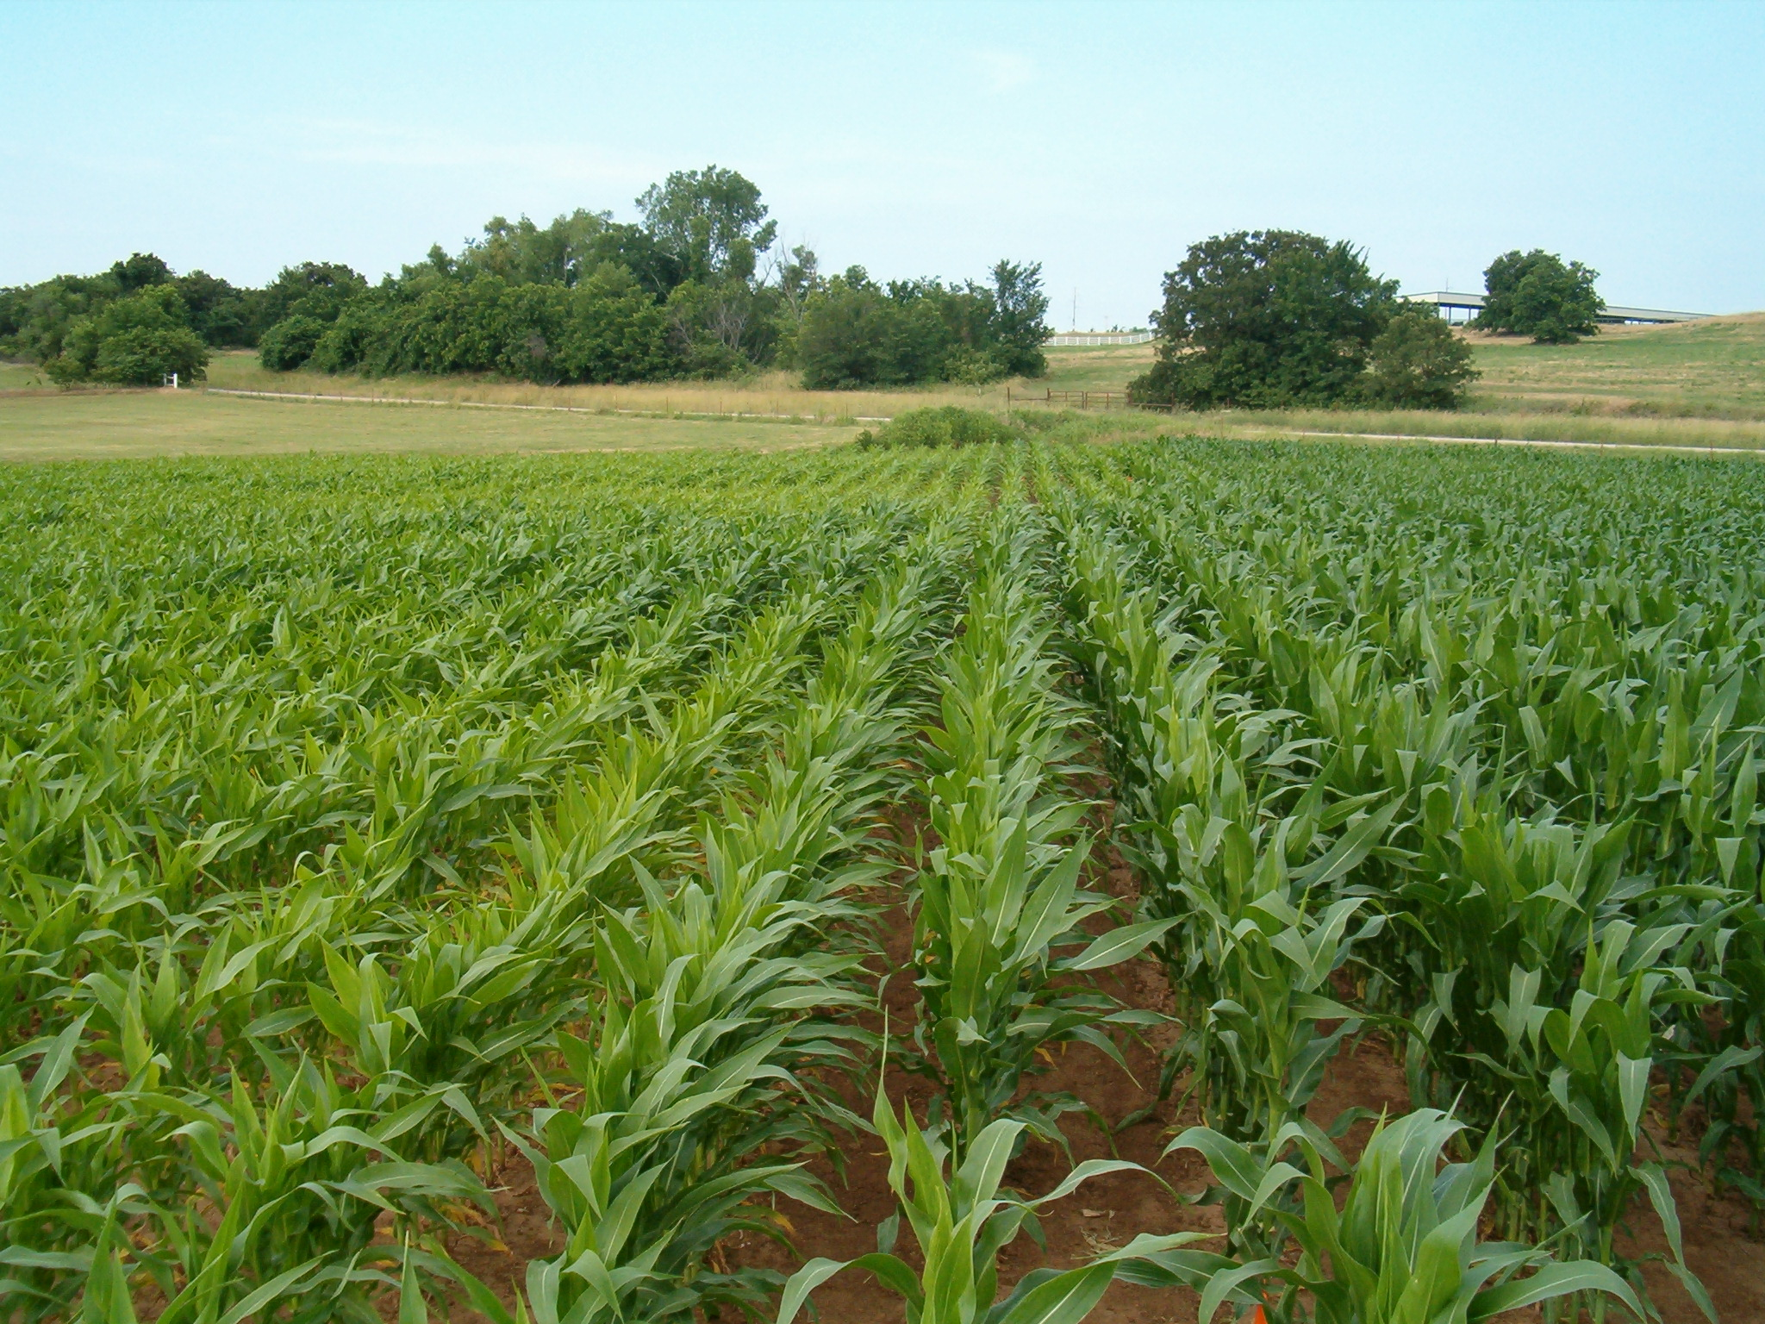
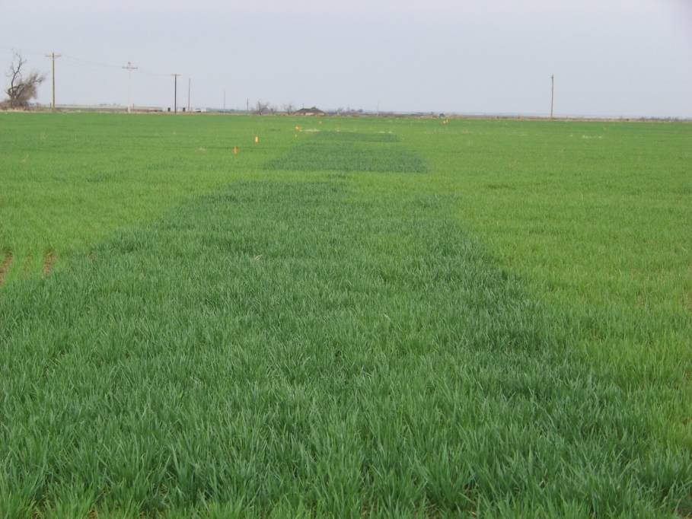
N Rich Strips, Dr. Brian Arnall

Slide 37
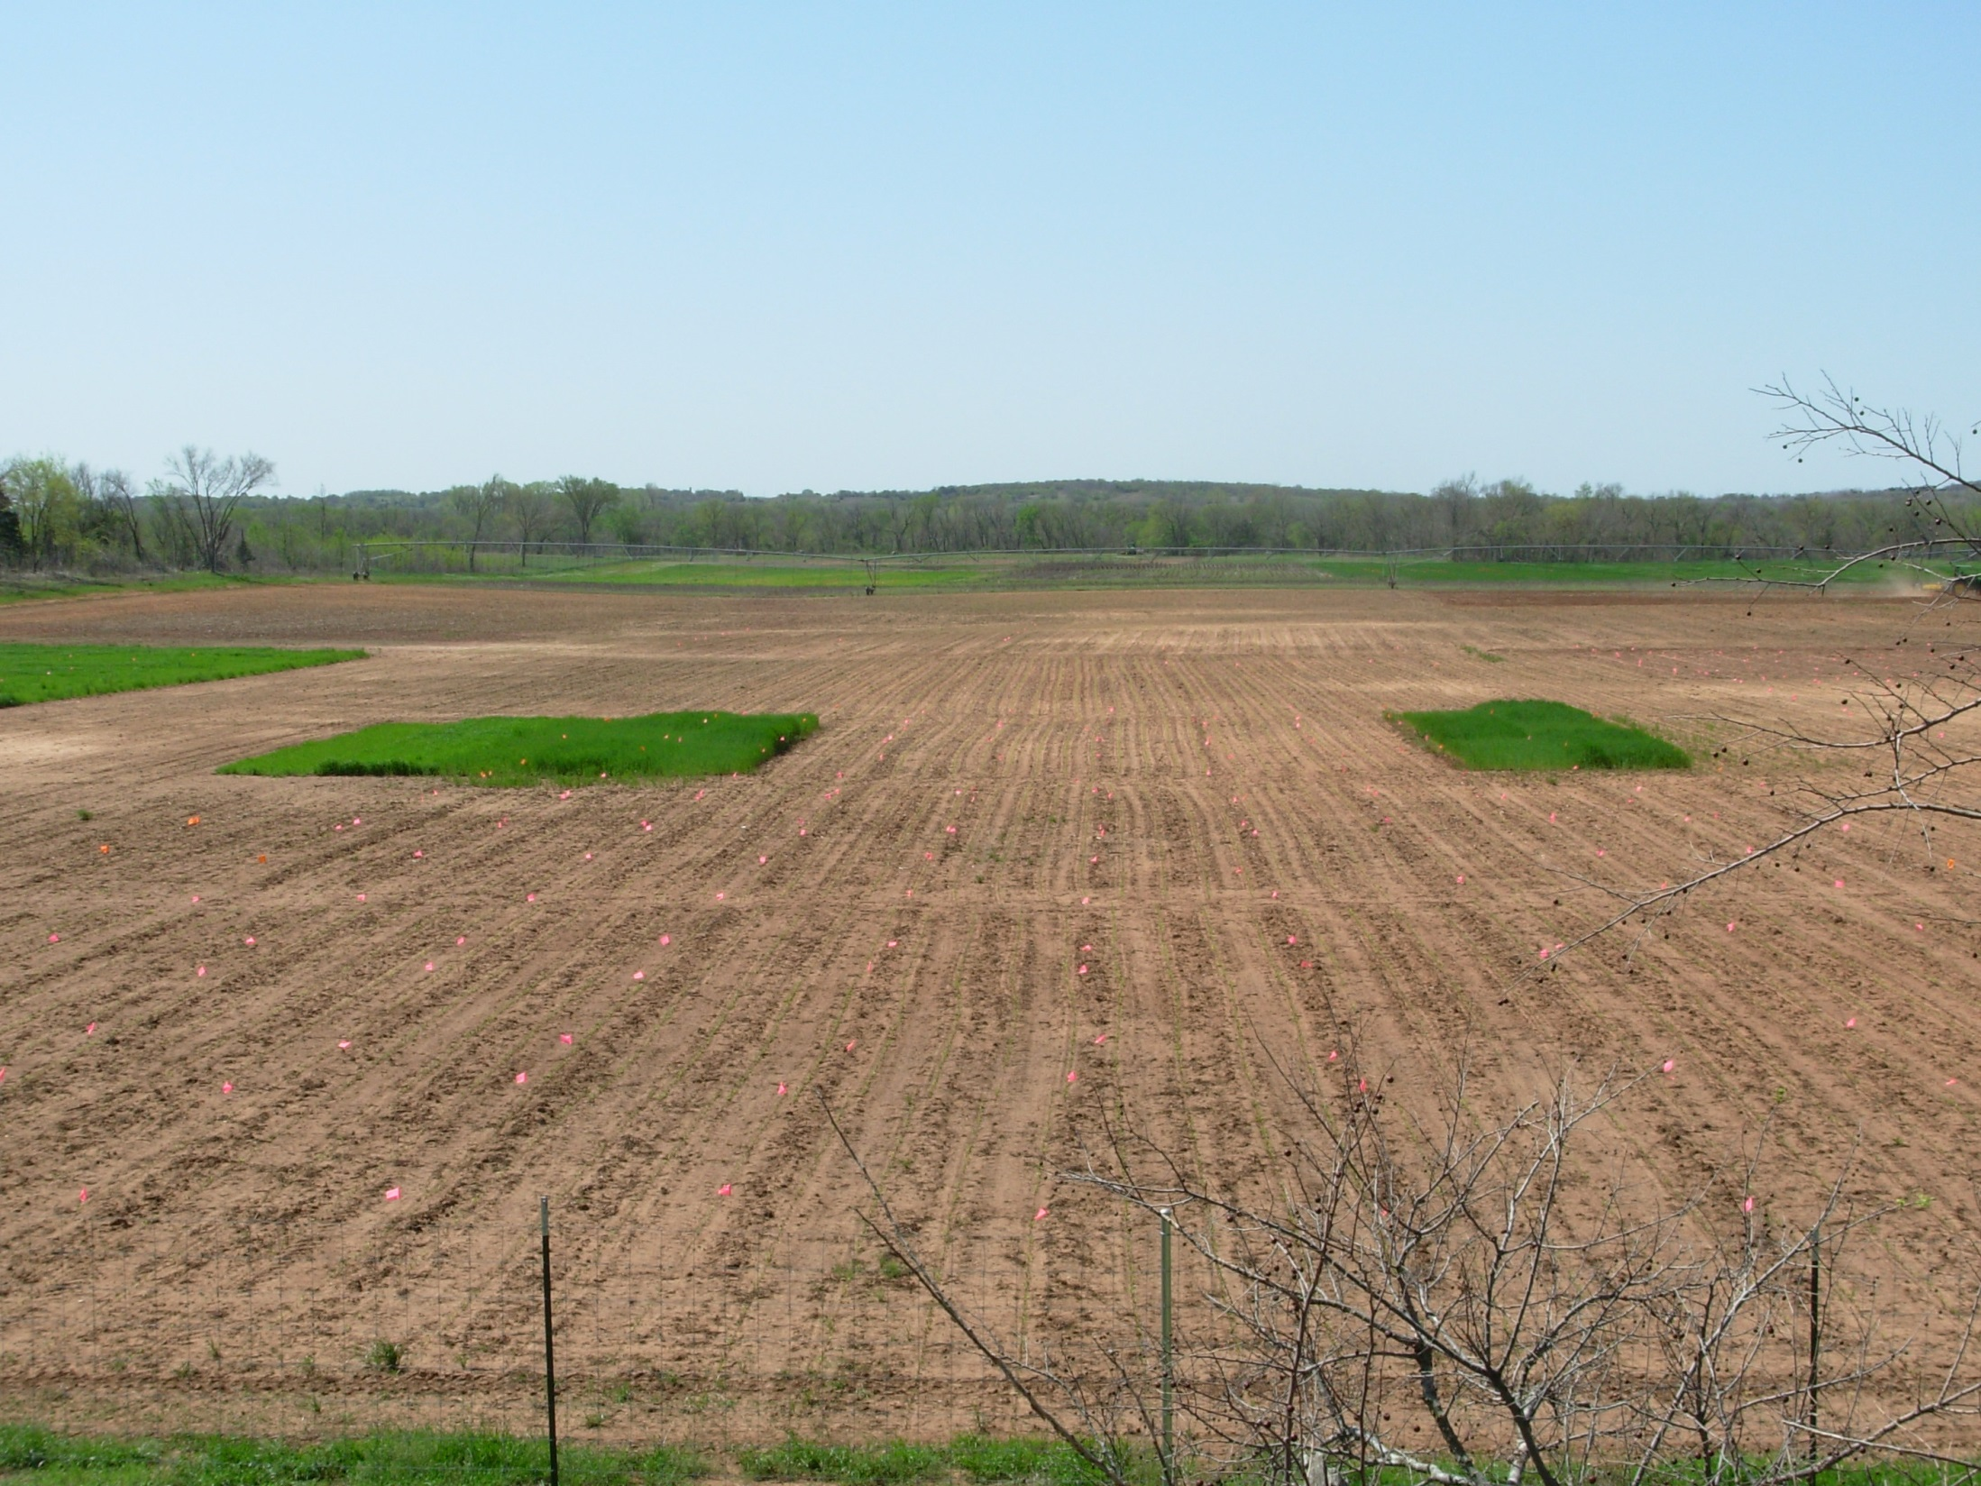
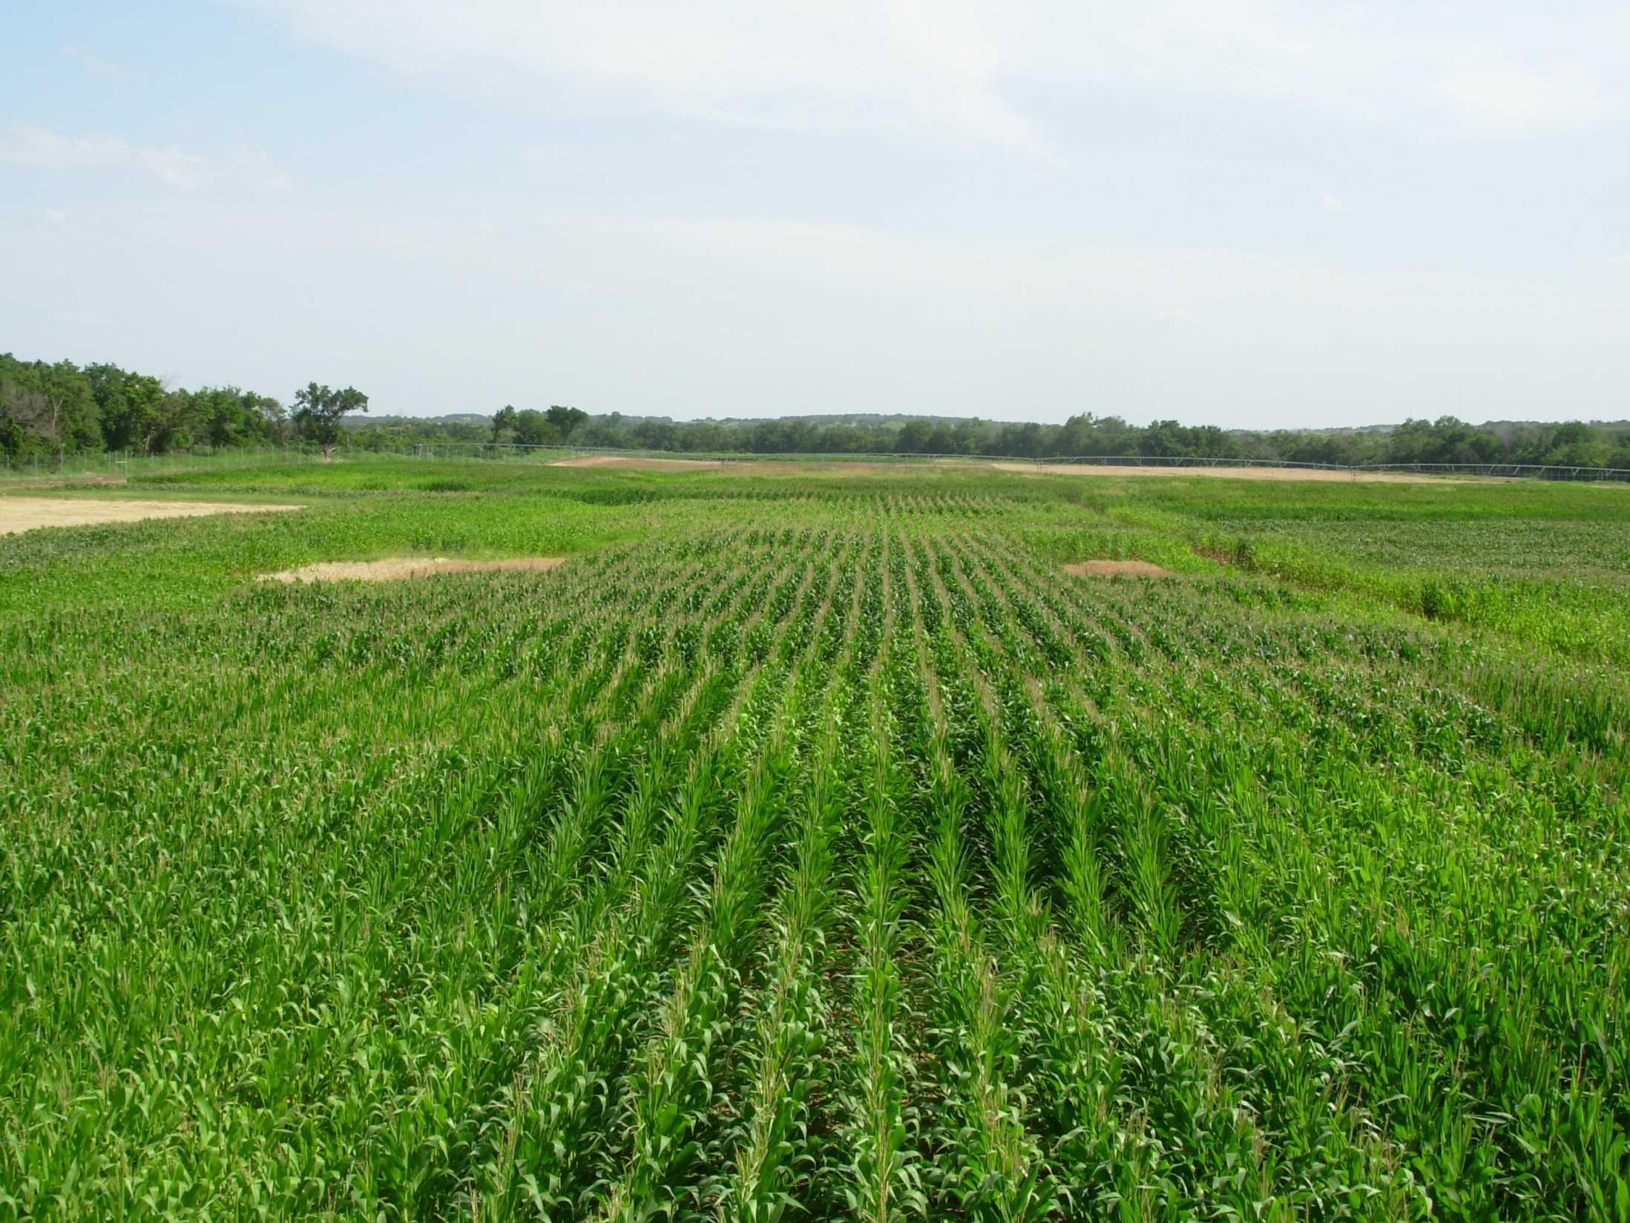
Indicator Crops, Dr. Eric Miller

Slide 38
Nitrogen Algorithm Corn
1. Establish preplant N Rich Strip (NRS)
2. Collect NDVI readings, 6-12 leaf
3. Predict potential yield (YP0, yield prediction equation).
4. Need NDVI and cumulative GDD from planting to sensing
5. Determine Response Index (RI) = NDVINRS/NDVIFarmer
6. Yield potential with added N, YPN =(YP0*RI)
7. Fertilizer Rec = (grain N uptake YPN – grain N uptake YP0/expected efficiency)
YP_{N}
RI
GDD from planting to sensing
YP₀
Planting date
NDVI (sensing date)

Slide 39
Regional Yield Prediction Equations

Slide 40
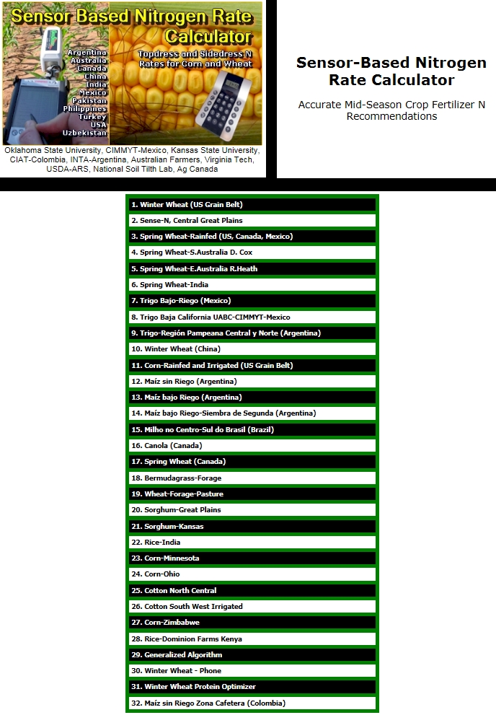
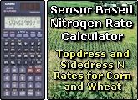
#10 Winter Wheat (China)
#11 Corn-US Grain Belt
nue.okstate.edu

Slide 41
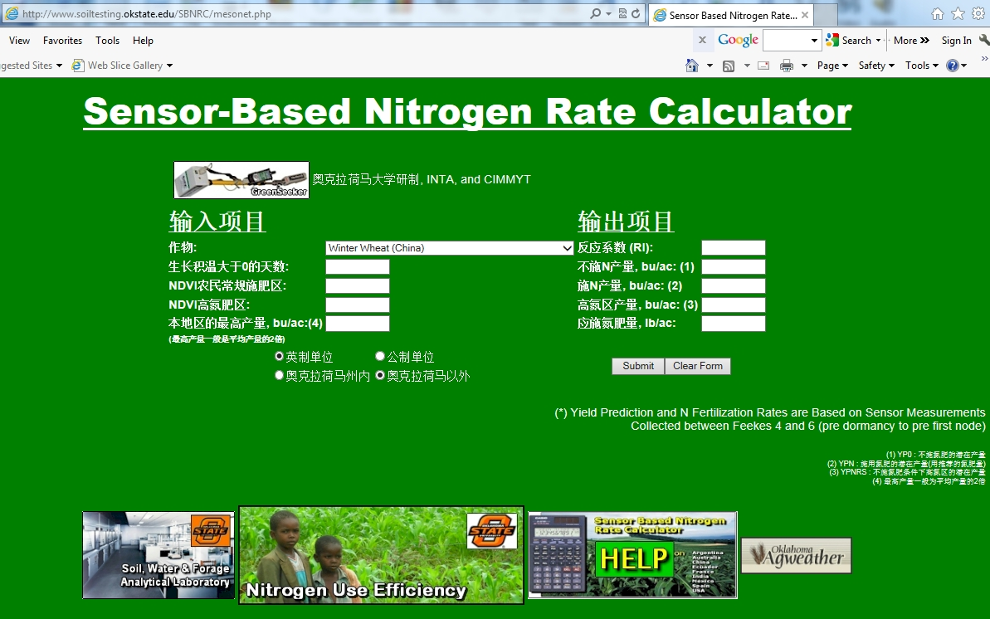
www.nue.okstate.edu

Slide 42
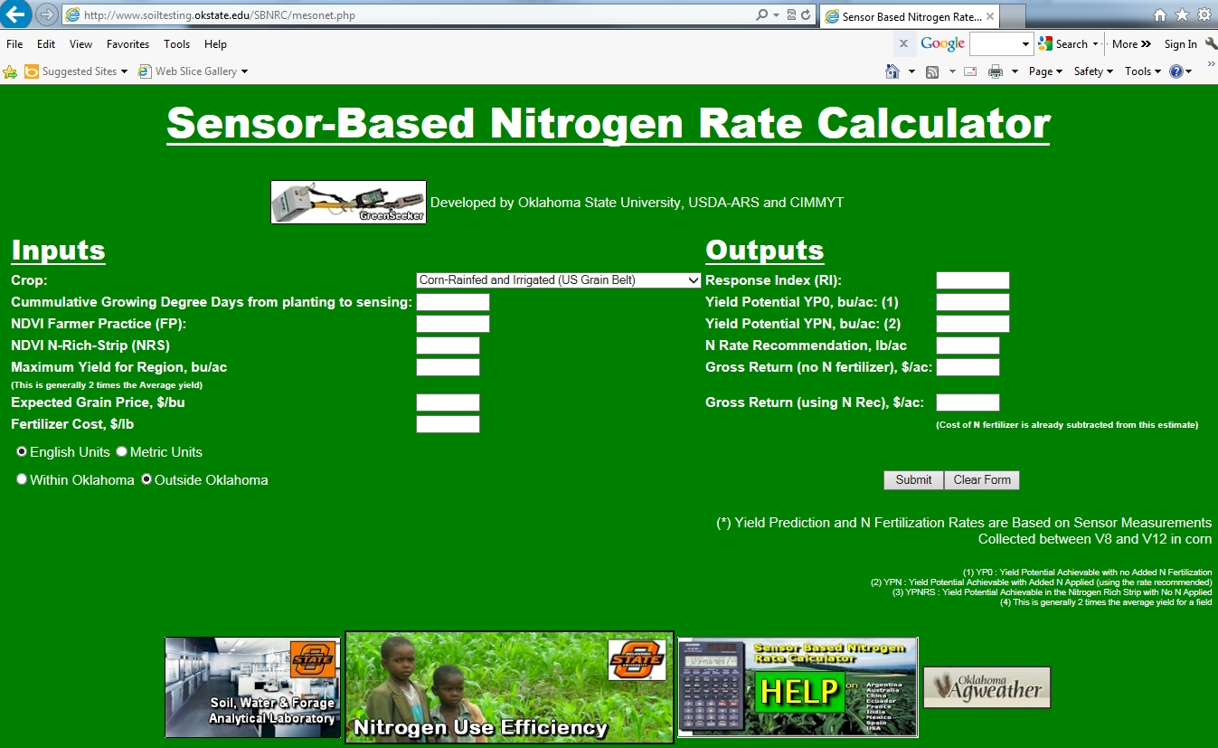
www.nue.okstate.edu

Slide 43
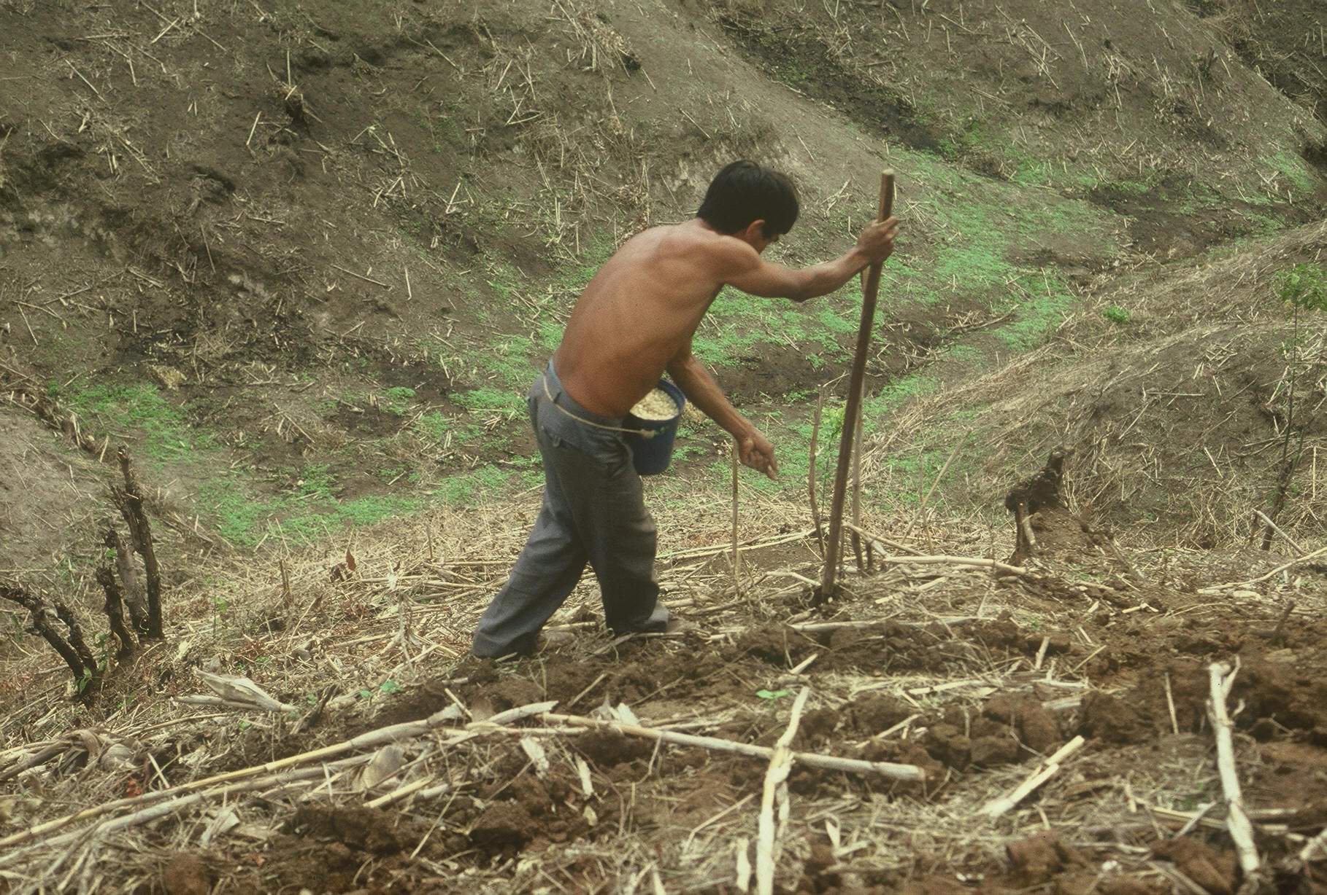

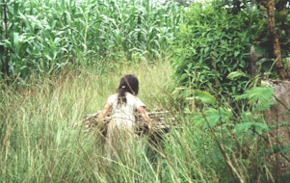

Service projects

Slide 44
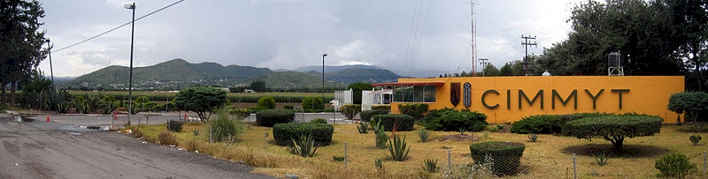

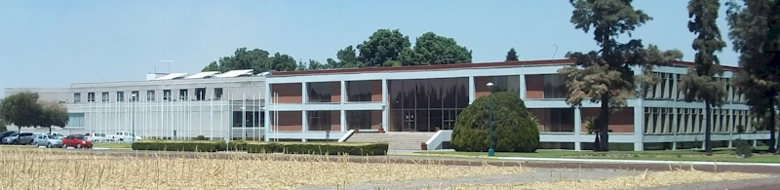
Centro Internacional de Mejoramiento de Maiz y Trigo

Slide 45
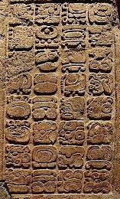


Teosinte

Slide 46
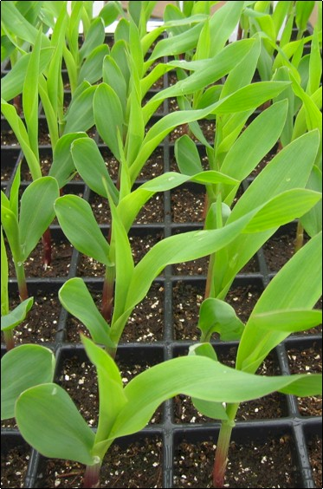
Torres, Guilherme, Jacob Vossenkemper, William Raun, and Randy Taylor. 2011. Maize (Zea mays L.) Leaf Angle and Emergence as Affected by Seed Orientation at Planting. J. Exp. Agric. doi:10.1017/S001447971100038X.
Koller, Adrian, Guilherme Torres, Michael Buser, Randy Taylor, William Raun and Paul Weckler. 2014. Relationship between maize kernel orientation and seed leaf azimuth follos Von Mises distribution. BAE
Torres, Guilherme M., Adrian Koller, Randy Taylor, and William R. Raun. 2014. Seed placement and leaf orientation effect on light interception and grain yield of maize (Zea mays L.). J. Exp. Agric.
Equipment developed by Dr. Randy Taylor, Dr. Adrian Koller, Dr. Nyle Wollenhaupt
Current MS Students, Jagmandeep Dhillon, Daniel Aliddeki

Slide 47
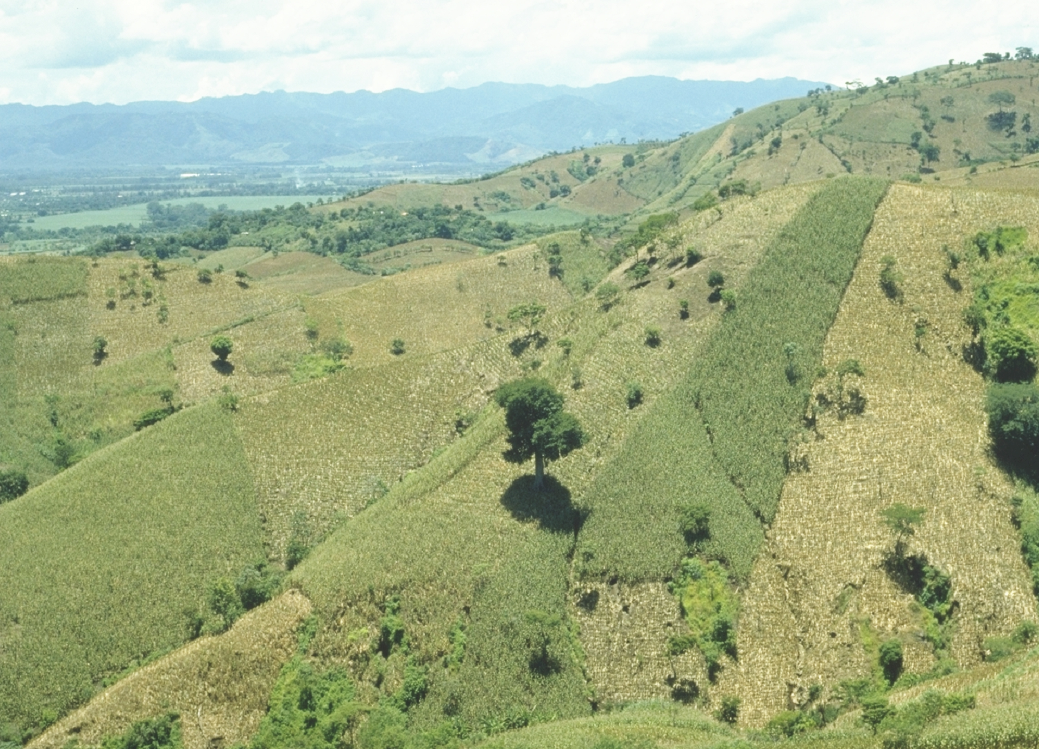
EL SALVADOR

Slide 48

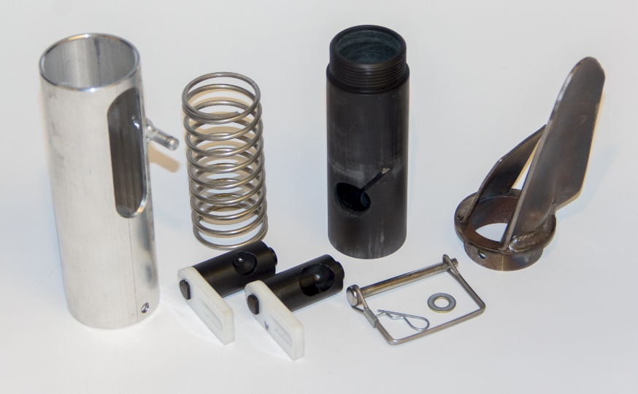
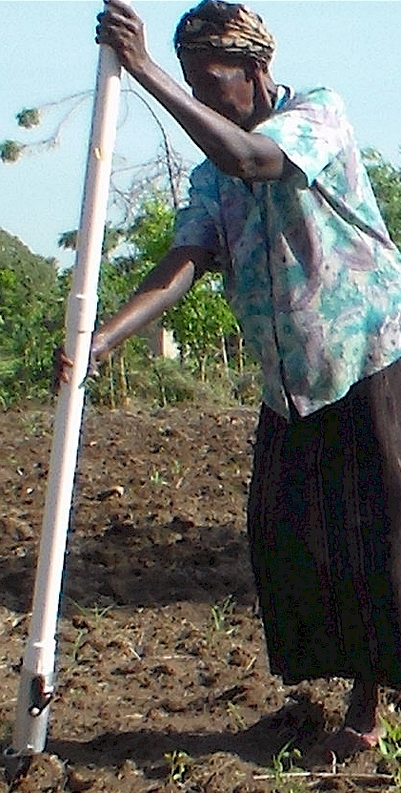
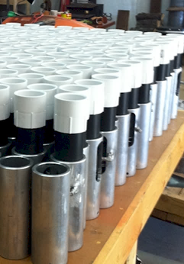
Drums

Slide 49
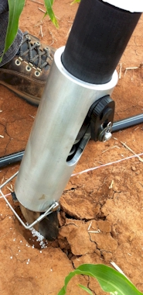
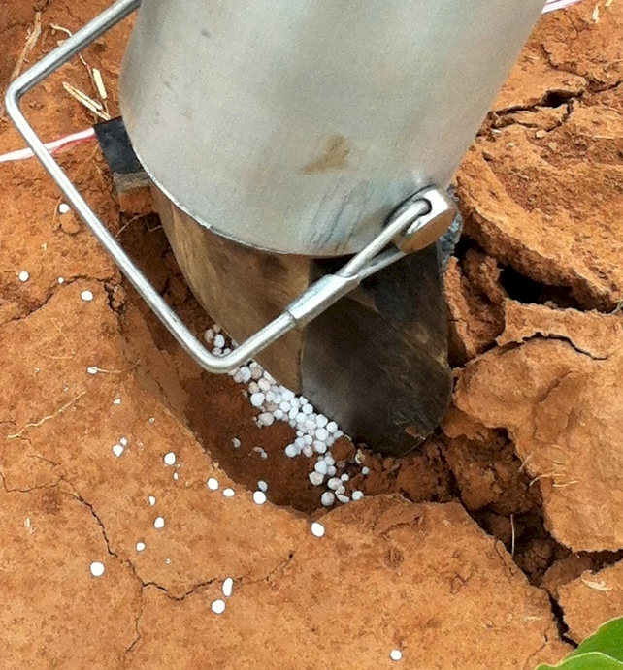
Mid Season Fertilizer N
Combined, Efaw and Perkins, 2013
Topdress N, Corn, V12 |  | 70,000 plants/ha
Methods | N, kg/ha | Mg/ha
Check | 0 | 6.6
Hand planter (0.9 g/plant) | 30 | 11.2
Hand planter (1.8 g/plant) | 60 | 10.6
Broadcast | 30 | 6.4
Broadcast | 60 | 7.0
Dribble urea | 30 | 9.3
Dribble urea | 60 | 7.8
Dribble UAN | 30 | 7.3
Dribble UAN | 60 | 10.4
SED = 1.81

Slide 50
Benefits
Remove chemically treated seeds from the hands of small farmers
Decrease soil erosion via improved plant spacing
Accommodate mid-season application of urea-N
Place urea below the surface reducing NH3 losses
Potential to increase maize production and NUE
Khim et al. (2014). Over three sites, planting 1 seed, every 0.16m increased yields by an average of 1.15 Mg ha⁻¹ (range, 0.33 to 2.46 Mg ha⁻¹) when compared to the farmer practice of placing 2 to 3 seeds per hill, every 0.48 cm.

Slide 51
Maize (FAOSTAT, 2013)
Area, ha Production, Mt Avg. Mt/ha
World 184,239,959 1,016,431,783 5.5 (87 bu/ac)
USA 35,478,012 353,699,441 9.9 (157 bu/ac)
China 35,276,500 217,830,000 6.2 (98 bu/ac)
Brazil 15,450,180 80,516,571 5.2 (83 bu/ac)
Low income Food Deficit Countries
49,356,985 117,590,512 2.4 (38 bu/ac)
60% hand
planted
29,614,180
USA 2014, 37,125,000 ha’s

Slide 52

Hand Planters
Person | Organization | Where | No. of Hand Planters
Dr. Isaiah Nyagumbo | CIMMYT, Kenya | Zimbabwe | 4
Dr. Pascal Kaumbutho | KENDAT, Kenya | Kenya | 2
 | Ethiopia | Ethiopia | 1
Dr. Peter Omara | Uganda | Uganda | 3
Dr. Edgar Ascencio | CARE, El Savador | El Salvador | 4
Dr. Fred Kanampiu | IITA, Kenya | Kenya | 2
Dr. Nyle Wollenhaupt | AGCO, Kansas | Kansas | 2
Dr. Ivan Ortiz-Monasterio | CIMMYT, Mexico | Mexico | 1
Kristin Lacy | Semilla Nueva | Guatemala | 2
Nyle Wollenhaupt | AGCO | Lusaka Zambia | 40
Melvin Siwale | AGCO | Lusaka Zambia | 10
Terry Tindall | JR Simplot | Lusaka Zambia | 25
Eric Lam | MAG | Honduras | 2
Eric Lam | CIMMYT | Bangladesh | 1
Dr. Luis Narro | CIAT | Colombia | 1
Dr. Joshua Ringer |  | Thailand | 1
Dr. Assoumane Maiga |  | Mali | 1
Total |  |  | 101
Notes:
52

Slide 54
If I Could Be Anything in the Nitrogen Cycle What Would it Be?
I'd be a molecule of nitrate
To suddenly appear as an oxidized product of ammonium
Or maybe the product of an electrical storm, from a giant burst of lightning
I could move through the water, and into the streams.
Traversing through sand, and silt, and clay, I'd be flat tired at the end of the day.
I could be denitrified and partially converted to a gas
Assimilated by plant roots until I was integral part of an exotic grass
Each day, my fate would be different
With a morning rain, I could move with the streams
At midday, I'd host lunch for the microbes that would be so much fun
And by dusk I'd bask on the sand by the setting sun
With time, I'd be part of plant proteins and resultant grain
I could feed millions, ending starvation and its cold hearted pain
Each year I'd be present for new seeds to germinate and grow
Dormant pastures would come alive, prairie flowers would blossom and glow
In the end I could turn sad faces into smiles, angst into joy,
lighting up the faces of poor children receiving their very first toy

Slide 55
5.7 billion dollars spent on N in corn, USA, 2011

Slide 56
References
Al-Kaisi, M. M., and X.Yin. 2003. Effects of nitrogen rate, irrigation rate, and plant population on corn yield and water use efficiency. Agron. J. 95(6), 1475-1482.
Bundy, L.G., T.W. Andraski, M.D. Ruark, and A.E. Peterson. 2011. Long-term continuous corn and nitrogen fertilizer effects on productivity and soil properties. Agron. J. 103:1346–1351.
Cooper, C.M. 1993. Biological effects of agriculturally derived surface water pollutants on aquatic systems—A review. J. Environ. Qual.22:402–408.
Eck, H. V. (1984). Irrigated corn yield response to nitrogen and water. Agron. J. 76(3), 421-428.
Fenster, W. E., C. J. Overdahl, G.W. Randall, and R. P. Schoper.1978. Effect of nitrogen fertilizer on corn yield and soil nitrates . (Vol. 153) Misc. Rept 153-1978. Agr. Exp. Station. U. of Minnesota, St. Paul.
Ismail, I., R.L. Blevins, and W. W. Frye. 1994. Long-term no-tillage effects on soil properties and continuous corn yields. Soil Sc. Soc. Am. J. 58(1), 193-198
Jokela, W. E., and G. W. Randall. 1989. Corn yield and residual soil nitrate as affected by time and rate of nitrogen application. Agron. J. 81(5), 720-726.
Mallarino, A.P., and E. Ortiz-Torres. 2006. A long-term look at crop rotation effects on corn yield and response to N fertilization. In: The Integrated Crop Management Conference Proceedings, Ames, IA. 29–30 Nov. 2006. Iowa State Univ. Ext. Ames. p. 209–213.
Peterson, T. A., and G. E. Varvel. 1989. Crop yield as affected by rotation and nitrogen rate. III. Corn. Agron. J. 81:735-738.
Rabalais, N. N., R. E. Turner, D. Justic, Q. Dortch, and W. J. Wiseman. 1999. Characterization of hypoxia. Rep.for the integrated assessment of hypoxia in the northern Gulf of Mexico. NOAA Coastal Ocean Program Decision Analysis Ser.No. 18. NOAA Coastal Ocean Program, Silver Spring, Md.
Randall, Gyles W., Jeffrey A. Vetsch, and Jerald R. Huffman. 2003. Corn production on a subsurface-drained mollisol as affected by time of nitrogen application and nitrapyrin. Agron. J. 95:1213-1219.
Rice, C. W., M.S. Smith, and R.L. Blevins. 1986. Soil nitrogen availability after long-term continuous no-tillage and conventional tillage corn production. Soil Sc. Soc. Am. J. 50 (5), 1206-1210.
Stecker, J. A., D. D. Buchholz, R.G. Hanson, N.C. Wollenhaupt and K. A. McVay. 1993. Broadcast nitrogen sources for no-till continuous corn and corn following soybean. Agron. J. 85(4), 893-897.
Shanahan, J. 2011. Determining Optimum Nitrogen Rates for corn. Crops Insights, Vol. 20, No. 6 Pioneer Hi-Bred, Johnston, IA.
United States Department of Agriculture. 2014. Crop Production 2013 Summary. National Agricultural Statistics Service. Jan. ISSN:1057-7823.
Varvel, G.E., W.W. Wilhelm, J.F. Shanahan, and J.S. Schepers. 2007. An algorithm for corn nitrogen recommendations using a chlorophyll meter based sufficiency index. Agron. J. 99:701-706.
Vetsch, J. A., and G. W. Randall. 2004. Corn production as affected by nitrogen application timing and tillage. Agron. J. 96(2), 502-509.
Woodruff, J. R., J.T. Ligon, and B. R. Smith. 1984. Water table depth interaction with nitrogen rates on sub-irrigated corn. Agron. J. 76(2), 280-283.

Slide 57

Yield influences N demand
Arnall et al. (2009), Agron. J.
Lory and Scharf (2003), Agron. J.
Fowler (2003), Agron. J.
Spiertz and DeVos (1983), Plant and Soil
N response (N demand) changes each year
Mullen et al. (2003), Agron. J.
Varvel et al. (1997), SSSAJ.
Bundy and Andraski (2004), Agron. J.
YP0 and RI are independent

Slide 58
Borlaug: Volume 3, Bread Winner. 1960-1969. Copyright 2004, 2010 by Noel Vietmeyer
…But the technology package was only one aspect. Once we had the package and had checked it for its validity, we still had to harness it to political policies. Otherwise, nothing would have happened and the technology, as good as it was, would never have been applied and food production would have stayed unchanged. We had to see that the credit was available for small farmers to buy the inputs needed to obtain these yields. We also had to see that pricing at the time of harvest was enough to stimulate farmers to adopt this package.
“Then, can man use honest work, God’s best medicine to gain his own livelihood.”
Norman E. Borlaug
“You can’t get him to admit he’s got a Nobel Prize, any other award (he has hundreds), honorary degrees (dozens), or that he’s helped anyone (millions, if not billions).” Noel Vietmeyer

Slide 59

Certificate of Authenticity
Nitrogen Cycle Ninja
On this day of February 3, 2015, in Bloomington IL, Dr. Howard Brown is formally granted NCN status. This renowned individual has achieved exemplary distinction, having brought honor and wisdom to our world. His nitrogen prowess is further characterized by being a warrior of understanding, master of peace, keeper of the truth, and defender of science.
Go therefore and spread the nitrogen truth to all citizens of the world.
Witness and NCN Representative
_______________________________

Slide 60
Corn, Animal Industry
Cattle, USA
95 million
NCBA, 2014
>50 percent, TX, NE, KS, CA, OK
Population, USA, 316 million census.gov, 2013
USA, 5 % of world pop
USA, 12 % of worlds N consumed
“meat production contributes 14 to 22 percent of the 36 billion tons of "CO₂-equivalent" greenhouse gases, the world produces each year”
Scientific American, 2009, Nathan Fiala

Slide 61
World area planted by hand ≈ corn area in the USA
Developing world, avg. farm size = 1 ha
potential planters ?
By 2050 there will be 9.1 billion people.
95% of the increased population will be in the developing world
Alexandratos, N. and J. Bruinsma. 2012. World agriculture towards 2030/2050: the 2012 revision. ESA Working paper No. 12-03. Rome, FAO.

Slide 62
Honorary
The cardholder is a certified Nitrogen Cycle Ninja as witnessed by a Grand Master. This individual has shown great prowess and knowledge of nitrogen in open biological systems and is thus granted full Ninja status.
N fixation, non-symbiotic fixation, blue-green algae, azotobacter, clostridium, symbiotic fixation, rhizobium japonicum, meliloti, trifoli, organic matter, animal and plant residues, decomposition, aminization, R-NH₂ + CO₂, urea, ammonification, nitrification, oxidation, aeration, NH₃ + R-OH + energy, volatilization, fixation, mineralization, (OS-3)NH₄, nitrosomonas, O₂, NO₂, nitrobacter, obligate autotrophic bacteria, increased acidity, NSERVE, (OS+5)NO₃, leaching, immobilization, denitrification, organic C, substrate, pseudomonas denitrificans, thiobacillus denitrificans, NO, N₂O, N₂, immobilization, plant uptake, nitrate reductase, nitrite reductase, plant N loss, N in rainfall, oxidative metabolism-photosynthesis, nitrate reduction, urea, pH-controlled, global warming, reduction, oxidation state, influence of temperature and moisture on N cycling,
_________________________________
NCN Grand Master

Slide 63
Becoming a Nitrogen Cycle Ninja. RAUN, and HATTEY. Okla. State Univ. Retention of cyclic information in biological sciences is poor. One exercise was evaluated to improve student retention of the nitrogen cycle. This was conducted within a three hour course ‘soil-plant relationships’ that had a mix of M.S. and Ph.D. students. The nitrogen cycle was thoroughly discussed in class and students had prior knowledge that this was fair game for quizzes. One week after this was discussed, an unannounced quiz was given and students were asked to provide a complete ‘graphic nitrogen cycle.’ Prior to this, they were informed that proper completion of this material would qualify them as a Nitrogen Cycle Ninja and that they would be given a card which authenticated that achievement. Also, once this information was adequately learned, they could use their card (which had a miniature N cycle and description of all components) on all subsequent exams. Non Ninja card holders would not benefit from this. Ninja status could only be achieved on unannounced quizzes, a sign of constant awareness and understanding of N dynamics. On the first quiz, only two students received their Ninja Card. By the second pop quiz on the N cycle (given two weeks later), 16 of 17 students were certified Nitrogen Cycle Ninjas. An anonymous post-class student survey found that most students were pleased with the exercise. Bill Raun, (405) 744-6418

Slide 64


