Slide 1
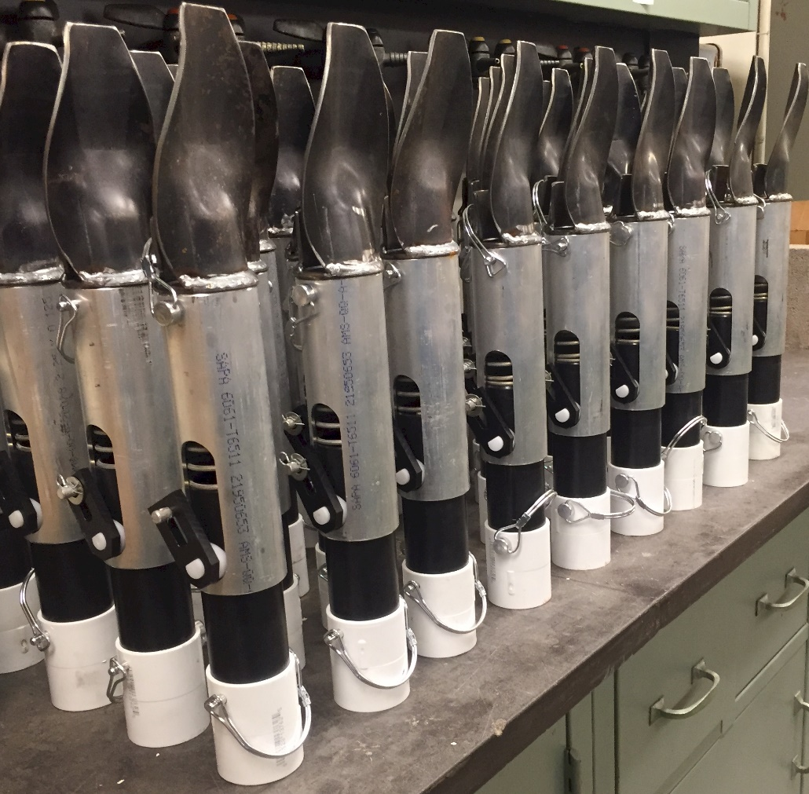


Adoption of a New Age Hand Planter for the Developing World
Saturday, December 5
108 Noble Research Center, 3:30-4:00
OSU Soil Biology Symposium
Randy Taylor
Jagmandeep Dhillon
Joshua Ringer
Daniel Aliddeki
Wayne Kiner
carla.garzon@okstate.edu

Slide 2
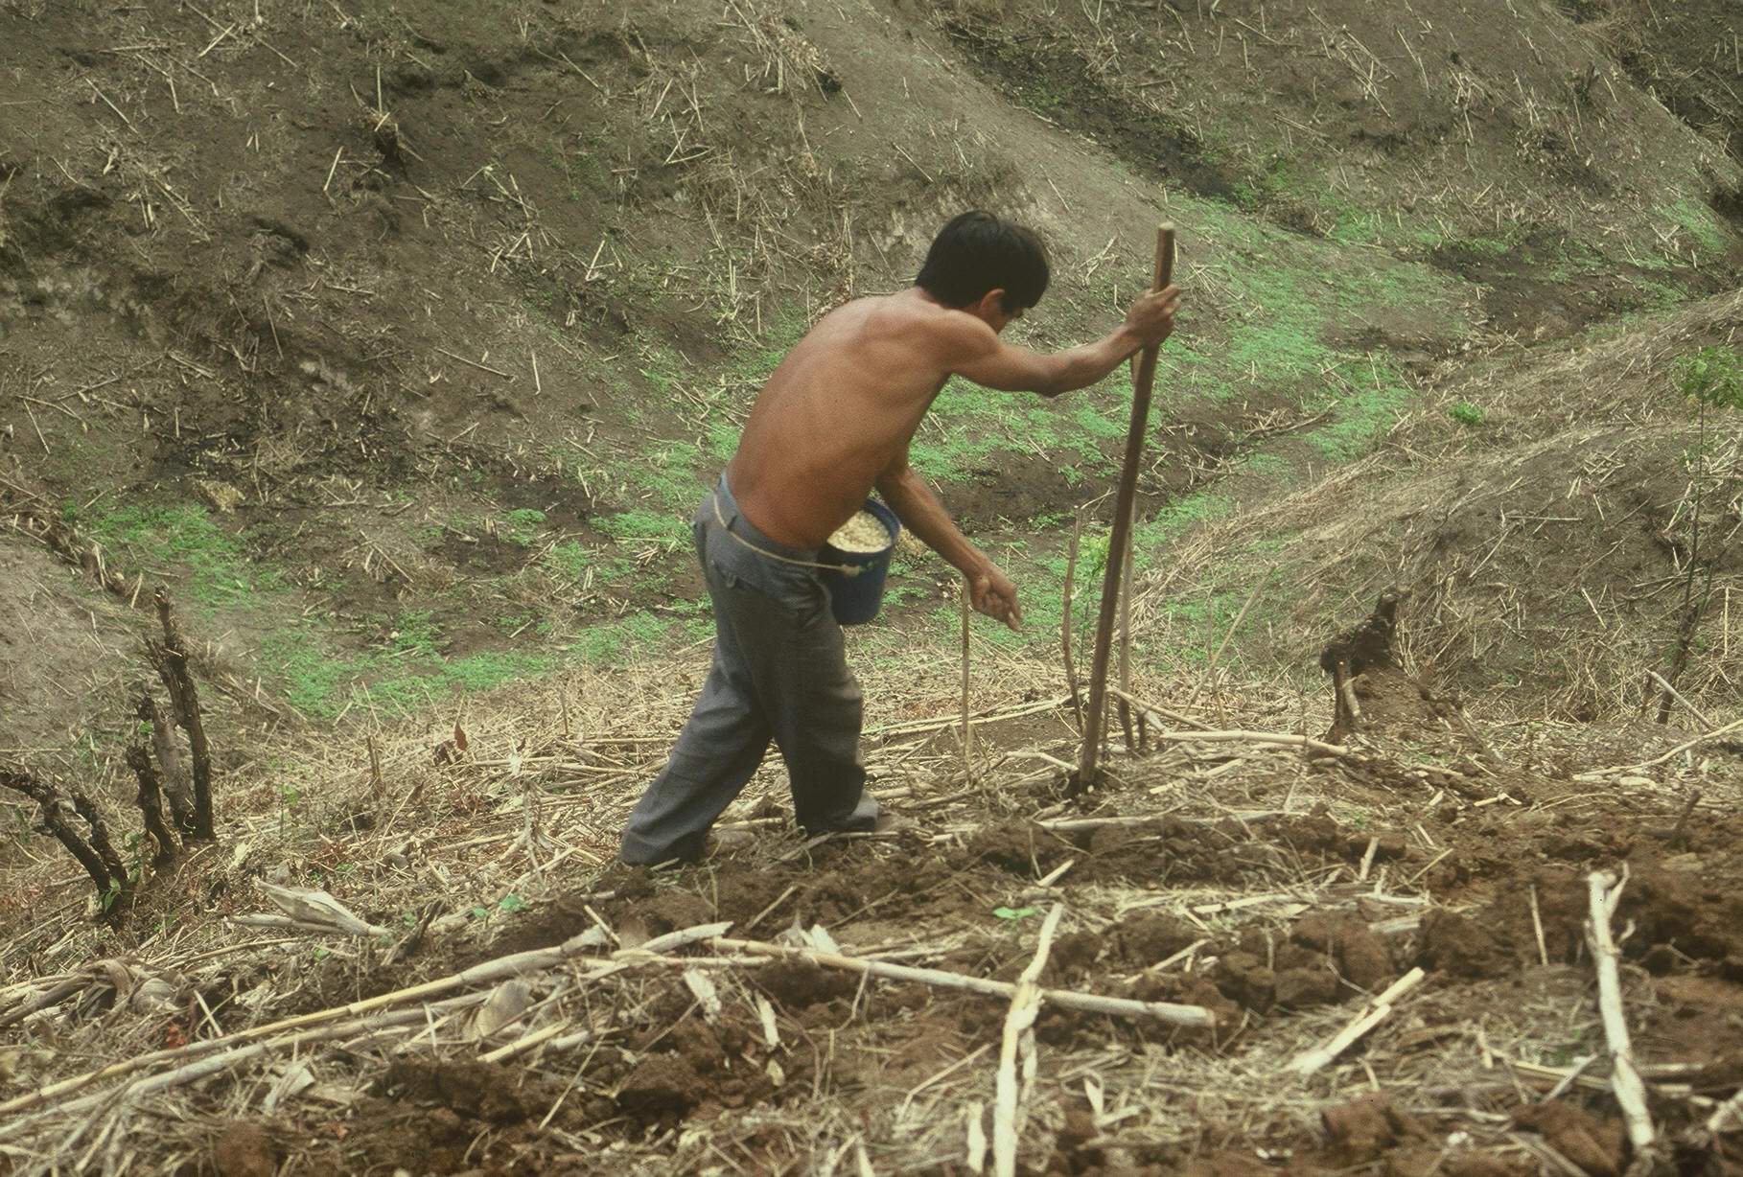

www.nue.okstate.edu

Slide 3
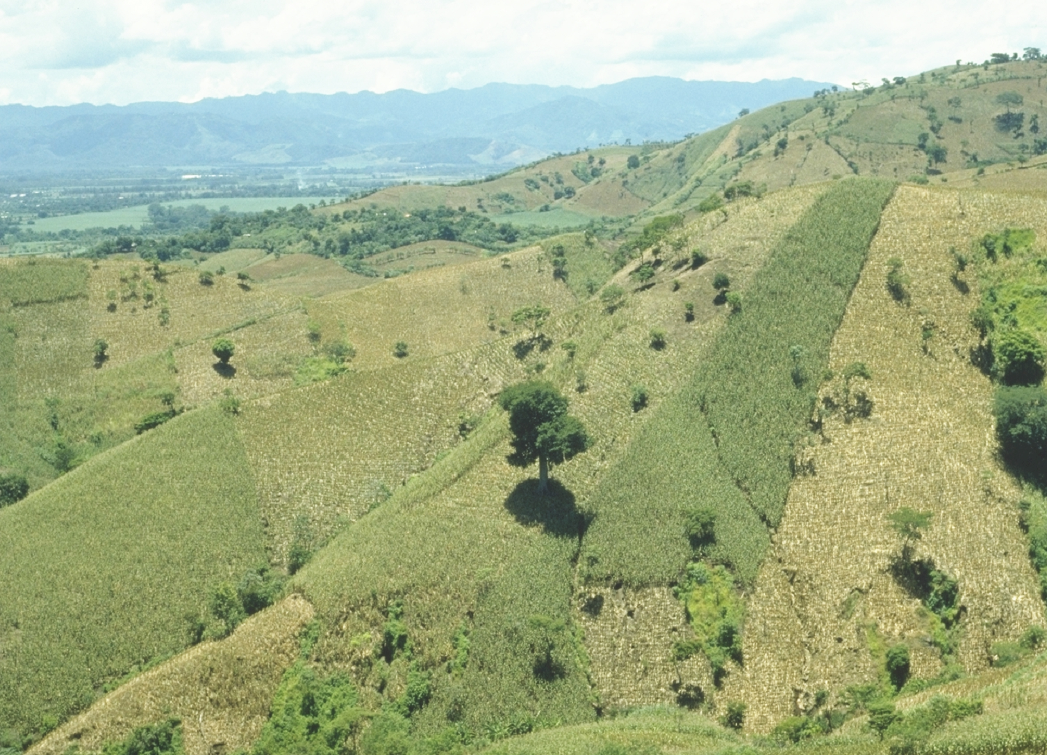
World area planted by hand ≈ corn area in the USA
Developing world, avg. farm size = 1 ha
potential planters ?
By 2050 there will be 9.1 billion people. 95% of the increased population will be in the developing world
EL SALVADOR
Alexandratos, N. and J. Bruinsma. 2012. World agriculture towards 2030/2050: the 2012 revision. ESA Working paper No. 12-03. Rome, FAO.

Slide 4
Maize (FAOSTAT, 2013)
Area, ha Production, Mt Avg. Mt/ha
World 184,239,959 1,016,431,783 5.5 (87 bu/ac)
USA 35,478,012 353,699,441 9.9 (157 bu/ac)
China 35,276,500 217,830,000 6.2 (98 bu/ac)
Brazil 15,450,180 80,516,571 5.2 (83 bu/ac)
Low income Food Deficit Countries
49,356,985 117,590,512 2.4 (38 bu/ac)
60% hand
planted
29,614,180
USA 2014, 37,125,000 ha’s

Slide 5


Adoption of Technology
Early stage technology (staging)
  Momentum
  Management Team
  Market Size, 100% = 30,000,000 planters
  Money
Can a large company/industry benefit by developing a product for developed nation farmers?
NGO delivery, NGO subsidized
https://www.youtube.com/watch?v=VisKBsqcCWA
OSU Hand Planter

Slide 6

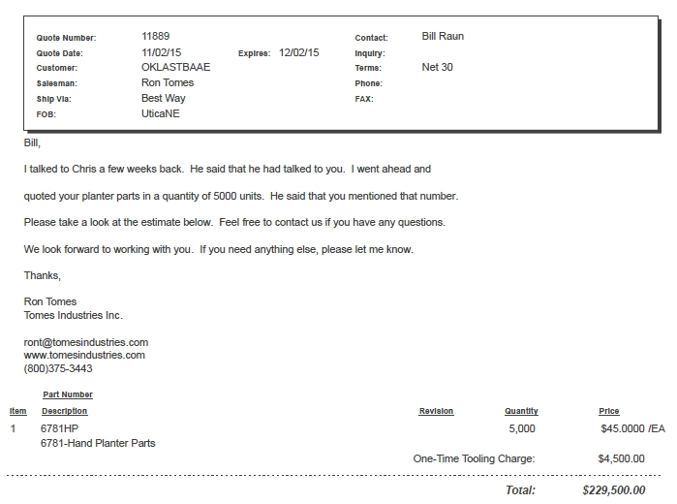
Current Cost Estimate

Slide 7
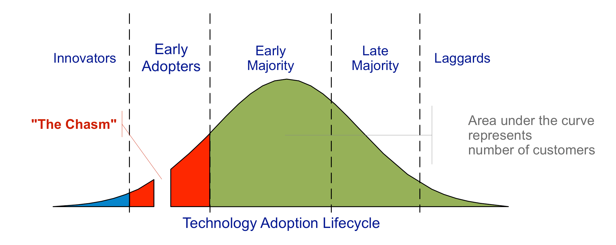
choosing a target market, understanding the whole product concept, positioning the product, building a marketing strategy, choosing the most appropriate distribution channel and pricing.

Slide 8
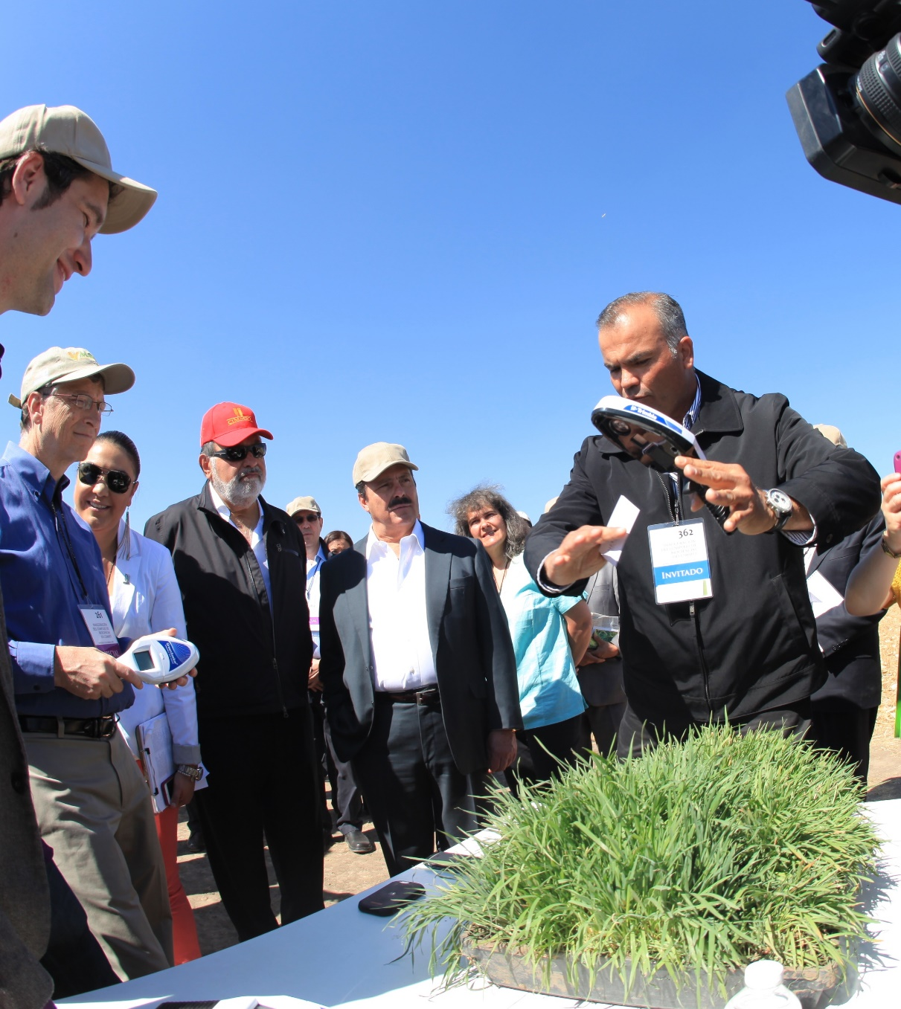
Hand-Held GreenSeeker Sensors

Slide 9
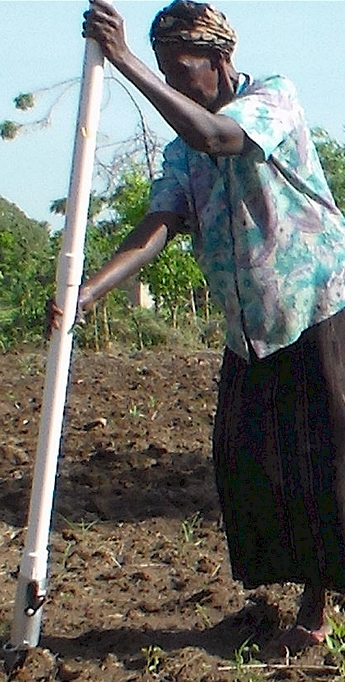
Modern researchers should therefore seek to understand the rationale behind traditional smallholder farmer behavior in technology use. J. Sust. Dev. 2012
Planter Ergonomics

Slide 10
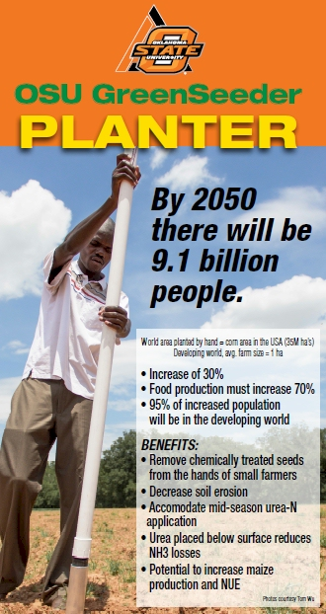
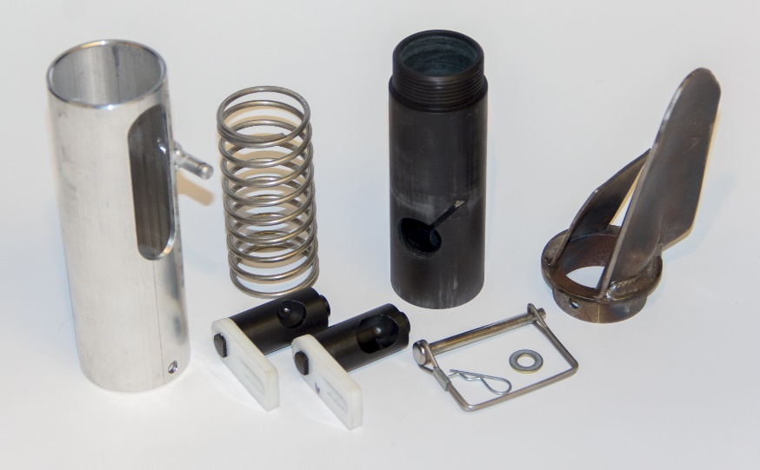
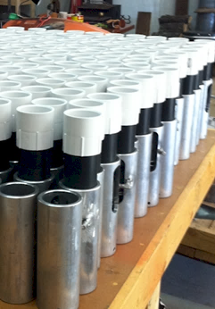
Drums

Slide 11
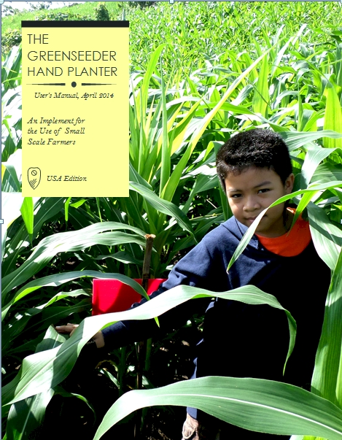
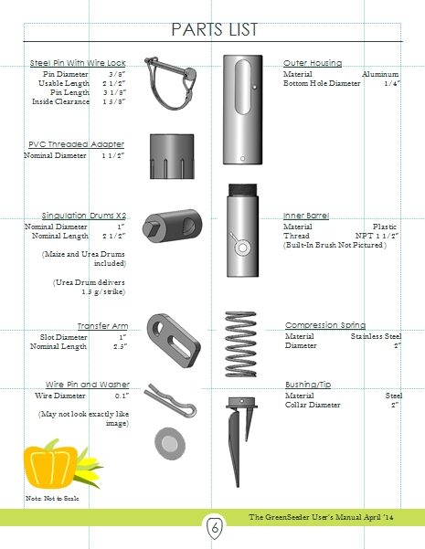
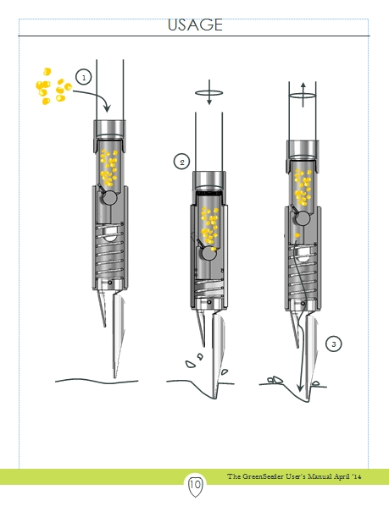
GreenSeeder Manual
http://www.nue.okstate.edu/Hand_Planter/Planter%20User's%20Manual%20EL.pdf

Slide 12
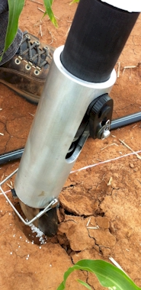
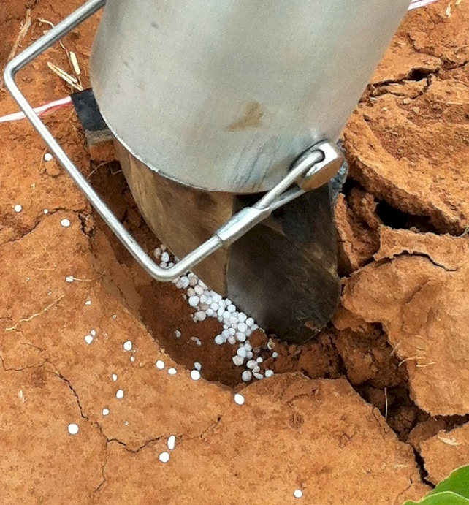
Mid Season Fertilizer N
Combined, Efaw and Perkins
Topdress N, Corn, V12 |  | 70,000 plants/ha
Methods | N, kg/ha | Mg/ha
Check | 0 | 6.6
Hand planter (0.9 g/plant) | 30 | 11.2
Hand planter (1.8 g/plant) | 60 | 10.6
Broadcast | 30 | 6.4
Broadcast | 60 | 7.0
Dribble urea | 30 | 9.3
Dribble urea | 60 | 7.8
Dribble UAN | 30 | 7.3
Dribble UAN | 60 | 10.4
SED = 1.81

Slide 13
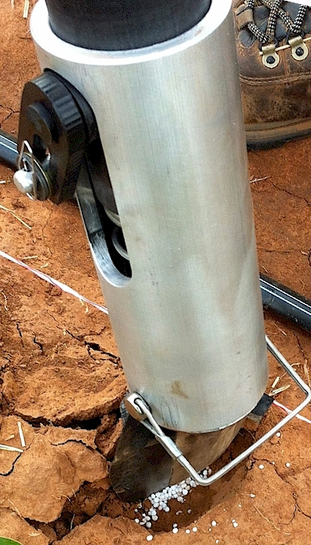
Benefits
Remove chemically treated seeds from the hands of small farmers
Decrease soil erosion via improved plant spacing
Accommodate mid-season application of urea-N
Place urea below the surface reducing NH3 losses
Potential to increase maize production and NUE
Khim et al. (2014). Over three sites, planting 1 seed, every 0.16m increased yields by an average of 1.15 Mg ha⁻¹ (range, 0.33 to 2.46 Mg ha⁻¹) when compared to the farmer practice of placing 2 to 3 seeds per hill, every 0.48 cm.

Slide 14
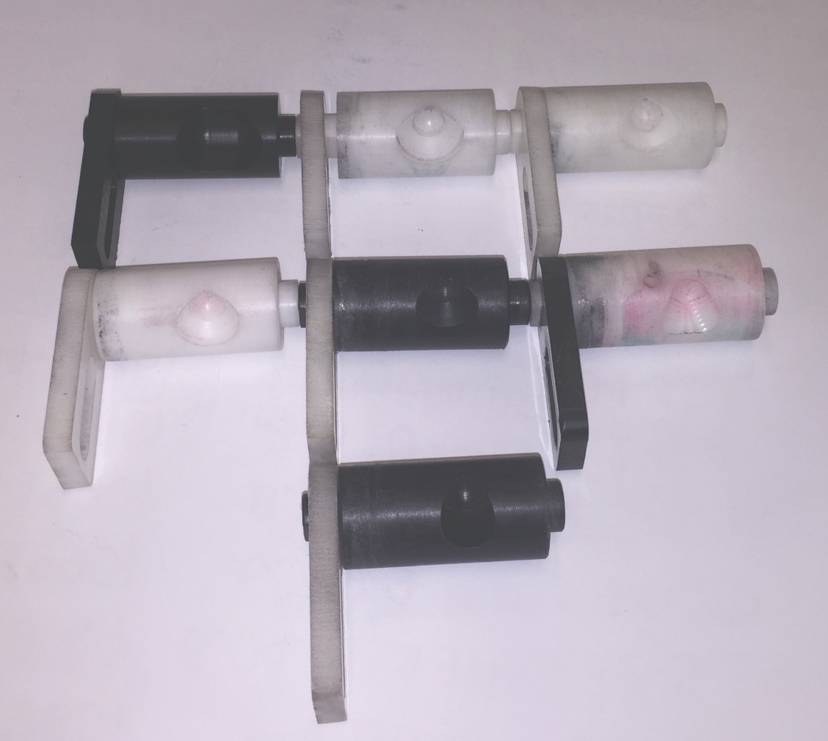
Internal drum, cavity size
Seed type
Seed size
Fertilizer
amount
source

Slide 15

Hand Planters
Person | Organization | Where | No. of Hand Planters
Dr. Isaiah Nyagumbo | CIMMYT, Kenya | Zimbabwe | 4
Dr. Pascal Kaumbutho | KENDAT, Kenya | Kenya | 2
 | Ethiopia | Ethiopia | 1
Dr. Peter Omara | Uganda | Uganda | 8
Dr. Edgar Ascencio | CARE, El Savador | El Salvador | 14
Dr. Fred Kanampiu | IITA, Kenya | Kenya | 2
Dr. Nyle Wollenhaupt | AGCO, Kansas | Kansas | 2
Dr. Ivan Ortiz-Monasterio | CIMMYT, Mexico | Mexico | 1
Kristin Lacy | Semilla Nueva | Guatemala | 2
Nyle Wollenhaupt | AGCO | Lusaka Zambia | 40
Melvin Siwale | AGCO | Lusaka Zambia | 10
Terry Tindall | JR Simplot | Lusaka Zambia | 25
Eric Lam | MAG | Honduras | 2
Eric Lam | CIMMYT | Bangladesh | 1
Roman Gordon | IDIAP | Panama | 2
Dr. Luis Narro | CIAT | Colombia | 6
Dr. Joshua Ringer |  | Thailand | 1
Dr. Assoumane Maiga |  | Mali | 1
Total |  |  | 130
Notes:
15

Slide 16
Bangladesh
Burundi
Belize
Brazil
Colombia
El Salvador
Ethiopia
Guatemala
India
Kenya
Malawi Mali
January 2014, on-line hand planter workshop http://nue.okstate.edu/Hand_Planter/osu_hand_planter_workshop.html
Mexico
Mozambique
Sierra Leone
Nepal
Philippines
Tanzania
Togo
Uganda
USA
Zambia
Zimbabwe

Slide 17
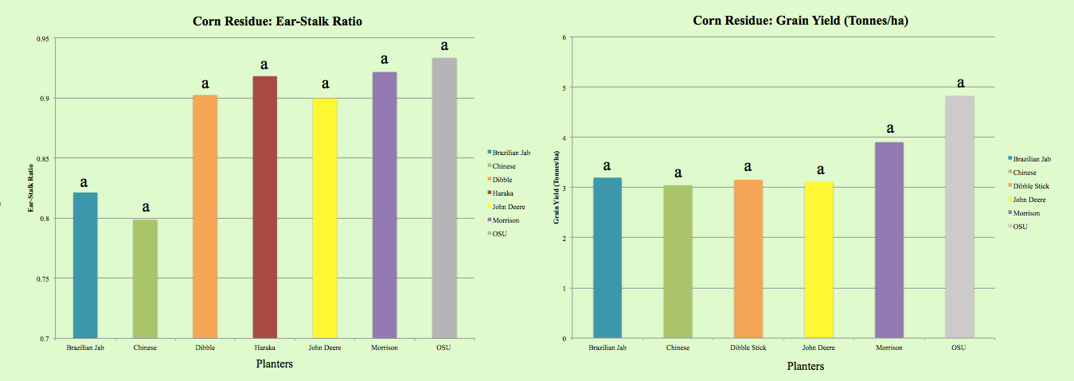
Becca Harman, University of Tennessee

Slide 18


Centro Internacional de Mejoramiento de Maiz y Trigo

Slide 19
“The most conservative man in traditional agriculture is the scientist, and sometimes I am not proud to be one of them. This is most discouraging. The scientist is a privileged person, the man should lead us out of the wilderness of static, underproductive agriculture, and yet by his apathy and failure to exercise his unique vision, he keeps us in the swamp of despair. The scientist fears change because he is in a relatively privileged position in his own society. If there is no breakthrough in yield, he will not be criticized. But if he makes a recommendation and something goes wrong, he may lose his job. “ N.E. Borlaug
“Wheat is an equal opportunity performer, it never discriminates. It grows as well for the poor as for anyone”
N.E. Borlaug

