Slide 1



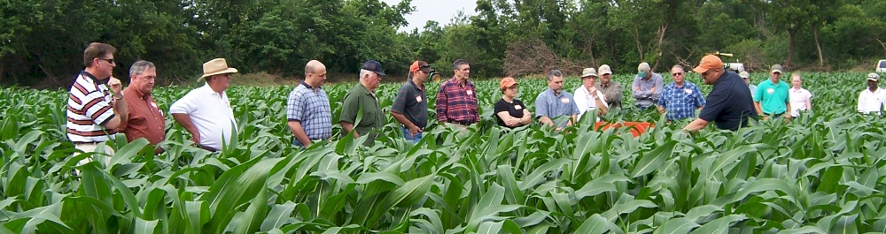





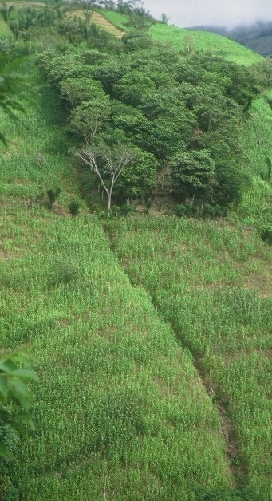










13th annual nitrogen use efficiency conference auburn, alabama aug 4, 2015

Slide 2
Connect/new ideas
workshop started in 1996, Lincoln, NE
international by 2002
obligated to share everything we know
common sense approach
younger scientists
need to get this right
future of NUE conference
Mexico 2016, Dr. Ivan Ortiz Monasterio?

Slide 3
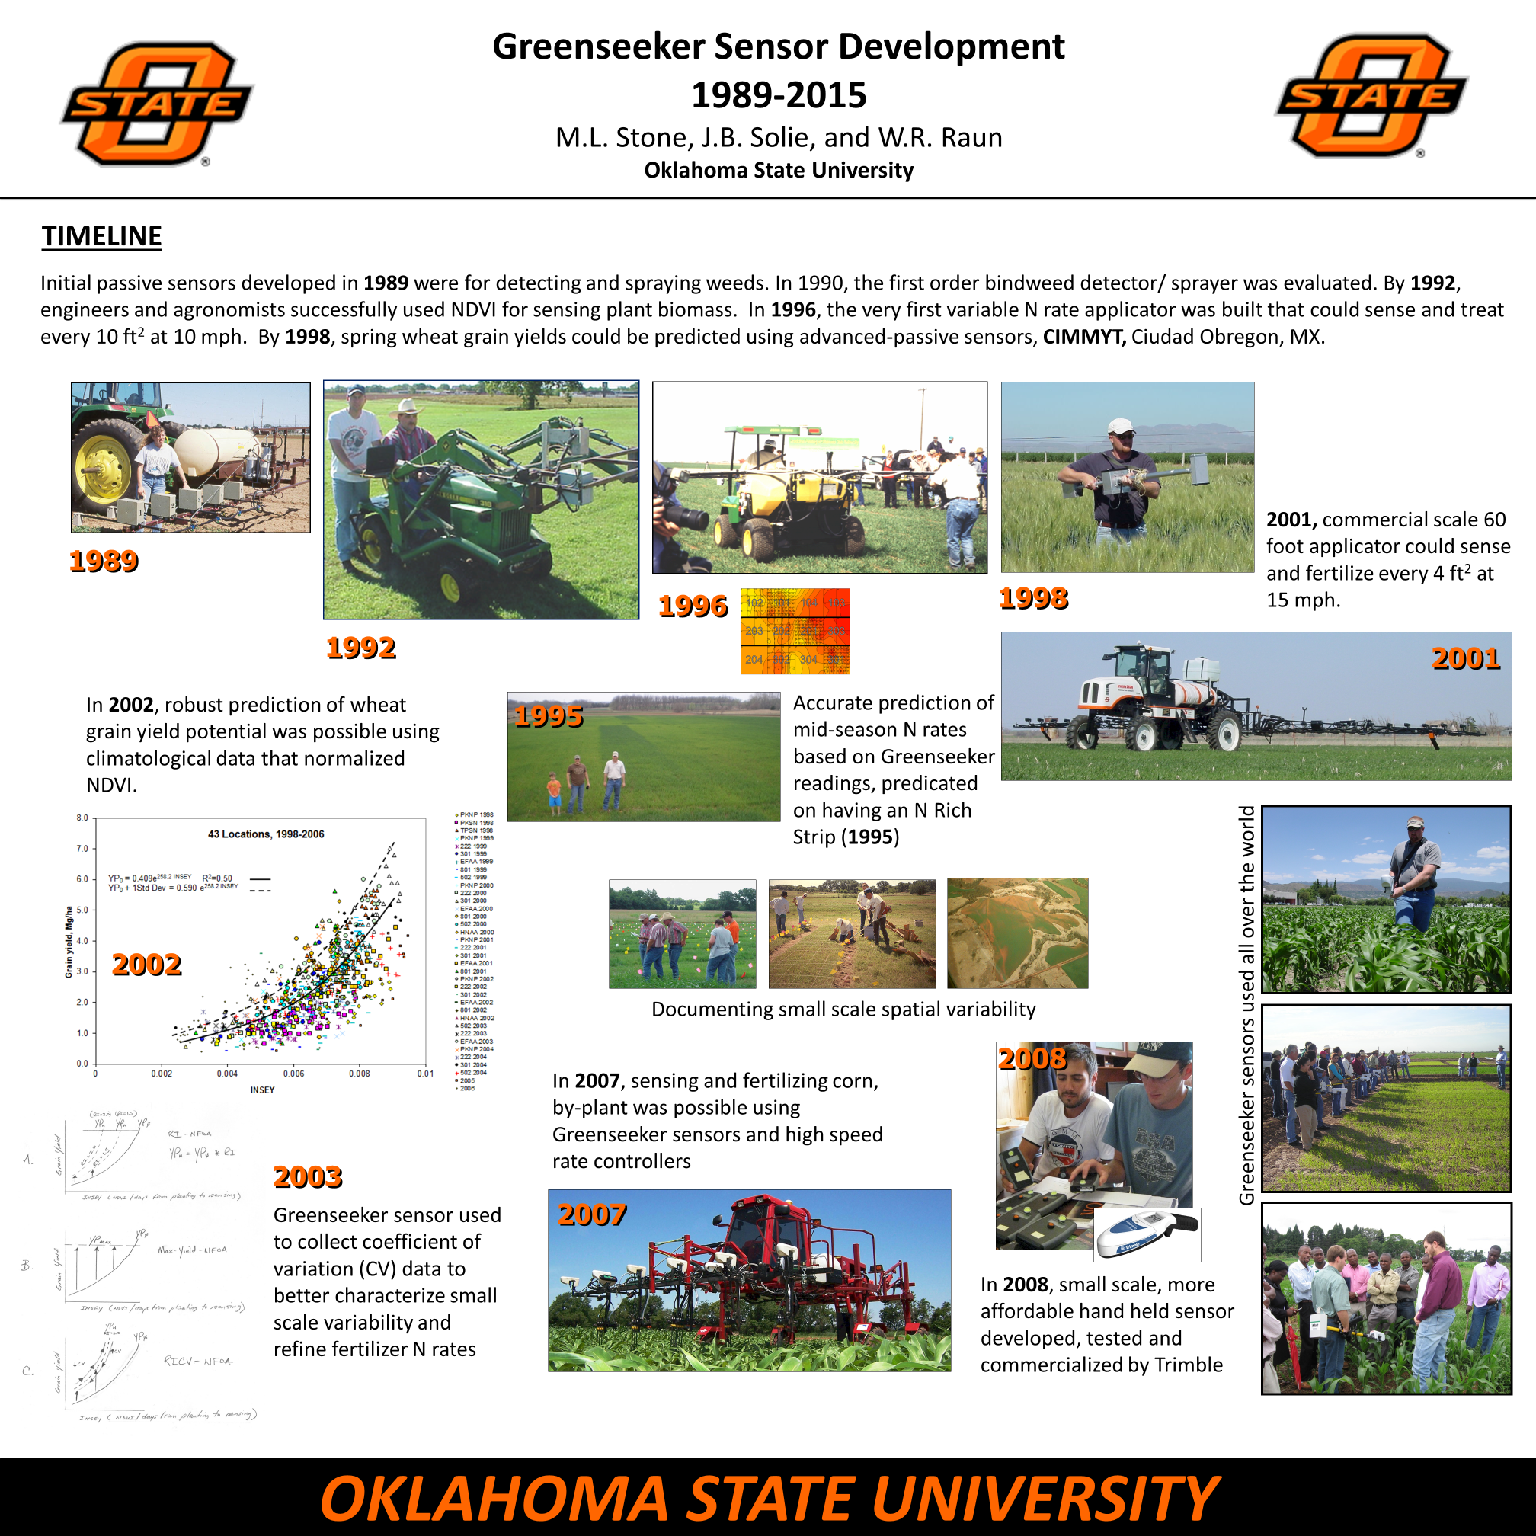

Slide 4
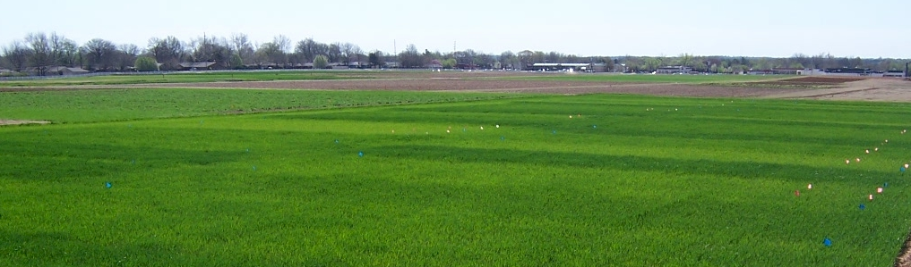
Present State of Sensor Based Nitrogen Algorithms
Yield influences N demand
Arnall et al. (2009), Agron. J.
Lory and Scharf (2003), Agron. J.
Fowler (2003), Agron. J.
Spiertz and DeVos (1983), Plant and Soil
N response (N demand) changes each year
Mullen et al. (2003), Agron. J.
Varvel et al. (1997), SSSAJ.
Bundy and Andraski (2004), Agron. J.
YP0 and RI are independent
Do Yield Goals Work?

Slide 5
Fertilizer recommendations that ignore yield entirely are limited to explaining less than 50% of the variation in the economic optimum N rate for maize (Lory and Scharf, 2003, Agron. J. 95:994-999)
Research conducted over locations and years in Missouri noted that economically optimum fertilizer N rates vary widely from year to year, and from place to place within a field (Scharf et al., 2005, Agron J. 97:452-461)

Slide 6
Dhital, Sulochana. 2015. Do nitrogen rates change every year. Prec. Agric.
Source | Location | Years | Years | High N Yield Range | Check plot Yield Range | Optimum N rate
 |  |  |  | Mg ha⁻¹ | Mg ha⁻¹ | Min | Max | Avg.
Bundy et al. (2011) | Wisconsin | 21 | 1958-1983 | 4.3-8.8 | 1.57-7.59 | 46 | 213 | 119
Bundy et al. (2011) | Wisconsin | 24 | 1984-2007 | 5.7-14.1 | 1.67-5.58 | 143 | 334 | 238
Mallarino and Torres (2006) | Iowa | 32 | 1979-2010 | 5.1-12.5 | 0.75-5.91 | 75 | 314 | 193
Mallarino and Torres (2006) | Iowa | 26 | 1985-2010 | 5.3-12.8 | 1.4-6.3 | 123 | 332 | 214
Varvel et al. (2007) | Nebraska | 11 | 1995-2005 | 10.4-13.6 | 3.5-10.9 | 67 | 280 | 191
Jokela et al.(1989) Carroll | Minnesota | 3 | 1982-1984 | 7.1-9.1 | 5-7.3 | 5 | 120 | 77
Jokela et al.(1989) Webster | Minnesota | 3 | 1982-1984 | 1.8-8.7 | 1.7-5.6 | 64 | 103 | 84
Fenster et al. (1976) Waseca | Minnesota | 7 | 1970-1976 | 7.12-10.65 | 2.71-7.43 | 55 | 227 | 140
Fenster et al. (1976) Martin | Minnesota | 7 | 1970-1976 | 4-9.6 | 3.8-8.2 | 21 | 116 | 62
Fenster et al. (1976) Martin | Minnesota | 6 | 1971-1976 | 6.2-12 | 6.2-11.3 | 0 | 34 | 15
Al Kaisi et al.(2003) | Colorado | 3 | 1998-2000 | 5-14.1 | 3.53-12.57 | 24 | 126 | 84
Ismail et al.(1994) NT | Kentucky | 20 | 1998-2000 | 5.2-10.9 | 2.1-7.4 | 32 | 211 | 117
Ismail et al.(1994) CT | Kentucky | 20 | 1970-1990 | 3.5-10.4 | 1.9-9.5 | 0 | 186 | 90
Rice et al.(1986) NT | Kentucky | 16 | 1970-1985 | 5.7-9.2 | 3.1-4.9 | 93 | 163 | 132
Rice et al.(1986) CT | Kentucky | 16 | 1970-1985 | 5-8.8 | 1.9-6.1 | 63 | 187 | 114
Stecker et al.(1993) | Missouri | 3 | 1988-1990 | 6.04-10.13 | 3.32-5.59 | 91 | 178 | 140
Stecker et al.(1993) | Missouri | 3 | 1988-1990 | 6.7-9.9 | 4.54-7.2 | 42 | 167 | 94
Stecker et al.(1993) | Missouri | 2 | 1989-1990 | 8.2-8.5 | 4.95-5.98 | 82 | 108 | 95
Peterson et al.(1989) | Nebraska | 4 | 1983-1986 | 3.9-10 | 2.1-6.4 | 10 | 200 | 96
Woodruff et al.(1983) | South Car. | 3 | 1974-1976 | 13-20.2 | 1.04-15.6 | 0 | 639 | 302
Eck (1982) | Texas | 3 | 1977-1979 | 3.41-13.21 | 1.79-5.03 | 13 | 300 | 146
Shapiro et al.(2006) RS 51cm | Nebraska | 3 | 1996-1998 | 9.4-11.14 | 6.24-8.93 | 64 | 88 | 76
Shapiro et al.(2006) RS76cm | Nebraska | 3 | 1996-1998 | 7.12-11.04 | 5.02-8.88 | 12 | 105 | 69
Meisinger et al. (1985) MT | Maryland | 4 | 1974-1977 | 5.8-8.2 | 1.8-2.6 | 117 | 213 | 168
Meisinger et al. (1985) MT | Maryland | 4 | 1974-1977 | 5.1-8.1 | 2.7-4.2 | 33 | 180 | 130
Gehl et al.(2005) Ellinwood | Kansas | 4 | 2001-2002 | 9-11.9 | 2.7-7.2 | 147 | 307 | 220
Gehl et al.(2005) Rossville | Kansas | 2 | 2001-2002 | 11.3-12.6 | 6.4-7.9 | 167 | 187 | 177
Gehl et al.(2005) scandia | Kansas | 2 | 2001-2002 | 3.8-11.5 | 2.7-7.4 | 47 | 147 | 97
Gehl et al.(2005) Manhattan | Kansas | 2 | 2001-2002 | 10.5-10.7 | 2.8-6.4 | 143 | 260 | 202
Total |  | 257 |  |  | average | 61 | 208 | 134
 |  |  |  |  | stdev | 50 | 114 | 63
CV=47

Slide 7
At some sites the 0-N check plot yielded the same as the high N rate plot after years of continuous maize production.
Conclusion
Static N recommendations do not account for the variability in soil available N and maize N uptake as influenced by environment (temperature/rainfall) (Dhital and Raun, 2015, Precision Agriculture)

Slide 8
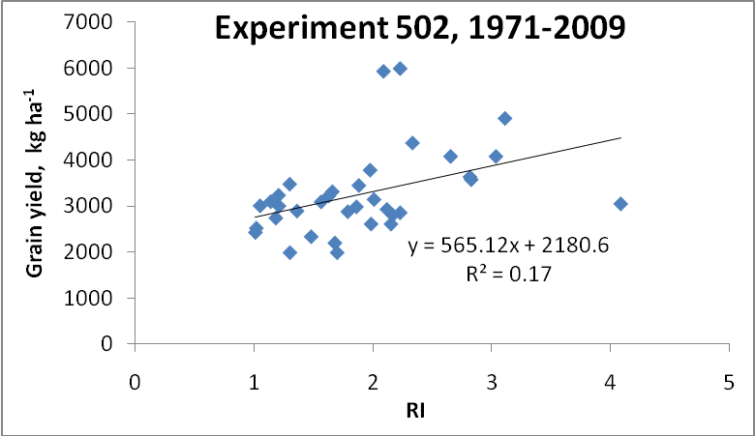
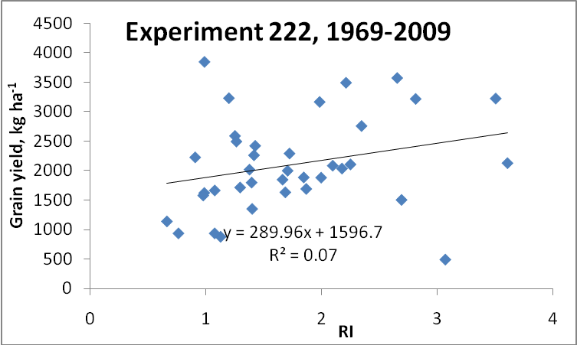
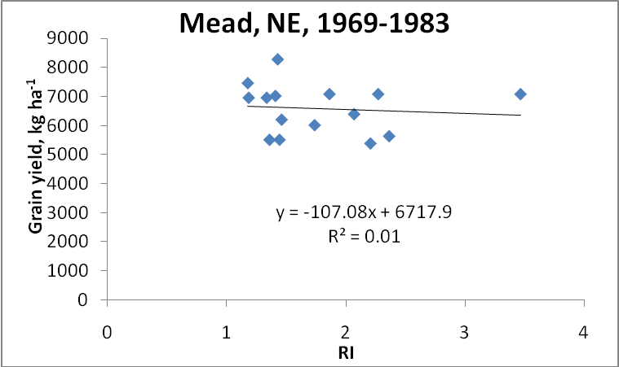
Independence of yield potential and crop nitrogen response (Prec. Agric. 12:508-518)
Nebraska
Oklahoma

Slide 9
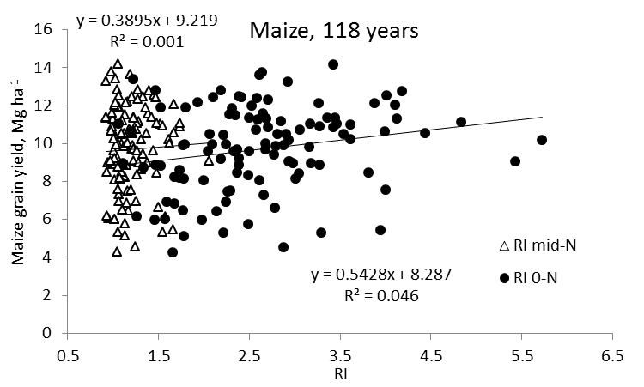
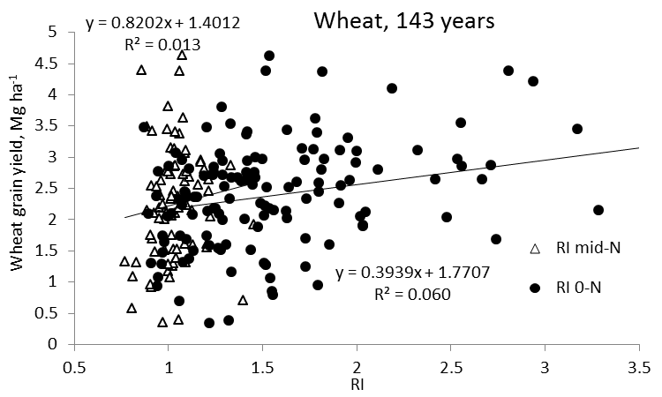
Independence of yield potential and nitrogen response (Agron J. 105:1335-1344)
Iowa
Nebraska
Wisconsin
Oklahoma
Because yield and response to N were consistently independent of one another, and as both affect the demand for fertilizer N, estimates of both should be combined to calculate realistic in-season N rates

Slide 10
Do yield goals work?
 | Trt 7 | Avg. Yield
Year | 112-20-55 | last 5 yr +20%
1971 | 2.51
1972 | 1.47
1974 | 1.87
1975 | 3.40
1976 | 3.14
1977 | 1.94 | 2.97
1978 | 2.59 | 2.36

Slide 11
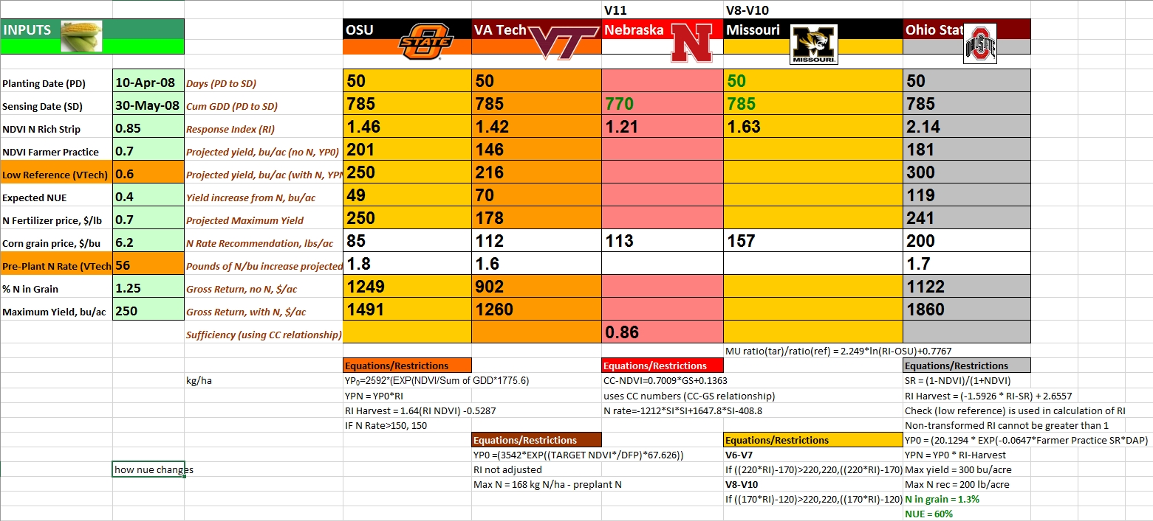
2008, Manhattan, KS

Slide 12
Question
This group has a robust set of answers to the Mid-Season Sensor Based Nitrogen Recommendations in wheat and corn

Slide 13
Algorithm requests
Peter Scharf University of Missouri
Raj Khosla Colorado State University
Ray Asebedo Kansas State University
Jeff Vetsch University of Minnesota
Olga Walsh University of Idaho
Wade Thomason Virginia Tech
David Clay South Dakota State University
Brenda Ortiz Auburn University
Richard Ferguson, Jim Schepers University of Nebraska
Kyle Holland, Jim Schepers Holland Scientific, UNL
Josh McGrath University of Kentucky
Harold van Es Cornell University
Brenda Tubana Louisiana State University
Brian Arnall Oklahoma State University
John Solie Auburn NE

Slide 14
Algorithms/Approaches
Holland Scientific, Univ. Nebraska, Kyle Holland, Jim Schepers
Oklahoma State University, Brian Arnall
Univ. Missouri, Peter Scharf
Virginia Tech, Wade Thomason
Cornell, Harold van Es
Kansas State University, Ray Asebedo, Dave Mengel

Slide 15
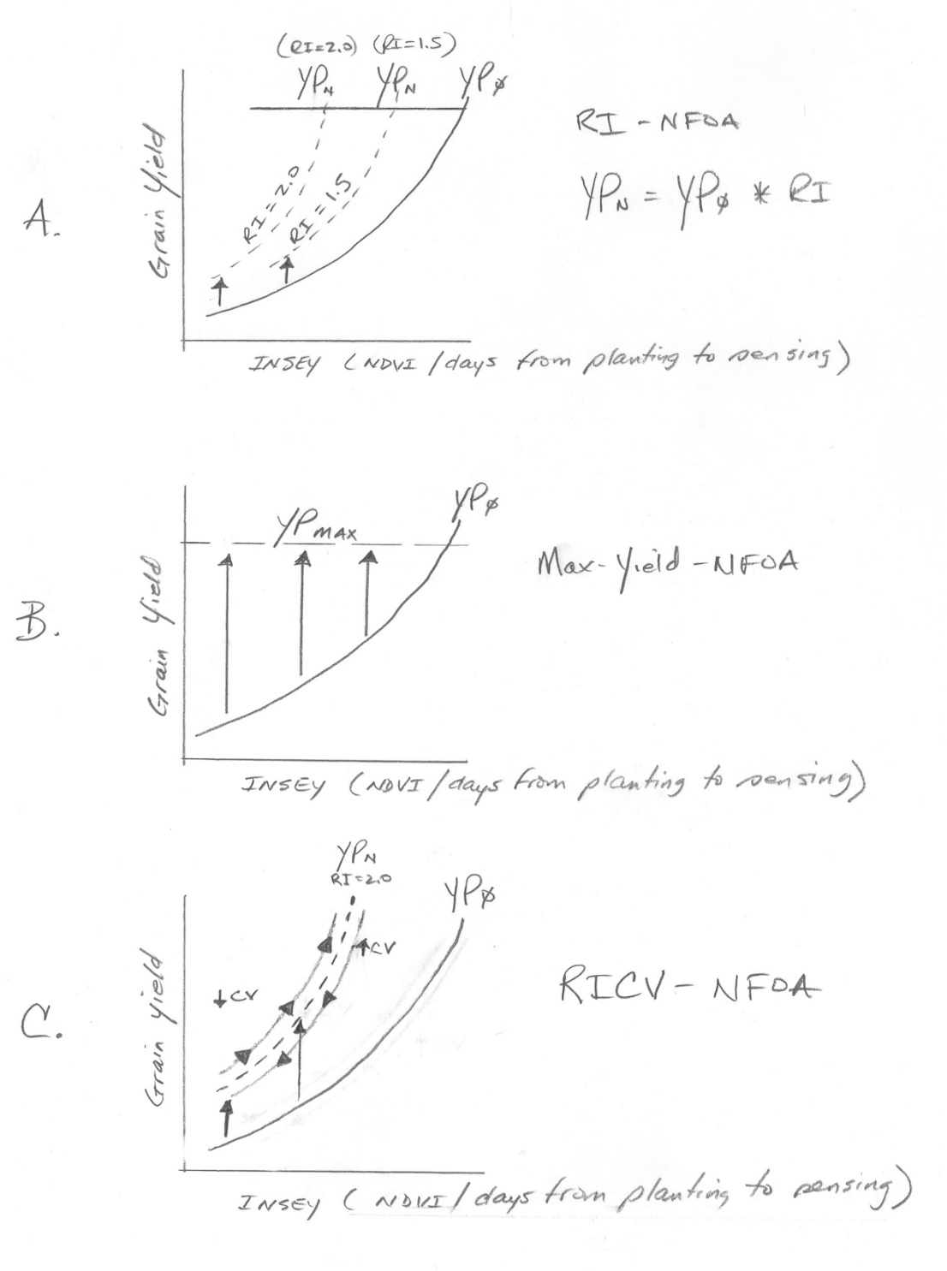
N theory
N algorithm

Slide 16
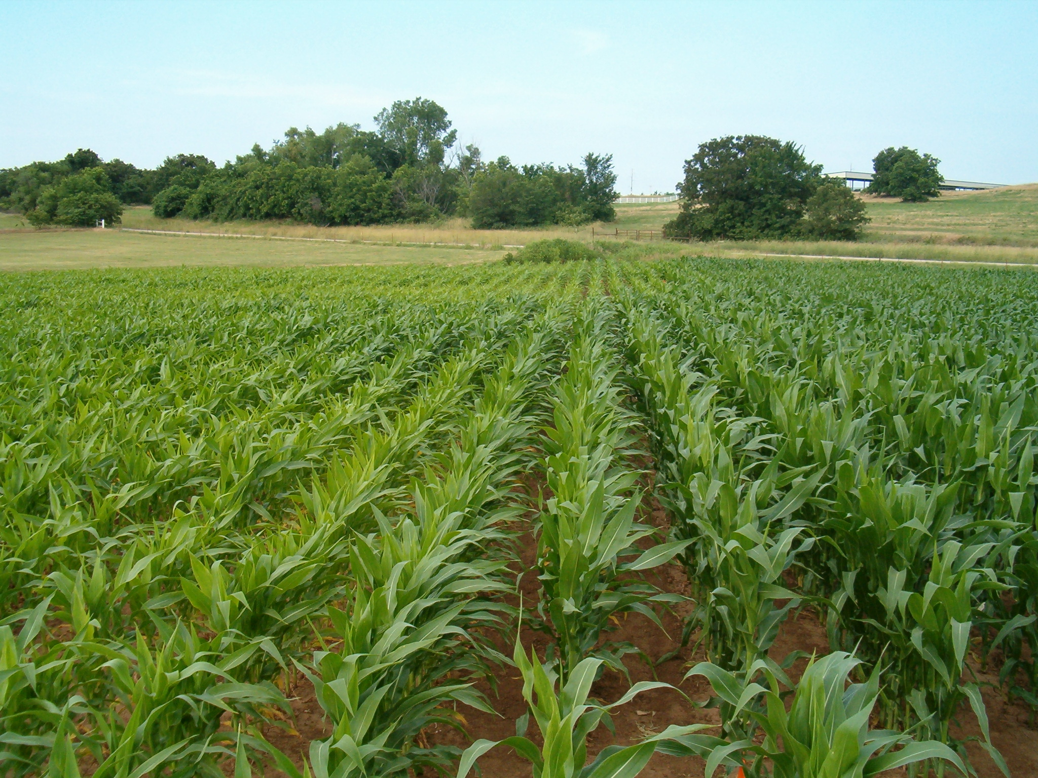
Nitrogen Algorithm Corn
1. Establish preplant N Rich Strip (NRS)
2. Collect NDVI readings, 6-12 leaf
3. Predict potential yield (YP0, yield prediction equation).
4. Need NDVI and cumulative GDD from planting to sensing
5. Determine Response Index (RI) = NDVINRS/NDVIFarmer
6. Yield potential with added N, YPN =(YP0*RI)
7. Fertilizer Rec = (grain N uptake YPN – grain N uptake YP0/expected efficiency)
YP_{N}
RI
GDD from planting to sensing
YP₀
Planting date
NDVI (sensing date)

Slide 17
OSU Corn Algorithm
YP₀=1291*(EXP(NDVI/Sum of GDD*2649.9) V8 to V12
RI = NDVI- N Rich Strip/ NDVI – Farmer Practice
YPN = YP0 * RI
N Rate = ((YPN – YP0)* 0.0125)/expected fertilizer use efficiency

Slide 18
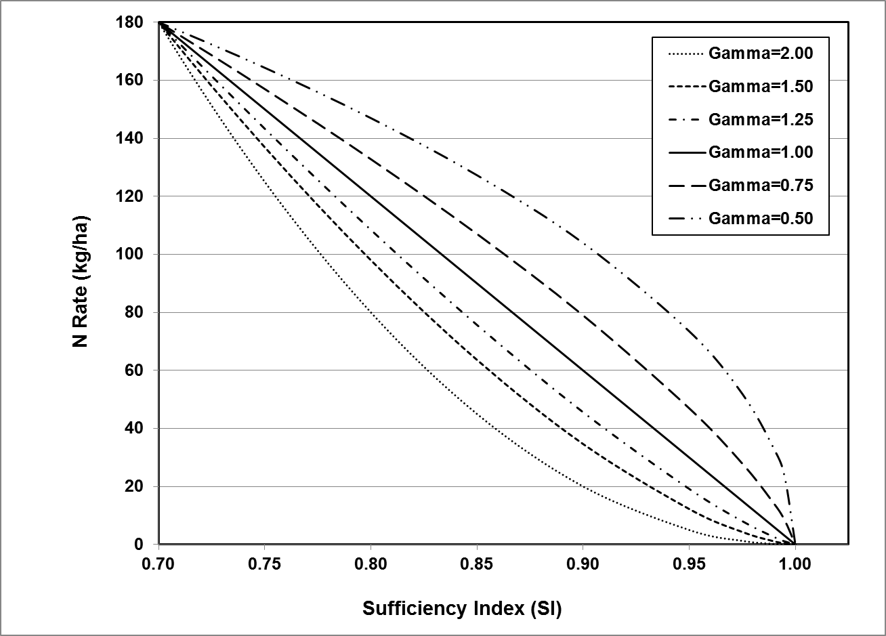
*Holland-Schepers Generalized N-Rate Model:
Zone Scaling
Management Inputs and Credits
Management Inputs and Credits
Sensor Data
Comments:
Calibration via VRS, PV or NRS techniques
Management inputs include climate and cropping history (e.g. yield, previous crop, etc..)
Algorithm now implements a decision support system for optimizing inputs (beta)
Gamma exponent can modify shape to crop nutrient response
N conservation using back-off function
*Holland, K. H., & Schepers, J. S. (2010). Derivation of a variable rate nitrogen application model for in-season fertilization of corn.
Agronomy Journal 102:1415-1424.

Slide 19


KSU Mid-Season Nitrogen Recommendation Algorithm for Grain Sorghum
Ray Asebedo, Drew Tucker, Dave Mengel
Optical Sensors using red NDVI
  Trimble Greenseeker
  Holland Scientific Crop Circle ACS-470
  Ag Leader Optrx
Components of Algorithm
  Nitrogen Reference Strip, 134-168 kg N/ha applied pre-plant
  Designed to be used 35 to 50 days after planting
  Compare N Reference NDVI to Target Area NDVI
  Calculate Response Index (NDVI N Ref/NDVI Target)
  Calculate In-season Estimate Yield for N Reference and Target Area
  Determine Expected Yield increase based on Response Index
  Estimate N Uptake
  Apply expected Nitrogen Use Efficiency to N Recommendation
Available for downloadhttp://soiltesting.okstate.edu/sensor-based-n-rate-calculator
Currently undergoing updates and new version will be available 2016

Slide 20
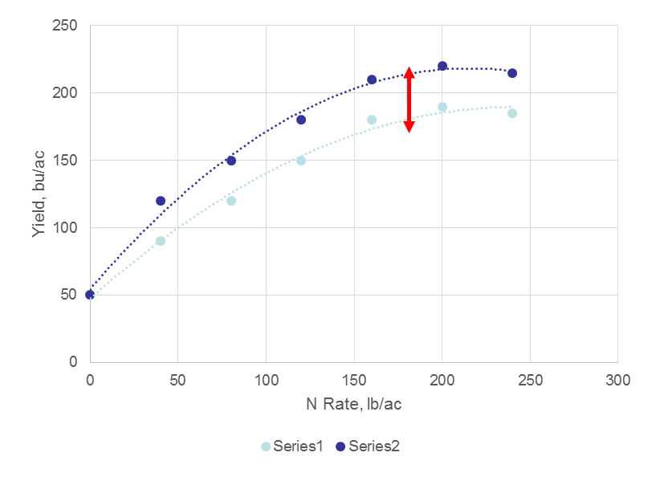
Response Index
N uptake in N-Rich area
N uptake in area to be Fertilized
= RI
Add in-season N
60 lb N
40 lb N
= 1.5
No in-season N

Slide 21
Relies on mid-season yield prediction

Slide 22
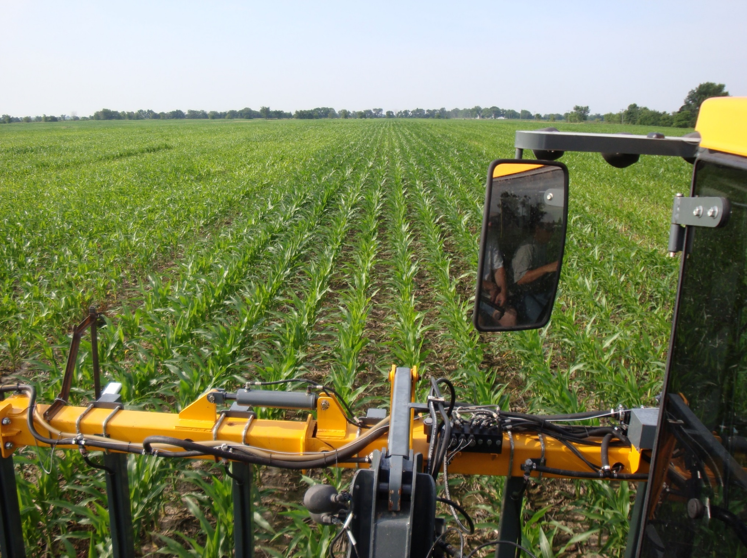
“N-Rich” Strip

Slide 24
University of Missouri
Sensor N demo cheat sheet
1. Install sensors directly over rows, 20 inches from canopy
2. Hook power box into power source (battery, cab outlet, or cigarette lighter outlet)
3. Run sensor lines into serial & power boxes
4. Put GPS up high, power up, run into serial box, verify performance
5. Run control line from serial box to controller
6. Install computer on stand, attach power, power up, hook to serial box (via USB)
a. We’ve had some bootup problems if USB cable is attached prior to boot
7. Start software (VRA09MT2)
8. Verify sensor type (H = Holland = Crop Circle; G = Greenseeker)
a. If not, change in display box
9. Put in equation parameters
Greenseeker V8 to V10 is N rate = [170 * (Vis/NIR)target / (Vis/NIR)ref] – 120

Slide 25
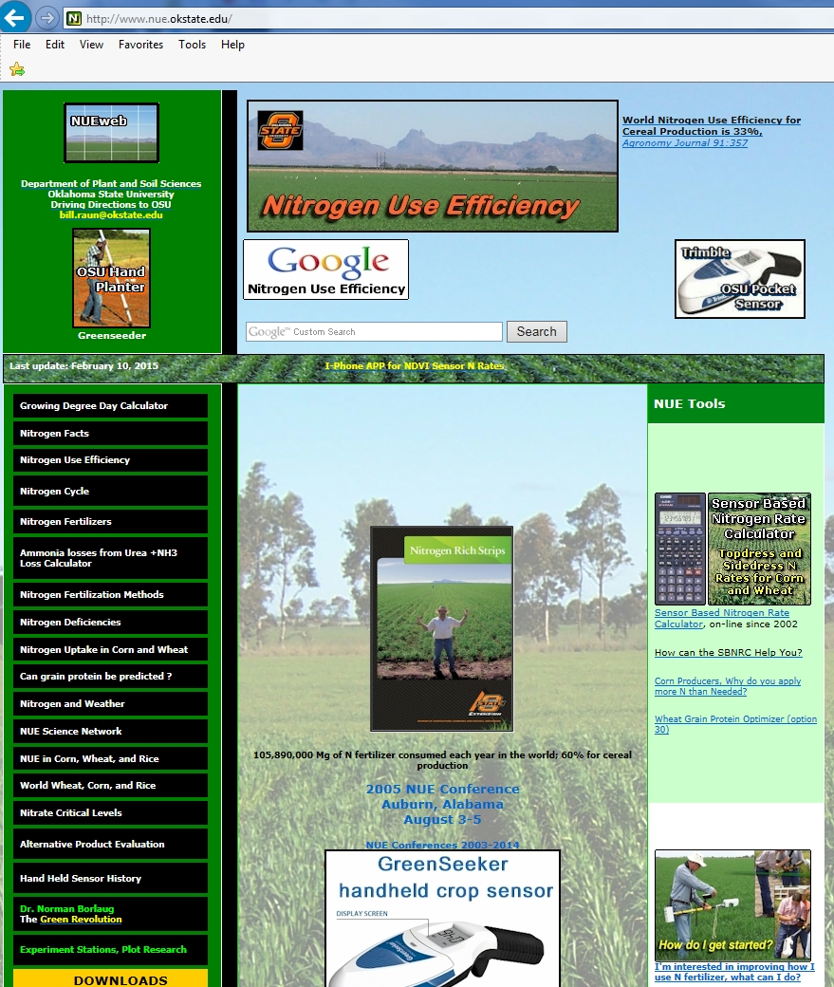
Sensor Based Nitrogen Rate Calculator
32 options
maize
winter wheat
spring wheat
rice
canola
bermudagrass
sorghum
protein (wheat)

Slide 26
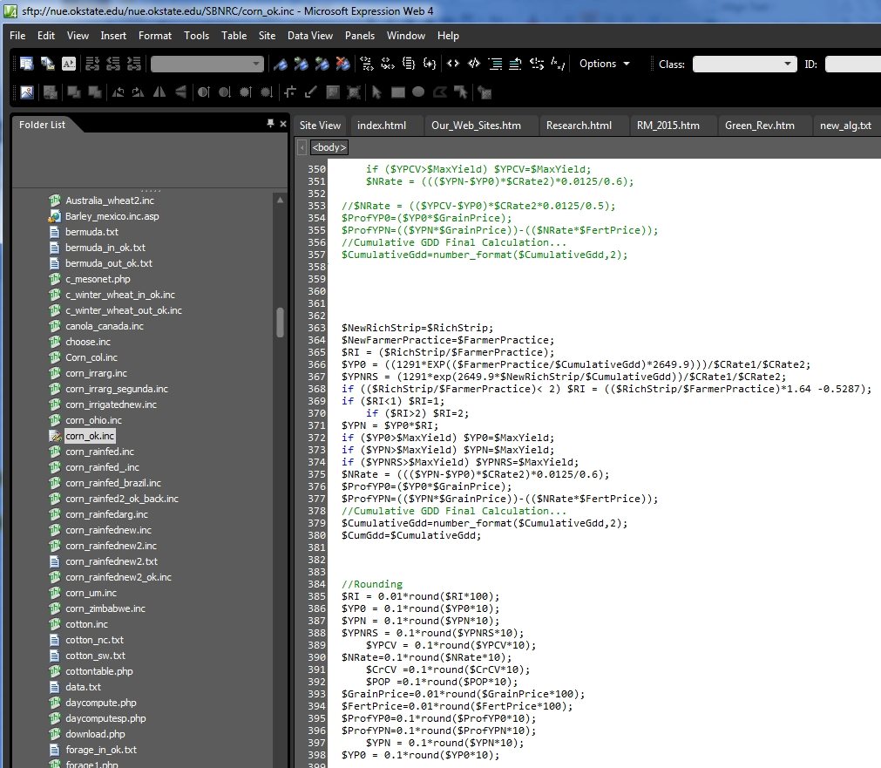
PHP code
editor
expression web

Slide 27
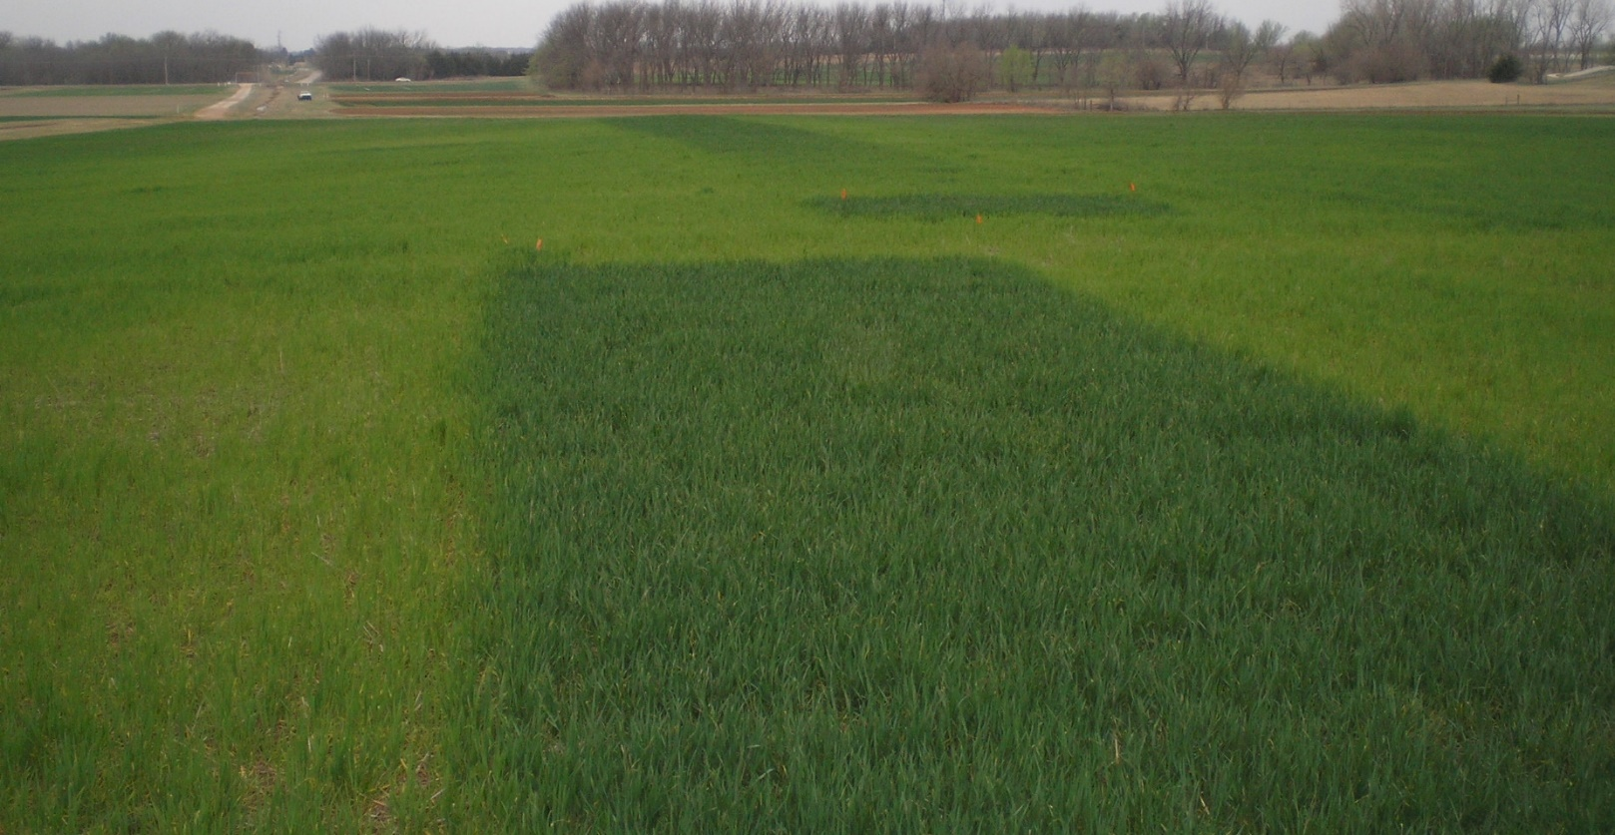


Slide 28
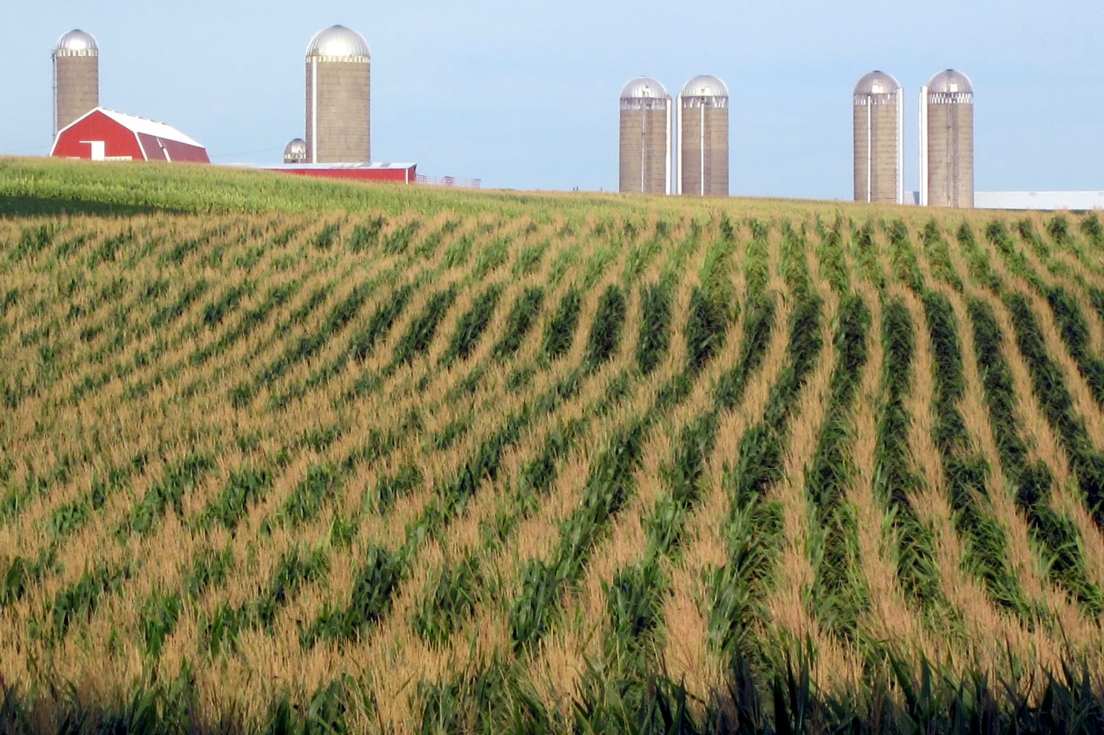
It’s Time to Rethink America’s Corn System
March 5, 2013, Jonathan Foley
Director, Inst. Env. Univ. Minnesota
Scientific American
Today’s corn crop is mainly used for biofuels (roughly 40 percent of U.S. corn is used for ethanol) and as animal feed (roughly 36 percent of U.S. corn, plus distillers grains left over from ethanol production, is fed to cattle, pigs and chickens). Much of the rest is exported. Small fraction of the national corn crop is directly used for food for Americans, much of that for high-fructose corn syrup.
Pete Shively, National Geographic

Slide 29
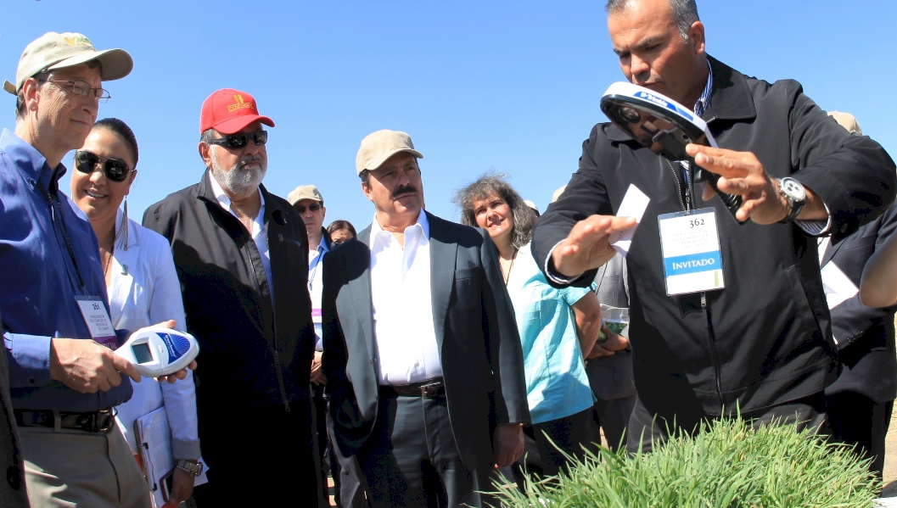
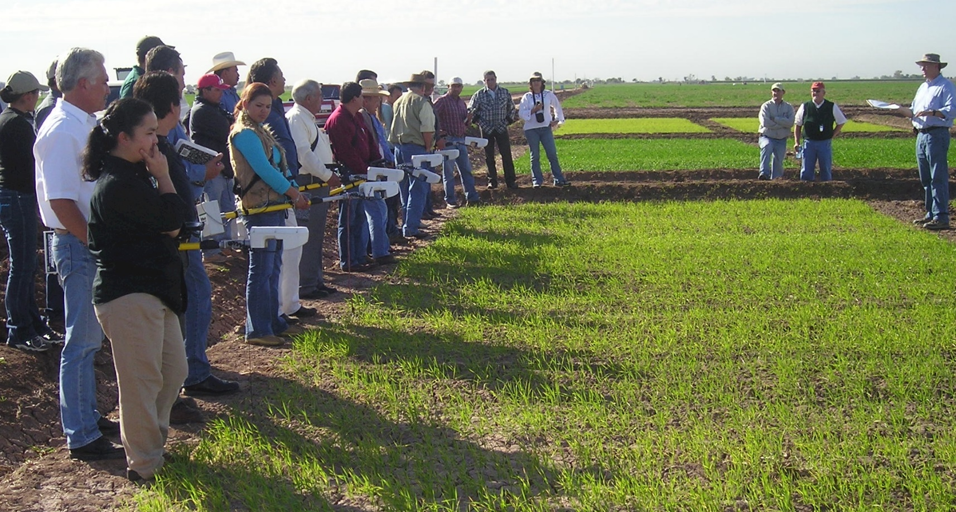

Slide 30
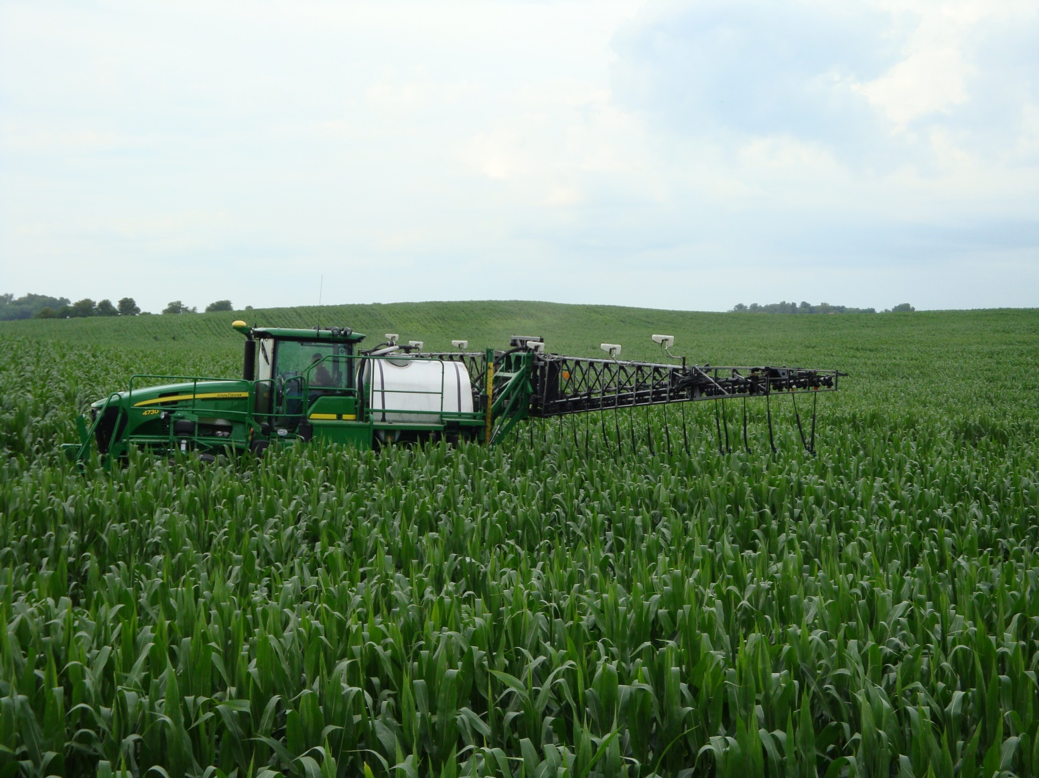
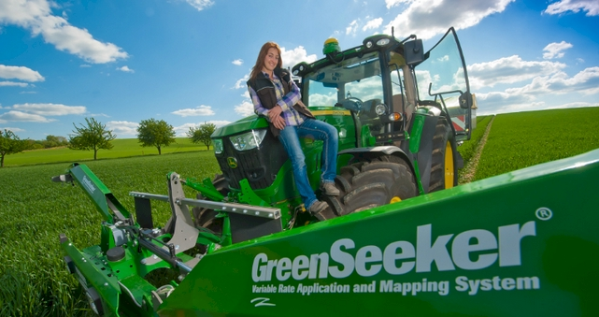

Slide 31

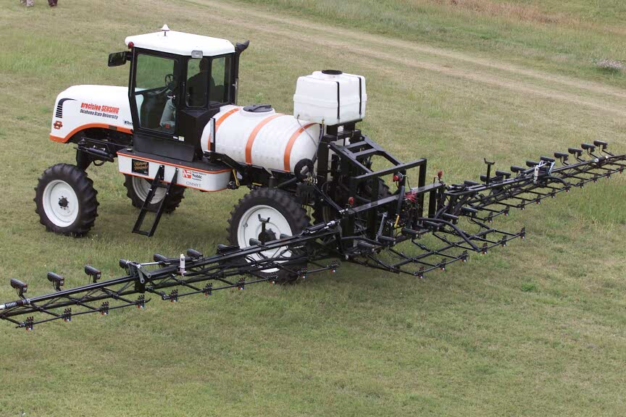
precision SENSING
Oklahoma State University 2001

Slide 32
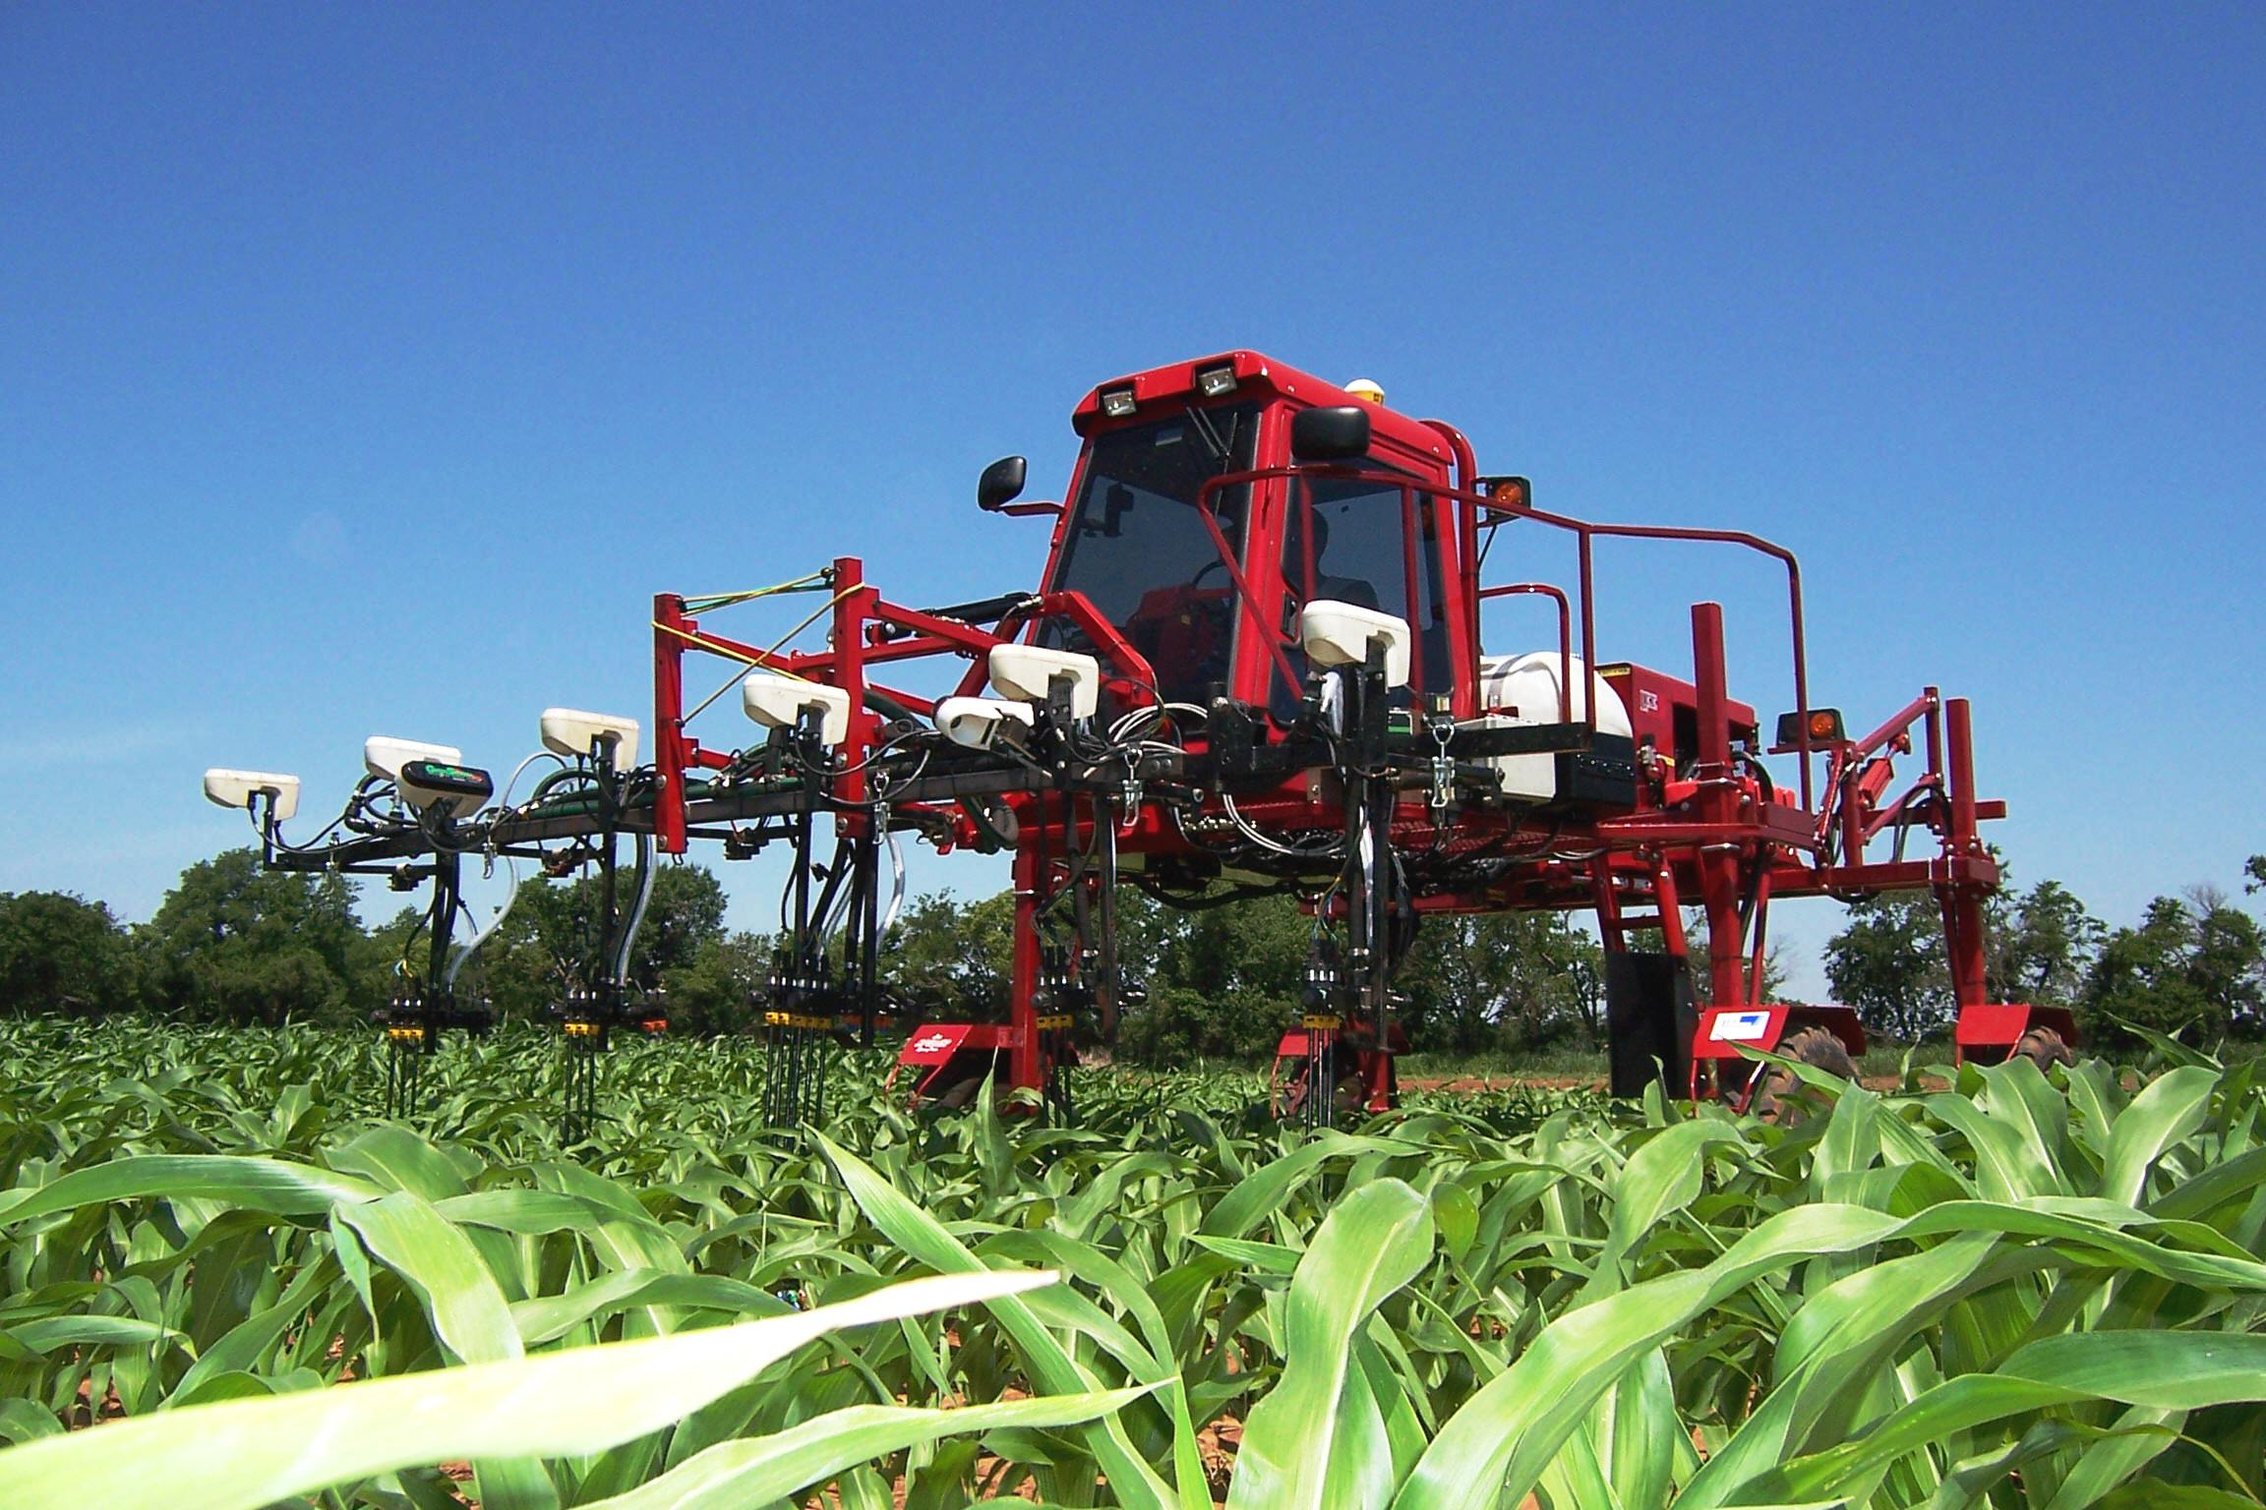
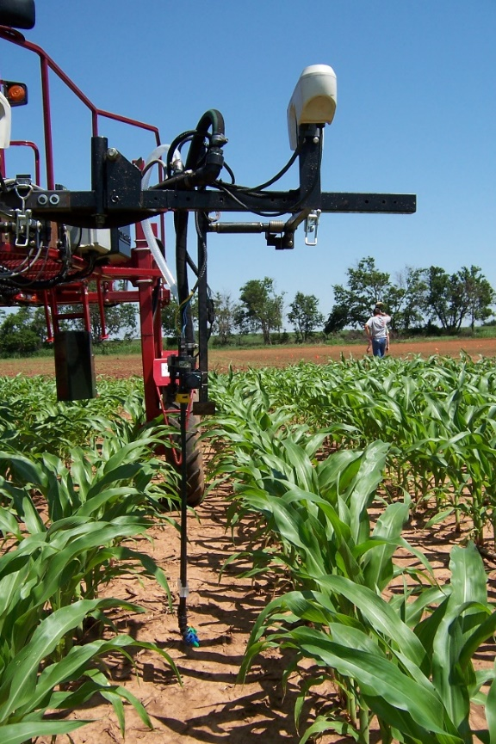
By-plant N Fertilization 2007
By plant statistical properties

Slide 33
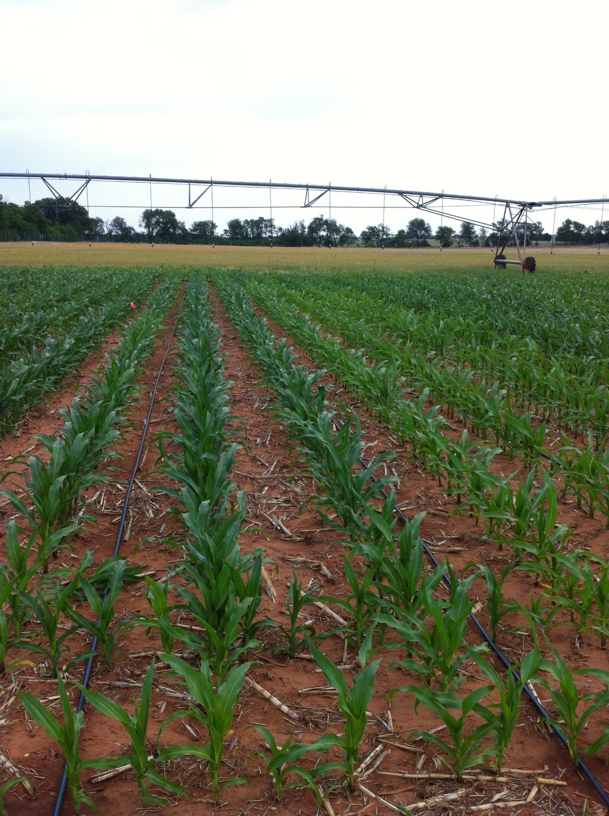
agricultural technology driven by corn

Slide 34
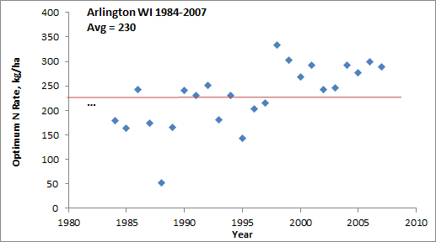
“Again, the results provide no clear indication of a change in N rates over time” (Page 11, Concepts and Rationale for Regional Nitrogen Rate Guidelines for Corn, ISU Extension, 2006)

Slide 35
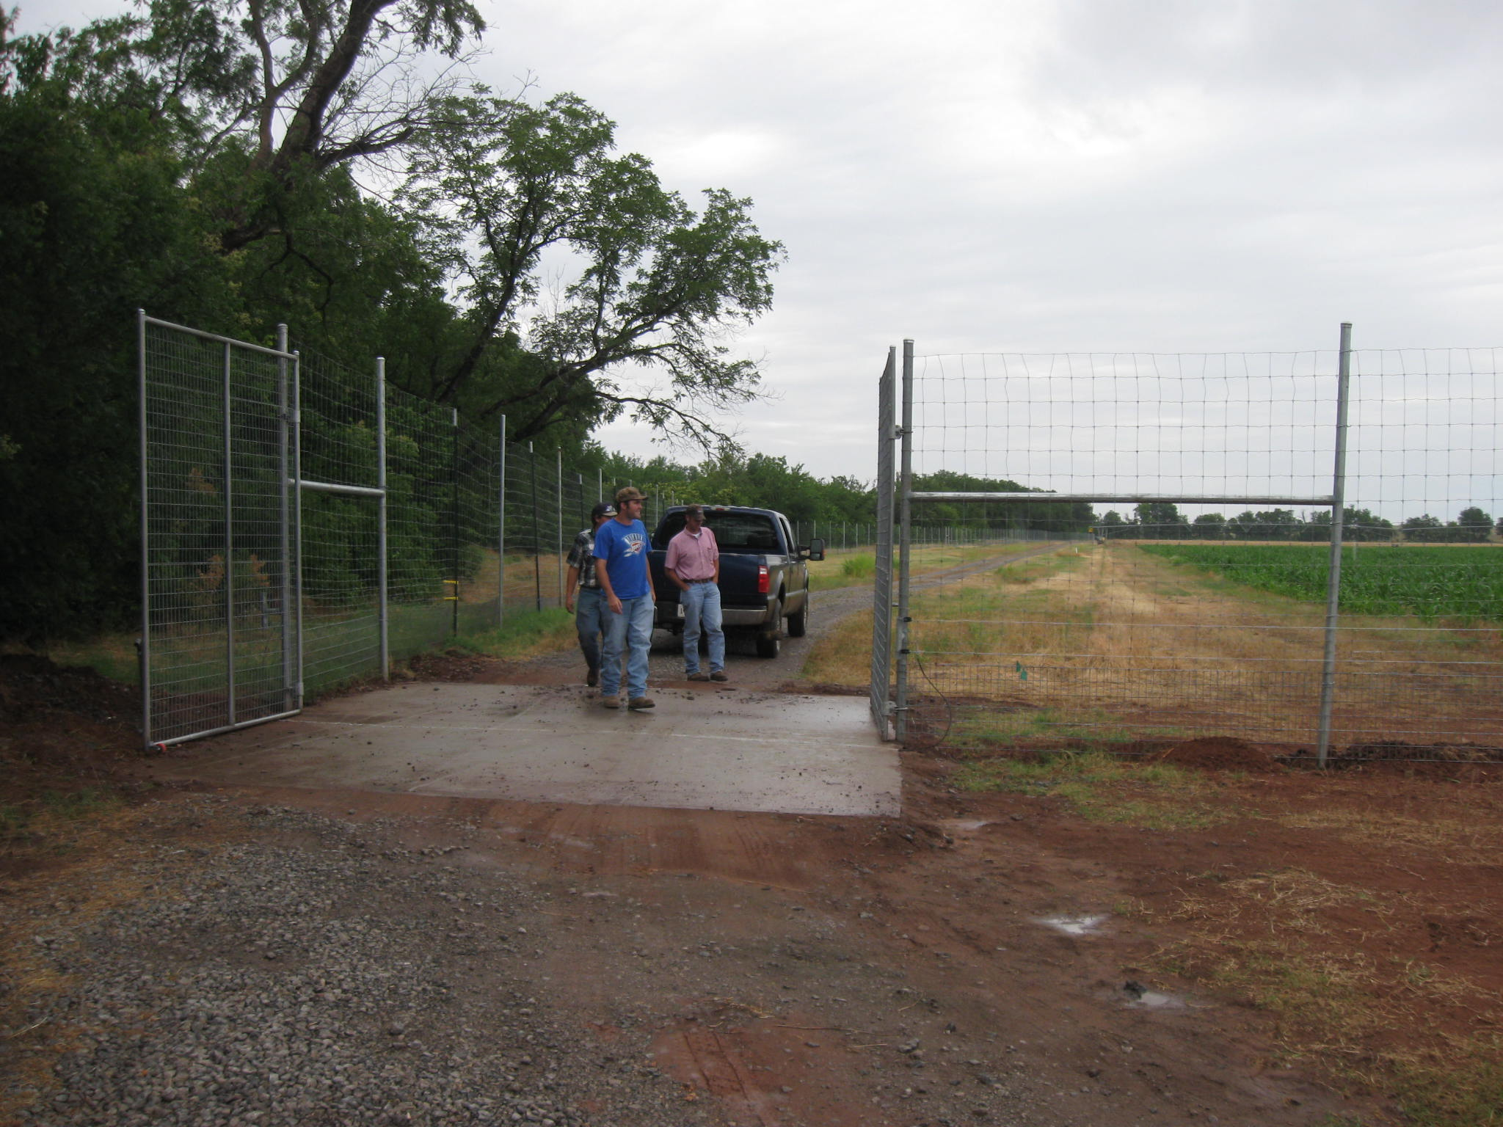
1. Feral hogs
2. Deer
3. Raccoons
4. 100F heat
Corn Research at Oklahoma State University is difficult,
nonetheless we believe it is the right thing to do

Slide 36
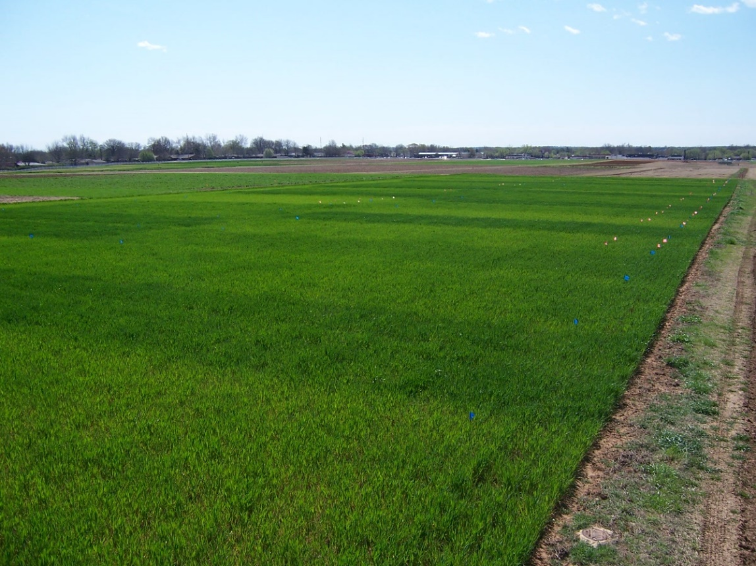
Long-Term Experiments
Class Projects

Slide 37
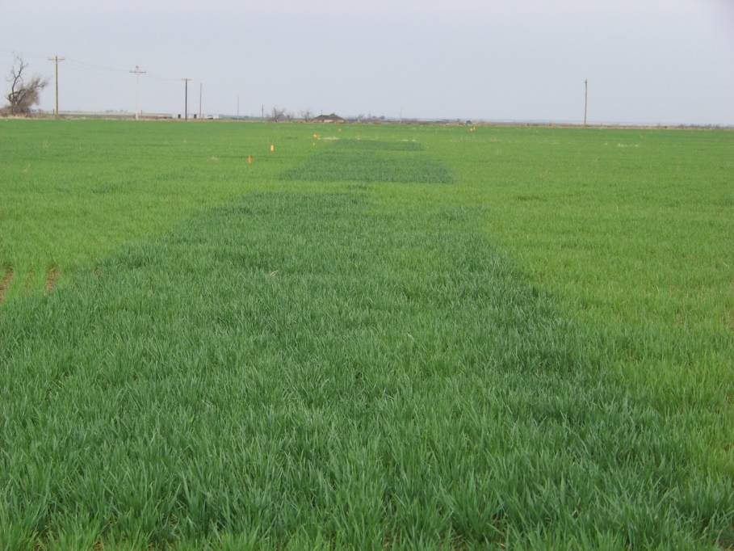
N Rich Strips, Dr. Brian Arnall

Slide 38
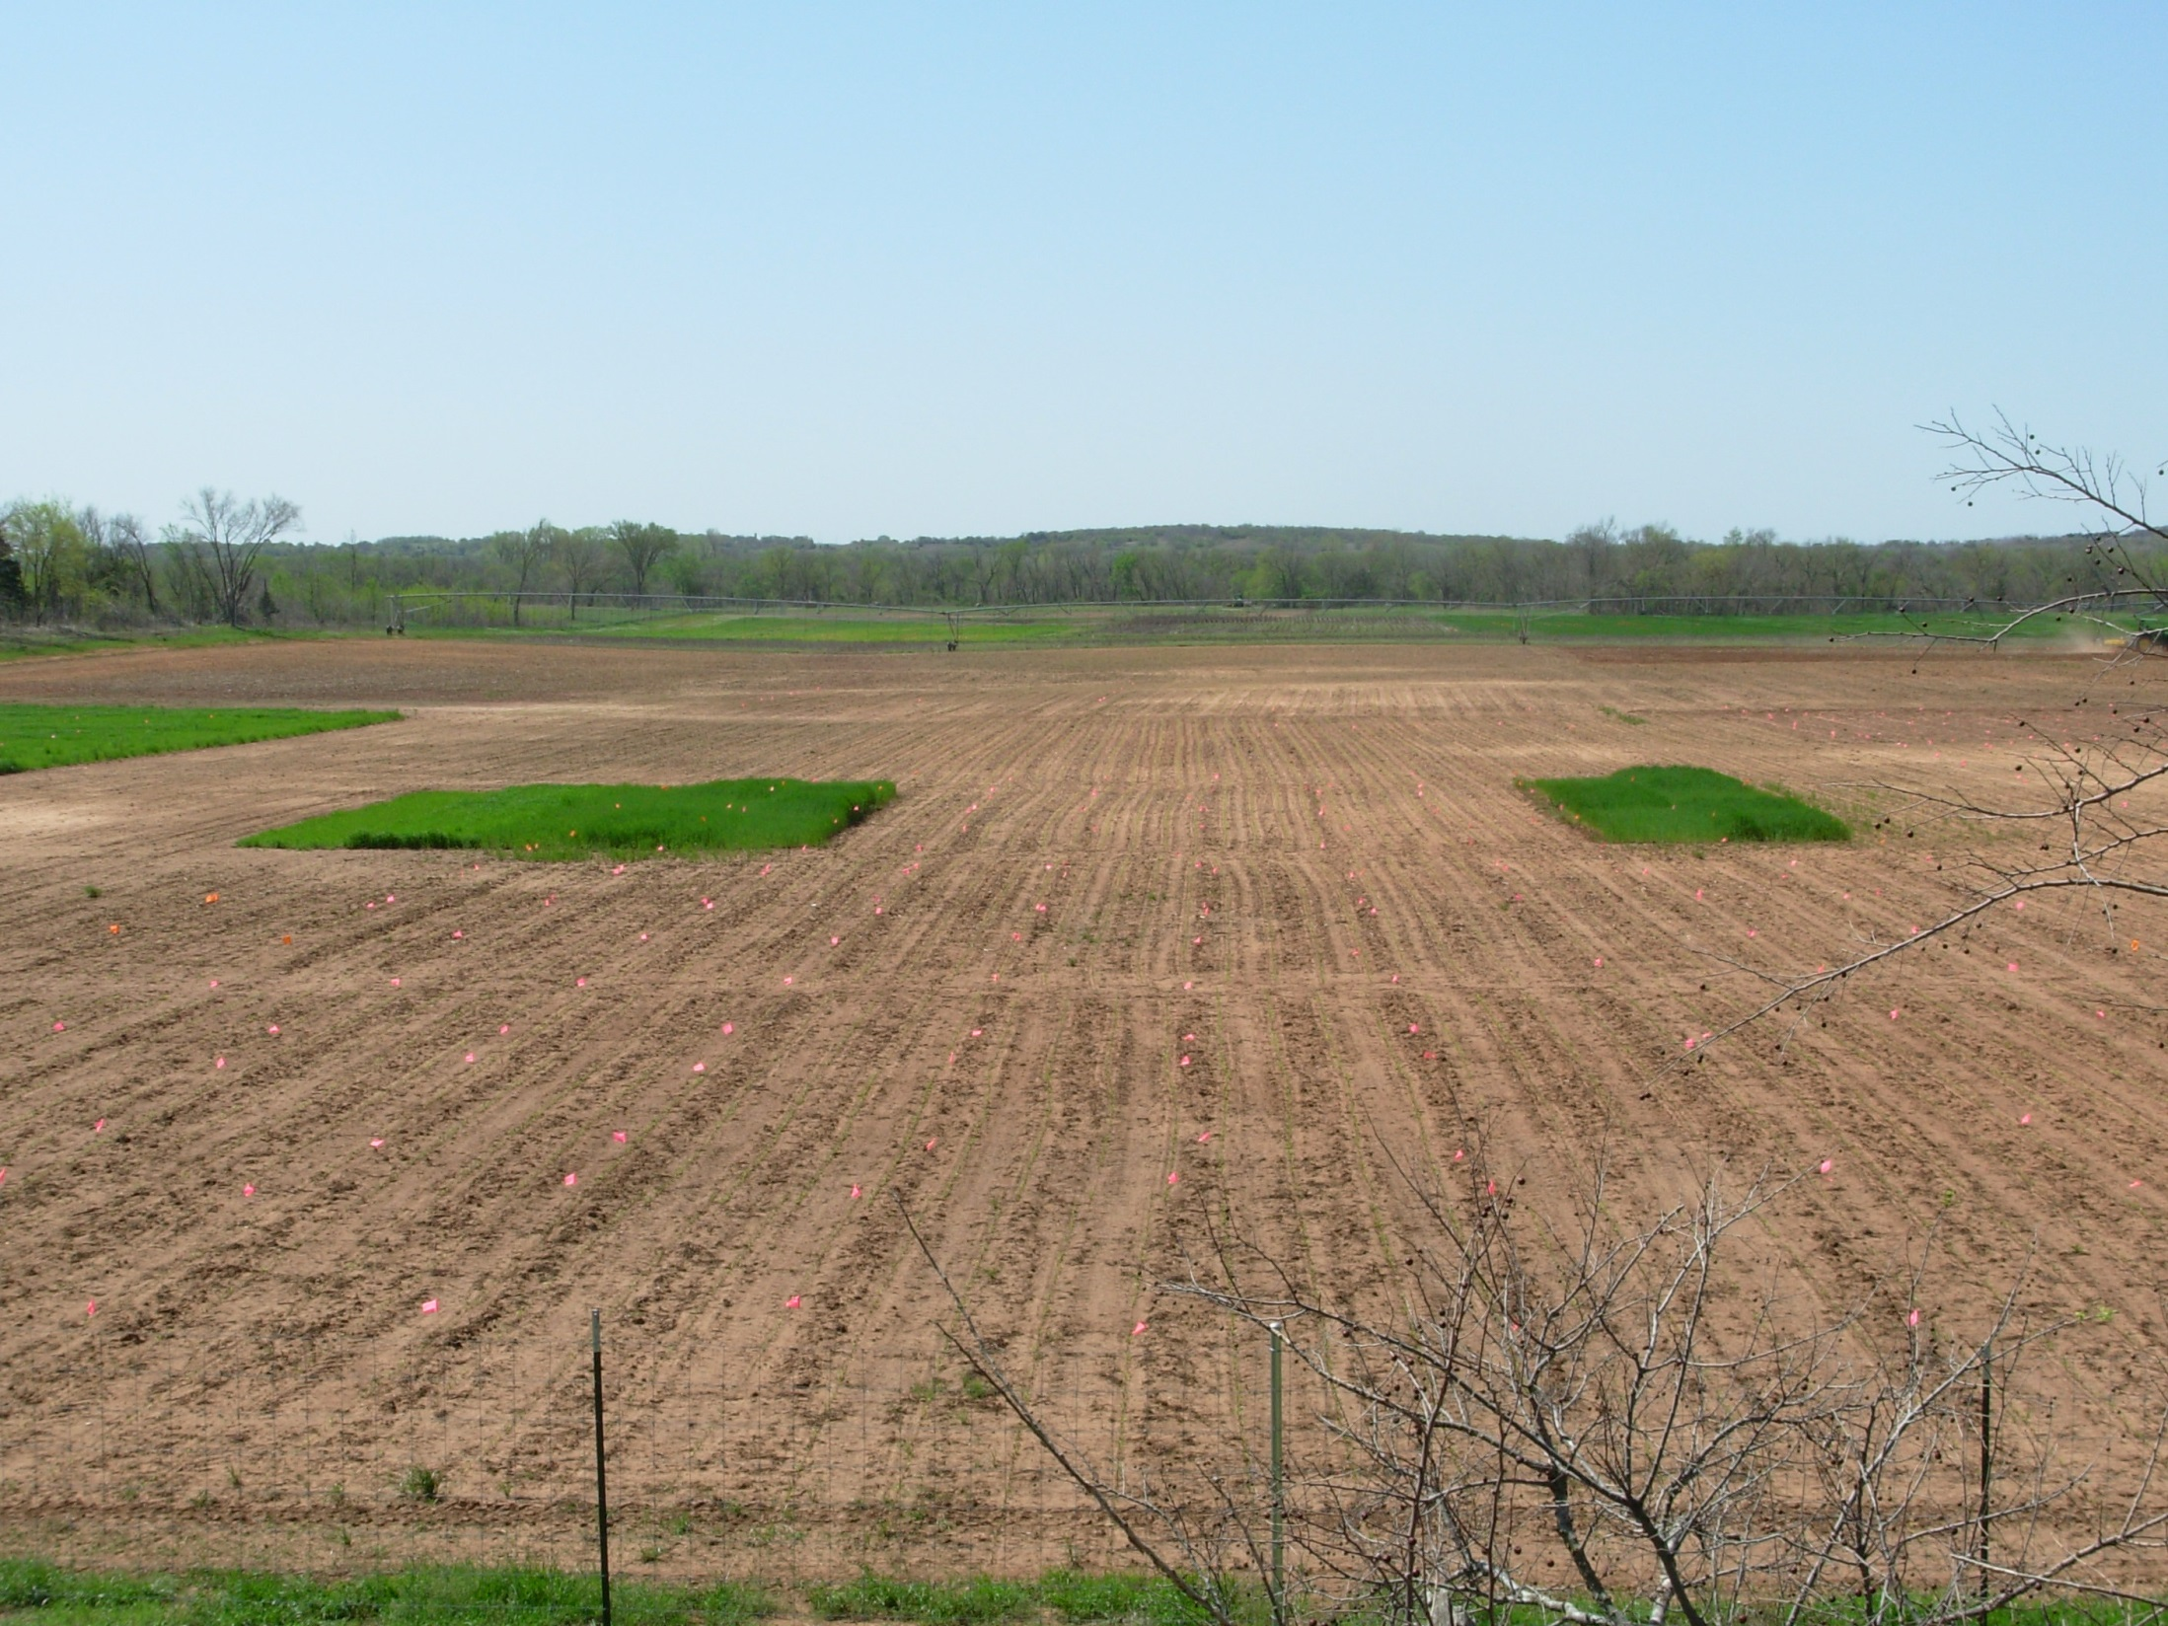
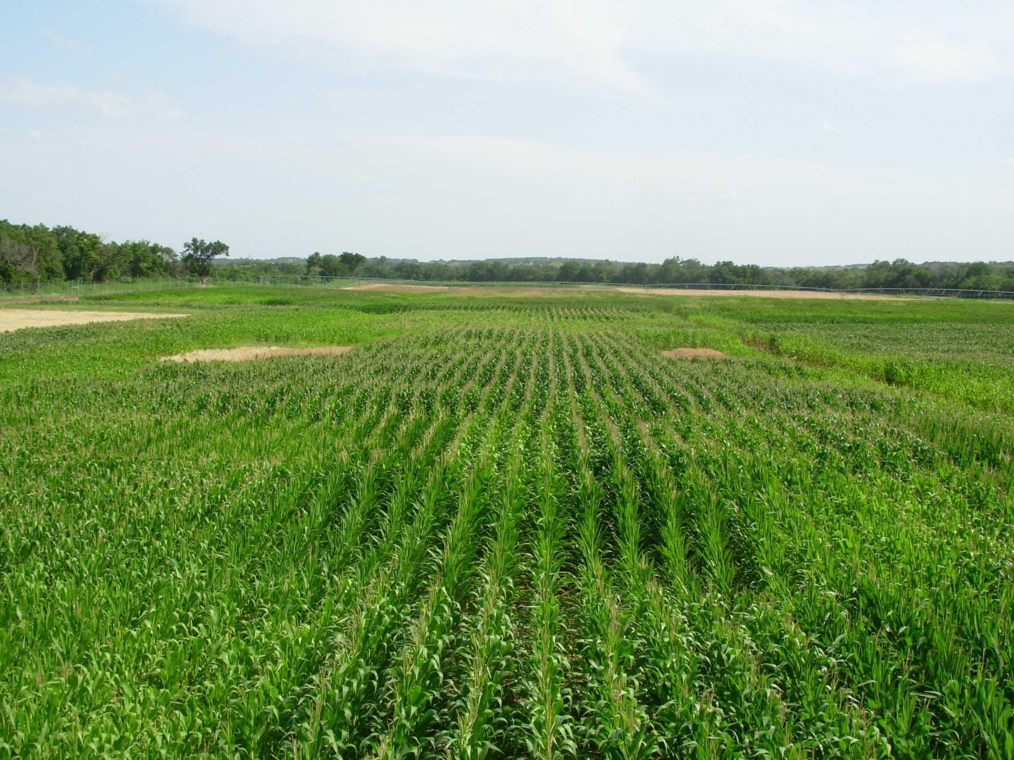
Indicator Crops, Dr. Eric Miller

Slide 39
Regional Yield Prediction Equations

Slide 40
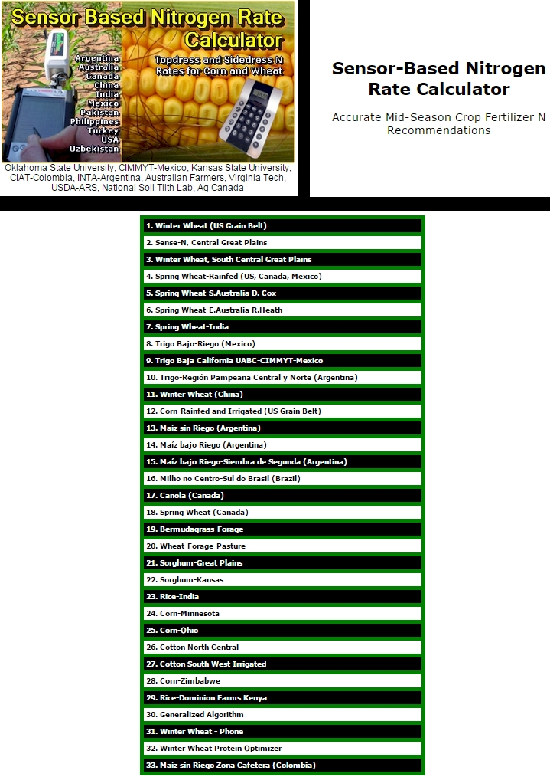
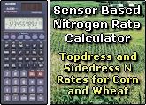
#11 Winter Wheat (China)
#12 Corn-US Grain Belt
nue.okstate.edu

Slide 41
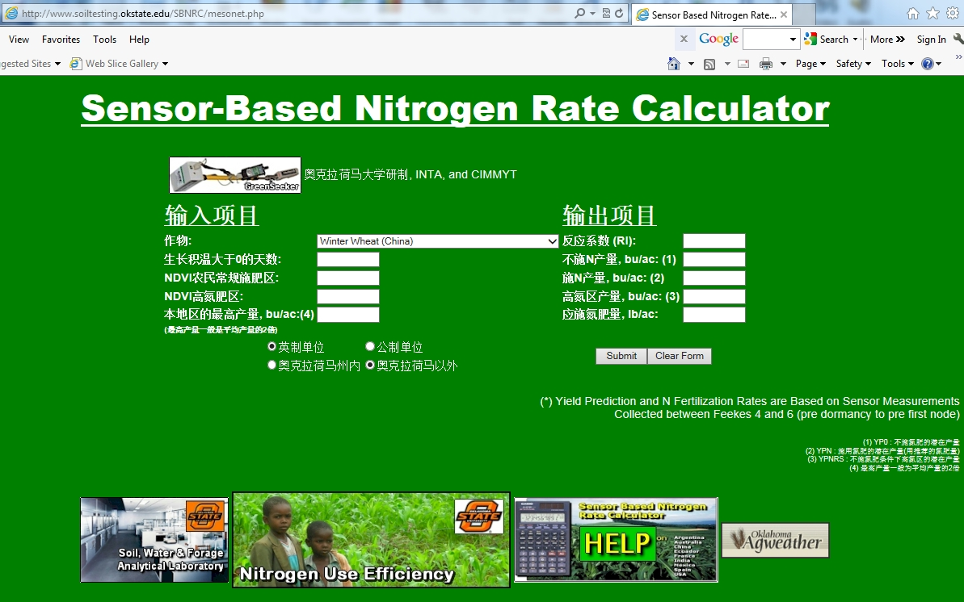
www.nue.okstate.edu

Slide 42
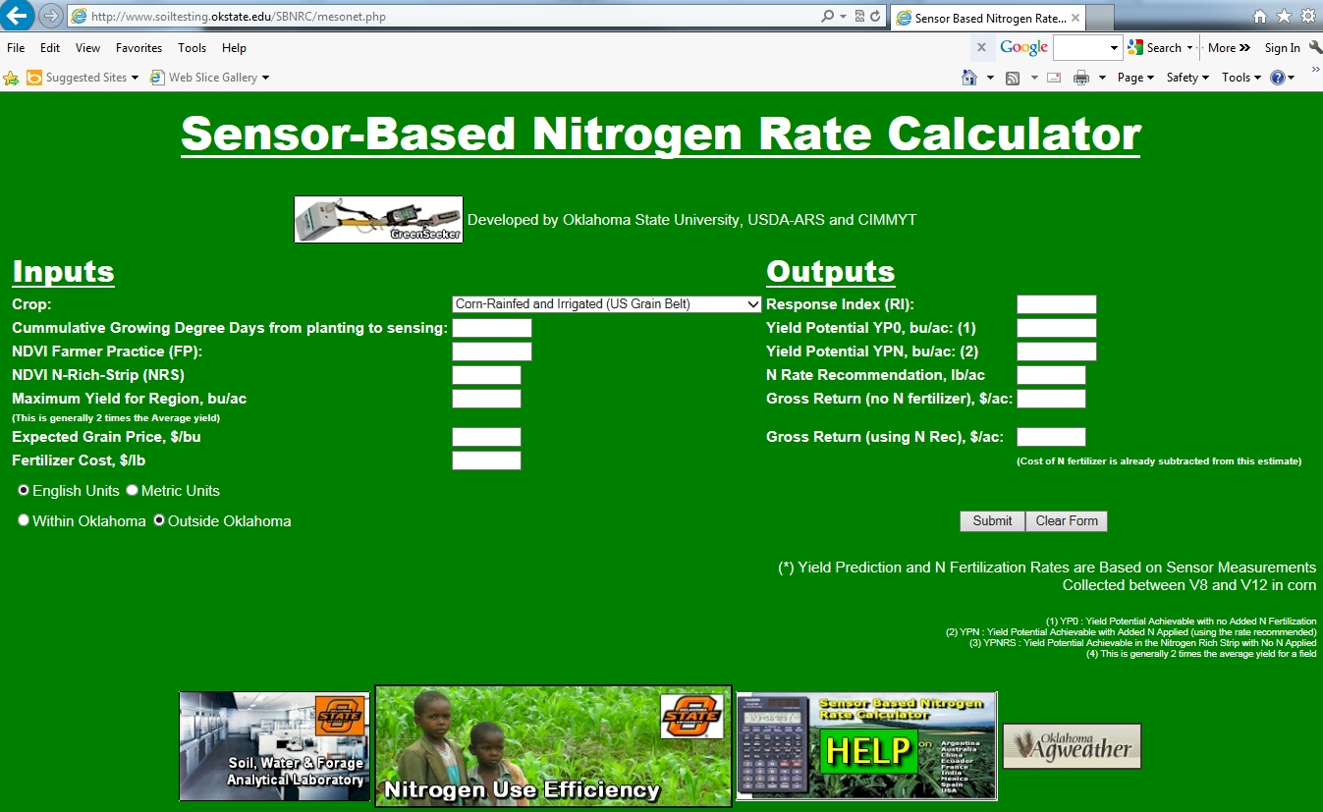
www.nue.okstate.edu

Slide 43
Response Index vs. Sufficiency

Slide 44
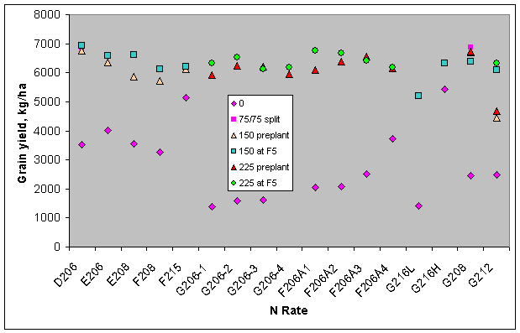
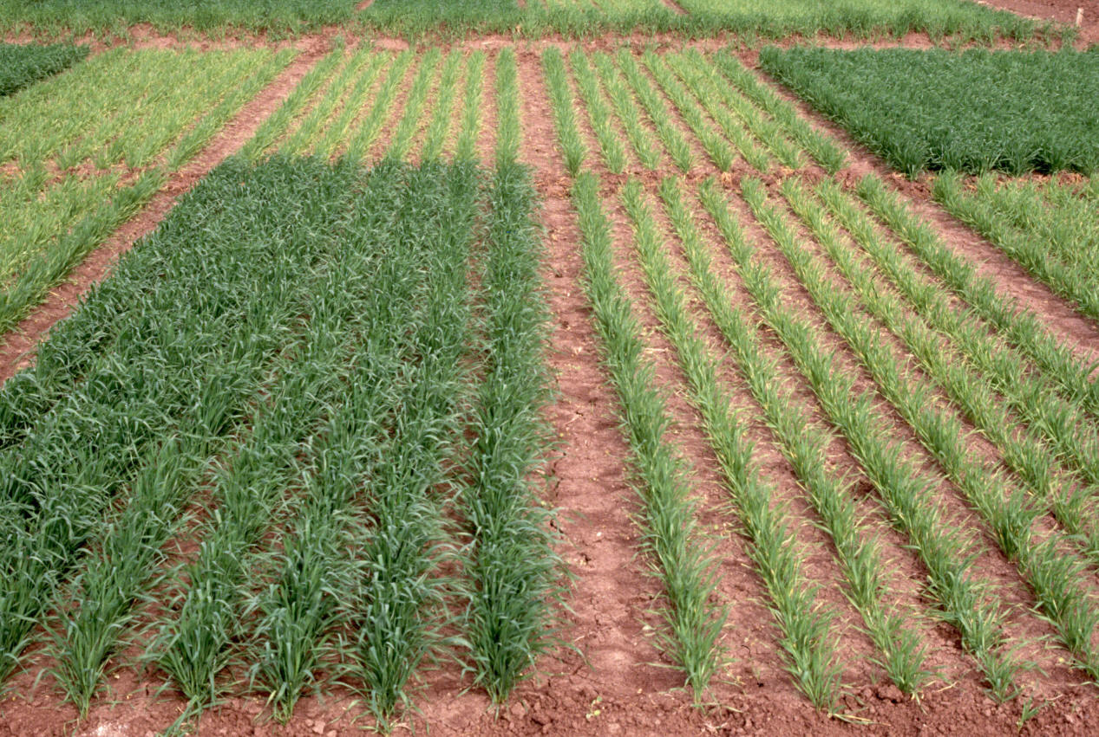
Ciudad Obregon, MX
Courtesy, Ivan Ortiz-Monasterio
CIMMYT

Slide 45
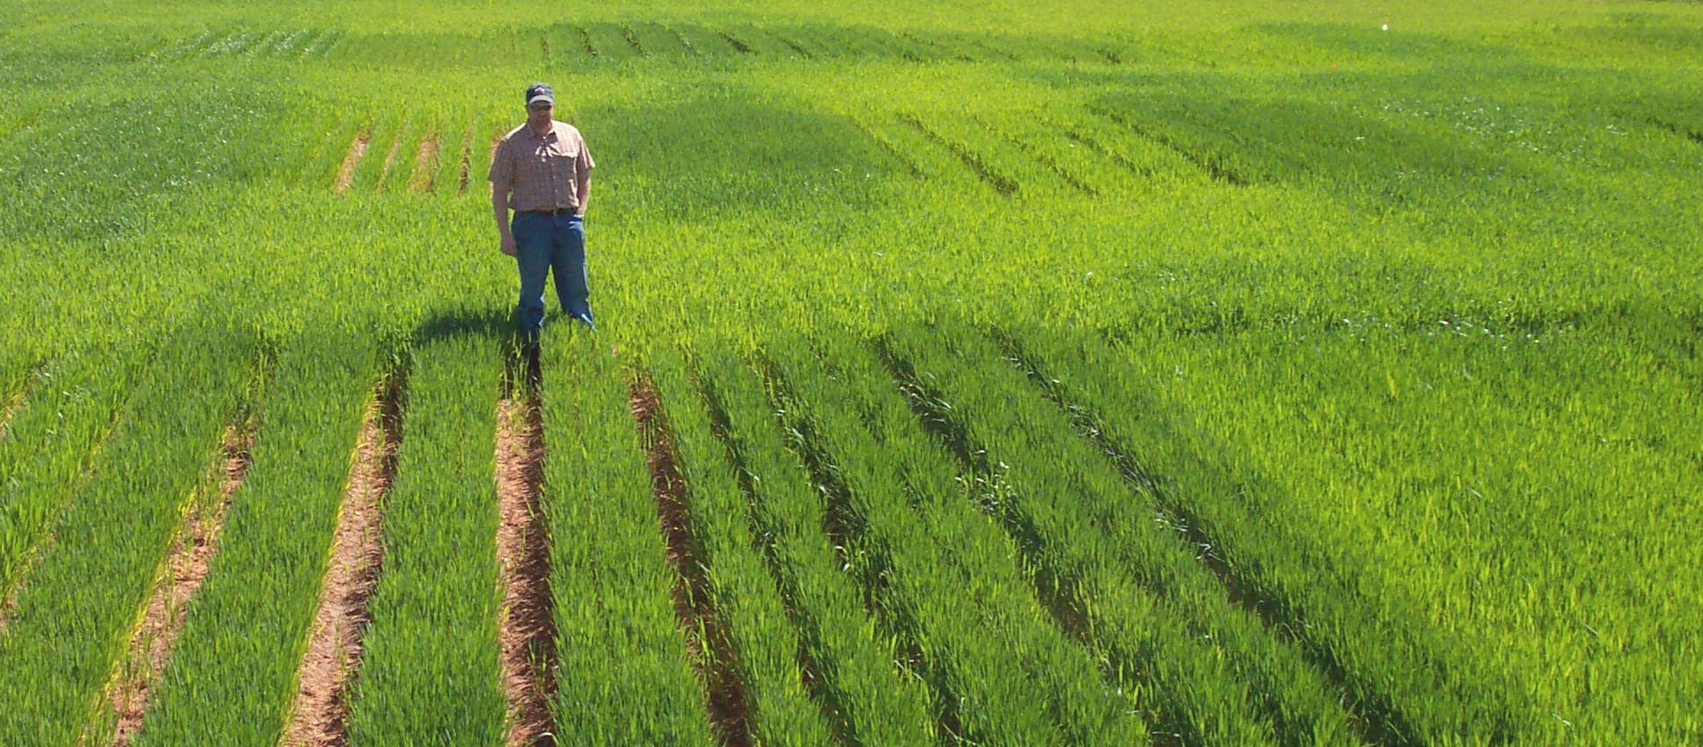
2014, USA
Population 322 million
Cattle Inventory 95 million
Acres
Corn 91.6 million
Soybean 84.8 million
Cotton 11.4 million

Slide 46
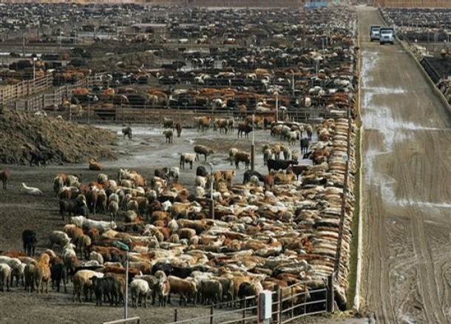
How Meat Contributes to Global Warming
February 2009 | By Nathan Fiala
Scientific American, February 2009
FAO report found that current production levels of meat contribute between 14 and 22 percent of the 36 billion tons of "CO2-equivalent" greenhouse gases the world produces every year. Half a pound of
hamburger for someone's lunch, a patty of meat the size of two
decks of cards releases as much greenhouse gas into the atmosphere as driving a 3,000-pound car nearly 10 miles.

Slide 47
Corn, Animal Industry
Cattle, USA
95 million
NCBA, 2014
>50 percent, TX, NE, KS, CA, OK
Population, USA, 316 million census.gov, 2013
USA, 5 % of world pop
USA, 12 % of worlds N consumed

Slide 48
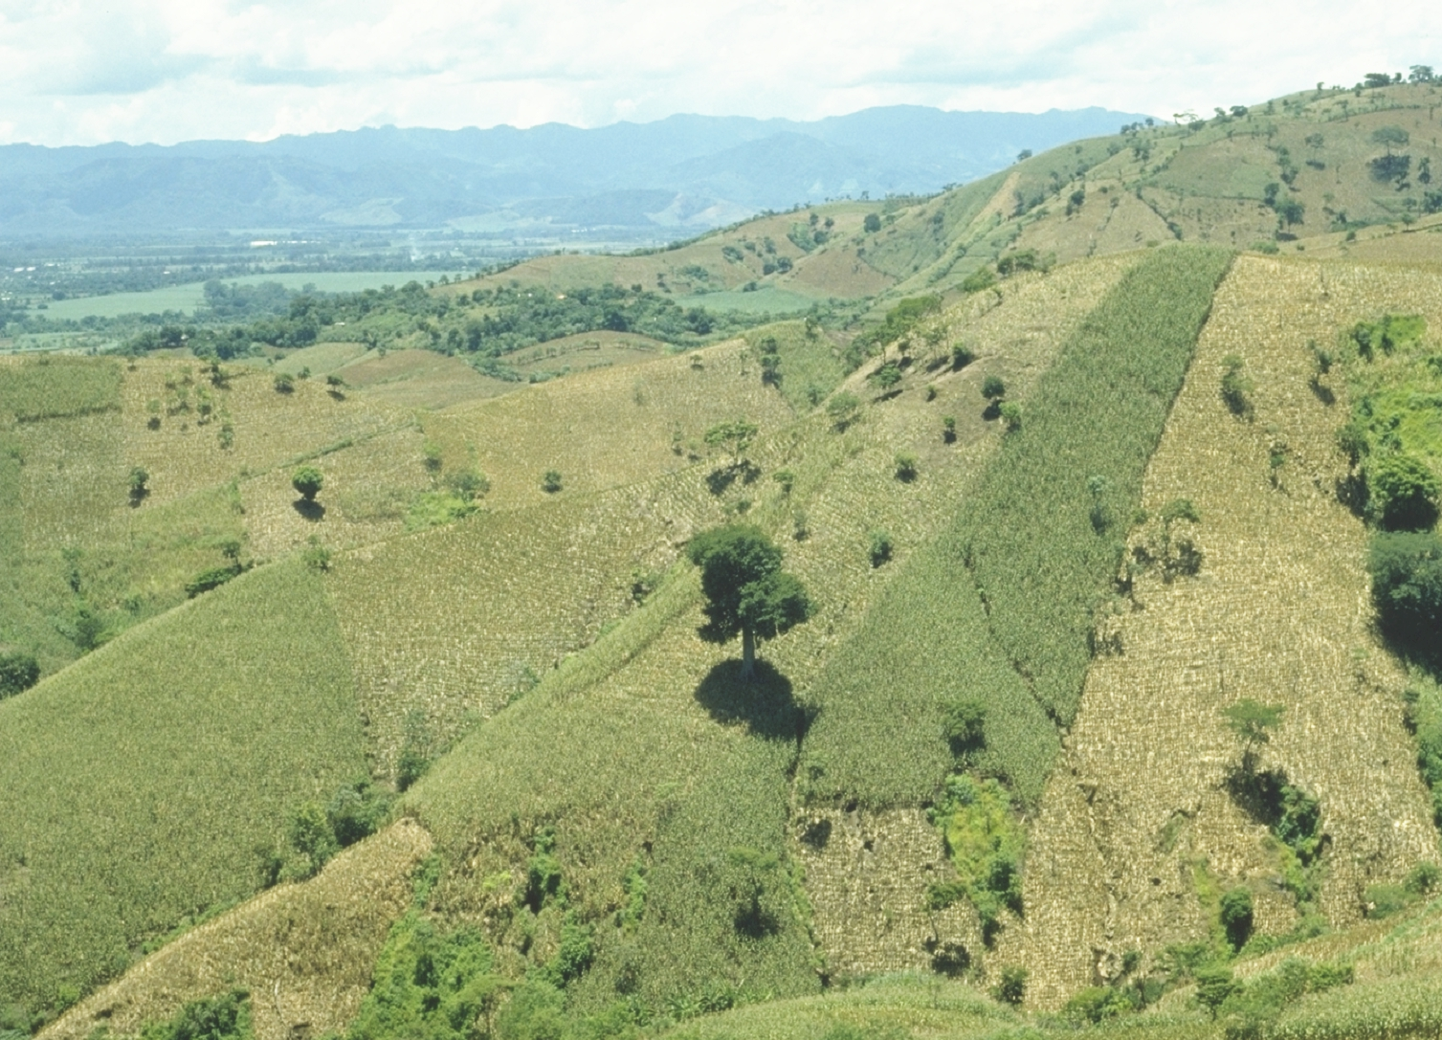
World area planted by hand ≈ corn area in the USA
Developing world, avg. farm size = 1 ha
potential planters ?
By 2050 there will be 9.1 billion people. 95% of the increased population will be in the developing world
EL SALVADOR
Alexandratos, N. and J. Bruinsma. 2012. World agriculture towards 2030/2050: the 2012 revision. ESA Working paper No. 12-03. Rome, FAO.

Slide 49
ATMOSPHERE
GLOBAL WARMING
15-40 kg/ha
N₂O
NO
N₂
INDUSTRIAL
FIXATION
LIGHTNING,
RAINFALL
CH_{4 ,} N₂O
N2 FIXATION
HABER BOSCH
PLANT AND ANIMAL
RESIDUES
SYMBIOTIC
NON-SYMBIOTIC
(1200°C, 500 atm)
MESQUITE
RHIZOBIUM
ALFALFA
SOYBEAN
BLUE-GREEN ALGAE
AZOTOBACTER
CLOSTRIDIUM
3H₂ + N₂ 2NH₃
MATERIALS WITH N
CONTENT > 1.5%
(COW MANURE)
MATERIALS WITH N
CONTENT < 1.5%
(WHEAT STRAW)
10-80 kg/ha
FERTILIZATION
PLANT
LOSS
AMINO
ACIDS
MICROBIAL
DECOMPOSITION
0-50 kg/ha
NH₃
IMMOBILIZATION
AMMONIA
VOLATILIZATION
AMINIZATION
ORGANIC
MATTER
HETEROTROPHIC
R-NH₂ + ENERGY + CO₂
BACTERIA (pH>6.0)
FUNGI (pH<6.0)
R-NH₂ + H₂O
pH>7.0
NH₂OH
AMMONIFICATION
FIXED ON
EXCHANGE
SITES
IMMOBILIZATION
R-OH + ENERGY + 2NH₃
Pseudomonas, Bacillus,
Thiobacillus Denitrificans,
and T. thioparus
N₂O₂⁻
MICROBIAL/PLANT
SINK
2NH₄⁺ + 2OH⁻
MINERALIZATION
+ NITRIFICATION
NO₂⁻
+O₂
DENITRIFICATION
Nitrosomonas
NO₃⁻
POOL
NITRIFICATION
OXIDATION STATES
DENITRIFICATION
LEACHING
LEACHING
VOLATILIZATION
NITRIFICATION
Nitrobacter
+ O₂
2NO₂⁻ + H₂O + 4H⁺
NH₃ AMMONIA -3
NH₄⁺ AMMONIUM -3
N₂ DIATOMIC N 0
N₂O NITROUS OXIDE 1
NO NITRIC OXIDE 2
NO₂⁻ NITRITE 3
NO₃⁻ NITRATE 5
TEMP 50°F
Joanne LaRuffa
Wade Thomason
Shannon Taylor
Heather Lees
Department of Plant and Soil Sciences
Oklahoma State University
ADDITIONS
LEACHING
LEACHING
LOSSES
LEACHING
OXIDATION REACTIONS
pH 7.0
0-40 kg/ha
REDUCTION REACTIONS

Slide 50
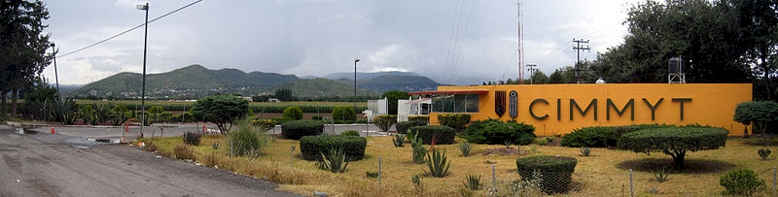

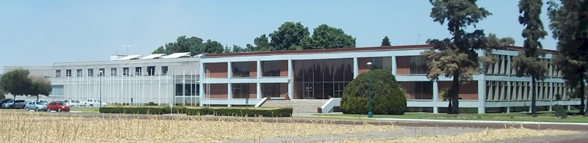
Centro Internacional de Mejoramiento de Maiz y Trigo

Slide 51
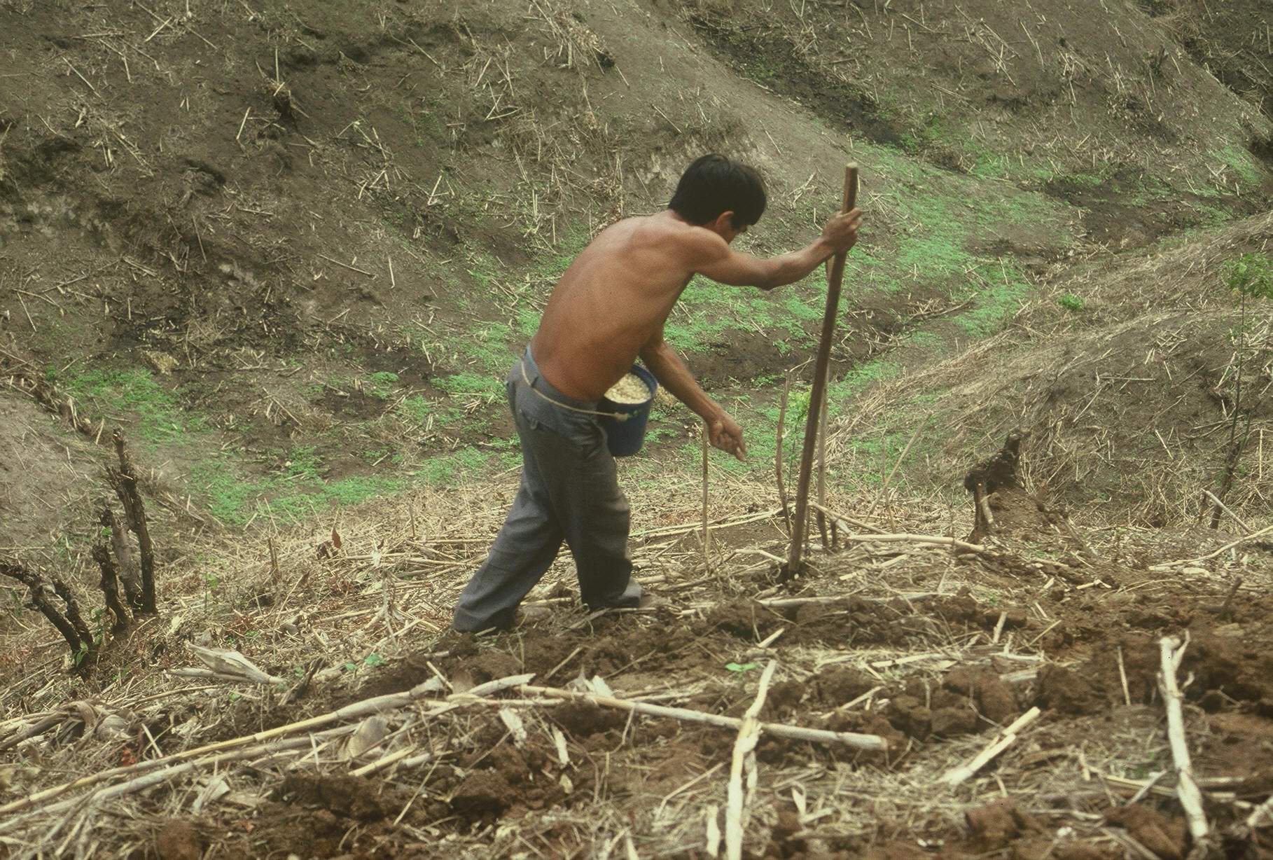
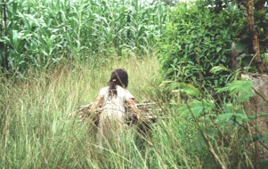

Service projects

Slide 52

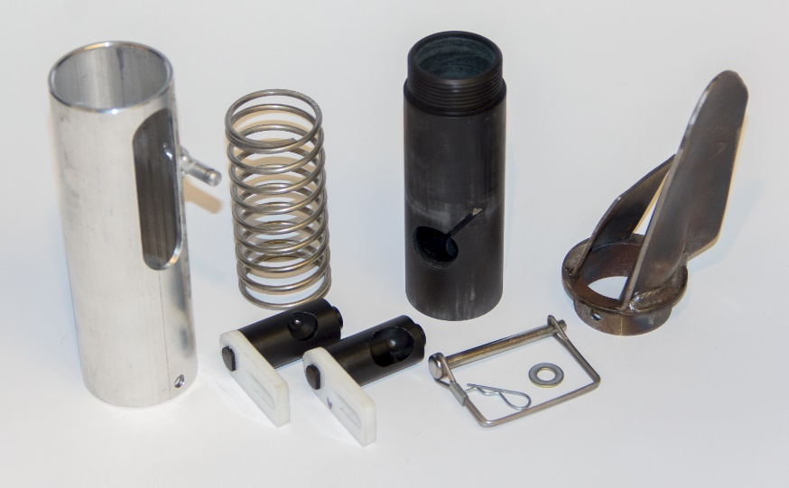
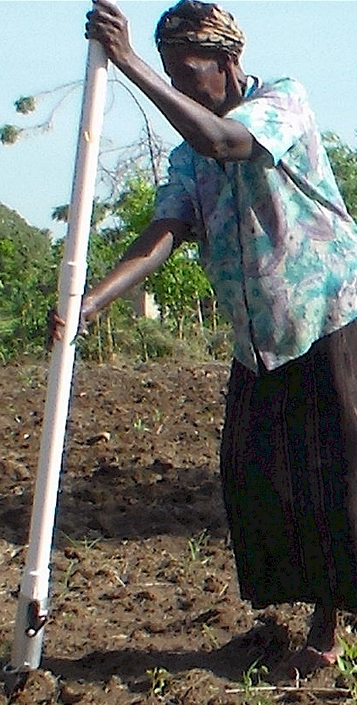
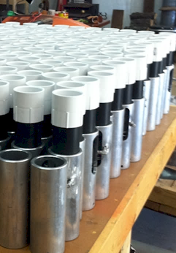
Drums

Slide 53
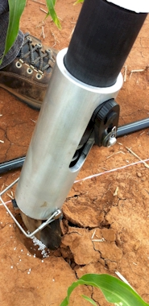
Benefits
Remove chemically treated seeds from the hands of small farmers
Decrease soil erosion via improved plant spacing
Accommodate mid-season application of urea-N
Place urea below the surface reducing NH3 losses
Potential to increase maize production and NUE
Khim et al. (2014). Over three sites, planting 1 seed, every 0.16m increased yields by an average of 1.15 Mg ha⁻¹ (range, 0.33 to 2.46 Mg ha⁻¹) when compared to the farmer practice of placing 2 to 3 seeds per hill, every 0.48 cm.

Slide 54



Teosinte

Slide 55

Mid Season Fertilizer N
Combined, Efaw and Perkins, 2013
Topdress N, Corn, V12 |  | 70,000 plants/ha
Methods | N, kg/ha | Mg/ha
Check | 0 | 6.6
Hand planter (0.9 g/plant) | 30 | 11.2
Hand planter (1.8 g/plant) | 60 | 10.6
Broadcast | 30 | 6.4
Broadcast | 60 | 7.0
Dribble urea | 30 | 9.3
Dribble urea | 60 | 7.8
Dribble UAN | 30 | 7.3
Dribble UAN | 60 | 10.4
SED = 1.81

Slide 56

Hand Planters
Person | Organization | Where | No. of Hand Planters
Dr. Isaiah Nyagumbo | CIMMYT, Kenya | Zimbabwe | 4
Dr. Pascal Kaumbutho | KENDAT, Kenya | Kenya | 2
 | Ethiopia | Ethiopia | 1
Dr. Peter Omara | Uganda | Uganda | 3
Dr. Edgar Ascencio | CARE, El Savador | El Salvador | 4
Dr. Fred Kanampiu | IITA, Kenya | Kenya | 2
Dr. Nyle Wollenhaupt | AGCO, Kansas | Kansas | 2
Dr. Ivan Ortiz-Monasterio | CIMMYT, Mexico | Mexico | 1
Kristin Lacy | Semilla Nueva | Guatemala | 2
Nyle Wollenhaupt | AGCO | Lusaka Zambia | 40
Melvin Siwale | AGCO | Lusaka Zambia | 10
Terry Tindall | JR Simplot | Lusaka Zambia | 25
Eric Lam | MAG | Honduras | 2
Eric Lam | CIMMYT | Bangladesh | 1
Dr. Luis Narro | CIAT | Colombia | 1
Dr. Joshua Ringer |  | Thailand | 1
Dr. Assoumane Maiga |  | Mali | 1
Total |  |  | 101
Notes:
56

Slide 57
Maize (FAOSTAT, 2013)
Area, ha Production, Mt Avg. Mt/ha
World 184,239,959 1,016,431,783 5.5 (87 bu/ac)
USA 35,478,012 353,699,441 9.9 (157 bu/ac)
China 35,276,500 217,830,000 6.2 (98 bu/ac)
Brazil 15,450,180 80,516,571 5.2 (83 bu/ac)
Low income Food Deficit Countries
49,356,985 117,590,512 2.4 (38 bu/ac)
60% hand
planted
29,614,180
USA 2014, 37,125,000 ha’s

Slide 58
Borlaug: Volume 3, Bread Winner. 1960-1969. Copyright 2004, 2010 by Noel Vietmeyer
…But the technology package was only one aspect. Once we had the package and had checked it for its validity, we still had to harness it to political policies. Otherwise, nothing would have happened and the technology, as good as it was, would never have been applied and food production would have stayed unchanged. We had to see that the credit was available for small farmers to buy the inputs needed to obtain these yields. We also had to see that pricing at the time of harvest was enough to stimulate farmers to adopt this package.
“Then, can man use honest work, God’s best medicine to gain his own livelihood.”
Norman E. Borlaug

Slide 59


My Wall of Fame waiting for your picture

