Slide 1
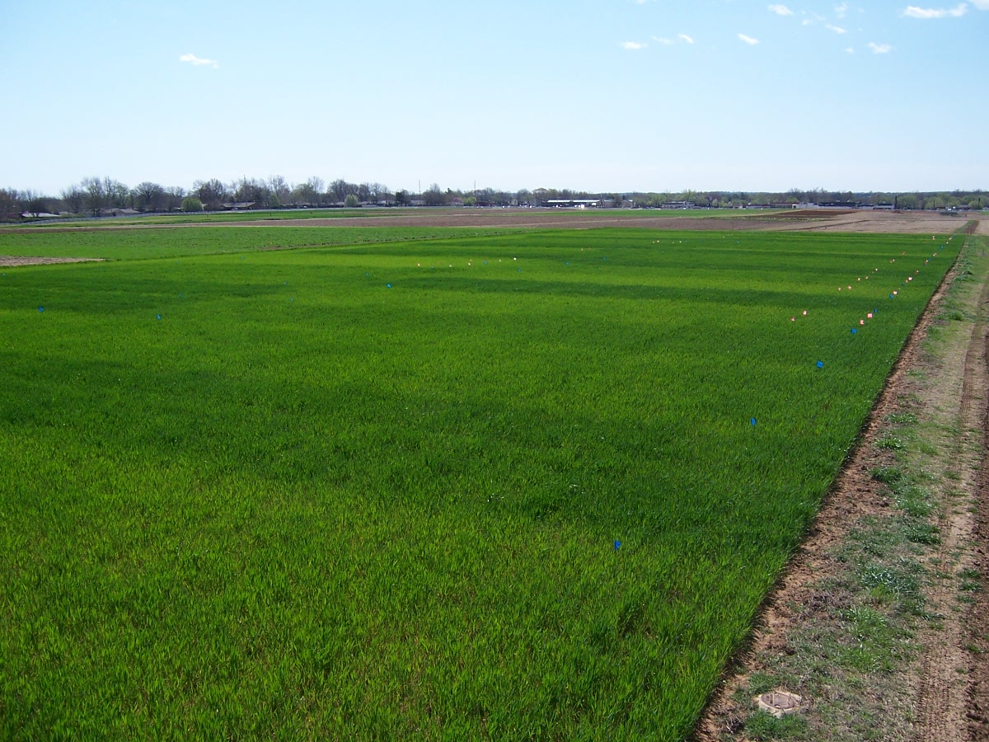
OSU Winter Crops School
Soil Fertility Research
Program Update
December 13, 2011

Slide 2
Current Research
Small scale variability in winter wheat grain yield
Pocket Sensor Evaluation and Testing
Hand Planter
By-Plant N fertilization (wheat and corn)
In-Season Methods to Estimate NUE
Sensor measurements to predict tiller density, grain protein
RTK corn, UAN distance
Foliar P corn, wheat
Estimating Plant Population (V4-V6) using NIR, Red, Red-edge
Urea Triazone's for N Rich Strips in Winter Wheat
Update RI-NDVI vs. RI-Harvest for both wheat and corn
Combining Corn and Wheat Data, joint INSEY Equation, GA Algorithm
Influence of population and N rate on yield (sense vegetative stages)
Seed placement, leaf orientation
Foliar N wheat (products/rates)

Slide 3
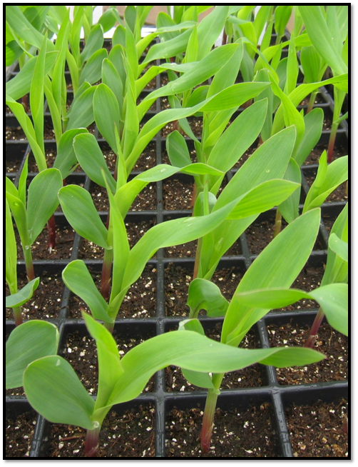
Seed Placement and Leaf Orientation

Slide 4
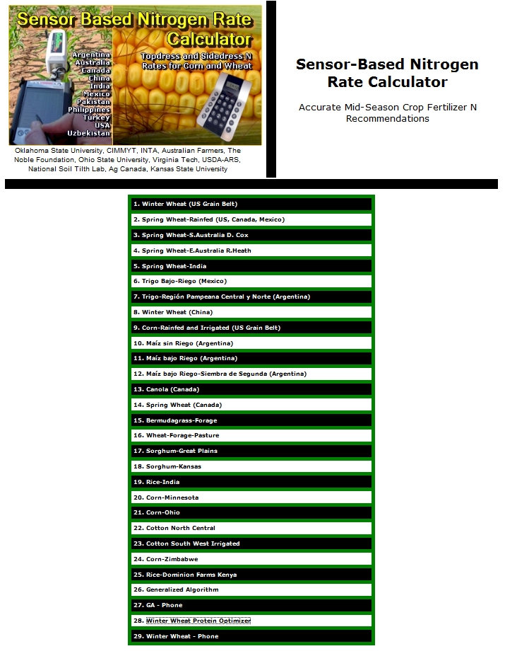
http://www.soiltesting.okstate.edu/SBNRC/SBNRC.php

Slide 5
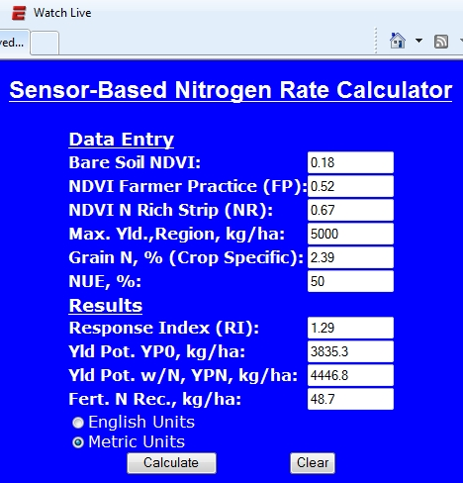
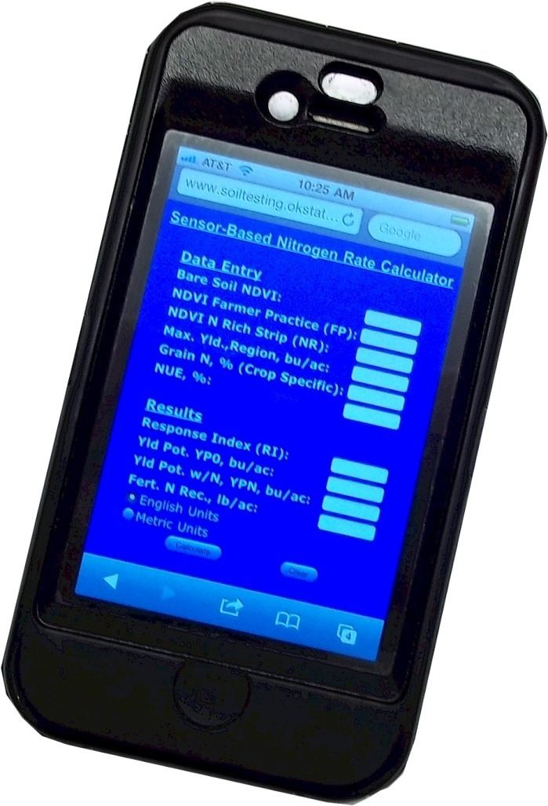

Slide 6
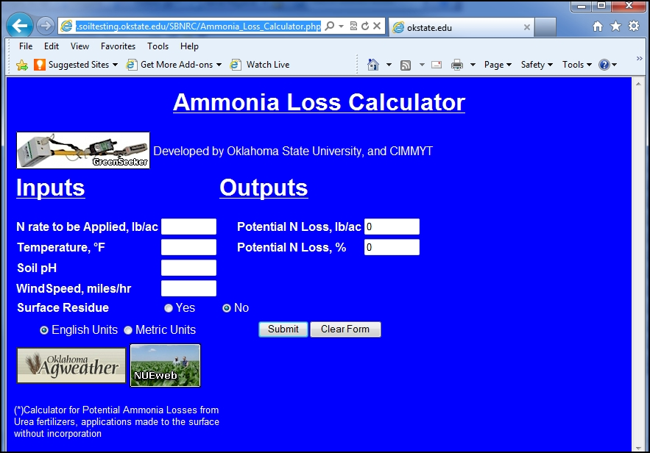
http://www.soiltesting.okstate.edu/SBNRC/Ammonia_Loss_Calculator.php
Macnack, Natasha, 2012. Applied model for estimating potential ammonia loss from surface applied urea. Commun. Soil Sci. Plant Anal. (in press).

Slide 7
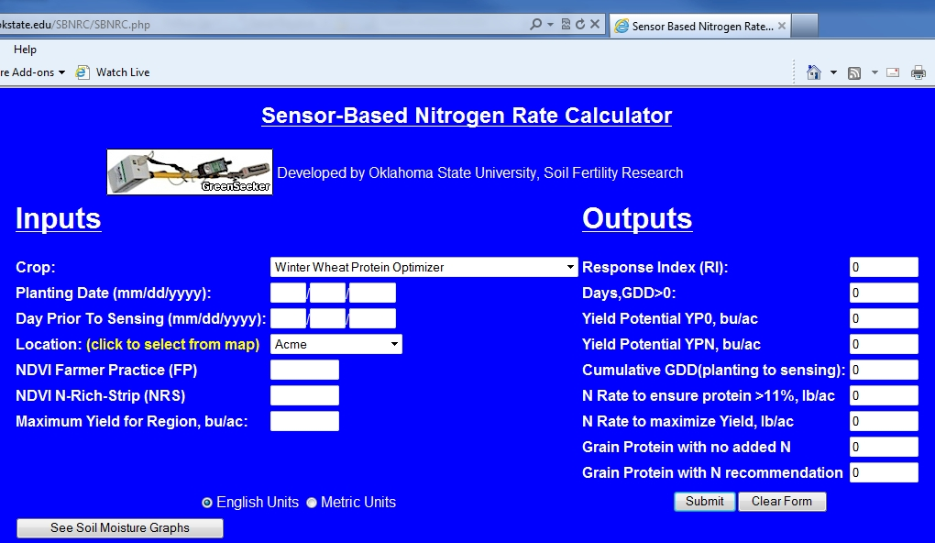
Winter Wheat Protein Optimizer

Slide 8
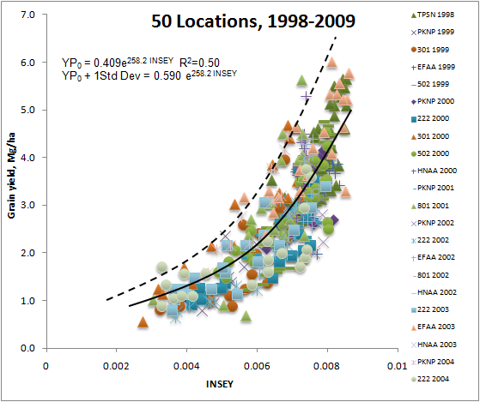
Predicting yield potential
INSEY = NDVI/cumulative GDD

Slide 9
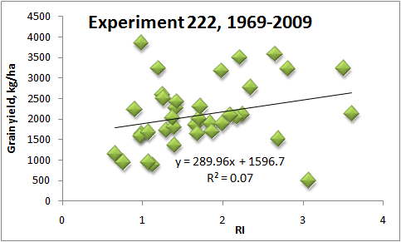
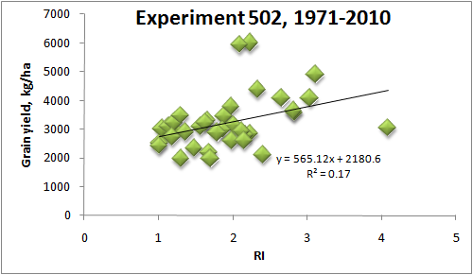
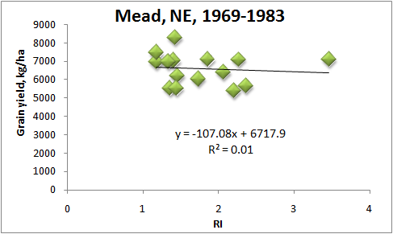
Because yield and N responsiveness were consistently found to be independent of one another, and since both influence the demand for fertilizer N, estimates of both should be combined to calculate realistic in-season N rates.

Slide 14
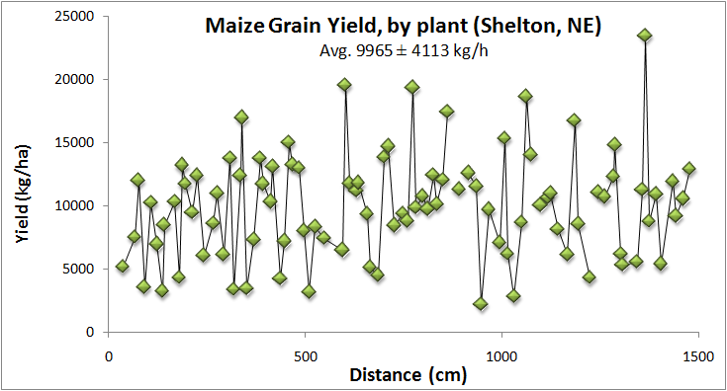

Slide 15
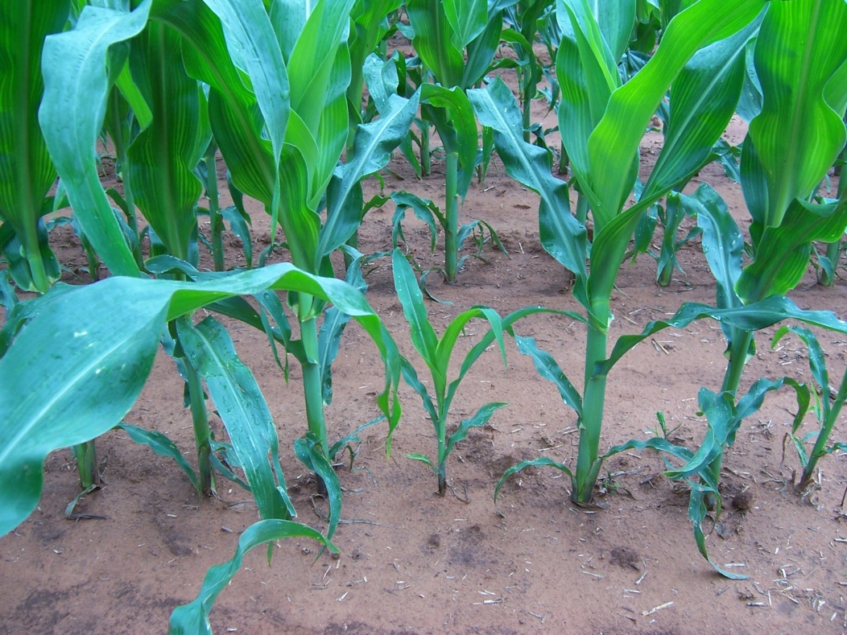
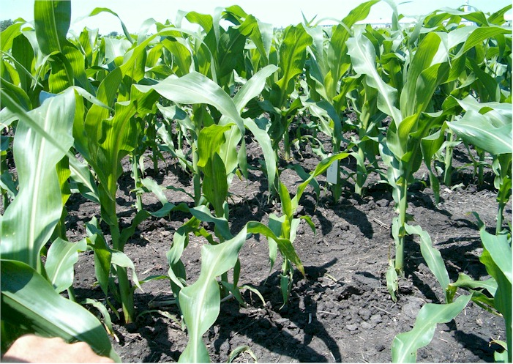
Over all sites in all countries and states, plant-to-plant variation in corn grain yield averaged 2765 kg ha⁻¹ (44.1 bu ac⁻¹).
Mexico, Argentina, Iowa, Virginia, Nebraska, Ohio, Oklahoma, 46 transects (Agron J. 97:1603)

Slide 16
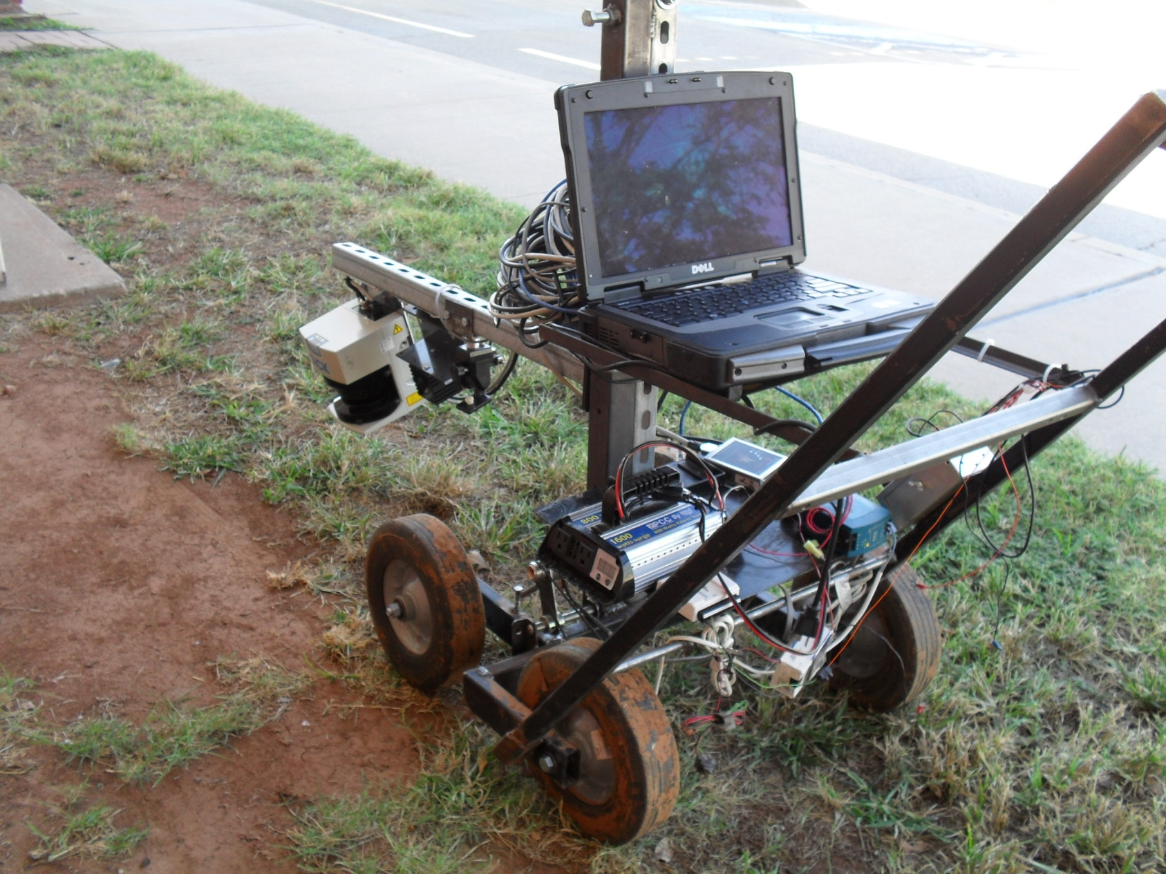
Microwave scattering

Slide 17
Algorithms, Yeyin Shi
BAE
Stalk Recognition Algorithm in One Scan
Matching Algorithm between Successive Scans
Stalk Diameter Estimation Algorithm in One Scan (next slice)

Slide 18
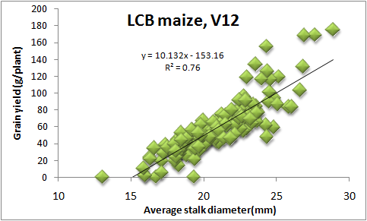
Dielectric properties,
  Estimates of maize stalk diameter

Slide 19
Seed Placement and Leaf Orientation

Slide 20
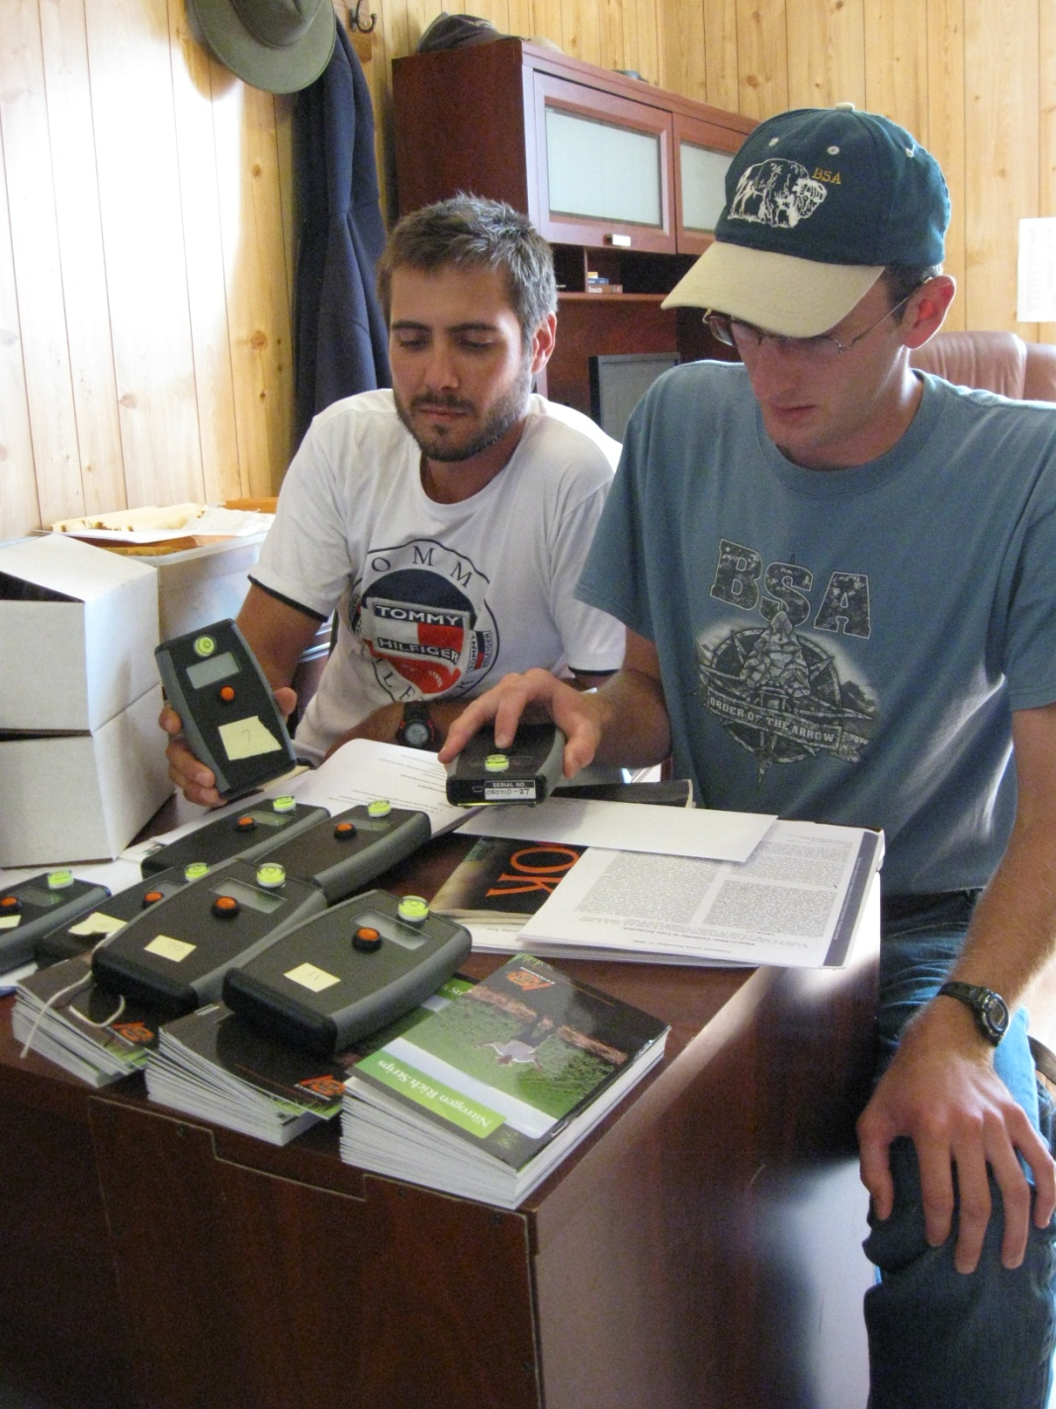
OSU Pocket Sensor
http://nue.okstate.edu/Pocket_Sensor/Pocket_Sensor.htm

Slide 21
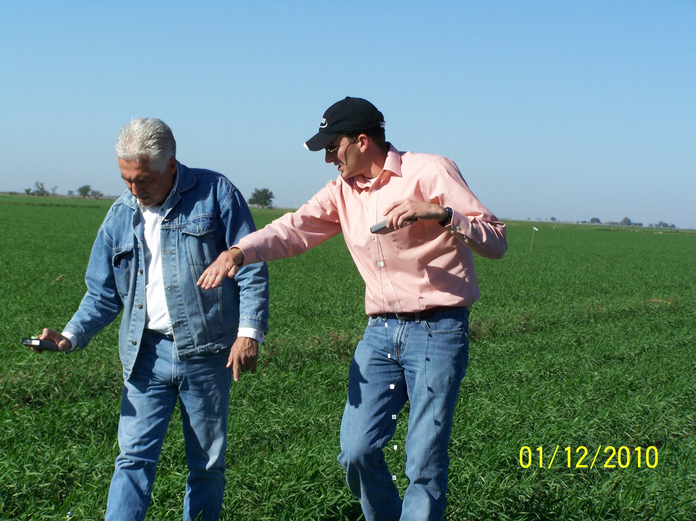
Farm advisor in Ciudad Obregon, manages 1000 ha using GreenSeeker technology

Slide 22
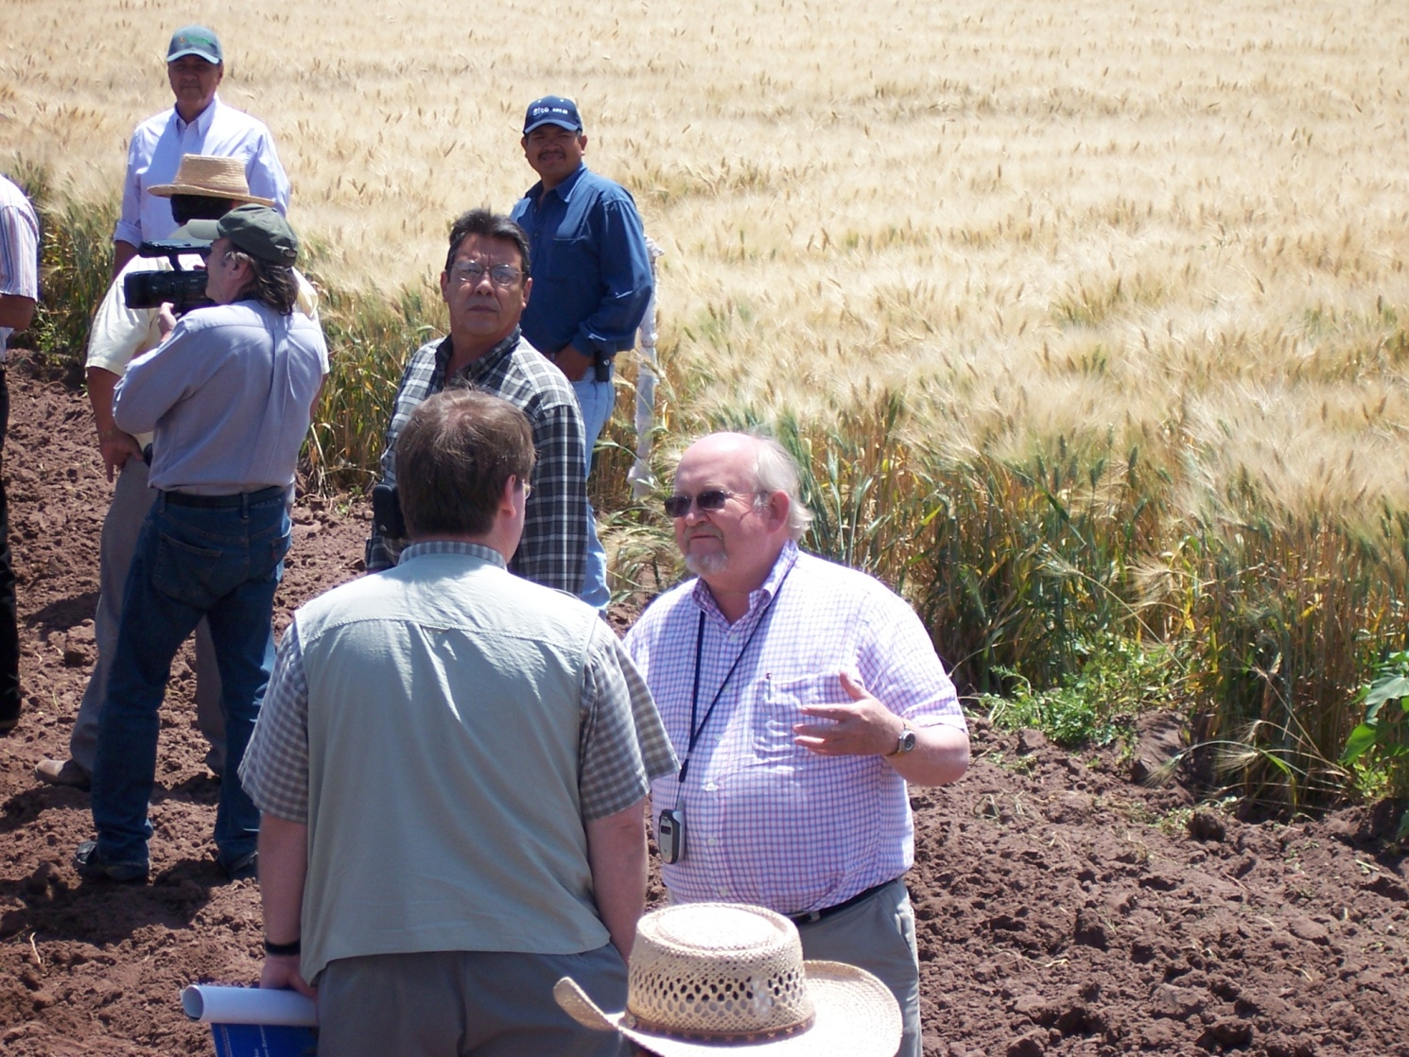
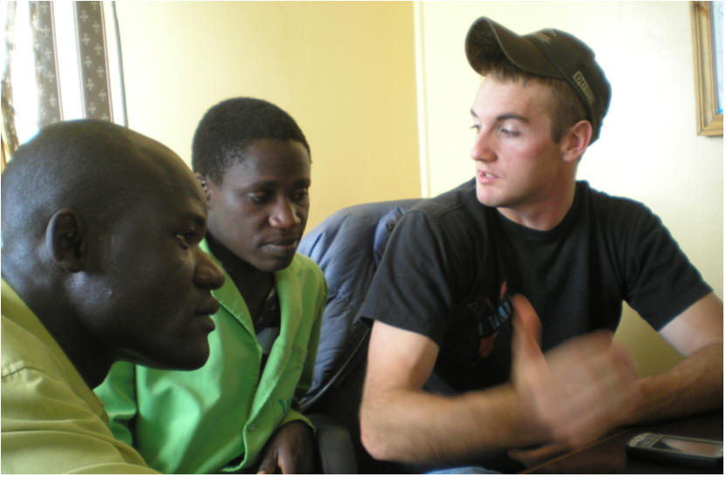
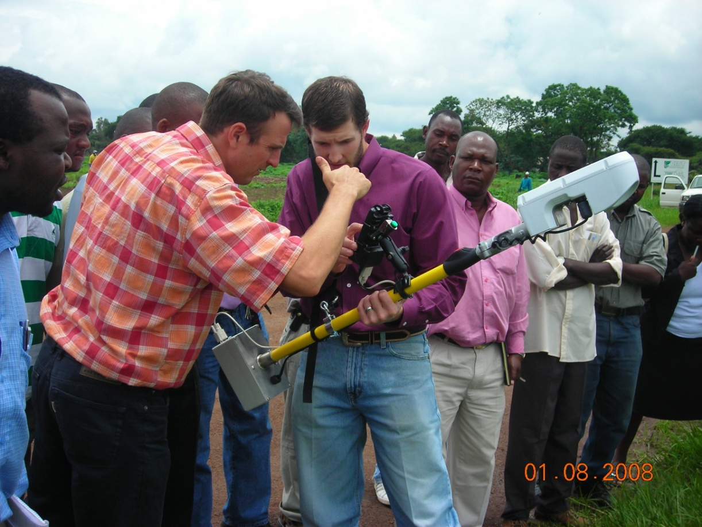
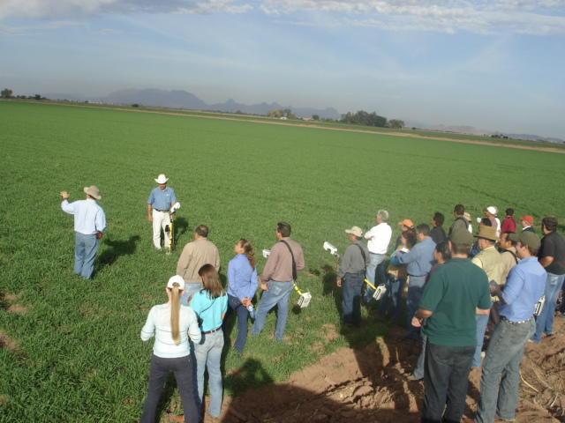
http://nue.okstate.edu/International_Student_Activities.htm
Ivan Ortiz Monasterio

Slide 23
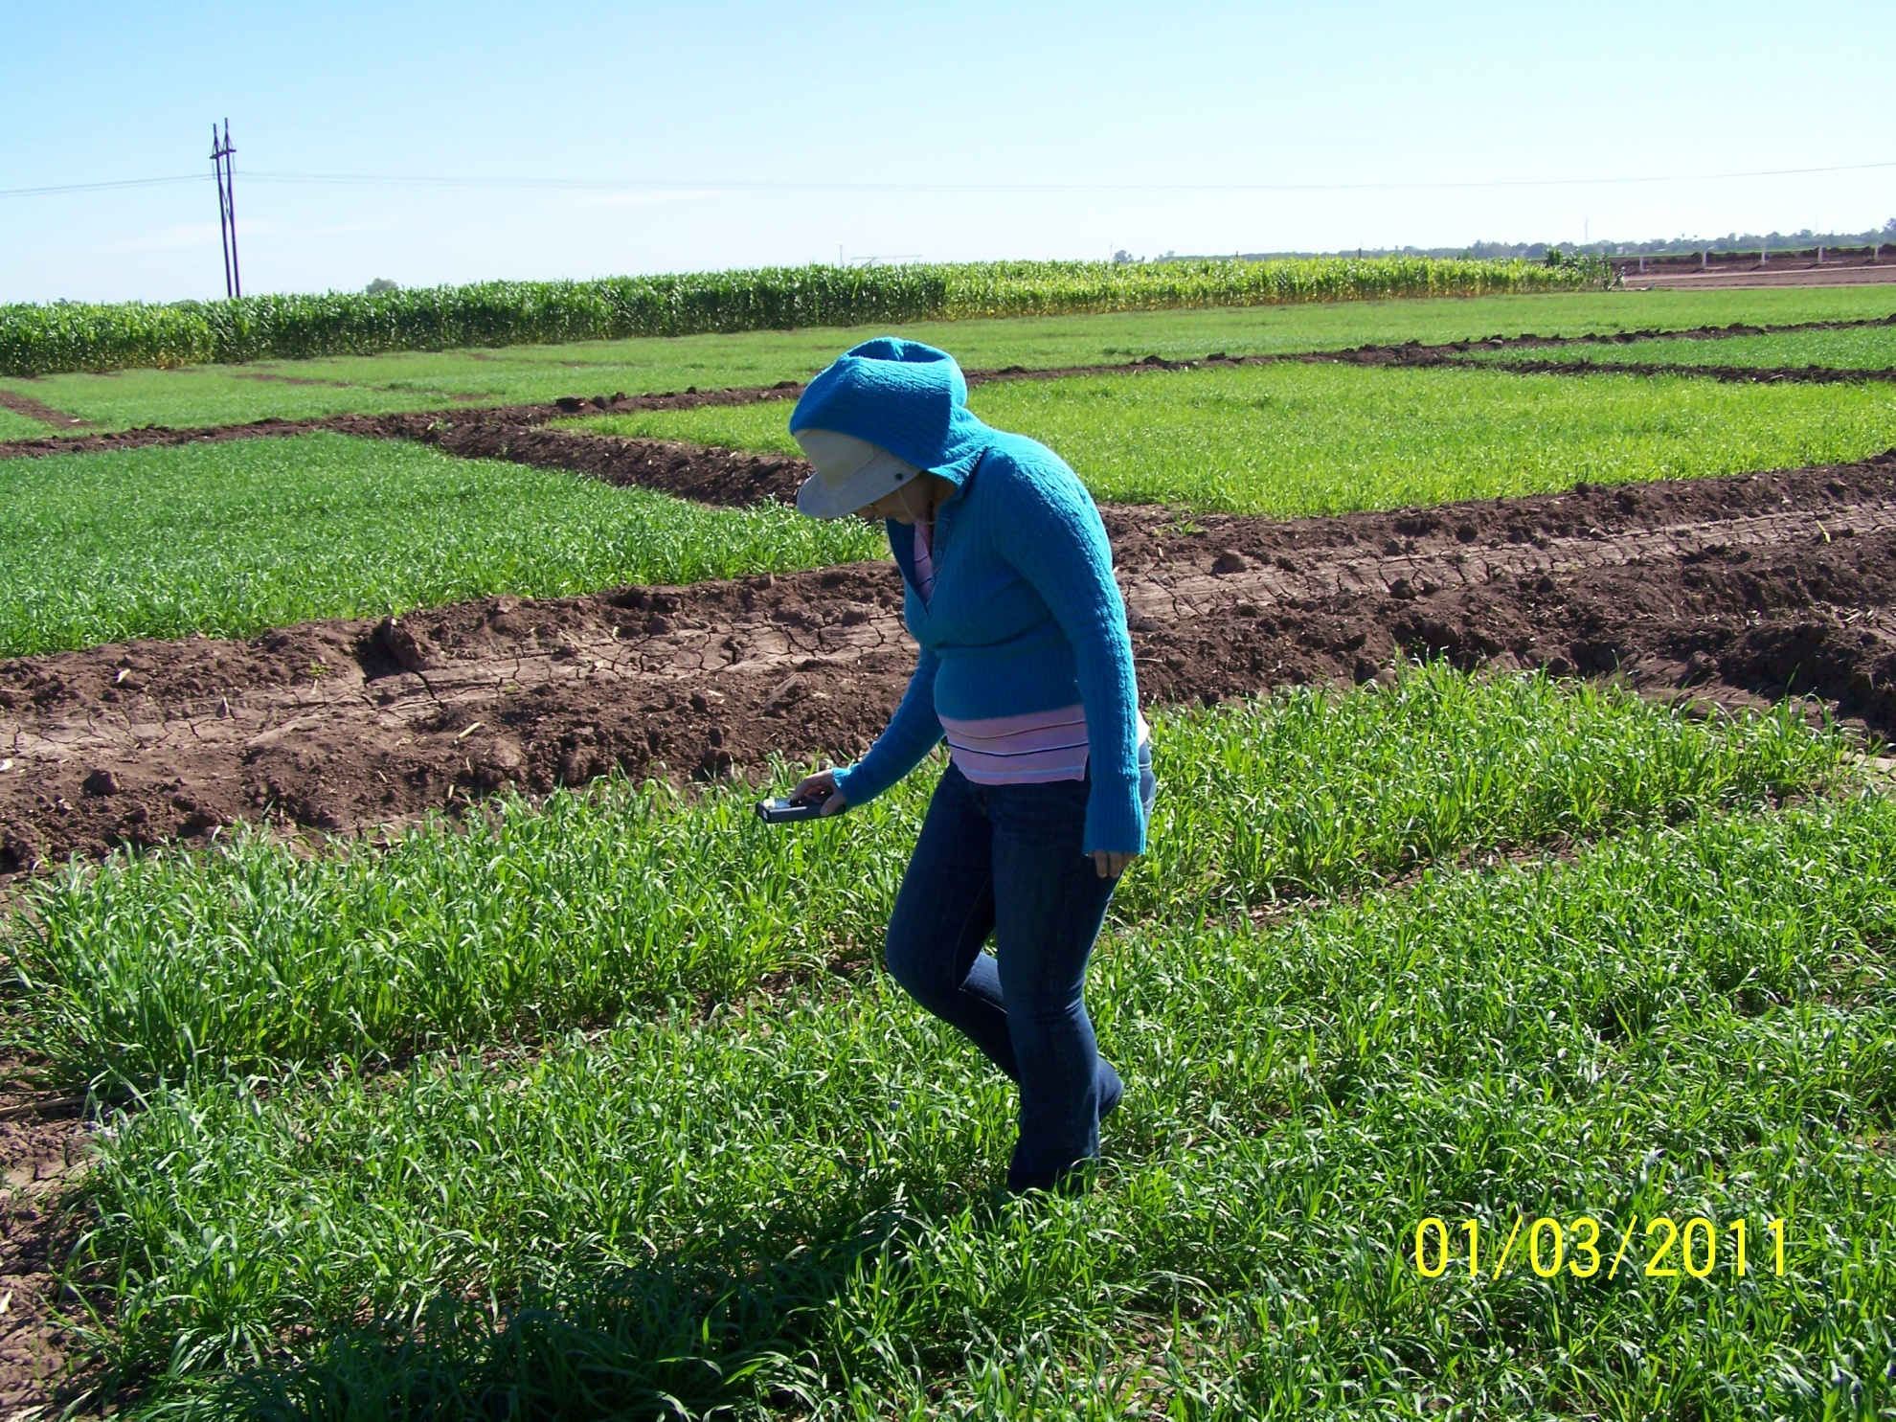
OSU Pocket Sensor
Ciudad Obregon, MX

Slide 24
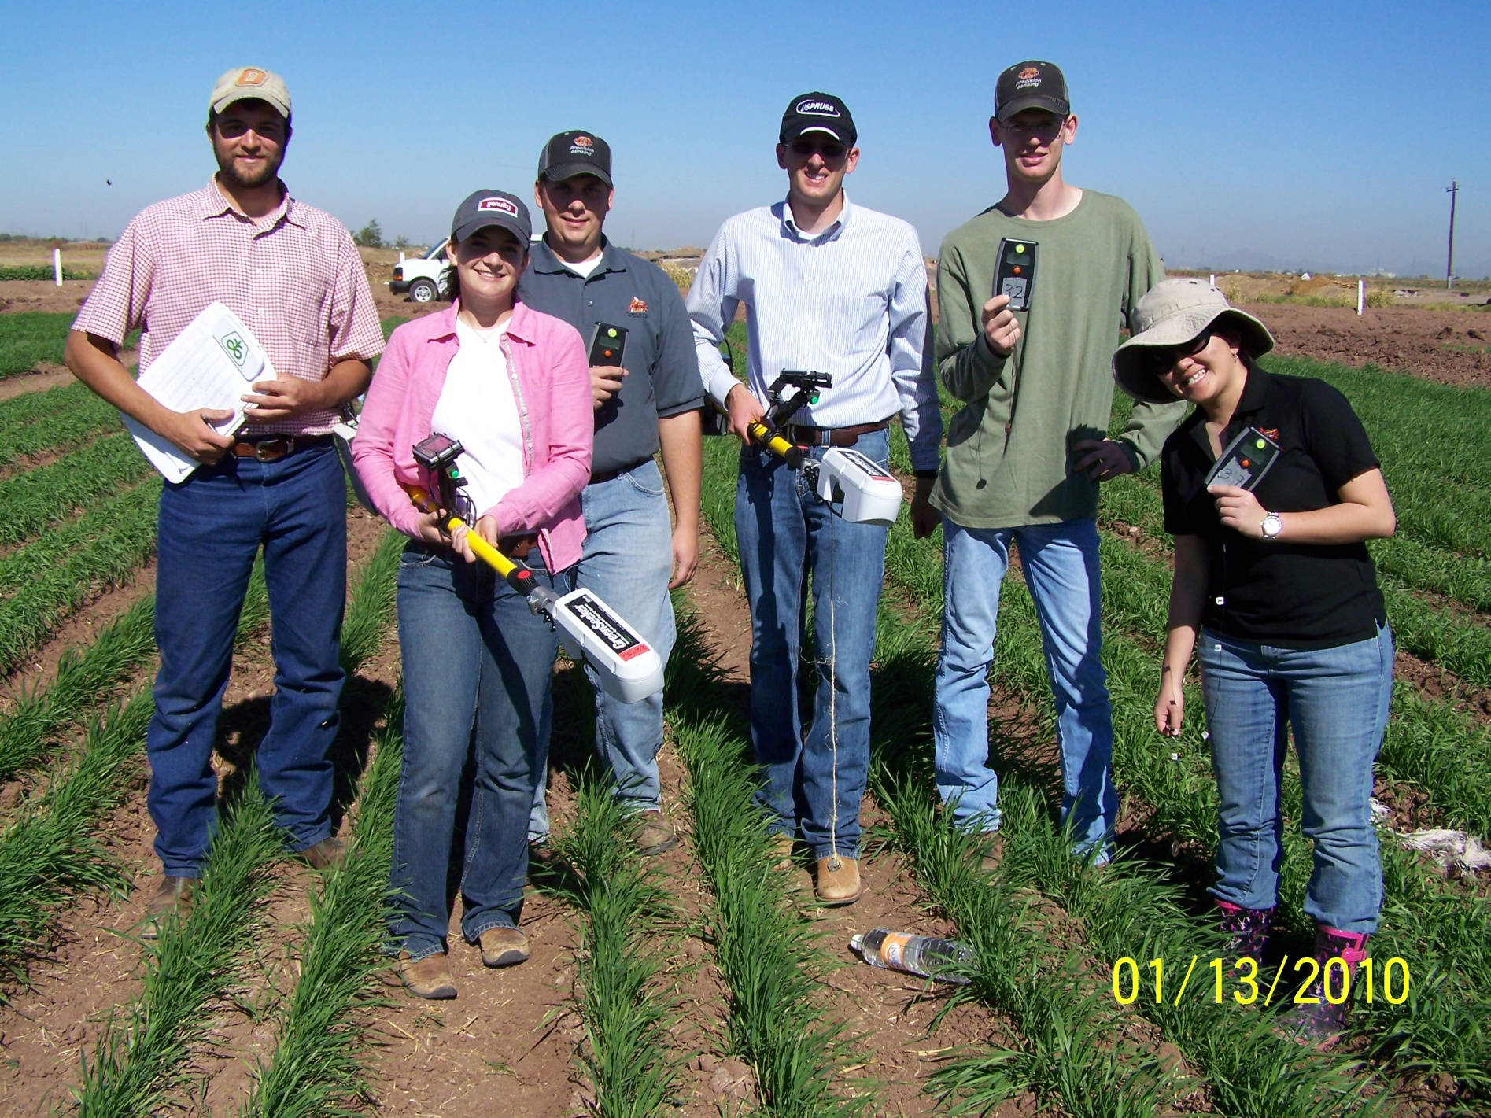


Slide 25
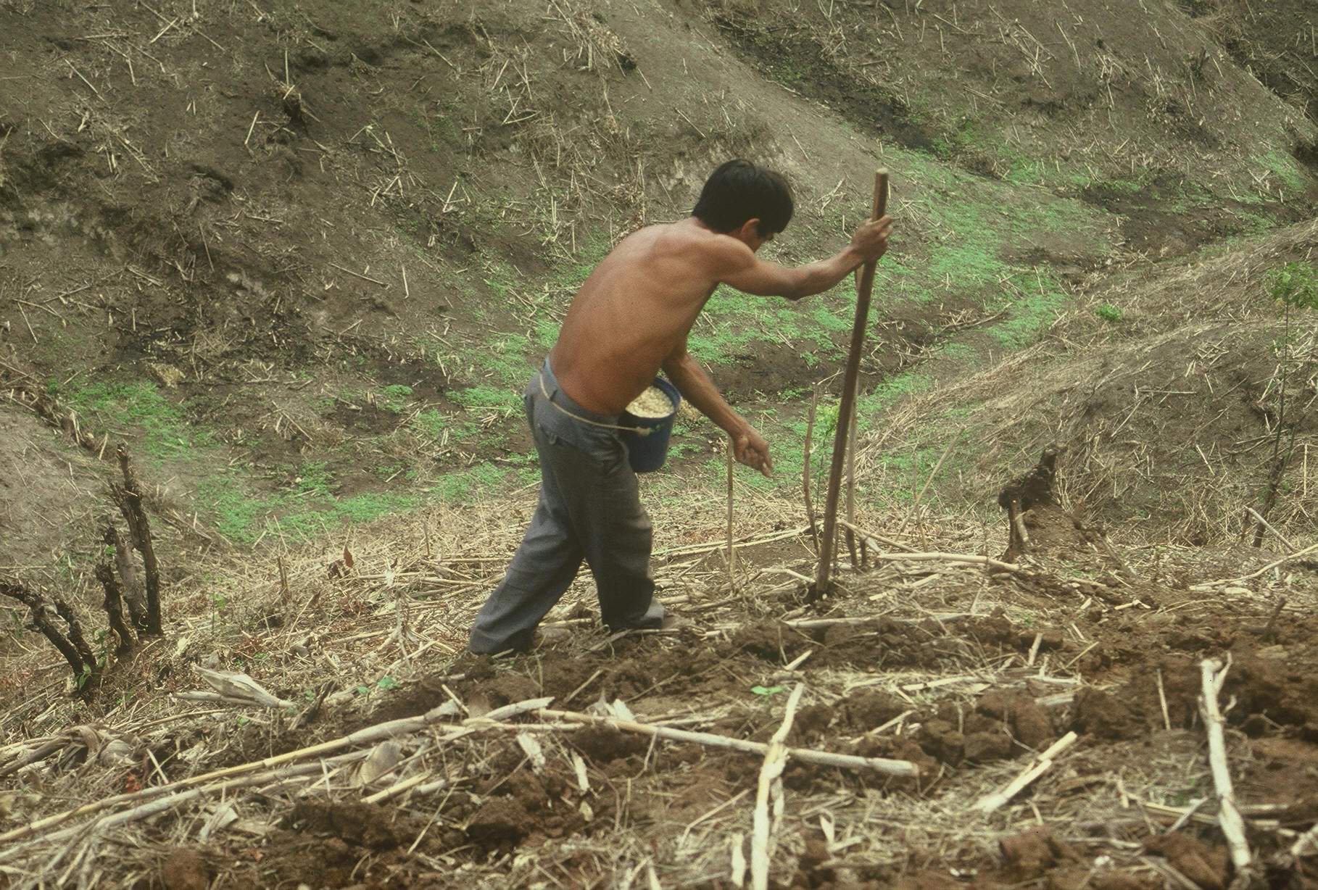


Slide 26
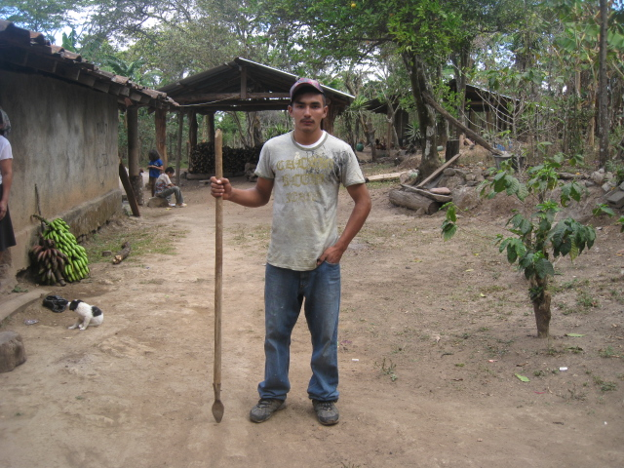
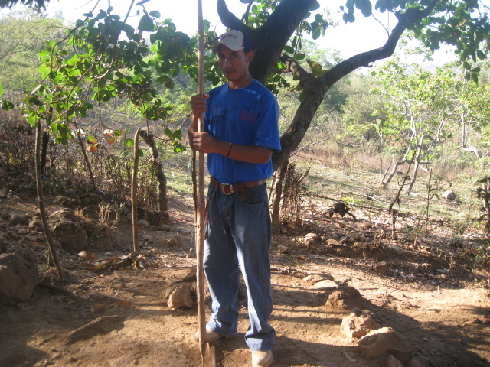
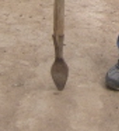
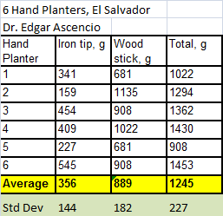
1,000,000 cycles
0.29g/seed
60,000 seeds/ha
3443 seeds/kg
1.0 kg hopper
17 times refill
http://nue.okstate.edu/Hand_Planter.htm

Slide 27
3rd world hand planter
Methods which homogenize maize plant stands and emergence can decrease plant-to-plant variation and increase grain yields (Martin et al., 2005)
Maize emergence delayed by as little as four days, resulted in a yield depression of 15 percent (Hodgen et al., 2007)
Third world maize yields hover near 2.0 Mg/ha
http://nue.okstate.edu/Hand_Planter.htm

Slide 28
Hand Planter
159,531,007 hectares of maize in 2009
34,409,010 hectares in the developing world 60% was planted by hand
    = 20,645,000 hectares or 13% of the total maize area in the world
A 25% yield increase on 60% of the hand planted maize area in the third world, worth more than 3 billion dollars/year (corn price at $0.26/kg)

Slide 29
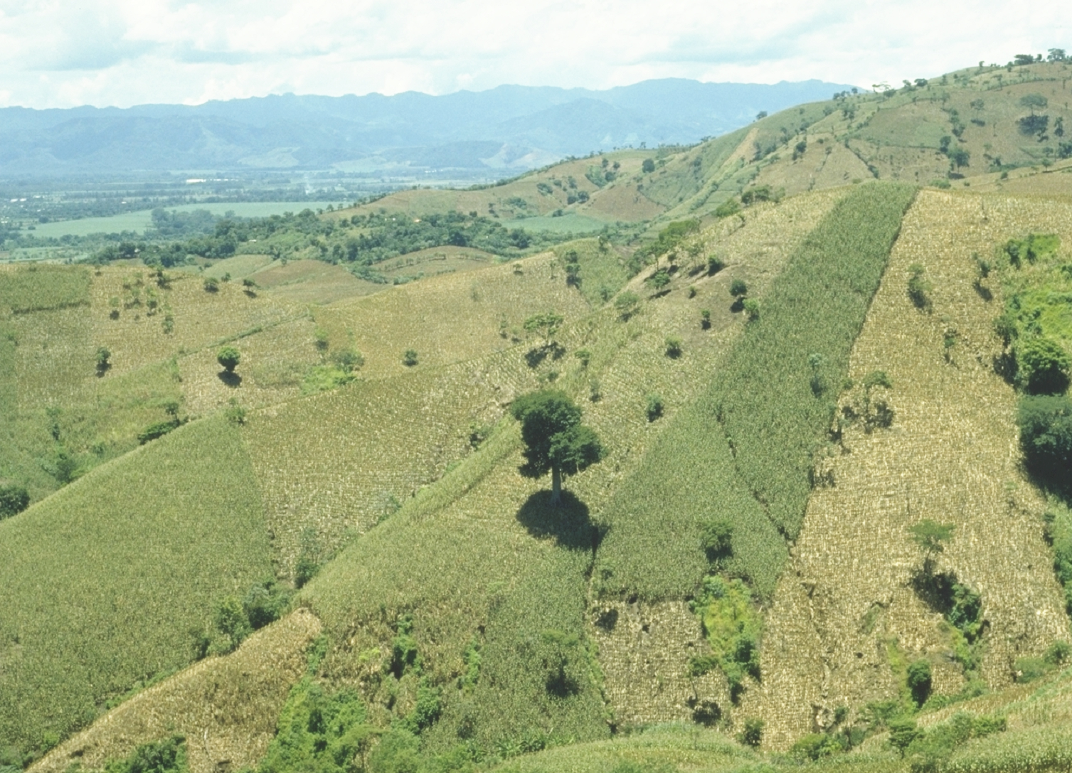

Slide 30
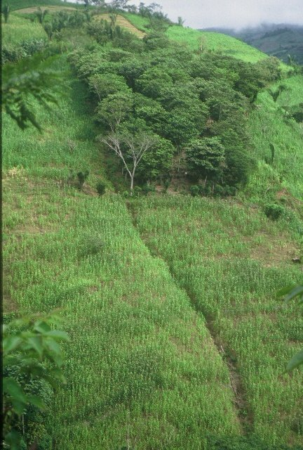
Sustainability
Productivity
Economic Risk

Slide 31
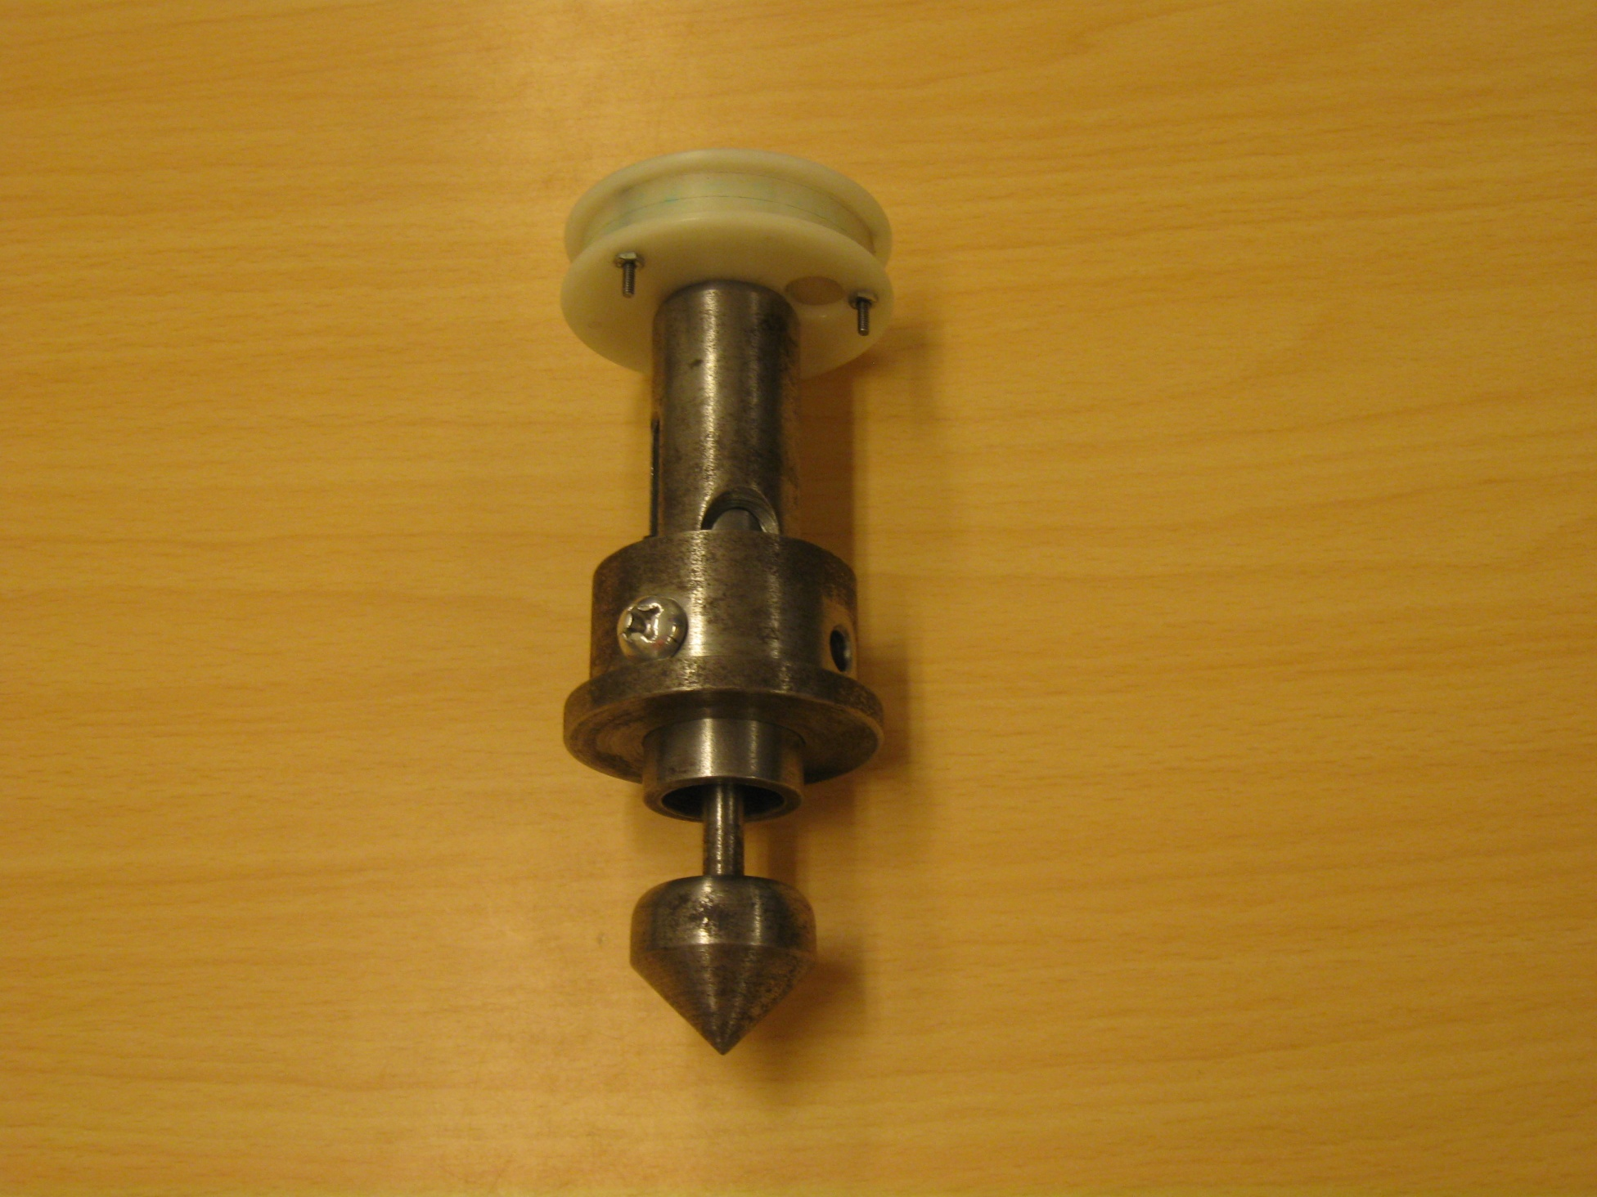
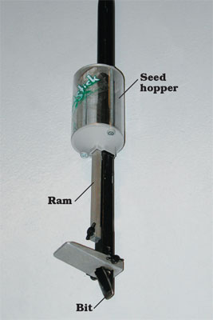
SeedStick

Slide 32
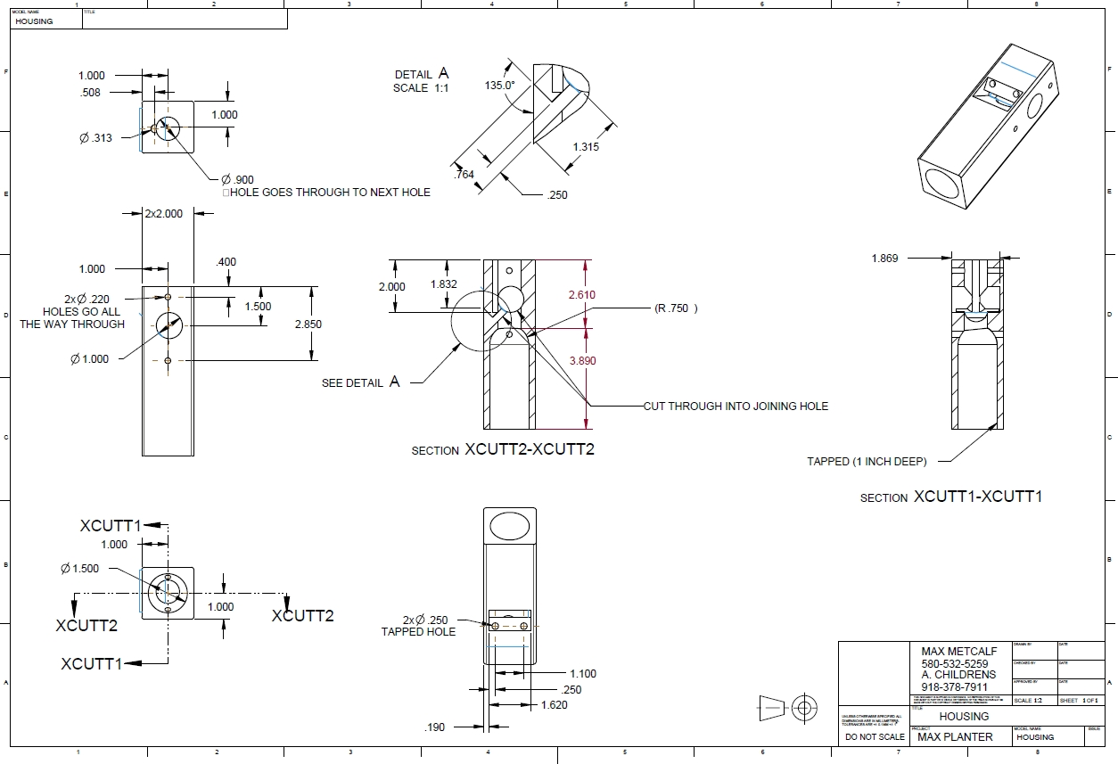
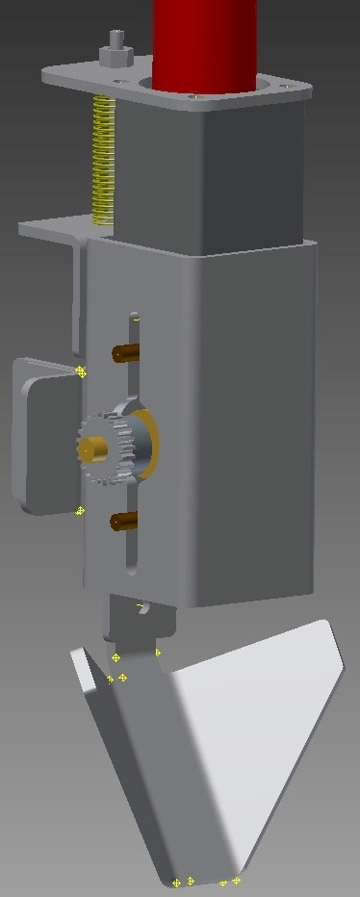
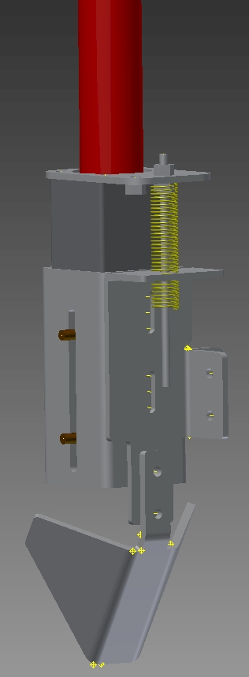

Slide 33
N Rich Strip
Extension
From 2005 to 2011, 18,413 Nitrogen Rich Strips were put on in Oklahoma that represented 1,473,040 acres. Average profits of $10.00/ac for OK producers using the GreenSeeker and OSU N Rate, Dr. Brian Arnall
NPKS strips, Lance Shepherd, Dr. Brian Arnall, Dr. Randy Taylor,

Slide 34
All that is gold does not glitter; not all those that wander are lost. — J.R.R. Tolkien (1892-1973)

