Slide 1
Soils Faculty August 7, 2018
1. Undergraduate degree requirements, course offering concerns, degree options in soils (Abit)
2. (corrections to our web page) (Deng)
3. Plan for the future, curriculum requirements.
4. Faculty inventory/disciplines and curriculum to meet the needs of our soil science degree programs
5. Personnel that could potentially fill voids in soil chemistry, soil morphology, soil genesis (permanent/temporary)

Slide 2
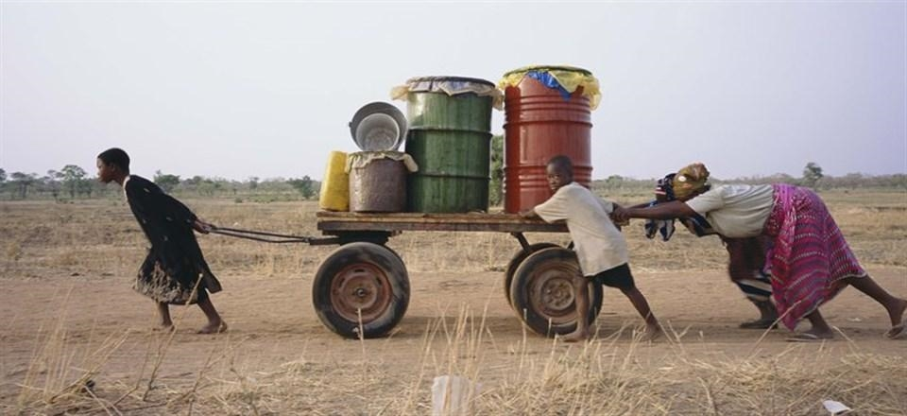
August 6, 2018
“If you want to go fast, go alone. If you want to go far, go together”

Slide 3
SBNRC, winter wheat OK, winter wheat KS, corn, great plains Submitted KUE SURVEY: World Use Efficiency
PUBLISHED
Hand Planter for the Developing World, Factor Testing and Refinement
Dhillon, Jagmandeep; Plant and Soil Sciences
Omara, Peter; Oklahoma State University, Plant and Soil Sciences
Nambi, Eva; Oklahoma State University, Plant and Soil Sciences
Eickhoff, Elizabeth; Oklahoma State University, Plant and Soil Sciences
Oyebiyi, Fikayo; Oklahoma State University, Plant and Soil Sciences
Fornah, Alimamy; Oklahoma State University, Plant and Soil Sciences
Ascencio, Edgar; Consultant
Figueiredo, Bruno; Oklahoma State University, Plant and Soil Sciences
Lynch, Tyler; Oklahoma State University, Plant and Soil Sciences
Ringer, Joshua; Horticulture and Landscape Architecture
Taylor, Randy; Engineering
Raun, William; Plant and Soil Sciences

Slide 4
Graduate School:
You will never have another opportunity be in graduate school again
You will never have another opportunity to excel and put yourself to the test like this ever again
Have to take advantage of the opportunities we are given
Must work together
Only one chance to work cooperatively together

Slide 5
Alimamy, Quick Fill system for the Hand Planter (1 liter coke bottles modified)? VIDEO
Eva/Peter, Flat versus Round, same number of seeds per kg?
Peter/Alimamy, Did his results get better over time (singulation)?
Fikayo/Peter/Eva/Alimamy, What are the consequence of misses? 2 to 3 per hole versus 5, 10, and 20% misses, Please set up this treatment structure. Where does this trial stand?
Tyler/Michael/Bruno, Early Season NDVI (two sites, where are these graphs)
Everett, as a part of sending him as an undergraduate to Mexico, he was supposed to put together a picture log?

Slide 6
Data/results/that have not been completely analyzed and written up
Experiment 601
Perkins N&P
Regional Wheat
Regional Corn
World NUE over time (5813)
Board example N uptake
Early season NDVI (updated graphs)
Work with Lollato

Slide 7
Green Use Efficiency | GRUE Factor
What is your main mode of transportation? (select one)
*reduce your carbon footprint by 1 lb for every mile you do not drive
4 door compact | 2
4 door car sedan | 0
2 door truck | -5
4 door truck | -5
motorcyle | 4
bicycle | 8
electric vehicle | 5
public transportation | 6
Do you carpool?
*for each gallon of gas saved your carbon footprint is reduced by 20 lbs
Yes | 4
No | 0
Do you use renewable sources of energy to power your home?
solar | 6
geothermal | 8
none | 0
Do you use reusable shopping bags at the grocery store?
*buying a set of bags and using them evertime could elimate the waste of 20,000 plastic bags
yes | 4
no | -2
Do you recycle?
everything | 8
plastics, tin cans, glass, cardboard, engine oil | 6
plastics, tin cans, glass, cardboard | 4
no | -8
Do you conserve water/energy? (select all that apply)
turn of tap water while brushing teeth | 2
only running a dishwasher when it is full | 2
washing clothes only when needed and air dry | 2
water the lawn in early morning or late evening | 2
Do you turn off lights and other electronics when not using them?
Yes | 4
No | -4
Do you smoke?
*one tree is destroyed for every 300 cigarettes
Yes | -8
No | 8
Do you often drink alcohol?
Yes | -4
No | 4
Do you use energy efficient appliances in your home?
Yes | 4
No | -2
Do you use effiencient lighting in your home such as LEDs or CFLs?
Yes | 4
No | -2
Do you garden or produce some food of your own?
Yes | 4
No | 0
Do you take home or donate leftovers from your order at a restaurant?
Yes | 4
No | -4
How much food do you waste daily? (i.e. throwing out leftovers ect.)
*around one third of food produces in the worldwide for human use is wasted
one pound | -2
two pounds | -4
a lot | -6
none | 8
Do you create a compost pile at home from leftovers?
Yes | 4
No | 0
Do you often use paper or plastic cups, plates, and silverware instead of reusable materials?
Yes | -4
No | 4
Do you often sign up for paperless billing or the use of digital paper?
* to print a Sunday edition of the New York Times requires 75,000 trees!
Yes | 4
No | -4
Do you use natural cleaning and/or cosmetic supplies?
Yes | 4
No | -2
Do you use cloth towels or paper towels for cleaning?
Cloth | 4
Paper | -2

