Slide 1
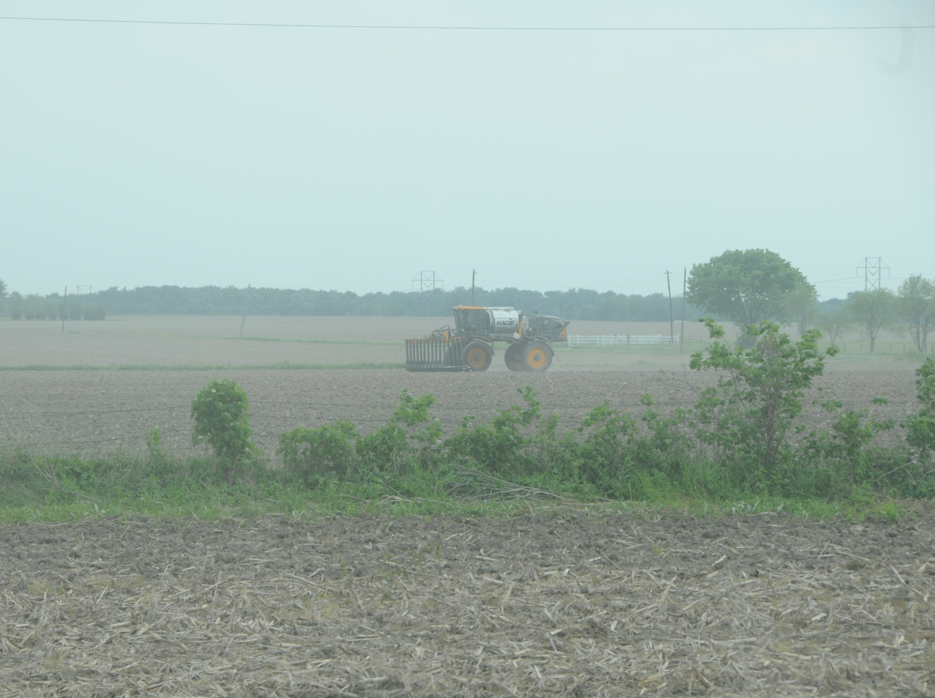
Experiences using sensor based N application
Mark Lehenbauer
Lehenbauer Farms, Inc
Hannibal, MO

Slide 2
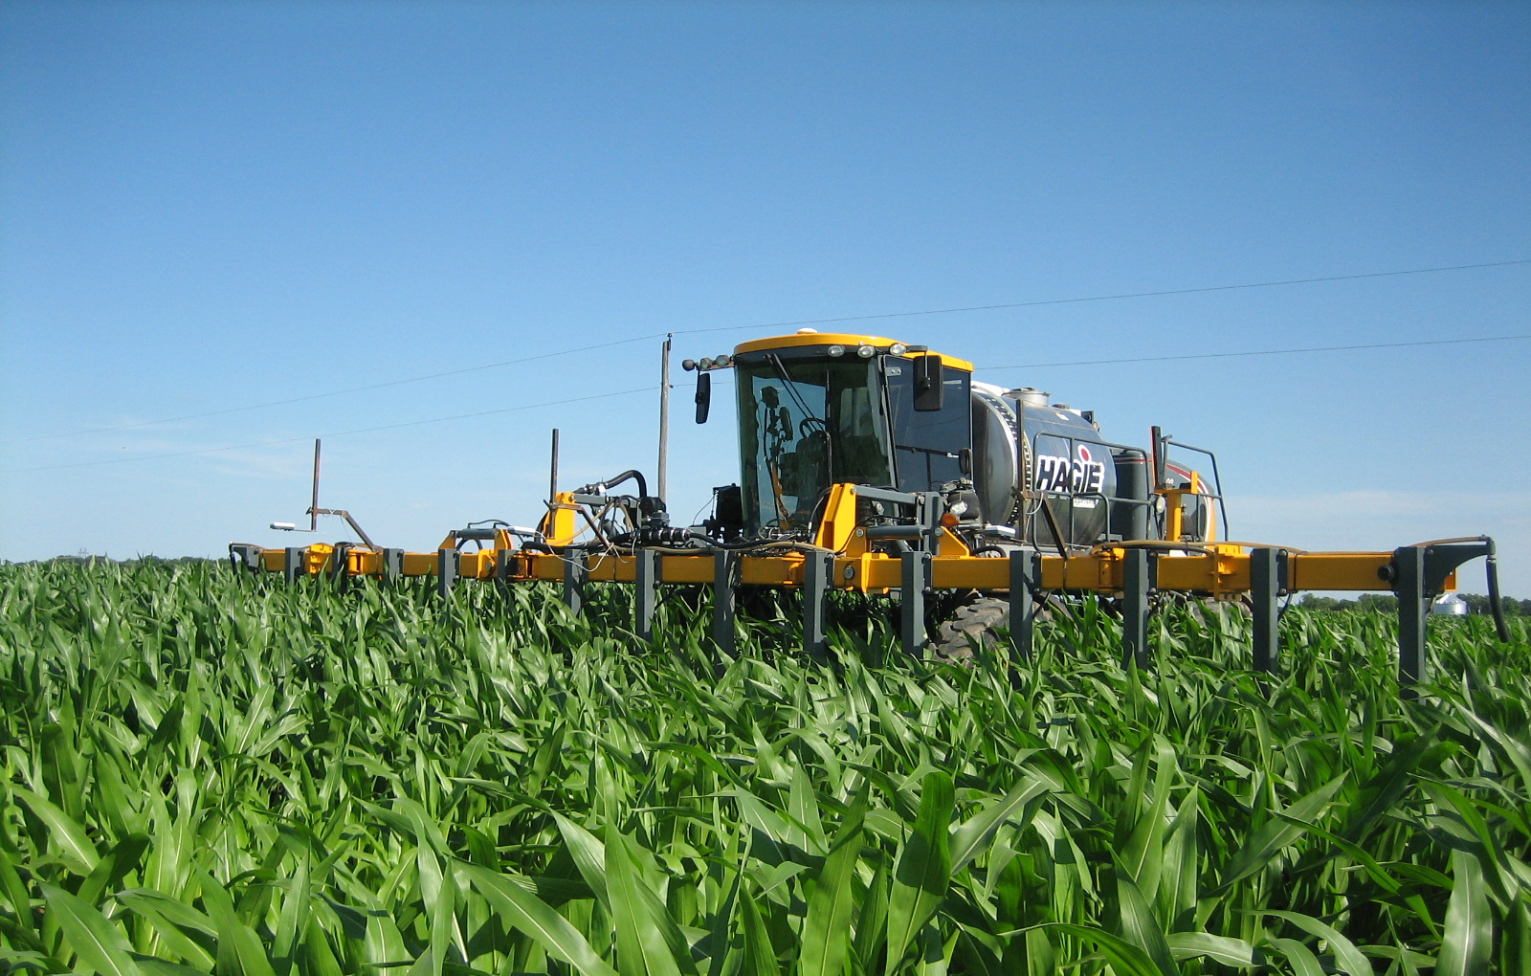
History on our Farm
2001
2005
2006
2008
Started sidedressing all corn acres
Went to late season sidedress
Started using sensors
Switched back to injection

Slide 3
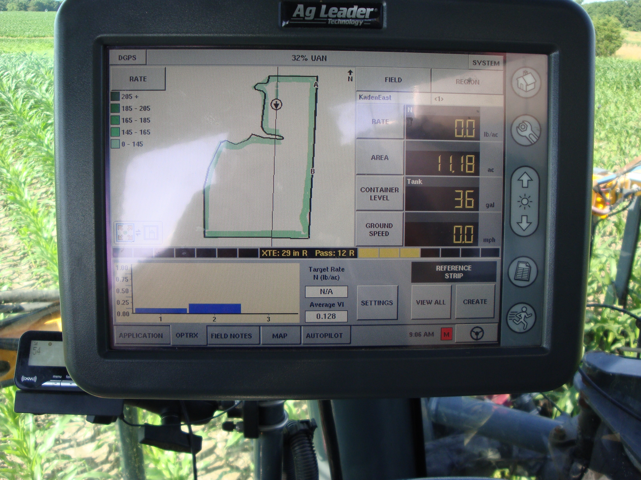
Lessons Learned
Sensors are ahead of equipment
Not a fix all solution
Have to use common sense when operating
Better than guessing

Slide 4
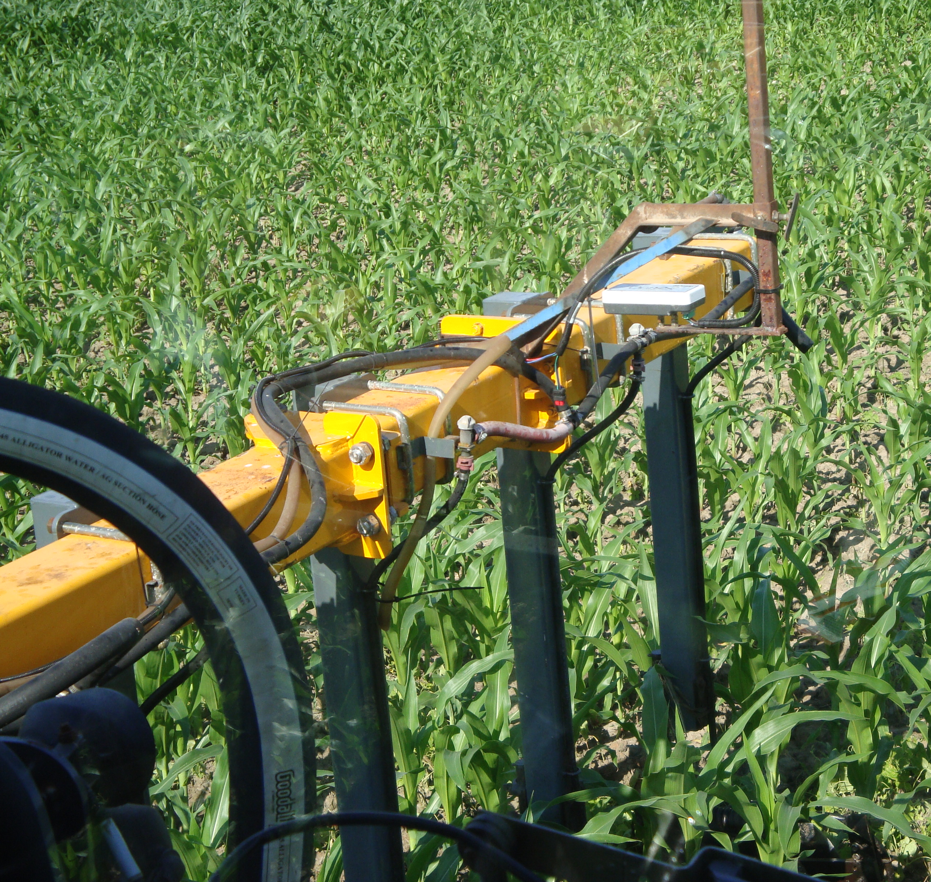
Suggestions
Start with small changes in your operation
Leave test strips
Collect your data
Monitor fields throughout season
Don’t wait for conditions to be perfect for sensors

Slide 10
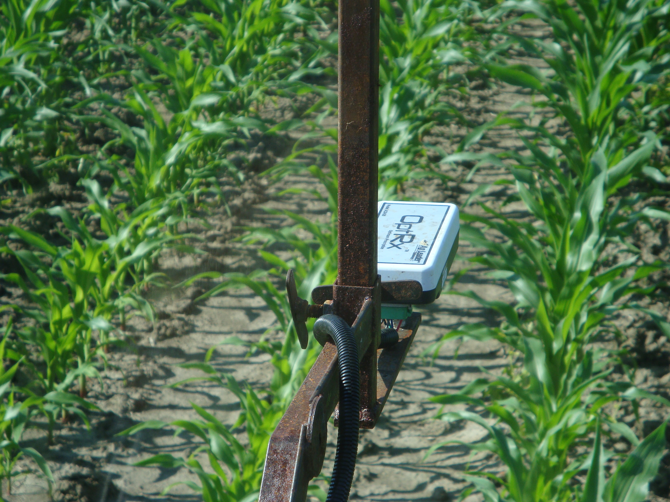

Slide 11
Mark Lehenbauer
(573) 406-4540
marklehenbauer@yahoo.com

