Slide 1
HAND SEED PLANTERS FOR AFRICA
INCREASING USE-ABILITY, MAINTENANCE, YIELD AND REDUCING COST OF THE HAND SEED PLANTER IN RURAL AREAS OF UGANDA

Slide 2
Facts about Uganda
-85 fresh water lakes, Lake Nalubaale (Victoria) the world’s second largest fresh water lake after lake Superior in the USA, 222 rivers.
-Source of the River Nile (World’s longest river) and a lifeline for six countries, on its banks fertile alluvial soils for agriculture to flourish.
-Has 30% of forest cover contributing in rainfall formation.
-Equatorial tropical climate with heavy rains at least 3 times a week.
-Soils are Clay silt loams with high percentages of humus and nitrogen content in soils.
-Fertility has been decreasing over time due to a number of factors, deforestation, use of poor farming methods etc.
Serve the land feed the hungry

Slide 3
Uganda’s Agriculture
-Agriculture contributes 48% to the Ugandan economy.
-Employs 80% of the people directly or indirectly (US less than 3%)
-65% women and youths who contribute 75% overall agriculture production, these live in rural areas.
-Farm small acreages of land (1-3 acres on average)
-Growing cereals, legumes and starchy foods.
-In many cases chemically treated seed is used posing a carcinogenic threat.
-Working long hours in the sun bending while planting seed.
-Use of heavy cast iron hoes and agricultural equipment.
-farming sloping lands, in central and south, this is tedious.
FIAT PANIS (LET THERE BE BREAD)

Slide 4
St Jude Family Projects and Rural Training Center
-NGO started in 1986 as a peasantry farm.
-Has worked with 186,000 rural farmers since 1993.
-Work revolves around teaching of better life long practical agricultural skills, and environmental protection in rural areas.
-Has an agricultural schools program targeting school children.
-Consortium of companies, eg, MOP, SCOA, SCOPE, DEMO FARM etc….
www.stjudefamilyprojects.org
ff FEED THE SOIL SO THAT IT FEEDS YOU

Slide 5
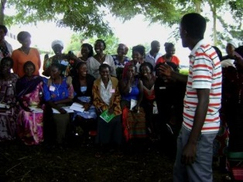
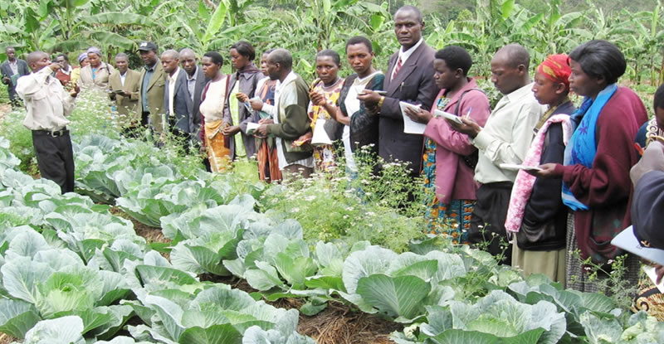
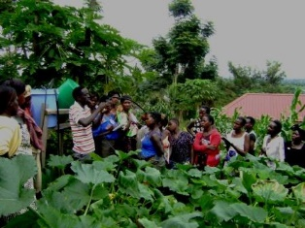
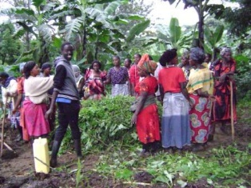
Our work in Communities
Some of our Work in rural communities of Uganda over the years.

Slide 6
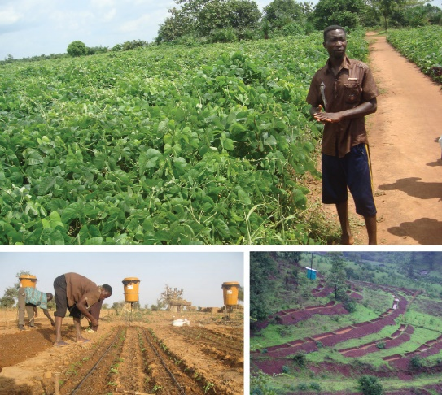
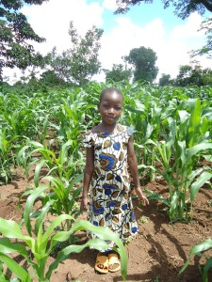
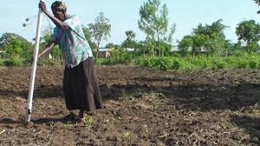
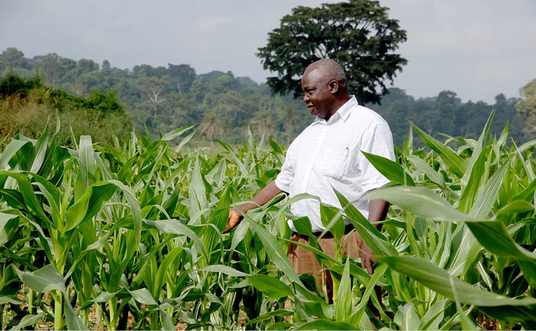
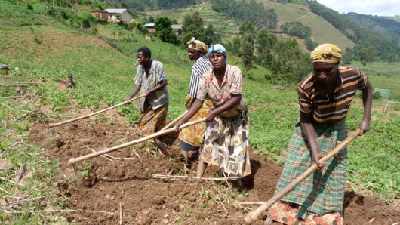
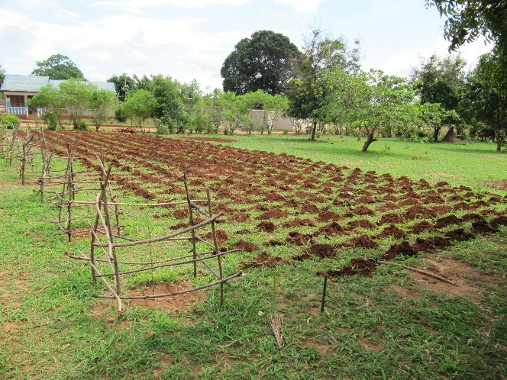
Hand Seed Planter Vs Hand Hoe

Slide 7
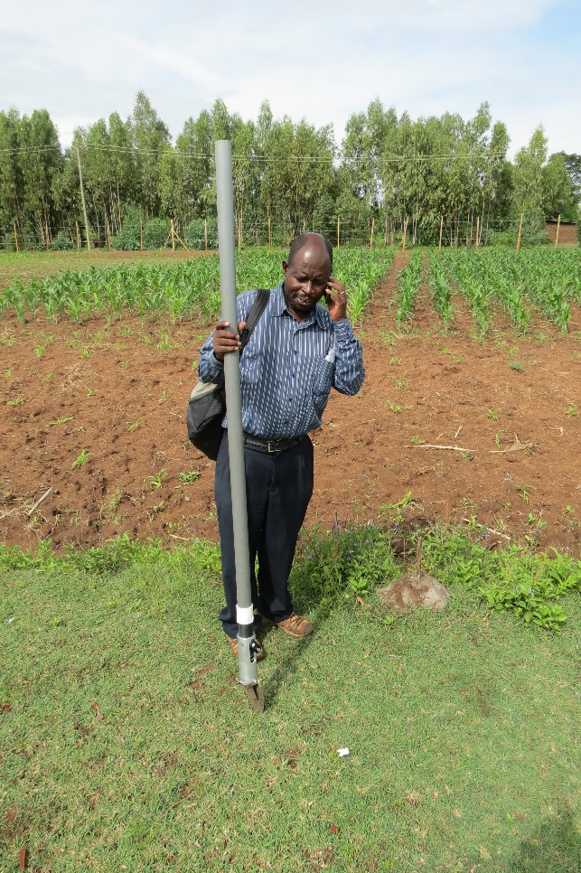
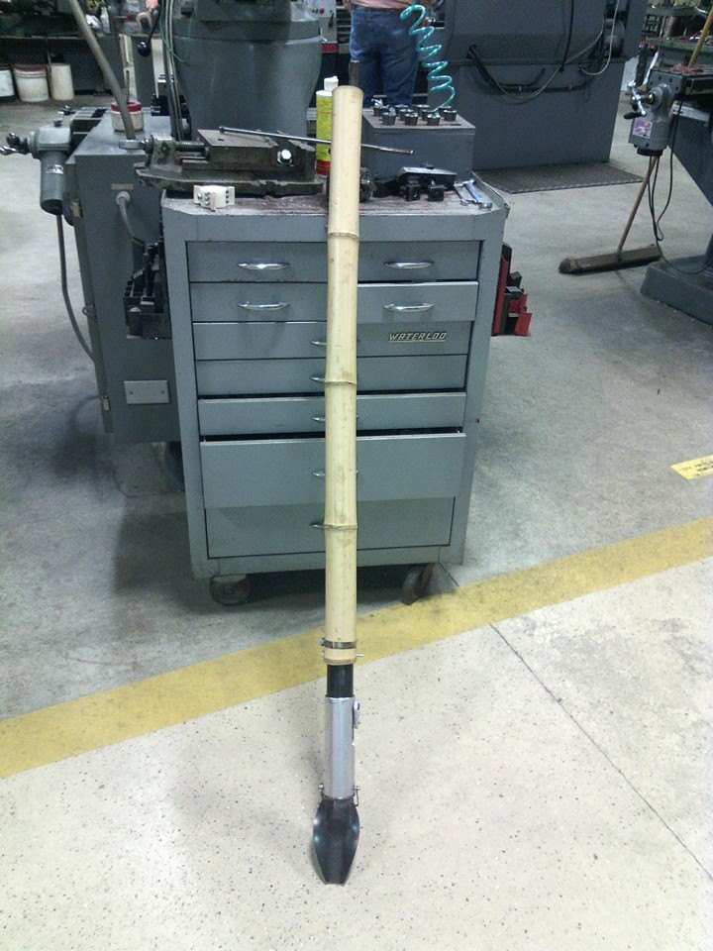
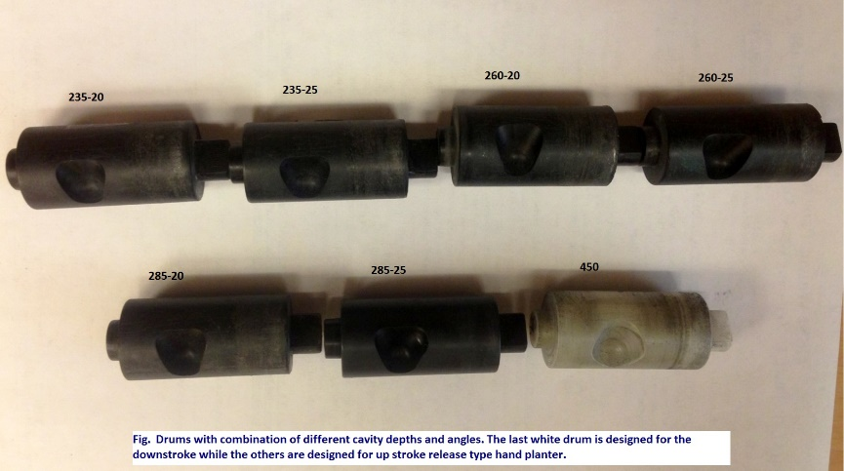
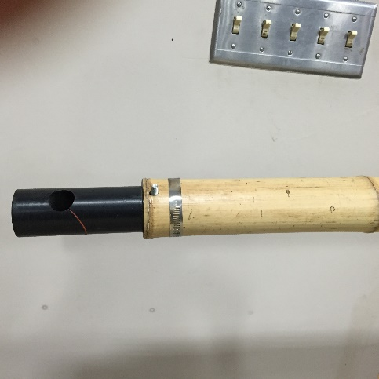
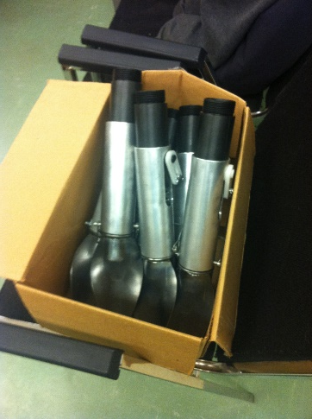
Ag. Knowledge dissemination

Slide 8
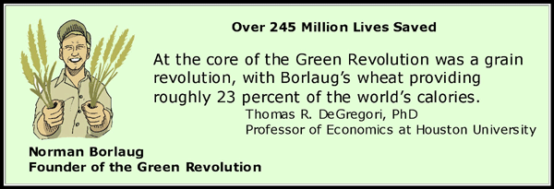
Modifications and Benefits
-Removal of chemically treated seeds from the hands of the farmer.
-Deduction in soil erosion through improved plant spacing.
-Accommodate mid season Urea and Nitrogen Fertilizer application.
-Place Urea below the surface reducing NH3 losses to the environment.
-Diversification of the Hand seed planter to suit all kinds of seed through doctoring of drums to suit various sizes of seeds.
-Reduce purchases and maintenance costs of the hand seed planter by using locally available materials like bamboo etc..

