Slide 1
The severe drought in Sao Paulo, Brazil
Mariana Ramos Del Corso

Slide 2
Brazil

Slide 3
Sao Paulo
It is one of the most important states in the country
One of the most productive economies in the country – 33% GDP
It is the richest state
40 million inhabitants in 2014

Slide 4
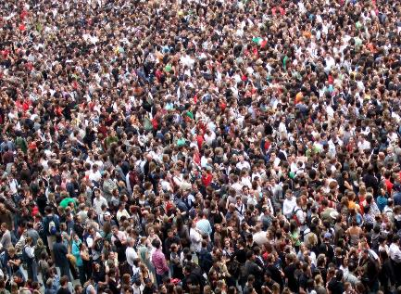
Water
Notes:
How water is important for you
Imagion all these people without water

Slide 5
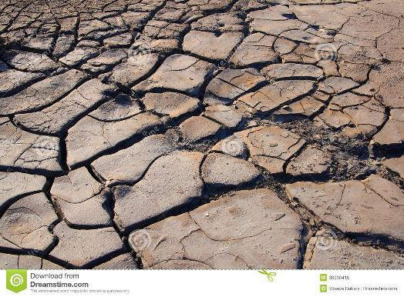
High temperatures and no rainfall
It is the worst drought in 80 years.
The southeast had the lowest indices of precipitation of the country.
In some regions the precipitation was 80% less than the historical average

Slide 6
Before and after
Notes:
Sp used to be known as rainy land
This photo is the representation of the drought

Slide 7
Grains were small and dried up.
The expectation return was 32 million of coffee bags, but they got only 28 million.
Decrease in 9.4% in 2014/2015, when compared to 2013/2014
The production might decrease of 15-20% in the production this year.

Slide 8
The root of the problem: Deforestation
In the last decade, 20% of the Amazon forest has been deforested
2 thousand trees are lost in 1 minutes
Almost 88% of Atlantic Forest was lost

Slide 9
Deforestation
70% of the precipitation in Sao Paulo depends on the Amazon forest
Atlantic Forest: protects rivers’ spring and help to maintain the local clime
Both forest maintain the hydrographic cycle of water

Slide 10
Deforestation
Decrease the quality of water
In a vegetation canopy: water is slowly filtered and then reaches underground and form rivers’ sources
Deforestation area: water leaches, carrying soil particles and silt rivers.

Slide 11
How agriculture can help…
We have to fight to increase the production without the cropland devastation.
70% of all the water is designated to agriculture industry.

Slide 12
Unesp Botucatu
Application of composted sewage sludge and residuary water in orange and tomatoes

Slide 13
Thank you, questions?

