Slide 1
Welcome to 14th Annual Nitrogen Use Efficiency meeting August 8-10, 2016 University of Idaho
Olga Walsh, Cropping Systems Agronomist & Extension Specialist, UI Parma R&E Center

Slide 2
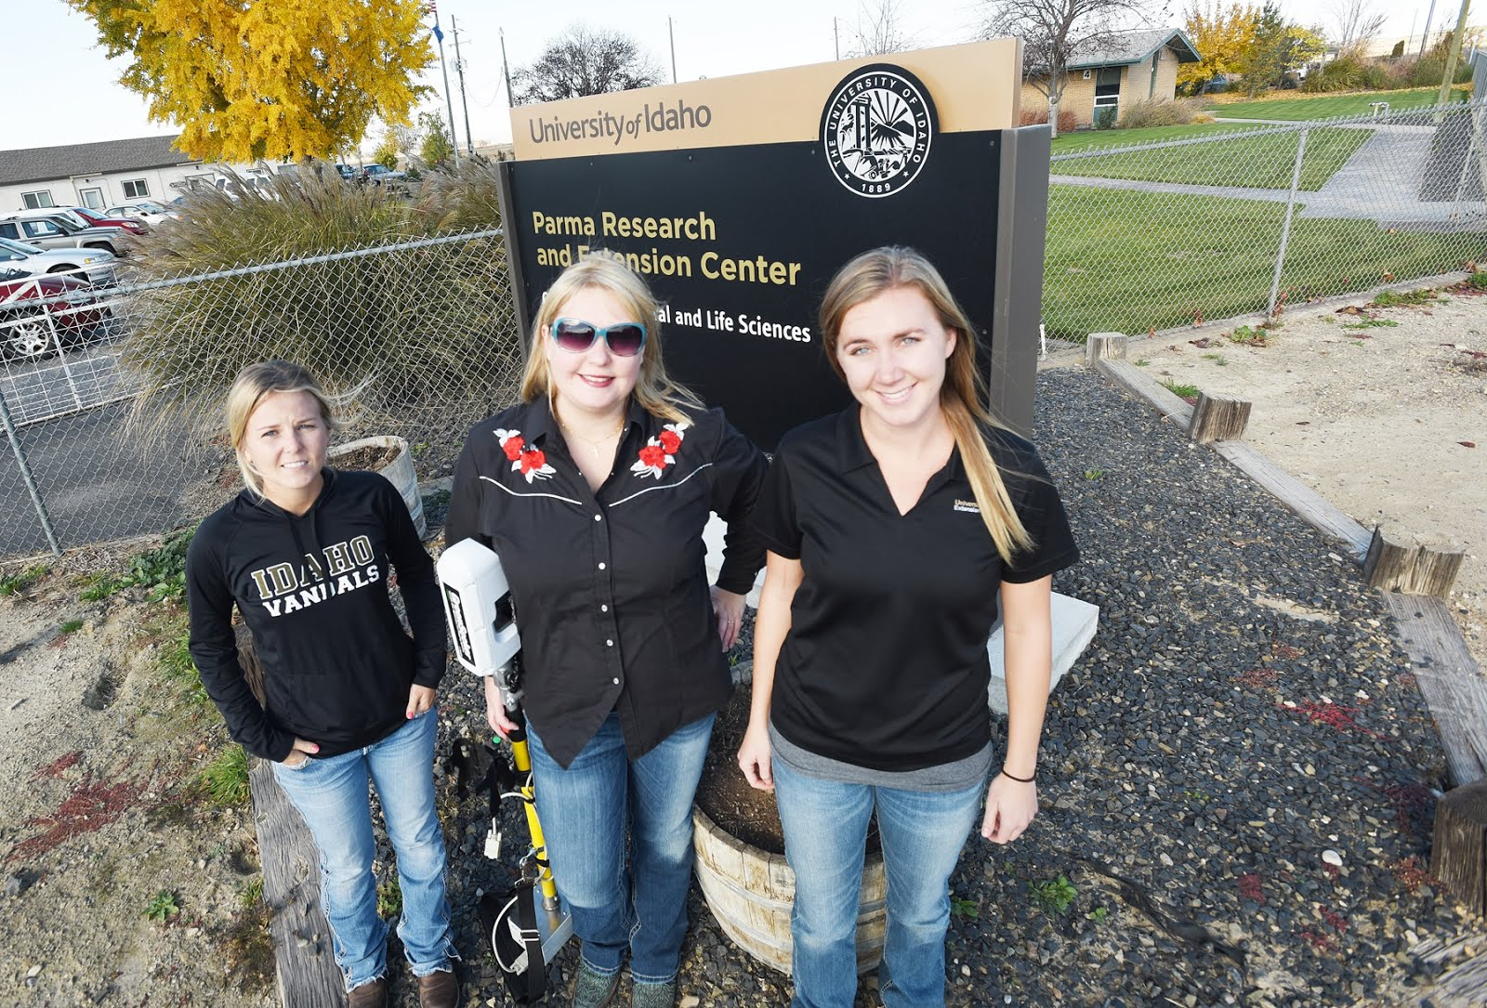
Jordan Mc-Clintick-Chess (on left) Agricultural Technician

Slide 3
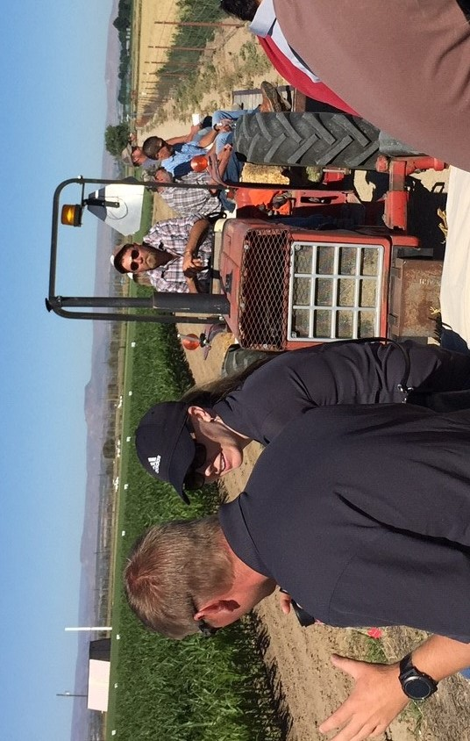
Steven Blanscet, Research Technician

Slide 4
2016 meeting
60 registered attendees from
3 countries
12 US states
21 institutions
Almost 30 posters – most are student competition
My cell: (208) 590-69-39

Slide 5
Day 1 – August 9, 2016
Start at 8:30 with coffee/poster set-up
8:50 – 10:30 – 4 oral presentations
Break
10:45 – 12:15 – 3 oral presentations
Lunch
2:15 – Load bus, travel to Parma for field tour
3:10 – 5:20 – Field tour
5:30 – 7:30 – Dinner at Parma Ridge winery
7:30 – 8:15 – Load bus/Back to hotel

Slide 6
Day 2 – August 10, 2016
Start at 8:45 with coffee/poster viewing
9:15 – 10:30 – 3 oral presentations
Break
10:45 – 11:45 – 2 oral presentations
11:45 – 12:00 – Discuss NUE 2017
12:00 – 12:15 – Dr. Marvin Stone Memorial poster competition for graduate students
Lunch to-go
1:00 - Adjourn

Slide 7
Poster set-up
Displayed on the wall
Use blue painters tape (provided at reception)
Poster competition – 3 volunteer judges needed
Poster judging – Wednesday, 10:30 – 10:45
1st place = $500; 2nd = $300; 3rd = $200

Slide 8
UI Parma field tour
UI FARM
Jim Barbour, Superintendent
Overview of Ag Research at UI Parma
Specialty crops: Mint and Hops
Jacob Blauer, Simplot - Phenotyping, potatoes
Olga Walsh
Nitrogen & Water study
UAV study
Robert Blair/Robert Schoepflin – UAV demo
UI ORCHARD
Mike Kiester – Fruit research
Duke Bulanon – UAV/software demo

Slide 9
Area: 83,574 sq mi, 14th in the US

Slide 10
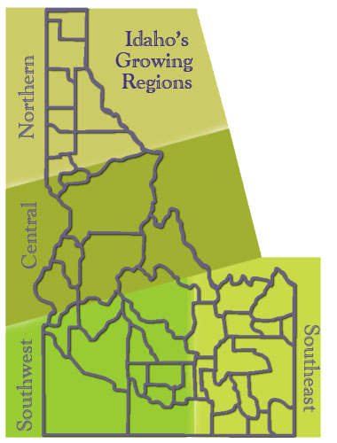

Slide 11
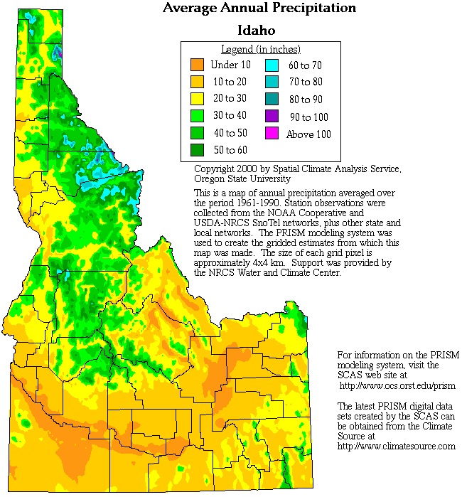
From under 10 in to over 60 in/year

Slide 12
4 ID growing regions
Northern/Central ID: mountains, forests, grasslands, extensive grain fields. Slightly to very acid, sandy to heavy clay soils.
South East ID: high plains and desert to the west, leading to foothills and high mountains to the east. Desert and lowland soils are often alkaline. Mountain soils are generally acidic. Soils range from sand to heavy clay, mostly - light-textured soils.
N and SE ID: cold hardy, early ripening fruit and cool season vegetable varieties; cereal production.

Slide 13
4 ID growing regions
South West ID: around Boise and Payette is ideal for growing many fruit and vegetable crops. The winter climate is relatively mild and the growing season long and warm, with frost-free periods of 120 to more than 150 days common.
More crop variation, potatoes, sugarbeets, beans, specialty crops, seed production

Slide 14
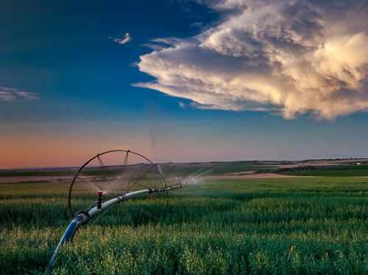
ID Cropping systems overview
Idaho has one of the nation's most diverse agricultural economies
Potatoes and wheat are known world wide
2015 cash receipts from ID agriculture broke all previous records at $7.9 billion, 9% decrease from 2014 (<<<wheat, barley, milk)
ID = 3rd largest Ag. state in the west, after CA and WA
As measured by sales – Agriculture is #1 business in ID = $24 billion in sales (directly and indirectly) = 20% of total economic input
ID Agriculture >120,000 jobs ~15% of ID employment

Slide 15
ID Cropping systems overview
Idaho crop production – Nationwide placement
Potatoes, #1
Barley, #2
Sugar beets, #2
Alfalfa, #4
Lentils, #4
Wheat, #5

Slide 16
Idaho cash receipts – 2015 crops
Potatoes - $871 million - Idaho’s highest-value crop
Wheat - $506 million
Hay - $485 million
Sugarbeets - $300 million
Barley - $286 million
Dry Beans - $71 million
Idaho’s net farm income is second-largest of the western states, after California

Slide 17
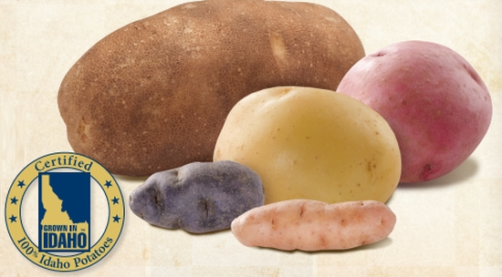
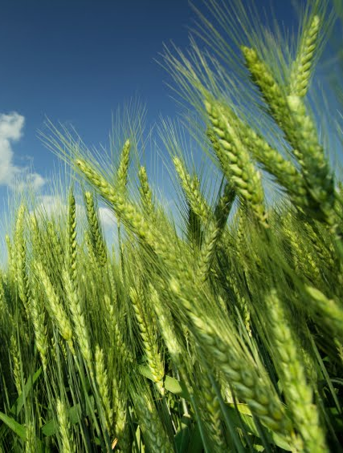
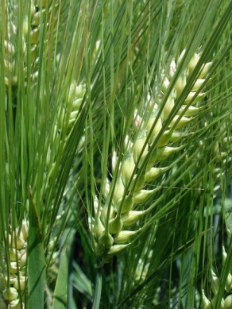
ID Cropping systems overview
Potatoes – “warm days and cool nights, ample mountain-fed irrigation and rich volcanic soil, give Idaho Potatoes their unique texture, taste and dependable performance” (www.idahopotato.com, 2014)
>400,000 acres are planted annually
~ 34% of the nation's fall harvested acreage
French fries market ~ 60%
Small grain (wheat and barley, some oats) grown in diverse production systems ranging from fully irrigated to low rainfall wheat-fallow
Wheat: soft white winter (SWW) and spring (SWS), hard red winter (HRW) and spring (HRS), and hard white winter (HWW) and spring (HWW), club (CW) and durum (DW), some feed wheat
Barley is grown for malt, animal feed, and human food
Valuable for the receipts to farms
Excellent rotation crops for other crops
www.idahowheatcommission, 2010; www.matara.cz, 2014

Slide 18
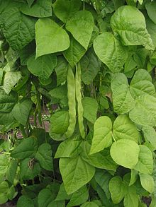
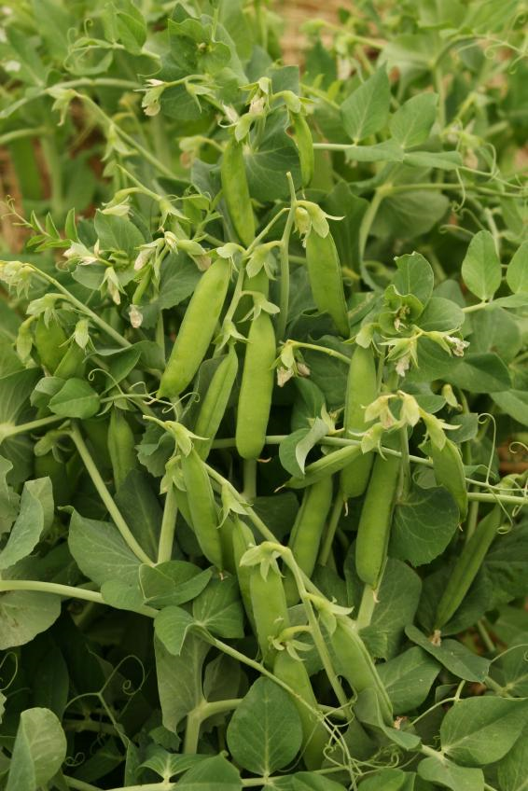
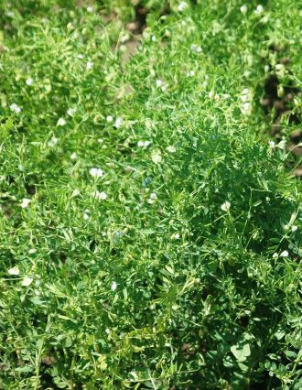
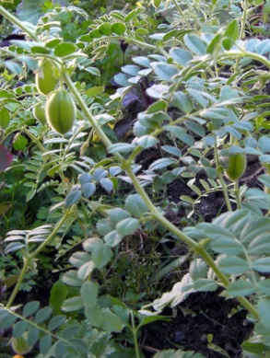
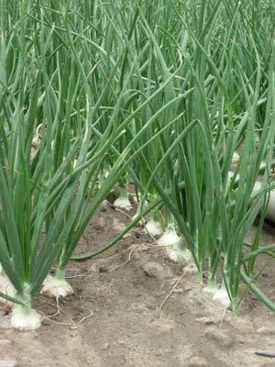
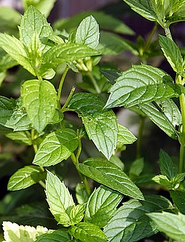
ID Cropping systems overview
Dry beans
Long growing season, rich volcanic soil, clear mountain water and a vigorous quality control program = highest quality, disease-free beans for food and seed
Sugar beets
Industry employ about 4,000, plus 1,500 in processing
Amalgamated plants in Nampa, Paul and Twin Falls
Processed into white, refined sugar, molasses, beet pulp, beet pellets and a animal feed
Peas, lentils and chickpeas
Cool season food legumes, important for dryland
Northern ID – one of two principal growing regions in US (Northern Plains and the Palouse)
Onions: almost 20,000 acres in Idaho/Oregon border = 1,415,500,000 pounds harvested annually
Mint: ~13,000 acres, ID is 3rd producer in the U.S; multiple uses – candy, toothpaste, gum, oil
Grape and wine – one of the fastest growing in the U.S. Account for 1,000 acres, 10-12 wineries, ~ 165,000 cases of wine annually (2002) Important for agricultural tourism.

