Slide 1
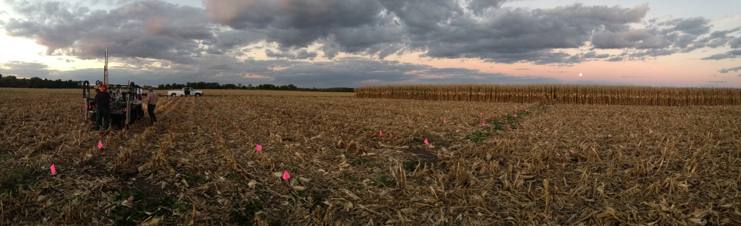
Which Fields Need Precision Nitrogen Management the Most?
Matt Yost, Christopher Bobryk, and Newell Kitchen
USDA–Agricultural Research Service, Cropping Systems and Water Quality Research Unit

Slide 2
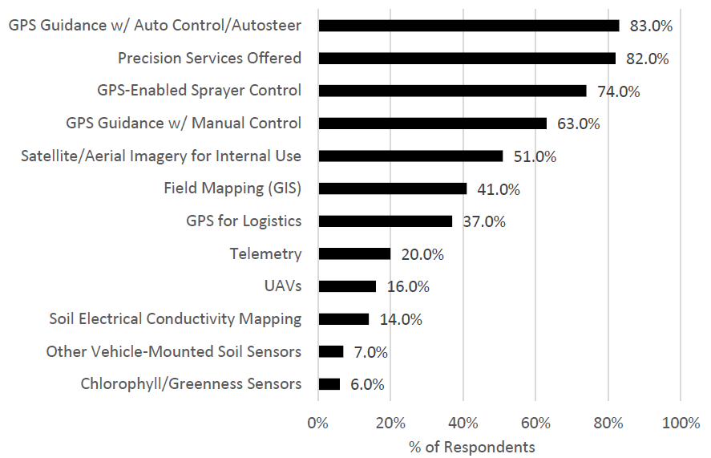

Precision Agriculture Adoption
Introduction
261 dealers in 2015
Erickson and Widmar, 2015

Slide 3
Low adoption of canopy sensors
Introduction
261 dealers in 2015
Erickson and Widmar, 2015

Slide 4
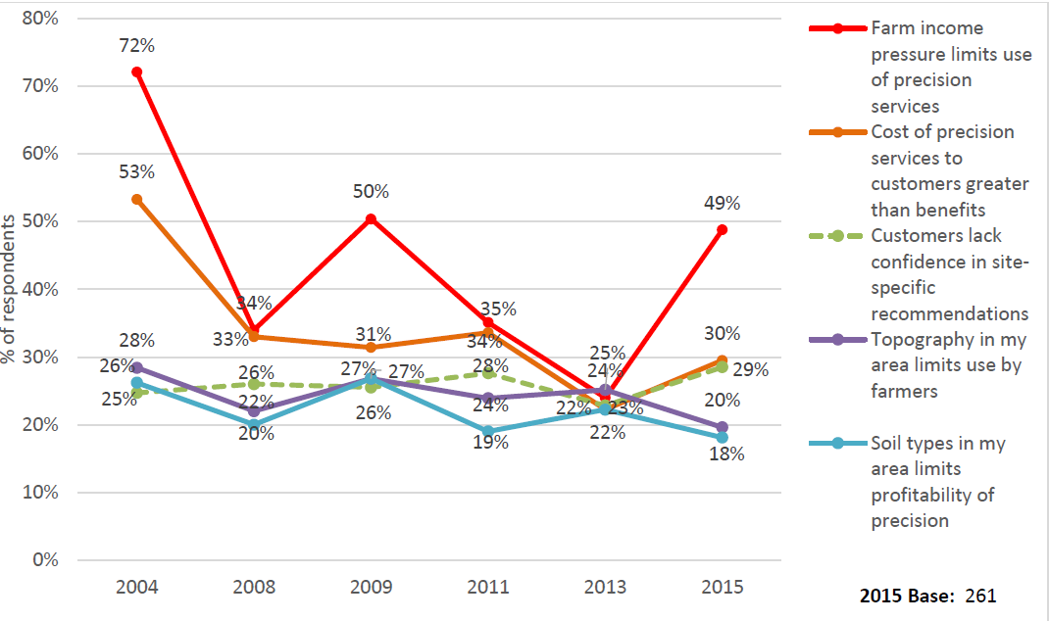
Barriers to adoption
Introduction
40%
30%

Slide 5
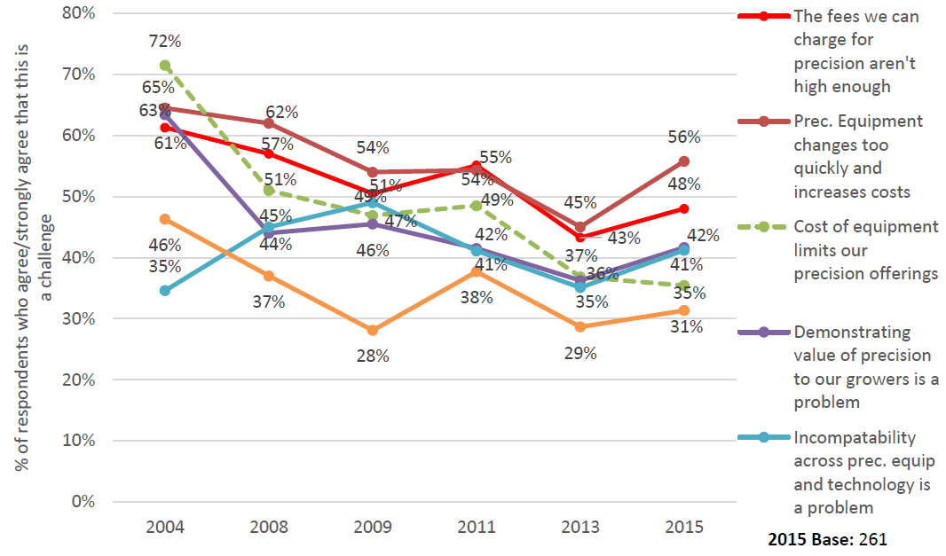
Barriers to adoption
Introduction
42%

Slide 6
Other barriers to canopy sensors
Introduction
High startup costs
Few opportunities to test technologies without large investment
Sequential adoption (one-technology-at-a-time)
Low government support / incentives
Too many algorithms
Do not increase return to N in every field
Project SENSE in Nebraska
Project SENSE in Nebraska
PA roundtable
Adjustments and regional evaluations
Targeting / Demo
Sharf et al., 2011; Franzen et al., 2016;
Schimmelpfennig and Ebel, 2016

Slide 7
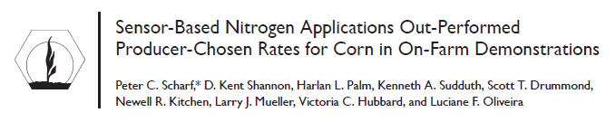
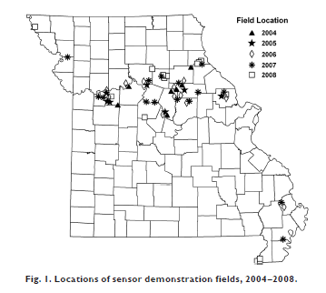
Evaluation of sensor performance
Introduction
55 fields

Slide 8
Overall sensors outperform producer rates
Introduction
MEAN = $43 ha⁻¹
Difference in return to N ($ ha⁻¹)

Slide 9
But, benefit is variable
Introduction
1/5
Much benefit
1/3
No benefit
Difference in return to N ($ ha⁻¹)

Slide 10
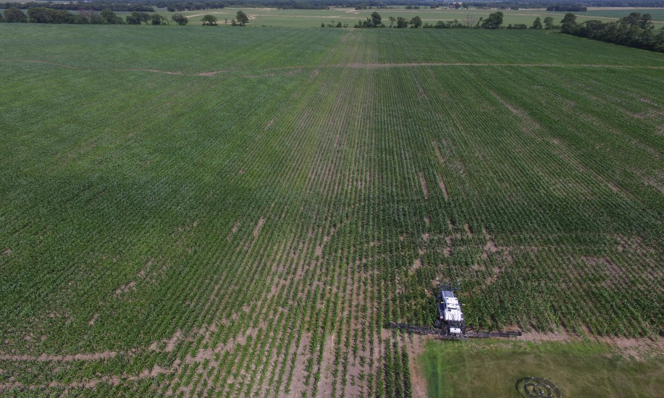
Which fields need precision N the most?
Introduction

Slide 11
Which fields need precision N the most?
Introduction
Those with the most variation in N supply, and the most vulnerable to N loss

Slide 12
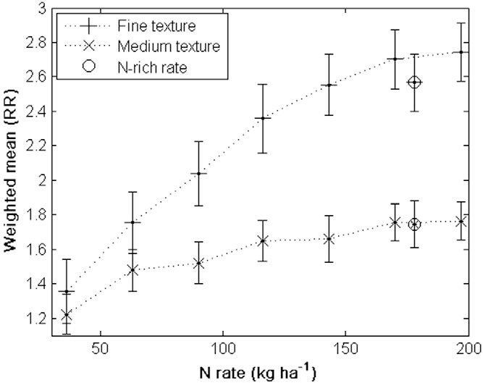
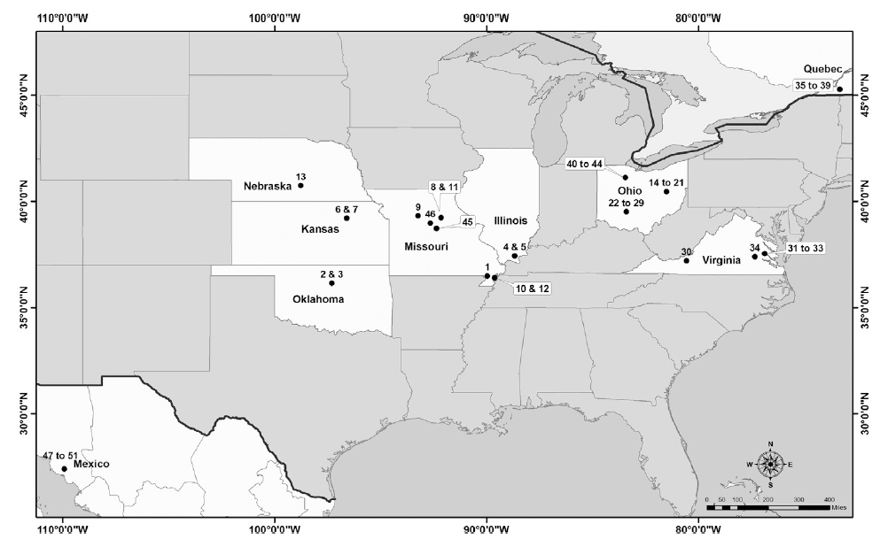
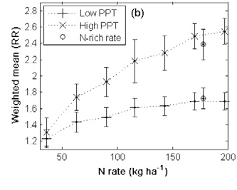
What influences soil N supply?
Introduction
SOIL TEXTURE
PRECIPITATION
Tremblay et al., 2012

Slide 13
Objective
Methods
Use public data to create an index for identifying fields or clusters of fields that need precise N management the most:
Fields with the most variation in soil texture, organic matter, and precipitation

Slide 14
Outline
Methods
Topsoil and profile clay and OM indices
Clustering of soil indices
Post hoc validation of soil indices
Precipitation index
Clustering of precipitation index
Combined soil and precipitation index

Slide 15
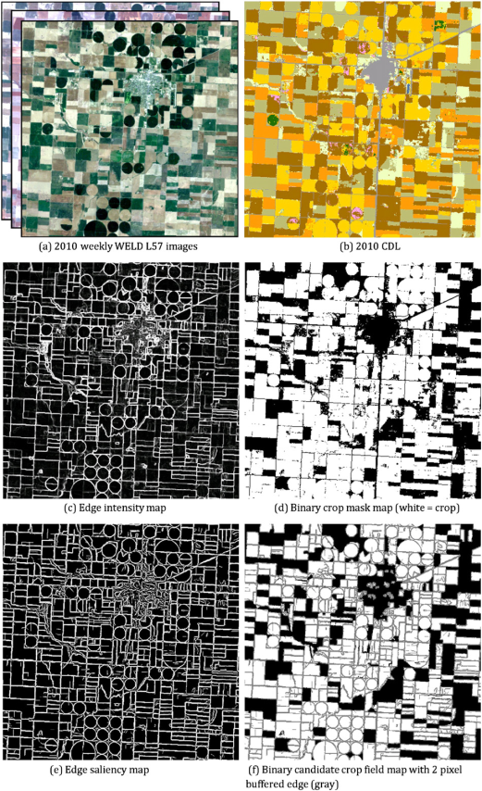
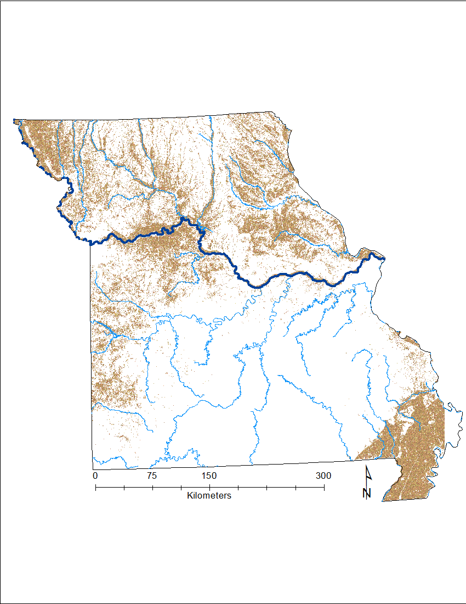
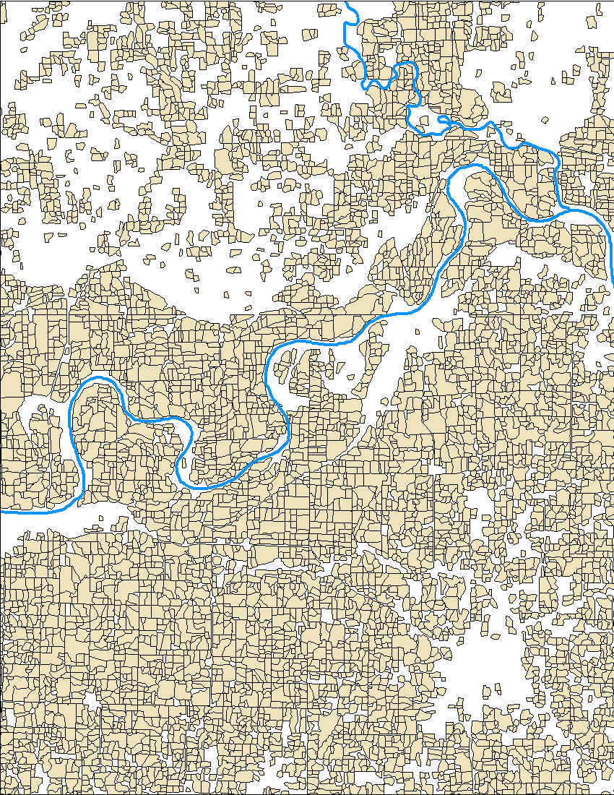
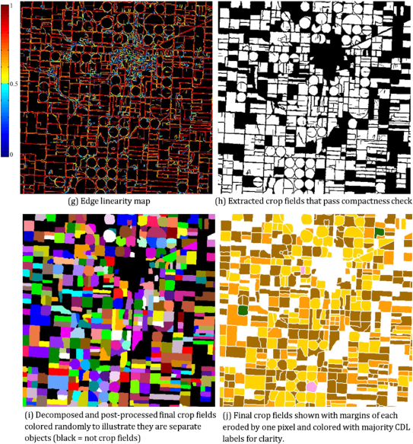
Field boundaries – Missouri as pilot
Methods
> 5 ha
N = 176,000 fields
  Yan, L., & Roy, D. P. (2016)

Slide 16
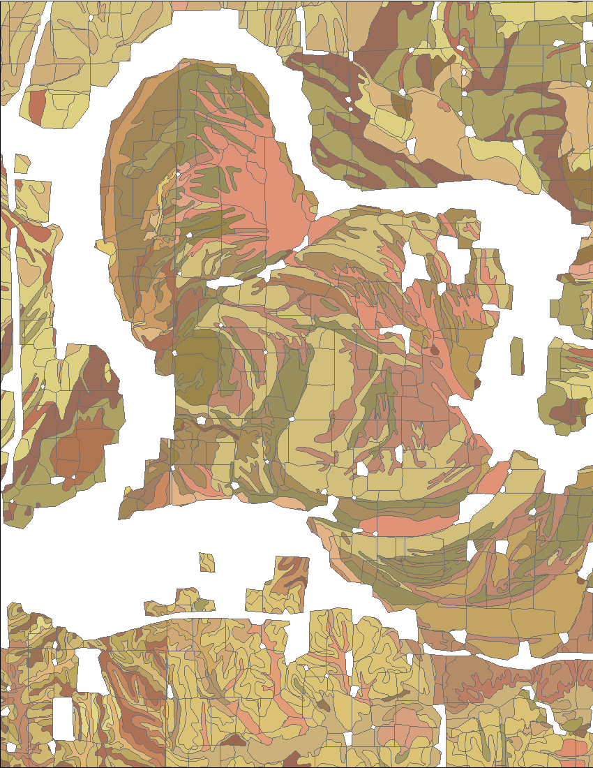
Soil data
Methods
SSURGO dataset
  Soil parameters
    Clay content
    OM content
  Depth increments
    0 – 30 cm
    0 – 60 cm
    0 – 90 cm
    0 – 120 cm

Slide 17
Soil data
Methods
SSURGO dataset
  Soil parameters
    Clay content
    OM content
  Depth increments
    0 – 30 cm (topsoil)
    0 – 60 cm
    0 – 90 cm
    0 – 120 cm (Profile)

Slide 18
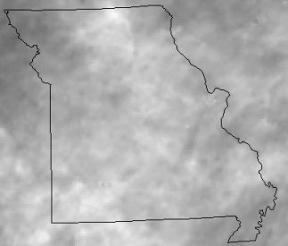
Weather data
Methods
  2006
  2007
  2008
PRISM climate data
  Annual total precipitation
  4 km
  2009
  2010
  2011
  2012
  2013
  2014
  2015

Slide 19
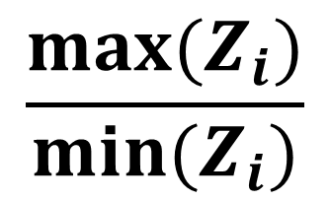
Calculating variability indices
Methods
Field boundaries
Clay and OM content
Precipitation
Soil / precipitation Variability index (VI) =
$$\frac{{max⁡(Z}_{i})}{{min⁡(Z}_{i})}$$

Slide 20
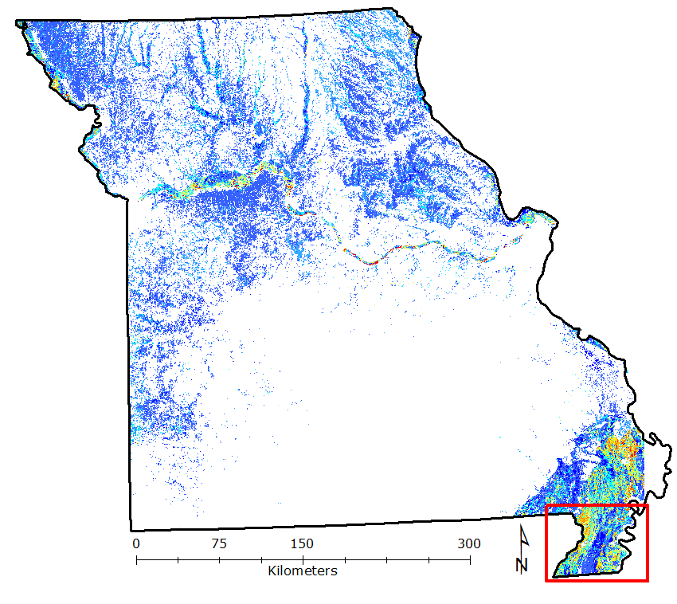
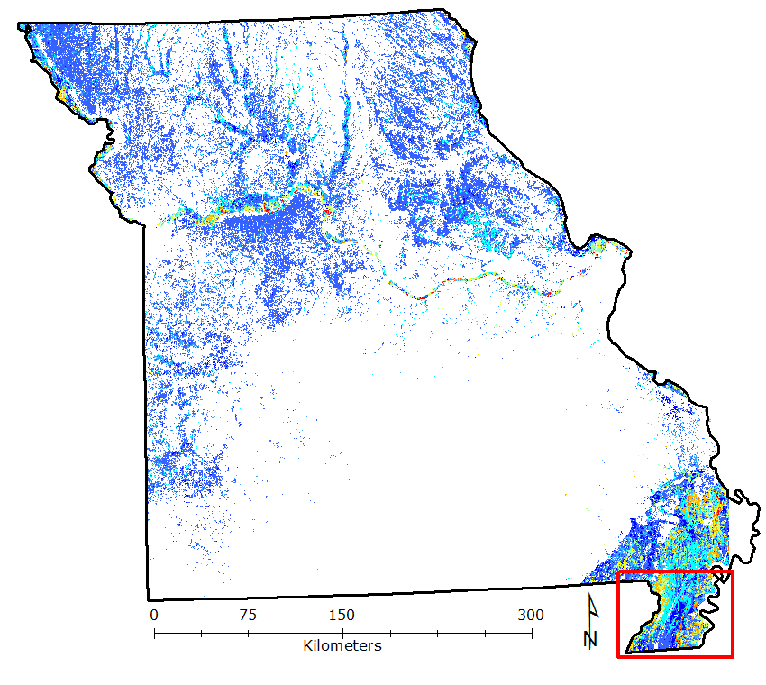
Soil variability index (Clay)
Results
0-30 cm
0-120 cm

Slide 21
Soil variability index (Clay)
Results
0-30 cm
0-120 cm

Slide 22
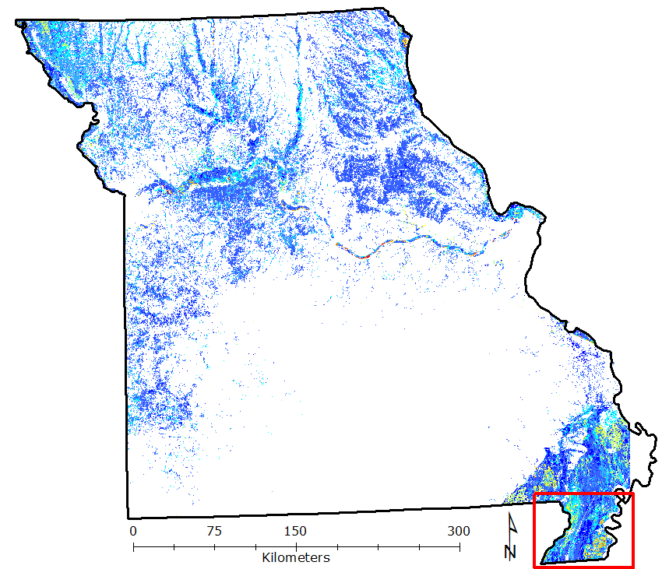
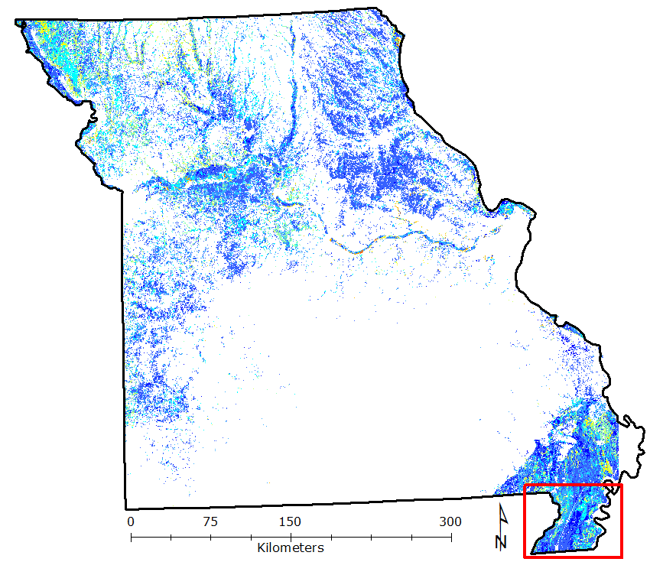
Soil variability index (Organic matter)
Results
0-30 cm
0-120 cm

Slide 23
Soil variability index (Organic matter)
Results
0-30 cm
0-120 cm

Slide 24
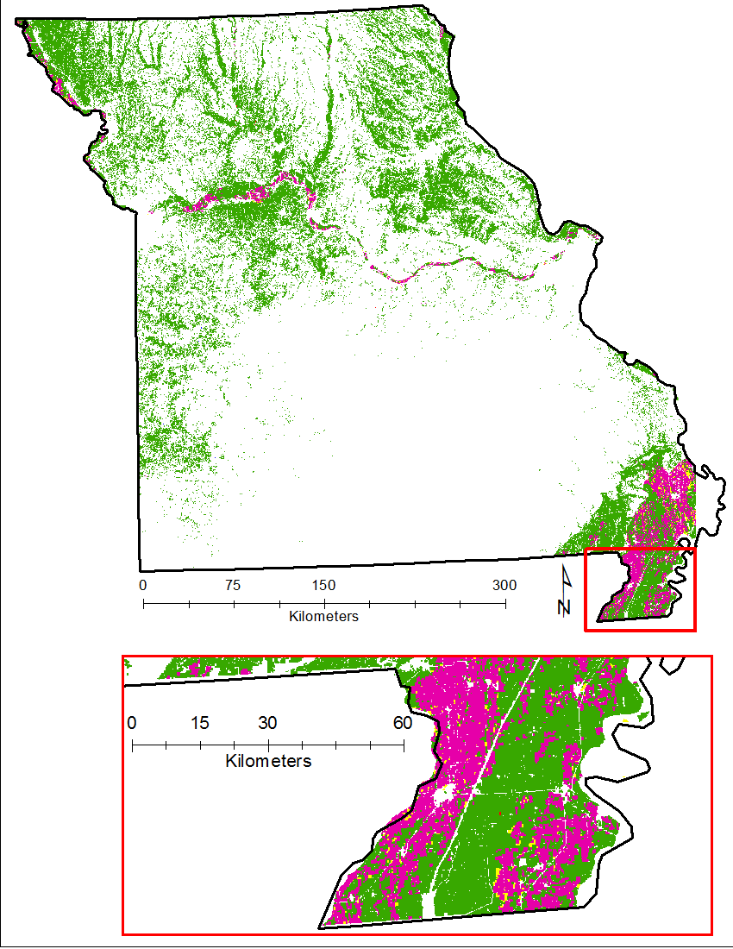
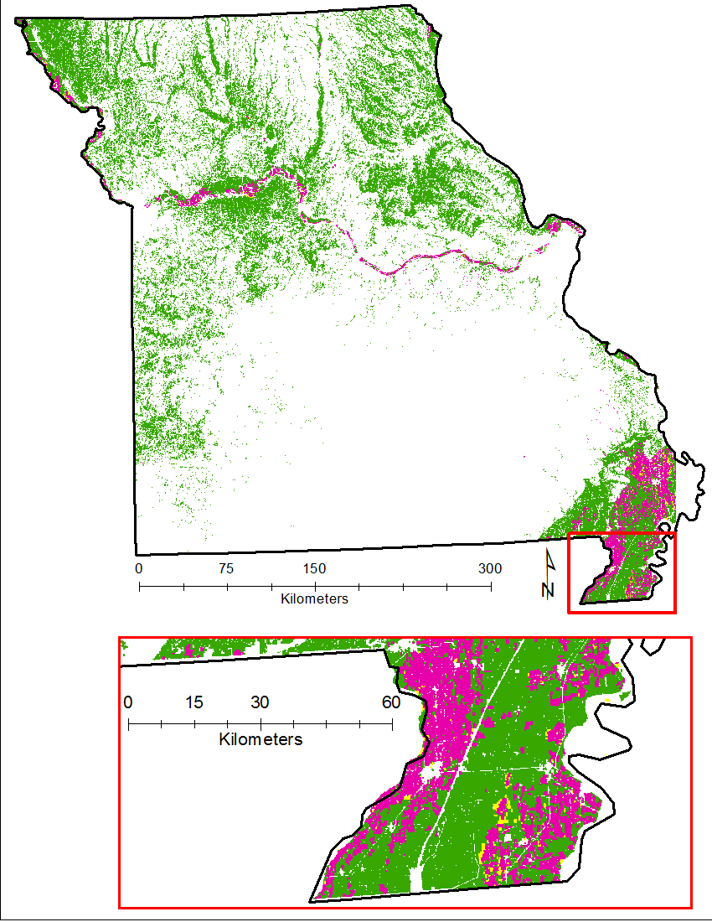
Index Clustering (Clay)
Results
0-30 cm
Not Significant
0-120 cm
High-High
High-Low
Anselin Local Moran’s I cluster and outlier analysis
Low-High
Low-Low

Slide 25
Index Clustering (Clay)
Results
0-30 cm
0-120 cm
Not Significant
High-High
High-Low
Low-High
Low-Low

Slide 26
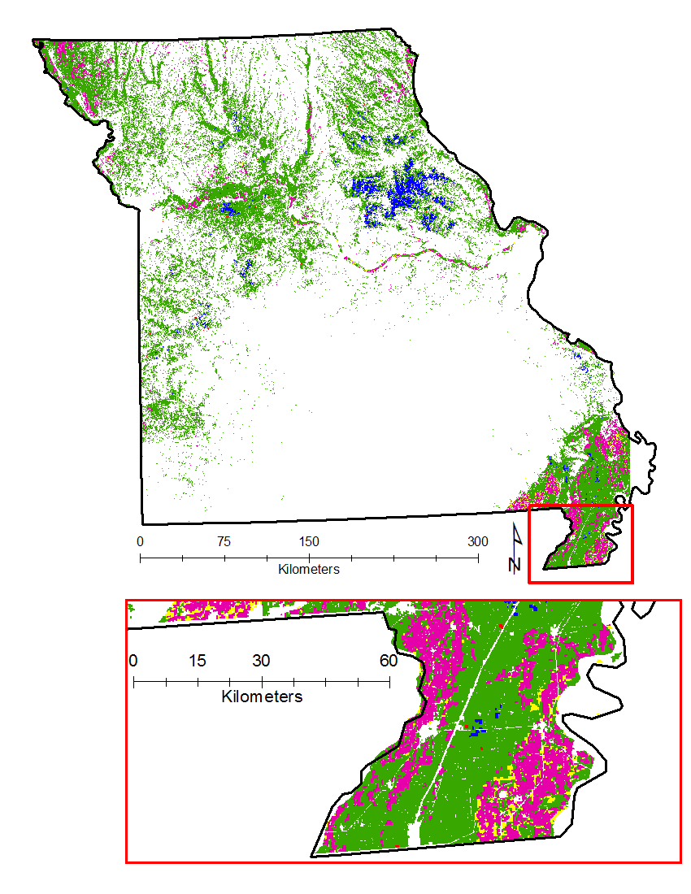
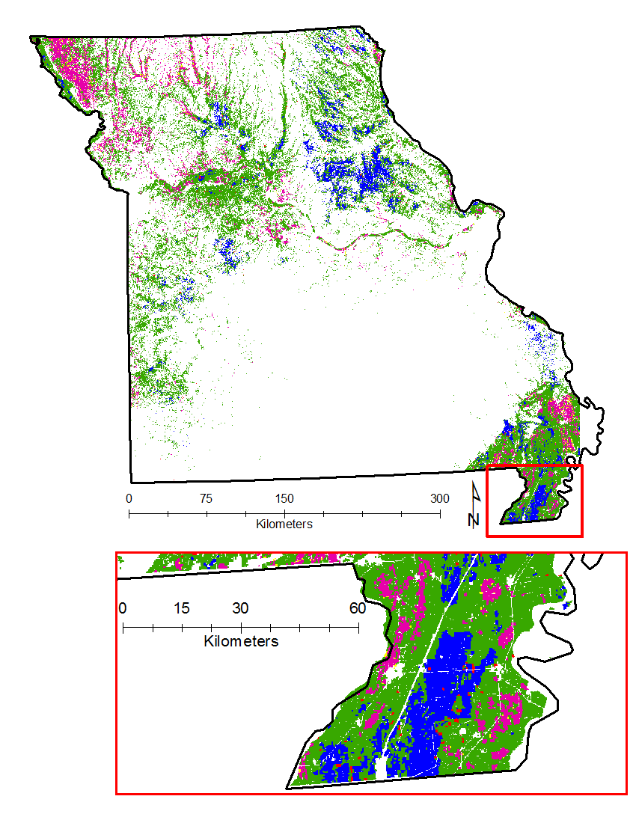
Index Clustering (Organic Matter)
Results
0-30 cm
Not Significant
0-120 cm
High-High
High-Low
Low-High
Low-Low

Slide 27
Index Clustering (Organic Matter)
Results
0-30 cm
0-120 cm
Not Significant
High-High
High-Low
Low-High
Low-Low

Slide 28
Soil variability patterns
Discussion
Similarities in variability
  Expansive distribution with minimal variation
Greatest diversity of VI values found along major river systems
  VI values delineated well by MLRA:
    Deep Loess Hills of NE MO
    Central Mississippi Valley Wooded Slope
    Mississippi River Alluvium

Slide 29
Soil variability patterns
Discussion
Majority of clustering was High-High
More Low-Low clustering with organic matter
  Most extreme case in claypan region
    Possibly due to variable topsoil depth above claypan
Clay
Organic matter
Low to Low
Clustering
High to High
Clustering

Slide 30
Soil variability validation
Results
45 fields
Scharf et al. 2011
Notes:
Its difficult to validate whether these indicies might work… or which is most related to potential variation.
For an initial evaluation, we examined the relationship between the soil variability indices and partial profits from using canopy sensors in 55 fields across Missouri from Scharf et al., 2011.

Slide 31
Precipitation variability
Results
Index
Index clustering

Slide 32
Clay + OM + precipitation variability
Results
Index
Index clustering

Slide 33
Clay + OM + precipitation variability
Results

Slide 34
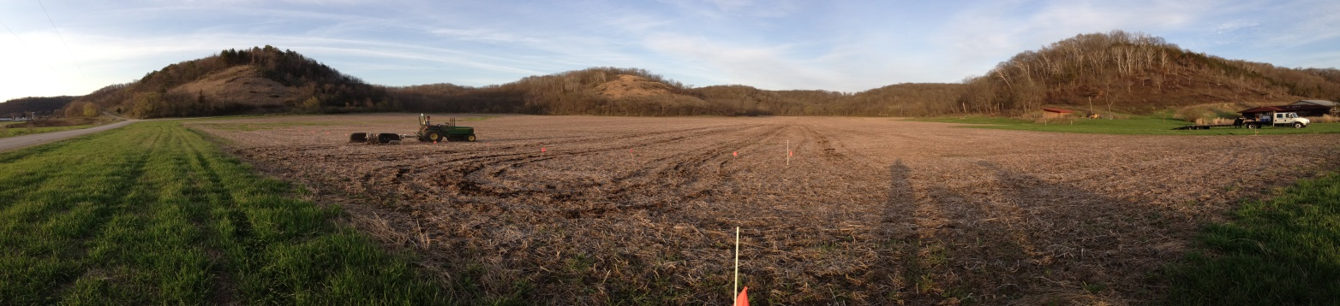
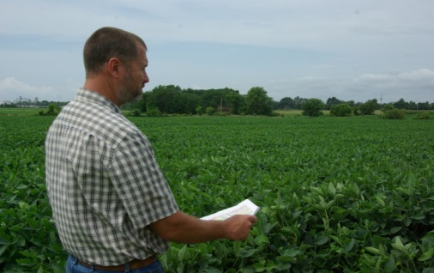
Summary and next steps
Conclusion
Combined soil and precipitation indices may help target precision N management (sensors, models, etc.)
Further validation is needed to determine whether indices relate to return to N
Vulnerability layers (runoff and leaching potential) need to be added to further target
Same approach could be used with more precise private soil and weather data
Notes:
allows individual producers to assemble a package of technologies specifically tailored to their operation
soils with greater variability tend to be more responsive to precision farming practices.
Most soils that are fairly homogeneous often reflect conservative estimates of monetary gains from using precision farming technology.
Fields generally exhibit yield variability; however, not all fields warrant VRT from an economic standpoint.
What researchers can do, however, is provide agribusiness firms, extension personnel, and farmers with a consistent means for evaluating this decision based on braod scale maps exhibiting groupings of soil variability.
What characteristics of clay affect NUE?

Slide 35
Acknowledgements
Thank you
  Chris Bobryk and Newell Kitchen
    USDA – Agricultural Research Service
  Peter Scharf
    University of Missouri
  Lin Yan and David Roy
    Geospatial Sciences Center of Excellence, South Dakota State University
  QUESTIONS?

Slide 36
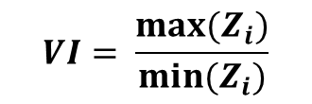
Processes
Methods
Field
Boundaries
Geostatistical
Clustering
Difference calculations
Anselin Local Moran’s I cluster and outlier analysis
Convert Data to polygons
2nd Dataset
Intersect with SSURGO
Aggregation of VI
SSURGO
$$VI= \frac{{max⁡(Z}_{i})}{{min⁡(Z}_{i})}$$
1st
Dataset
Depth/Area Weighting
Soil Property Extraction
ESRI ArcGIS
R Stats

