Slide 1
Dr. Barbara Stoecker International Nutrition and World Hunger NSCI 5553 326 Human Sciences 4:30 – 6:20 April 8, 2014 http://nue.okstate.edu/Hand_Planter.htm

Slide 2
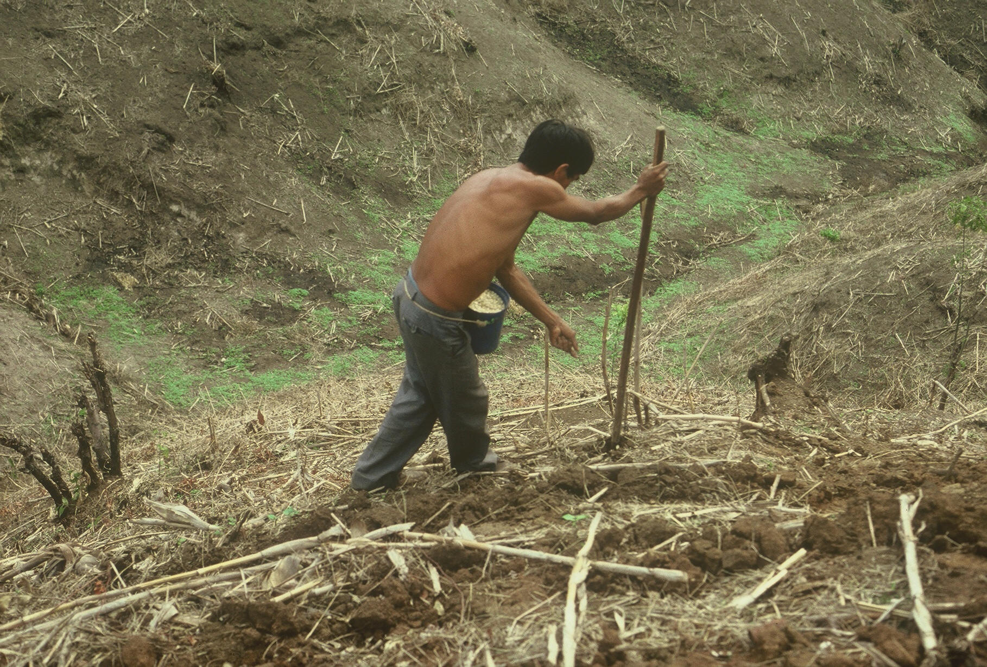

Slide 3
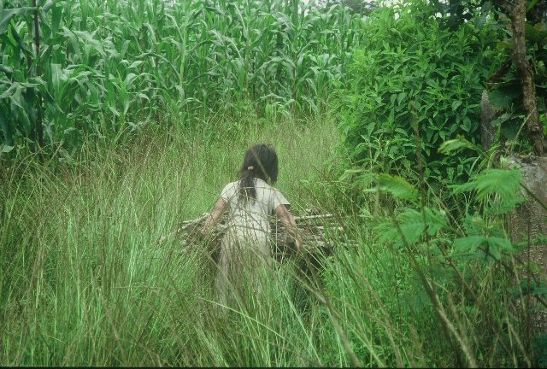
Care

Slide 4
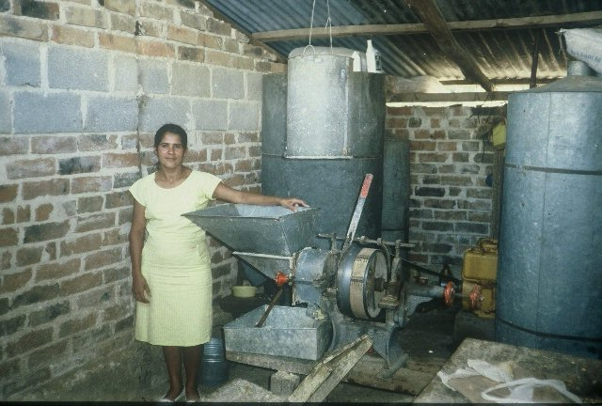
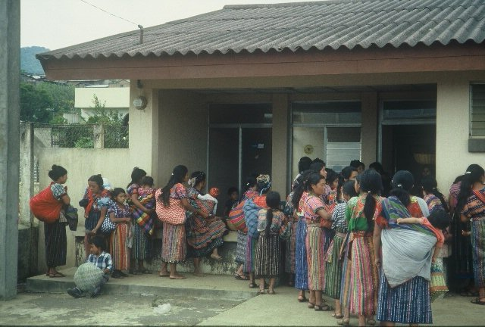

Slide 5
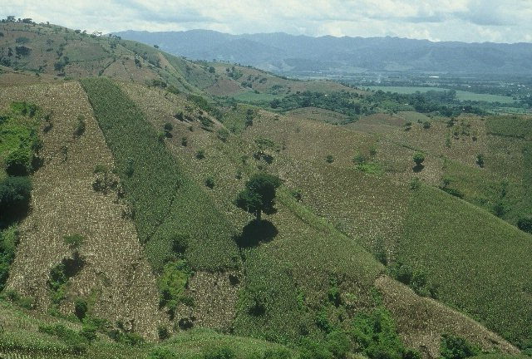
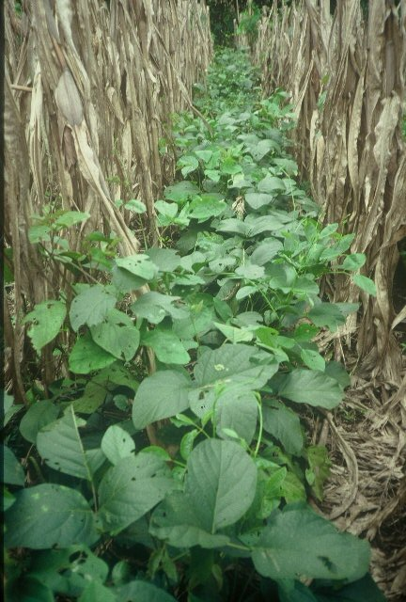
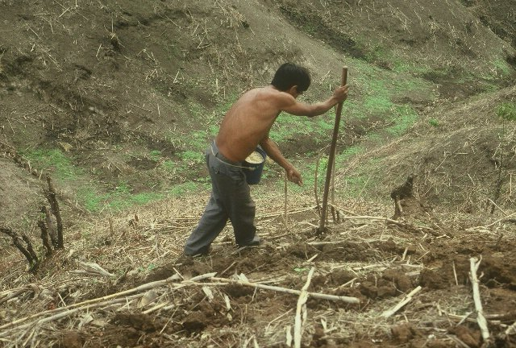

Slide 6
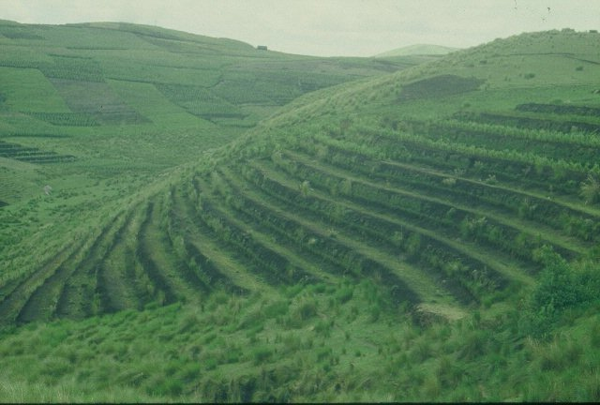

Slide 7
Picture
Importance of photo journalism
Incorporating images/experience
Communication

Slide 8
World Maize
177,000,000 ha’s in 2012 (FAOstat)
872,000,000 Mg, produced, 4.9 Mg/ha
48,370,000 ha’s in the developing world
60% planted by hand ≈ 29,000,000 hectares or 16% of the total maize area in the world

Slide 9
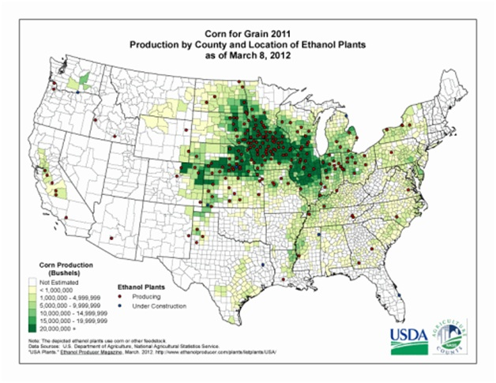
35,000,000 ha’s maize USA (86,000,000 acres corn USA)

Slide 10
World Maize Production
Global Biogeochemical Cycles 22: GB1022. doi:10.1029/2007GB002947

Slide 11
2012, Maize Statistics
 | Area, ha’s |  | Production, Mg
World | 177,000,000 |  | 872,066,770
USA | 35,359,790 | 19% | 273,832,130 | 31%
China | 34,966,000 | 19% | 208,234,649 | 24%
Developing (DW) | 48,370,000 | 27% | 97,000,000 | 11%
by hand (60% of DW total) | 29,000,000 | 16% | 58,000,000 | 6%

Slide 12
Corn Growers Association

Slide 14
Hand Planter Need
Methods which homogenize maize plant stands and emergence can decrease plant-to-plant variation and increase grain yields (Martin et al., 2005)
Maize emergence delayed by as little as four days, resulted in a yield depression of 15 percent (Hodgen et al., 2007)
Third world maize yields hover near 2.0 Mg/ha (Dowswell, et al., 1996)
“OSU Hand Planter”

Slide 15
http://nue.okstate.edu/Hand_Planter.htm

Slide 16
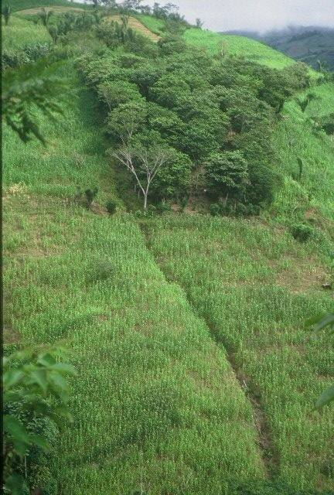
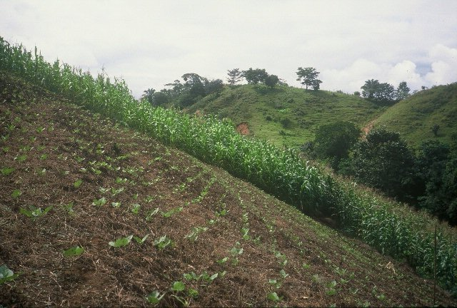
Honduras

Slide 17
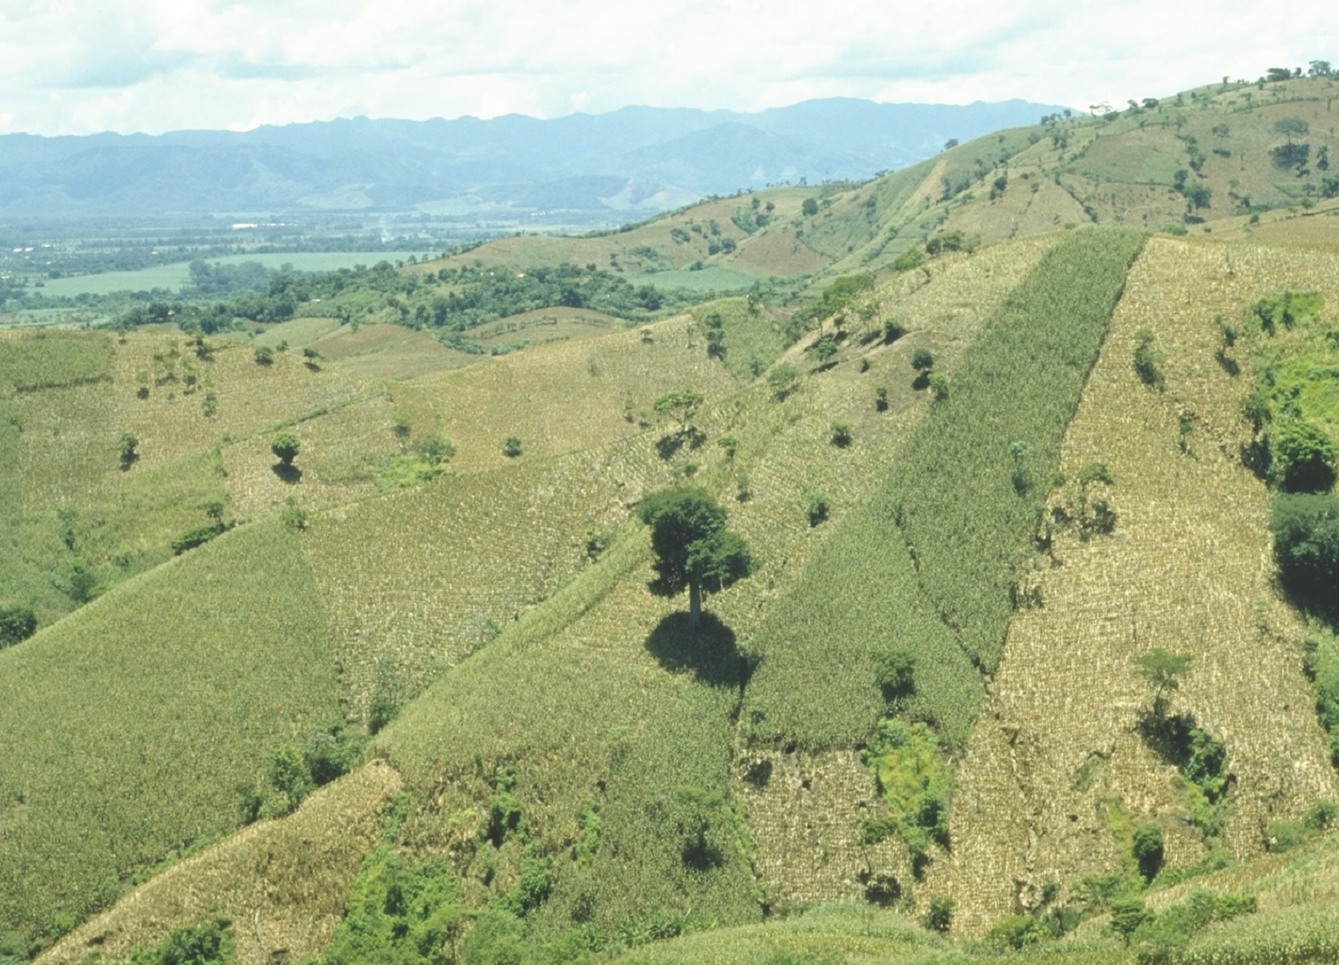
Opico Quezaltepeque, El Salvador

Slide 18
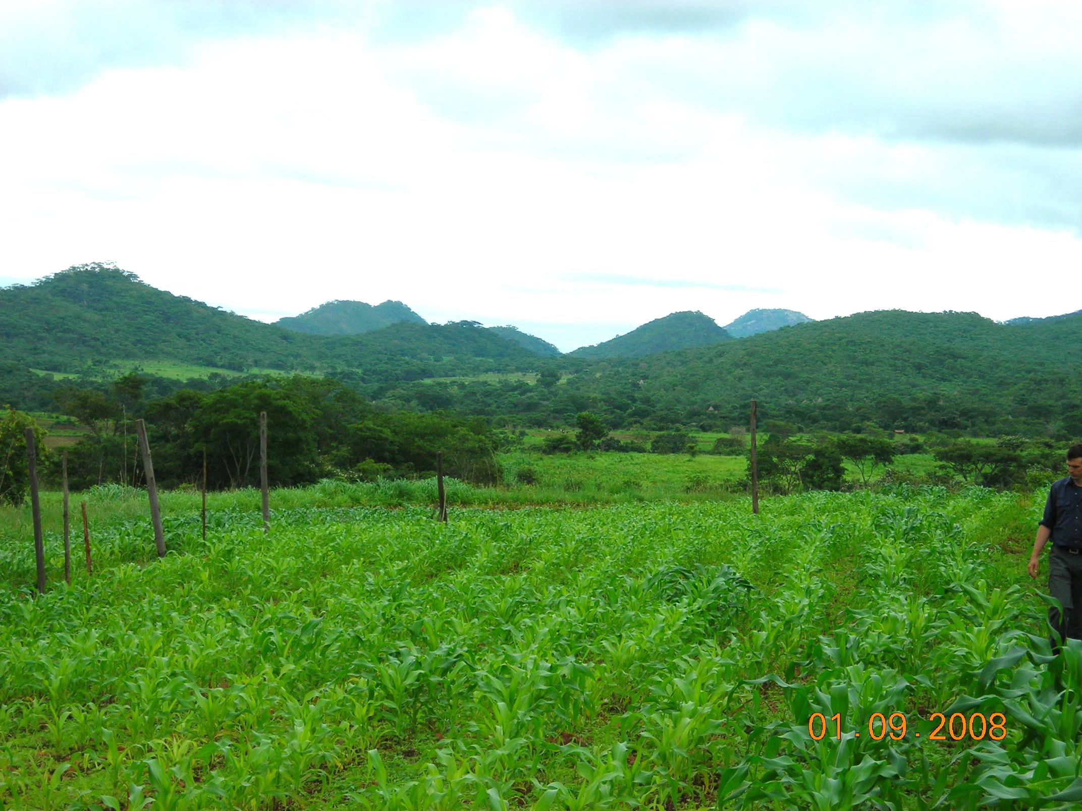
Zimbabwe

Slide 19
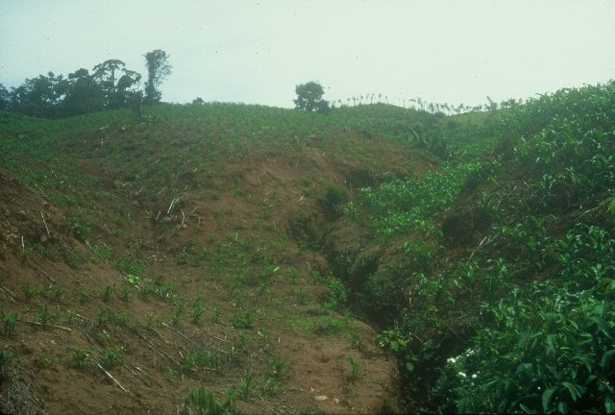
Dominican Republic

Slide 20
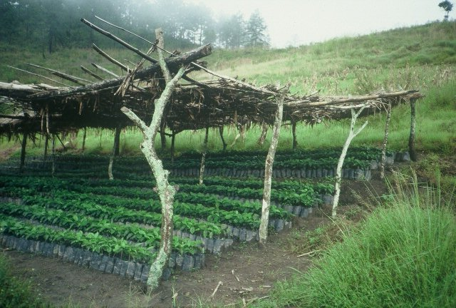
Alternatives

Slide 21
Bangladesh
Burundi
Belize
Brazil
Colombia
El Salvador
Ethiopia
Guatemala
India
Kenya
Malawi
http://nue.okstate.edu/Hand_Planter/osu_hand_planter_workshop.html
Mexico
Mozambique
Sierra Leone
Nepal
Philippines
Tanzania
Togo
Uganda
USA
Zambia
Zimbabwe

Slide 22
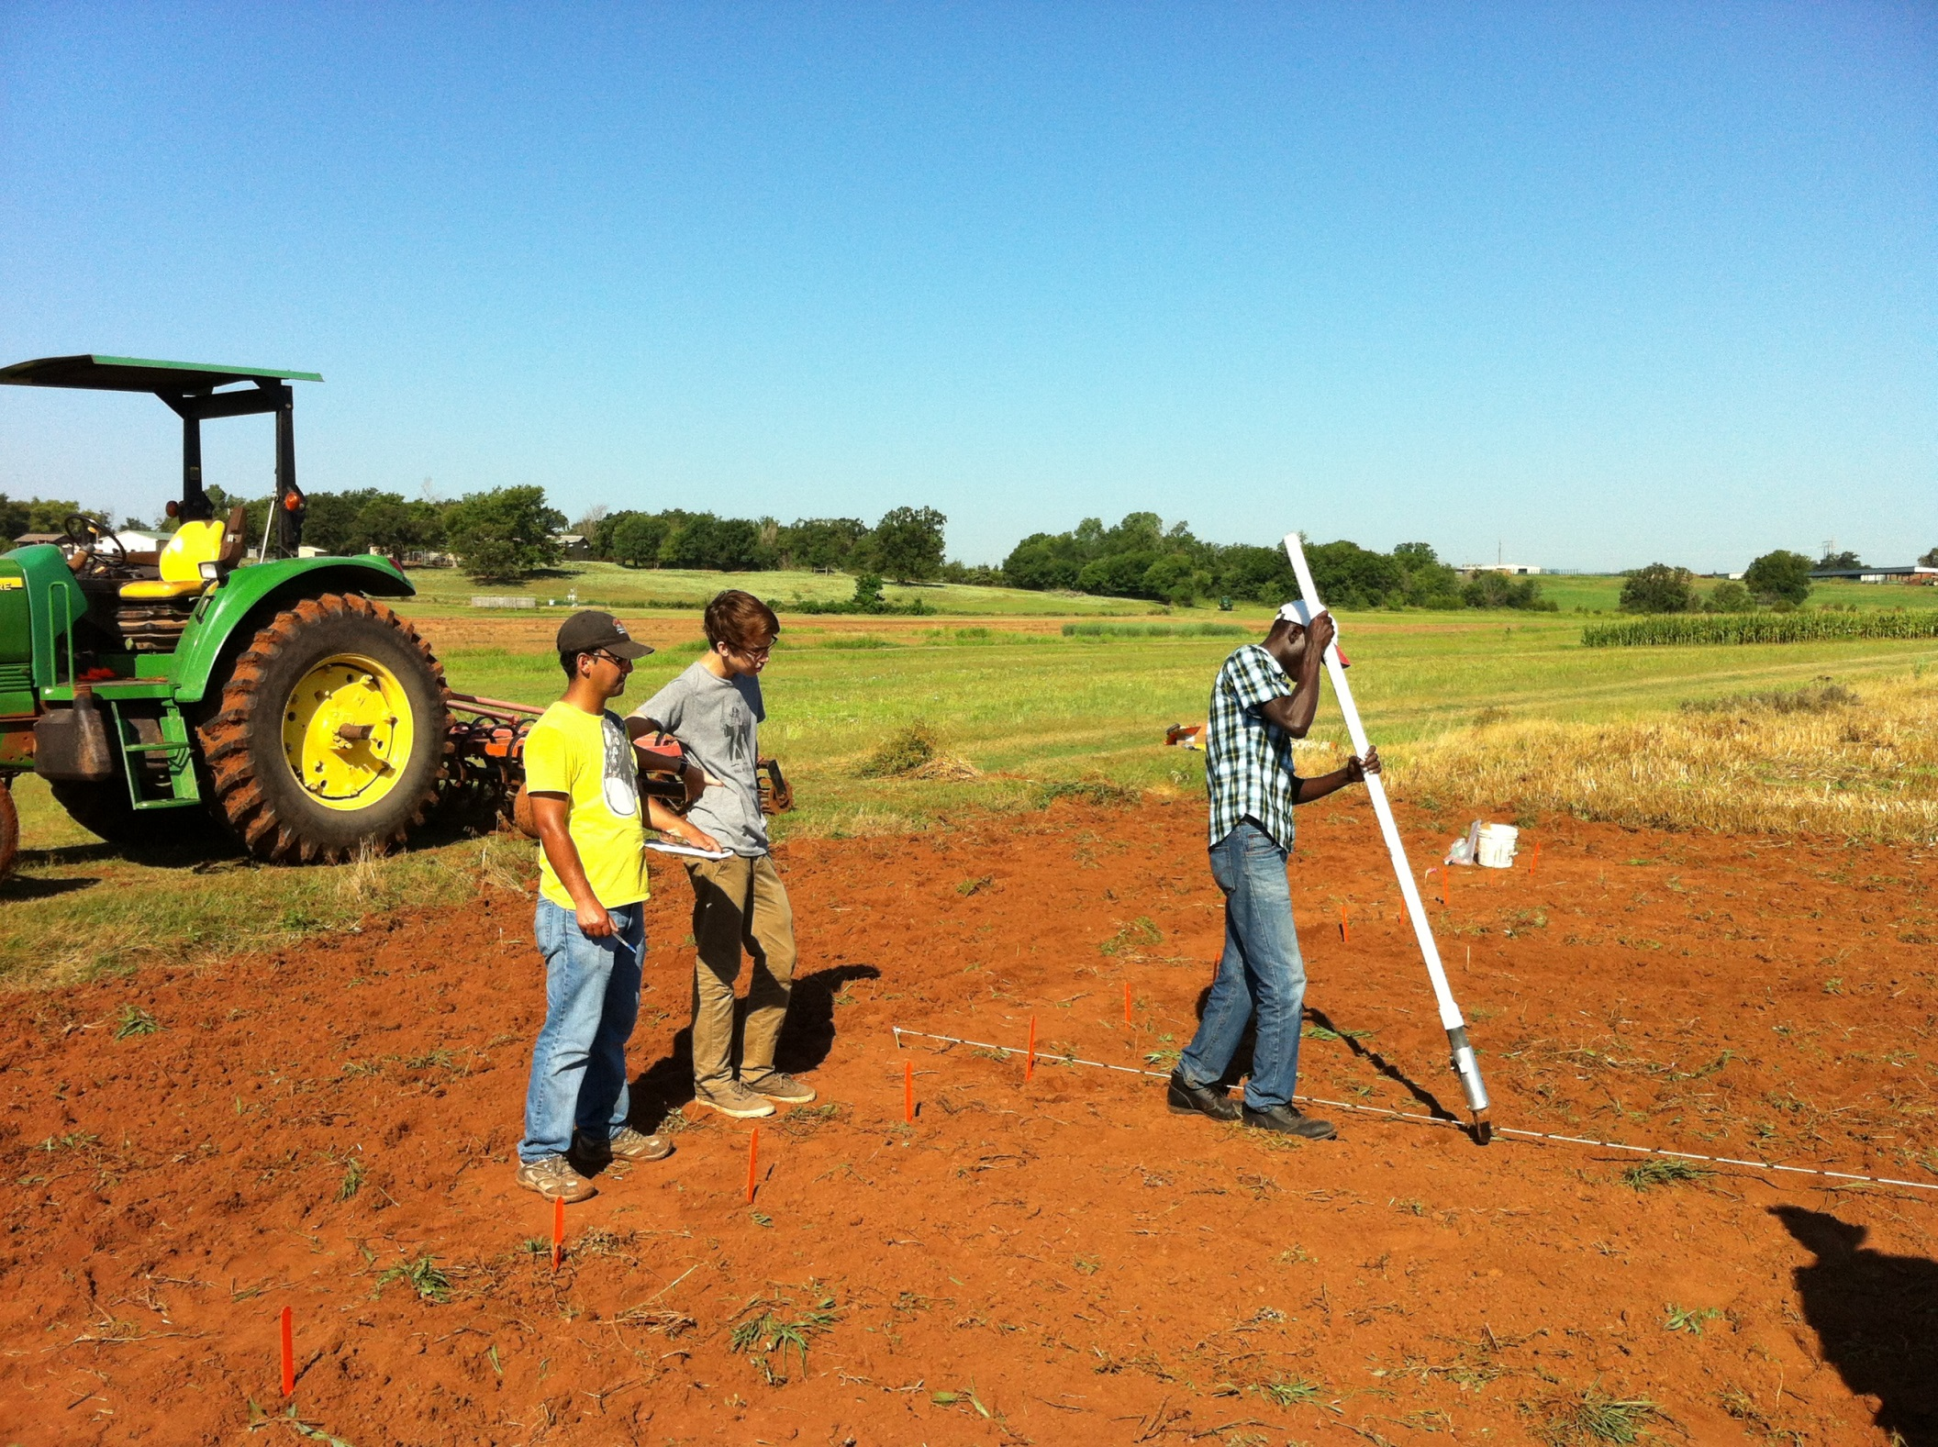
http://nue.okstate.edu/Hand_Planter.htm

Slide 23
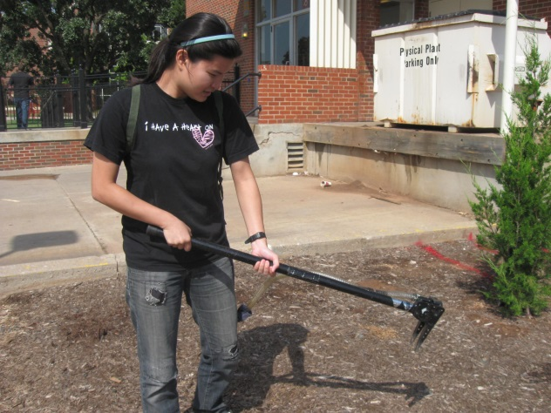
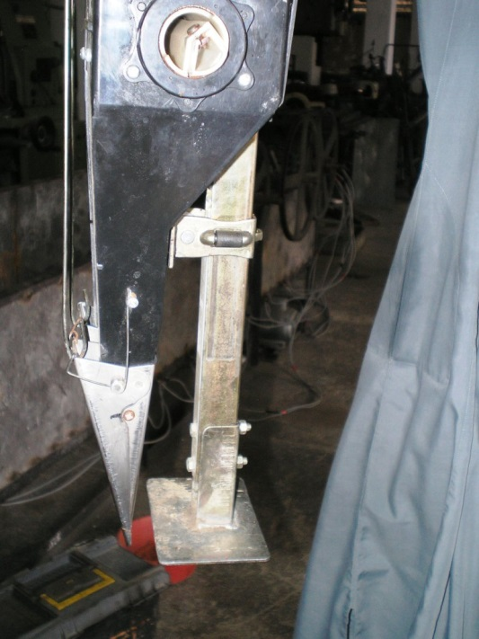
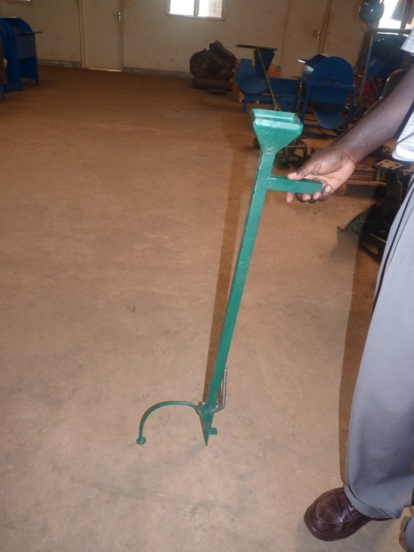
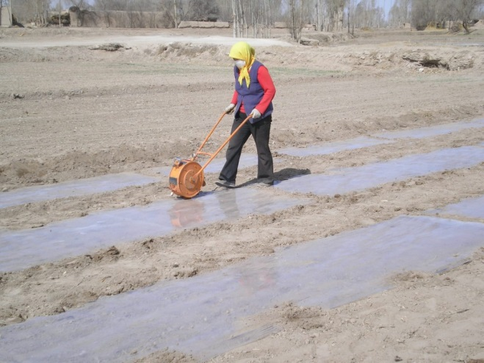
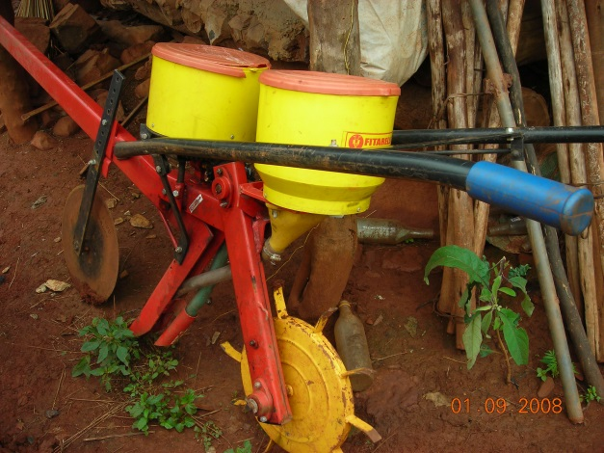
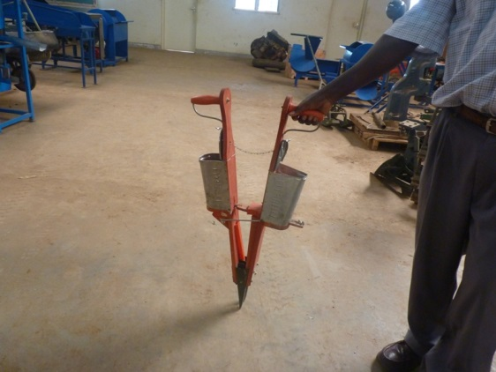
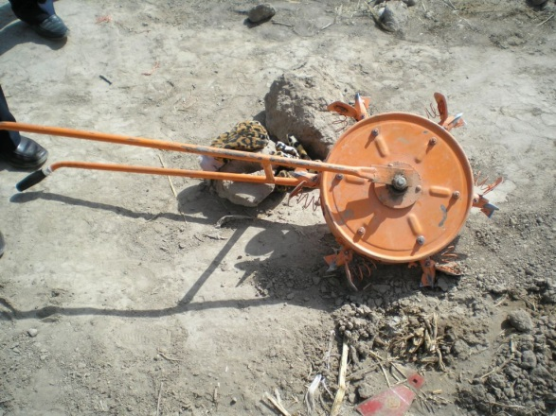

Slide 24
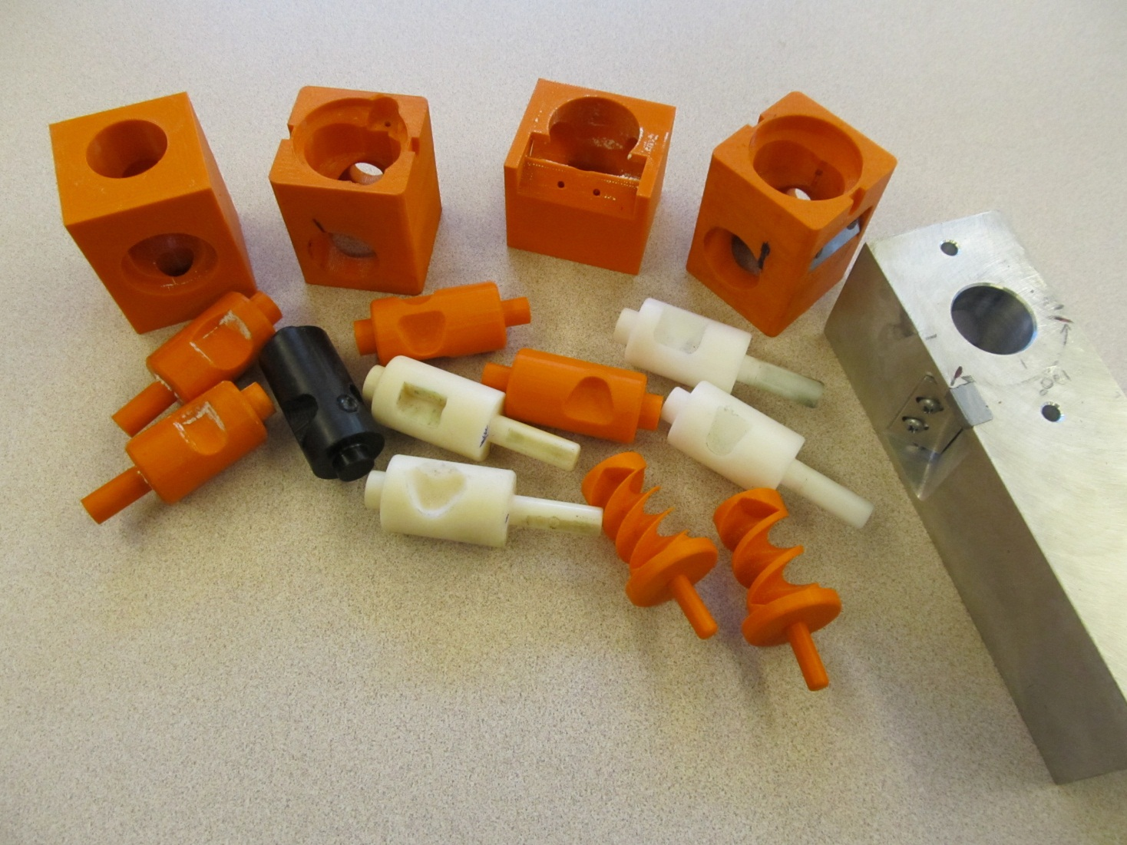
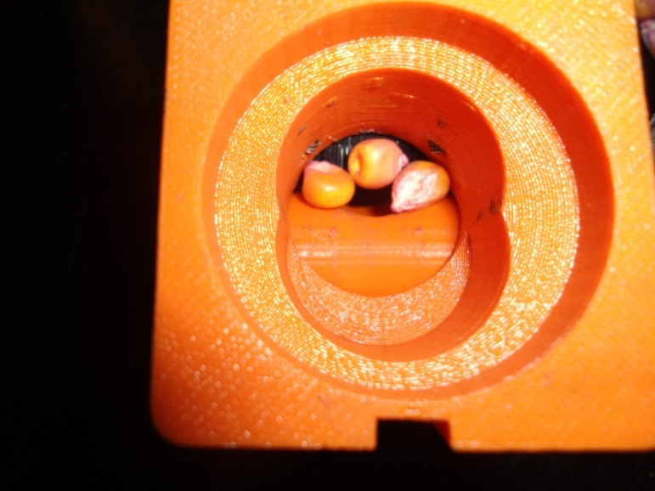
Singulation Design

Slide 25
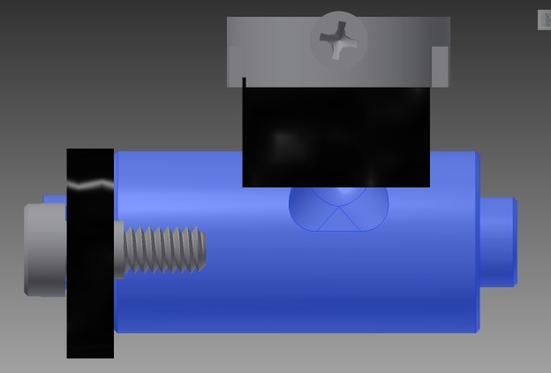
Reciprocating Drum Action
Drum rotates with the cavity moving back into the seed hopper as the spring is compressed.
Spring is fully compressed and the singulation drum cavity is exposed to seed in the hopper
Drum position when planter is relaxed.
As the force on the spring is released, the singulation drum rotates back to the initial ‘relaxed’ position and the seed is dropped.

Slide 26
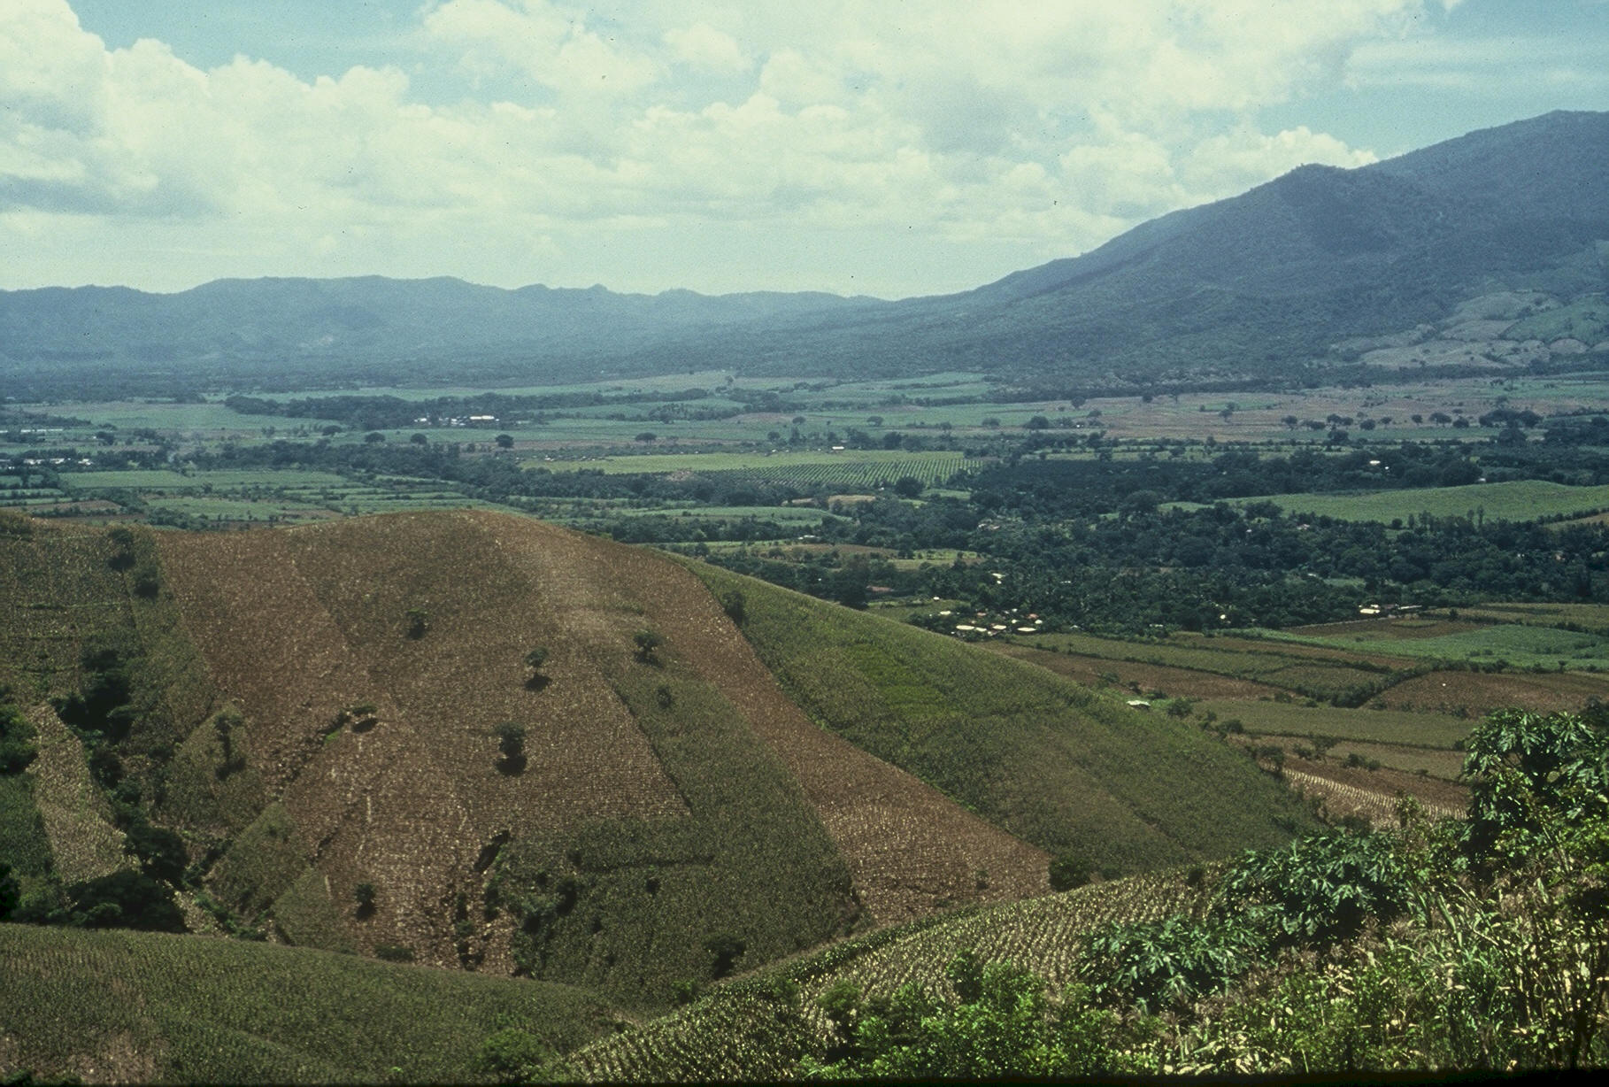
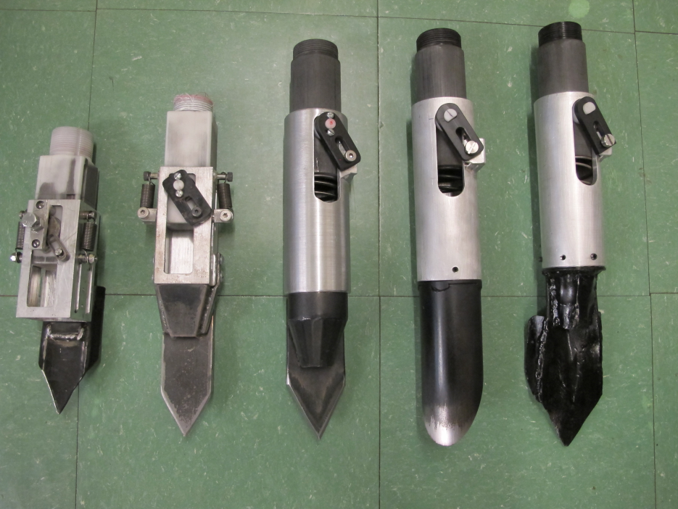

Slide 27
Planter Action
The planter is pressed down and compresses the internal spring.
Singulation drum rotates and seed is released on the down stroke.
The planter is ‘relaxed’ and the spring returns it to the initial position.

Slide 28
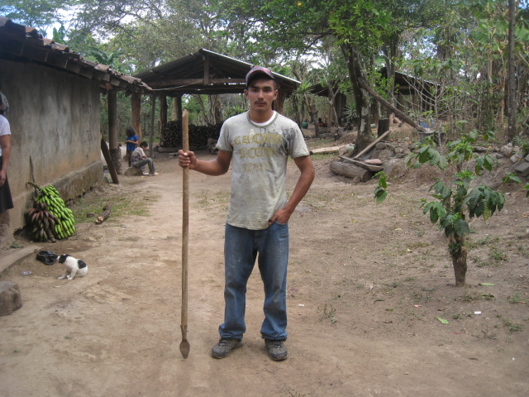
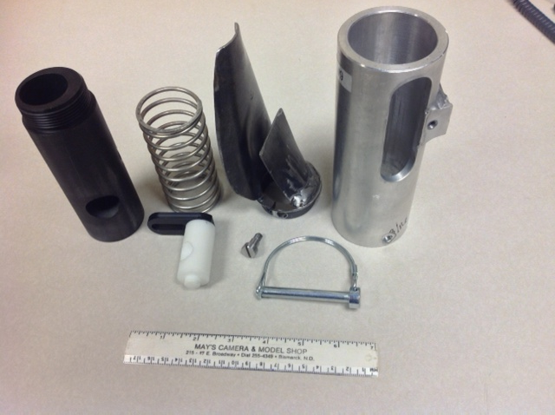
seed size (2653-4344 seeds/kg) seed type, shape
fertilizer
1,000,000 cycles
0.29g/seed
60,000 seeds/ha
3443 seeds/kg
1.0 kg hopper
17 times refill
http://nue.okstate.edu/Hand_Planter.htm

Slide 29
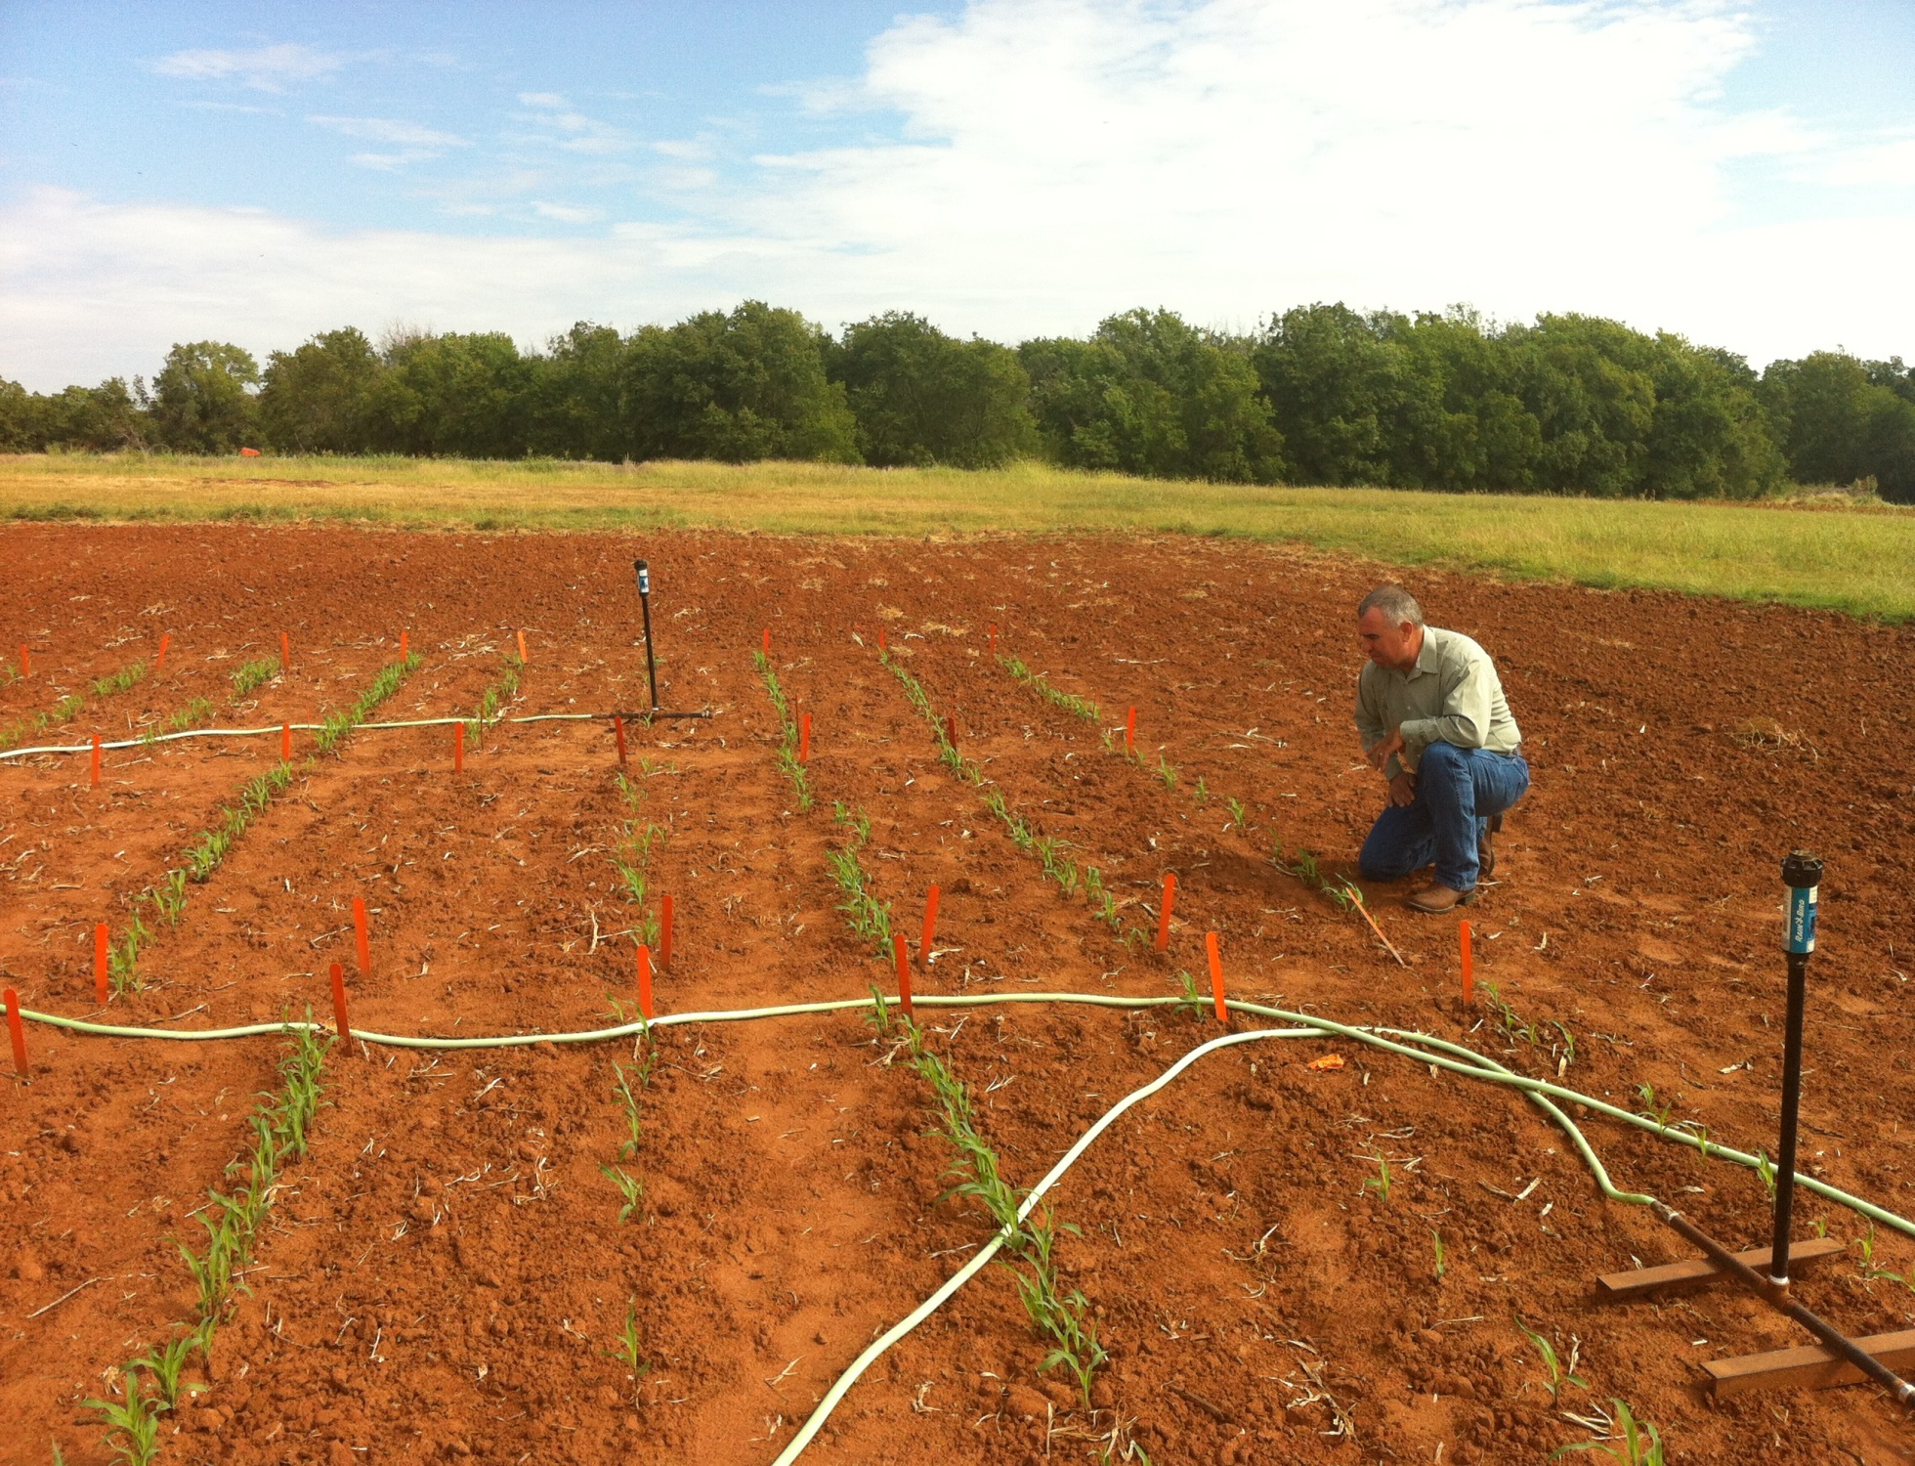
Dr. Randy Taylor
Dr. Nyle Wollenhaupt
1,000,000 cycles, no failures 1 hectare, 100,000 seeds/ha, 10 years

Slide 30
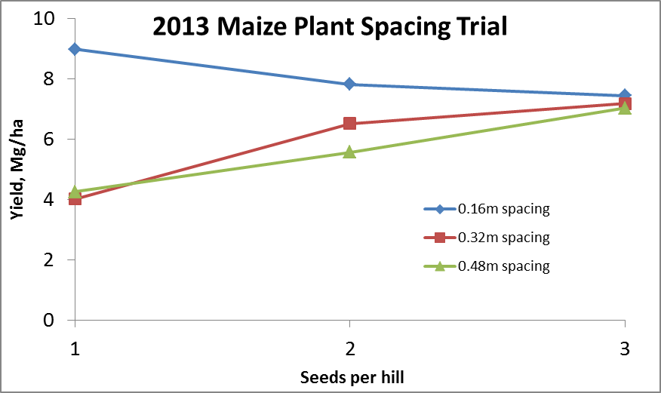
Importance of Singulation
0.76m Row Spacing
Heterogeneity in plant spacing, and plant stands reduce yields (1997, Nielsen, Purdue)

Slide 31
Nov 13, 2013
SED = 8.6

Slide 32
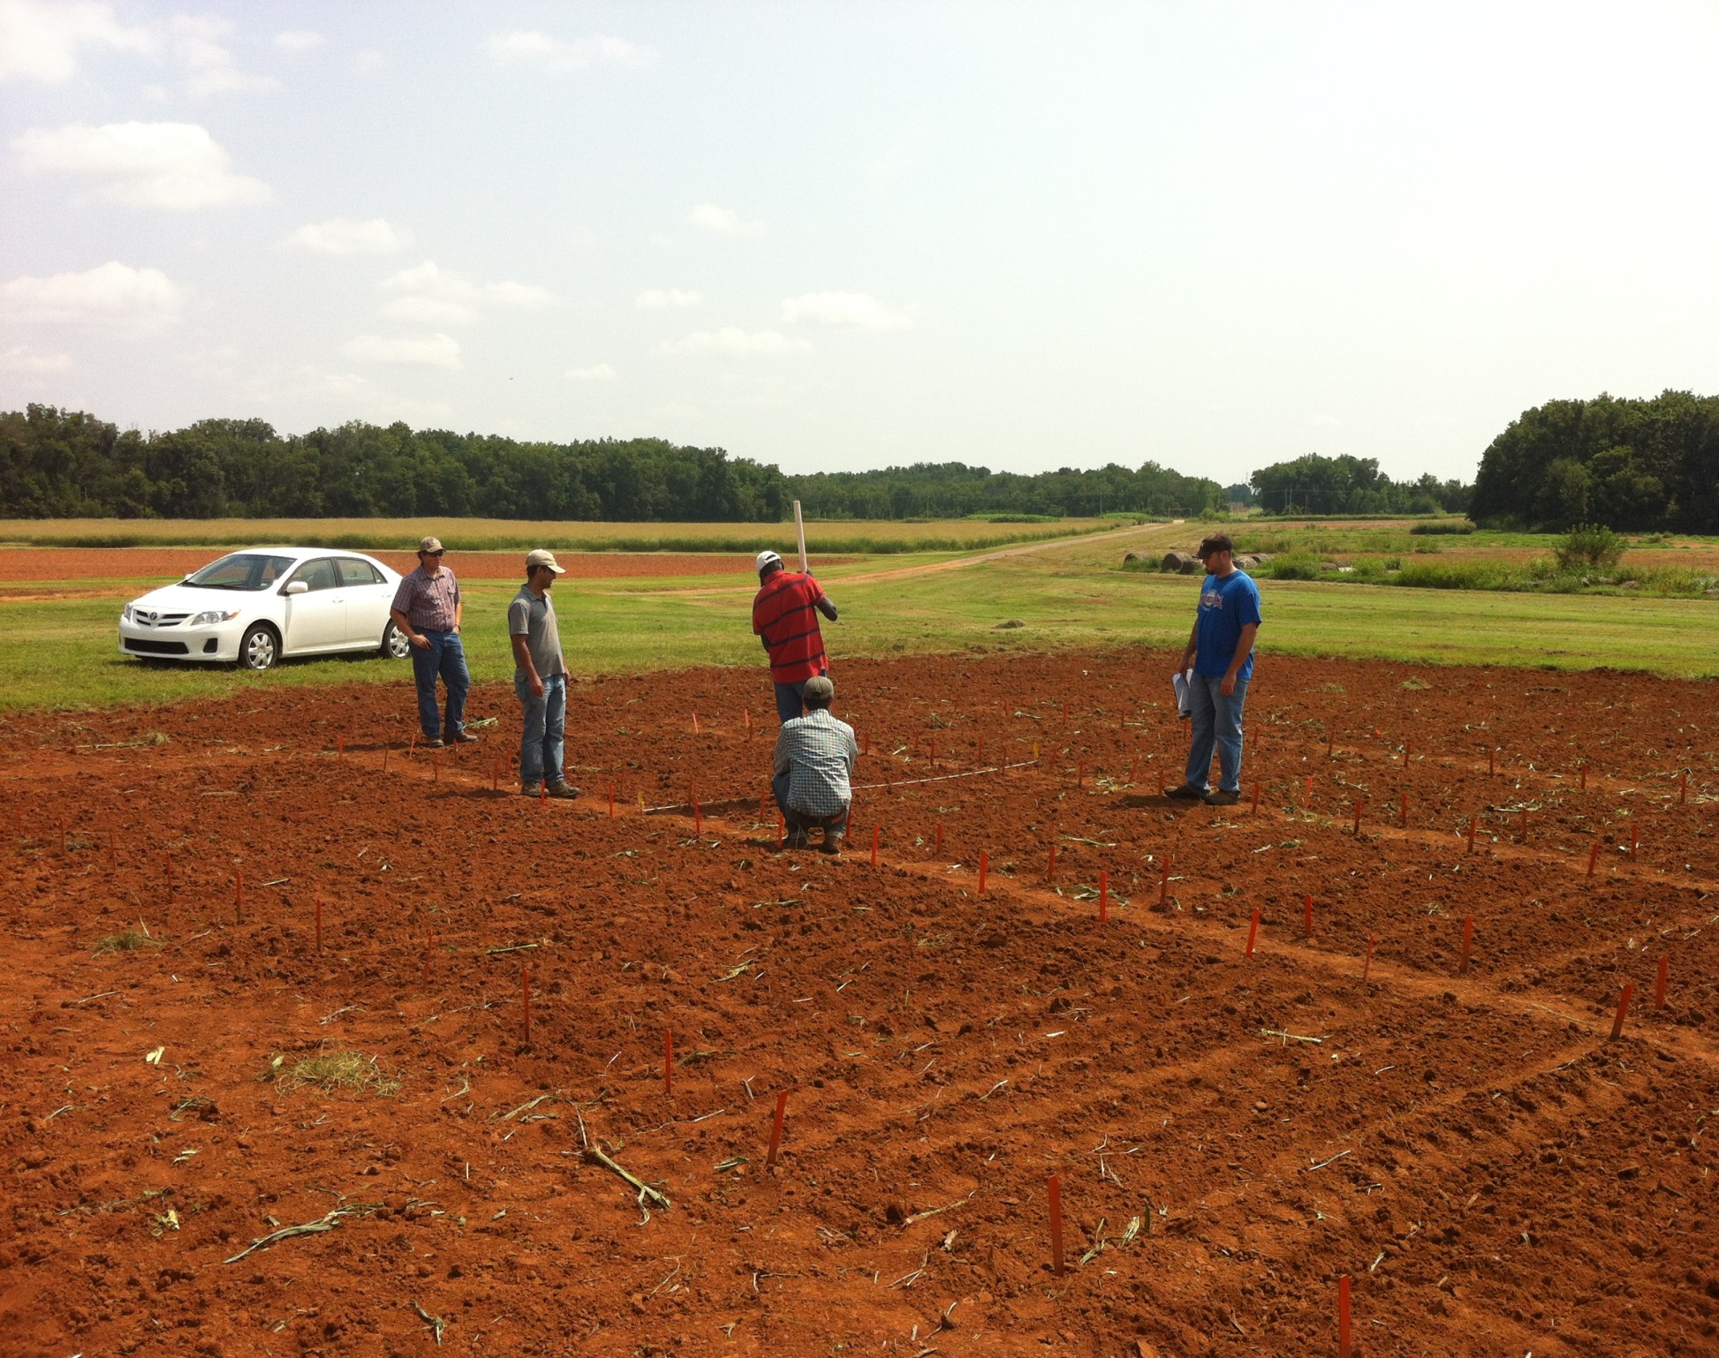

Slide 33
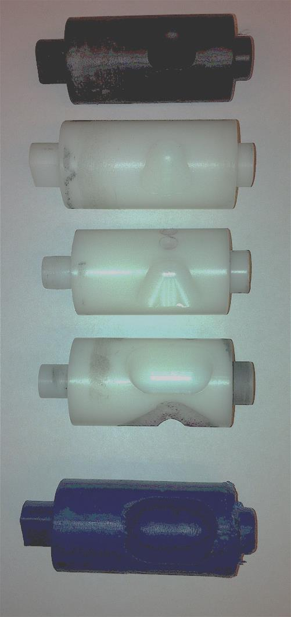
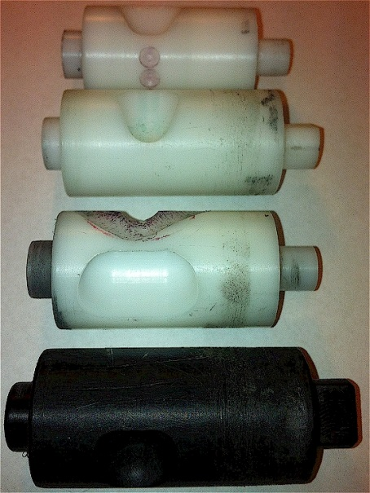
Rotating Drum
Drum | Mass (g) | Volume (cm³)
A | 0.69 | 0.507
B | 0.71 | 0.521
OS | 0.88 | 0.646
OM | 3.36 | 2.468
OC | 3.38 | 2.482

Slide 34
Mid Season Fertilizer N
Combined, Efaw and Perkins, 2013
Topdress N, Corn, V12 |  | (70,000 s/ha)
Methods | N, kg/ha | Mg/ha
Check | 0 | 6.6
Hand planter (0.9 g/plant) | 30 | 11.2
Hand planter (1.8 g/plant) | 60 | 10.6
Broadcast | 30 | 6.4
Broadcast | 60 | 7.0
Dribble urea | 30 | 9.3
Dribble urea | 60 | 7.8
Dribble UAN | 30 | 7.3
Dribble UAN | 60 | 10.4
SED = 1.81

Slide 35
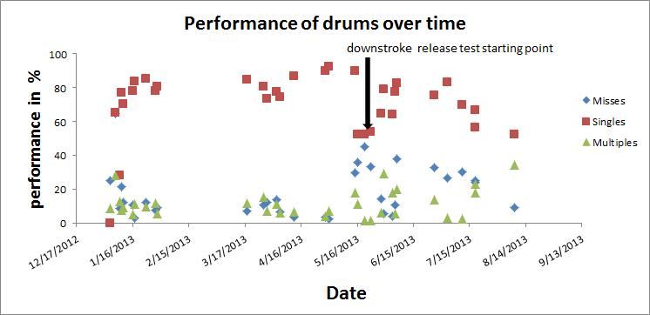

Slide 36
Thailand Mexico Zambia El Salvador Guatemala
Regional Trials: El Salvador, Thailand, Colombia, Uganda, Zambia

Slide 37
Variables
Brush size, location, stiffness
Drum orientation
Drum cavity size
Drum angle
Internal Housing (1, 2, 3) (brush position)
Seed size, shape (range from 2652 to 4344 seeds/kg)
Operator (many)

Slide 38
Benefits
Remove chemically treated seeds from the hands of small farmers
Decrease soil erosion via improved plant spacing
Accommodate mid-season application of urea-N
Place urea below the surface reducing NH3 losses
Potential to increase maize production and NUE

Slide 39
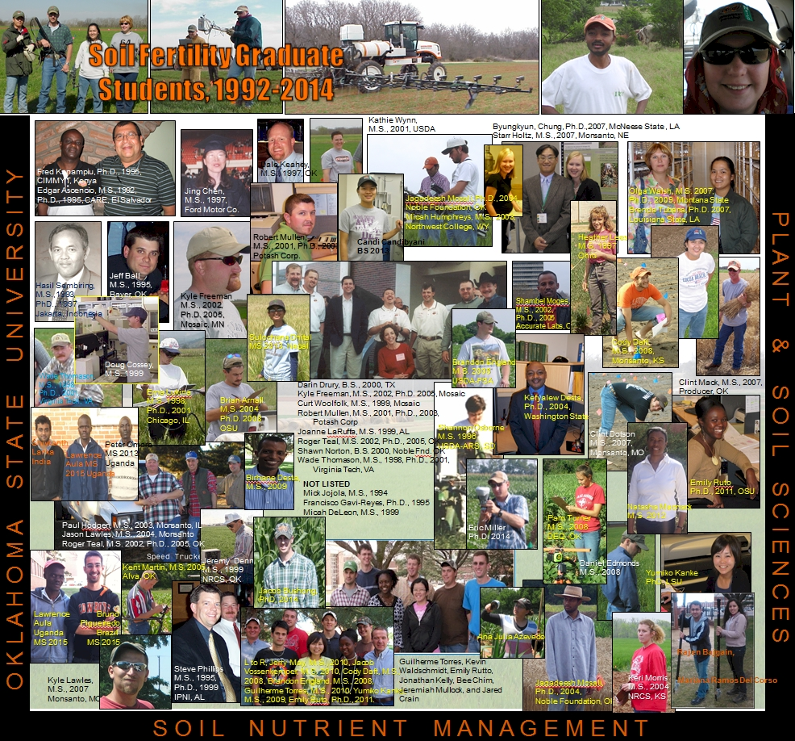

Slide 40
Latitude
“The human mind, when stretched by a new idea, can never shrink to its original size” Oliver Wendell Holmes

Slide 41
By 2050 there will be 9.1 billion people.
Increase of 30%
Food production during the same period will have to increase 70%
95% of the increased population will be in the developing world

Slide 42
Agriculture and the Environment
Food and Agricultural Organization, “Livestock's Long Shadow” surveys damage done by sheep, chickens, pigs and goats. But in almost every case, the world's 1.5 billion cattle are most to blame. Livestock are responsible for 18 per cent of the greenhouse gases that cause global warming, more than cars, planes and all other forms of transport put together.
The Independent.co.uk

Slide 43
Of the 7 billion people in the World, more than 1 billion live on less than $1 per day.
More than 2.7 billion live on less than $2 per day.

Slide 44
Grain production is vital because worldwide people get 48% of their calories from eating grain directly. As incomes rise, the percent drops dramatically as diets change to include more meat, milk, eggs and other foods that require more grain to produce. About 48% of grains are eaten directly, 35% fed to animals, and 17% for ethanol and other fuels.
Worldwatch Institute, August 12, 2011 worldwatch.org

Slide 45
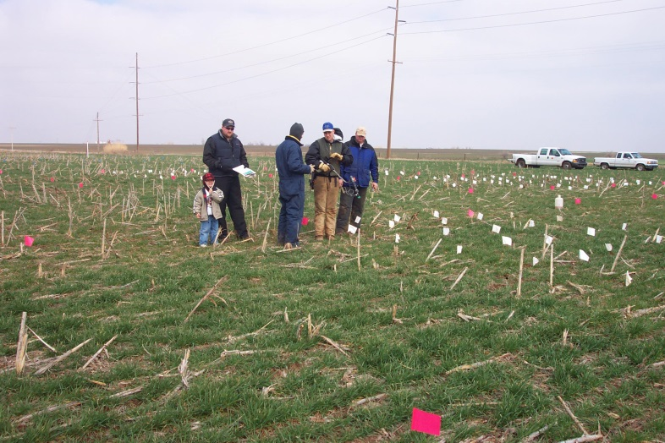
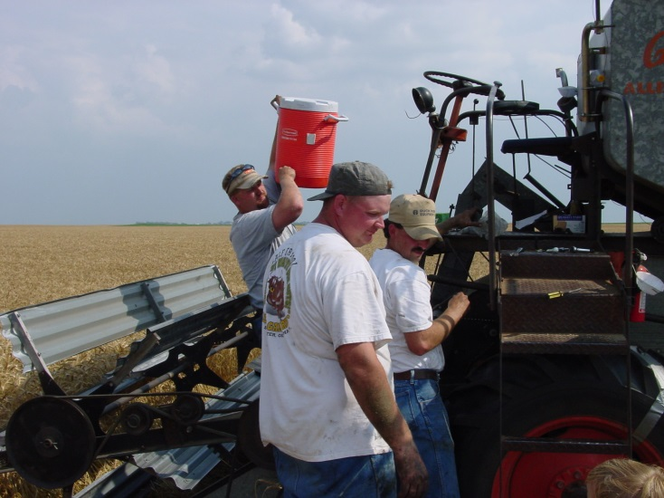
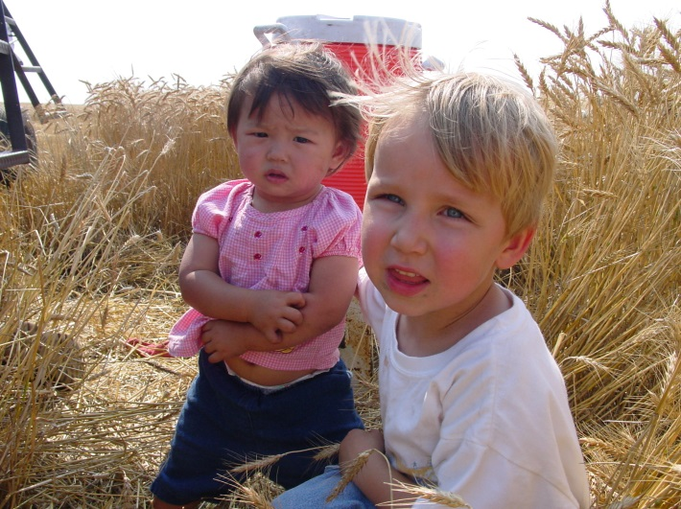
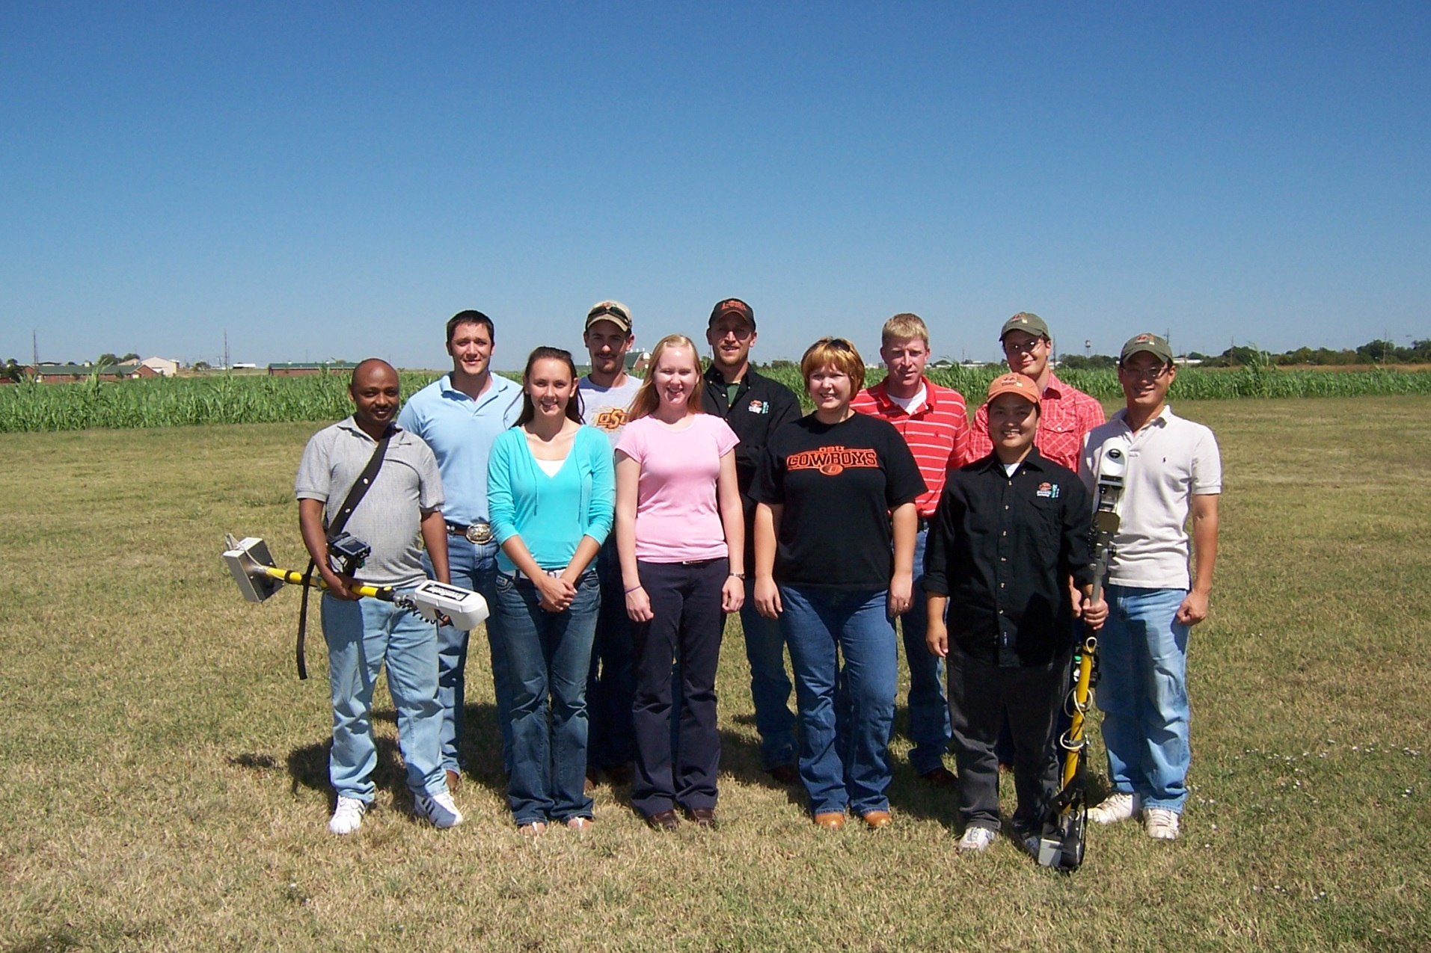
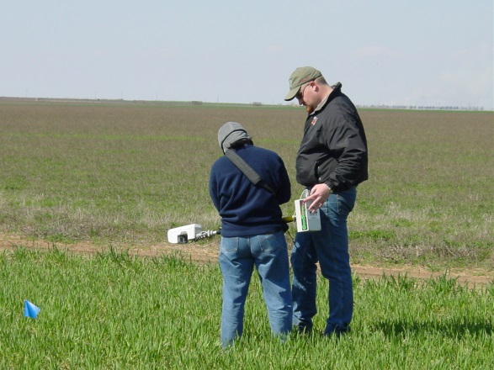
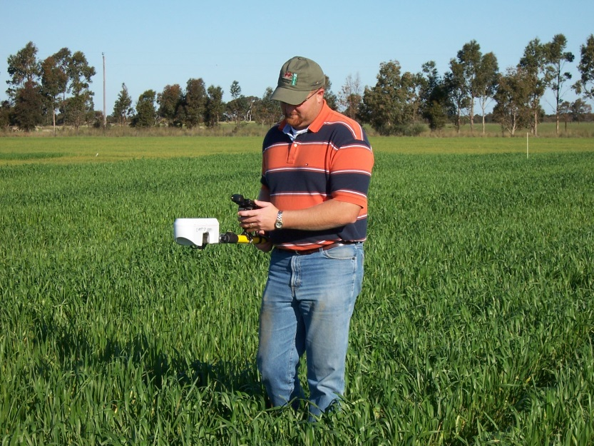
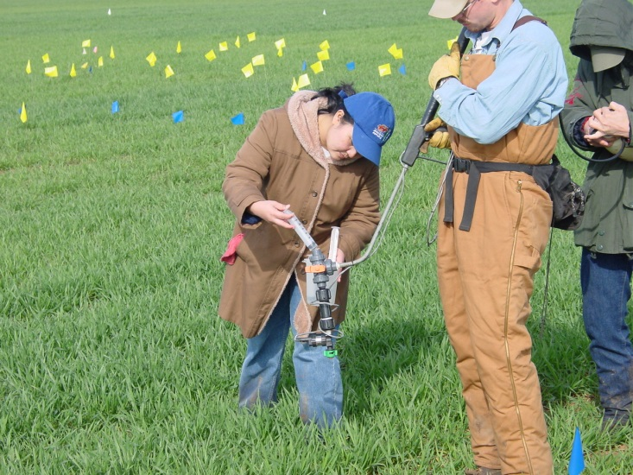

Slide 46
