Slide 1
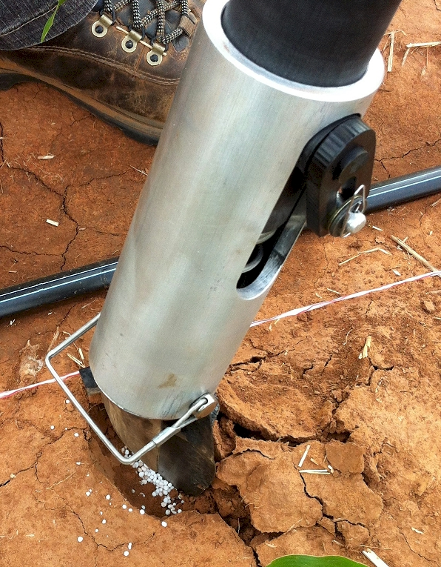
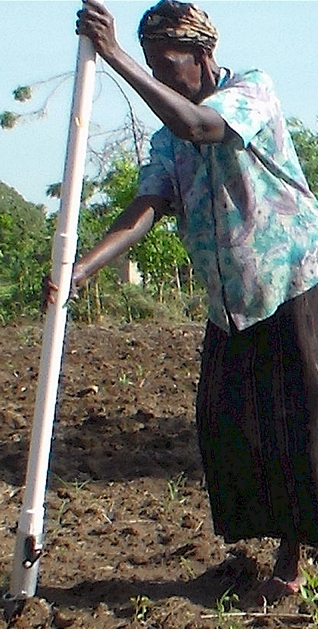


OSU Nutrient Management Update, 2015
PASS Seminar
September 14, 2015
Feb 16, 2015

Slide 2

nue.okstate.edu

Slide 3

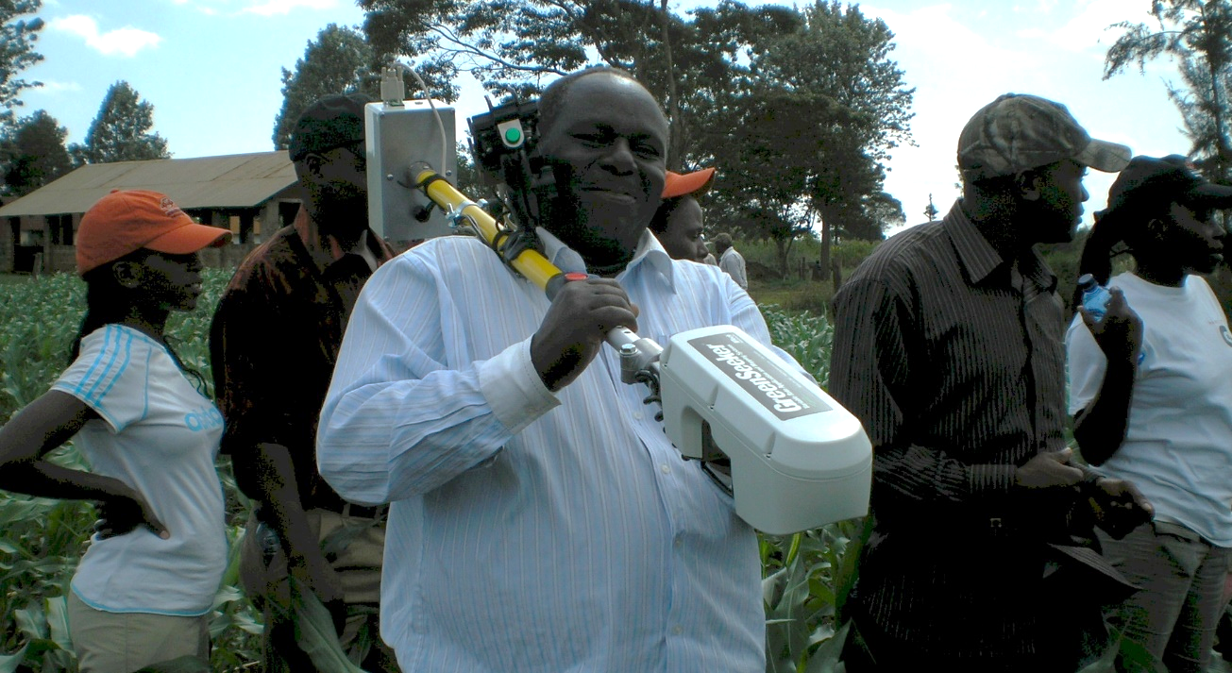

Jerry May
Jake Vossenkemper
Kenya, 2009

Slide 4


Norman Borlaug Mother Teresa
1914 – 2009 1910 - 1997

Slide 5
Sulochana Dhital, Nepal
Effect of Preplant/Early Irrigation, Nitrogen and Population Rate on Winter Wheat Grain Yield.
Variability in Optimum N Rates for Maize in the Central Great Plains.
Jagmandeep Dhillon, India
Evaluation of Drum Cavity Size and Planter-tip on Singulation and Emergence in Maize (Zea Mays L.)
Daniel Aliddeki, Uganda
Influence of Tillage and sidedress Nitrogen on maize (Zea mays L), plant stand and grain yield using the Green Seeder Hand Planter with altered drum cavity sizes
Ethan Driver, California
Optimum Preplant Nitrogen Rates in Corn and Wheat
Ryan Schlobohm, Oklahoma
Evaluation of Mid-Season Application Depth of Urea Ammonium Nitrate (UAN) Fertilizer in Corn (Zea Mays L.)
Nicole Remondet, Oklahoma
Minimum fertilizer N needed at planting, and later top dress N, for maximum wheat grain yields
Mariana Del Corso, Brazil
Evaluation of foliar UAN rate and application timing on wheat grain yield and protein
Effect of macro-climate on organic matter, soil pH and nitrogen content in a long term trial in Oklahoma
Bruno Morandin Figueiredo, Brazil
Effect of micronutrient fertilizers on winter wheat grain yield
Melissa Golden, Oklahoma
Development of Oklahoma Wheat MRNT Calculation based on long-term data
Accuracy of MRNT versus SBNRC
Tyler Lynch, Oklahoma
Long-term data base analysis

Slide 6
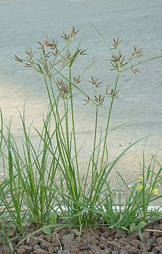
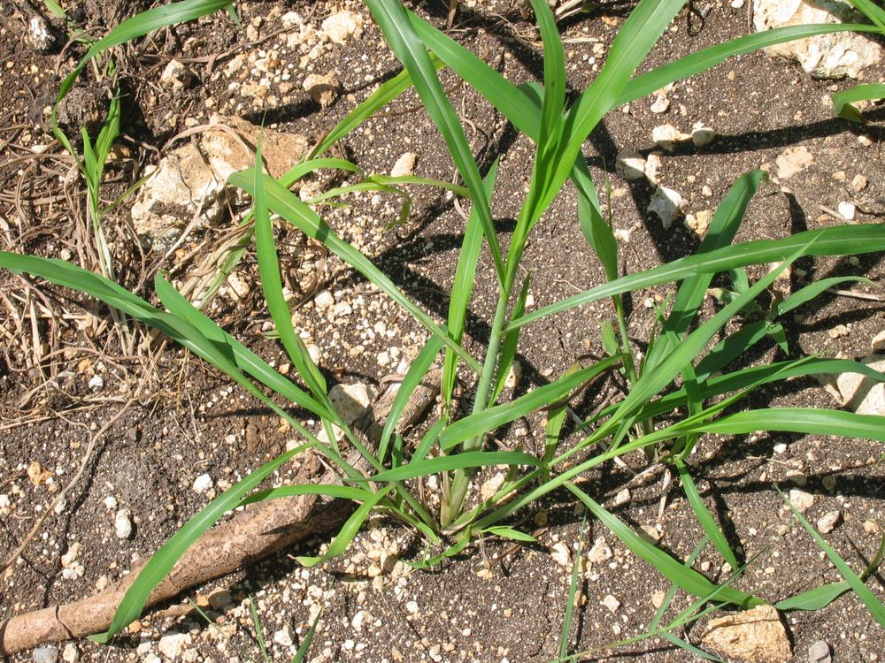

Weed science
  Cyperus rotundus (nutsedge)
  Rottboellia cochinchinensis (itchgrass, caminadora)
  Phalaris minor (canarygrass)
Soil Chemistry
  Willard Lindsay, Chemical equilibria in soils
  Solubility diagrams
  Supersaturation of P bands with CaSO4

Slide 7
NUE http://nue.okstate.edu/Index_Publications.htm
Source Year NUE Crop
Agron J. 91:357-363. 1999 1999 33 Cereals
J. Plant Nutr. 23:1505-1516 2000 30-82-forage Wheat
J. Plant Nutr. 25:2261-2283 2002 26-66-forage Wheat
J. Plant Nutr. 26:1561-1580 2003 32.8 Magruder Wheat
J. Plant Nutr. 35:538-555 2012 33 Corn
Comm. SSPA. 00:1-15 2014 30 Wheat
SBNRC (+50%)
still a lot to do

Slide 8
NUE
Exp. 502,1971-2015
(N uptake treated - N uptake check)/N rate
(#7 and #2) 100-40-60 and 0-40-60 (N-P2O5-K2O)

Slide 9
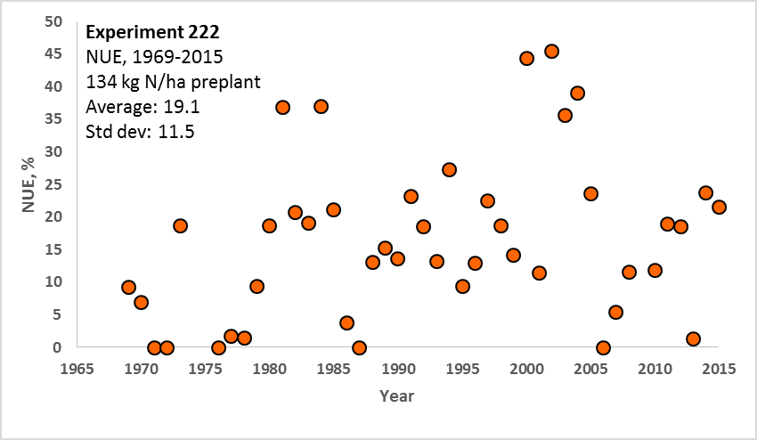
NUE
Exp. 222,1969-2015
(N uptake treated - N uptake check)/N rate
(#4 and #1) 120-60-40 0-60-40 (N-P2O5-K2O)

Slide 10
Land-grant university
  Designated to receive the benefits of the Morrill Acts of 1862 and 1890
  Morrill Acts funded educational institutions by giving them federally controlled land
  Mission, agriculture, science, military science, and engineering
  Most of these universities are public, excluding Cornell, Univ. Delaware, MIT
  Hatch Act 1887 provided federal funds to states for agricultural experiment stations under the state’s land-grant university
  Smith-Lever Act of 1914 included cooperative extension

Slide 11

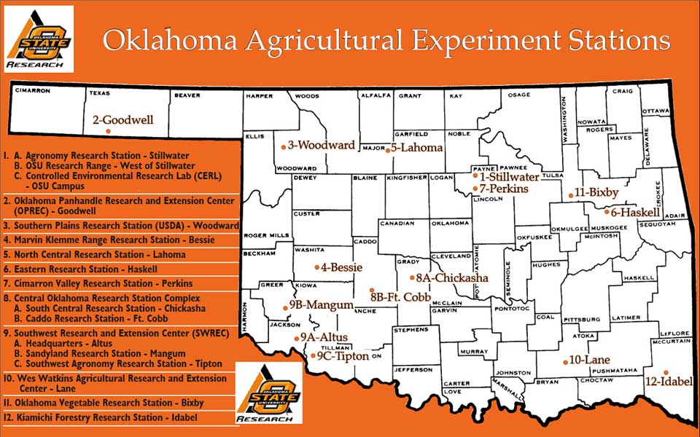

Slide 12
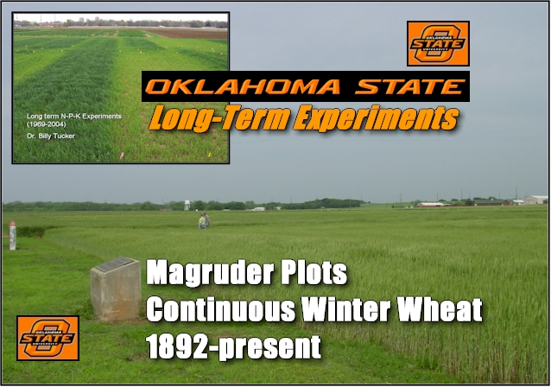

Slide 13


OSU Ongoing Long-Term Experiments
Experiment | Location | Focus | Crop | Year Established
222 | Stillwater (DATA) | NPK | wheat | 1968
301 | Efaw | Municipal wastes | wheat | 1993
302 | Efaw | Animal wastes | wheat | 2000
406 | Altus | NPK irrigated | wheat | 1965
407 | Altus | NPK dryland | wheat | 1965
439 | Altus | NPK | cotton | 1971
501 | Lahoma | NPK | sorghum (1970-2004) canola (2005-present) | 1970
502 | Lahoma (DATA) | NPK | wheat | 1970
503 | Lahoma | P Source Method | wheat | 1970
504 | Lahoma | P Source | wheat | 1970
505 | Lahoma | N Source | wheat | 1970
701 | LCB | Zero-Till Topdress | wheat | 2001
Magruder Plots | Stillwater (DATA) | NPK-lime | wheat | 1892
http://nue.okstate.edu/Long_Term_Experiments.htm

Slide 14
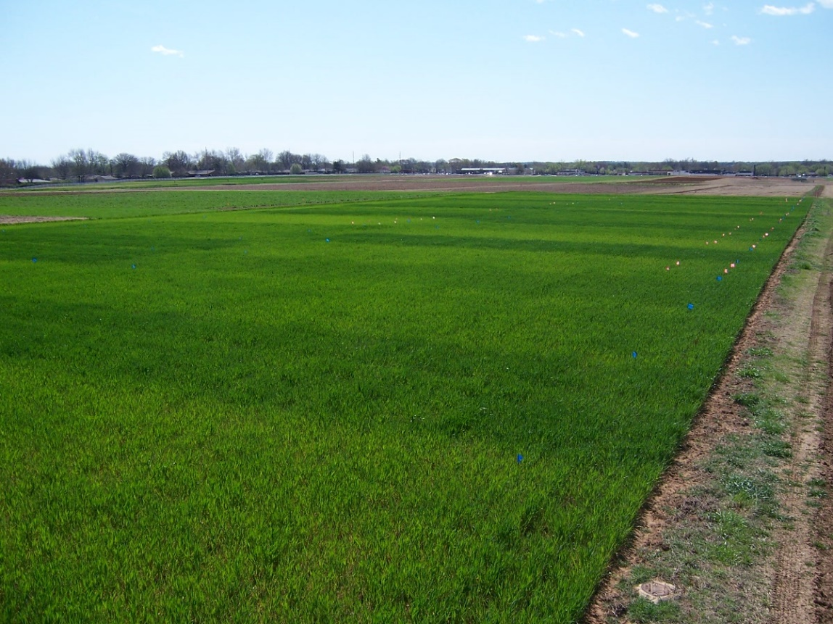

Long-term Experiment
#222, Stillwater, Ok
Khalid al-Asaad, Curator
http://www.nytimes.com/2015/08/20/world/middleeast/isis-palmyra-syria-antiquities-scholar-beheaded.html?_r=0

Slide 15
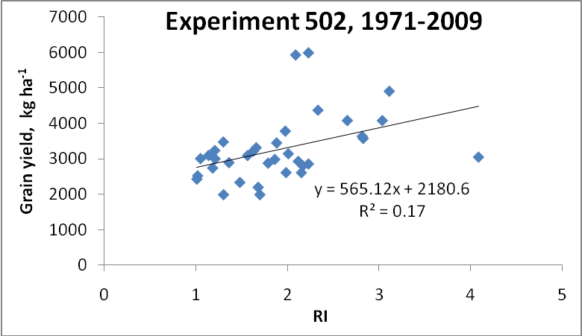
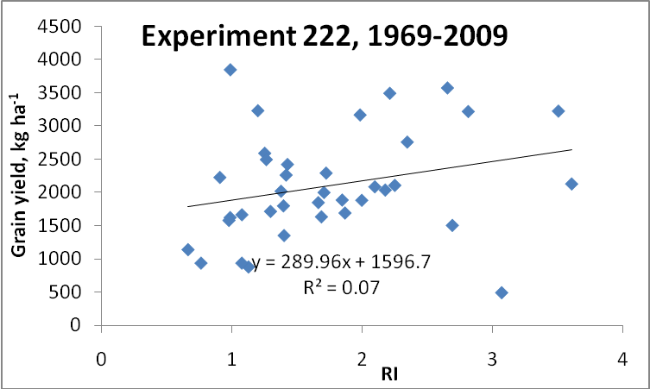
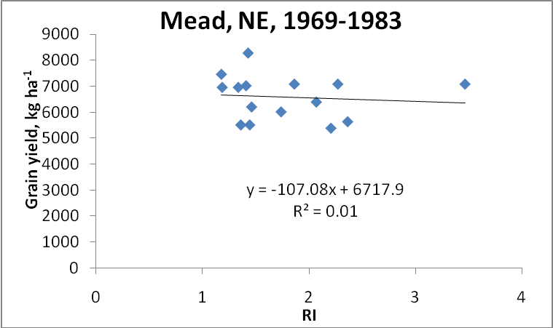
Independence of yield potential and crop nitrogen response (Prec. Agric. 12:508-518)
Nebraska
Oklahoma

Slide 16
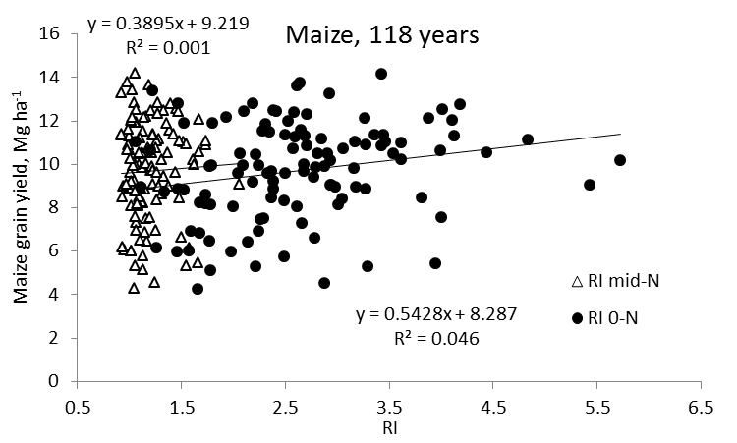
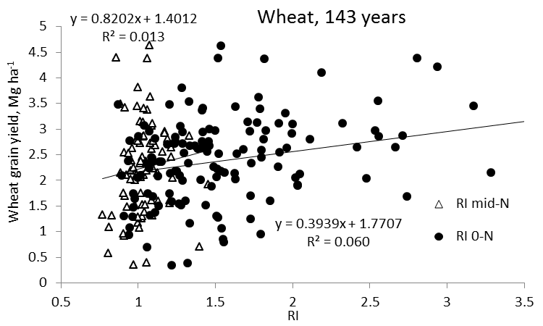
Independence of yield potential and nitrogen response (Agron J. 105:1335-1344)
Iowa
Nebraska
Wisconsin
Oklahoma
Because yield and response to N were consistently independent of one another, and as both affect the demand for fertilizer N, estimates of both should be combined to calculate realistic in-season N rates

Slide 17
Value of yield goals?
 | Trt 7 | Avg. Yield
Year | 112-20-55 | last 5 yr +20%
1971 | 2.51
1972 | 1.47
1974 | 1.87
1975 | 3.40
1976 | 3.14
1977 | 1.94 | 2.97
1978 | 2.59 | 2.36

Slide 18
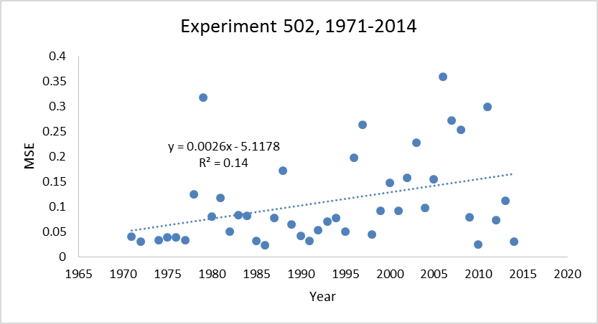
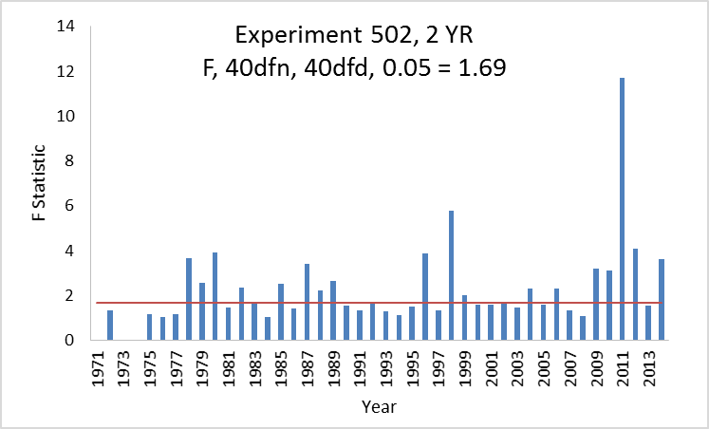
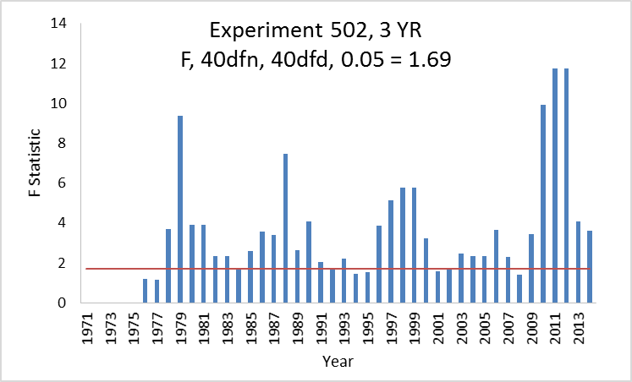
SOIL 5112
Student Paper
spring 2015
Golden, Melissa, Bruno Figueiredo, Jagmandeep Dhillon, Mariana Ramos Del Corso, Nicole Remondet, Mame Diatite-Koumba, Shawntel Ervin, Daniel Alidekki, Ethan Driver, Bill Jones, James Lasquites, Samuel Zoca, Patrick Watkins, and Jeremiah Mullock. 2015. Relationship between mean square errors and wheat grain yields in long-term experiments. J. Plant Nutr. (in press)

Slide 19
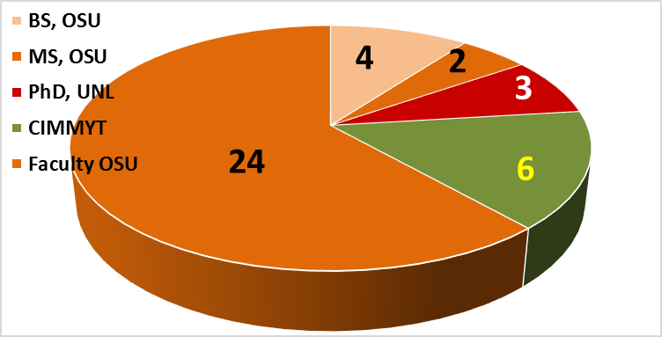
career focus sense of urgency
university 9
cimmyt 6
OSU 24
post PhD 30
rule 80 = 82

Slide 20
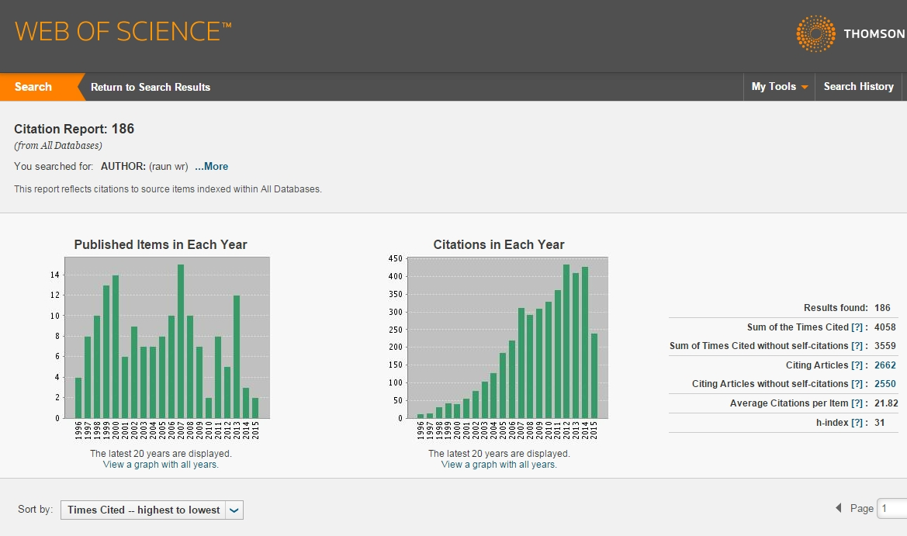
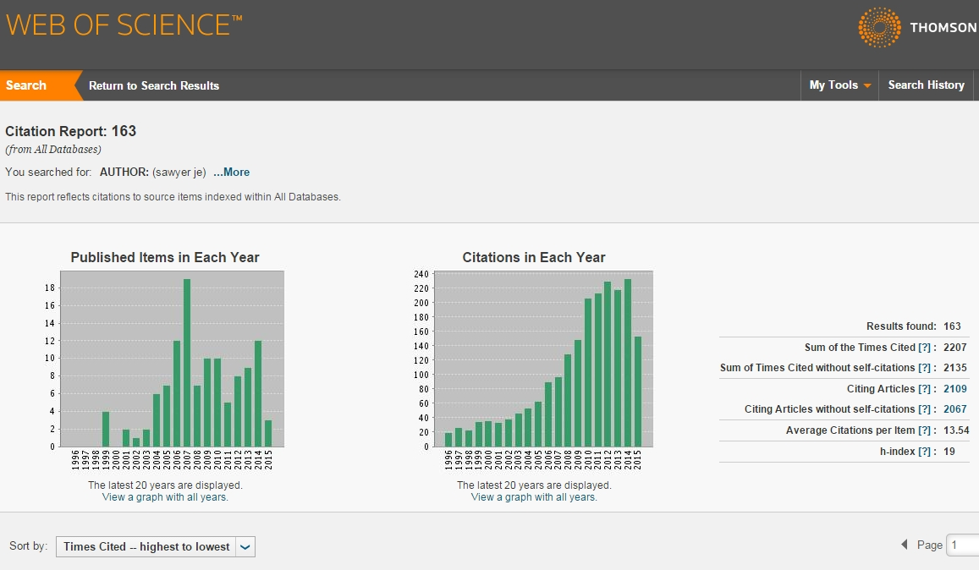
webofknowledge.com

Slide 21
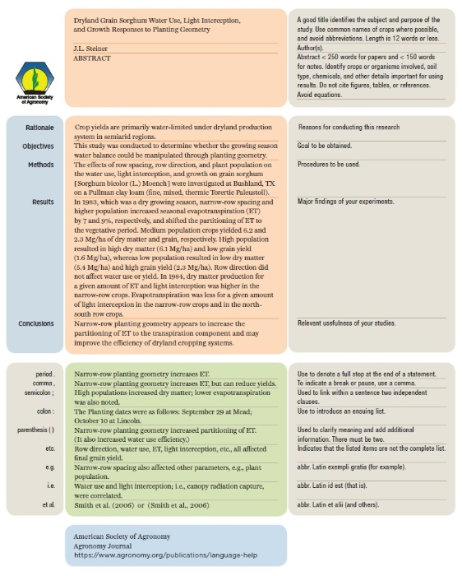
abstract =
handshake
Total = 638
Rejected outright = 154
Reviewed = 484
Accepted = 40%

Slide 22

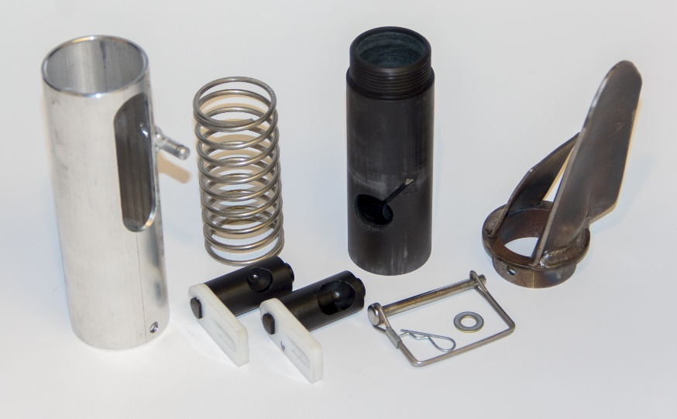
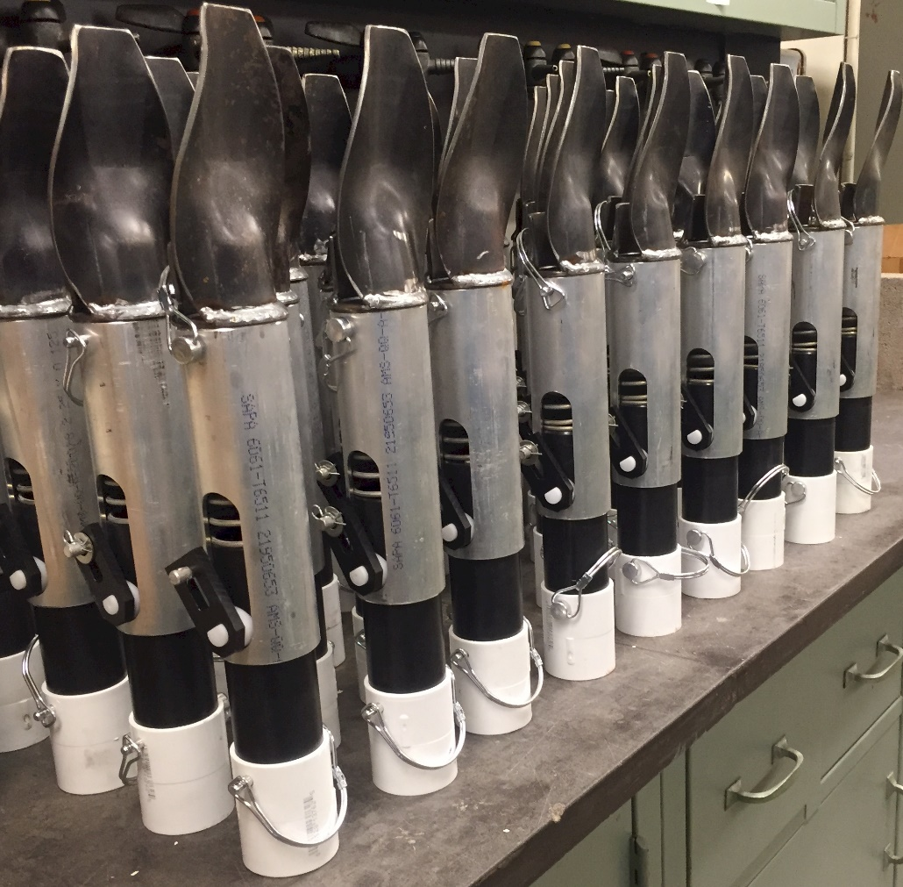
50 Additional Planters
September 4. 2015

Slide 23
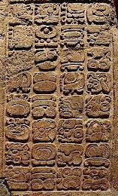


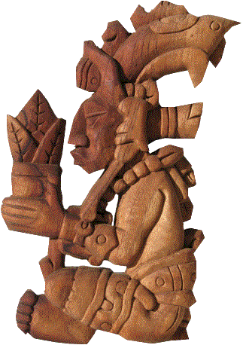
Maize (teosinte) “corn”
- first domesticated in Tehuacan, MX, 3600 BC
- western civilization, discovered in Cuba, 1492
1880 62M ac 25M ha
1900 95M ac 38M ha
1910 100M ac 40M ha 32 bu/ac
1917 111M ac 45M ha
2015 88M ac 54M ha 124 bu/ac

Slide 24
Country Maize area, ha Maize production, Mt Yield, Mt/ha
WORLD 177,379,507 872,066,770 4.9
USA 35,359,790 273,832,130 7.8
Brazil 14,198,496 71,072,810 5.1
China 34,966,000 208,234,649 6.1
India 8,400,000 21,060,000 3.04
Mexico 6,923,900 22,069,294 3.18
Country Wheat area, ha Wheat production, Mt Yield, Mt/ha
WORLD 215,489,485 670,875,110 3.11
China 24,139,000 120,580,000 5.0
India 29,900,900 94,880,000 3.2
Russian Fed. 21,277,900 37,719,640 1.8
USA 19,826,170 61,755,240 3.2
Australia 13,920,140 29,905,009 2.2
France 5,303,300 40,300,800 8.0
Country Rice area, ha Rice production, Mt Yield, Mt/ha
WORLD 163,199,090 719,738,273 4.41
India 42,500,000 152,600,000 3.57
China 30,297,000 204,285,000 6.73
Indonesia 13,443,443 69,045,141 5.30
17% or 30.1 M ha’s maize, grown on marginal landscapes

Slide 25

Hand Planters
DEMAND
First | Last | Location | Number
Rachel | Zelon | Guatemala | 5
Isaiah | Nyagumbo | CIMMYT Kenya | 4
Pascal | Kaumbutho | Kendat Kenya | 2
Fred | Kanampiu | IITA, Kenya | 2
Melvin | Siwale | Lusaka Zambia | 10
Terry | Tindall | Lusaka Zambia | 25
Ed | Long | USA | 50
Edgar | Ascencio | El Salvador | 10
Julian | Montoya | Colombia | 5
Luis | Narro
Assoumane | Maiga | Mali | 1
Christian | Thierfelder | Zimbabwe | 2
Ed | Long | DRC | 4
John | Kruse | Honduras | 2
Brian | Luff | Indiana | 1
Luis | Narro | Colombia | 6
Wade | Thomason | Virginia | 10
Joe | Kejr | Guatemala | 5
Peter | Smith | Kenya | 500
Peter | Omara | Uganda | 5
Roman | Gordon | Panama | 2
Edgar | Ascencio | El Salvador | 5
Joshua | Ringer | Asia | 5
Eric | Lam | Honduras` | 2
Javier | Orellana | Colombia | 2
M | Tattaris | CIMMYT | 2
Argemiro | Moreno | Colombia | 2
Ivan | Ortiz-Monasterio | Mexico | 2
Lynn | Brandenberger | USA | 2
J | Montoya | CIMMYT | 2
M | Gutierrez | Kansas State | 2
Hadi | Ibrahim | Philippines | 5
Leo | Espinoza | Central America | 2
Kevin | Talley | Malawi | 2
Tom | Herlehy | Rwanda, Tanzania
Francisco | Casares | El Salvador
 |  | Total | 686
Notes:
25

Slide 26
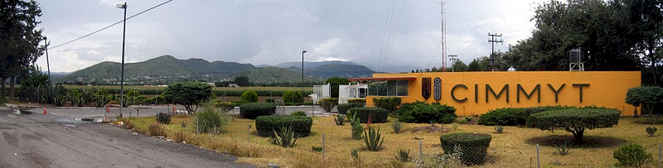

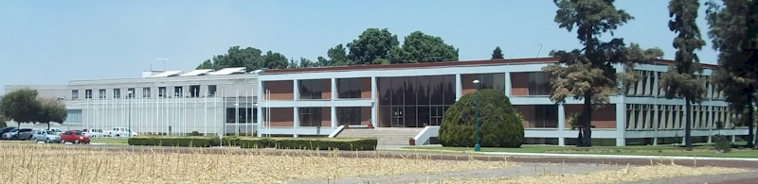
Centro Internacional de Mejoramiento de Maiz y Trigo

Slide 27
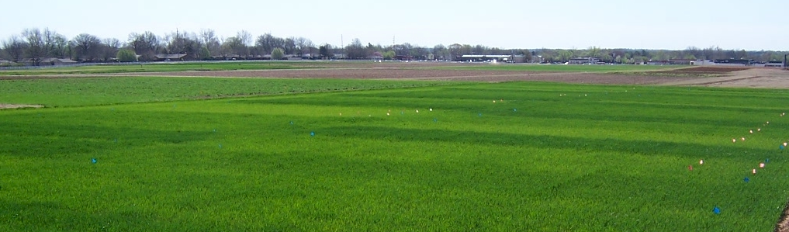
Present State of Sensor Based Nitrogen Algorithms
Yield influences N demand
Lory and Scharf (2003), Agron. J.
Spiertz and DeVos (1983), Plant and Soil
Arnall et al. (2009), Agron. J.
Fowler (2003), Agron. J.
N response (N demand) changes each year
Mullen et al. (2003), Agron. J.
Varvel et al. (1997), SSSAJ.
Bundy and Andraski (2004), Agron. J.
YP0 and RI are independent
Arnall et al. Agron. J. (2013)
Raun et al. Prec. Agric. (2011)
Can yield goals be used?

Slide 28

Nitrogen Algorithm status
Peter Scharf Univ. Missouri High N Ref Sufficiency
Ray Asebedo Kansas State Univ. N Rich, YP0
Olga Walsh Univ. Idaho N Rich, YP0, NUE 0.50 dryland/irrigated
Wade Thomason Virginia Tech N Rich, YPN using RI
Josh McGrath University of Kentucky N Rich, YPN using RI
Brenda Ortiz Auburn Univ. N Rich, YP0
Brian Arnall Oklahoma State University N Rich, YP0
Ivan Ortiz-Monasterio CIMMYT N Rich, YP0, RI
Brenda Tubana Louisiana State University N Rich, YP0 Sugarcane, cotton, rice
John Solie Auburn NE N Rich, YP0 Continuous function
Kyle Holland, Jim Schepers Holland Scientific, UNL Virtual Rich Strip, Sufficiency
Harold van Es Cornell University Crop Model
Jeff Vetsch Univ. Minnesota MRTN
David Clay South Dakota State Univ. N Rate=1.2*(yld goal)-credits
Raj Khosla Colorado State Univ. Managements Zones, N Rich
Richard Ferguson Univ. Nebraska N Rate= 1.2*(yld goal)-credits EC117

Slide 29
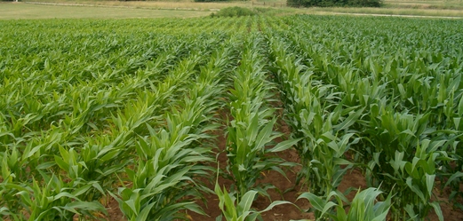
OSU Corn Algorithm
YP₀=1291*(EXP(NDVI/Sum of GDD*2649.9) V8 to V12
RI = NDVI- N Rich Strip/ NDVI – Farmer Practice
YP_{N} = YP₀ * RI
N Rate = ((YP_{N} – YP₀)* 0.0125)/expected NUE
YP_{N}
RI
Planting date
GDD from planting to sensing
YP₀
NDVI (sensing date)

Slide 30

Theory was right because we worked as a team
Sensor Based Nitrogen Rate Calculator
32 options
maize
winter wheat
spring wheat
rice
canola
bermudagrass
sorghum
protein (wheat)

Slide 31
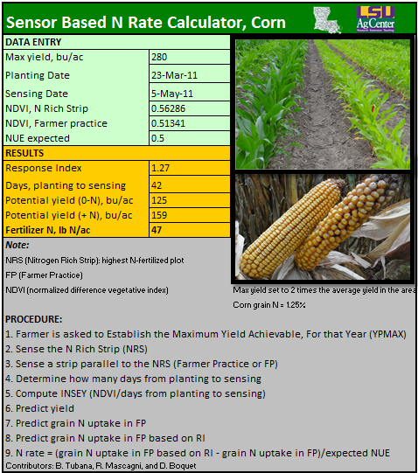
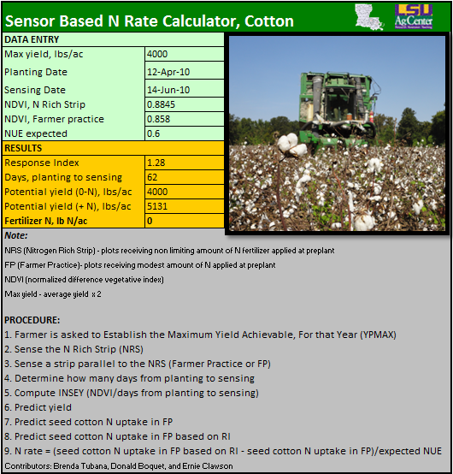
Corn and Cotton SBN also sugarcane and rice

Slide 32
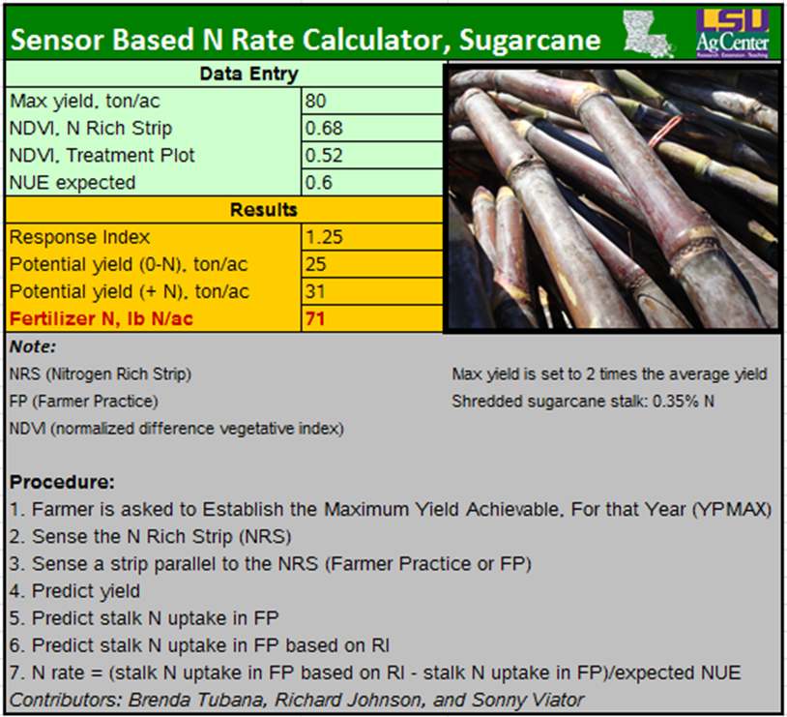
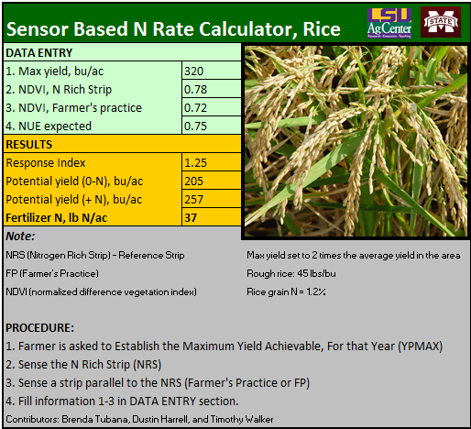
Sugarcane and Rice SBN

Slide 33
summary
focus
  nue long-term
  hand-planters
work with others
  disciplines
need to deliver

