Slide 1



Great Plains Soil Fertility Conference
March 4, 2014

Slide 2
He was instrumental in developing practical site-specific nutrient management strategies in the western Great Plains. His vision and practical approaches have been important in its adoption by growers and ag-industry in Colorado and neighboring states
Dave Franzen, NDSU

Slide 3
“He was perceptive about cultural differences that were important for him to succeed …, and he always reached out to others. As a major adviser, I just had to point him in the general direction regarding projects, and then work hard to stay ahead of his resource needs! He is truly a credit to our profession, and I feel privileged and honored to know and work with him and his lovely wife, and to count them as friends. I look forward to the many important contributions to our science, and to a better world for others, that I know he will make in the future.”
Dr. Mark Alley, KOCH Ind.

Slide 4

Dr. Raj Khosla
Monfort Professor
Assistant Dean of Int. Programs
Colorado State University

Slide 5
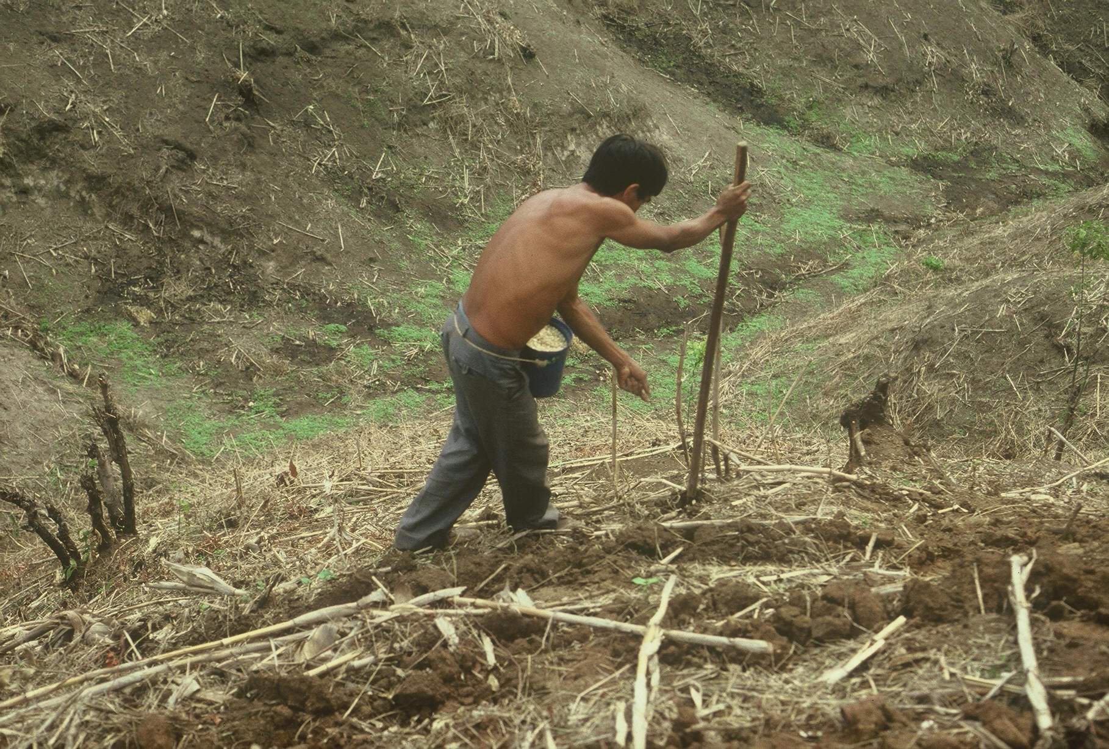

OSU Hand Planter
Dr. Edgar Ascencio (CARE, CENTA)

Slide 6

World Maize
176,000,000 ha’s in 2012 (FAOstat)
875,000,000 Mg, produced, 4.9 Mg/ha
48,370,000 ha’s in the developing world
60% planted by hand
≈ 30,000,000 hectares or 12% of the total maize area in the world

Slide 7
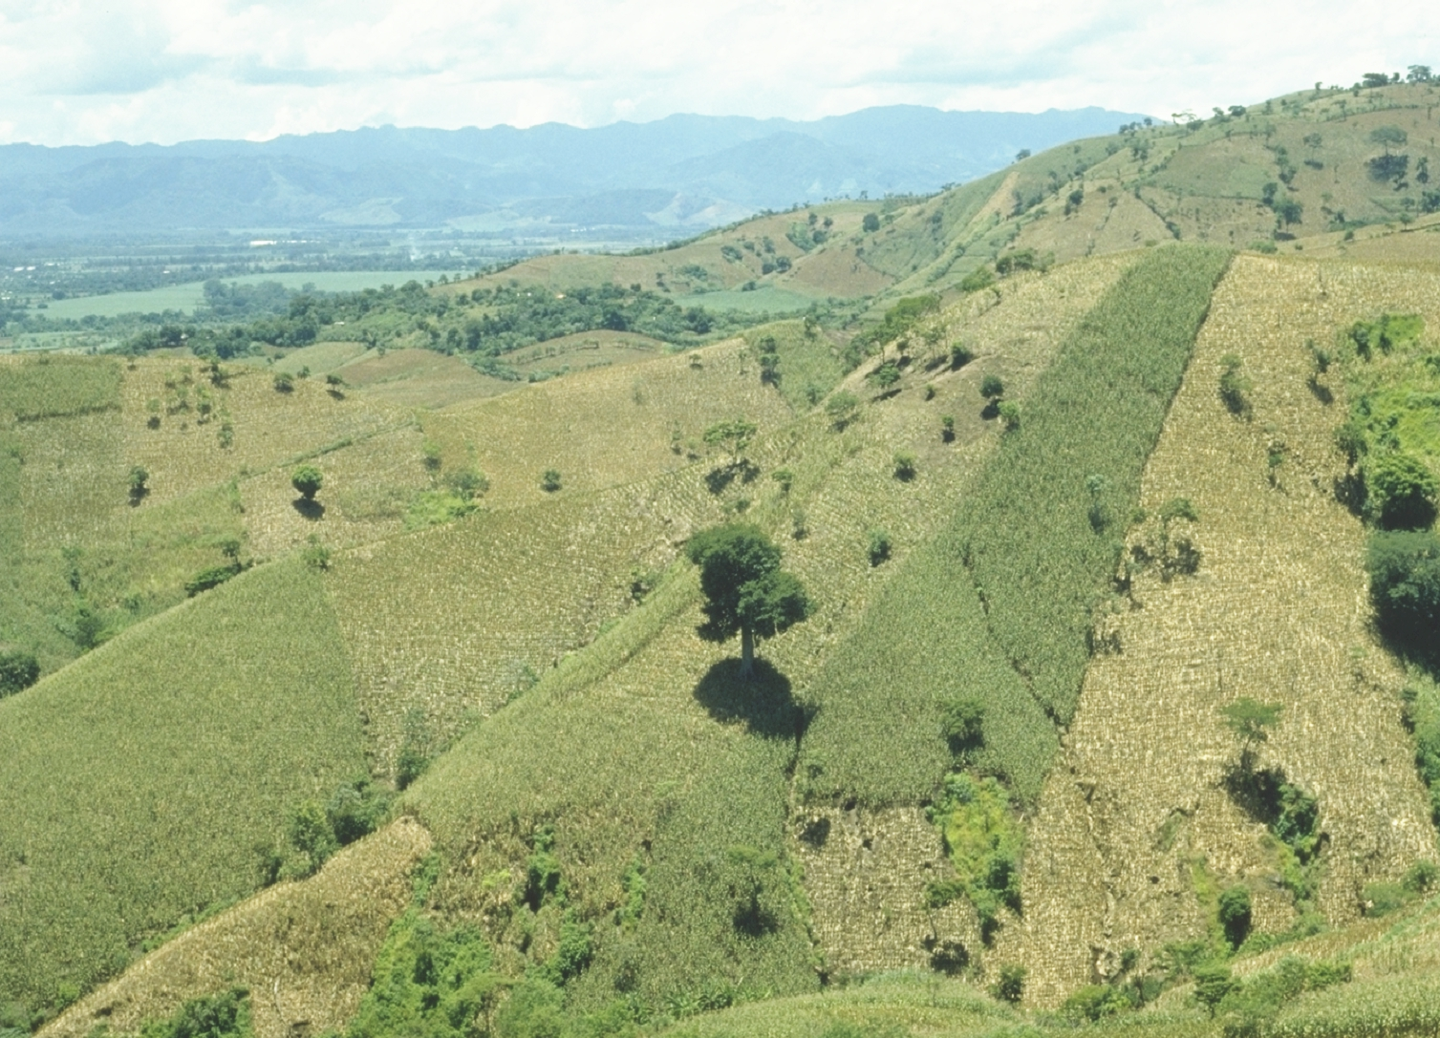
Opico Quezaltepeque, El Salvador

Slide 8
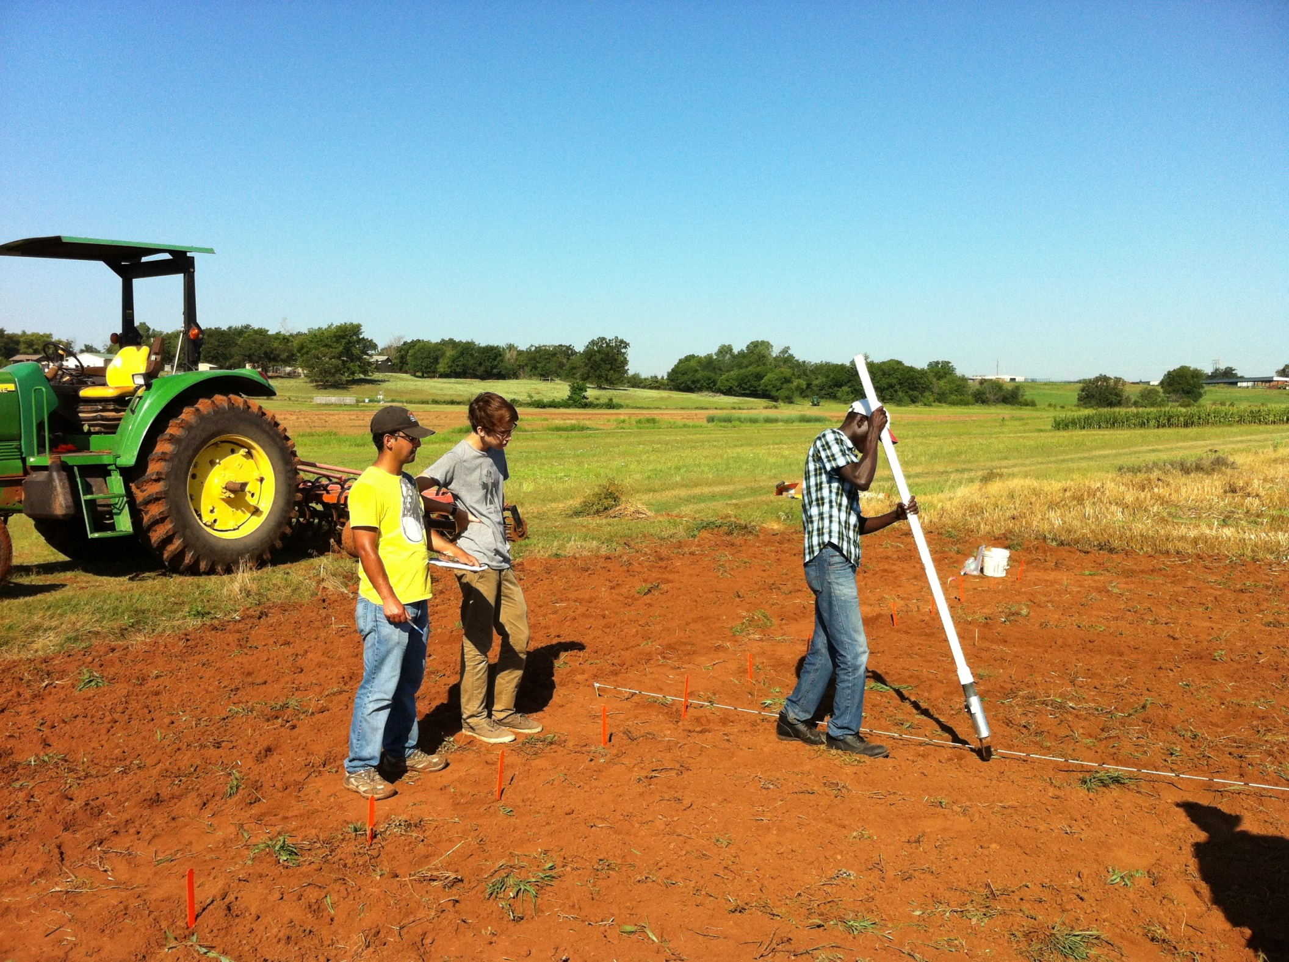



http://nue.okstate.edu/Hand_Planter.htm

Slide 9
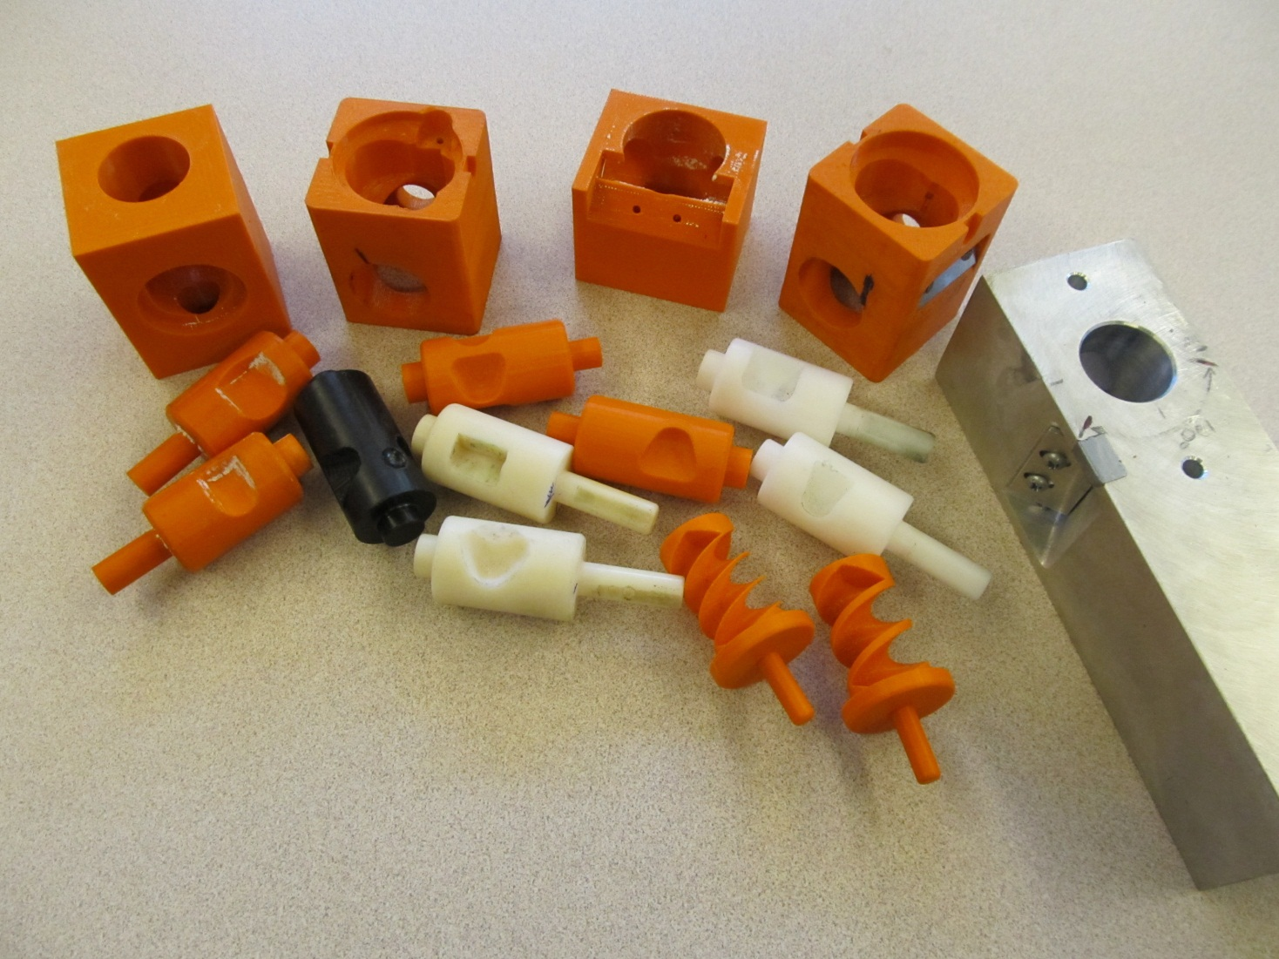
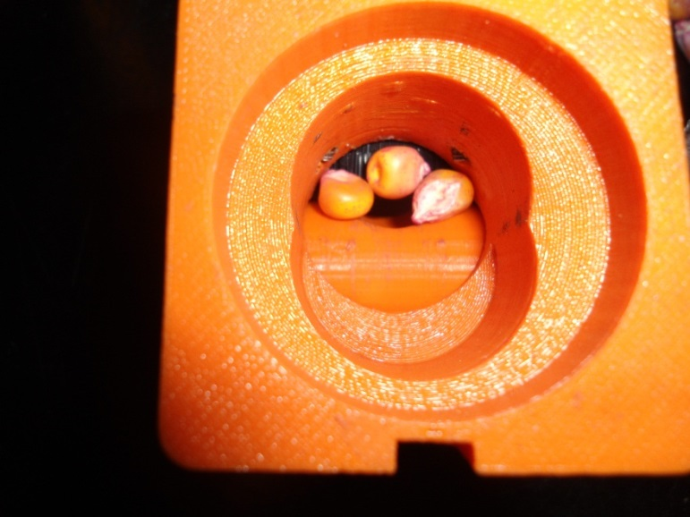
Singulation Design

Slide 10
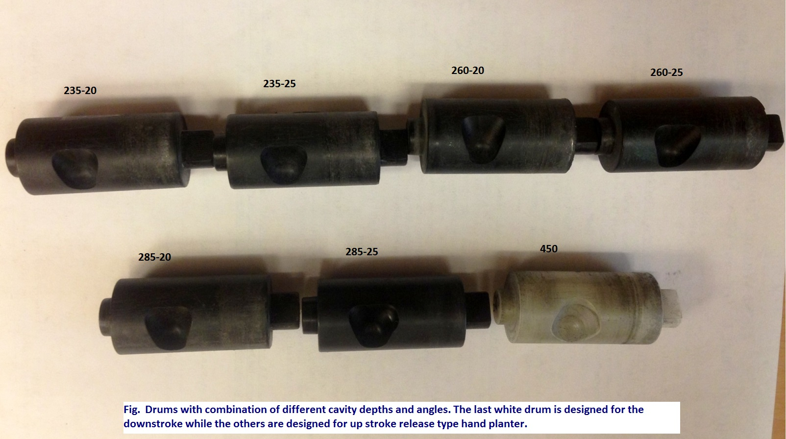
Internal Drum (cavity size/seed size)

Slide 11
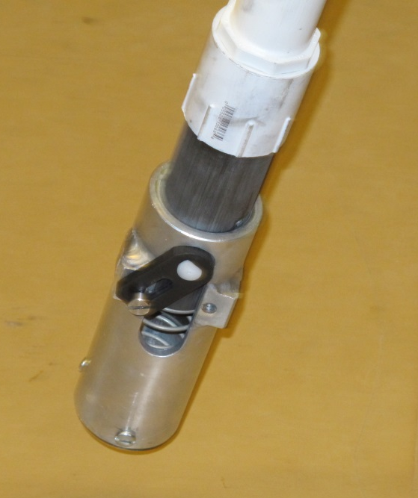
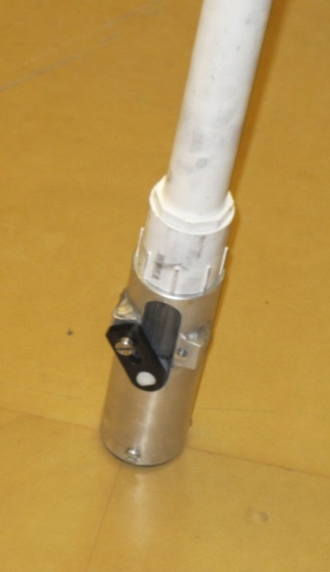
Planter Action
The planter is pressed down and compresses the internal spring.
Singulation drum rotates and seed is released on the down stroke.
The planter is ‘relaxed’ and the spring returns it to the initial position.

Slide 12
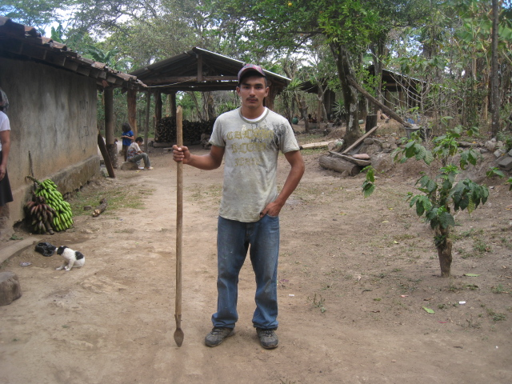
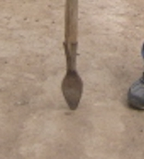
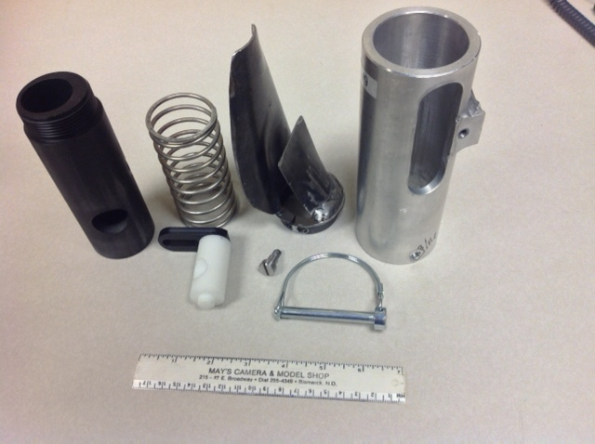
seed size (2653-4344 seeds/kg)
seed type, shape
fertilizer
1,000,000 cycles
0.29g/seed
60,000 seeds/ha
3443 seeds/kg
1.0 kg hopper
17 times refill
http://nue.okstate.edu/Hand_Planter.htm

Slide 13
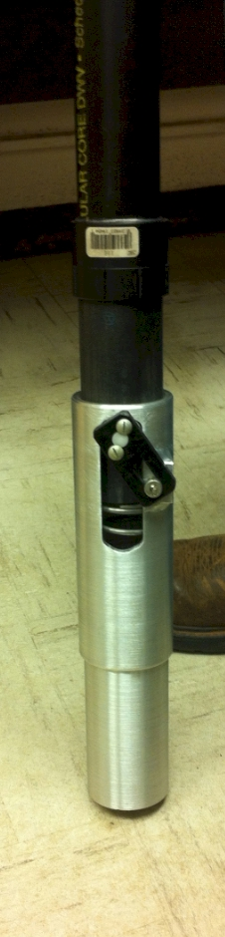
Mid Season Fertilizer N
Combined, Efaw and Perkins, 2013
Topdress N, Corn, V12 |  | (70,000 s/ha)
Methods | N, kg/ha | Mg/ha
Check | 0 | 6.6
Hand planter (0.9 g/plant) | 30 | 11.2
Hand planter (1.8 g/plant) | 60 | 10.6
Broadcast | 30 | 6.4
Broadcast | 60 | 7.0
Dribble urea | 30 | 9.3
Dribble urea | 60 | 7.8
Dribble UAN | 30 | 7.3
Dribble UAN | 60 | 10.4
SED = 1.81

Slide 14
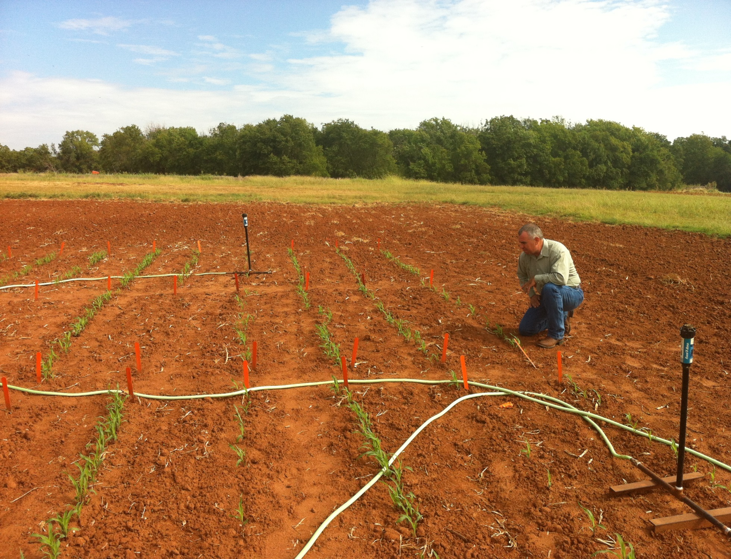
Dr. Randy Taylor
Dr. Nyle Wollenhaupt

Slide 15
Nov 13, 2013
SED = 8.6

Slide 16
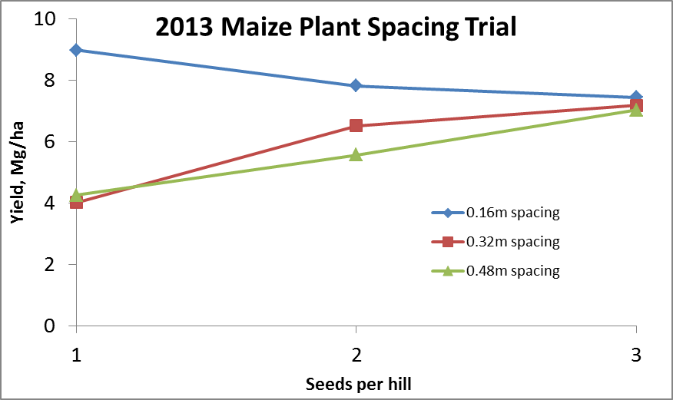
Importance of Singulation
0.76m Row Spacing
Heterogeneity in plant spacing, and plant stands reduce yields
(1997, Nielsen, Purdue)

Slide 17
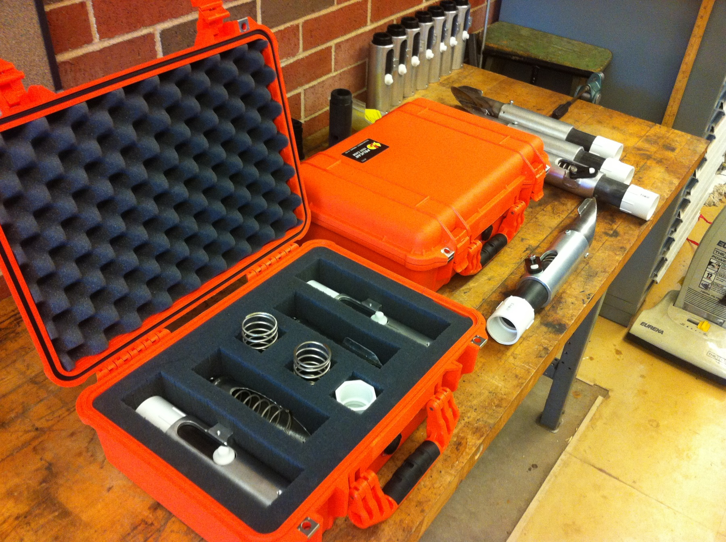
Thailand Mexico Zambia
El Salvador Guatemala
Regional Trials: El Salvador, Thailand, Colombia, Uganda, Zambia

Slide 18
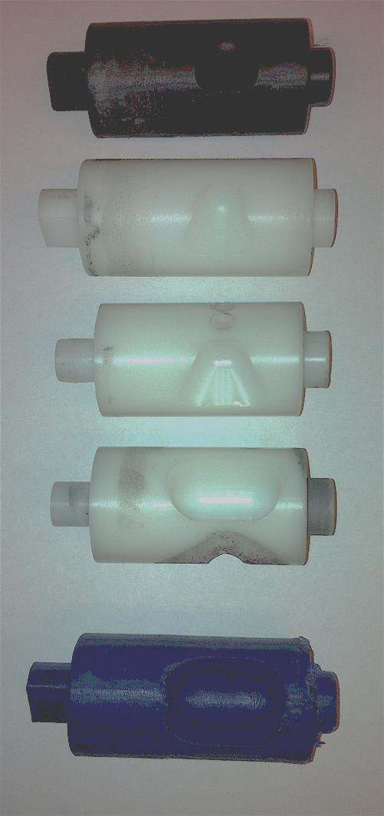
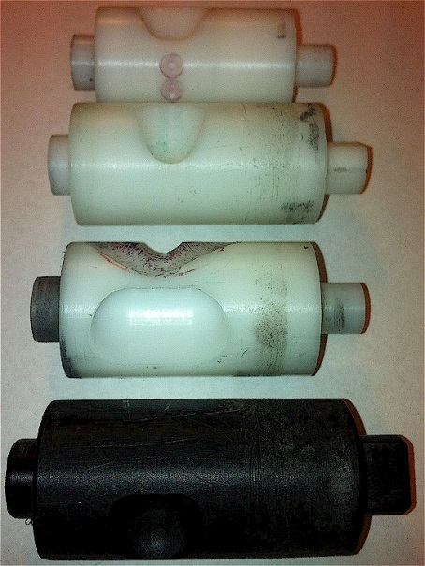
Rotating Drum
Drum | Mass (g) | Volume (cm³)
A | 0.69 | 0.507
B | 0.71 | 0.521
OS | 0.88 | 0.646
OM | 3.36 | 2.468
OC | 3.38 | 2.482

Slide 19
Variables
Brush size, location, stiffness
Drum orientation
Drum cavity size
Drum angle
Internal Housing (1, 2, 3) (brush position)
Seed size, shape (range from 2652 to 4344 seeds/kg)
Operator (many)

Slide 20
Commercial Plans
Injection molding (various parts)
AGCO
Indigdev
NGO-model

Slide 21
Impact of Yield Level on Nitrogen Demand for Maize in the Midwest
Oklahoma State University, Stillwater, OK
bill.raun@okstate.edu (405 744 6418)

Slide 22
Long Term Trials Evaluated
 | Location | Soil, management | Year Initiated | Years included (total years) | Crop
OK | ¹Stillwater, OK, Magruder | Kirkland silt loam | 1892 | 1958-2011 (53) | winter wheat
WI | ²Arlington, WI | Plano silt loam | 1958 | 1958-2007 (49) | maize
OK | ³Altus, OK, Exp. 406 | Tillman-Hollister clay loam | 1966 | 1966-2011 (45) | winter wheat
OK | ³Altus, OK, Exp. 407 | Tillman-Hollister clay loam | 1966 | 1966-2011 (45) | winter wheat
NE | ⁴Shelton, NE | Fine-silty, mixed, mesic, Pachic Haplustoll, | 1991 | 1995-2005 (11) | maize
IA | ⁵Nashua, IA, NERF | Kenyon loam | 1979 | 1979-2010 (32) | maize
IA | ⁵Kanawha, IA, NIRF | Webster silty clay loam | 1954 | 1985-2010 (26) | maize
 |  |  |  | 261
²Bundy and Andraski (2004)
³Raun et al. (1998)
⁴Varvel et al. (2007)
⁵Mallarino and Ortiz-Torres (2006)
Arnall, D.B., A.P. Mallarino, M.D. Ruark, G.E. Varvel, J.B. Solie, M.L. Stone, J. L. Mullock, R.K. Taylor, and W.R. Raun. 2013. Relationship between grain crop yield potential and nitrogen response. Agron. J. 105:1335–1344

Slide 23
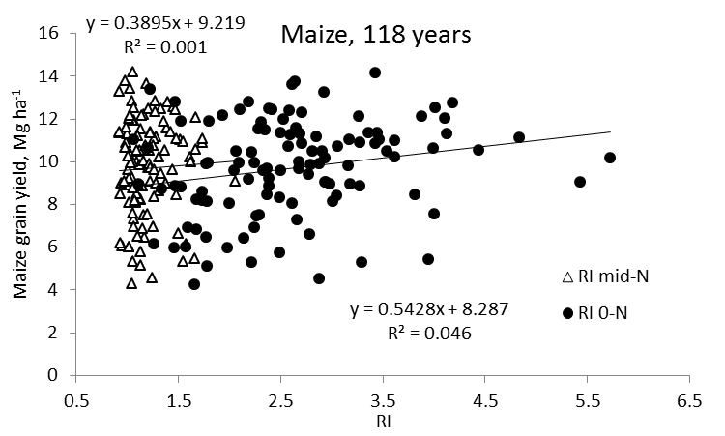
Maize

Slide 24
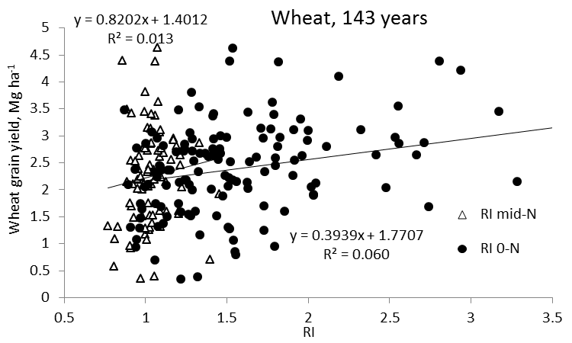
Wheat

Slide 25
Yield level and N Response, Wheat

Slide 26
Yield level and N Response, Maize

Slide 27
Literature, N Rates
Understanding that grain yield and N rate are not related is critical for N rate recommendations
Analyzed a total of 170 site years of maize field experiments in the Central Great Plains.
Optimum N rate = (N uptake max yield - N uptake check plot)/NUE

Slide 28
Maize
Source | Location | Years | Years | High N Yield Range | Optimum N rate
 |  |  |  | Mg ha⁻¹ | Min | Max | Avg.
Bundy et al. (2011) | WI | 20 | 1958-1983 | 4.3-8.8 | 46 | 213 | 119
Bundy et al. (2011) | WI | 23 | 1984-2007 | 5.7-14.1 | 143 | 334 | 230
Mallarino and Torres (2006) | IA | 32 | 1979-2010 | 5.1-12.5 | 75 | 316 | 195
Mallarino and Torres (2006) | IA | 26 | 1985-2010 | 5.3-12.8 | 124 | 326 | 215
Varvel et al. (2007) | NE | 11 | 1995-2005 | 10.4-13.6 | 67 | 280 | 191
Jokela et al.(1989) Carroll | MN | 3 | 1982-1984 | 7.1-9.1 | 5 | 120 | 77
Jokela et al.(1989) Webster | MN | 3 | 1982-1984 | 1.8-8.7 | 64 | 103 | 84
Fenster et al. (1976) Martin | MN | 7 | 1970-1976 | 7.12-10.65 | 21 | 116 | 60
Fenster et al. (1976) Waseca | MN | 7 | 1970-1976 | 4-9.6 | 55 | 227 | 140
Al Kaisi et al.(2003) | CO | 3 | 1998-2000 | 8.3-10.8 | 24 | 126 | 84
Ismail et al.(1994) | KY | 19 | 1970-1990 | 4.7-10.5 | 15 | 175 | 100
Rice et al.(1986) | KY | 16 | 1970-1985 | 5.7-9.2 | 93 | 163 | 132
Total |  | 170 |  | average | 61 | 208 | 136
 |  |  |  | stdev | 43 | 87 | 59
+ sd 195
Avg. 136
- sd 77

Slide 29
Optimum N rates differed radically from one year to the next at all sites
N rates temporally dependent and unpredictable within specific locations
Fundamental theory has to right

Slide 30
Latitude
“The human mind, when stretched by a new idea, can never shrink to its original size” Oliver Wendell Holmes

Slide 31
We cannot talk about agriculture without talking about the environment; we cannot talk about the environment with talking about agriculture; and we cannot talk about either without talking about the entire world.
Dr. Bobby Stewart

Slide 32
By 2050 there will be 9.1 billion people.
Increase of 30%
Food production during the same period will have to increase 70%
95% of the increased population will be in the developing world

Slide 33
Agriculture and the Environment
Food and Agricultural Organization,
“Livestock's Long Shadow” surveys damage done by sheep, chickens, pigs and goats. But in almost every case, the world's 1.5 billion cattle are most to blame. Livestock are responsible for 18 per cent of the greenhouse gases that cause global warming, more than cars, planes and all other forms of transport put together.
The Independent.co.uk

Slide 34
Methane and Nitrous Oxide Emissions
Emmission % | Reference
18 | U.S. Environmental Protection Agency (USEPA). 21012. Inventory of U.S. greenhouse gas emissions and sinks: 1990—2010. U.S. Environmental Protection Agency, Washington, DC. www.epa.gov/climatechange/ghgemissions/usinventoryreport.html. (Accessed 27 January 2014)
12 to 23 | Denman KL, Brasseur G, et al. (2007) Couplings between changes in the climate system and biogeochemistry. In ‘Climate Change 2007: the physical science basis. Contribution of working group I to the fourth assessment report of the Intergovernmental Panel on Climate Change’. (Eds S Solomon, D Qin, M Manning, Z Chen, M Marquis, KB Averyt, M Tignor and HL Miller) pp. 499–587. (Cambridge University Press: Cambridge, United Kingdom and New York, NY, USA)
 | Harper, L.A., O.T. Denmead, J.R. Freney, and F.M. Byers. 1999. Direct measurements of methane emissions from grazing and feedlot cattle. J. Anim. Sci. 77:1392-1401.
 | Neitzert, F., Olsen, K. and Collas, P. 1999. Canadas Greenhouse Gas Inventory: 1997. Emissions and removals with trends. Greenhouse Gas Division, Pollution Data Branch, Environmental Canada, Ottawa, ON.
 | Johnson, K.A., and D.E. Johnson. 1995. Methane emissions from cattle. J. Anim. Sci. 73:2483:2492.
18 | FAO. 2006. Livestock’s long shadow: environmental issues and options. ftp://ftp.fao.org/docrep/fao/010/a0701e/a0701e.pdf
18 | Rubin, E. S., R. N. Cooper, R. A. Frosch, T. H. Lee, G. Marland, A. H. Rosenfeld, and D. D. Stine. 1992. Realistic mitigation options for global warming. Sci. 257:148-149, 261–265.
 | Koneswaran, G. and D. Nierenberg. 2008. Global Farm Animal Production and Global Warming: Impacting and Mitigating Climate Change. Environ. Health Perspect. 116:578–582.
 | Steinfeld, H., P. Gerber, T. Wassenaar, V. Castel, M. Rosales, C. de Haan. 2006. Livestock’s Long Shadow: Environmental Issues and Options. Rome:Food and Agriculture Organization of the United Nations.
 | Paustian, K., M. Antle, J. Sheehan, and P. Eldor. 2006. Agriculture’s Role in Greenhouse Gas Mitigation. Washington, DC: Pew Center on Global Climate Change
25-30 | Koneswaran, Gowr & Nierenberg, Danielle. Global Farm Animal Production and Global Warming Impacting and Mitigating Climate Change.
 | Environ Health Perspect. 2008 May; 116(5): 578–582. Published online 2008 January 31. doi: 10.1289/ehp.11034 PMCID: PMC2367646 Commentary

Slide 35
Soil Organic Carbon (Tillage)
The percent increase in atmospheric CO₂ due to a worldwide decrease of 3% in soil organic matter of arable land was estimated to be 20 mg kg⁻¹
Decrease in soil organic matter accounted for 6 to 25% of the 80 mg kg⁻¹ (340-260) increase in atmospheric CO₂ over the last 150 years
Mullen, R. W., et al. (1999) 'Estimated increase in atmospheric carbon dioxide due to worldwide decrease in soil organic matter', Communications in Soil Science and Plant Analysis, 30:1713-1719

Slide 36
Of the 7 billion people in the World, more than 1 billion live on less than $1 per day.
More than 2.7 billion live on less than $2 per day.
The World Bank has estimated that the number of people in developing countries with household incomes of $16,000 will increase from 352 million in 2000 to 2.1 billion by 2030.
Where will these problems likely be solved?

Slide 37
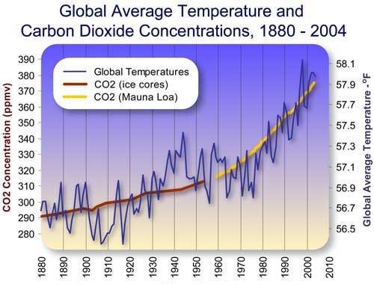
U.S. 6.9% 3770 cal Ethiopia 57% 1950 cal
Ireland 8.5% 3530 cal Bolivia 61% 2090 cal
France 13.8% 3550 cal Angola 80% 1950 cal
Italy 14.7% 3550 cal
Twenty poorest countries spend more than 50% of income on food.

Slide 40
At the top of the food chain rankings, people in U.S. and Canada consume about 800 kg annually, mostly as meat, milk and eggs. At the bottom, India consumes about 200 kg consuming nearly all directly, leaving little for conversion to protein. The world average production of grain per person is about 350 kg per person compared to 285 in 1961.
(Food and Agriculture Organization Statistics, Rome)

Slide 41
Bundy, Larry G., Todd W. Andraski, Matthew D. Ruark and Arthur E. Peterson. 2011. Long-term continuous corn and nitrogen fertilizer effects on productivity and soil properties. Agron. J. 103:1346-1351.
Brezonik, P. L., Bierman Jr, V. J., Alexander, R., Anderson, J., Barko, J., Dortch, M., ... & Wiseman Jr, W. J. (1999). Effects of reducing nutrient loads to surface waters within the Mississippi River Basin and the Gulf of Mexico. National Oceanic and Atmospheric Administration National Ocean Service Coastal Ocean Program.
Blevins, R. L., Cook, D., Phillips, S. H., & Phillips, R. E. (1971). Influence of no-tillage on soil moisture. Agronomy Journal, 63(4), 593-596.
Bundy, L.G., and T.W. Andraski. 1995. Soil yield potential effects on performance of soil nitrate tests. J. Prod. Agric. 8:561–568
Cerrato, M.E., and A.M. Blackmer. 1990. Comparison of models for describing maize yield response to nitrogen fertilizer. Agron. J. 82:138–143.
David, M. B., Gentry, L. E., Kovacic, D. A., & Smith, K. M. (1997). Nitrogen balance in and export from an agricultural watershed. J. Environ.Qual., 26(4), 1038-1048.
Davis, D.M., P.H. Gowda, D. J. Mulla, and G.W. Randall. 2000. Modeling nitrate nitrogen leaching in response to nitrogen fertilizer rate and tile drain depth or spacing for southern Minnesota, USA. J. Env. Qual. 29:1568-1581.
Derby, N. E., Steele, D. D., Terpstra, J., Knighton, R. E., & Casey, F. X. (2005). Interactions of nitrogen, weather, soil, and irrigation on maize yield. Agronomy journal, 97(5), 1342-1351.
Fenster, W. E., C. J. Overdahl, Randall, G. W., & Schoper, R. P. (1978). Effect of Nitrogen Fertilizer on Maize Yield and Soil Nitrates (Vol. 153). Agricultural Experiment Station, University of Minnesota.
Ismail, I., Blevins, R. L., & Frye, W. W. (1994). Long-term no-tillage effects on soil properties and continuous maize yields. Soil Science Society of America Journal, 58(1), 193-198
Jaynes, D. B., Colvin, T. S., Karlen, D. L., Cambardella, C. A., & Meek, D. W. (2001). Nitrate loss in subsurface drainage as affected by nitrogen fertilizer rate. J. Environ.Qual. 30(4), 1305-1314.
Jokela, W. E., & Randall, G. W. (1989). Maize yield and residual soil nitrate as affected by time and rate of nitrogen application. Agronomy journal, 81(5), 720-726.
Lory, J.A., and P.C. Scharf. 2003. Yield goal versus delta yield for predicting fertilizer nitrogen need in maize. Agron. J. 95:994-999.
Mallarino, A.P., and E. Ortiz-Torres. 2006. A long-term look at crop rotation effects on maize yield and response to N fertilization. In: The Integrated Crop Management Conference Proceedings, Ames, IA. 29–30 Nov. 2006. Iowa State Univ. Ext., Ames. p. 209–213.
Malzer, G.L., P.J. Copeland, J.G. Davis, J.A. Lamb, P.C. Robert, and T.W. Bruulsema. 1996. Spatial variability of profitability in site- specific N management. p. 967–975. In P.C. Robert et al. (ed.) Precision agriculture. Proc. Int. Conf., 3rd, Minneapolis, MN. 23–26 June 1996. ASA, CSSA, and SSSA, Madison, WI
Mamo, M., Malzer, G. L., Mulla, D. J., Huggins, D. R., & Strock, J. (2003). Spatial and temporal variation in economically optimum nitrogen rate for maize. Agron. J. 95(4), 958-964.
Onken, A.B., R.L. Matheson, and D.M. Nesmith. 1985. Fertilizer nitrogen and residual nitrate-nitrogen effects on irrigated maizeyield. Soil Sci. Soc. Am. J. 49:134–139.
Randall, Gyles W., Jeffrey A. Vetsch, and Jerald R. Huffman. 2003. Maize production on a subsurface-drained mollisol as affected by time of nitrogen application and nitrapyrin. Agron. J. 95:1213-1219.
Raun, W. R., J. B. Solie & Stone, M. L. (2011). Independence of yield potential and crop nitrogen response. Precision Agriculture, 12(4), 508-518
Scharf, P. C., Kitchen, N. R., Sudduth, K. A., Davis, J. G., Hubbard, V. C., & Lory, J. A. (2005).Field-scale variability in optimal nitrogen fertilizer rate for maize. Agron. J. 97(2), 452-461.
Schlegel, A.J., and J.L. Havlin. 1995. Maize response to long-termnitrogen and phosphorus fertilization. J. Prod. Agric. 8:181–185.
Varvel, G.E., W.W. Wilhelm, J.F. Shanahan, and J.S. Schepers. 2007. An algorithm for maize nitrogen recommendations using a chlorophyll meter based sufficiency index. Agron. J. 99:701-706.
Vetsch, Jeffrey A., and Gyles W. Randall. 2004. Maize production as affected by nitrogen application timing and tillage. Agron. J. 96:502-509.

Slide 42
Grain production is vital because worldwide people get 48% of their calories from eating grain directly. As incomes rise, the percent drops dramatically as diets change to include more meat, milk, eggs and other foods that require more grain to produce. About 48% of grains are eaten directly, 35% fed to animals, and 17% for ethanol and other fuels.
Worldwatch Institute, August 12, 2011 worldwatch.org

