Slide 1

Digital Representation of Soil Properties and Function – Applications for Nutrient Management.
Phillip R. Owens, Brad Joern and Jim Camberato, Purdue University

Slide 2
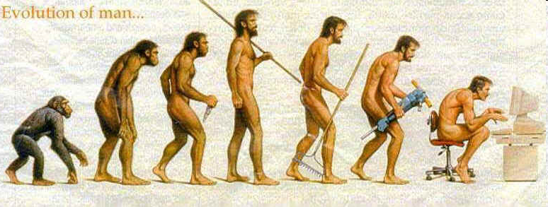
“Evolutionary Geomorphologist”
Overview of problems with using the current soil survey
Newly developed digital mapping for soil functional properties
Terrain-soil relationships to develop elucidate potassium distribution
Examples of topographic and soil controls on yield
Future work

Slide 3
Soil Survey – Illustrates soil structural/visual differences
Fc – Fincastle: Fine-silty, mixed, superactive, mesic Aeric Epiaqualfs
Bs – Brookston: Fine-Loamy, mixed, superactive, mesic Typic Argiaquolls
Kk – Kokomo: Fine, mixed, superactive, mesic, Typic Argiaquolls
Pa – Patton: Fine-silty, mixed, superactive, mesic, Typic Endoaquolls
Ca – Carlisle muck: Euic, mesic, Typic Haplosaprist
Limitations
Soil Survey has hard boundaries
(up to 2 acres of inclusions)
Interpretations are not based on
management
Created using best available
technology at the time
Notes:
This is the current product as provided on hard copy (when available) and on line (pdf and/or web soils survey);
These soils were classified as taxonomically different however due to management interpretations added to their description, confusion has been introduced in the form of wide and overlapping ranges for certain soil properties that are the ones that are more of interest to users rather than taxonomy. Just like with Botany and plants, no one remembers the Latin name of a certain weed but a lot of people know what they are good and bad for.

Slide 4
Digital Soil Mapping
Define topographic attributes which
determine differences in soils
Data mine to define geologic material
which soil formed from (sand, clay)
Formalize the terrain-soil relationship
to automate the soil distribution
Determine properties that relate to
function (nutrient response)

Slide 5
Soils in Howard County
5 soils cover 80% of the land on Howard County
Are there relationships between these 5 soils and terrain attributes?
Can we use those relationships to improve the survey in an update context?

Slide 6
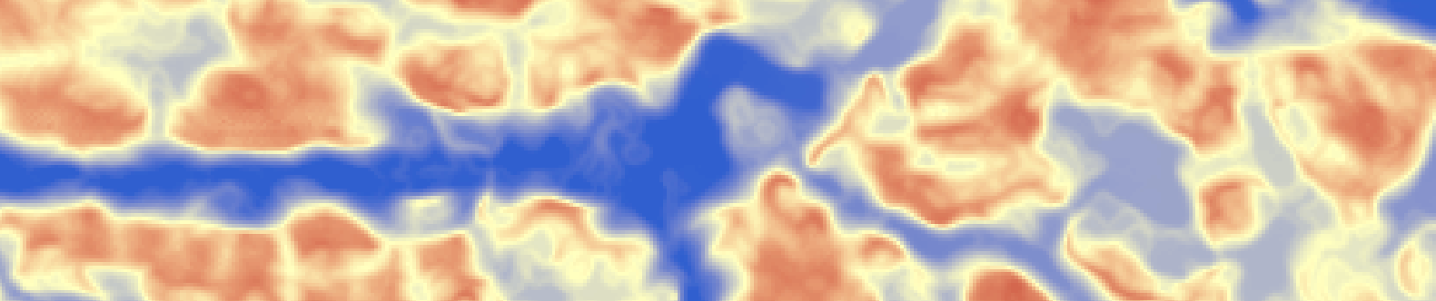
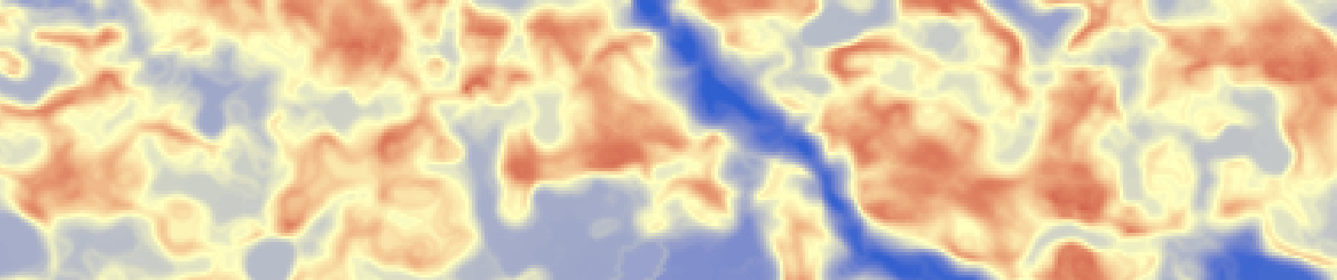
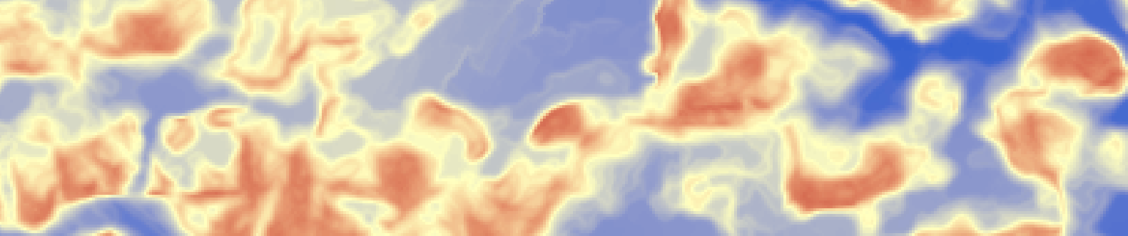
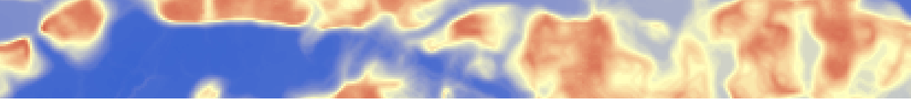
Shaded Relief Elevation Model,
242 to 248 meters
Wetness Index, 8 to 20
Slope, 0 to 4%
SSURGO
Brookston
Fincastle

Slide 7
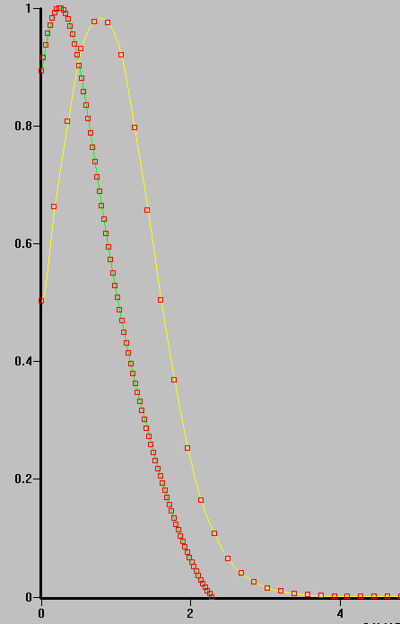
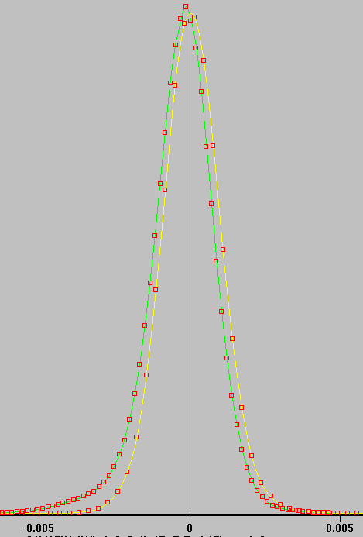
Frequency distributions
Terrain attribute:
Altitude above channel network
Terrain attribute:
Curvature
Frequency
Frequency
Fincastle
Brookston
Fincastle
Frequency
Brookston
ABCN
Curvature
*Data extracted with Knowledge Miner Software

Slide 8
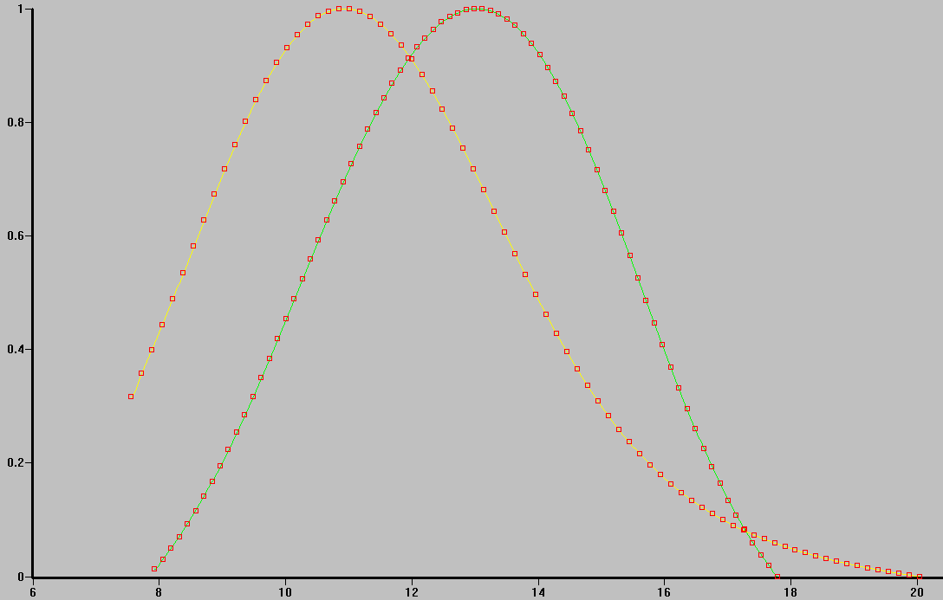
Frequency, Wetness Index
Terrain attribute:
Wetness Index
Fincastle
Brookston
Frequency
Wetness index
*Data extracted with Knowledge Miner Software

Slide 9
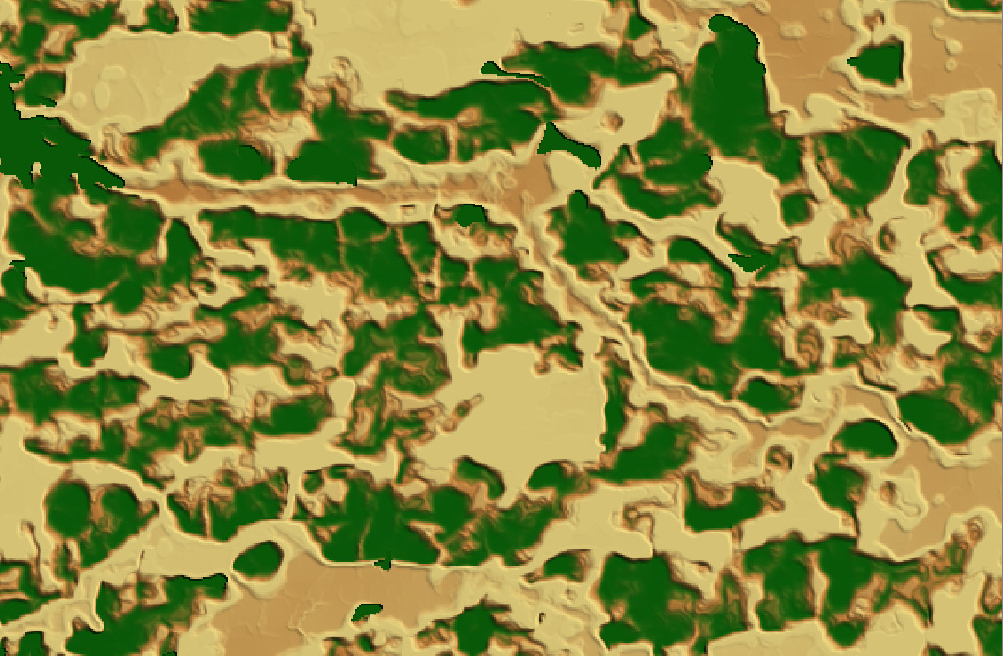
Terrain-Soil Matching for Brookston
Fuzzy membership values (from 0 to 100%)
2%
100%
*Information derived from Soil landscape Interface Model (SoLIM)

Slide 10
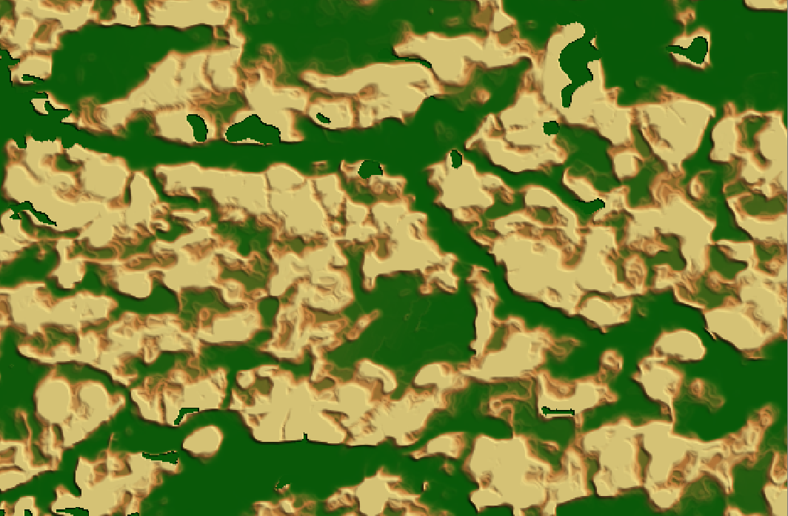
Terrain-Soil Matching for Fincastle
Fuzzy membership values (from 0 to 100%)
97%
5%
*Information derived from Soil landscape Interface Model (SoLIM)

Slide 11

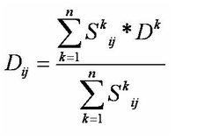
Create Property Map with SoLIM
To estimate the soil property SoLIM uses:
We already have S^{k}_{ij} – the fuzzy membership value used to make the hardened soil map.
So we only need to specify D^{k}, the representative values of the property of interest for each soil
D_{ij}: the estimated soil property value at (i, j);
S^{k}_{ij}: the fuzzy membership value for kth soil at (i, j);
D^{k}: the representative property value for kth soil.
In this case, let’s assign values to carbonate depth for Fincastle and Brookston in the east section of the county.
Fincastle: 100 cm (low range of OSD)
Brookston: 170 cm (high range of OSD)

Slide 12
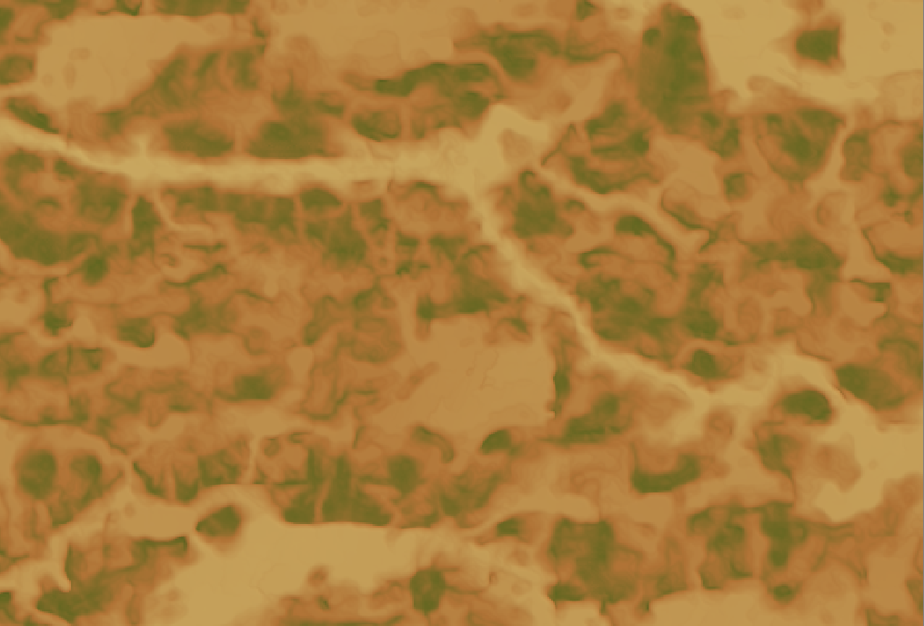
Predicted depth to carbonates
100 to 170 cm
100 to 170 cm

Slide 13
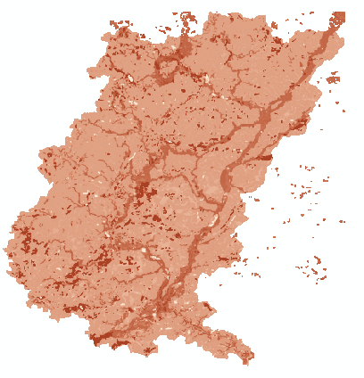
Available Water Holding Capacity
Taxonomic Soil Maps: Structural Heterogeneity
Available Water Capacity: Functional Homogeneity

Slide 14
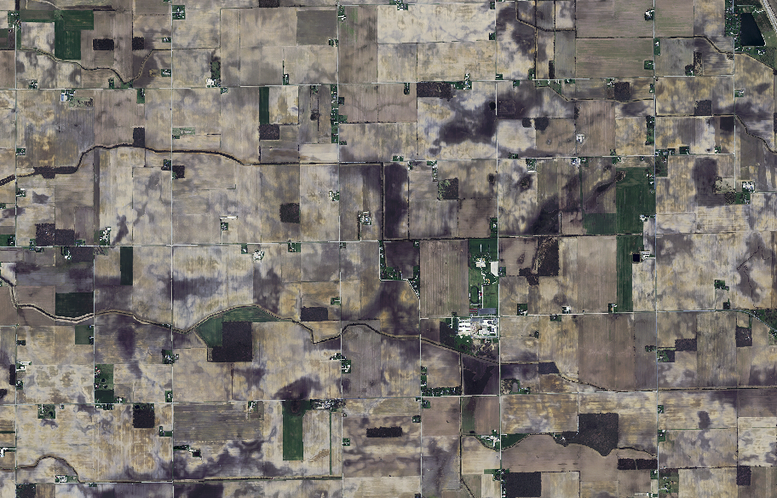
Aerial Photography of Howard County

Slide 15
Soil Carbon Content Estimates: Howard County, IN

Slide 16
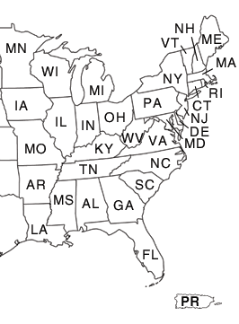
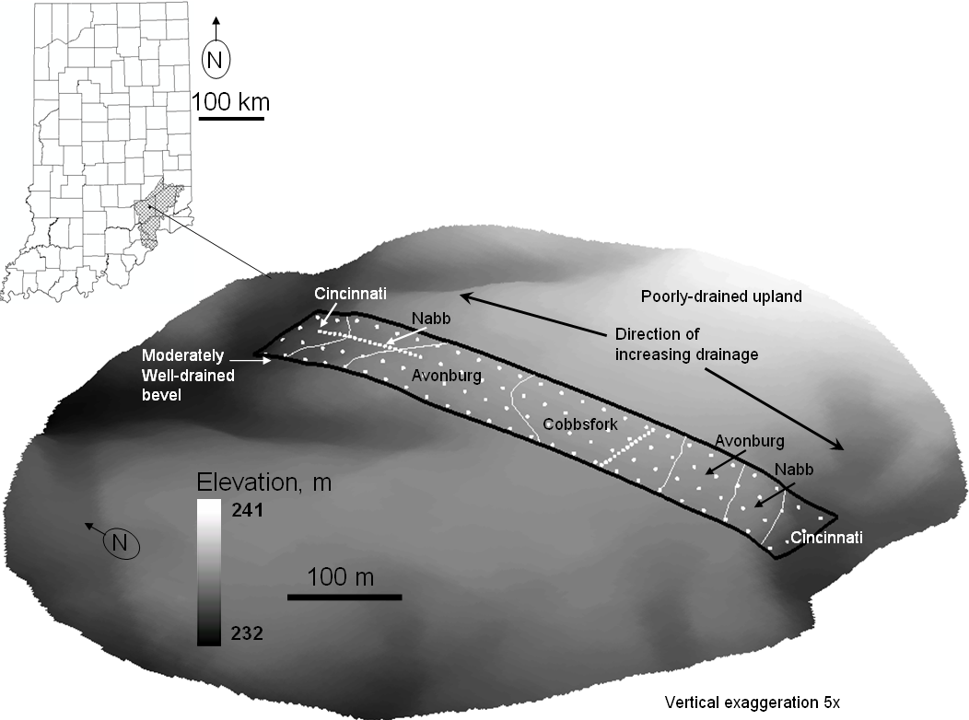
Potassium variability across a drainage catena
No-till past ~10 yr
Soils differ by drainage
No tile drainage in the field

Slide 17
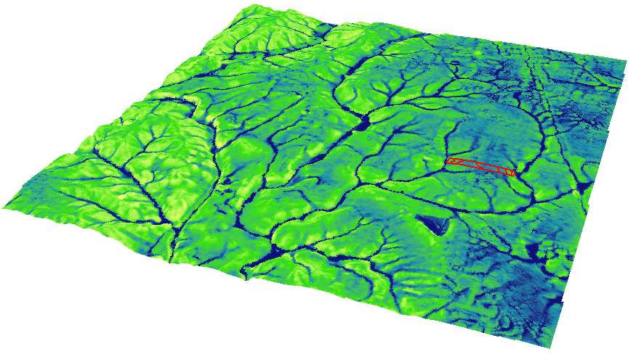
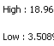
Topographical wetness index, TWI
TWI
N
High TWI:
--flat areas
--areas of convergent overland flow
Related to potassium availability?
  TWI = ln(a/tan(B)) (Quinn et al 1995).

Slide 18
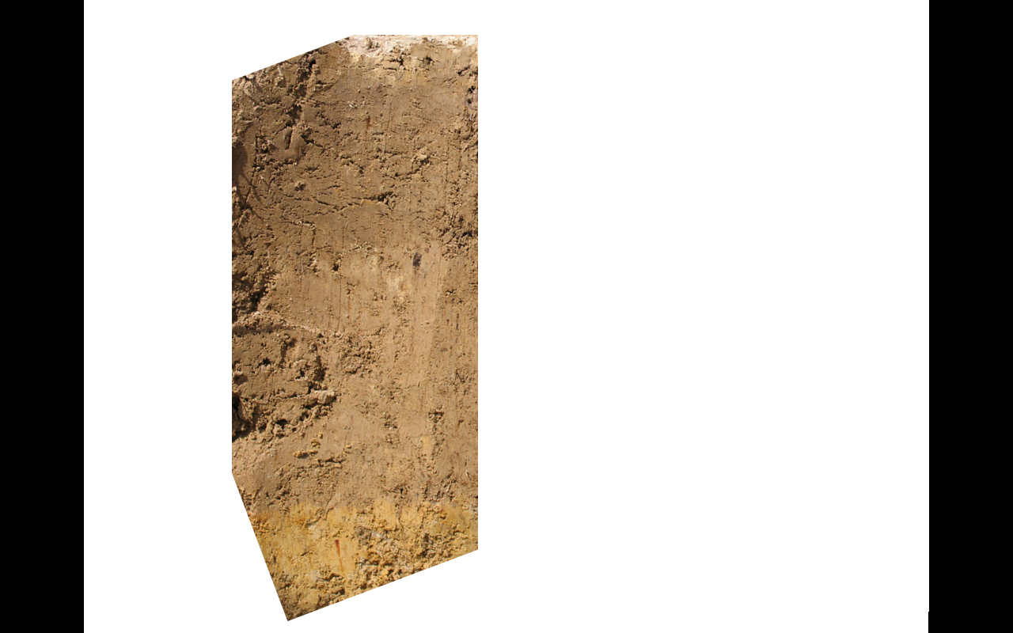
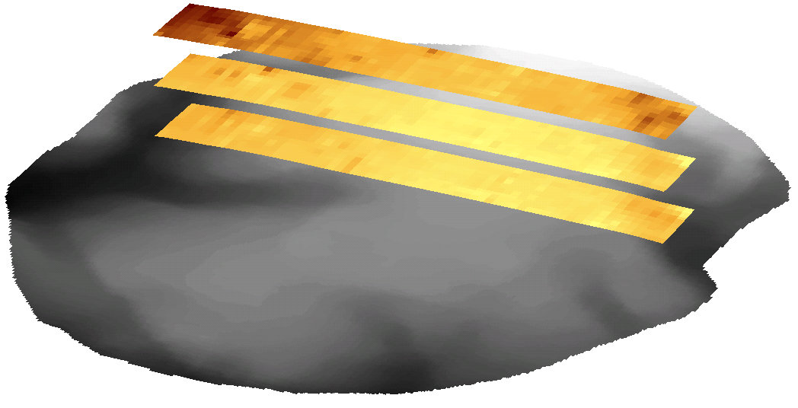
Exchangeable K
Surface runoff
Leaching
K
mg/kg
250
50
5 cm
30 cm
60 cm

Slide 19
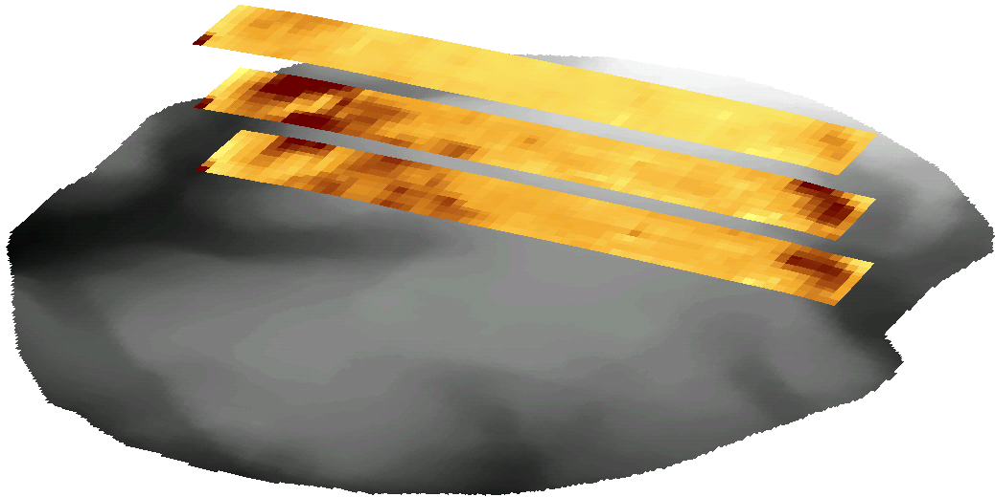
Nonexchangeable K
Differential weathering
Fixation
Ferrolysis
K
mg/kg
2600
800
5 cm
30 cm
60 cm

Slide 20
Results
Exchangeable K
  Related to TWI, and negative (p < 0.05)
  10 cm exchangeable K related to elevation (p < 0.001)
  Higher in better drained soils at all depths*
Nonexchangeable K
  Strongly related to TWI, and negative (p < 0.001)
  Negatively related to extremes in elevation
  Higher in better drained soils at all depths*
TWI can be used for determining fertility management zones

Slide 21
Relationship of topography and yield

Slide 22
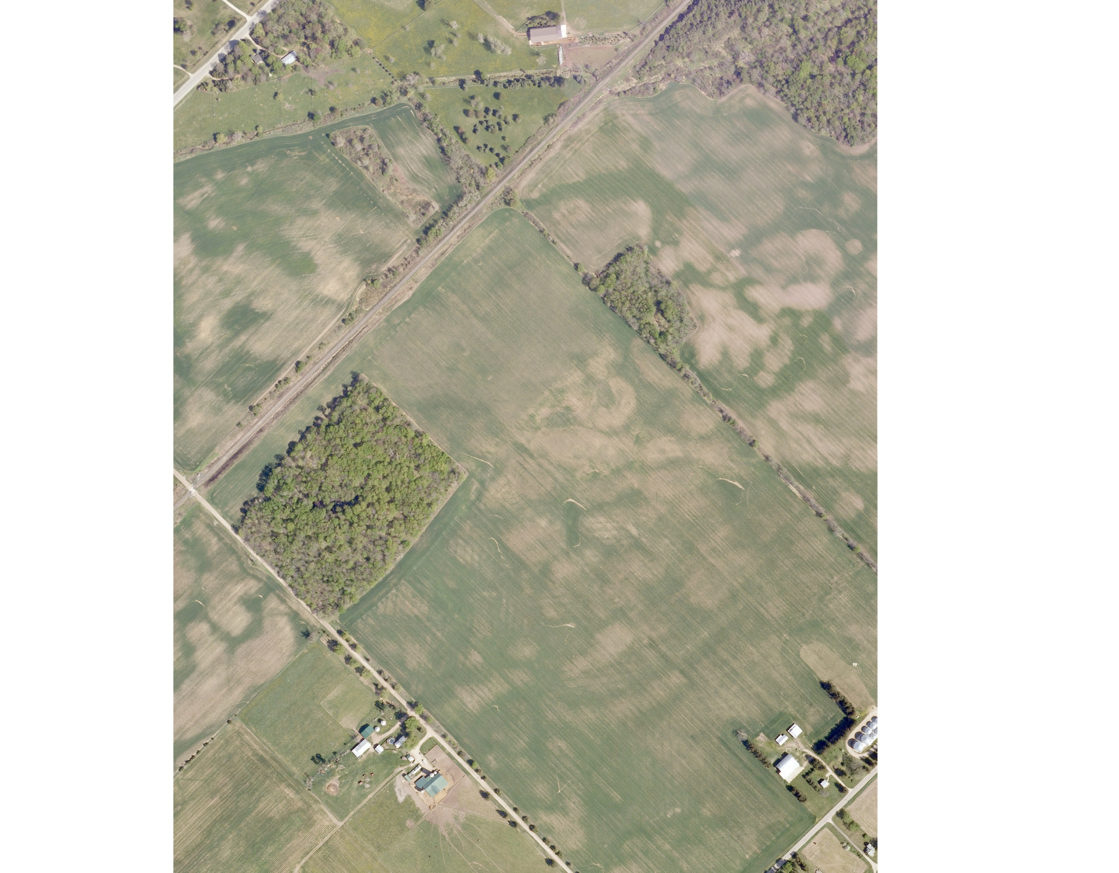

Slide 23
Corn 95
Soybean 96
Wheat 97
Corn 98
Soybean 99
Wheat 00
Corn 01
Soybean 02
Wheat 03
Normalized yield maps from 1995 to 2003, 3 cycles of the rotation, greens and blues represent areas where the yield was above average, red/yellow below average, blue- highest yields, yellow- lowest yields
Yield Index = crop yield per pixel/average yield on field (yr)

Slide 24
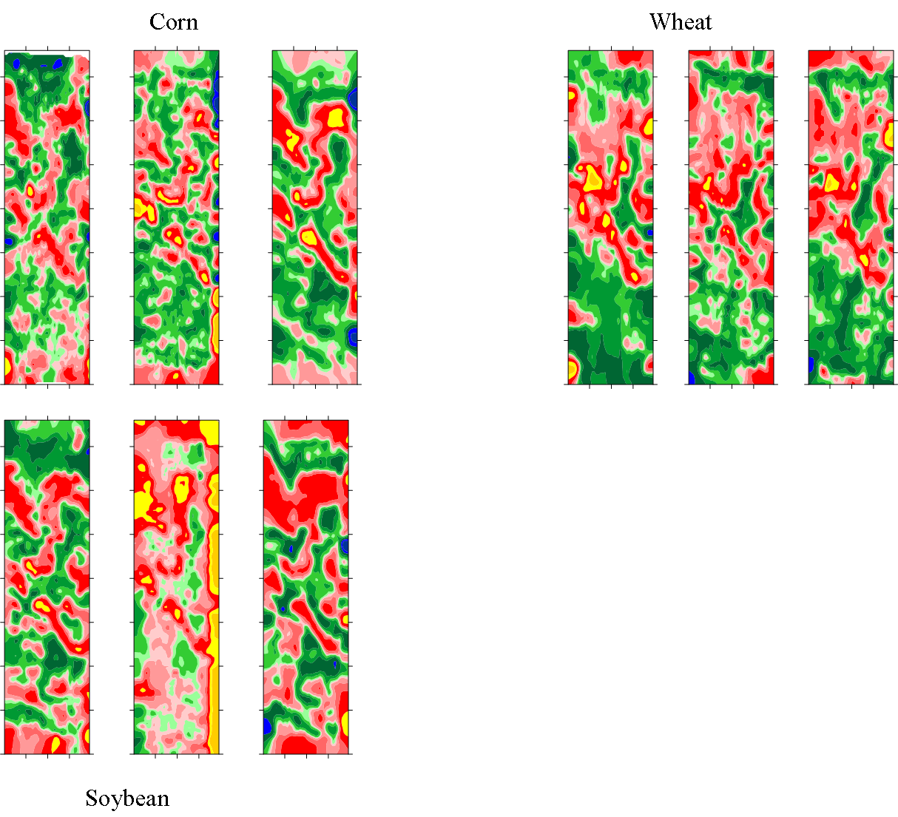
Normalized yield maps from 1995 to 2003, 3 cycles of the rotation, greens and blues represent areas where the yield was above average, red/yellow below average, blue- highest yields, yellow- lowest yields

Slide 25
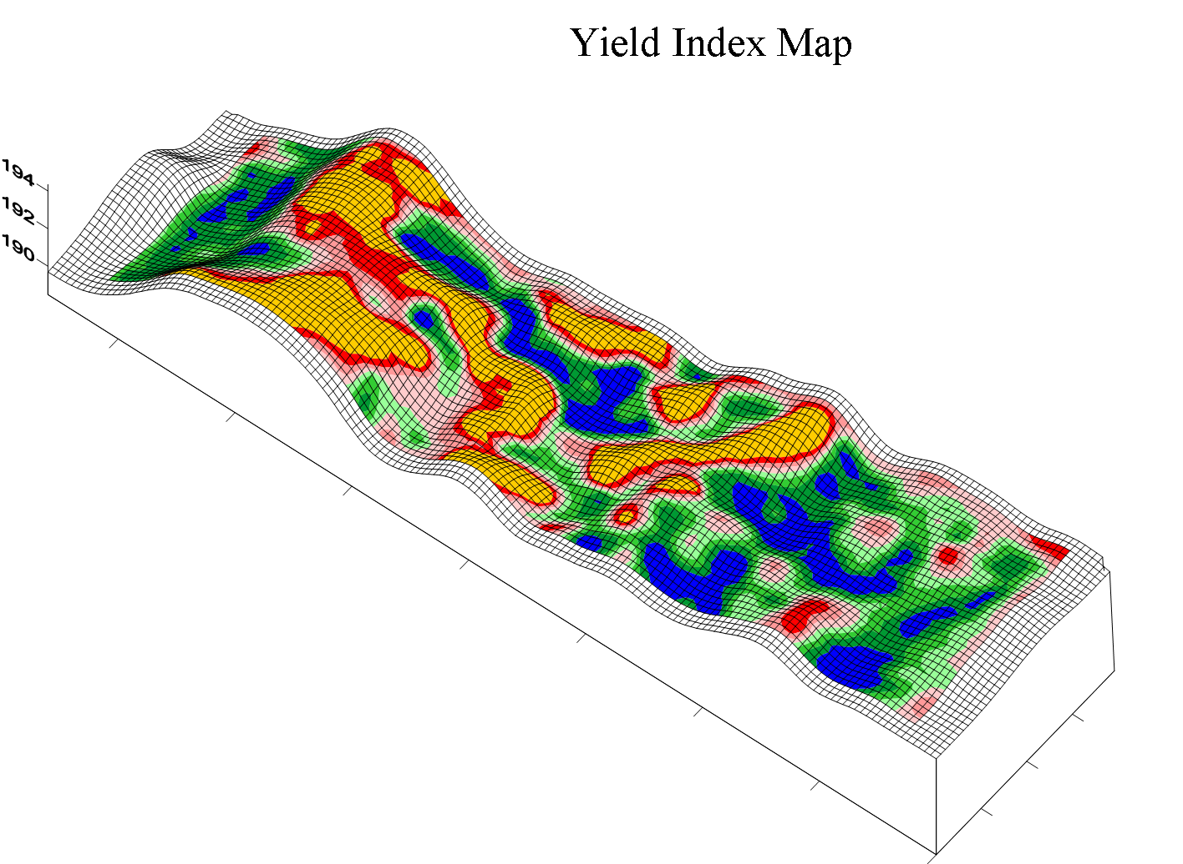
Normalized yield maps averaged from all crops (1995 to 2003), greens and blues represent areas where the yield was above average, red/yellow below average, blue- highest yields, yellow- lowest yields

Slide 27
Conclusions
Soil information can now be translated to continuous layers of soil properties.
Determine the properties (OM, water storage, water table, etc) that affect yield – we can develop an algorithm of multiple soil properties to predict yield.
Use the predictions for cost-benefit analysis
D_{ij}: the estimated soil property value at (i, j);
S^{k}_{ij}: the fuzzy membership value for kth soil at (i, j);
D^{k}: the representative property value for kth soil.

Slide 28
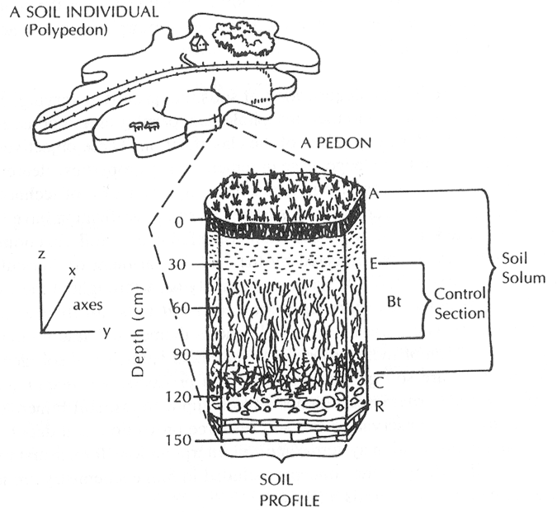
Soil – A reservoir and transport medium for nutrients and water

Slide 29
Understanding soil function is the key to predicting nitrogen use efficiency
Function is a use dependent question (and sometimes crop specific)

