Slide 1
Generalized Algorithm Tying the Loose Threads
August 2013

Slide 2
Dr. Marvin Stone Emeritus Regents Professor Oklahoma State Univ. has pronounced the first axium of sensor based farming (perhaps somewhat facetiously) If we draw a declining straight line between NDVI and nitrogen application rate, we will always improve a crop’s nitrogen use efficiency.

Slide 3
To which Solie proposed the following corollary:
All We Need to know is where to draw the line

Slide 4
What Constitutes a Good Model
Is elegant
Contains few arbitrary or adjustable elements
Agrees with and explains all existing observations
Make detailed predictions about future observations that can disprove or falsify the model if they are not borne out
(Hawking and Mlodinow (2010)

Slide 5
Minimize Model Inputs
Farmer and agronomic advisor set yield goal of field or area with in field (YldGoal)
Optically measure NDVI of a NRich N reference strip (NRndvi) $NDVI= \frac{ρ_{NIR}− ρ_{Red}}{ρ_{NIR}+ ρ_{Red}}$
Optically measure NDVI of an adjacent farmer practice N reference strip (FPndvi)

Slide 6
Why Yield Goal?
Farmers and advisors understand the concept of yield goal and yield data by farm, usually by field and frequently by management zone. Yield goals are still used, and are still relevant for the majority of areas where corn and wheat are produced in the world, e.g.
Kansas State (Dr. Dave Mengel)
The Ohio State (Dr. Robert Mullin)
University of Nebraska (Dr. Richard Ferguson)
Oklahoma State University (Dr. Hailin Zhang)

Slide 7
Performance Requirements
Predict yield and N requirements for at least two species (maize and wheat) over vegetative growth stages.
Calculate actual N rate for a fixed rate N application AND Build an N application rate curve for applicators capable of continuously sensing and variably applying N fertilizer
Acceptable error in application rate?

Slide 8
Why Reexamine Model Parameters?
Original (2011) algorithm parameters were determined from non-linear regression with no specific limitations applied to the analysis.
In 2013, we used a step-wise technique to optimize the model to fit for all data and meet certain theoretical requirements.

Slide 9
Original Symmetric Sigmoid Yield Model
NRndvi
N Rich NDVI
Where is this point?

Slide 10
Selected Experiments

Slide 11
Yield Potential Calculations Generalized Algorithm - August 2013
Determine yield goal which is the yield potential with sufficient N
Measure N rich, (NRNDVI) & farmer practice (FPNDVI)
Calculate Inflection Point and Calculate Curvature
Wheat
$$InfPt=0.50 NRndvi$$
$$K=0.10 NRndvi$$
Corn
$InfPt= NRndvi$ – 0.2
$$K=0.7 NRndvi$$

Slide 12
Yield Potential Calculations Generalized Algorithm - August 2013
Calculate YP0 using parameters for maze and wheat
Compute actual N rate using percent N in grain and NUE. NUE is the “fudge” factor”.
(Editorial comment: there are more than 60 years of experimental data which need to be condensed to an overall efficiency.)
$$N_{rate}=\frac{\left(YPN−YP0\right) \%N}{NUE}$$

Slide 13
2011 - Estimated Available-N Curves Developed by adjusting sigmoid parameters
Approximately 340 corn and wheat NDVI/Yield data sets
Parameters adjusted to minimize absolute difference
N application curves were developed for corn, wheat, and corn and wheat (combined)

Slide 14
2013 - Estimated Available-N Curves developed by adjusting sigmoid parameters for selected nearly complete N application curves
15 application curves selected from wheat and from corn data.
Mean absolute difference (MAD) for each data set were compared with Table Curve simple sigmoid fit to each data set.

Slide 15
Mean Absolute Error
Wheat | 2013 Alg | TC Nlin | Delta |  | 2011 Alg | TC Nlin | Delta
Average | 0.537 | 0.480 | 0.057 |  | 0.554 | 0.457 | 0.097
Median | 0.472 | 0.425 | 0.047 |  | 0.532 | 0.451 | 0.081
Corn | 2013 Alg | TC Nlin | Delta |  | 2011 Alg | TC Nlin | Delta
Average | 0.816 | 0.702 | 0.114 |  | 1.022 | 0.663 | 0.359
Median | 0.804 | 0.779 | 0.088 |  | 0.940 | 0.597 | 0.319

Slide 16
Parametric Equations
Year | Crop | Parameter | Parametric Equation
2011 | Wheat | Infl Point | InfPt=0.808 * NDVI -0.0477
 |  | Curvature | K = 0.1923 * NDVI – 0.0113
 | Corn | Infl Point | InfPt = 0.783 *NDVI-0.0480
 |  | Curvature | K= 0.155 * NDVI – 0.0101
 | Corn&Wht | Infl Point | InfPt = 0.773 * NDVI – 0.479
 |  | Curvature | K = 0.168 * NDVI -0.0104
2013 | Wheat | Infl Point | InfPt = 0.5 * NRndvi
 |  | Curvature | Curve = 0.1 * NRndvi
 | Corn | Infl Point | InfPt = NRndvi - 0.2
 |  | Curvature | Curve = 0.08 * NRndvi

Slide 17
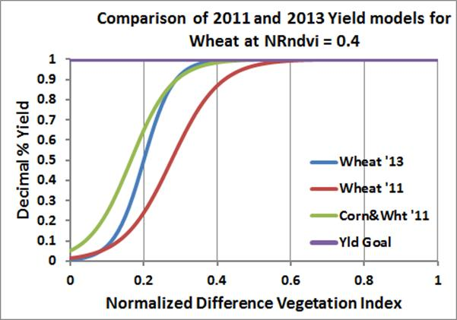
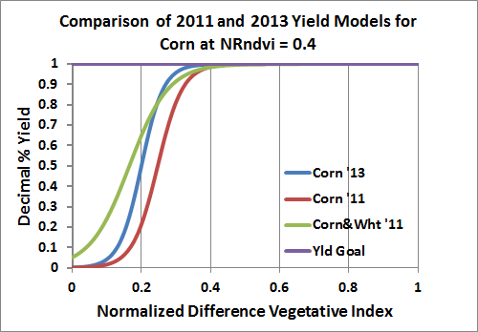

Slide 18
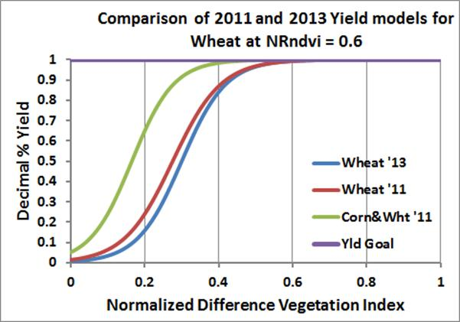
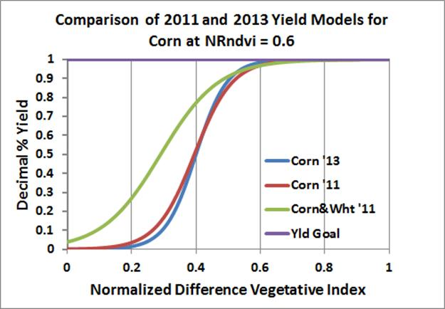

Slide 19
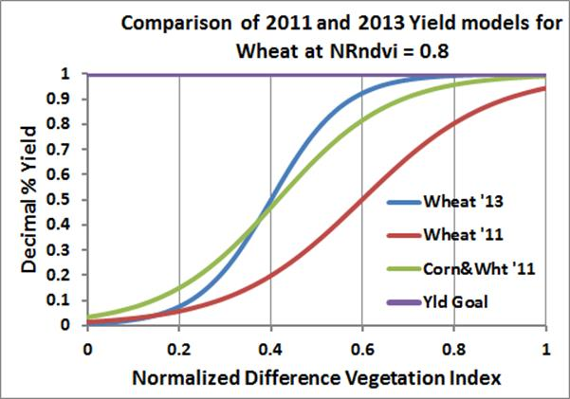
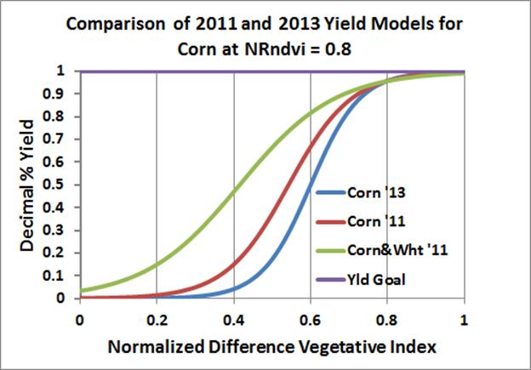

Slide 20
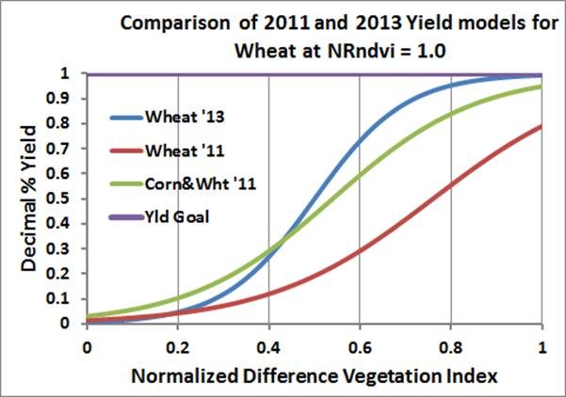
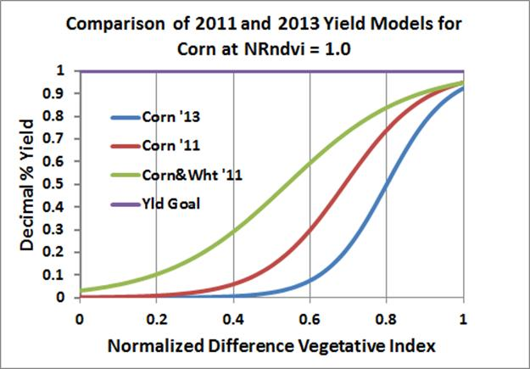

Slide 23
Is this Model “Good Enough”? What is your standard? Should you settle for “Good Enough”
Which Parameter Set Do You Use?

Slide 24
Remember: Almost doesn’t count except in horseshoes and precision variable rate application

Slide 25
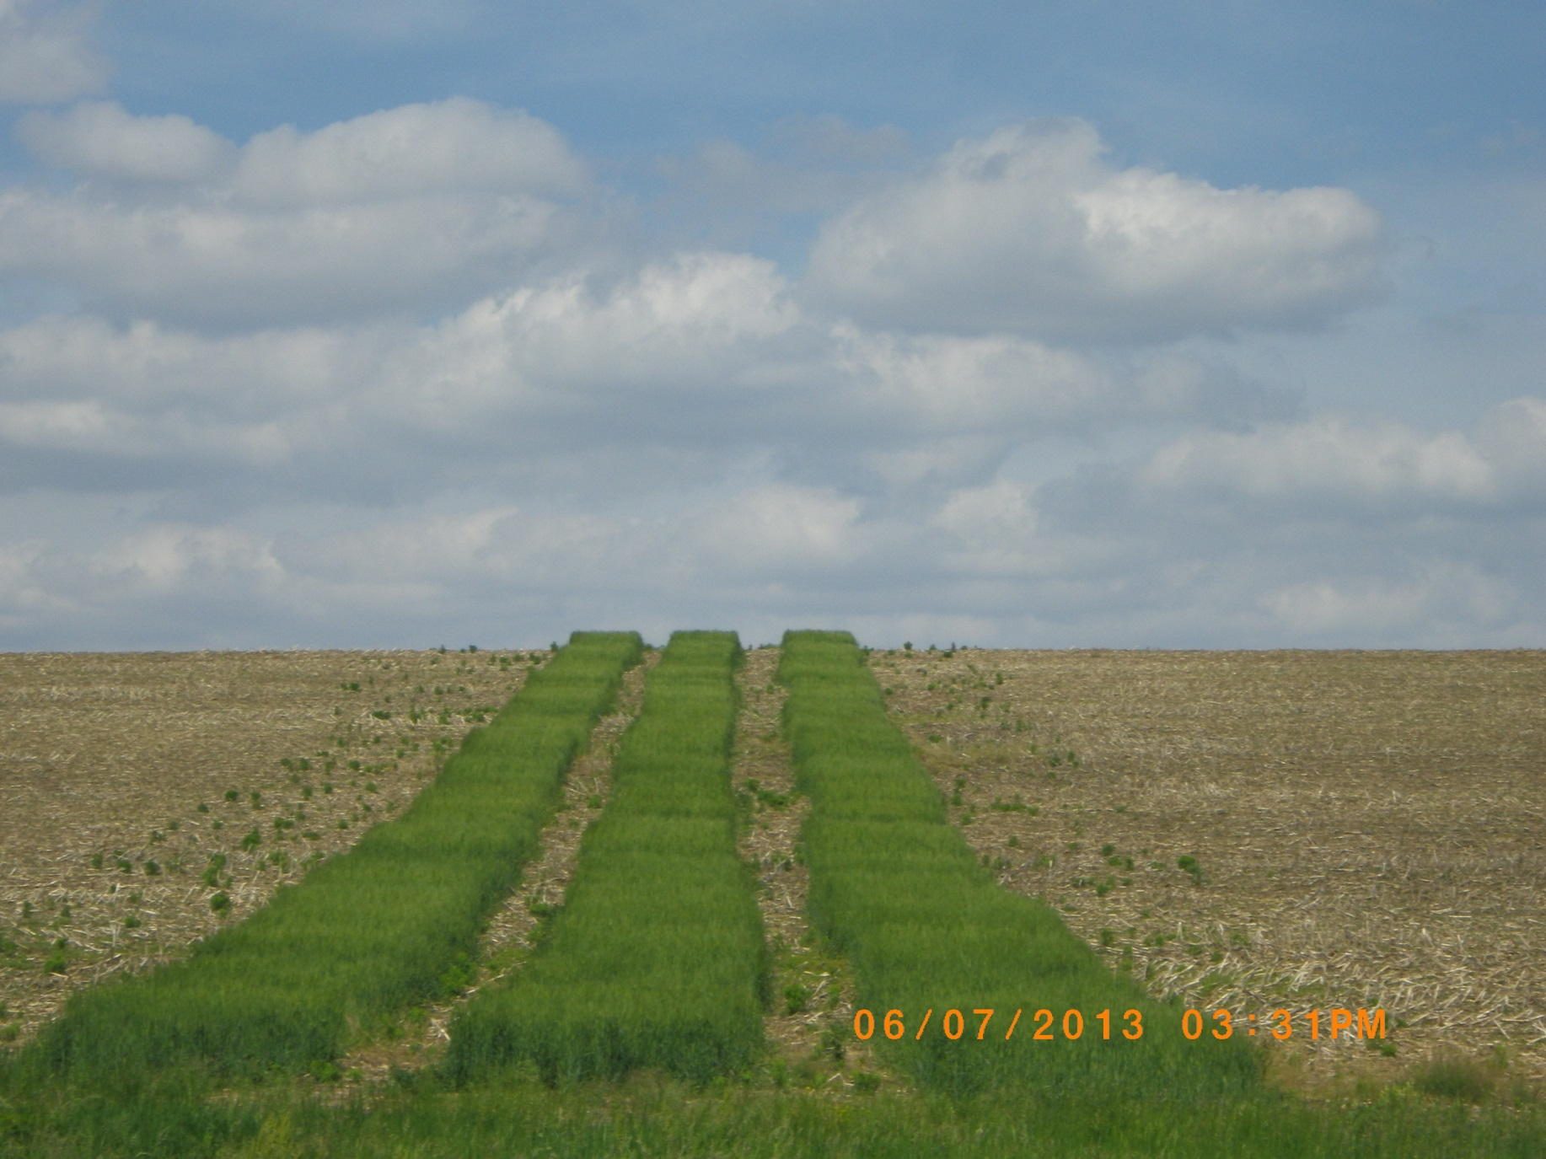
How can you use optical sensors now?

